Slide 1


ACACSO Website Redesign
A smarter, faster, and more organized platform — built to preserve 15+ years of industry knowledge and make every conference experience better for members, speakers, and organizers.
2025 REDESIGN
WORDPRESS PLATFORM

Slide 2

The Challenge
Why We Updated the Site
The old site created friction at every turn. Members struggled to register, find presentations, and stay informed — while admins spent hours on manual coordination.
Hard to Navigate
Manual Registration
Disorganized Content
Difficult to Update
No logical structure or search capability
Relied on a single technical administrator
Time-consuming email-based coordination
15+ years of presentations — hard to find

Slide 3
Overview
What's New
The redesigned site delivers meaningful upgrades across every area — from how members register to how knowledge is stored and discovered.
Online Registration & Payment
Searchable Presentations
Fully online sign-up with integrated Square credit card processing
Filter by year, topic, presenter, or conference
Cleaner Conference Pages
Mobile-Friendly
Agenda, hotel info, and registration all in one place
Fast, modern design that works on any device
Easy to Manage
Suggested Topics
Visual editor — no technical expertise required
Improved discoverability of relevant industry content

Slide 4
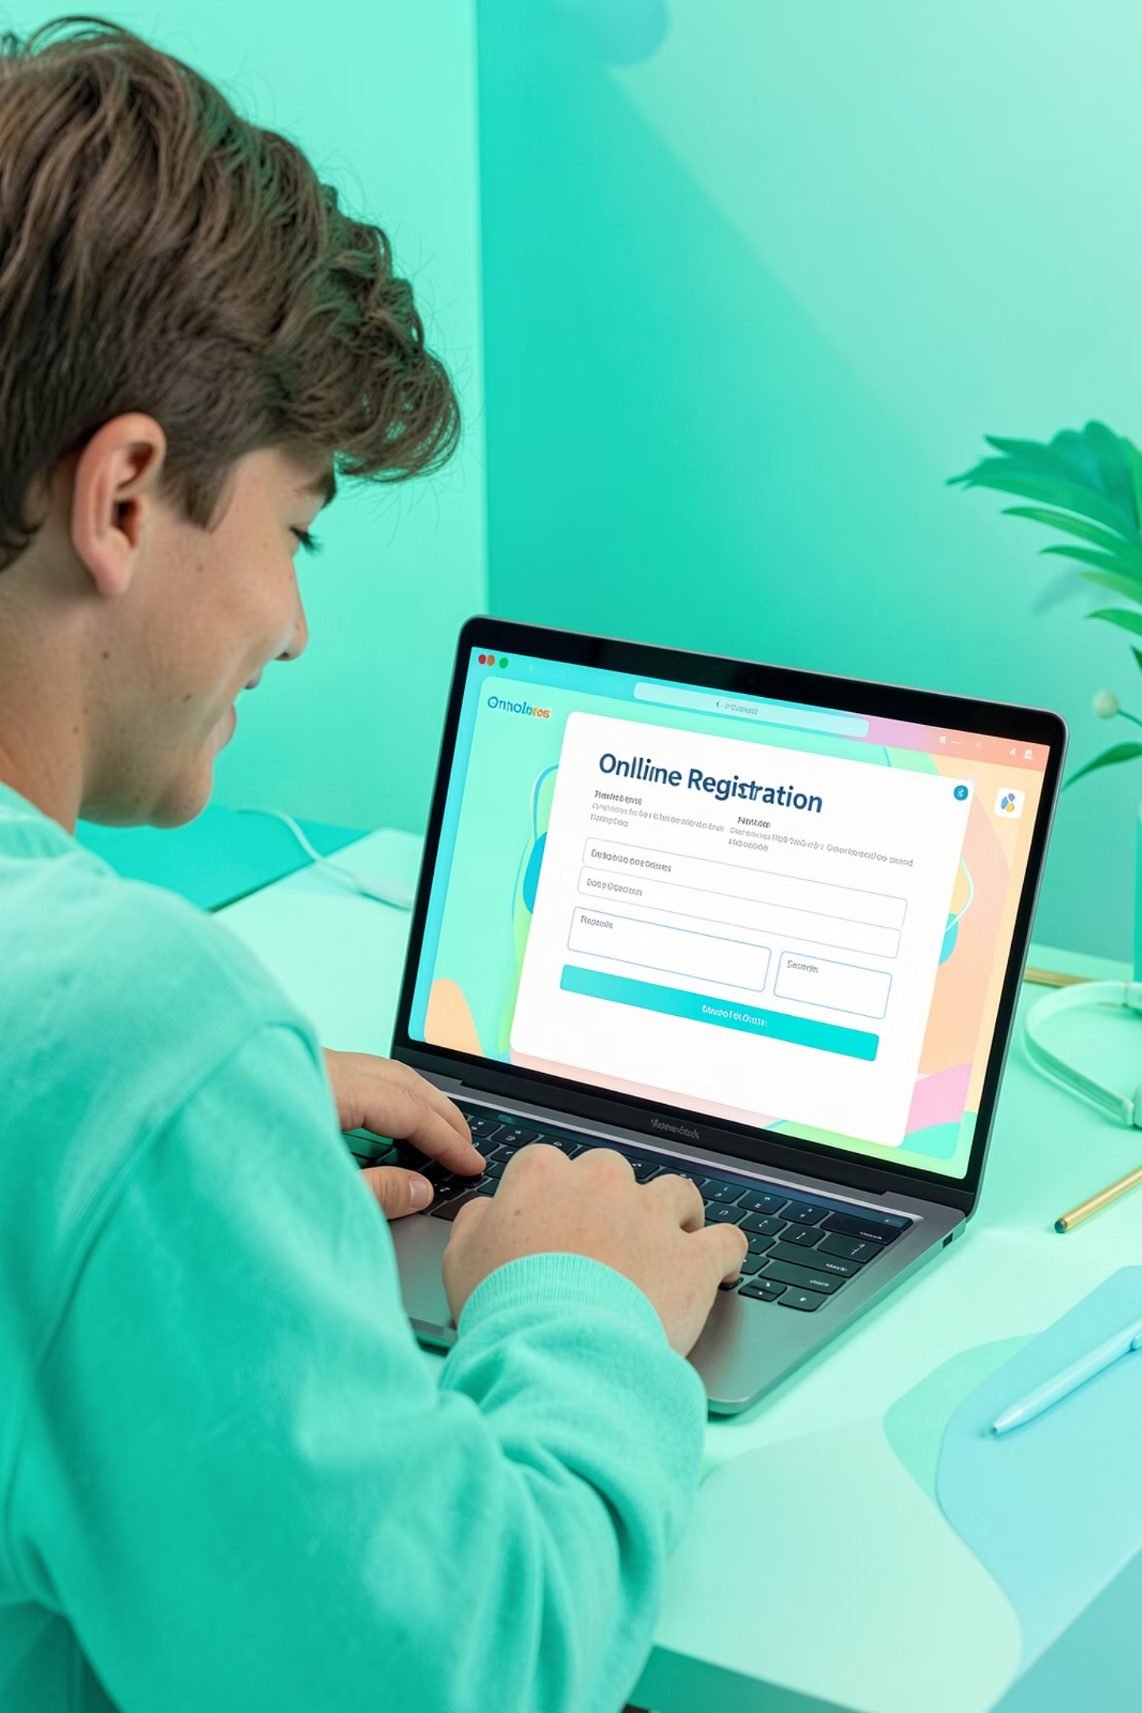
Registration — Now Fully Online
⚡ Sign Up in Minutes
💳 Credit Card Payments
End-to-end online registration — no more email back-and-forth
Secure, integrated Square payments accepted directly on the site
📋 Auto Attendee Tracking
Automated reporting replaces manual spreadsheets entirely

Slide 5

Knowledge at Your Fingertips
Presentations Library
Every presentation now has its own dedicated landing page — complete with a summary, searchable keywords, and topic tags like OT-10, Car Hire, and TOL. What was once a buried archive is now a living knowledge base.
Individual presentation pages
Topic tagging & keywords
15+ years made usable
The full archive is now searchable and organized
Each talk gets its own URL, summary, and metadata
Consistent tagging improves search and SEO discoverability

Slide 6
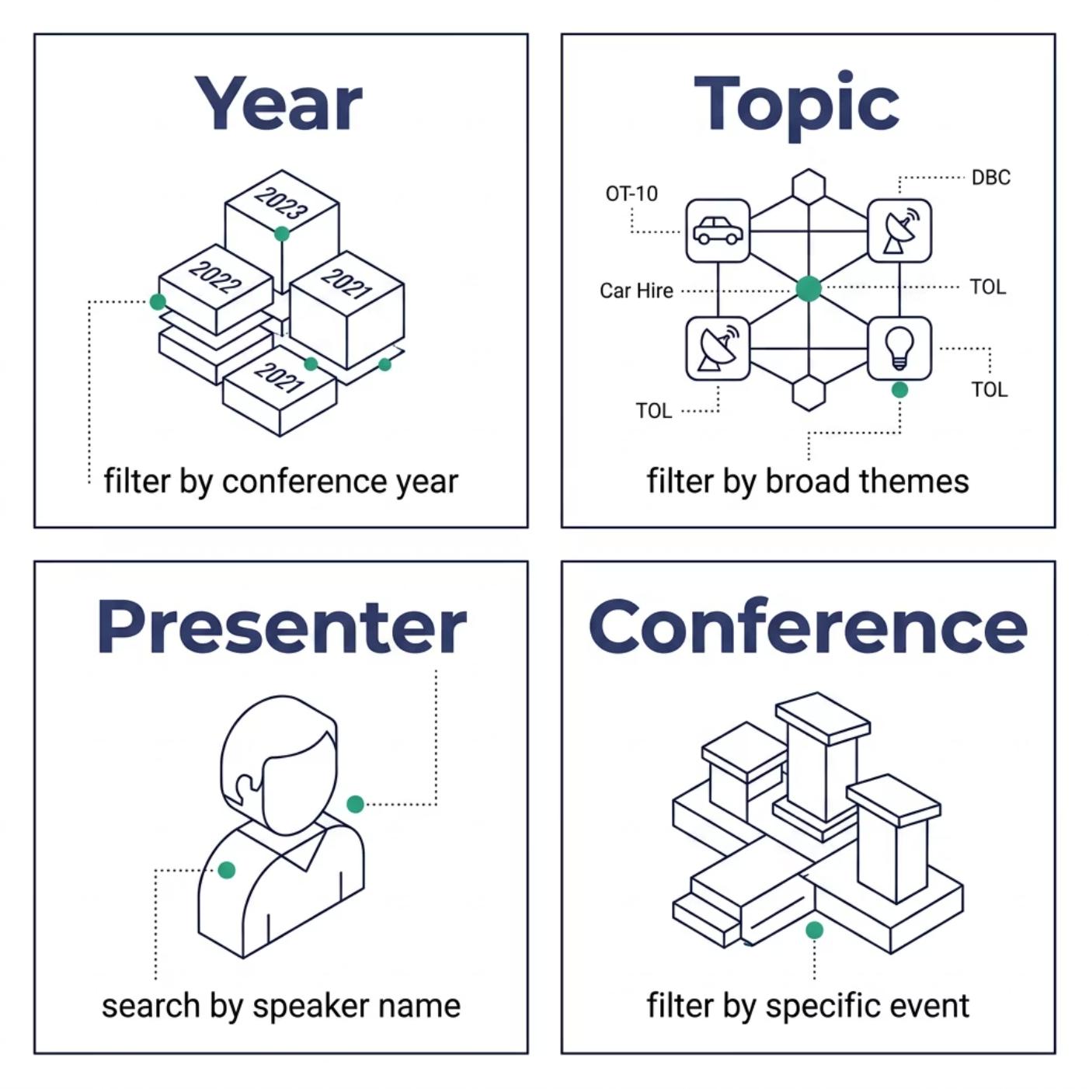


Find What You Need
Search & Filtering
Powered by FacetWP, the advanced filtering system lets members quickly locate exactly what they need — whether they're researching a specific OT-10 topic or revisiting a presenter's past work.
The presentations archive is transformed from a static file dump into a dynamic, usable knowledge base.

Slide 7
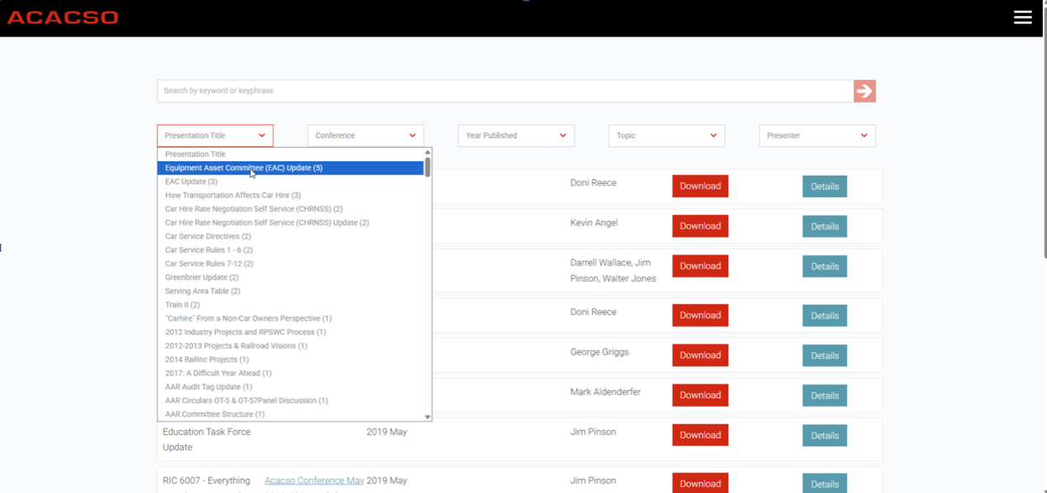

Slide 8
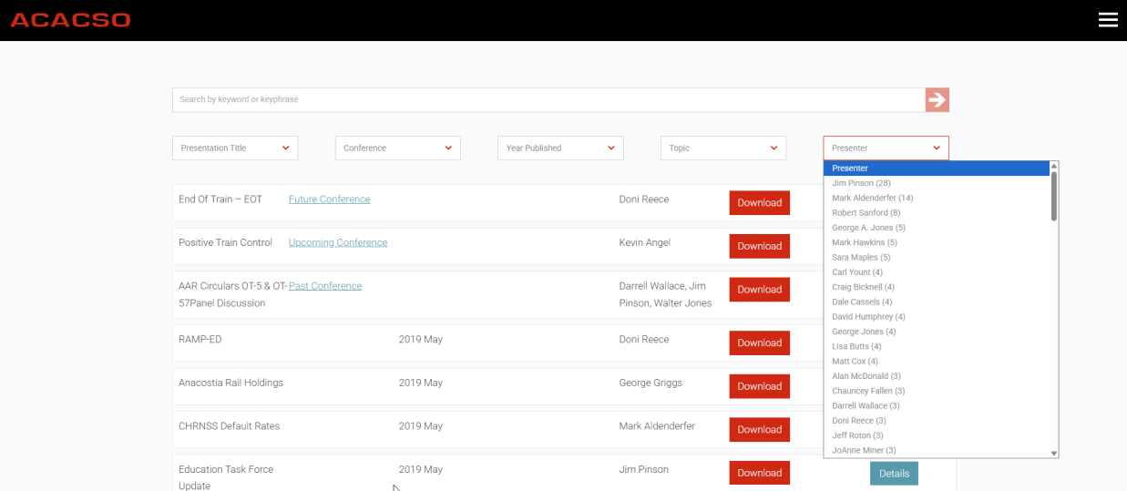

Slide 9
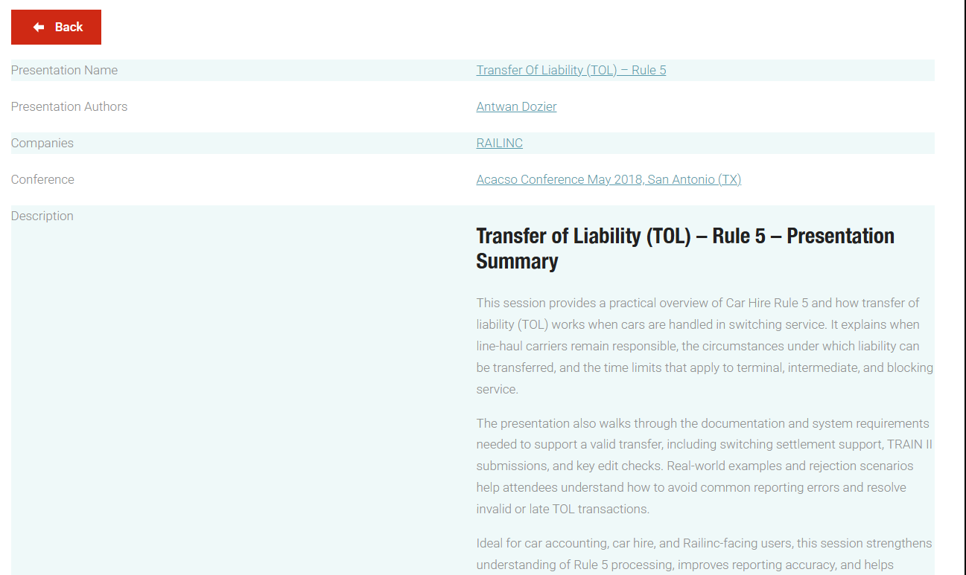

Slide 10
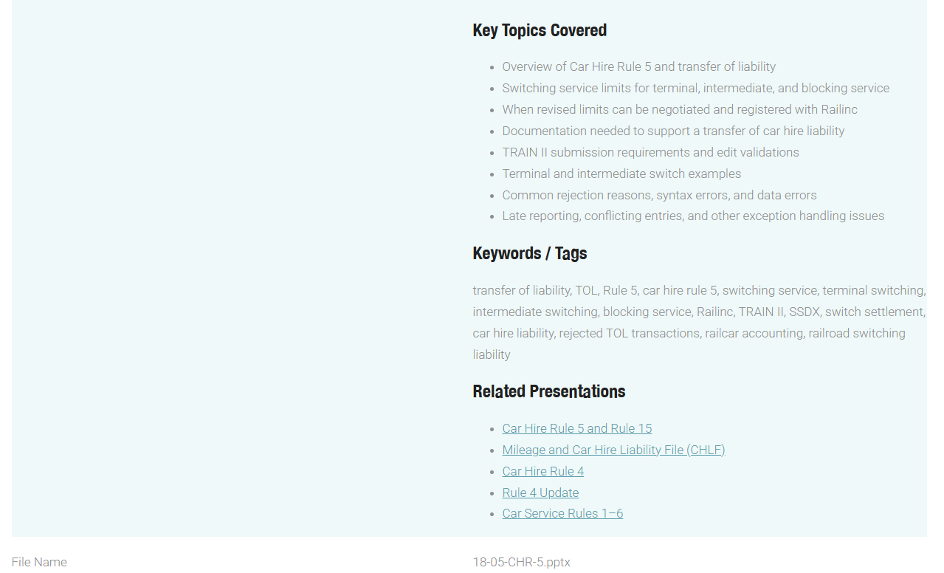

Slide 11

Conference Pages — Everything in One Place
Each conference now has a centralized hub that brings together all the information attendees need — before, during, and after the event.
📅 Agenda Highlights
Session schedule and key events
🏨 Hotel & Logistics
Venue details and travel information
🖊️ Registration
Direct access to online sign-up
📂 Past & Future Events
Links to related presentations and archives

Slide 12
Content Management
Easier for Everyone to Manage
Built for Non-Technical Users
Technology Stack
The site uses Breakdance Builder, a visual drag-and-drop editor. Any board member or volunteer can update pages, add content, and manage events — no coding required.
01
WordPress
Visual editor — point-and-click page building
Templates — consistent structure across all pages
Multiple users — reduces single-admin dependency
Hosted by SunnyHQ — reliable, supported infrastructure
Non-proprietary, widely supported CMS
02
Breakdance Builder
Visual editor for page management
03
Gravity Forms
Flexible registration form handling
04
FacetWP
Advanced search and filtering engine

Slide 13

Looking Ahead
What's Next
Phase 2
Phase 4
Phase 1
Add related-content links between presentations
Phase 3
Improve registration, receipts, and admin hub
Complete presentation summaries for archive
Expand resources and reference library
The redesign is a foundation, not a finish line. Upcoming enhancements will deepen the value of the presentations library, streamline registration communications, and potentially build out a dedicated admin documentation hub for board use.

Slide 14


More Than a Website
The new ACACSO site is a long-term platform for industry knowledge, collaboration, and efficient conference management — built to grow with the organization.
🔍 Explore the Site
📝 Use Registration
Browse the presentations library and new conference pages
Try the new online sign-up for the next event
💬 Share Feedback
Your input shapes what we improve next
Standardize presentation summaries and consistently tag new content — this keeps the knowledge base growing and searchable for every member.

