Slide 1
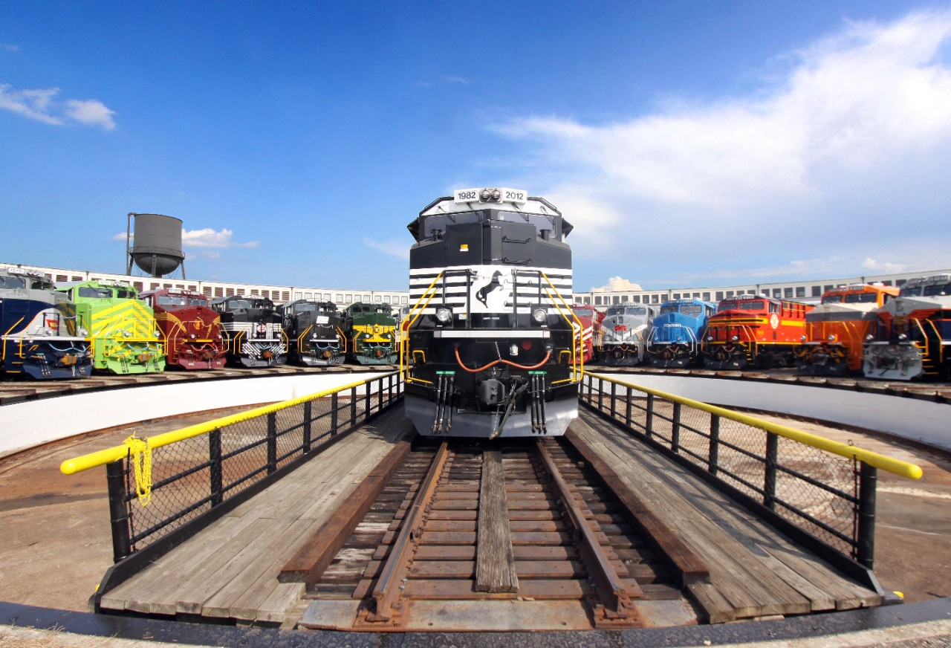
Norfolk Southern

Slide 2
Norfolk Southern Time Line
1827 – South Carolina Canal Railroad receives charter
1830 – Best Friend of Charleston begins service
1838 – Norfolk & Western is born
1884 – Pier 1 opens in Norfolk, VA
1894 – Southern Railway is born
1963 – Pier 6 opens in Norfolk, VA
1982 - Norfolk & Western merges with Southern Railway to form Norfolk Southern
1999 – NS and CSX agree to Conrail split
2010 – Opens the Heartland Corridor
2012 – Celebrates 30th Anniversary

Slide 3
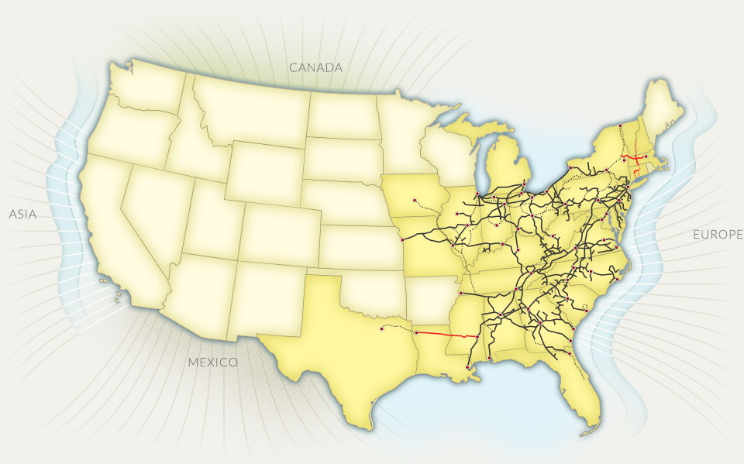
NS Today

Slide 4
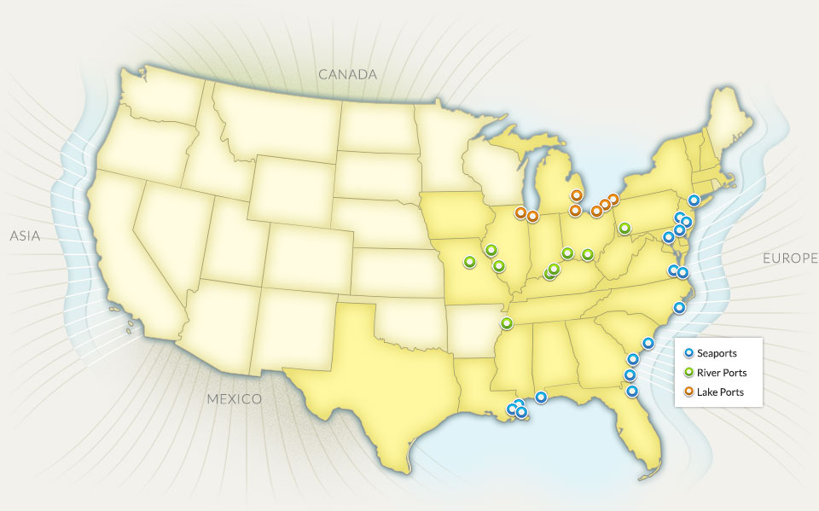
NS Served Ports
Notes:
.

Slide 5
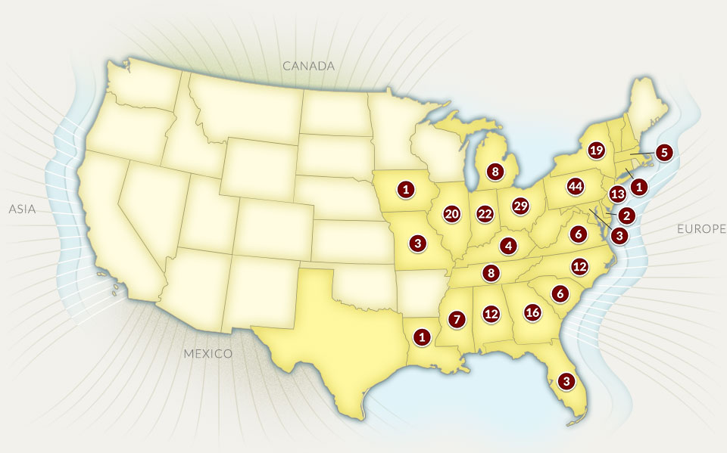
NS Shortline Partners

Slide 6
2012 Operating Revenues

Slide 7
2012 Shipment Volumes

Slide 8
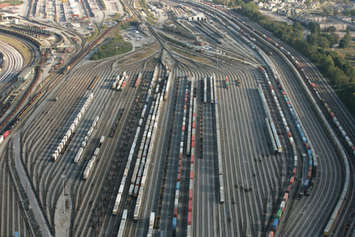
Revenue Growth
Industrial Development
Capital Investment
Intermodal
Crude Oil
Paper and Forrest
Advertising

Slide 9
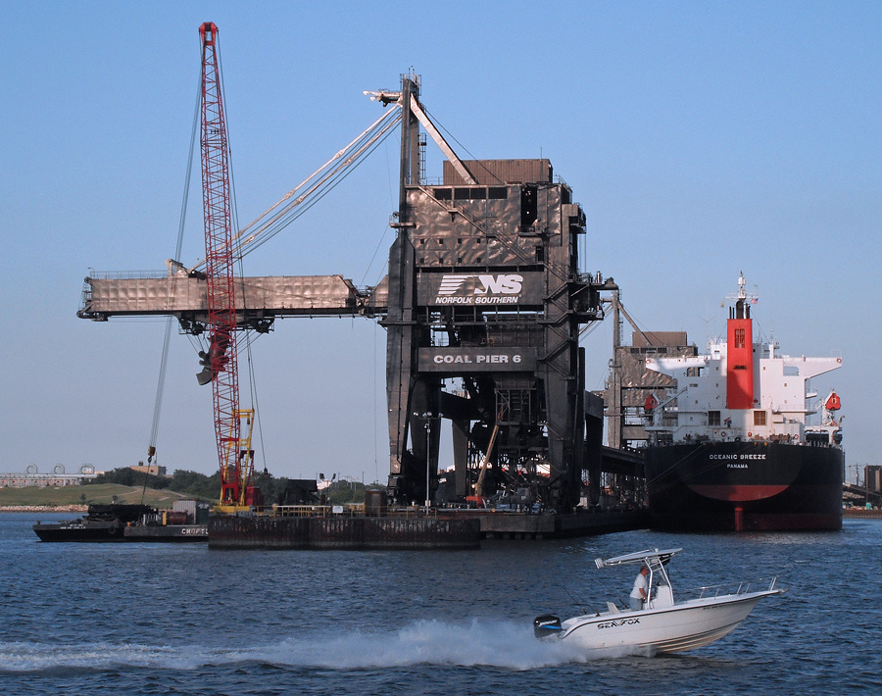
Lamberts Point & Pier 6
Spans 400 acres at Lamberts Point
Can hold 6,500 rail cars on 150 miles of track
Ship loaders are 182 feet tall and weigh 2400 tons
Loaded a record 159,941k tons into M/V Cape Dover
Transloaded more than 1.2 billion tons of coal since 1883

Slide 10
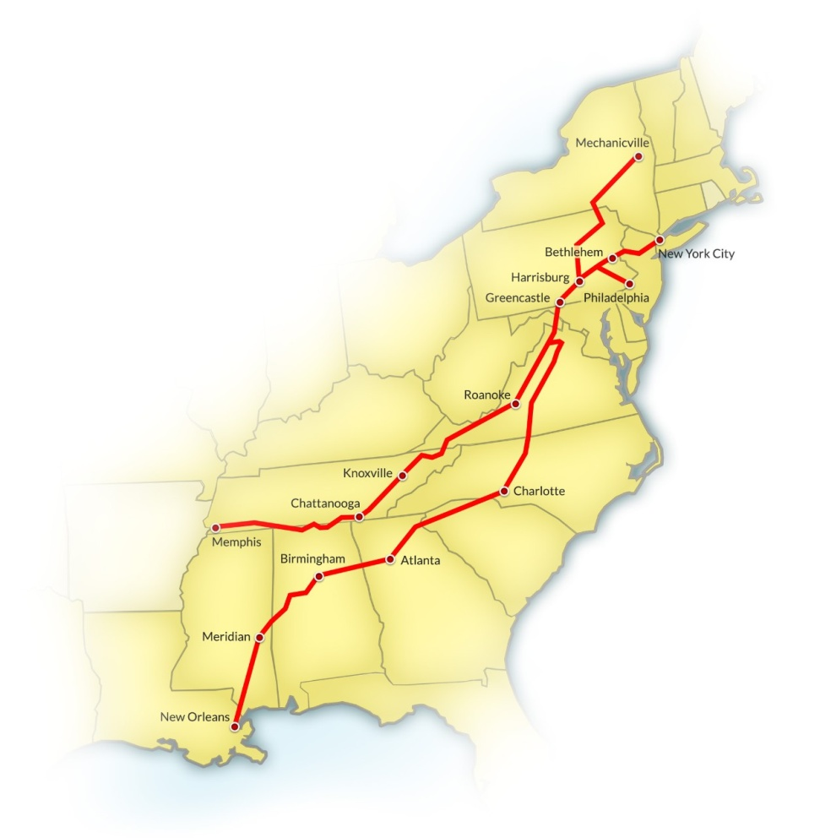
Crescent Corridor Projections
Create 122,820 new jobs by 2030
Save more than $575M in traffic congestion annually
Reduce 1.9M tons of carbon dioxide annually
Save more than 169M gallons of fuel annually
Remove 1.3M long haul trucks annually

Slide 11




















NS Celebrates 30th Anniversary

Slide 12
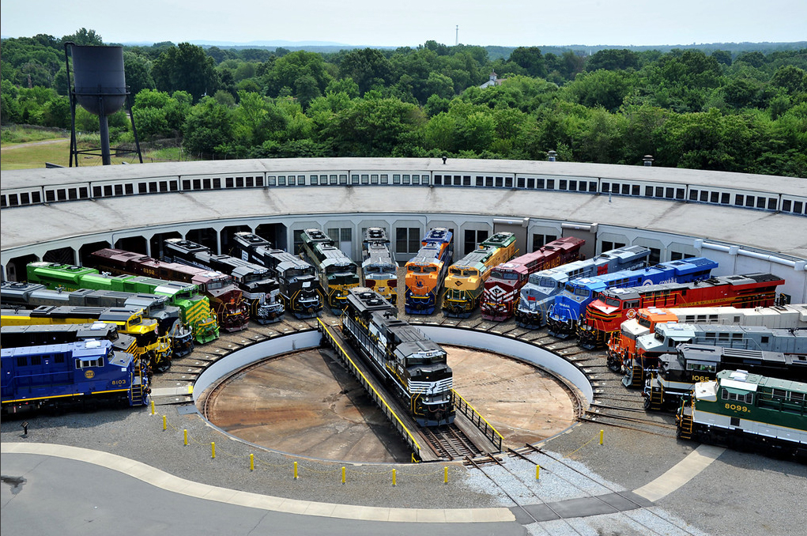
Heritage Locomotives

Slide 13
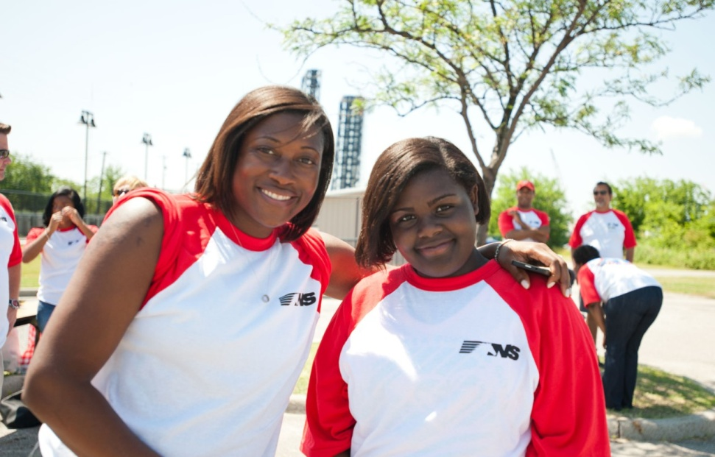
NS Family
30,416 employees across the NS network
Enola Locomotive Shop employees were the first group to work 2M injury-free service hours
Thoroughbred Volunteers contributed 3,200 volunteer hours in 2012
Education assistance $5k/year
DARS assistance if needed

Slide 14
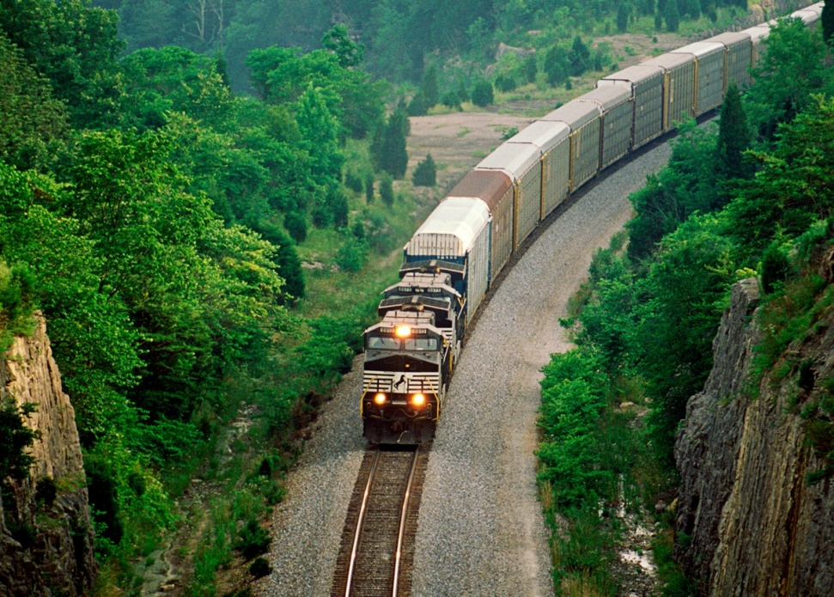
Environmental Stewardship
72% of NS locomotives are equipped with idling-reduction technology
First Railroad to use a 100% biodiesel
Top ranked railroad in Newsweek’s 2012 Green Rankings
Started Trees for Trains in 2012
Environmental site improvements

Slide 15
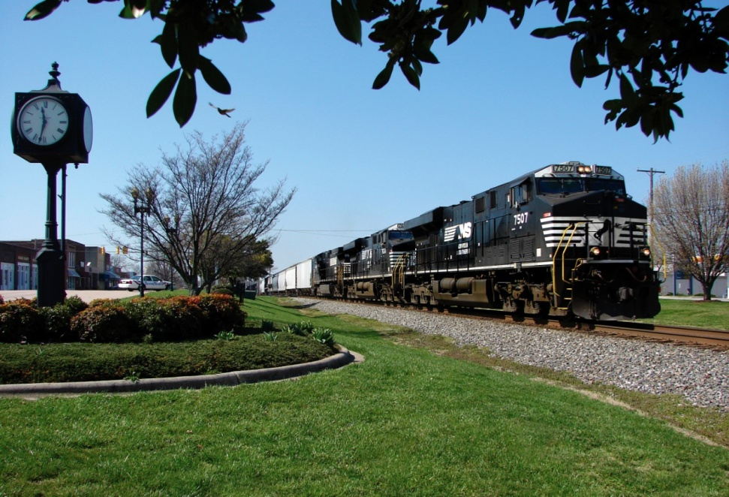
Socially Responsible
Donated $6.98M to local communities through the NS Foundation
Named to G. I. Jobs Magazines Top 100 Military Friendly Employers
Ranked 4th for adoption benefits by the Dave Thomas Foundation
Provides yearly Emergency Responder training

Slide 16
Questions?

