Slide 1
UMLER
Umler Equipment Management Information System
ACACSO
May 7-9, 2014
Jean Kincade

Slide 2
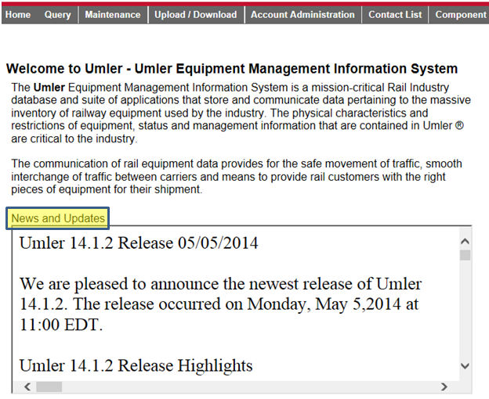
UMLER Home Page

Slide 3
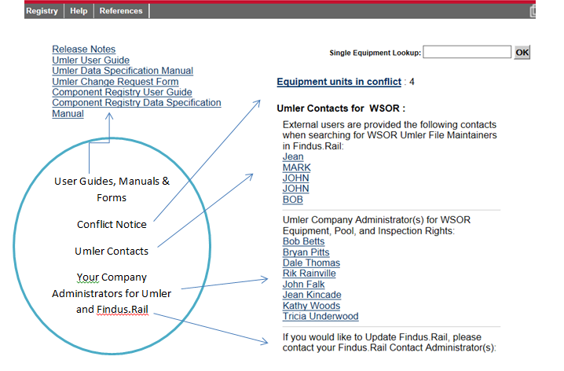
UMLER Home Page

Slide 4
Changes to Umler
Changes are made to the system to assist users with regulatory compliance.
  Transport Canada
    Protective Directive #34 (B525 & B526)
  AAR
  FRA
  Committee Recommendations

Slide 5
Umler Change Request Form
Used for Umler System Changes requested by users for:
  New elements
  Deletion of elements
  New permissible values
  Business rule changes
  Functionality or view changes in the Umler System

Slide 6
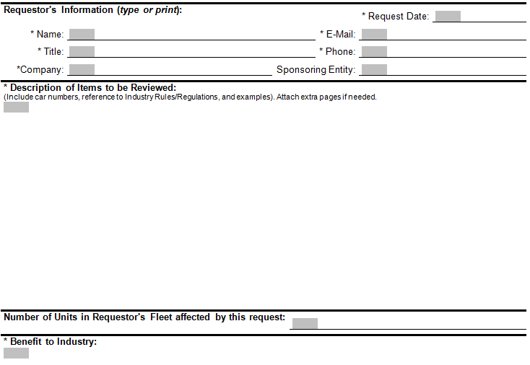
Umler Change Request Form

Slide 7
Process for Umler Changes
Step 1
Data Quality Task Force will review
Step 2
DQTF many request more information or clarification from submitting party
Step 3
Umler Committee Review
Step 4
Umler Committee will assign priority level
Step 5
Assigned to Umler Release
May return to DQTF for further clarification
Railinc will assign difficulty level
Manuals updated
Business Rules updated

Slide 8
System Validation Task Force
All elements of each equipment type in the data specification manual are being reviewed.
Submit the Umler change request form if you would like more fields added or changes to current ones.
Now is the time to do this, prior to SVTF completing the process.

Slide 9
Query
Display unit
  Single unit
Equipment Query
  Range of cars by initial or series
  Customize output
  Select details for query
Car Management Query
  Search all pools
  Search your pools

Slide 10
Query
Transaction Log
  Details available by clicking on the log id number
Inspection History
  ABT, Autorack, Vflat, Locomotive, Reflectorization
Historical Lineage Query
  Shows prior ID & dates
    Two cars with same EIN cannot be active
Equipment Unit Comparison
  Compares two equipment units

Slide 11
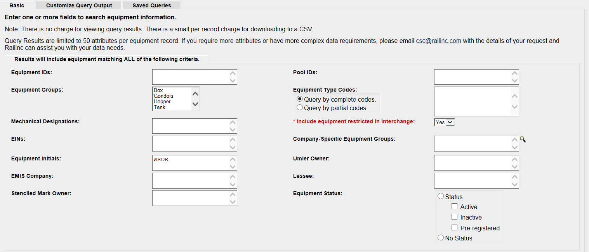
Equipment Query

Slide 12
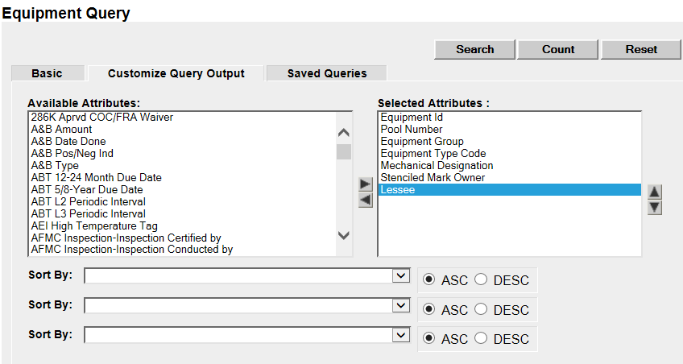
Customize Equipment Query
Notes:
Default values are listed. Hold Control key, click on ones you want to add/remove and click on arrow.

Slide 13
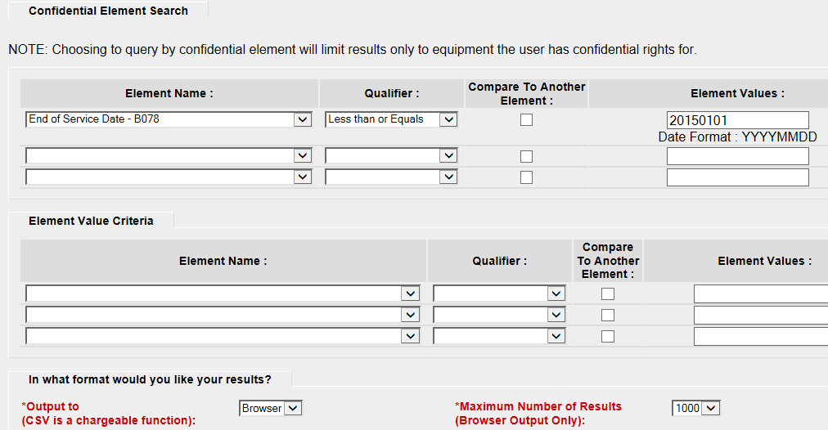
Confidential Element Query

Slide 14
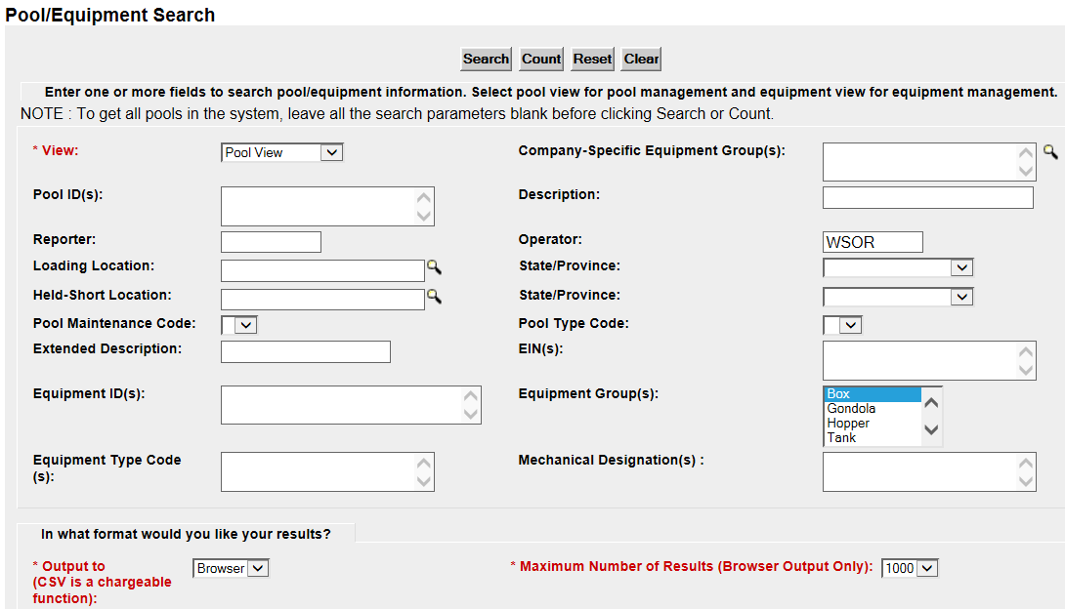
Car Management Query

Slide 15
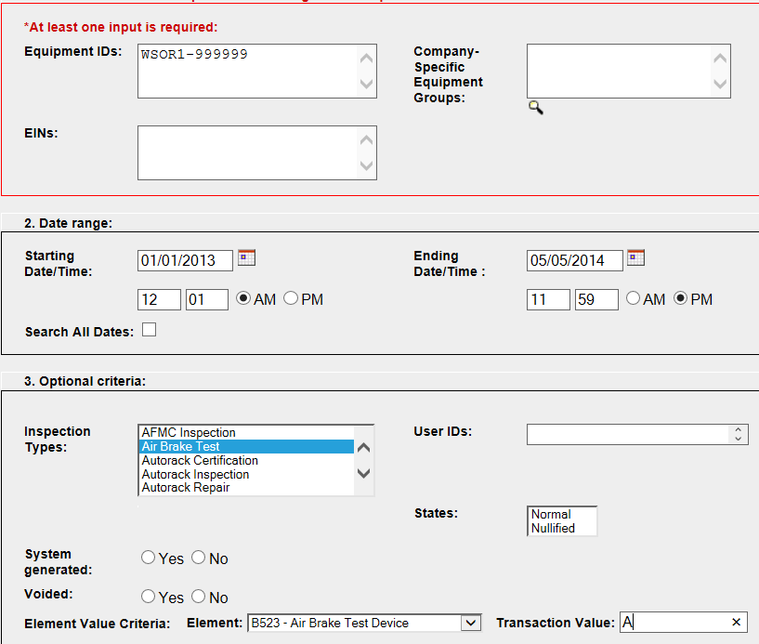
Inspection History
Notes:
Star Code

Slide 16
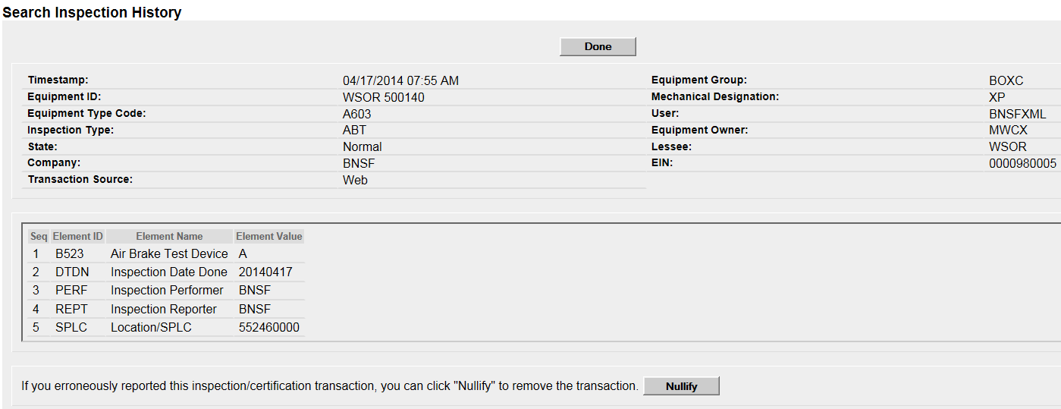
Inspection History
Notes:
Automatic vs manual ABT device.
Car owner, and the performer/reporter can nullify.

Slide 17
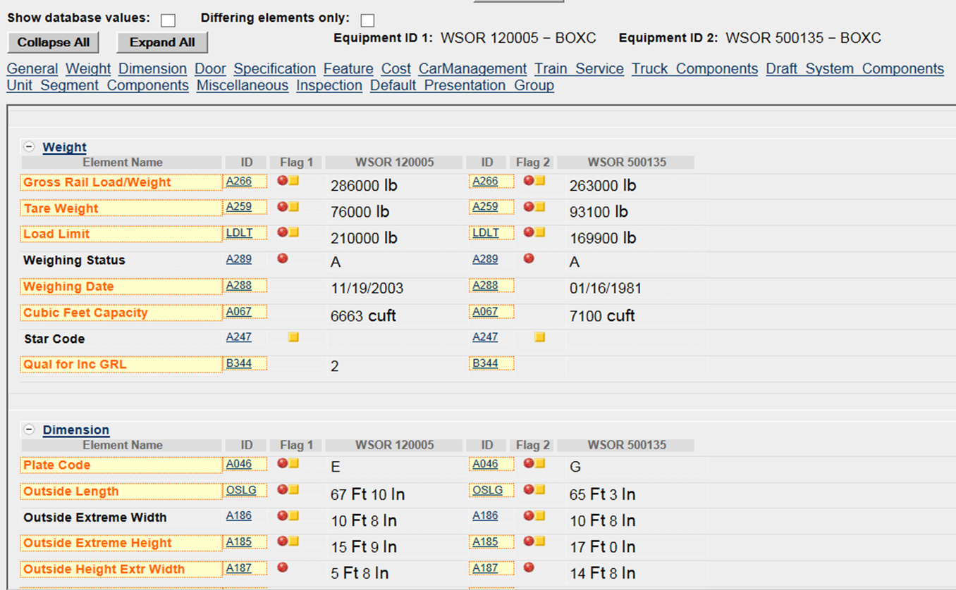
Equipment Unit Comparison
Notes:
Star Code

Slide 18
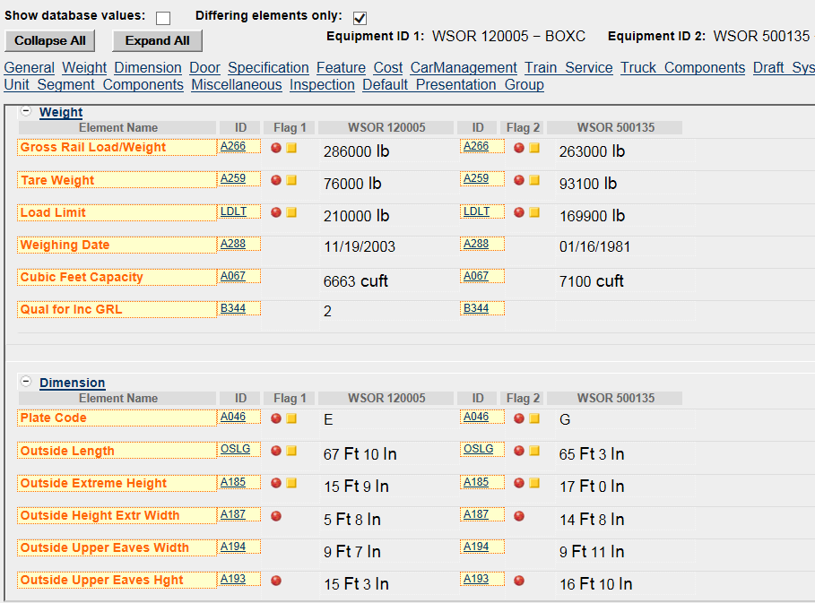
Differing Elements Only View

Slide 19
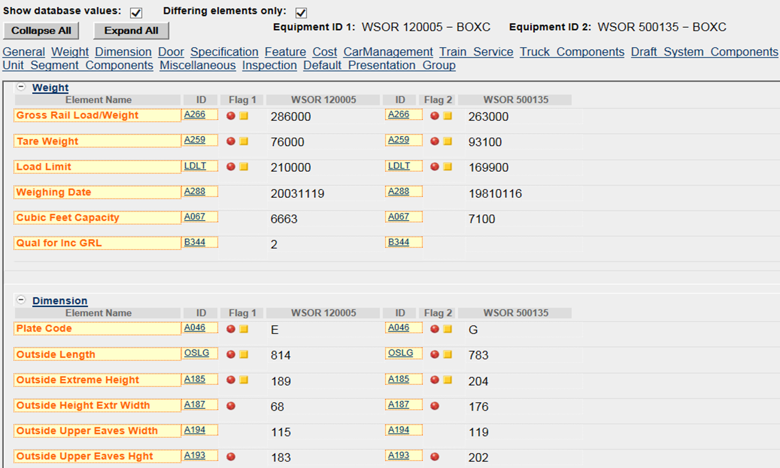
Database Values – Differing Elements

Slide 20
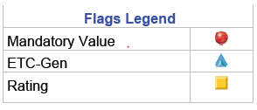
Umler Flags
Discussion on adding new flag for regulatory fields.

