Slide 1
TRAIN Messages 101
ACACSO
May 10, 2018
Kellie Bates
Norfolk Southern

Slide 2
Agenda
Overview and History
Impact on Car Hire
Impact on DDCT
TRAIN II Manual Location

Slide 3
TRAIN II
Tele
Rail
Automated
Information
Network

Slide 4
Purpose/History
Need for industry-wide control of car location and utilization
Enables better management of car fleet
Used to monitor the full movement cycle of cars
Provides up to date information on railcar locations
Increases flow of the car fleet industry-wide

Slide 5
Communication
Communication is two ways with the TRAIN II System
Railroads provide location information to Railinc
A railroad or car owner can request a status (location) on any car
Railinc will respond with the latest data
Railinc will respond with errors in messages
Communication is from a real-time environment
Data can be furnished in batch (every 30 mins) or real-time (as received at Railinc)

Slide 6
TRAIN II Input Includes
- Placements - Bad Order Storage/Hold Reports
- Loading Reports - Empty Car Destination Reports
- Origin and Destination Reports - Car Grade Inspections
- Interchanges - Early Warning Inspections
- Regional Boundary Crossings - ETA’s (Estimated Time of Arrival)
- Arrivals at Destination - Ramped and Deramped
- Unloadings - Shipper Rejection Reasons

Slide 7
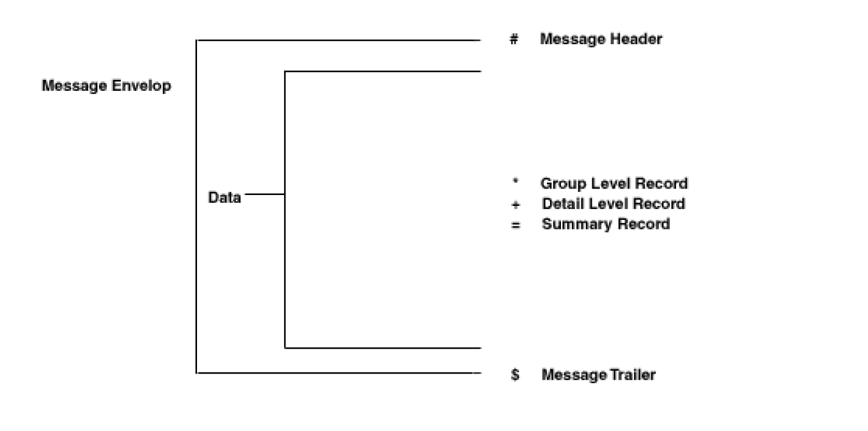
Message Structure

Slide 8
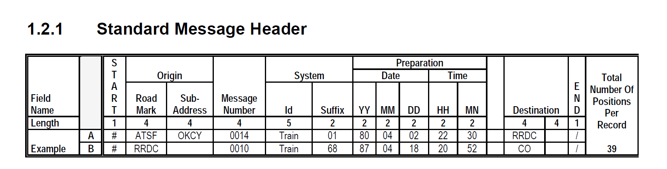
Message Header

Slide 9
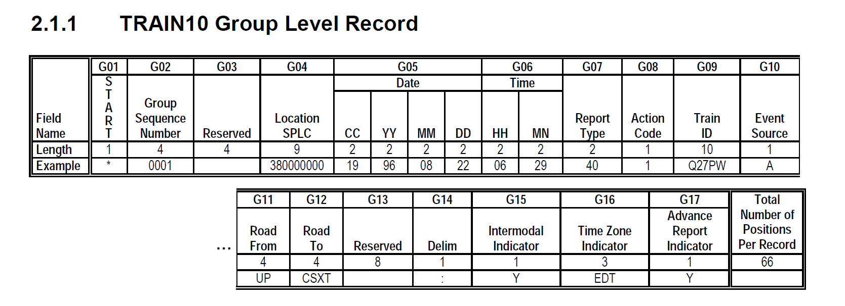
TRAIN 10 Group Level Record

Slide 10
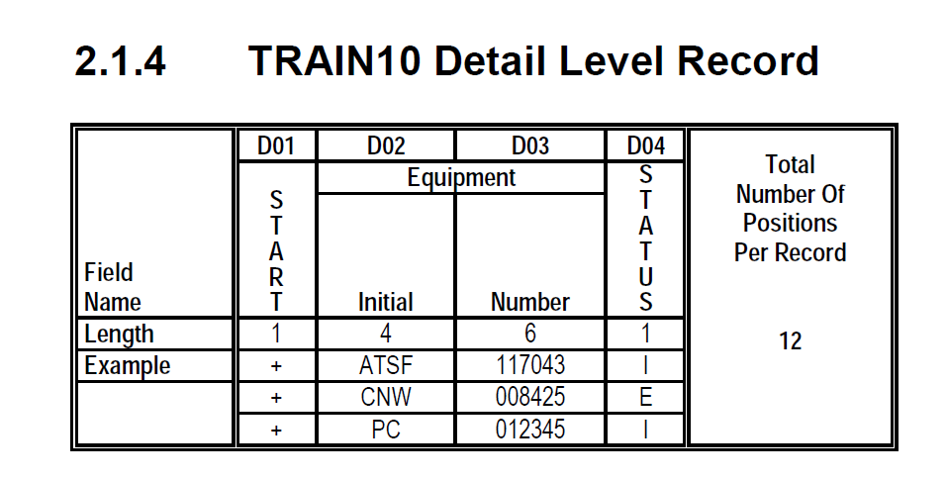
TRAIN10 Detail Level Record

Slide 11
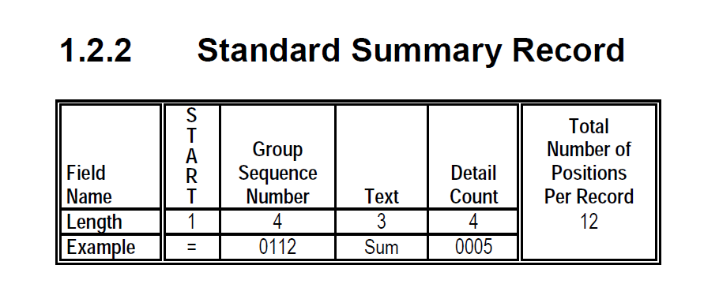
Summary Record

Slide 12
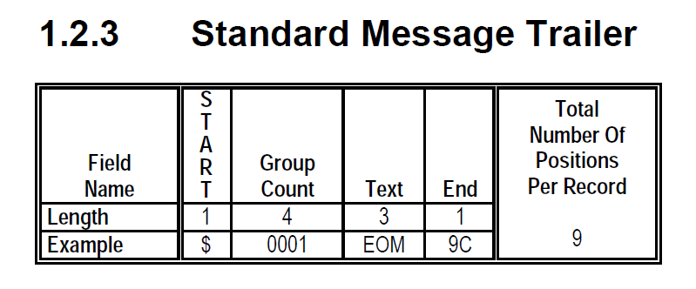
Message Trailer

Slide 13
Message Info
TRAIN 10 Messages are preferred and highly recommended
Additional details not present in other messaging types
TRAIN 01/31 messages have less details
If a TRAIN 10 message contains an error, a TRAIN 50 message is returned
If a TRAIN 01/31 message contains an error, a TRAIN 51 message is returned
All of the edits are industry defined

Slide 14
Impact on Car Hire
Without the TRAIN II system, there would be no centralized processing of car hire messages
Therefore…
Car hire is affected in every way by TRAIN II

Slide 15
TRAIN II Impact on Car Hire
Messages that impact car hire:
TRAIN 10 – Interchange, car movements, etc.
TRAIN 10 Types 80, 81, 84, 85 – TOL (Rule 5)
Carrier/car owner submits to Railinc
TRAIN 26/29 – TOL (Rule 15)
Carrier/car owner submits to Railinc
TRAIN 28 – TOL (Rule 4, 5, and 15)
Railnc to carrier/car owner
TRAIN 50 – Error Messages
TRAIN 61, 62, 63 – Junction Advice
TRAIN 69 – Interchange Advice

Slide 16
TRAIN Message Types
01 – Report a delivery/receipt of equipment
02 – Report equipment movement from any Car Service Region to another
03 – Report equipment movement events
06 – Report desired movement instructions
08 – Report Various Events:
Bad Order/Hours to Repair
Rule 5 Switching Car Hire TOL, Report Types 80, 81, 84, and 85
Rule 15 Car Hire TOL, Report Types 82 and 83
Several events with TRAIN ID
10 – Designed to incorporate reporting of events currently handled by TRAIN01, TRAIN02, TRAIN03, and TRAIN08 with expanded functionality (i.e. century, event source indicator, etc.)
Page 231 of Manual

Slide 17
TRAIN Message Types
17 – Allow input of entries to update the Parameter Tracing Master Table
18 – Allow input of Parameter Trace Registrations from the Industry PC Package
24 – Advise a TRUK reporter on a non-TRUK move
26 – Rule 15 TOL
28 – Data provided as requested in the TRAIN08, Transfer of Liability message
31 – Delete and/or correct erroneous Interchange Reports (TRAIN01/TRAIN51)
32 – Delete and/or correct erroneous Regional Boundary Crossing Reports (02/52)
33 – Delete and/or correct erroneous Car Movement Reports (03/53)
50 – Identify violations of edit criteria found in the Group and Detail Level records at an Event Report (TRAIN10)
Page 231 of Manual

Slide 18
TRAIN Message Types
51 – Identify violations of edit criteria found in the Group and Detail Level records of an Interchange Report (TRAIN01/31)
52 – Identify violations of edit criteria found in the Group and Detail Level records of a Regional Boundary Crossing Report (TRAIN02/32)
53 – Identify violations of edit criteria found in the Group and Detail Level records of a Car Movement Report (TRAIN03/33)
56 – Identify exceptions to the edit criteria found in the Group and Detail Level records of the referenced Waybill Report (TRAIN06)
57 – Identify violations of edit criteria found in the Group Level records of the parameter Tracing Table Entry (TRAIN17) message
Page 231 of Manual

Slide 19
TRAIN Message Types
58 – Identify violations of edit criteria found in the Group Level or Detail Level records of the TRAIN08 Reports
61 – Junction Report (Option 1)
62 – Junction Report (Option 2)
63 – Junction Report to Lessee
69 – Identify delivery and receipt Interchange Reports that do not match data which are detected during continuity analysis
74 – Last road known to have reported a car
75 – Last known carrier of a car
Page 231 of Manual

Slide 20
TRAIN Message Types
76 – Advise an inquirer (who is in the Inquiry Parameter Table) that a unit movement has occurred and responds with the appropriate data based on the type of output that is requested in the table
80 – Indicate to recipient of message that the equipment moved from one Car Service Region to another. Indicate to recipient of message that a Car Movement has been reported. Indicate to a recipient of message that a Waybill has been reported.
82 – Advise the lessee/appurtenance owner or owner of a car that its grade has changed due to inspection or Waybill reportings
83 – Advise anyone who wants it of all cars whose grade has changed
Page 231 of Manual

Slide 21
TRAIN Message Types
88 – Advise the lessee/appurtenance owner or owner of a covered hopper of the last commodity in it due to Waybill Reportings
89 – Advise anyone who wants it of all covered hoppers whose last commodity has changed due to Waybill Reportings
98 – Acknowledge receipt of and/or identify violations of edit criteria found in the Group Level records of the Parameter Tracing Master Table entry (TRAIN18) message
Page 231 of Manual

Slide 22
TRAIN II Impact on Car Hire
Submitting Parties
Carriers that use railcars (users authorized to submit)
Receiving Parties
Carriers, car owners, shippers
Transmission Methods
MQ Connections
FTP Connections

Slide 23
TRAIN II Impact on DDCT
Car hire for DDCT cars is managed through the following special road marks:
DSP7
DVR7
SHP7
DEAD
DSP8
SHP8
SHOP
TRAIN messaging for DDCT is handled via TRAIN 10 messages
Unique messages for DDCT are not necessary

Slide 24
TRAIN II Impact on DDCT
Submitting parties and receiving parties
Damaging carriers
Handling carriers
Car mark owners
Transmission method
MQ Connections
FTP Connections

Slide 25
TRAIN II Manual
Purpose
Details related to every single TRAIN message type including error details
Contains sample forms and instructions for completion
Event Code Table
Pages 221–225 (ARIL, BADO, DFLC), the code description, TRAIN report type, locating Y/N
Shipper Reject Codes
Page 228 (A – Dirty, D – Grade Not Satisfactory For Shipper’s Requirement)
Examples of Car Gradings – page 229
Bad Order Reason/Status Codes – page 230
Notes:
-

Slide 26
TRAIN II Manual
Get a copy of the manual by:
Railinc Customer Support – 877-RAILINC (877-724-5462)
csc@railinc.com

Slide 27
Questions?

