Slide 1
Suppressed Interchanges & Haulage
ACACSO Conference

Slide 2
Today’s Agenda
Definition of Suppression, Haulage and Trackage
Reporting Suppressed Interchanges
Example Suppressions
Reporting Haulage Interchanges
Example Haulages
Questions
Notes:
High level overview of OT5 along with a statement on the modernization which enabled Railinc to progress at such a rapid pace with the enhancements that took place this year.

Slide 3
Definition of Suppression and Haulage
Car hire is not owed by the carrier in physical possession of a car.
Suppression – The carrier in physical possession of the car is usually a short line.
  OT 28 Railroads
  Ownership by Class I’s
  Non Subscribers to OT-10
Haulage – The carrier in physical possession of the car is working as an agent for another carrier.
  Confidential agreement – Railinc knows only the information required to administer the car hire
  Movement events are masked to show the haulage rights carrier as the carrier operating the train
Notes:
High level overview of OT5 along with a statement on the modernization which enabled Railinc to progress at such a rapid pace with the enhancements that took place this year.

Slide 4
Definition of Trackage
Trackage – One carrier operates over the track of another.
  Railinc typically does not have in depth knowledge of the agreements.
  Movements should be reported as though they occurred on the possession carrier lines.
  Car Hire typically remains with the carrier operating the train – not the owner of the track.

Slide 5
Suppressed Interchanges Overview

Slide 6
Suppressed Interchanges
Suppressed interchanges allow for Car Hire Responsibility to remain with the delivering carrier. The receiving carrier should not be responsible for Car Hire.
With suppressed interchanges there is no masking and the interchange is not updated.
Suppressed interchanges will not send LCS messages.
Notes:
High level overview of OT5 along with a statement on the modernization which enabled Railinc to progress at such a rapid pace with the enhancements that took place this year.

Slide 7
Suppressed Interchanges
The suppression will end with the next reported valid interchange.
LCS “G” Gap records may be created on the suppression end interchange.
  When the equipment is delivered to a carrier other than the delivering carrier in the suppression start.
  Carrier A → Carrier B → Carrier C
Notes:
High level overview of OT5 along with a statement on the modernization which enabled Railinc to progress at such a rapid pace with the enhancements that took place this year.

Slide 8
How to report Suppressed Interchanges to Railinc
Suppressed interchanges are reported to Railinc through the TRAINII system.
There are two methods for reporting suppressed interchanges:
  Report the interchange as suppressed by reporting a TRAIN10 or TRAIN31 message with the suppressed flag:
      TRAIN10 G08 Action Code = 4
      TRAIN31 G08 Action Code = 4
  Register the Junction Interchange as inhibited:
      All interchanges reported at the junction will be suppressed.
      Update Form can be found in the TRAINII Manual.
      For more information please contact the Railinc Customer Success Team.
Notes:
RPSWC overview has hopefully already taken place by someone else, reiterate the project for this year and who participated.
Between March and September we tackled three key themes
Controlling Entity Contacts, Storage Location Detail and Equipment Health

Slide 9
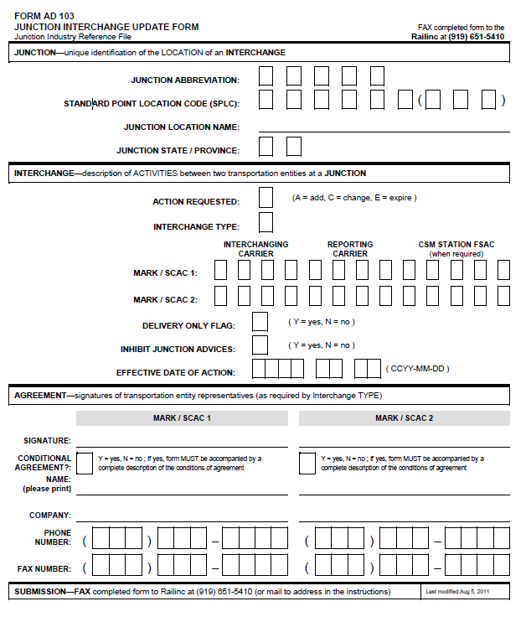
Junction Interchange Update Form

Slide 10
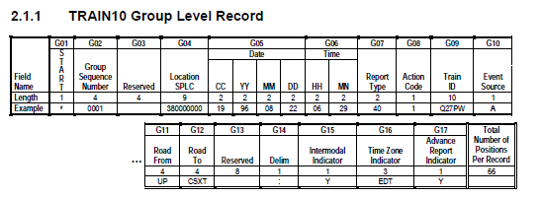
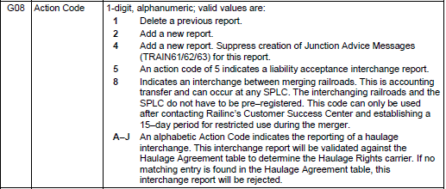
TRAIN10 Suppressed Interchange Reporting

Slide 11
Suppression Example
Event Type | From Carrier | To Carrier | LCS Code | Liable Carrier
DFLC | AAAA |  | A | AAAA
ICHD | AAAA | BBBB | 8 | AAAA
ICHR | AAAA | BBBB | 8 | AAAA
PACT | BBBB |  | 8 | AAAA
PFPS | BBBB |  | 8 | AAAA
ICHD | BBBB | AAAA | 8 | AAAA
ICHR | BBBB | AAAA | 8 | AAAA
ARIL | AAAA |  | A | AAAA
DFLC | AAAA |  | A | AAAA
In this example the equipment is returning to back to the delivering Carrier AAAA and no LCS Gap records are needed. Liability stays with Carrier AAAA while the equipment moves on Carrier BBBB. No, LCS messages are sent.

Slide 12
Haulage
Interchanges Overview

Slide 13
Haulage Interchanges
Haulage interchanges allow for Car Hire Responsibility to remain with the delivering carrier or transferred to a third carrier. The receiving carrier is not typically responsible for Car Hire.
Haulage interchanges and movement events will be masked according to the haulage information on file at Railinc.
LCS Codes will be sent to the carriers to indicate the haulage has started or has completed (Only issued as TRAIN69):
  E – Issued to notify that a haulage has started
  F – Issued to notify that a haulage has ended

Slide 14
How to report Haulage Interchanges to Railinc
Haulage interchanges are reported to Railinc through the TRAINII system as either a TRAIN10 or TRAIN31 message:
  TRAIN10 G08 Action Code = A-J
  TRAIN31 G08 Action Code = A-J
The action code of A-J must match the agreement indicator from the haulage registration along with the below rules:
  Delivering carrier must = Movement carrier 1
  Receiving carrier must = Movement carrier 2
  SPLC of the interchange must = SPLC on the agreement
The carrier listed in the car hire responsible field will be the carrier masked as moving the equipment.
Notes:
RPSWC overview has hopefully already taken place by someone else, reiterate the project for this year and who participated.
Between March and September we tackled three key themes
Controlling Entity Contacts, Storage Location Detail and Equipment Health

Slide 15
TRAIN10 Haulage Interchange Reporting

Slide 16
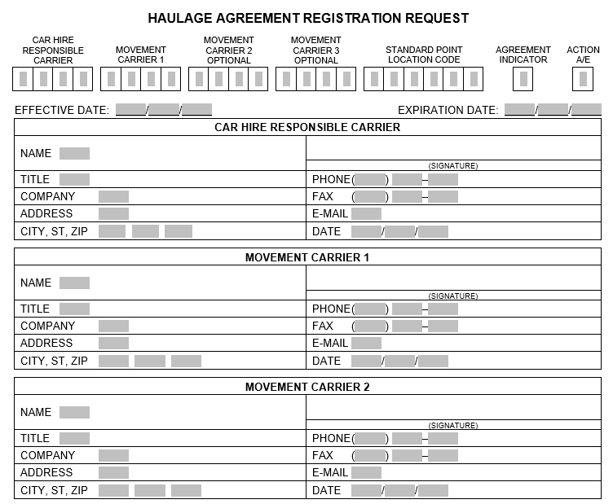
Haulage Agreement Registration Request Form

Slide 17
Two Carrier Haulage Example
AS REPORTED |  |  |  |  |  | MASKED DUE TO HAUALGE
Event Type | From Carrier | To Carrier | LCS Code | Liable Carrier |  | Event Type | From Carrier | To Carrier | LCS Code | Liable Carrier
DFLC | AAAA |  | A | AAAA |  | DFLC | AAAA |  | A | AAAA
ICHD | AAAA | BBBB | A | BBBB |  | ARIL | AAAA | BBBB | A | AAAA
ICHR | AAAA | BBBB | A | BBBB |  | DFLC | AAAA | BBBB | A | AAAA
PACT | BBBB |  | A | BBBB |  | PACT | AAAA |  | A | AAAA
PFPS | BBBB |  | A | BBBB |  | PFPS | AAAA |  | A | AAAA
ICHD | BBBB | AAAA | A | BBBB |  | ARIL | AAAA | AAAA | A | AAAA
ICHR | BBBB | AAAA | A | BBBB |  | DFLC | AAAA | AAAA | A | AAAA
ARIL | AAAA |  | A | AAAA |  | ARIL | AAAA |  | A | AAAA
DFLC | AAAA |  | A | AAAA |  | DFLC | AAAA |  | A | AAAA
In this example Carrier AAAA interchanges the equipment to Carrier BBBB which will return the equipment to AAAA. The haulage process will mask the events so the equipment looks to be on Carrier AAAA for the entire movement.

Slide 18
Three Carrier Haulage Example
AS REPORTED |  |  |  |  |  | MASKED DUE TO HAUALGE
Event Type | From Carrier | To Carrier | LCS Code | Liable Carrier |  | Event Type | From Carrier | To Carrier | LCS Code | Liable Carrier
DFLC | AAAA |  | A | AAAA |  | DFLC | AAAA |  | A | AAAA
ICHD | AAAA | BBBB | A | BBBB |  | ICHD | AAAA | CCCC | V | CCCC
ICHR | AAAA | BBBB | A | BBBB |  | ICHR | AAAA | CCCC | A | CCCC
PACT | BBBB |  | A | BBBB |  | PACT | CCCC |  | A | CCCC
PFPS | BBBB |  | A | BBBB |  | PFPS | CCCC |  | A | CCCC
ICHD | BBBB | CCCC | A | BBBB |  | ARIL | CCCC | CCCC | A | CCCC
ICHR | BBBB | CCCC | A | BBBB |  | DFLC | CCCC | CCCC | A | CCCC
ARIL | CCCC |  | A | AAAA |  | ARIL | CCCC |  | A | CCCC
DFLC | CCCC |  | A | AAAA |  | DFLC | CCCC |  | A | CCCC
In this example carrier AAAA interchanges the equipment to carrier BBBB which will deliver the equipment to CCCC. The haulage process will mask the events so the equipment looks to be on Carrier CCCC for the entire movement.

Slide 19
Review
Haulage and Suppression moves begin with interchanges reported to Railinc through TRAINII.
Haulage moves will end with one of the following:
  An interchange is reported after the start of haulage. If a new haulage start is reported the prior haulage will end and new haulage will start
  Continuity
  Or the haulage has been active for 60 days with no interchange reported
  OR the Load/Empty status on the equipment changes twice
Suppression moves will end with the next reported interchange.
Suppression does not mask events but haulage will.

Slide 20
Review
If you are having issues with a haulage or suppression please contact Railinc.
Haulage and suppression can be complex if you are creating a new suppression or haulage please contact Railinc.
If you would like more information or have questions about haulage or suppression please contact Railinc.

Slide 21
Questions?
Contact Railinc’s Customer Success Team:
by Phone (877) RAILINC (1-877-724-5462)
or by email csc@railinc.com

Slide 22
Railinc Keeps You Moving.
Mark Aldenderfer
Product Manager - Asset Utilization and Compensation
Phone 919-651-5239
Email: Mark.Aldenderfer@railinc.com

