Slide 1
Serving Area Process
ACACSO Conference
May 10, 2018

Slide 2
Today’s Agenda
What is Serving Area?
How Do I Receive Access to the Serving Area File?
How Do I View Serving Areas?
How Do I Add a Serving Area?
How Do I Expire a Serving Area?
Questions

Slide 3
What is Serving Area?

Slide 4
Overview
In Circular OT-10, Car Hire Rule 22 defines Serving Area as: “Standard Point Location Codes (SPLC) within a reasonable geographic distance of the industry being serviced used to stage, prepare or store cars for use by the shipper.”
The most common reclaims taken under Rule 22 are:
  Account Type 224 “Held Short”
  Account Type 222 “At Loading Point”
    Serving Area Locations

Slide 5
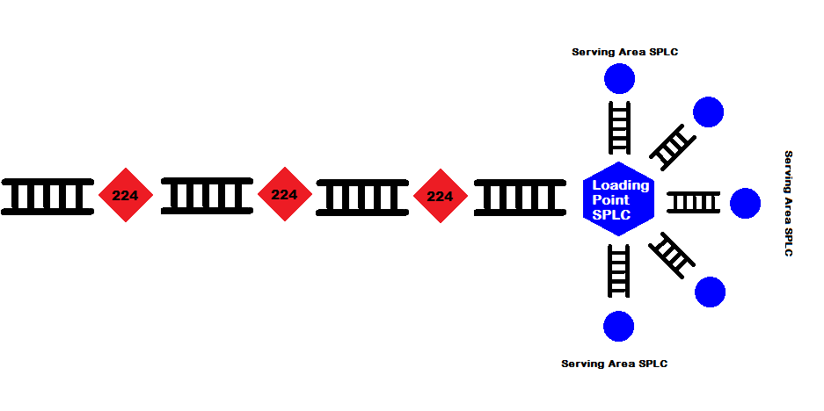
Rule 22 Account Type 224 vs 222

Slide 6
Serving Area Reference File
In December 2017, the Rule 22 Project Team and Railinc created a Serving Area File within the CASS application
Under Circular OT-10, this file should contain a list of the serving area(s) associated with each loading point
Designed to streamline the reclaims process under Rule 22
The Serving Area process allows users to search, add, and update serving areas in a central location

Slide 7
How Do I Receive Access to the Serving Area File?

Slide 8
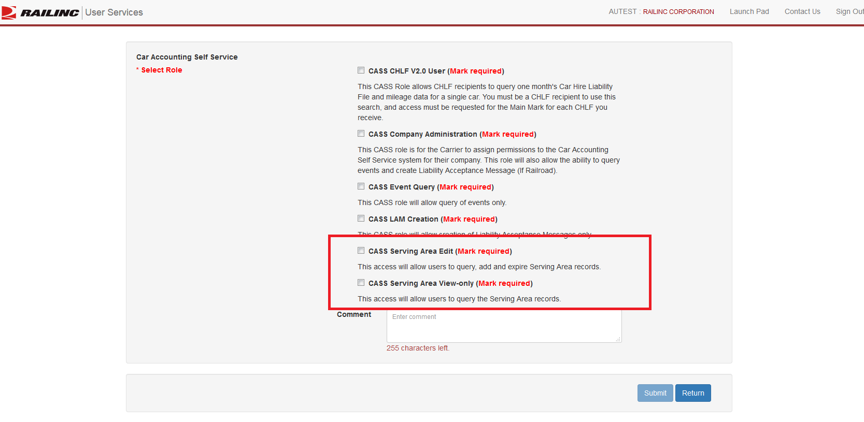
Single Sign-On (SSO) Roles & Permissions
Serving Area File is found within the Car Accounting Self-Service application (CASS)
Need SSO User ID
CASS Company Admin can grant permissions to your User ID
Two Roles:
  CASS Serving Area View-Only
  CASS Serving Area Edit

Slide 9
How Do I View Serving Areas?

Slide 10
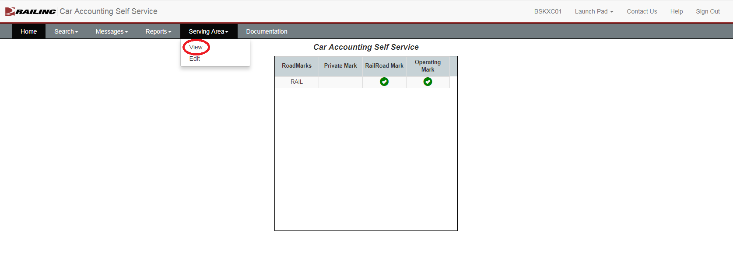
Accessing Serving Area View
Serving Area Search is found within the CASS application under the Serving Area -> View tab

Slide 11
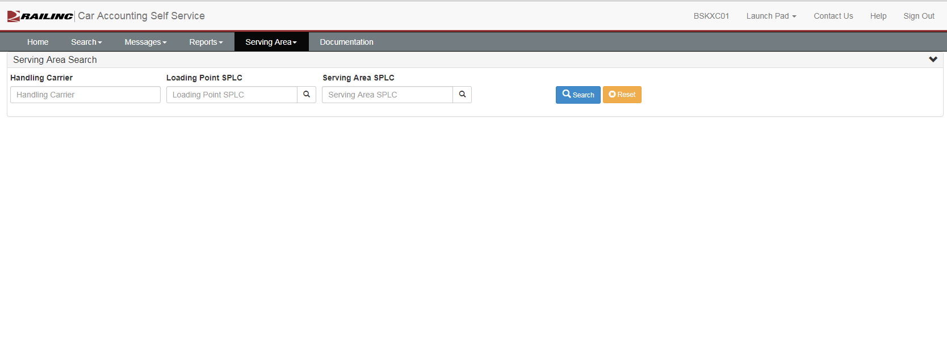
Serving Area View

Slide 12
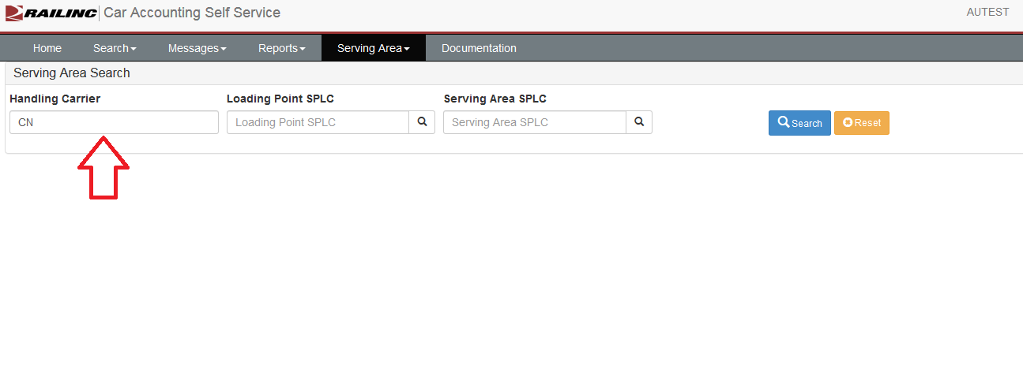
Serving Area View
Query records in several different ways:
  1. Handling Carrier

Slide 13
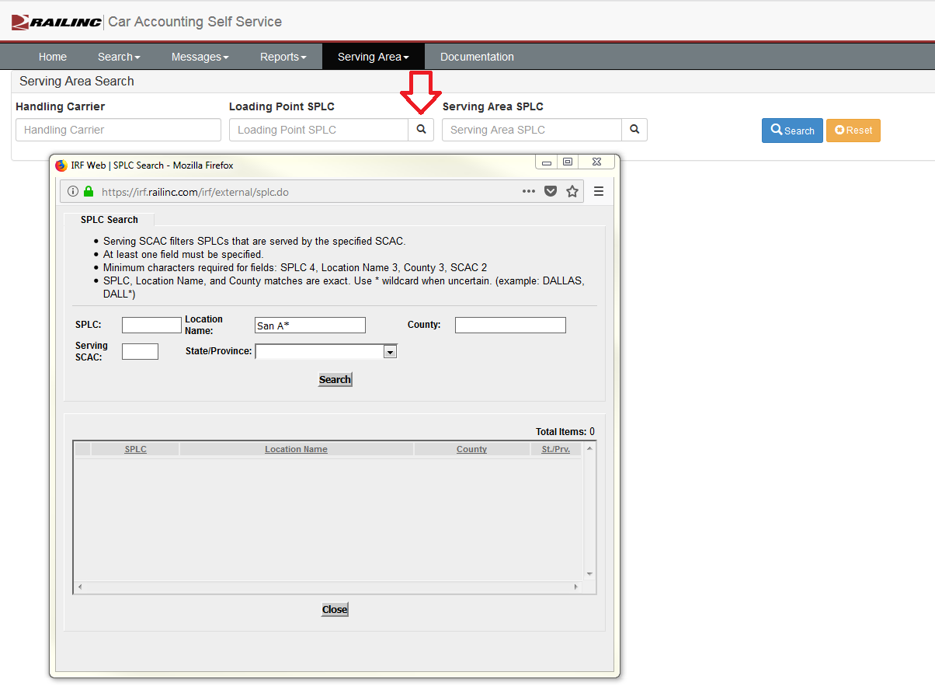
Serving Area View
Query records in several different ways:
  2. Loading Point SPLC
    Typing in the SPLC
    Selecting the magnifying glass and searching SPLCs

Slide 14
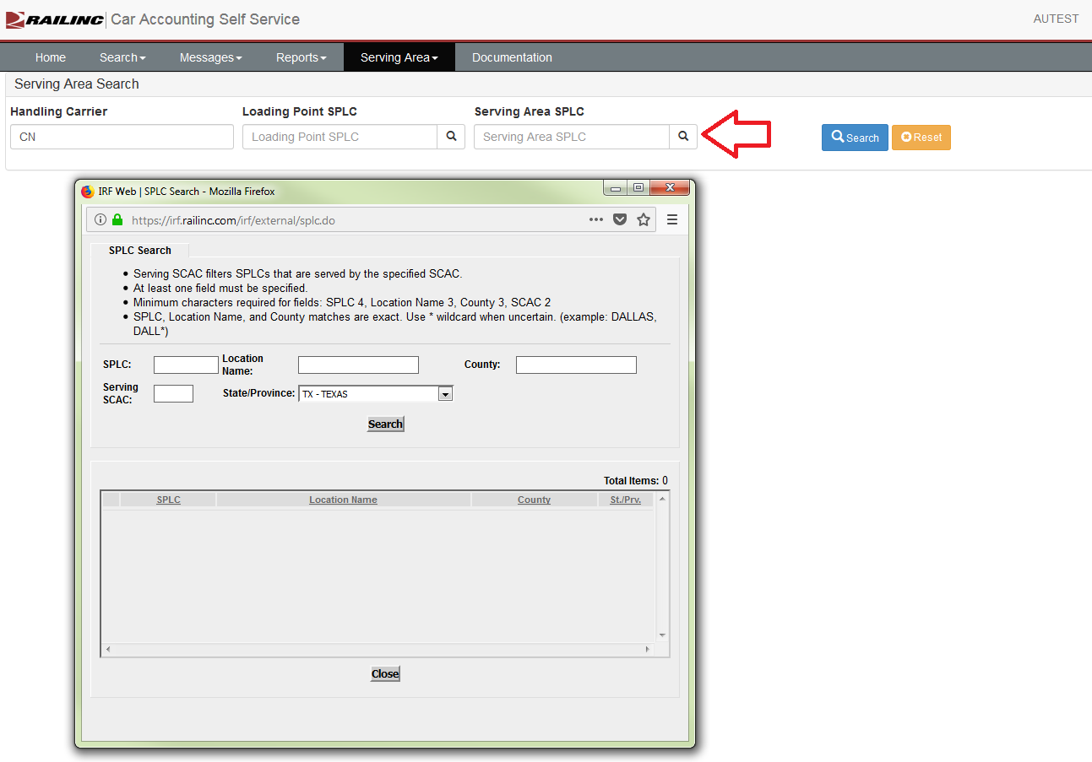
Serving Area View
Query records in several different ways:
  3. Serving Area SPLC
    Typing in the SPLC
    Selecting the magnifying glass and searching SPLCs

Slide 15
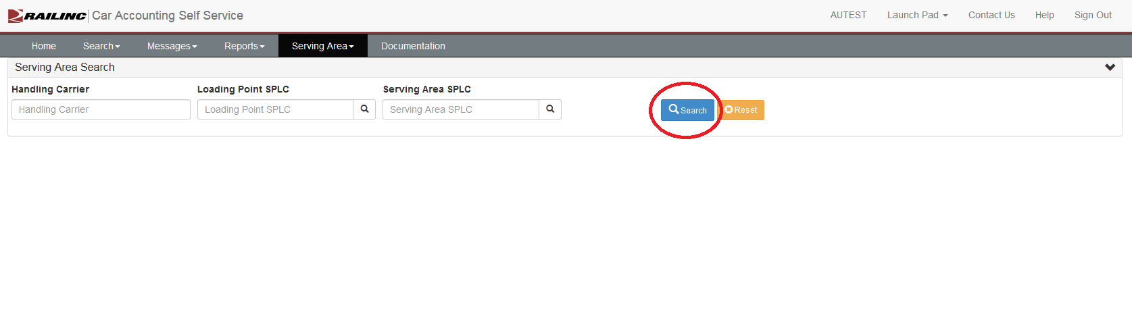
Serving Area View
Query records in several different ways:
  4. Search All records
    Ensure all fields are blank, select ‘Search’

Slide 16
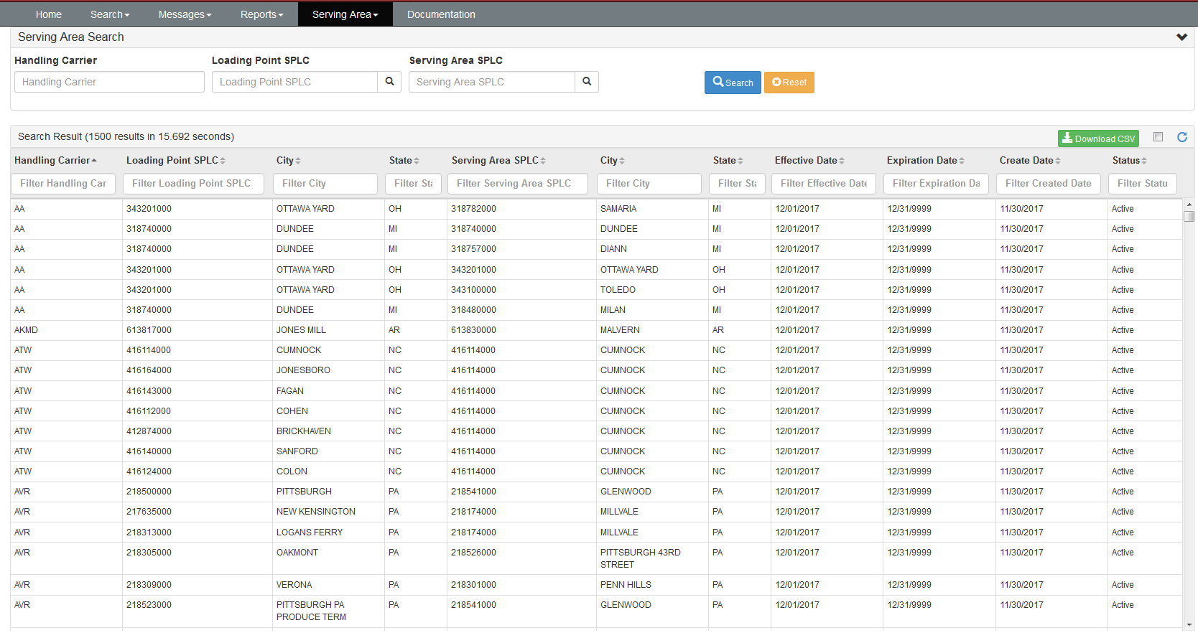
Serving Area View

Slide 17
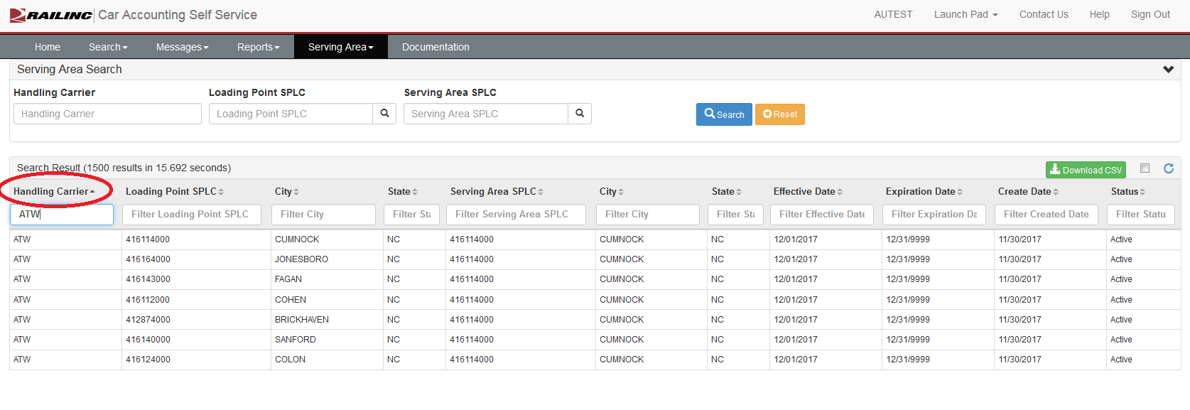
Serving Area View
Ability to filter on individual columns within your search results

Slide 18
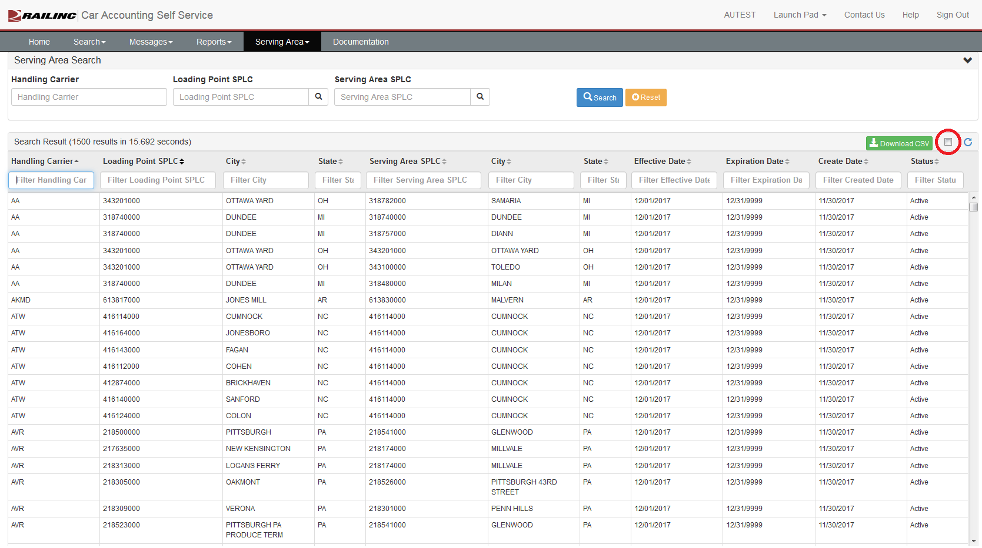
Serving Area View CSV Download
The “View” option will only return 1500 records at a time
CSV download will retrieve the entire Serving Area File
To download results to CSV:
  Ensure the check box next to “Download CSV” is checked
  Then click on ‘Download CSV”

Slide 19
How Do I Add a Serving Area?

Slide 20
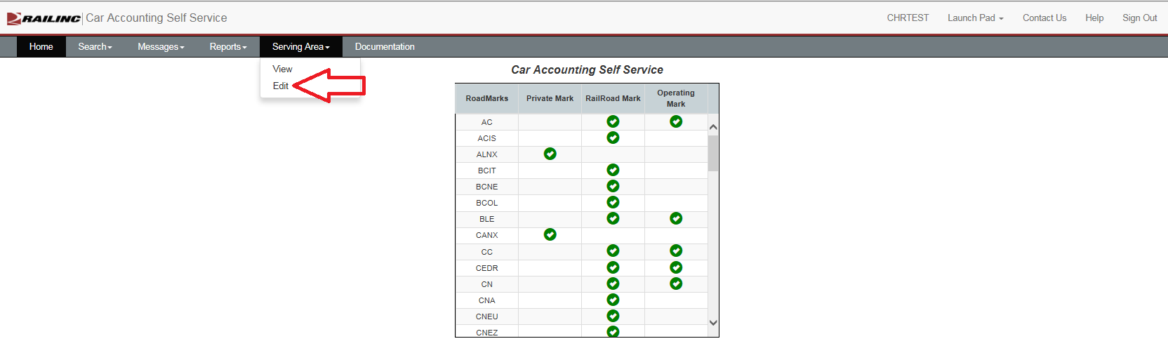
Accessing Serving Area Edit
Serving Area Search is found within the CASS application under the Serving Area -> Edit tab

Slide 21
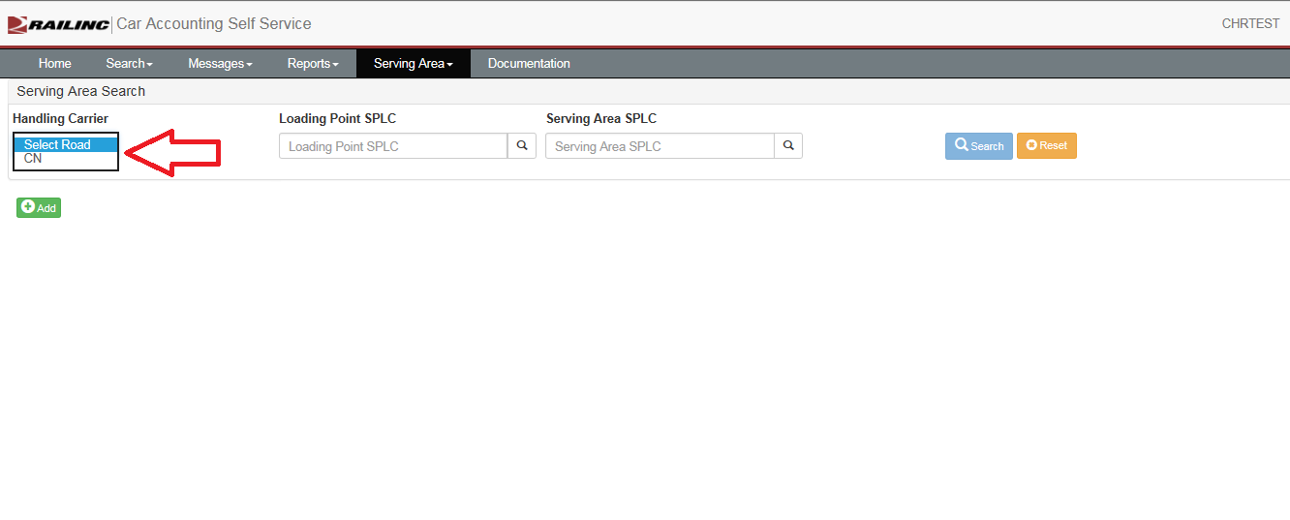
Adding a Serving Area
Only have the ability to add Serving Areas for your railroad
You can have permissions to add for multiple railroads
On this page, you can only view the records you have the ability to update

Slide 22
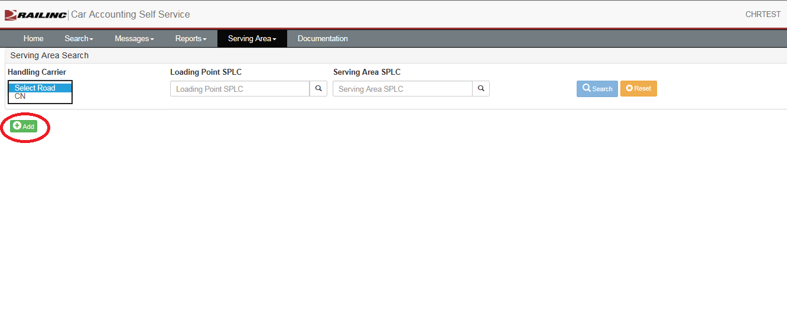
Adding a Serving Area
Two ways to add a Serving Area:
  1. From the Edit page

Slide 23
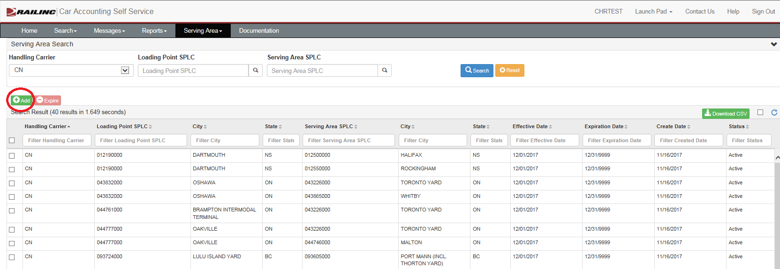
Adding a Serving Area
Two ways to add a Serving Area:
  2. From the Results page

Slide 24
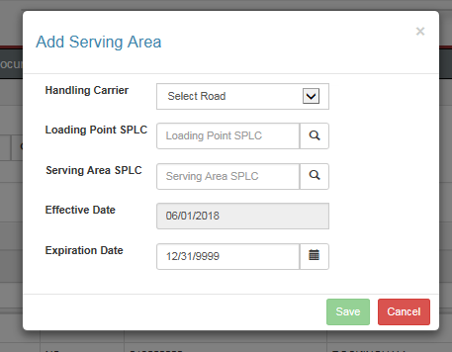
Adding a Serving Area
All fields are required
The Effective Date will always be the 1st day of the month
The Expiration Date will always be the last day of the month
The magnifying glass next to the SPLC’s will provide an advanced SPLC search
“Save” will add the Serving Area

Slide 25
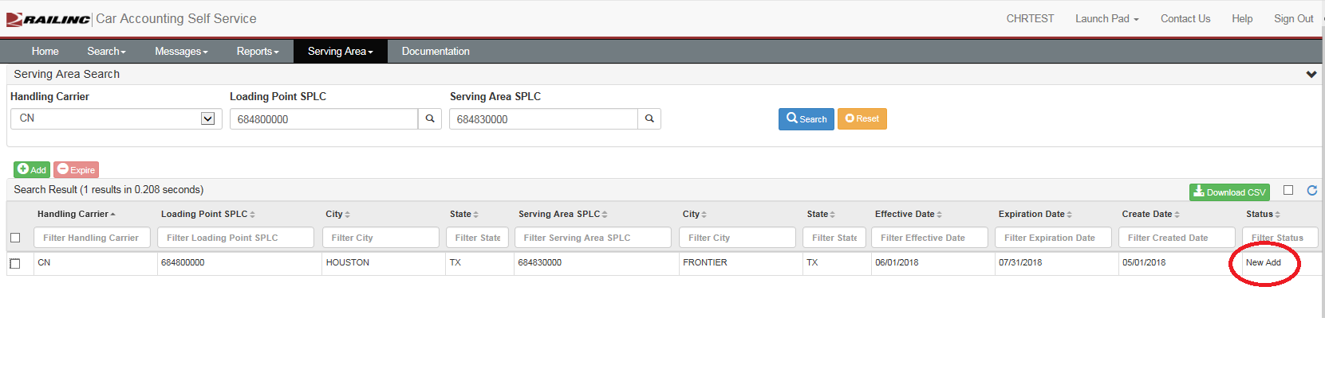
Adding a Serving Area
New Add will show on the Results page with “New Add” status

Slide 26
How Do I Expire a Serving Area?

Slide 27
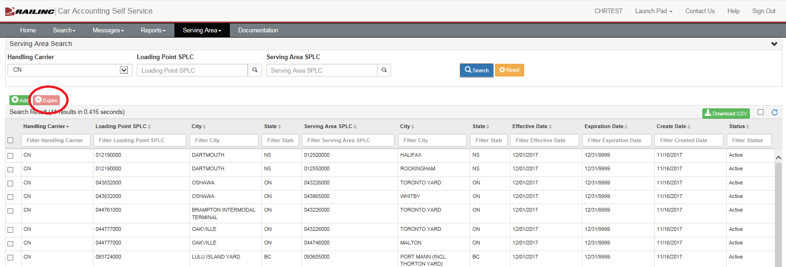
Expiring a Serving Area
The “Expire” button is found on the Serving Area Edit page

Slide 28
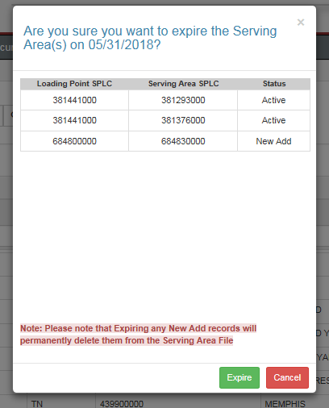
Expiring a Serving Area
Select the check boxes next to the records which need to be expired
Multiple records can be expired at one time
Expiration date is always the last day of the current month

Slide 29
Questions?
Contact Railinc’s Customer Success Team:
by Phone (877) RAILINC (1-877-724-5462)
or by email csc@railinc.com

Slide 30
Railinc Keeps You Moving.
Katie Cunningham
Phone: 919-651-5239
Email: Katelyn.Cunningham@railinc.com

