Slide 1
Railinc Mileage Process
Mark Aldenderfer
ACACSO
November 12, 2014

Slide 2
Today’s agenda
Railinc Mileage Process
Applications Using Mileage
CHLF and Railinc Mileage

Slide 3
Railinc Mileage Process
Railinc Mileage starts with the FRA Network
ESRI Mapping Software is used:
To Add Event Reporting Locations to the FRA Network based on Latitude and Longitude points for each Reporting Location
Miles are applied to event pairs

Slide 4
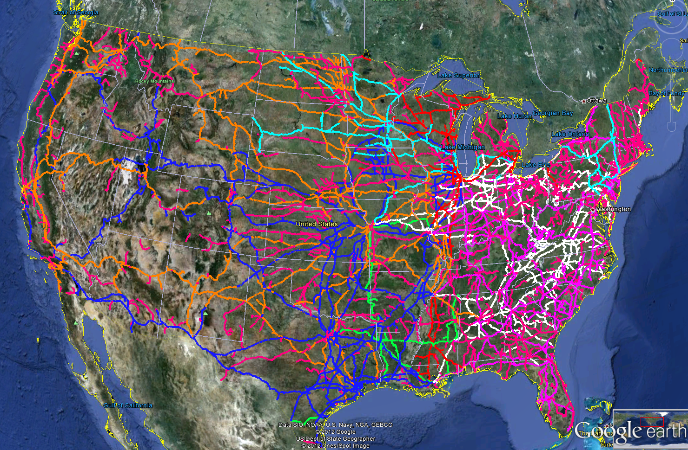
Railinc Mileage Process

Slide 5
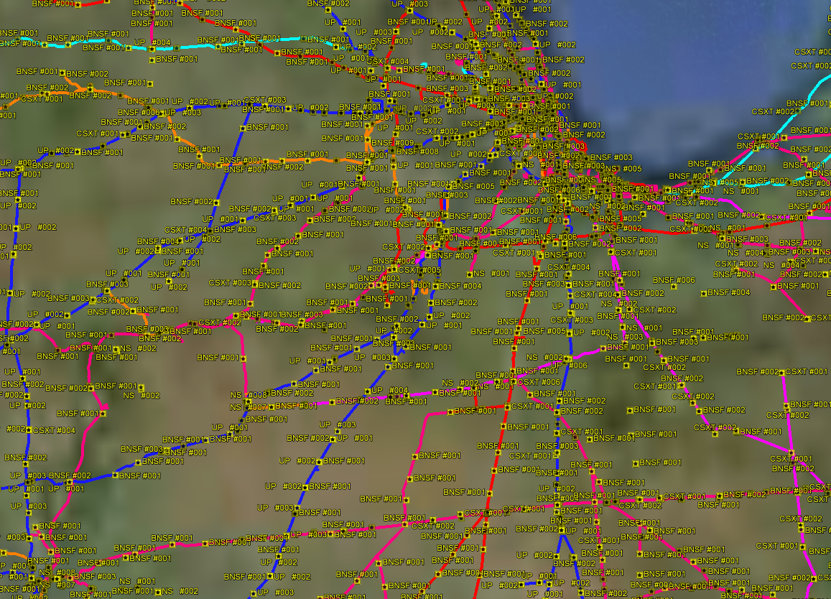
Railinc Mileage Process

Slide 6
Railinc Mileage Process
The Railinc Mileage Process uses movement events reported to Railinc through the TRAINII system
LCS is used to remove Illogical reported events from mileage calculations

Slide 7
Railinc Accumulated Mileage Uses
Car Hire Liability V2 File
State Miles sent with Actual File
Centralized Car Hire – 2014 Foundation Project
Mileage Reporting
CEPM – in production since 2011
Metrics: miles traveled by car type, usage patterns, fleet utilization comparison and more
Notes:
The goal is for this committee to understand that there are MANY uses for mileage
And for carriers to supply better IRF data to increase mileage accuracy

Slide 8
Car Hire Liability File
Expanded in 2013 to Include
Loaded and empty cycles
Mileage
CHARM rate information

Slide 9
Car Hire Liability File
CHLF uses LCS evaluated Interchanges to create a start and end of Car Hire Liability
The Mileage Process will use all the reported events between the Start of Car Hire Liability to the End

Slide 10
Car Hire Liability File
CHLF Start: 11/09 18:58
CHLF End: 11/10 07:57
Total Miles 50
Event Time | Loc | From | To
11/09 18:58 | A | CSXT | UP
11/09 22:00 | B | UP
11/09 22:30 | C | UP
11/10 01:45 | D | UP
11/10 03:00 | E | UP
11/10 05:32 | F | UP
11/10 07:57 | G | UP | BNSF
From Event | To Event | Miles
A | B | 5
B | C | 5
C | D | 20
D | E | 5
E | F | 10
F | G | 5

Slide 11
Questions?

