Slide 1

Safety Standards For Class 3 Liquids: A Review of Regulatory Proposals and Comments
James H. Rader
Senior Vice President
Watco Compliance Services

Slide 2
Discussion Points
Current Class 111A100W1 Tank Cars
P-1577: Industry Petition to Improve the Design Standard for Tank Cars Transporting PG I and II Materials
CPC-1232: Industry Design Standard for Tank Cars Transporting Petroleum Crude Oil, Alcohols N.O.S., and Ethanol and Gasoline Mixtures
PHMSA Docket HM-251 ANPRM and NPRM
Position Statements from Selected Commenters
New Tank Car Construction and Retrofit Capability

Slide 3
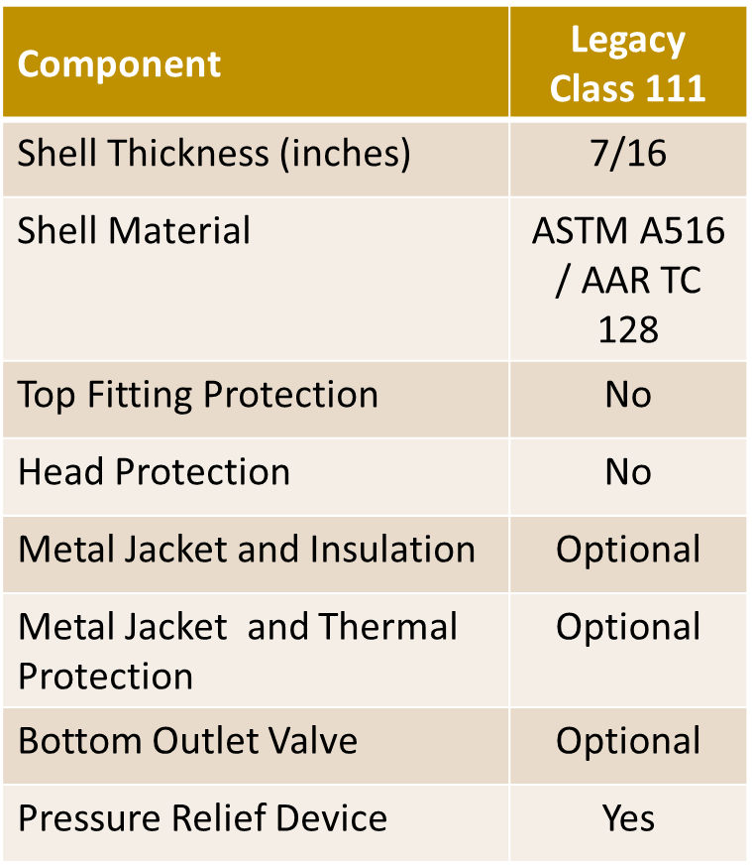
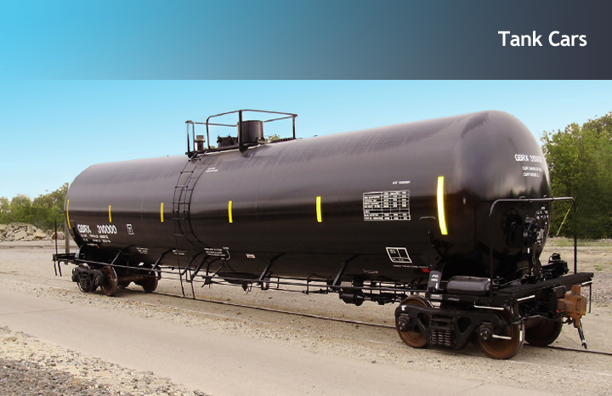
Current Class 111A100W1
Notes:
Built since the late 1950s
General purpose tank car for bulk liquids and some solids
Tanks transport materials not subject to the DOT regulations and low to medium hazardous liquids and solids
Considered a “non-pressure” tank car, because the tank and service equipment design are generally associated with products with low to no vapor pressure

Slide 4
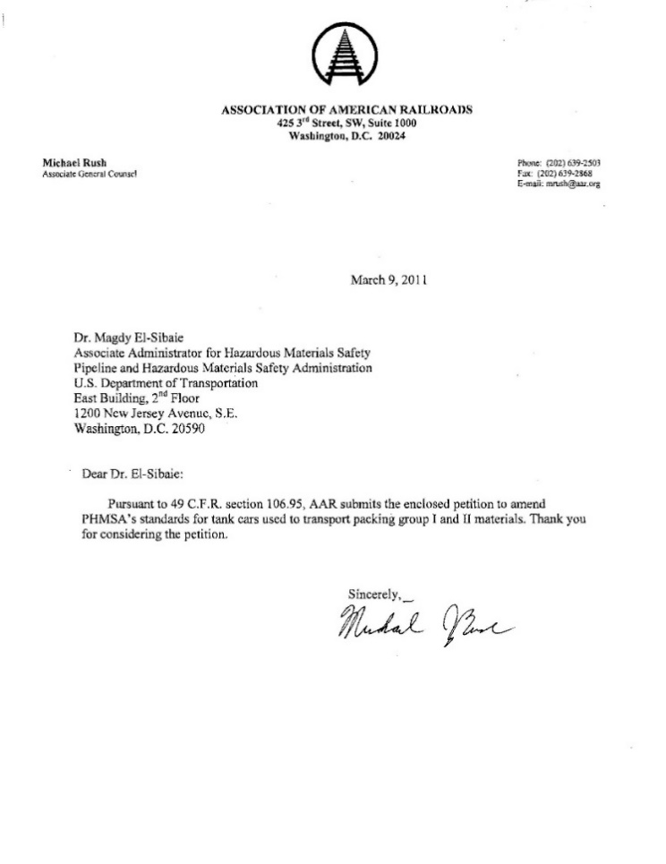
Industry Petition P-1577
March 9, 2011: Industry Petitions PHMSA to amend the regulations to require an improved tank car standard when such tanks transport any Packing Group I or II material. These standards apply to all hazard classes and include:
Top fitting protection;
Use of a re-closing pressure relief device;
Normalized steel plate with an increase in tank shell thickness for non-jacketed tanks; and
Half-height head shields.
Notes:
The petition sought to improve the crashworthiness of tank cars in accidents to help prevent the release of material:
Top fitting protection
Reclosing PRD
Increase metal thickness
Non-Jacketed
½-inch thick AAR TC-128 Gr B, N ; or
9/16-inch ASTM A516, N
Jacketed
7/16-ich thick AAR TC-128 Gr B, N; or
½-inch thick ASTM A516, N

Slide 5
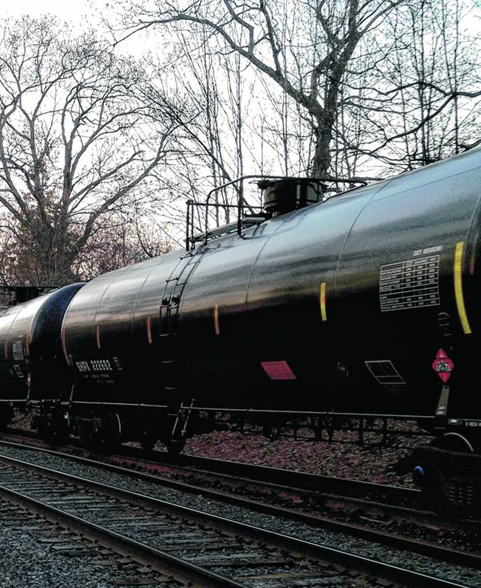
AAR CPC-1232
August 31, 2011: The AAR issues CPC-1232 in response to growing concerns with respect to the performance of DOT 111A tank cars in accidents when such tanks transport a Packing Group I or II material with one of the following shipping names:
petroleum crude oil;
alcohols n.o.s.; and
ethanol and gasoline mixtures.
The circular implemented new requirements for the construction of a tank ordered after October 1, 2011 transporting these products.
Notes:
Shortly after submission of the industry petition, the safe transportation of crude oil, ethanol, and other flammable liquids have become politically challenged as a series of catastrophic train accidents manifest shortcomings in our engineering systems and the current and the industry petition tank car to ensure public safety. In response, the industry, through the AAR issues CPC-1232.

Slide 6
Major Crude Oil / Ethanol Accidents
Incident | Date | # Cars derailed | Speed at derailment | Unit train | Product Loss (gal) | Cause of Derailment
New Brighton, PA | 2006 | 23 | 37 | Yes | 485,278 | Rail
Painesville, OH | 2007 | 7 | 48 | No | 76,153 | Rail
Luther, OK | 2008 | 5 |  | Yes | 243,000 | Cross level
Rockford, IL | 2009 | 19 | 19 | Yes | 232,963 | Washout/Rail
Arcadia, OH | 2011 | 31 | 46 | Yes | 834,840 | Rail
Tiskilwa, IL | 2011 | 10 | 34 | No | 143,534 | NTSB Investigation
Columbus, OH | 2012 | 3 | 23 | No | 53,347 | NTSB Investigation
Plevna, MT | 2012 | 17 | 25 | No | 245,336 | Undetermined
Lac-Mégantic | 2013 | 63 | 43 | Yes | 1,500,000 | Securement
Aliceville, AL | 2013 | 26 | 39 | Yes | 630,000 | TBD
Casselton, ND | 2013 | 13 | 42 | Yes | 476,436 | Broken Axle on an Adjacent Train
Vandergrift, PA | 2014 | 21 | 31 | No | 10,000 | TBD
Lynchburg, VA | 2014 | 17 | 23 | Y | 30,000 | TBD
LaSalle, CO | 2014 | 5 | 9 | Y | 5,000 | TBD
The Tipping Point
Notes:
As noted in this slide, there have been several catastrophic railroad accidents involving loss of life and substantial property damage. Rockford, Illinois, Lac Mégantic, Quebec, Casselton, North Dakota, and Lynchburg, Virginia provide critical reminders of our need to ensure that we establish safe operating practices and engineering systems to detect defects in track and equipment. As explained later, the railroads have taken voluntary actions to address human factor caused accidents and the detection of defects in track structures and rail equipment. In addition to railroad operating and maintenance initiatives is the need to ensure for the proper classification of crude oil, and to consider changes in tank car design, so that if an accident does occur, the likelihood of a release is minimized.
Without addressing the holistic system (railroad operations and maintenance, tank car design, and the hazards of the product), railroads face ruinous liability if an accident occurs in an undesired location. Lac Mégantic provides an example as the cost of that derailment is estimated in the billions.

Slide 7
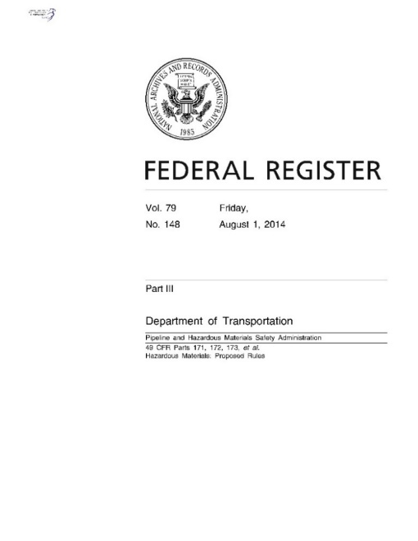
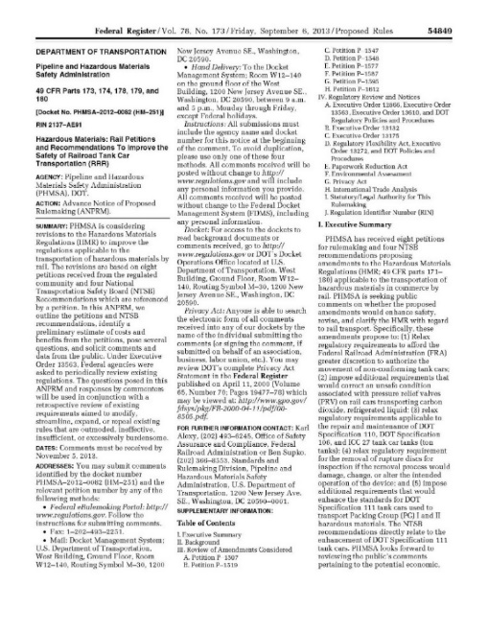
DOT Docket HM-251
On September 6, 2013, PHMSA publishes an ANPRM, under Docket HM-251, soliciting comments on the industry petition.
The ANPRM solicited comments concerning the benefits and costs of new tanks and retrofitting existing tanks, and if DOT should consider additional safety measures based on the consequences associated with recent unit-train derailments.
On August 1, 2014, PHMSA published an NPRM proposing new operational, design, and classification requirements for certain trains transporting large quantities of flammable liquids.
The NPRM included options for both design of the tank and the operation of trains when such trains include 20 or more cars of a flammable liquid.

Slide 8
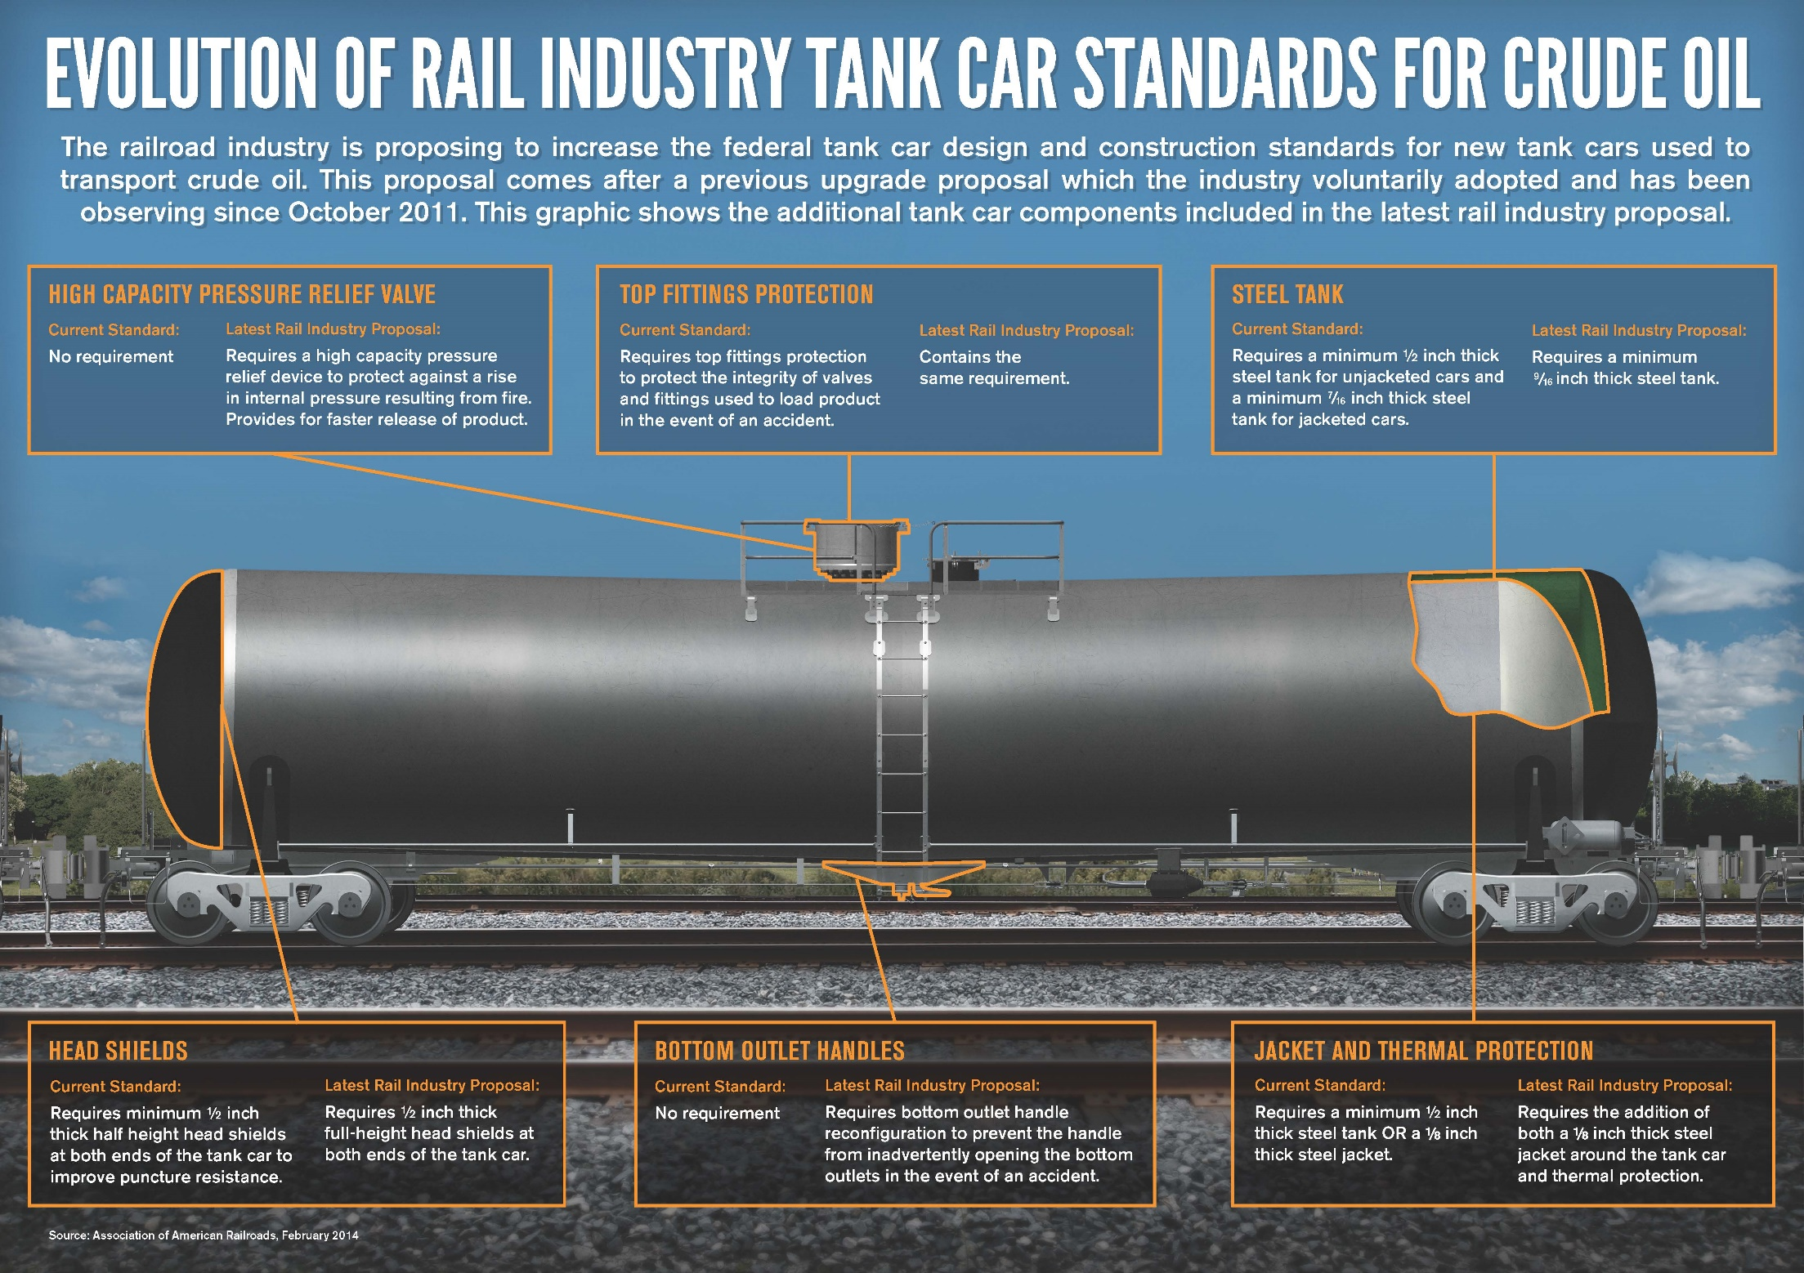
Notes:
Courtesy of the AAR.

Slide 9

Legacy DOT 111

Slide 10
Thicker Tank Shell

Slide 11
11-Gauge Metal Jacket
Thermal Protection

Slide 12
½-Inch Thick Full Head Shields

Slide 13
Top Fitting Protection
High-Capacity PRD

Slide 14
Bottom Outlet Handle Protection or Disengagement

Slide 15
New Car Proposal, Design, and Retrofit Suggestions from Selected Commenters

Slide 16
NPRM New Tank Car Options
Component | Option 1 | Option 2 | Option 3
Tank Material | TC-128 Gr. B, N | TC-128 Gr. B, N | TC-128 Gr. B, N
Bursting Pressure | 500 | 500 | 500
Minimum Shell Thickness | 9/16 | 9/16 | 7/16
Test Pressure | 100 | 100 | 100
Top Fitting Protection | 179.102-3 | App. E 10.2.1 | App. E 10.2.1
BOV Handle Protection | Yes | Yes | Yes
Head Protection | 179.16 | 179.16 | 179.16
Metal Jacket | 1/8 | 1/8 | 1/8
Insulation (e.g., glass fiber) | Optional | Optional | Optional
Thermal Protection | 179.18 | 179.18 | 179.18
High-Cap. Reclosing PRD | Yes | Yes | Yes
Braking | ECP | DP or EOT | DP or EOT
GRL | 286 | 286 | 286

Slide 17
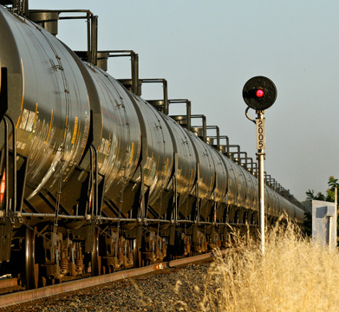
General Comments to the NPRM
Comments reviewed to date:
Do not support ECP
Do not support HHFT
Speed restrictions
“Triggering” the design of the tank
Strongly recommend harmonization of the standards in North America
Concerns about shop capacity
State 6-month ramp-up period
General support longer retrofit period, but aggressive
Phased approach (crude oil, ethanol, than other Class 3 liquids)

Slide 18
New Tank Cars for Class 3 Liquids
Component | GBX / GBW | RSI Class 3 (crude oil and ethanol) | RSI Class 3 (other than crude oil and ethanol) | AAR / API
Tank Material | TC-128 Gr. B, N | TC-128 Gr. B, N | TC-128 Gr. B, N | TC-128 Gr. B, N
Minimum Shell Thickness | 9/16 | 9/16 | 7/16 | 1/2
Top Fitting Protection | App. E 10.2.1 | App. E 10.2.1 | App. E 10.2.1 | App. E 10.2.1
BOV Handle Protection | Yes | Yes | Yes | Yes
Head Protection | Full | Full | Full | Full
Metal Jacket | 1/8 | 1/8 | 1/8 | 1/8
Insulation (e.g., glass fiber) | Optional | Optional | Optional | Optional
Thermal Protection | 179.18 | 179.18 | 179.18 | Prescriptive Std.
High-Cap. Reclosing PRD | Yes | Yes | Yes | Yes
Braking | DP or EOT | DP or EOT | DP or EOT | DP or EOT

Slide 19
Existing Non-Jacketed Tanks for Class 3 Liquids Order on or Before October 1, 2011
Component | GBX / GBW | RSI Class 3 (PG I and II) | RSI Class 3 (PG III other than crude oil and ethanol) | AAR / API
Tank Material | As Built | As Built | As Built | As Built
Minimum Shell Thickness | 7/16 | 7/16 | 7/16 | 7/16
Top Fitting Protection |  |  |  | Valve Protection
BOV Handle Protection | Yes | Yes | Yes | Yes
Head Protection | Full | Full |  | Full
Metal Jacket | 1/8 | 1/8 |  | 1/8
Insulation (e.g., glass fiber) | Optional | Optional |  | Optional
Thermal Protection | 179.18 | 179.18 | 179.18 | Prescriptive Std.
High-Cap. Reclosing PRD | Yes | Yes | Yes | Yes
Braking | DP or EOT | DP or EOT | DP or EOT | DP or EOT

Slide 20
Existing Non-Jacketed Tanks for Class 3 Liquids Ordered After October 1, 2011
Component | GBX / GBW | RSI Class 3 (PG I and II) | RSI Class 3 (PG III other than crude oil and ethanol) | AAR / API
Tank Material | As Built | As Built | As Built | As Built
Minimum Shell Thickness | 1/2 | 1/2 | 1/2 | 1/2
Top Fitting Protection | App. E 10.2.1 | App. E 10.2.1 | App. E 10.2.1 | App. E 10.2.1
BOV Handle Protection | Yes | Yes | Yes | Yes
Head Protection | Full | Full | Half | Full
Metal Jacket | 1/8 | 1/8 |  | 1/8
Insulation (e.g., glass fiber) | Optional | Optional |  | Optional
Thermal Protection | 179.18 | 179.18 | 179.18 | Prescriptive Std.
High-Cap. Reclosing PRD | Yes | Yes | Yes | Yes
Braking | DP or EOT | DP or EOT | DP or EOT | DP or EOT

Slide 21
Existing Jacketed Tanks for Class 3 Liquids Ordered on or Before October 1, 2011
Component | GBX / GBW | RSI Class 3 (PG I and II) | RSI Class 3 (PG III other than crude oil and ethanol) | AAR / API
Tank Material | As Built | As Built | As Built | As Built
Minimum Shell Thickness | 7/16 | 7/16 | 7/16 | 7/16
Top Fitting Protection | App. E 10.2.1 |  |  | Valve Protection
BOV Handle Protection | Yes | Yes | Yes | Yes
Head Protection | Full
Metal Jacket | 1/8 | 1/8 | 1/8 | 1/8
Insulation (e.g., glass fiber) | Glass Fiber | Glass Fiber | Glass Fiber | Glass Fiber
Thermal Protection | 179.18 | 179.18 | 179.18
High-Cap. Reclosing PRD | Yes | Yes | Yes | Yes
Braking | DP or EOT | DP or EOT | DP or EOT | DP or EOT

Slide 22
Existing Jacketed Tanks for Class 3 Liquids Order After October 1, 2011
Component | GBX / GBW | RSI Class 3 (PG I and II) | RSI Class 3 (PG III other than crude oil and ethanol) | AAR / API
Tank Material | As Built | As Built | As Built | As Built
Minimum Shell Thickness | 7/16 | 7/16 | 7/16 | 7/16
Top Fitting Protection | App. E 10.2.1 | App. E 10.2.1 | App. E 10.2.1 | App. E 10.2.1
BOV Handle Protection | Yes | Yes | Yes | Yes
Head Protection | Full | Full | Full | Full
Metal Jacket | 1/8 | 1/8 | 1/8 | 1/8
Insulation (e.g., glass fiber) | Glass Fiber | Glass Fiber | Glass Fiber | Glass Fiber
Thermal Protection | 179.18 | 179.18 | 179.18
High-Cap. Reclosing PRD | Yes | Yes | Yes | Yes
Braking | DP or EOT | DP or EOT | DP or EOT | DP or EOT

Slide 23
Existing DOT 111 Tank Cars
New DOT 117 Tank Cars
As-built thickness
Crashworthy BOV handle
High-capacity PRD
Thermal protection
Full-head protection
Require metal jacket
9/16-inch thickness
Metal jacket
Full-head protection
Thermal protection
High-capacity PRD
Crashworthy BOV handle
Projected Outcome
(e.g., October 1, 2015)

Slide 24
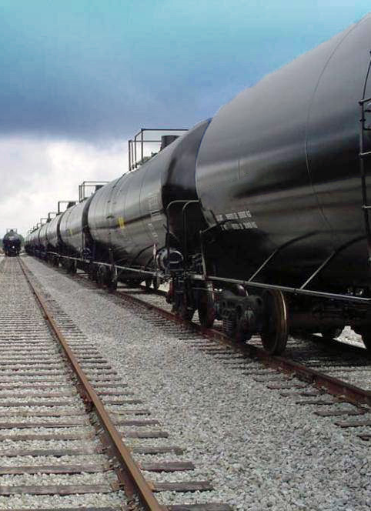
Constraints on New Car Construction and Retrofit Capacity
Given the magnitude of new car demand and the potential for retrofitting the existing fleet, efficiencies of moving petroleum crude oil by rail face the following challenges:
Number of tank car manufacturing facilities to produce cars
Number of tank car repair facilities to:
Perform tank car qualifications
Perform tank car retrofits
Availability of skilled human capital
Availability of parts

Slide 26
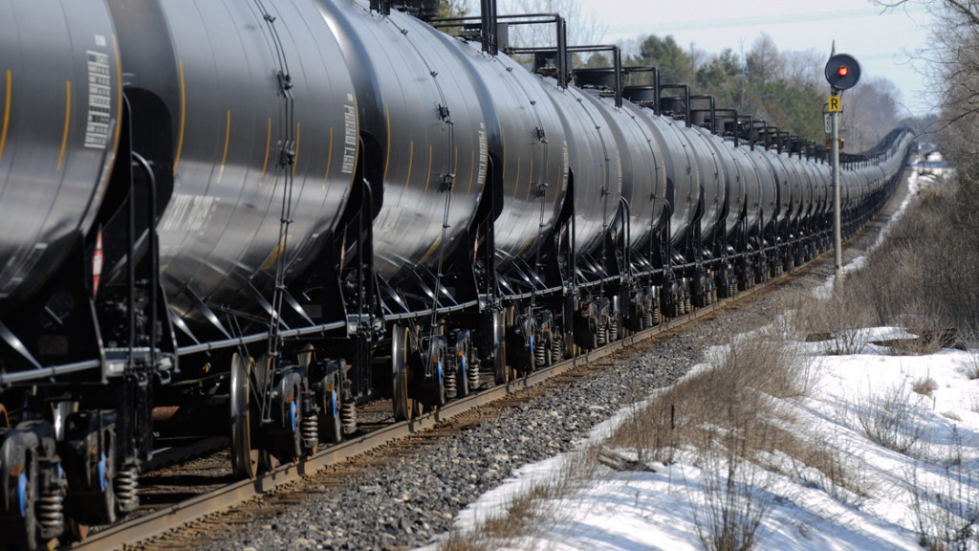
James H. Rader
Senior Vice President
Watco Compliance Services
630-946-3516
jrader@watcocompanies.com
wcs@watcocompanies.com

