Slide 1
Liability Continuity System (LCS)
Sara Maples
ACACSO
May 11, 2017

Slide 2
Agenda
High-level Overview
History and Purpose
Message Types

Slide 3
High-level Overview
Car movement events reported by railroads to Railinc via TeleRail Automated Information Network (TRAIN) reporting system
Events stored in Event Repository
Used by many industry processes
The TRAIN II Manual, available at www.railinc.com, contains specific message formats that must be used to transmit events to Railinc

Slide 4
History and Purpose
LCS implemented in January 1999
Establishes a common set of transactions for car hire calculation
Analyzes car movement and interchange events to assure continuity is maintained
One entity must be responsible for every hour of a month

Slide 5
History and Purpose
Interchange discrepancies resolved using industry developed rules
Missing interchanges created by LCS
All hours in a month must be allocated to a carrier
Prior to LCS, carriers paid car hire based on internal records
Interchange discrepancies frequently left the car mark owner underpaid
Car mark owner had to mediate between carriers
Claims could, and did, remain unresolved for years
Notes:
Truck Bolsters were manufactured by Nation Castings of Mexico in Sahagun Mexico

Slide 6
History and Purpose
LCS analysis occurs 120 hours (five days) after the event date/time
This delay allows accurate event reporting
Once an LCS record is created, no changes can be made
No correction process is required for LCS interchanges

Slide 7
LCS Message Types
LCS decisions are categorized by the type of activity included in the analysis
Junction Types indicate what information LCS had for analysis
Junction Types allow carriers to investigate potential reporting problems

Slide 8
V – Verified Interchange
Both carriers report the interchange at exactly the same time and location

Slide 9
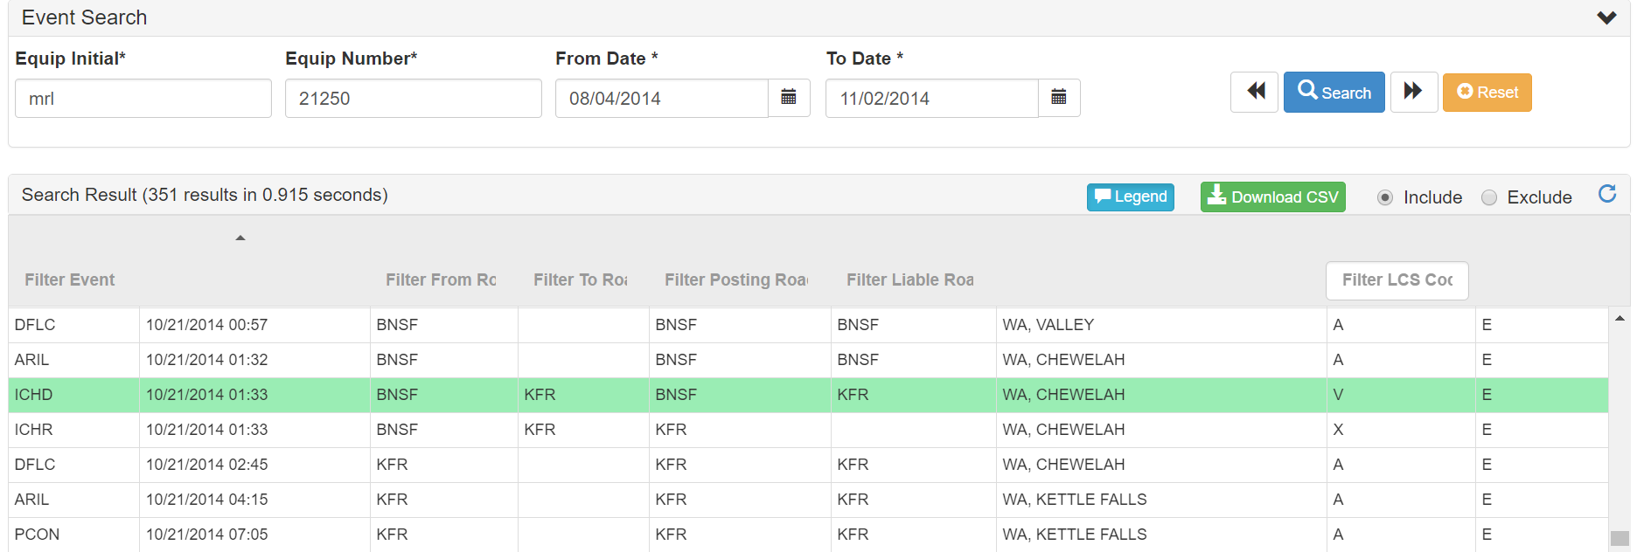
V – Verified Interchange
Notes:
ICHD and ICHR reported with same event ts; Delivery ‘V’, Receipt ‘X’

Slide 10
B – Split Interchange
B – Both parties report an interchange – times differ by four hours or more
LCS will “split the difference”
Half the disputed time allocated to each carrier

Slide 11
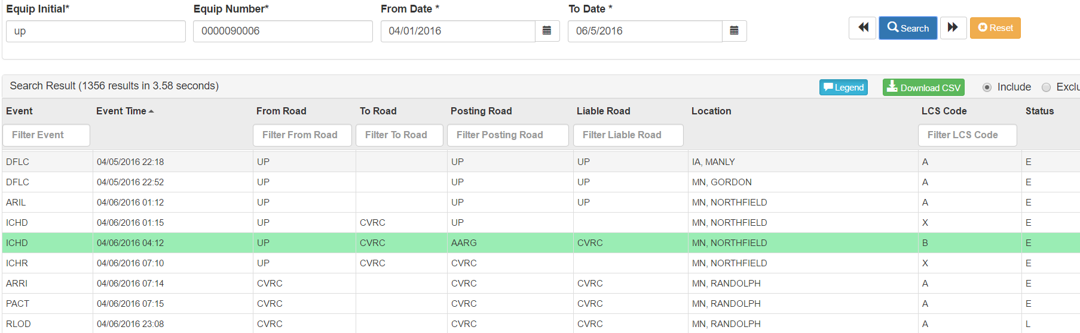
B – Split Interchange

Slide 12
W – Verified Delivery
W – Both carriers report – times differ by four hours or less
LCS accepts the delivering carrier record
Consistent with industry practice prior to LCS
Notes:
More detailed information in later presentation.

Slide 13
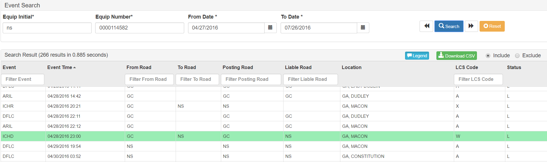
W – Verified Delivery
Notes:
The above CASS inquiry shows that KFR reported a receipt from BNSF on 11/07/2011 at 20:07. BNSF reported the delivery at 10/07/2011 at 23:15. The difference between 20:01 and 23:15 is less than four hours. LCS accepted the delivery reported by BNSF. (Again the LCS record is highlighted in green.)

Slide 14
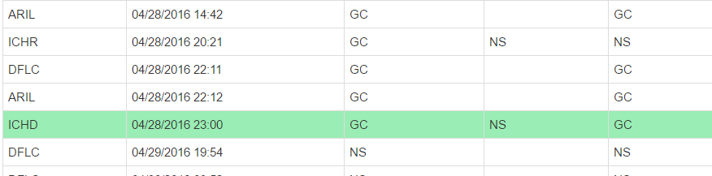
W – Verified Delivery
Notes:
The above CASS inquiry shows that NS reported a receipt from GC on 4/28/2016 at 20:21. GC reported the delivery at 4/28/2016 at 23:00. The difference between 20:21 and 23:00 is less than four hours. LCS accepted the delivery reported by GC. (Again the LCS record is highlighted in green.)

Slide 15
G – Gap Interchange
G – No interchange reported – movement events show possession changed
LCS creates a gap interchange
LCS interchange created one minute prior to first event reported by receiving carrier

Slide 16
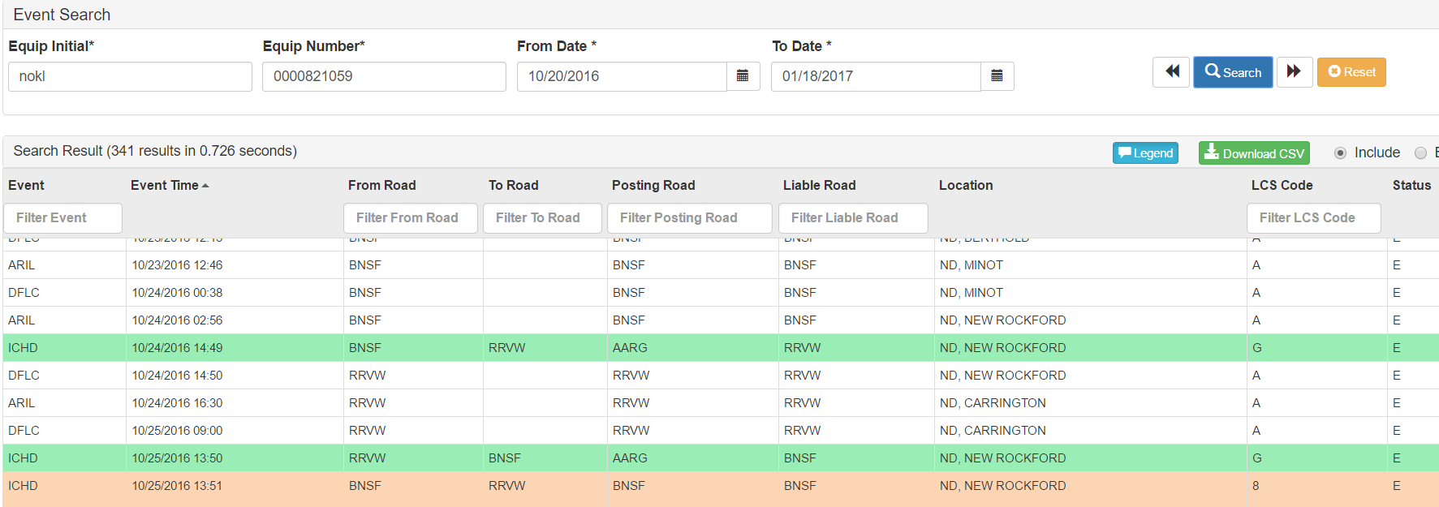
G – Gap Interchange

Slide 17
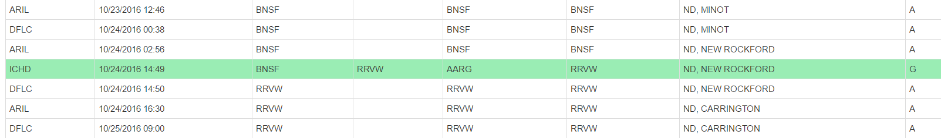
G – Gap Interchange
Notes:
Gap was created - forward/backward continuity; Interchange was not reported so when LCS evaluated events after 120 hours, gap was created from BNSF to RRVW

Slide 18
D – Delivery Only
D – Only the delivering carrier reported interchange
The record is used as reported
LCS favors reporting carriers over non-reporting carriers

Slide 19
R – Receipt Only
R – Only receiving road reported interchange
LCS uses the reported event
LCS rules favor reporting carriers over non-reporting carriers

Slide 20
C – Liability Acceptance Message
C – Car owner or user accepts liability: TRAIN31 Type 5
Created only by the company that accepts liability for a car
Used when physical inspection reveals a car is not where LCS “thinks” it is
CASS allows carriers to create this message.

Slide 21
Haulage Messages
L – Start of haulage
M – End of haulage
Q – Haulage terminated due to multiple load/empty status changes
LCS interchanges car to current handling carrier
Industry approved business rule – more than two changes in load/empty status terminate haulage

Slide 22
O & P One Road Reporting
O – One road reporting – delivering carrier
LCS uses delivering carrier record
Receiving carrier report disregarded
P – One road reporting – receiving carrier
LCS uses receiving carrier record delivering; delivering carrier report disregarded
Negotiated interchange agreements can allow one carrier to be responsible for all interchange reporting at a specific location

Slide 23
T – Missing TRUK Report
T – Missing TRUK reporting
“Out to TRUK” event indicates a trailer/container has left railroad control
Reporting carrier liability continues until the trailer/container returned to railroad control
“In from TRUK” is reported when trailers/containers return
LCS creates an interchange to maintain continuity when TRUK events are missing

Slide 24
Z – Intermodal Match
Z – TRUK reports were matched by the system

Slide 25
Questions?

