Slide 1

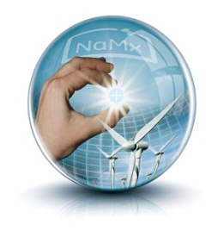
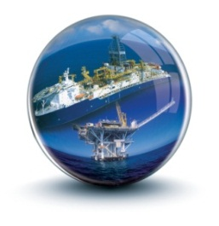



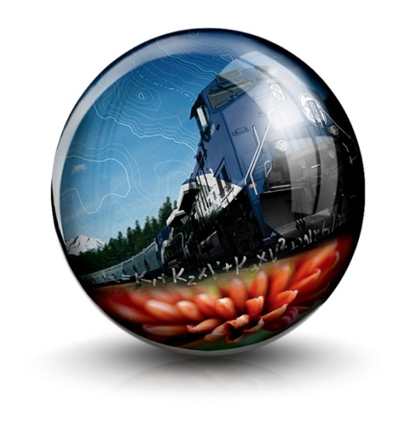
GE Transportation Optimization Solutions
ACASCO Annual Conference
Atlanta, GA
November 13, 2013

Slide 2
Notice of Non-Disclosure
The information, data, analyses, charts, graphs, and other content (the “Content”) of this presentation contain the proprietary and confidential information of General Electric Company and its affiliates (“GE”) and should not be copied or modified or divulged or disclosed to any third parties at any time without the express written consent of GE. GE intends for this Content to receive all protections available to GE under intellectual property rights and laws, and that GE shall have all rights to enforce such protections. This Content is provided “as is” and for informational purposes only, and GE assumes no liability whatsoever for its use.

Slide 3
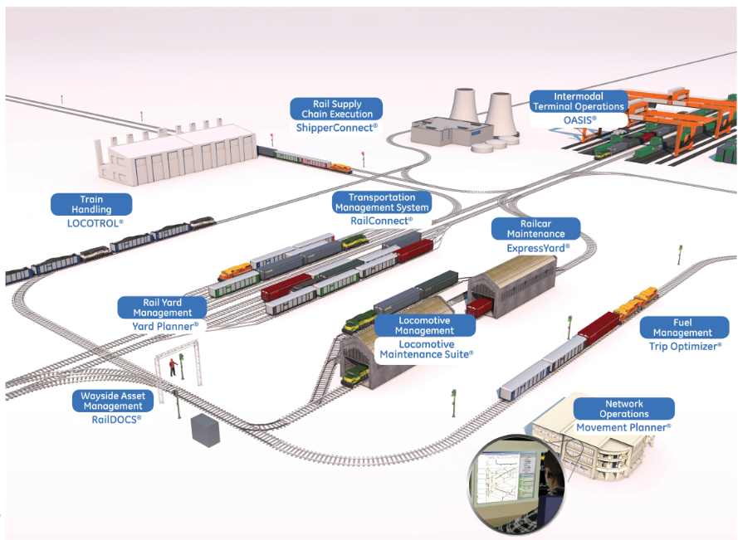
Our solutions portfolio today
Big Industry Challenges:
High operating & capital costs
Capacity constraints, aligning capacity with demand
High customer order fulfillment expectations
Industry Imperatives:
“Integrated” solutions vs. “point” solutions
Increased visibility into business process and operations
Increased collaboration between value chain partners
Real-time communications and data sharing for faster decisions
Shared interest in creating new value through integration of systems, data and operations

Slide 4


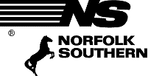
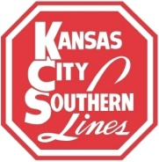
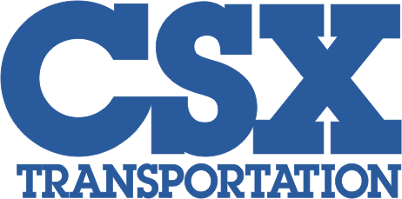



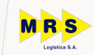





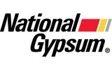



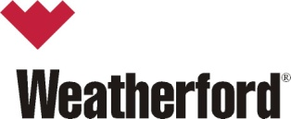




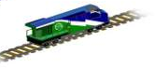



Focus on two core markets: railroads and rail shippers
Rail Carriers
Rail Shippers
NA Class 1
NA Shortline
International
Integrated Mine/Rail
Bulk Shippers
Point “A”
Objective:
Most effective transportation mode
Point “A”
Point “B”
Road
Shippers
Rail
Shippers
Marine
Shippers
Multimodes
Shippers
Point “B”
Objective: Most efficient rail network
Railroads require software and solutions for operations, assets, and network optimization
Key Priorities
Integrate legacy systems
Enterprise Asset Management
Intelligence / Analytics
Rail shippers require rail supply chain execution software and solutions
Key Issues
Rail Renaissance is driving volume
Demand for process automation
Increased SaaS adoption and use

Slide 5
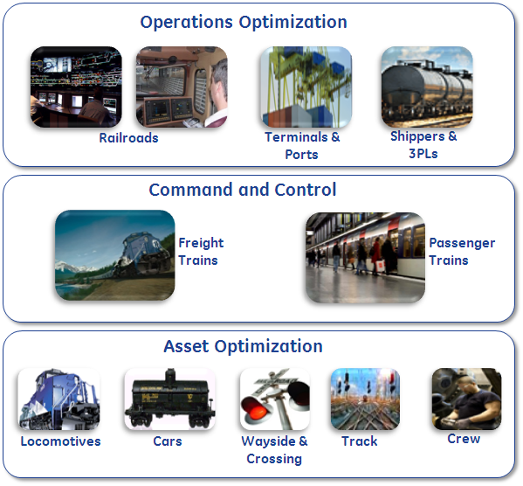
A strong foundation of capabilities …
Multiple Missions
Optimized for velocity
Operations
Mission Executed
Safely & on-time
Asset
Healthy Assets
Available for a mission

Slide 6
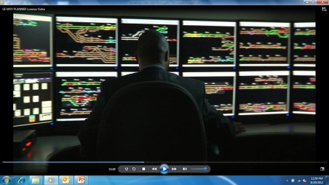
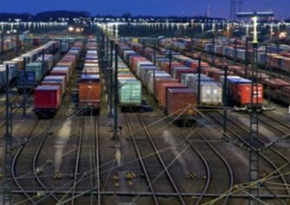
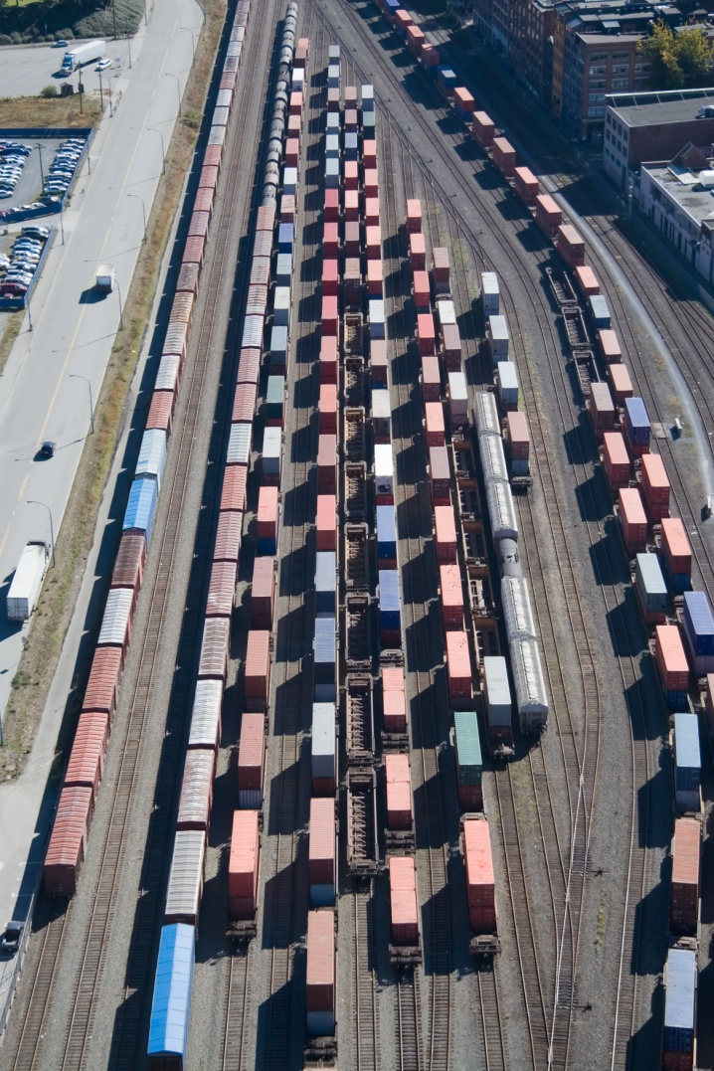
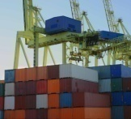
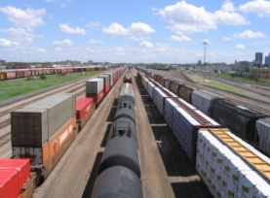
Vision for tomorrow - connected systems, data analytics, mobile
Railroads
Rail Shippers
Rail Network Optimization
Rail Supply Chain Execution
Network Planning, Execution
Yard Planning, Execution
Operations Mgmt.,
Railroad & Terminals
Supply Chain Execution
Products
Network / Operations & Asset Optimization
RailConnect
OASIS
ShipperConnect
Movement Planner
Yard Planner
Transportation Management System
Revenue Management System
Equipment Management System
Intermodal Terminal Operating System
Rail Track & Trace
Electronic Bill of Lading
Yard Management
Demurrage Management
Transload Management
Rail Fleet Optimization
Optimal Fleet Sizing
ExpressYard
Railcar Maintenance & Repair
Raildocs
Wayside Asset Management System

Slide 7
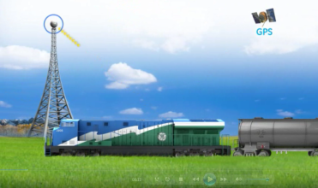
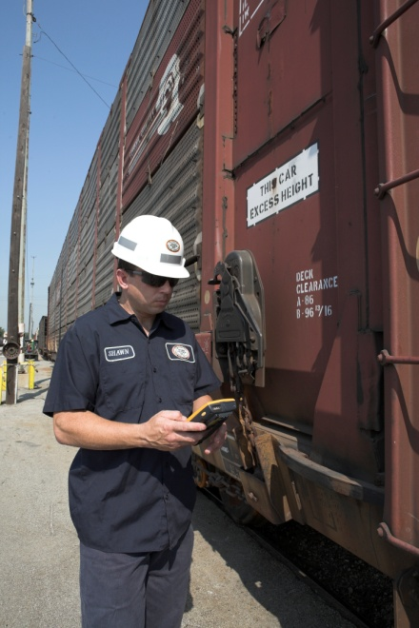
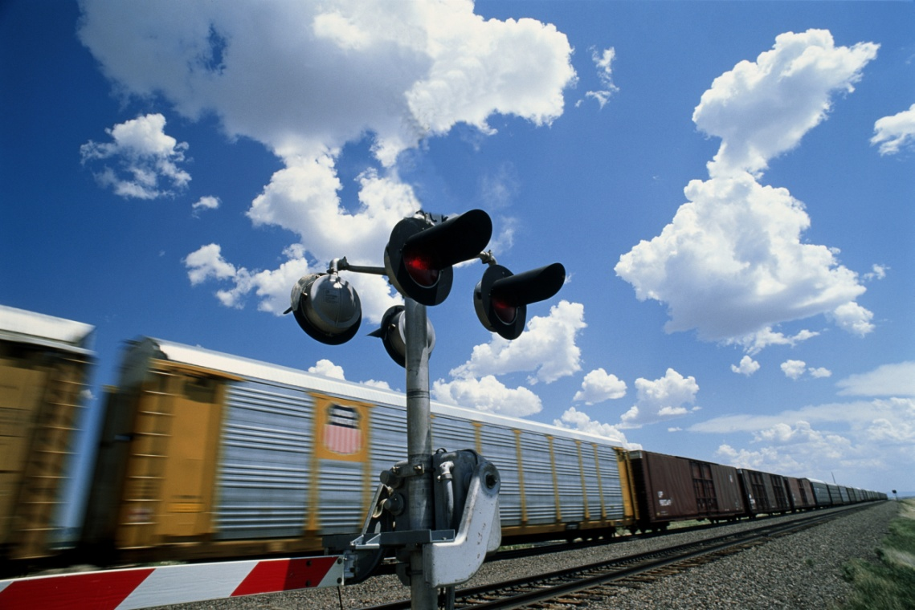
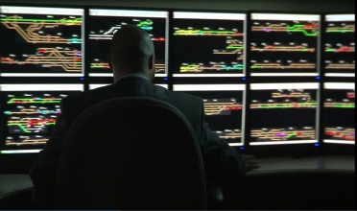
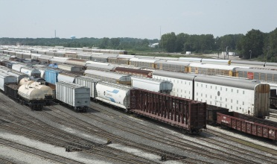
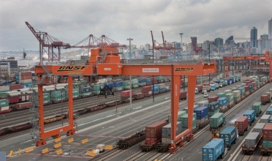
RailConnect360 - unlocking new capabilities and value
Asset Optimization….Increasing asset reliability, availability, utilization
Locomotives
Railcars
Wayside Assets
Make asset smarter, more self-aware, and more efficient
Transition from “break-fix” to “predict & prevent” services model
Operations Optimization…Increasing efficiency, visibility, velocity/capacity
Provide visibility into business processes and operations.
Automate manual processes
Improve information flow
Enable instant, automated decision making
Increase real-time data sharing across network
Railroads
Shippers
Terminals
Drive lower costs, less waste, and higher productivity

Slide 8
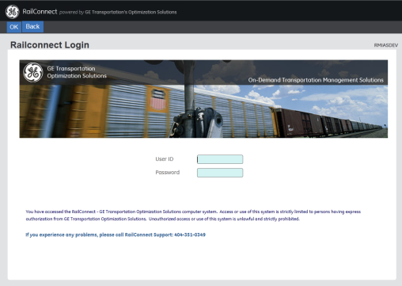
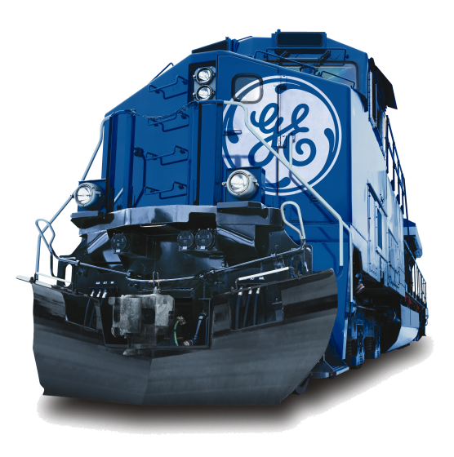
RailConnect - Transportation Management System (TMS)
Product Description
TMS is used for managing rail operation functions such as yard and inventory control, train movement, waybill control, and assessing charges such as switching and demurrage/miscellaneous billing
RailConnect TMS provides high visibility over all rail assets and helps railroads automate all aspects of train and switching operations.
TMS facilitates the seamless interchange of rail traffic between multiple railroads.
Key Features
Fact Sheet
Car and Train Scheduling – railcar and train trip plans and schedules. Measures actual performance against the plan
Car Orders / Empty Car Distribution – module that keeps track of customer equipment orders
Automatic Events – Powerful set of automated movements for Loading/ Unloading, Inspections, Notifications, Placements, Releases etc...
Advanced Blocking – Powerful set of “Blocking” Rules Tables to automatically classify and block cars as they are received or delivered and move over the Railroad infrastructure
466 railroad companies use RailConnect to manage their operations.
96% of the North American fleet of cars moves through TMS.
60b+ bytes of EDI data are processed (annually).
RailConnect TMS manages over 8+ million carloads annually.

Slide 9
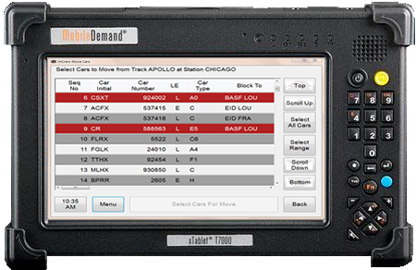
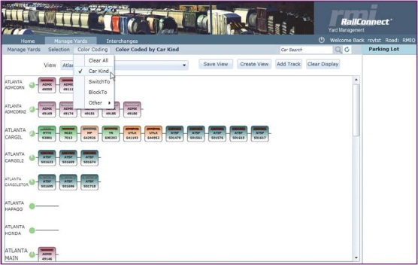
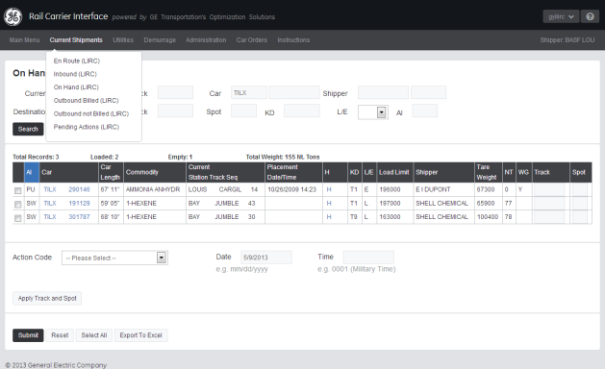
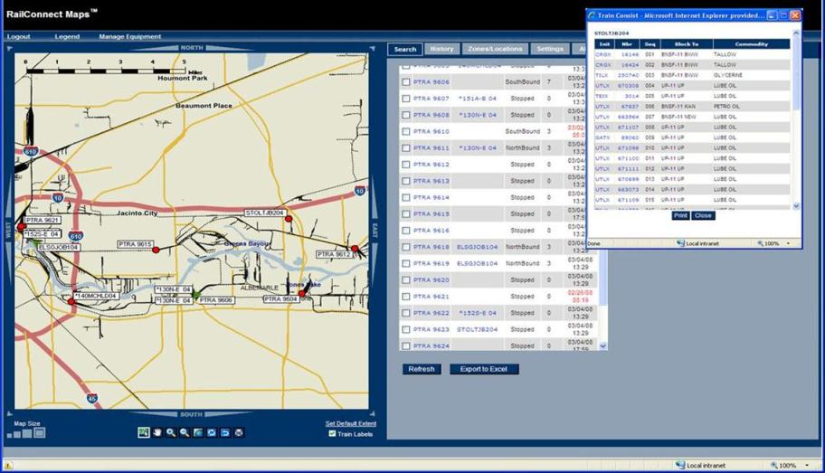
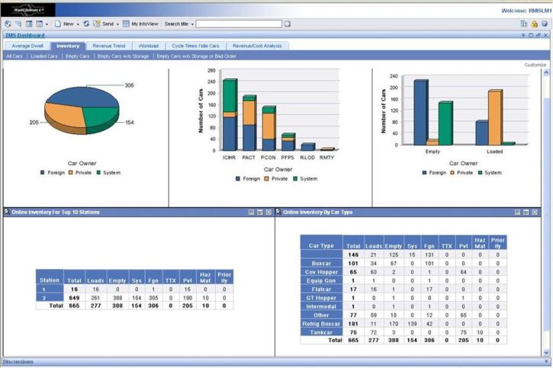
RailConnect Key Modules…
mCrew
Crews Capture Events (Arrivals, Departures, Places, Pulls)
Completely Integrated with TMS for Real-Time Updates
Cost-Effective Communications/Equipment
Supplement or Alternative to AEI
RailCarrier Interface
Shippers order cars in, load or unload cars, report rejections or releases.)
Integrated with TMS for real-time event reporting.
eBOL module for 404 billing
GeoRailTrace
Capable of receiving GPS feeds from locomotives providing information such as speed and direction
Integrated with TMS train module for complete list of cars, destinations, ETA’s, etc…
GeoFencing capability provides low cost solution for AEI
RailConnect Yard
Complete Visibility of Cars in Yard
Open/Available tracks
Station/Track/Car level management
Business Intelligence Reporting
Ad Hoc reporting
Scheduled Reports
FTP extracts
Notes:
RCY (Yard Management) development has been stalled, but, needs to be revived. GeoRailTrace needs a technology refresh. mCrew to be re-developed as an app (as opposed to windows executable)

Slide 10
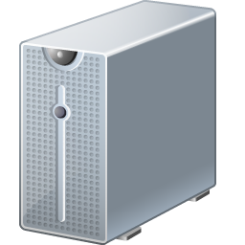
RailConnect TMS Integration
RCI – RailCarrier Interface
mCrew – Mobile Reporting
RCY – Yard Management
RMS - Revenue
RTT -Tracing
EDI
BMS – Bulk Management
Oasis
Hump/Scales
EY – Repair Billing
BI – Strategic Reporting
EMS – Car Hire

Slide 11

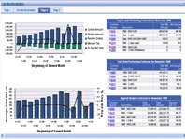
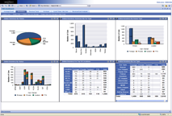

RailConnect – Equipment Management System (EMS)
Fact Sheet
First Class I implementation went live in 2012
Payable Monthly Volume - 350 Payable Railroad Clients, 1.2 million cycles per month, 600k cars per month, $29.5 million in carhire calculated, $8.1 million of reclaims
Receivable Monthly Volume -115 equipment owner IDs, 75k railroad and privately marked cars, 42k trailers and containers processed, $36 million collected per month
Key Features
Carhire Payable
Carhire Receivables
Car Management Business Intelligence
Automates carhire processing to determine the amount due to or claims against car owners
Provides a thorough audit of monthly carhire earnings and produces claims where shortages are detected
Daily operating KPI dashboards, reports, and data analytics that drive velocity on the railroad
EMS ® Benefits / Value
Reclaim Processing and Management – Full application of Reclaim adjustment
Automated Car Owner Reports – Reports sent to Equipment Owners automatically.
AAR Data Exchange Compliant – Seamless integration with industry standard AAR Data Exchange
Automated Audit Processes – Ensures car hire rules and agreements are applied correctly and payments are accurate
Car Hire Payable Managed Services available – Managed Car Hire Audit Services available for higher level of analytics/diagnosis of over payments and adjustments of reclaims.

Slide 12
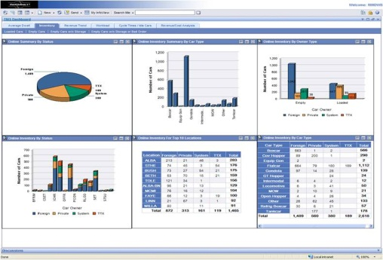
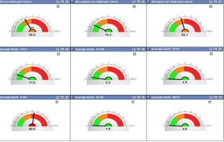
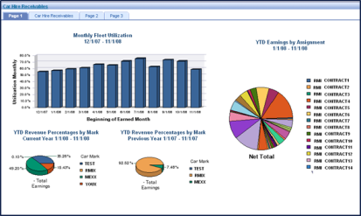
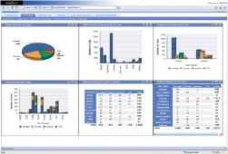

RailConnect – Revenue Management Advanced Analytics (RMAA)
Product Description
REVENUE MANAGEMENT ADVANCED ANALYTICS - Business Intelligence (BI) Service offering that specializes in revenue management. Providing fast, comprehensive, and user-friendly business solutions to support accounting & decision-making.
Scope of Analytics
Performance Management
Marketing
Financial Reporting
Accounting
Key Features
Fact Sheet
Ready-made reporting solutions
Can be used by non-technical users
Connects business processes
Supports decision-making
Integrates data sources
Drives workflow
Enables self-reporting
Increases business velocity
Establishes best practices
Easy to deploy and train
Reduces costs
Improves cash flow
Increases productivity
Improves business performance
Enables faster, better decisions
Increases accuracy & consistency
Improves cycle times
Improves revenue recognition
Provides actionable knowledge
Provides single source of information

Slide 13


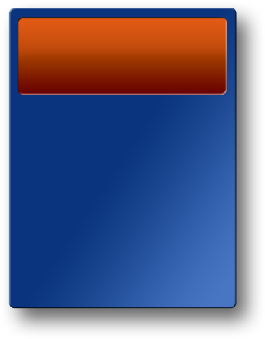
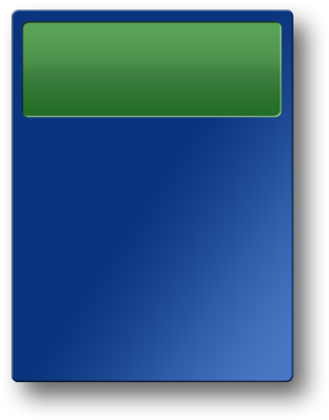


RailConnect Advanced Analytics Road Map
Revenue Management
Transportation Management
Car Hire
Management
Interline Accounting
Freight Rating & Invoicing
Month-end Accounting
Switching & Haulage
Incidental Charges
Revenue Audit
Variance Analysis
Performance Management
Financial Revenue Reporting
Consolidated Revenue Analytics
Revenue by Customer
Revenue Ton Miles
Daily Operating Reports
Station Dwell
Idle Equipment
Online Inventory
Gross Ton Miles
Train Management
Interchange Reports
Car Movement History
Key Operating Metrics
Customer Cycle & Demurrage
Event Reporting Automation
Inbound Cars
Car Hire Expense
Car Hire Earnings
Equipment Utilization
Cycle Times
Audit & Reclaims
LCS Reporting
Exception & Error Reporting
What If Scenarios
Fleet Management
KPI’s That Drive Car Hire
Reconciliation with TMS Events
Car Hire Rates

Slide 14
Extended Portfolio

Slide 15
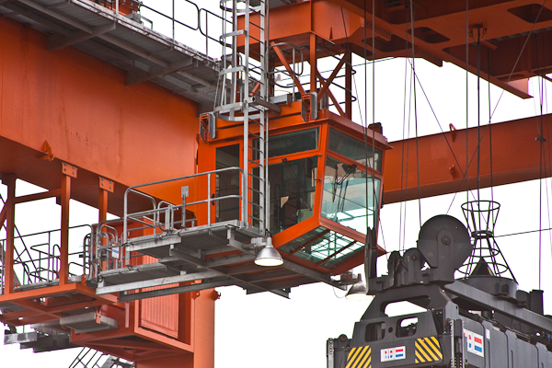
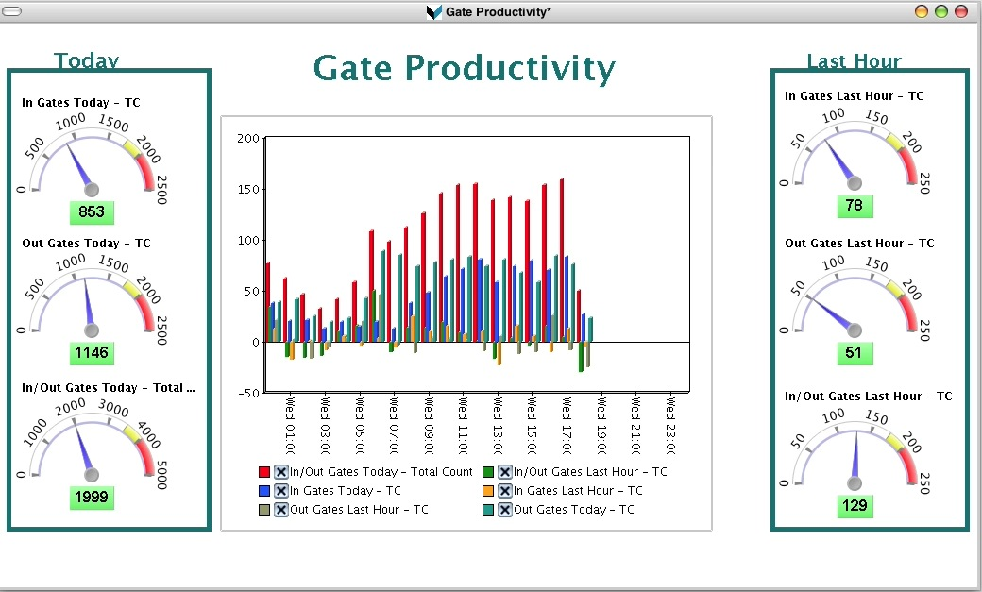
OASIS – Intermodal Terminal Operations
Product Description
OASIS is a Terminal Operating System (TOS) that is used to optimize, manage, and provide visibility into the container handling process
OASIS allows operators to enhance yard and gate efficiency, reduce operating costs, increase yard and equipment utilization, boost throughput to handle increased capacity, and minimize errors and improve customer service
Key Features
Quick Facts
In-Gate Out-Gate Processing
Work Order Management
Container Inventory/Chassis Management
Train Loading and Unloading
Business Intelligence and Reporting
Most of the North American Class I railroads use OASIS to help operate their respective inland terminals
Installed at more than 100 intermodal terminals across North America
Most of the North American Class I railroads use OASIS to help operate their respective inland terminals
Handles more than 25M lifts and 25M gate moves a year
Terminals operated by OASIS experience monetary saving and improved efficiency, reducing operating expenses by over $45M annually
15

Slide 16

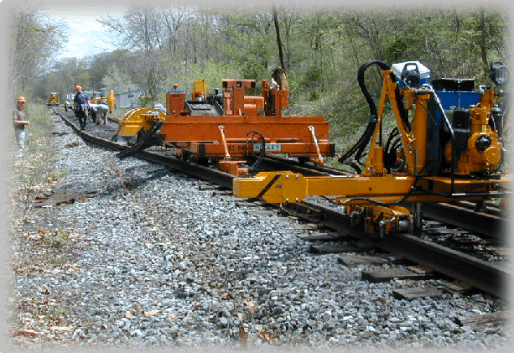
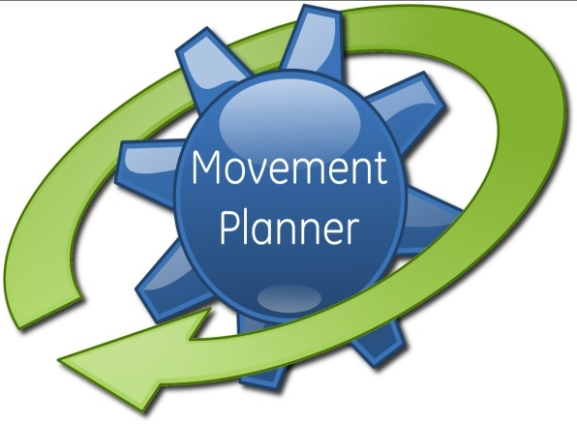
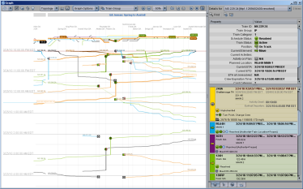
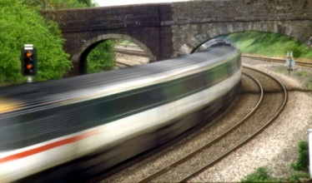
Real-time Network Optimization Automated solutions for a dynamic environment
Railroad Segment
Operational Objectives
Constraints
Timetable
Configurable Business Objectives
Dynamic train priority
Track Constraints
Permanent Speed Restrictions
yard/depot Capacities
Optimized Plan
Real-time Status
Real-time train trip optimization
Up to 12 hours planning horizon
“What if“ analysis
Auto Route Setting
Train Location
Delay Reports
Temporary Track Obstructions
Rolling stock/car and Crew status
Dispatcher inputs
Improving Velocity/Punctuality…Managing exceptions

Slide 17
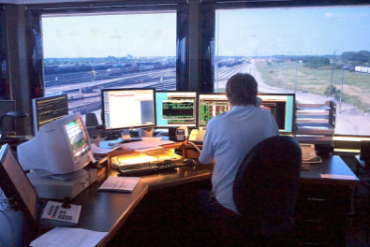
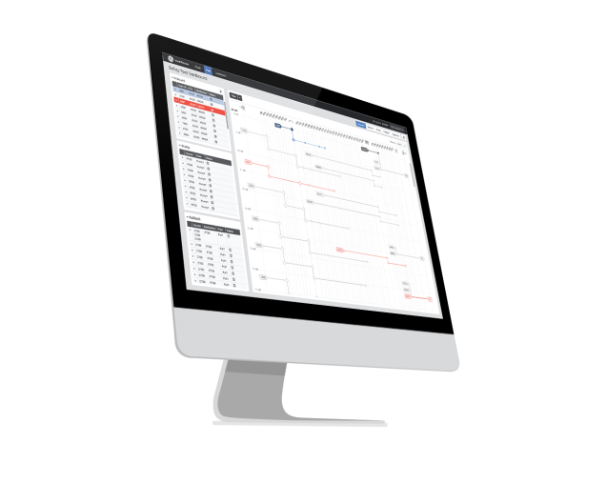
Yard Planner – Yard Operations Optimization
Product Description
Yard Planner is a yard optimization planning system used by a yard master to forecast the optimal movement of car inventory through the yard
Product goal is to reduce car dwell time and improve car connection performance
Yard Planner provides yard state and operating plan visualizations, leveraging best in class tools and while focusing on user experience design
Key Features
Quick Facts
Train departure driven heuristic algorithm designed to optimize all facets of yard including resources and track constraints
Web-based application simplifies deployment and end user access opportunities
Utilizing SWCOE Industrial Internet Design System (IIDS)
Large focus in user experience (UX) as a key product differentiator
Joint development partnership with Norfolk Southern
60% of car life spent in a yard; 70% of that time within the yard is idle
Integration with Movement Planner could have significant impact to network performance
Brosnan Yard (Macon, GA) pilot scheduled for Q4, 2013
Full production system implementation in 2014

Slide 18
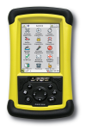
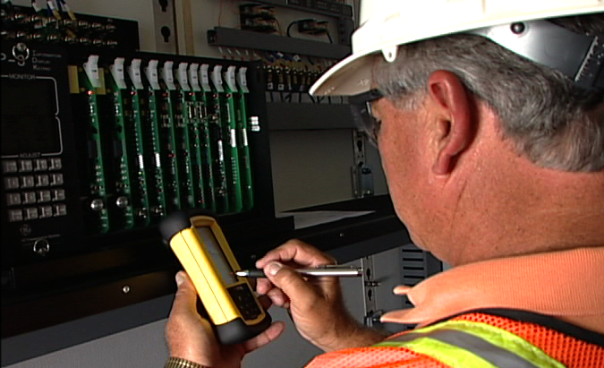
RailDOCS – Wayside Asset Management
Product Description
RailDOCS is an integrated software solution that provides a platform for configuration management, testing, inspecting, and maintaining signal and communications equipment and track
Ensures compliance with railroad and government requirements
Key Features
Quick Facts
Tests and Inspections System – Used to standardize, plan, report and schedule routine testing and inspection activities
Configuration Management System – Manages configurations and guidelines for every component and identifies how these components work together
Signal Maintenance Auditing – Ensures the content and timeliness of testing and inspection records
Employee Mgt (Hours of Service) – Tracks and provides management of employee time and availability
Over 4,700 active users
Track over 1,000,000 separate configurable items in over 150,000 products
Process an average of 3,000 test and inspection forms submitted daily
Store over 4.6M test forms for over 100,000 locations
Manage over 600,000 drawings with the Plan Management Program
18

Slide 19
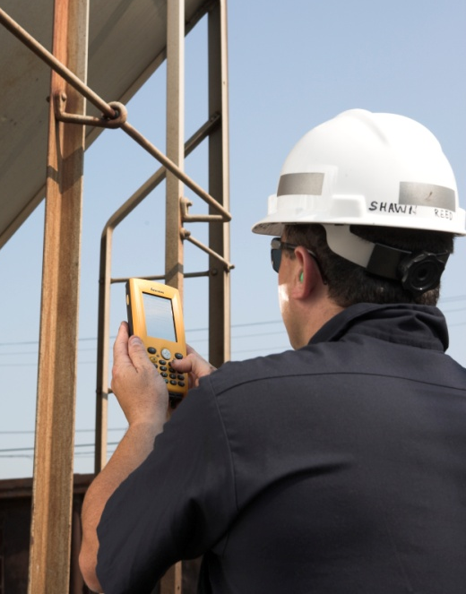

EXPRESSYARD – Railcar Maintenance Management
Product Description
Manage freight car repair billing, parts inventory, employee labor hours, early warnings, and maintenance advisories for railcars
EXPRESSYARD allows equipment owners and railcar repair shops to streamline and integrate operations and ensure compliance with repair billing standards
Key Features
Quick Facts
Capture repair data and calculates billing
Utilize wireless handheld to capture data in field
Over 126 companies, 425 repair shops
More than 350,000 repairs per month
Servers handle 3.2M transactions per month
Customers save over $34M per year in time and money
Manage the inventory / part control process
Provide early warning and maintenance advisory
Produce repair invoice for car owners

Slide 20


ShipperConnect – Rail Supply Chain Execution
Product Description
ShipperConnect is a transportation management and rail supply chain execution software platform for rail shippers and 3PLs
Complete and consolidated information from over 500 railroads on location, status, and ETAs of rail assets and shipment inventory
Comprehensive e-Commerce platform for shippers to communicate billing, car orders, and other information with railroads
Enables inventory management across the rail supply and terminal network
Key Features
Quick Facts
Web Portal for Railroad Communication
Rail Yard Management
Transload Management
Asset Management
Freight Rate Management
Demurrage Management
4,000 Active Customers billing and requesting switching via the internet
130 Industrial Shippers using Track and Trace
30 Shippers Using Yard Management
1,500 Separate Customers On-line and ready for new services
20

