Slide 1
Damage Defective Car Tracking (DDCT) System
ACACSO
May 11, 2017

Slide 2
DDCT Overview
The Damaged and Defective Car Tracking System was designed to serve as a centralized system to track damaged and defective cars under AAR Interchange rules and Car Hire rules
Railroads, Car Owners and Disposition Location Entities are required, per AAR Rule 115, to utilize DDCT

Slide 3
What is DDCT
The Damaged and Defective Car Tracking (DDCT) system was implemented January 5, 2011
DDCT was developed for the electronic transmission of defects and damages on cars
Replaced physical defect card placed on car
DDCT allows handling carriers (HC), car mark owners (CMO) and shops to communicate about incidents
Defect card information is captured in accordance with AAR Interchange Rule 102
Car Owner provides disposition to handling carrier to move car to shop
Requires shop couplet to be registered in FindUs.Rail
Interfaces with several Railinc application throughout incident lifecycle

Slide 4
What is DDCT
Handling Carriers, Car Owners and Shops receive notifications related to incidents as they move through the different stages of the incident life cycle.
Handling Carriers and Car Owners report damages or defects to AAR Interchange Rules 1, 95A, 102, 107, 96, and 108
Rules 1, 95 and 108 allow one car per incident
Rules 96 and 107 allow multiple cars per incident
Defect Cards can be created per AAR Interchange Rule 102 with or without an associated DDCT incident

Slide 5
DDCT Incident Types
Damaged Incident Carrier Responsibility
Defective Incident Car Owner Responsibility
Rule 107 – Major Damage
Car Hire Implications
Settlements can be offered
Dispositions made
Defect Cards are created
Rule 108 – Major Defects
Car Hire Implications
Dismantle can be authorized
Dispositions made
Load up can be authorized
Rule 95 – Minor Damage
Defect Cards are created
Rule 96 – Major Defects
Dispositions made
Rule 102 – Defect Card
Stand alone Defect Card
Rule 1 – Minor Defects
Car Hire Implications
Dispositions made

Slide 6
Applications that Interface with DDCT
DDCT interfaces with several industry applications at Railinc such as:
Umler- used to verify equipment is registered and capture the stencil mark owner (SMOW)
For Rule 107 the cost and weight information is captured so that the estimated depreciated value (EDV) can be calculated
Industry Reference Files (IRF)- reference files such as Standard Transportation Commodity Code (STCC) and Standard Point Location Code (SPLC)
Event Repository (ER)- used to verify HC has possession (TRAIN/EDI messages)
Liability Continuity System (LCS)- DDCT sends events related to the Car Hire process
FindUs.Rail- contact information for CMO, HC and shop couplets to send notifications related to incidents
Early Warning- displays equipment related to DDCT incidents on respective Maintenance Advisory (MA) letters
Equipment Health Management System (EHMS)- DDCT receives the THD and Wild alerts that are reported to EHMS. DDCT opens a rule 1 incident for the given car

Slide 7
FindUs.Rail
FindUs.Rail is required for DDCT to transmit notifications to the HC, CMO and Shop
AAR Interchange Rule 114 mandates participation
HC’s and CMO’s must list a contact primary and or secondary contact for the Damaged Defective Car Tracking category to receive notifications.
The Damaged Defective Car Tracking category functions are:
Handling Carrier Damaged Car Management
Handling Carrier Defective Car Management
Handling Carrier ICB Management
Mark Owner Damaged Car Management
Mark Owner Defective Car Management
Mark Owner ICB Management
Shops must list a contact in the Repair Shop category to have their shop listed in DDCT for disposition
Each shop location must have a contact in order for disposition to be requested for that location.
Must enter company ID and SPLC to create shop couplet

Slide 8
Agenda
DDCT Overview
High Level Process Flow
Car Hire Processing in DDCT

Slide 9
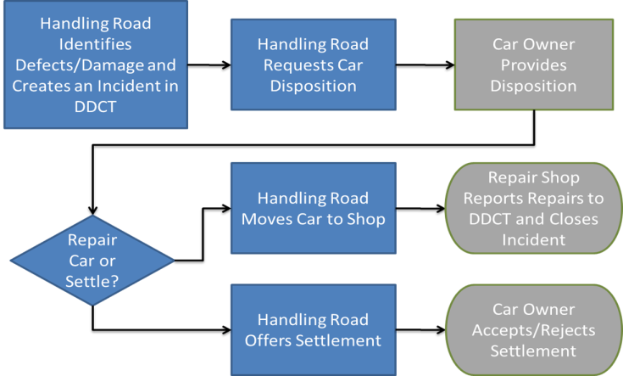
High Level DDCT Mechanical Process Flow

Slide 10
HC Creates Incident and Request Disposition
Incidents are only opened by HC in DDCT
Must have possession of the car on the incident date
HC notes defects or damages related to car per AAR Rules 1, 95A, 96, 107, or 108
Rules 1, 95, 102 and 108 allow a single car to be added to an incident
Rules 96 and 107 allow multiple cars to be added to an incident
HC creates incident based upon:
Information related to defects/damages found, location (SPLC) and commodity (STCC)
Requests disposition from CMO to determine where to send car for repairs
CMO contact listed in FindUs.Rail is notified
The CMO is determined by the stencil mark owner in UMLER
For Rule 107 incidents the HC can request Actual Depreciated Value (ADV)

Slide 11
Car Owner Provides Disposition
CMO is responsible for providing disposition to the HC
Determines where car is sent for repairs
Utilizes shop couplets registered in FindUs.Rail to report to the HC where to send car
Can advise HC to continue movement based on waybill
HC will ten create a waybill to move car (handled outside DDCT)
CMO has visibility to incident details once HC requests disposition
Defect Cards are visible if created for the incident
Estimated Depreciated Value (EDV) is visible on Rule 107 incidents
CMO must enter the Actual Depreciated Value (ADV) when providing disposition on Rule 107
HC will offer settlement based upon their review

Slide 12
Shops Reporting Repairs
Shops receive a notification advising them that a car is enroute to their location
Helps shop to plan for repairs to be completed and discuss questions with CMO
Shop must report Car on Hand to view the details of incident
Visibility includes the incident details (excluding confidential info) and defect card if one exists
Shops must report repairs to the DDCT incident when completed
An incident closes once it reaches an End State (incident is removed from MA letter at that time)
For Rule 107 incidents, the equipment is removed once it reaches an end state BUT the incident closes after 90days when all equipment are at an end state.

Slide 13
Offering Settlement or Salvage Value and End States
For Rule 107 the HC receives the Actual Depreciated Value (ADV) from the CMO
If the HC offers settlement, the CMO can then accept it or reject it.
If rejected the car will be sent to home shop for repairs
If ADV is rejected, the CMO will have the opportunity to provide another value
For Rule 108 the CMO may provide the Salvage Value of the car.
If the CMO provides the Salvage Value, the accept it or reject it.
If the HC accepts the Salvage Value then the car status is set to Dismantled and the incident closes.
If rejected the CMO can provide Disposition or opt to provide a new Salvage Value.
An incident will close once all cars have reached an end state
End states are any of the following:
Dismantled - HC decides to scrap car
Removed - HC or CMO can remove car from incident
Settlement Accepted - HC accepts settlement offered by CMO
Car Repairs Completed - Shop reports repairs to defects/damages on incident

Slide 14
Interchange Bureau (ICB) Records
Interchange Bureaus:
Create ICB Records for CMO and HC notification
Identify multiple defects/actions taken on a car in interchange
Review updates to the ICB record by authorized parties
ICB Record Types:
Transfer of Load: Equipment badly damaged and cannot move to destination requiring lading to be transferred to another car for furtherance.
Load Adjustment: Lading is off center and must be righted before moving to destination.
Defect Identification: ICB discovers car is damaged and an incident is required to be created by delivering carrier – Rule 1, 108, 95, 96 or 107.
Decline: Upon inspection by HC, no defect is found. Equipment is then moved through the interchange point.

Slide 15
Agenda
DDCT Overview
High Level DDCT Mechanical Process Flow
Car Hire Processing in DDCT

Slide 16
Rule 107 Process
Handling Carrier takes responsibility for damage
Major Damage that may require scrap settlement or Heavy Repairs
Incident sub-type is required
Settlement ends the Incident and the car hire analysis
Damaged Incident Carrier Responsibility
Rule 107 – Major Damage
Car Hire Implications
Settlements can be offered
Dispositions made
Defect Cards are created

Slide 17
Rule 107 Incidents - Car Hire Rule 7
Car Hire Liability for Rule 107 incidents is supported by Car Hire Rule 7
Damaging carrier is responsible for car hire
Liability is moved by DDCT LCS out of handling carrier’s account to these marks:
DVR7
DSP7
SHP7
DEAD
Damaged Incident Carrier Responsibility
Rule 107 – Major Damage
Car Hire Implications
Settlements can be offered
Dispositions made
Defect Cards are created

Slide 18
Rule 107 Incidents - Car Hire Rule 7
DVR7
Depreciated Value or Disposition has been requested by the handling carrier but equipment owner has not responded within 15 day time limit
Car Hire is liability is moved into the equipment owner’s account

Slide 19
Rule 107 Incidents - Car Hire Rule 7
DSP7
Equipment has been interchanged to an intermediate carrier after DV/Disposition has been provided by the equipment owner
Car Hire is liability is moved into the car owner’s account

Slide 20
Rule 107 Incidents - Car Hire Rule 7
SHP7
Equipment has been reported as being on-hand at a repair shop
Interchange to SHOP can be reported through the DDCT application or TRAINII event reporting showing “SHOP” as the “To road”
Car Hire is liability is moved into the car owner’s account

Slide 21
Rule 107 Incidents - Car Hire Rule 7
DEAD
Equipment owner decides to scrap the car
Subsequent movement events will be marked with LCS code “X” for inactive
If equipment was approved to be dismantled but instead returned to service please contact Railinc’s Customer Support Center

Slide 22
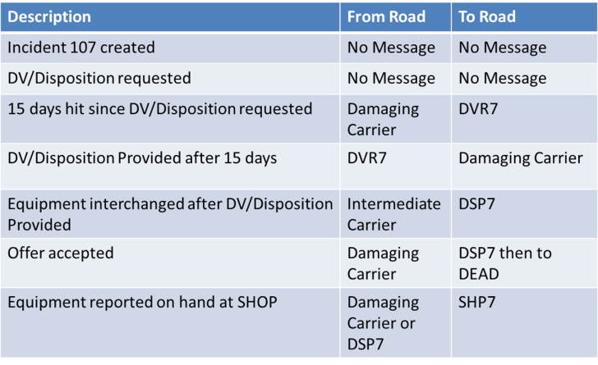
Rule 107 Incidents - Car Hire Rule 7

Slide 23
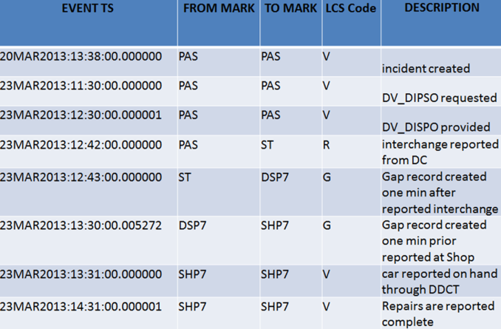
Rule 107 Incidents - Car Hire Rule 7

Slide 24
Rule 1 DDCT Process
Most common incident
Minor defects that are Car Owner responsibility
Used for Truck Hunting, Early Warning, and other common situations that require home shop disposition from the car owner
Car owner has multiple options for disposition
Defective Incident Car Owner Responsibility
Rule 1 – Minor Defects
Car Hire Implications
Dispositions made

Slide 25
Rule 108 Process
Major Defects that are Car Owner responsibility
May require a Load up of defective car on a “hospital car” for move
Car owner can opt out of transfer costs by authorizing dismantle of car
Defective Incident Car Owner Responsibility
Rule 108 – Major Defects
Car Hire Implications
Dismantle can be authorized
Dispositions made
Load up can be authorized

Slide 26
Rule 1/108 Incidents – Car Hire Rule 8
Car Hire Liability for Rule 1 and 108 incidents is supported by Car Hire Rule 8
Liability is moved by LCS out of handling carrier’s account to these marks:
DVR7 – status of disposition
DSP7 – compliance with disposition
SHP7 – SHOP status
DEAD – settlement status - permanent
Defective Incident Car Owner Responsibility
Rule 1 – Minor Defects
Car Hire Implications
Dispositions made
Rule 108 – Major Defects
Car Hire Implications
Dismantle can be authorized
Dispositions made
Load up can be authorized

Slide 27
Rule 108 Incidents – Car Hire Rule 8
DSP8
Car Hire Liability is in the equipment owner’s account
Disposition has been requested from equipment owner by possession road

Slide 28
Rule 108 Incidents – Car Hire Rule 8
SHP8
Equipment has been reported as being on-hand at a repair shop
Interchange to SHOP can be reported through the DDCT application or TRAINII event reporting showing “SHOP” as the “To road”
Car Hire liability is moved into the car owner’s account

Slide 29
Rule 108 Incidents – Car Hire Rule 8
DEAD
Equipment owner decides to scrap the car
Subsequent movement events are marked with LCS code “X” for inactive
If equipment was approved to be dismantled but instead returned to service please contact Railinc’s Customer Support Center

Slide 30
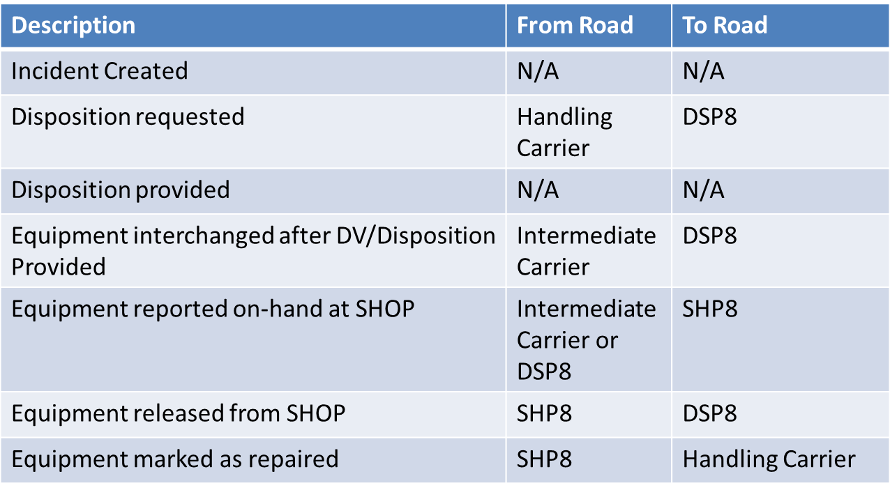
Car Hire Events for Rule 1/108 Incidents

Slide 31
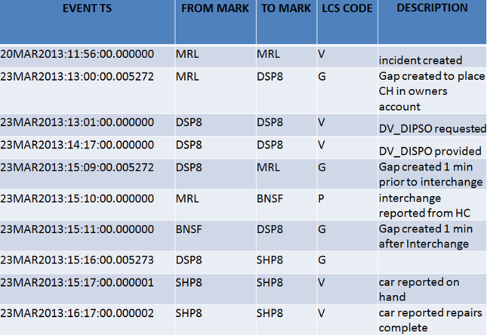
Car Hire Rule 8 Incident Example Events

Slide 32
Questions?

