Slide 1
Equipment Assets Committee American Short Line & Regional Railroad Association Car Hire Training

Slide 2
Car Hire Training Tag for ASLRRA 2012
Training TAG was formed in 2011 to create car hire training for the 2012 ASLRRA meeting, being held on April 23-25th in Indianapolis.
Diverse team or car accounts joined the tag, and Matt Cox served as secretary.
Training was scheduled for Sunday April 22nd 2012.
On March 15th 2012 only 6 people had signed-up for the course.
ASLRRA & Railinc sent out notices of the course being offered in their respective email news & alerts.
Training was given on April 22nd with 67 attendees.
May 24, 2012 – TAG was sunset after completing its mission and Training Task Force was created with Barb Ward as the Chair.

Slide 3
Course Outline
Car Hire 101 – April 22, 2012 Indianapolis
Introduction & AAR structure – Joanne Miner, ShipXpress
Overview & Car Hire History - George Jones CSX
Determination of Car Hire Rates - Ken Jacobs BNSF
Interchange Reporting – Brigid Rich, North Shore Railroads
Liability Continuity System (LCS) – Barb Ward, CN
Reporting Settlement – Elan Neal, Genesee & Wyoming Railroad
Reclaims – Lisa Butts, Watco
Transfer of Liability (TOL) – Eric Smith, RMI
Haulage – Eric Smith, RMI
Damaged & Defective Car Tracking (DDCT) – Gary Snyder, Greenbrier Companies
Claim Processing – Gary Snyder, Greenbrier Companies
Rules Recap – Jim Pinson, Railinc
Car Hire 101 Outline – April 28, 2013 Atlanta
8:00am – 8:15am Introduction Todd Poland Watco Companies
8:15am – 9:00am Overview & Car Hire History Dale Cassels CSX
9:00am – 9:20am Car Accounting Self-Service (CASS) Jim Pinson Railinc
9:20am – 9:40am Determination of Car Hire Rates Ken Jacobs BNSF
9:40am – 10:00am Refreshment Break
10:00am – 10:20am Interchange Reporting Brigid Rich North Shore Railroads
10:20am – 10:40am Liability Continuity System (LCS) Walter Jones Norfolk Southern Corporation
10:40am – 11:00am Reporting & Settlement Elan Neal Genesee & Wyoming Railroad
11:00am – 11:20am Car Hire Rules 1-4 & 25 Jim Pinson Railinc
11:20am – 11:45am Reclaims Chauncey Fallen GATX
11:45am – 1:20pm Lunch Break
1:20pm – 1:40pm Transfer of Liability (TOL) Elizabeth Morris-Thompson GE Transportation
1:40pm – 2:00pm Damaged & Defective Car Tracking (DDCT) Gary Snyder Greenbrier Companies
2:00pm – 2:20pm Car Hire Rules 5-15 & 22 Jim Pinson Railinc
2:20pm – 2:40pm Refreshment Break
2:40pm – 3:00pm Haulage Lisa Gering BNSF
3:00pm – 3:20pm Claims Processing Gary Snyder Greenbrier Companies
3:20pm – 3:40pm Car Hire Rules 16-21, 23 & 24 Jim Pinson Railinc
3:40pm – 4:00pm Conclusion Todd Poland Watco Companies
Car Hire 201 Outline – April 28, 2013 Atlanta
8:00AM-8:15AM - Introduction, safety briefing, and what’s to be covered JoAnne Miner, Director - RailSync, ShipXpress
8:15AM-9:45AM - Damaged & Defective Car Tracking (DDCT) System In Detail:
The Mechanical Side: Chip Summey, Business Analyst - Asset Health, Railinc
9:45AM-10:15AM - Refreshment break
10:15AM-11:45AM - Damaged & Defective Car Tracking (DDCT) System in Detail:
The Car Hire Side: Matt Cox, Business Analyst II, Railinc
11:45AM-1:20PM - Lunch and errands
1:20PM-2:30PM - Reclaims In Detail Barb Ward, Manager, Car Accounting, CN
2:30PM-2:45PM - Break
2:45PM-3:55PM - Transfer of Liability In Detail
Lisa M. Butts, Car Accting Manager, Watco Companies LLC
3:55PM-4:00PM - Recap, final questions and concluding remarks JoAnne Miner, Director - RailSync, ShipXpress

Slide 4
Committee Structure
AAR
Board of
Directors
Safety and
Operations
Management
Committee
(SOMC)
Policy and
Advocacy
Management
Committee
(PAMC)

Slide 5
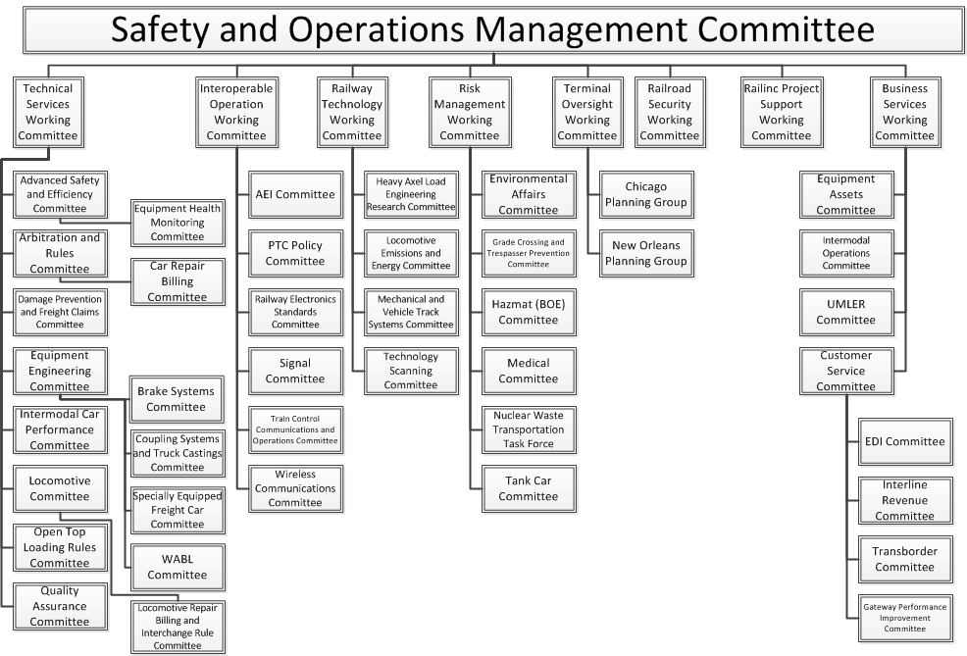
SOMC Organization Chart

Slide 6
Training Task Force - ASLRRA 2013
Task Force sent a survey to all of 2012 participants and the feedback received requested a more advanced course.
Started preparing two courses for the 2013 ASLRRA meeting, 101 & 201. Added handouts, changed 101 format and created 201 course.
Training was given on April 28th 2013 for both 101 (57) & 201 (12) participants.
Had survey forms available and completed at class time, and received very good feedback. Most of the 101 participants wished we would have given the 201 course the next day so they could have taken both. The 201 participants requested we continue with this level of detail and enhance to other areas.
ASLRRA 2014 in San Diego on April 22-25. ASLRRA informed the Task Force that they were receiving very low attendance feedback and most were senior management so didn’t want to waste the trainers time with such low numbers. We canceled car hire training for the 2014, but ASLRRA asked that we plan on participating in the 2015 meeting in Orlando.
Barb Ward stepped down as chair in March and Task Force voted a new chair.
Task Force is currently concentrating on the creation of a car accounting certification program, as well as actively looking for different venues to provide training.

Slide 7
Car Hire Training Outline
Presenter: Lisa Butts
Watco Companies

Slide 8
Definition and Purposes of Car Hire
Definition: Rental paid by the user of rail equipment to the owner of the equipment
Purpose: Provide income to equipment owners.
Purpose: Encourage good equipment utilization.

Slide 9
Governance—Railroad Car Hire
Railroad car hire is governed by AAR Circular OT-10, Code of Car Hire Rules and Interpretations – Freight
Circular OT-10 is published on the Railinc website - www.railinc.com.
Click the Reference Files tab
Select AAR Circulars
OT-10 is listed as one of the AAR Circulars

Slide 10
Governance—Private Car Hire
Private car hire is governed by tariff RIC 6007
RIC 6007 is available on the Railinc website (www.railinc.com)
Click the Reference File tab
Click on National Tariffs
Select RIC 6007

Slide 11
Governance—Trailers and Containers
Trailer and container per diem is governed by bilateral agreement and by AAR Circular OT-36, Code to Trailer Hire Rules. Circular OT-36 is published on the Railinc website, www.railinc.com.
Click the Reference Files tab
Select AAR Circulars
OT-36 is listed as one of the AAR Circulars

Slide 12
Movement Events
Car Hire Rate
Negotiations
CHARM
Liability Continuity System - LCS
DDCT
Carriers Report Car
Hire Payables
Haulage
Flags
TOL
Reclaims
TOL
Event Repository - ER
Car Hire Data Exchange - CHDX
Car Hire Receivables
CASS
CHLF
Claims
Railroad Clearinghouse

Slide 13
Car Hire Reporting
Car hire is reported 1 month & 10 days in arrears
January data will be reported by March 10
Users of rail equipment report monthly to the equipment owners
Time equipment was used
Distance traveled
Applicable rate
Amount due
Car hire data are sent electronically to the Car Hire Data Exchange (CHDX) process at Railinc.
Railinc sorts the data and sends it to the equipment owners.

Slide 14
Movement Events
Car Hire Rate
Negotiations
CHARM
Liability Continuity System - LCS
DDCT
Carriers Report Car
Hire Payables
Haulage
Flags
TOL
Reclaims
TOL
Event Repository - ER
Car Hire Data Exchange - CHDX
Car Hire Receivables
CASS
CHLF
Claims
Railroad Clearinghouse

Slide 15
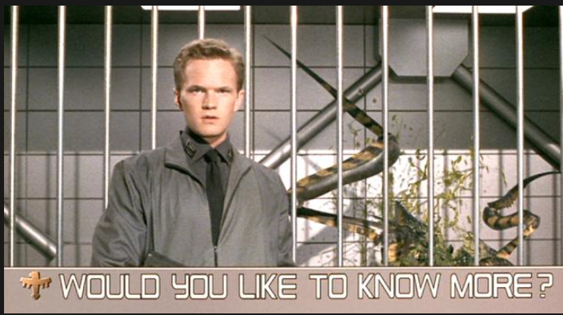

Slide 16

Determination of Rates
When a car enters service its default rate is assigned
The default rate is the lowest, positive, negotiated rate in effect for the previous quarter
Subsequent negotiations can raise or lower the rate paid by a carrier
Railinc provides the Bid and Offer system to facilitate car hire rate negotiation
Either owner or user can start the process
When the parties agree to a rate, it is stored in the Car Hire Accounting Rate Master (CHARM)

Slide 17
Movement Events
Car Hire Rate
Negotiations
CHARM
Liability Continuity System - LCS
DDCT
Carriers Report Car
Hire Payables
Haulage
Flags
TOL
Reclaims
TOL
Event Repository - ER
Car Hire Data Exchange - CHDX
Car Hire Receivables
CASS
CHLF
Claims
Railroad Clearinghouse

Slide 18
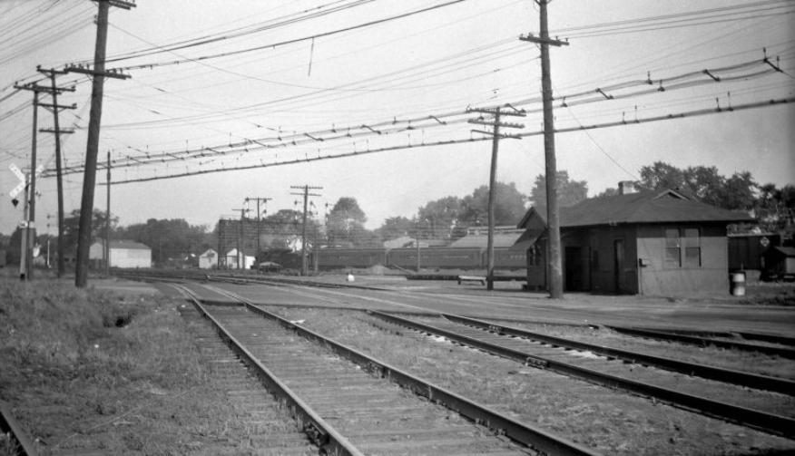
Interchange Reporting
Definition – Exchange of railcars between carriers
Interchange has been accomplished when:
They are placed upon the track agreed upon as the interchange track
They are preceded by or accompanied the necessary data for forwarding
They are accepted by the receiving road.

Slide 19
Movement Events
Car Hire Rate
Negotiations
CHARM
DDCT
Liability Continuity System - LCS
Carriers Report Car
Hire Payables
Haulage
Flags
TOL
Reclaims
TOL
Event Repository - ER
Car Hire Data Exchange - CHDX
Car Hire Receivables
CASS
CHLF
Claims
Railroad Clearinghouse

Slide 20
LCS History and Purposes
LCS was implemented in January 1999
Establishes a common set of transactions for the calculation of car hire
Analyzes car movement and interchange events to assure that continuity is maintained
One entity must be responsible for every hour of a month

Slide 21
LCS History and Purposes (cont'd)
Interchange discrepancies are resolved using industry developed rules
Missing interchanges are created by LCS
All hours in a month must be allocated to a carrier
Prior to LCS, carriers paid car hire based on internal records
Interchange discrepancies frequently left the car mark under paid
Car mark owner had to mediate between carriers
Claims could, and did, remain unresolved for years

Slide 22
LCS History and Purposes (cont'd)
LCS analysis occurs 120 hours (5 days) after the event date/time
This delay allows accurate even reporting
Once an LCS record is created, no changes can be made
No correction process is required for LCS interchanges

Slide 23

Transfer of Liability Overview
Transfer of Liability (TOL) allows carriers to electronically move car hire liability to another carrier in specific situations
TOL differs from reclaim in that TOL is not a separate financial transaction
TOL messages must be used in car hire calculation
There is no need to create reclaims because the TOL events correctly reflected the car hire liability

Slide 24
Movement Events
Car Hire Rate
Negotiations
CHARM
Liability Continuity System - LCS
DDCT
Carriers Report Car
Hire Payables
Haulage
Flags
TOL
Reclaims
TOL
Event Repository - ER
Car Hire Data Exchange - CHDX
Car Hire Receivables
CASS
CHLF
Claims
Railroad Clearinghouse

Slide 25
Haulage Overview
Haulage is a bilateral agreement between carriers where one carrier agrees to move cars as an agent for another carrier
The bilateral nature of the agreements means the normal car hire rules may not apply.
The provisions of the haulage agreement will take precedence.

Slide 26
Haulage Overview (cont'd)
The carrier hiring the agent is referred to as the haulage rights carrier.
The agent carrier is referred to as the hauling carrier.

Slide 27
Haulage Overview (cont'd)
Haulage introduces complexity into car hire calculation for two reasons
Car hire (time and mileage) is typically paid by the haulage rights carrier. Car hire is not owed by carrier in physical possession of car
Movements reported by the hauling carrier are masked - It appears that the haulage rights carrier performed the work

Slide 28
Movement Events
Car Hire Rate
Negotiations
CHARM
DDCT
Liability Continuity System - LCS
Carriers Report Car
Hire Payables
Haulage
Flags
TOL
Reclaims
TOL
Event Repository - ER
Car Hire Data Exchange - CHDX
Car Hire Receivables
CASS
CHLF
Claims
Railroad Clearinghouse

Slide 29


Slide 30
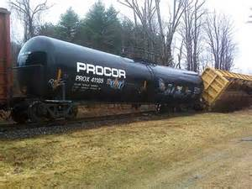
Overview of DDCT
Effective January 2011 Damaged & Defective Car Tracking (DDCT) system was implemented
Intended to automate the handling of Bad Ordered, Damaged and Defective equipment
Eliminate Defect Cards
Utilize FindUs.Rail to manage participation
Eliminate the Car Hire Rule 7 and 8 reclaims
Manage information flow from incident through shop release

Slide 31
Overview of DDCT (cont'd)
Prior to DDCT Car Hire Rules 7 and 8 allowed reclaim of certain time on damaged/defective cars. The reclaims tended to be inaccurate because of:
Availability of Information
Timeliness of Information
Accuracy of Information
Reclaims were often counter reclaimed
Manual intervention was frequently required

Slide 32
Movement Events
Car Hire Rate
Negotiations
CHARM
Liability Continuity System - LCS
DDCT
Carriers Report Car
Hire Payables
Haulage
Flags
TOL
Reclaims
TOL
Event Repository - ER
Car Hire Data Exchange - CHDX
Car Hire Receivables
CASS
CHLF
Claims
Railroad Clearinghouse

Slide 33
Overview of Claim Processing
Car hire claims are issued to request additional payment when a car owner believes all car hire owed has not been paid
A claim must identify
The car initial and number
The interchange dates
The amounts allowed by all user
The amounts short by all users
Appendix J, Code of Car Hire Rules illustrates the specific form of a claim.

Slide 34
Movement Events
Car Hire Rate
Negotiations
CHARM
Liability Continuity System - LCS
DDCT
Carriers Report Car
Hire Payables
Haulage
Flags
TOL
Reclaims
TOL
Event Repository - ER
Car Hire Data Exchange - CHDX
Car Hire Receivables
CASS
CHLF
Claims
Railroad Clearinghouse

Slide 35
Overview of Reclaims
As a general rule, a carrier owes car hire for all the time a car is in its possession.
In some cases, the industry has determined that car hire is not due.
Car hire is paid through the current reporting and settlement processes and recovered through a reclaim

Slide 36
Overview of Reclaims (cont'd)
Reclaims can be processed two ways – electronically or via paper.
To recover car hire payments electronically, the transaction is included in the CHDX file
This electronic reclaim reduces the amount owed by the using carrier.

Slide 37
Overview of Reclaims (cont'd)
The second way to recover reclaim amounts is through a paper transaction
The using carrier can complete a reclaim form and send the form to the car mark owner
The car mark owner will review, approve and allow the reclaim on the next payable CHDX file due the car mark owner
Almost all reclaim transactions are handled electronically

Slide 38
Counter Reclaims
The electronic processing of reclaims limits the car mark owner’s ability to review and approve reclaims
A counter reclaim can be made by the carrier that paid an electronic reclaim
A record is added to the CHDX file that takes the amount of the disputed reclaim away from the carrier that created the original reclaim transaction
The first counter reclaim can be processed electronically
All subsequent transactions must be handled via paper (It is encouraged for the two roads to make contact via phone to discuss and resolve counter reclaim issues)

Slide 39
Movement Events
Car Hire Rate
Negotiations
CHARM
Liability Continuity System - LCS
DDCT
Carriers Report Car
Hire Payables
Haulage
Flags
TOL
Reclaims
TOL
Event Repository - ER
Car Hire Data Exchange - CHDX
Car Hire Receivables
CASS
CHLF
Claims
Railroad Clearinghouse

Slide 41
Helpful Links
https://www.railinc.com/rportal/home
https://www.railinc.com/rportal/car-hire-training
http://www.acacso.org
https://www.linkedin.com

