Slide 1
Car Hire Claims Workshop 101
November 13, 2013

Slide 2
AGENDA
8:30 to 8:45 Introductions & Attendance
8:45 to 9:00 AAR Certification on Car Hire Claims Discussion and Goal
9:00 to 9:15 Car Hire Process & Connection to the Issuing of Time &
Rate Claims
9:15 to 9:25 Break
9:40 to 9:55 Time Claim Examples
9:55 to 10:05 Time Claim Question Forum
10:05 to 10:20 Rate Claim Overview
10:20 to 10:35 Rate Claim Examples
10:35 to 10:45 Rate Claim Question Forum
10:45 to 10:55 Break
10:55 to 11:30 Conclusion

Slide 3
VISION
Formal training
Mentorship
Certification from AAR

Slide 4
WHAT are claims?
Statements from car mark owners that request car hire adjustments from the users of the cars.
Claims are covered under Car Hire rule 11 in the OT-10
Appendix J, Code of Car Hire Rules illustrates the specific form of a time claim which represents the majority of claims

Slide 5
WHAT are claims?
Car hire claims are issued to request additional payment when a car owner believes all car hire owed has not been paid
  Generally covers shorted Time or underpaid Rates
  A claim IS NOT a reclaim
    Reclaims allow for the reduction of car hire amounts to be paid
  A claim stops when the car owner is paid in full

Slide 6
WHAT are claims?
Claims issued on RR marked equipment must be for amounts greater than $25.00
  Claims issued on TTX equipment can be for any amount
A claim must identify
  The car initial and number
  The interchange dates
  The amounts allowed by all users
  The amounts short by all users

Slide 7
WHY do we have claims?
Car hire was not calculated using interchange created by LCS
  Car Hire Rule 9 requires use of LCS interchanges in car hire calculation
  If record(s) other than LCS/TOL are used, the claim is due and should be allowed with 15 % penalty

Slide 8
WHY do we have claims?
An arrangement between interchange partners dictates that car hire be paid by another carrier
  Bilateral arrangements should not reduce or delay payment to the car mark owner
  Reclaims can be used to properly allocate car hire expense between the handling carriers
  The claim should be paid with a 15% penalty

Slide 9
WHY do we have claims?
A haulage agreement relieves a carrier of car hire responsibility
  Adjustments due to a haulage agreement should be made through reclaims or other methods
  Funds due the car mark owner should not be delayed due to agreements between handling carriers
  Car hire and 15% penalty should be paid

Slide 10
WHY do we have claims?
Switching activity was not recognized
  In order to decline a claim because of switching activity, a valid TOL must be supplied
  In the absence of a TOL, car hire is owed to the car mark owner
  Car hire and 15% penalty should be paid based on LCS and TOL records

Slide 11
How do we respond to claims?
Accept and pay the claim

Slide 12
How do we respond to claims?
Claims can be declined because
  Claim was issued outside time limits
  LCS records place liability with another carrier
    Can be verified using internal system or Railinc’s Car Accounting Self Serve (CASS) system accessed at www.railinc.com
    Contact csc@railinc.com for information related to getting access
  TOL records place the liability with another carrier
  Claim that was issued is invalid

Slide 13
How do we respond to claims?
Carriers receiving claims must pay any additional car hire owed – based on LCS records - with all resulting penalties
  If roads don’t reply within timelines, carrier “buys” the claim and owes a 30% penalty

Slide 14
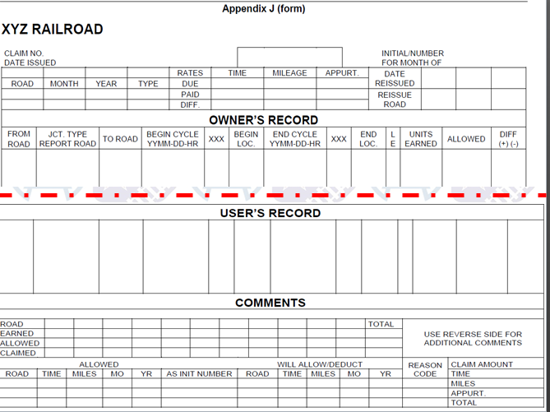
WHAT does a claim look like?

Slide 15
Car Hire Reporting Timeline
Jan
Cars move on Railroads
Feb
RR’s Adjust Car Hire for prior month events and TOL’s
Mar
RR’s reports Jan (current) car hire and reclaims to Railinc (CHDX)
Railinc reports earnings to car mark owner
Apr
May
RR’s take additional reclaims on part of Jan earnings
Settle Cash for Jan car hire
RR’s report Supplemental Jan Car Hire to Railinc
RR’s report Jan Car Hire Adjustments including reclaims to Railinc (CHDX)
June
Car Hire Claims for Jan Car Hire must be issued no later than June 30th
Car Hire Claims can be issued for Jan Car Hire no earlier than May 1st
July
Aug
Sept
Oct
Mileage Deductions related to Jan moves must be reported to Railinc by July’s CHDX processing
Jan Car Hire Claims must be worked and sent to issuing party no later than Aug 31st
Claims that are being reissued must by sent no later than Oct 31st
Nov
Dec
Reissued Claims received must me worked and responded to no later than December 31st
Notes:
The above chart shows the timeline for processing claims. Car hire claims can be issued starting in May. Claims must be issued by the end of June. The claims must be worked no later than August 31. Reissued claims must be worked by the end of December.

Slide 16
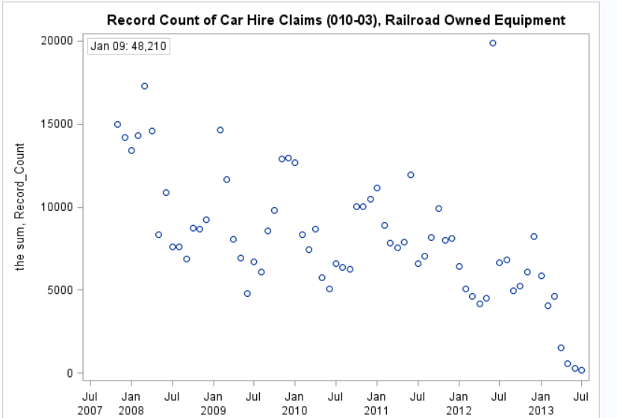
STATS

Slide 17
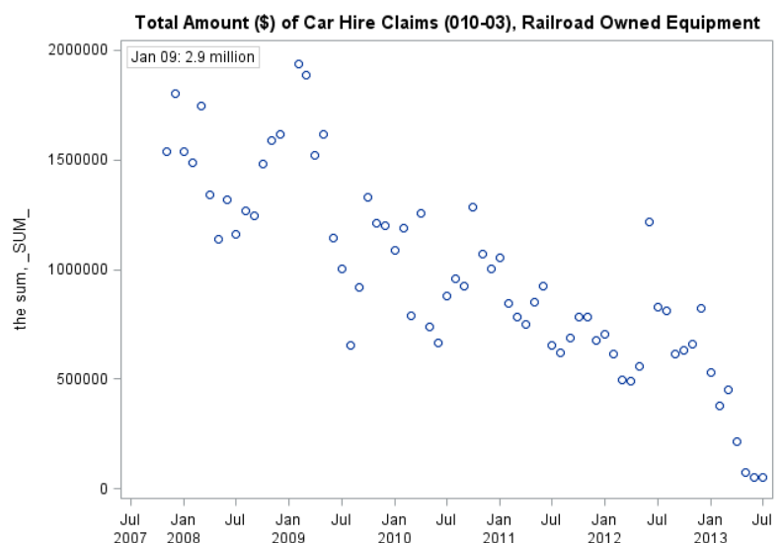
STATS

Slide 18
EXAMPLES

Slide 19
QUESTIONS???

