Slide 1
Reclaims
Presented By:
Chauncey Fallen
Manager-Transportation Services
GATX Corporation- Rail
Notes:
Intro
Goal (s)
Able to answer-What are reclaims/ Why do they exist/When are reclaims valid/ How to process & How to address invalid reclaims.
Understanding impact to your respective Car Hire Ledger- Net Payer or Net Receiver
Importance of Communication & Relationship- partner or user railroad.

Slide 2
Movement Events
Car Hire Rate
Negotiations
CHARM
Liability Continuity System - LCS
DDCT
Carriers Report Car
Hire Payables
Haulage
Flags
TOL
Reclaims
TOL
Event Repository - ER
Car Hire Data Exchange - CHDX
Car Hire Receivables
CASS
CHLF
Claims
Railroad Clearinghouse
Notes:
Reclaims are probably one of the most misunderstood areas of Car Accounting. As illustrated above, reclaims are generally calculated separately from the calculation of car hire liability and feed into the reporting and settlement flow.
A frequent question is why do reclaims exist? The reason that reclaims exist is to simplify the calculation and settlement of car hire.
All equipment mark owners expect to be paid for all of the time that equipment was in a user’s account. All equipment mark owners have systems that compare LCS junction advice with CHDX receivables to be sure that all the car hire due was paid. If a user simply did not pay car hire, the owner’s system would generate a claim. The user would have to explain the reason for the non-payment. The owner would have to verify the answer and cancel the claim.
In the long run, it has been simpler to handle reclaims as a separate transaction.
As computer technology has progressed, most reclaims have been converted to other electronic transactions, thus eliminating “separate transaction handling” (automating). Rules 5 and 15 are now handled through Transfers of Liability (TOL). Rules 7 and 8 are now handled through LCS messages created by the Damaged & Defective Car Tracking process.

Slide 3
Overview of Reclaims
As a general rule, a carrier owes car hire for all the time/mileage a car is in its possession
In some cases, the industry has determined that car hire is not due
Car hire is paid through the current reporting and settlement processes and recovered through a reclaim
Notes:
There are a couple of misunderstandings that probably need to be addressed before the discussion of reclaims.
Reclaims are not the opposite of claims. Reclaims are a completely separate calculation from the normal car hire calculation. Reclaims are due to systems identifying and quantifying situations in which, by rule or by bilateral agreement, car hire is not due.
Reclaims do not represent re-work or indicate that a system has failed (i.e. error)- REPEAT. In fact, the opposite is true. Accurate reclaims indicate that a system has correctly identified a situation in which car hire was not owed. The car hire that was paid can be recovered.
Generally, car hire is paid from the time a user receives a car in interchange until the car is delivered to the next carrier. In some specific cases, the industry has determined that car hire is not owed. In these cases, car hire is recovered through a reclaim. Direct impact to your Car Hire ledger account- Net Payer- Reduce expense paid or Net Receiver- Reduce revenue earned.

Slide 4

Overview of Reclaims (cont'd)
Reclaims can be processed two ways – electronically or via paper
To recover car hire payments electronically, the transaction is included in the CHDX file
This electronic reclaim reduces the amount owed by the using carrier
Notes:
Reclaims can be processed manually on paper. But by far, the more widely used method is to process reclaims electronically through the CHDX process. The reclaim transaction is included in the CHDX process with a code that identifies the transaction as a reclaim and flags the amount as due the equipment user.

Slide 5
Overview of Reclaims (cont'd)
The second way to recover reclaim amounts is through a paper transaction
The using carrier can complete a reclaim form and send the form to the car mark owner
The car mark owner will review, approve and allow the reclaim on the next payable CHDX file due the car mark owner
Almost all reclaim transactions are handled electronically
Notes:
In order to process a reclaim manually, a paper form (Circ. OT-10-CHR-Appendix N & K) is completed identifying the car hire to be reclaimed. The document is sent to the equipment mark owner. The owner has an opportunity to review the document and “allow” the reclaim. “Allow” means to report the transaction in the next CHDX file. Remember this is where your “Negative Payable” threshold(s) become important.

Slide 6
Car Hire Reporting Timeline
Jan
Cars move on Railroads
Feb
RR’s Adjust Car Hire for prior month events and TOL’s
Mar
RR’s reports Jan (current) car hire and reclaims to Railinc (CHDX)
Railinc reports earnings to car mark owner
Apr
May
RR’s take additional reclaims on part of Jan earnings
Settle Cash for Jan car hire
RR’s report Jan Car Hire Adjustments including reclaims to Railinc (CHDX)
June
Car Hire Reclaims for Jan Car Hire must be issued no later than June 30th
Notes:
The timing of reclaims is governed by Car Hire Rules 13 and 14, a detail timetable is laid out in Appendix O & P. For activity that occurred in January, the reclaims may be included in the March or April CHDX files. Paper (Supplemental) reclaims must be filed by June. (Cash flow is a significant advantage of processing reclaims electronically.)

Slide 7
Counter Reclaims
The electronic processing of reclaims limits the car mark owner’s ability to review and approve reclaims
A counter reclaim can be made by the carrier that paid an electronic reclaim
A record is added to the CHDX file that takes the amount of the disputed reclaim away from the carrier that created the original reclaim transaction
The first counter reclaim can be processed electronically
All subsequent transactions must be handled via paper (It is encouraged for the two roads to make contact via phone to discuss and resolve counter reclaim issues)
Notes:
Unfortunately, not all reclaims deducted on the CHDX file are accurate. The equipment mark owner has an opportunity to review the transactions and recover any funds withheld in error. This is allowed under the CHR process known as a “Counter Reclaims”; most counter reclaims are processed via the CHDX file. A record is created that flags the transaction as a counter reclaim and indicates that the funds are due the equipment mark owner.
The first counter reclaim can, and usually is, processed through the CHDX file. If there is not agreement after a reclaim and a counter reclaim have been processed, the file must be handled manually. The parties to the dispute are encouraged to make contact via phone to discuss and resolve the dispute. Your reaching out directly to partner or user road will expedite resolving these matters.

Slide 8
Car Hire Reporting Timeline
Jan 2012
Cars move on Railroads
Feb 2012
RR’s Adjust Car Hire for prior month events and TOL’s
Mar 2012
RR’s reports Jan (current) car hire and reclaims to Railinc (CHDX)
Railinc reports earnings to car mark owner
Apr 2012
RR’s take additional reclaims on part of Jan earnings
Settle Cash for Jan car hire
RR’s report Jan Car Hire Adjustments including reclaims to Railinc (CHDX)
Oct 2012
Car hire counter must be responded to by October 30, 2012
Jan 2013
Rebuttal to the counter of the counter must be responded to by January 31, 2013
Jun 2012
Car hire reclaim countered by June 30, 2012
Notes:
The above timeline shows that reclaims taken in the March and April CHDX files, must be countered by the June CHDX file. There must be a response to the counter reclaim by October.

Slide 9
Reclaims Allowed by the Car Hire Rules
The Car Hire Rules allow for reclaims in three situations
Car Hire Rule 4 allows for reclaim when an empty car is moved under revenue billing
Car Hire Rule 22 allows for reclaim when assigned cars are empty and idle
Car Hire Rule 21 allows for reclaim on cars with a D Transportation Code
Bilateral agreements can always be negotiated between two carriers
Notes:
Currently there are four situations in which reclaims are allowed. Reclaim is allowed under Car Hire Rule 4 when empty cars are moved under revenue billing. Reclaim is allowed under Car Hire Rule 21 when cars are assigned a D Transportation Code. These cars have not been on the Mark Owner’s road. Reclaim is allowed under Car Hire Rule 22 when empty, assigned cars become idle. Finally, reclaim is allowed based on a bilateral agreement.
Car Hire Rules 5, 7, 8 and 15 used to allow for reclaim. As the processes have been automated, the reclaim provisions have been removed from these rules. Reclaims are no longer valid under these four rules.

Slide 10
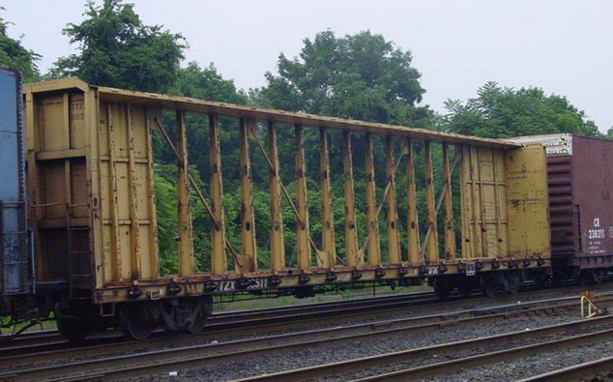
Car Hire Rule 4 Reclaims
If an empty car is moved with revenue billing, time and mileage payments can be reclaimed for the time and mileage associated with the cycle covered by the revenue billing
Notes:
Car Hire Rule 4 allows reclaim of time and mileage paid for an empty car that moves under revenue billing. Please note though, that the Industry is underway to automate this reclaim, will look for this to be completed by the end of this year-2013.

Slide 11
Car Hire Rule 22 Reclaims
Car Hire Rule 22 allows reclaim on cars that are in assigned service, empty and idle
Loading Point (222) reclaims are for cars that arrive at a customer location (loading point)
Reclaim is allowed from the arrival at the loading point until demurrage free time starts (usually placement) or until the car is released loaded
Notes:
Car Hire Rule 22 allows reclaim on assigned (customer, shipper, and carrier pools) cars while they are empty and idle. There are basically two kinds of Rule 22 reclaims. Reclaim is allowed for cars that are at the loading point and on cars that are held short of the loading point.
Reclaim is allowed on cars that are at the loading point from the date/hour of arrival until demurrage free time starts. Normally demurrage free time starts with the placement of the car. In some cases, no demurrage is supposed to be assessed. In these cases, the reclaim will end when the car is released loaded.

Slide 12
Car Hire Rule 22 Reclaims (cont'd)
Held Short (224) reclaims are for cars that cannot be moved to the loading point
When cars cannot be moved to the loading point, they can be held at a point short of the loading point
Reclaim is allowed from the arrival at the holding point until the departure from the holding point (In excess of 24 hours)
Notes:
When shipping facilities are not operating or are congested, normal operating practice may dictate against taking more cars into a loading facility. These cars can be held at a point other than the loading point. These cars are said to be “held short”.
Reclaim is allows on “held short” cars from the time of arrival at the holding point (In excess of 24 hours) until the car leaves the holding point. Car mark owner is responsible to validate using sighting messages and communicate with partner & user road that reclaim was taken appropriately via CHR 22.

Slide 13
Bilateral Reclaim Agreements
Subscribers to the Code of Car Hire Rules always have the option of negotiating bilateral arrangements
Many of these agreements involve reclaim arrangements
Bilateral reclaims are processed in the same way that reclaims defined in the car hire rules are processed
Notes:
Subscribers to the Car Hire Rules always have the option of negotiating bilateral arrangements that better accommodate the needs of the parties.
Frequently, bilateral agreements contain car hire relief or reclaim provisions. It is important that each of you become familiar with those terms and communicate with your partner or user roads to ensure no misapplication of these reclaims.
Bilateral reclaims can be processed through the CHDX process like all other reclaims.

Slide 14


Tidbits…..
https://www.railinc.com/rportal/web/guest/findus
http://acacso.org/
DOCUMENT & COMMUNICATE!!!!
Notes:
Who are the players
Where can you find there contact
Help with understanding CHR such as Reclaims
Open communication with those contact at the partner & user roads

Slide 15
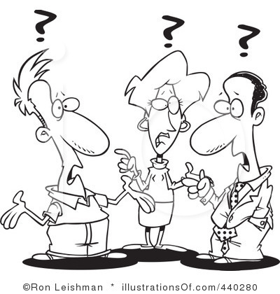
Notes:
Conclusion
Better understanding- What are reclaims/Why the exist/When are they valid/How to process.
Appreciation of impact to your respective Car Hire ledger when processing and/or validating reclaims
As with many other complex processes, communication is the key to processing reclaims without disputes and excessive counter reclaims.

