Slide 1
ACACSO
May 2018
Q1 2018

Slide 2
Customer First Foundation Principles
Customer First - Safety Always!
Value Our Customers
Earn their business every day by providing Safe, Accurate, and Timely Service
Create solutions that deliver value for our Customers and Watco over the long term
Value Our People
SAFE Service, ALWAYS
Be Honest and Fair
Safely Improve Every Day
Always do the right thing and always try to find a better way
Build a tremendous future by making decisions that protect our Customer, Team, Community, and Environment

Slide 3
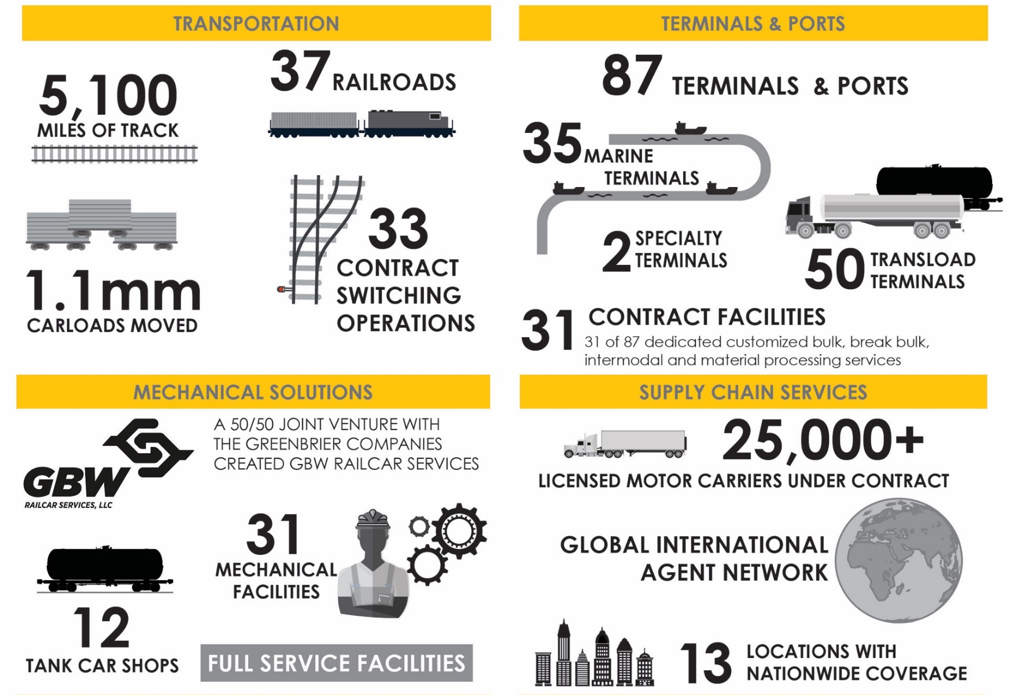
Watco’s Unique Service Offerings

Slide 4
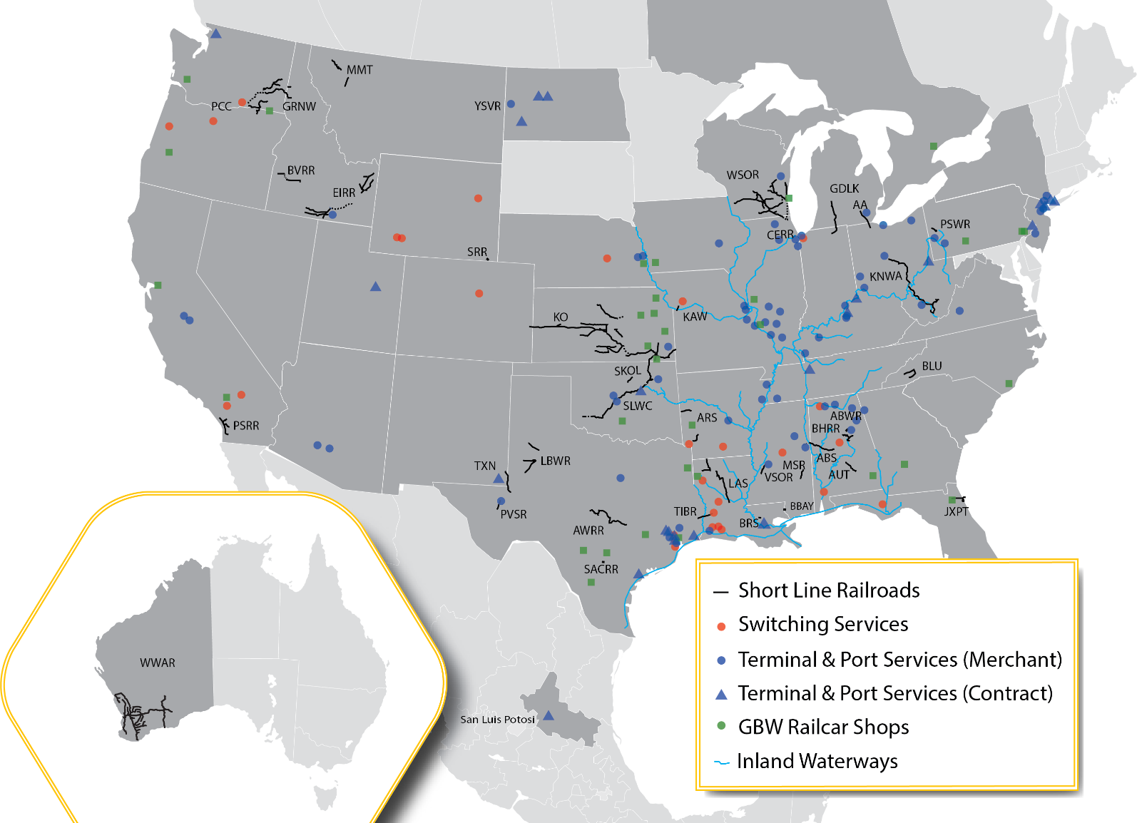
Watco System Map

Slide 5
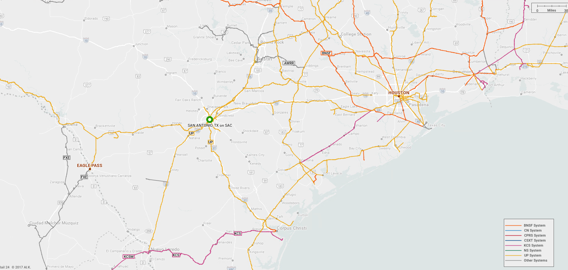
Positioned Well for Texas and Beyond
Notes:
Port San Antonio is an invaluable asset to the San Antonio community. It has been so for over 100 years since this site was first established as Kelly, and it is a dynamic place today providing opportunities to thousands of families throughout this region
Gateway from Mexico to the various US regions
Distribution point into Mexico
Businesses in the energy, manufacturing, transloading, warehousing, recycling, ground transportation and other sectors are thriving at the Railport going to these various regions

Slide 6
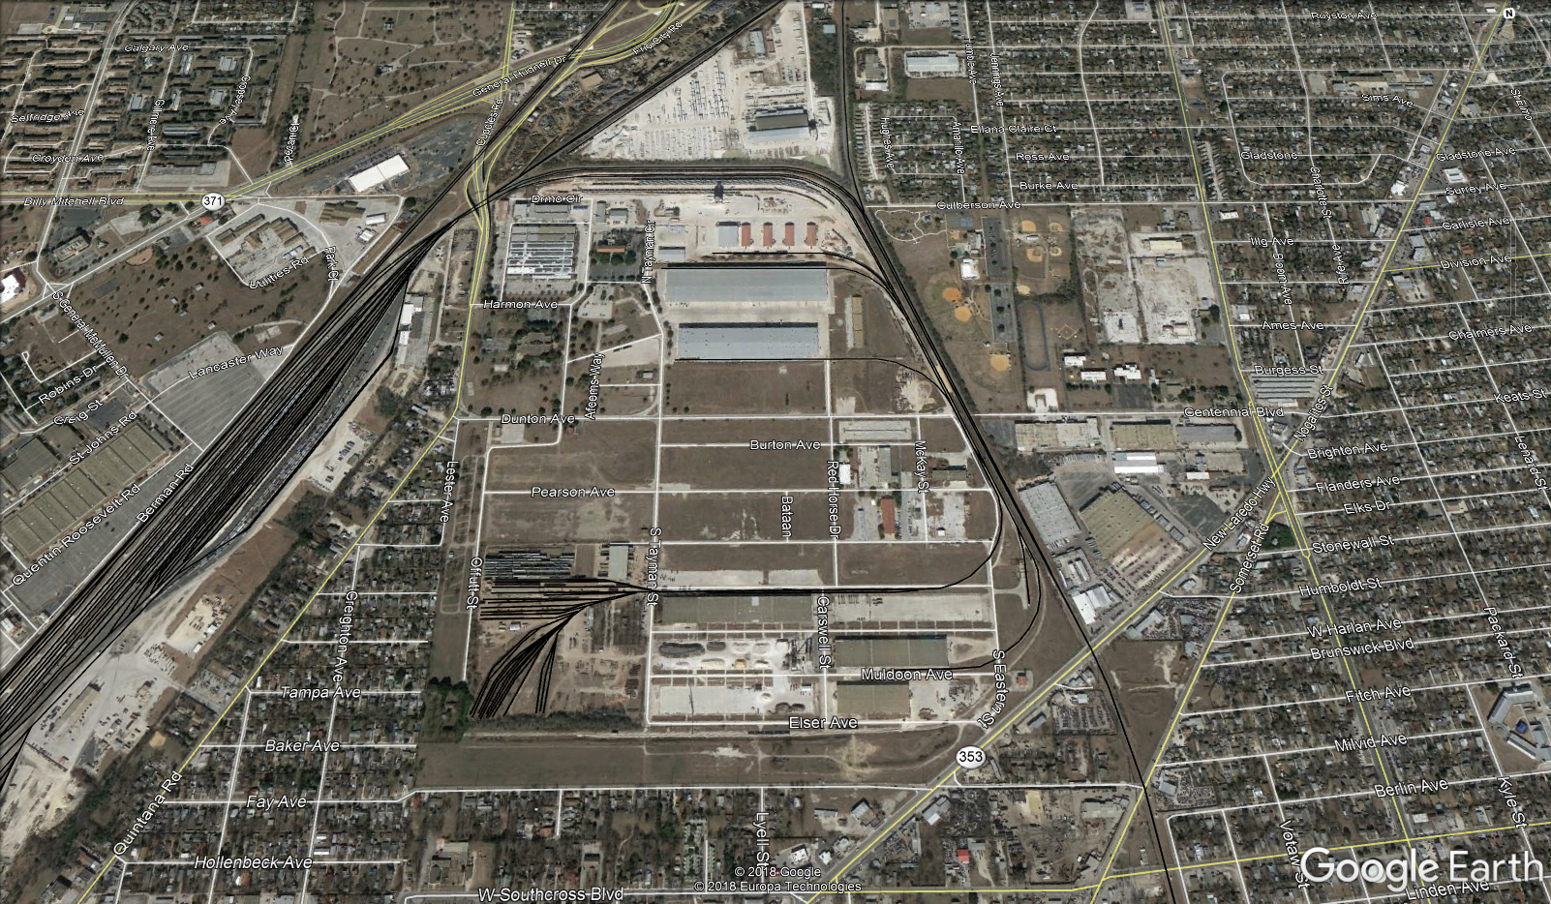
San Antonio Central Railroad
Notes:
350-acre property
There are 150 rail-served acres for the development of new built-to suit facilities
Transload, cross-dock, distribution/warehouse facilities, Manufacturing
Approximately 7 miles of rail
Efficient truck access to interstate highways 10, 35 and 37
Entire site is a designated foreign-trade zone (FTZ #80-10)
Access to the Port’s industrial airport on the region’s largest runway, Kelly Field (SKF)
In-house expertise in industrial build-to-suit / construction management
On-site U.S. Customs
Strongly committed to workforce development in partnership with Alamo Colleges and St. Philip’s College, whose manufacturing, aerospace and diesel mechanics training facilities are located at East Kelly Railport
Access to BNSF Railway /
Union Pacific lines

Slide 7
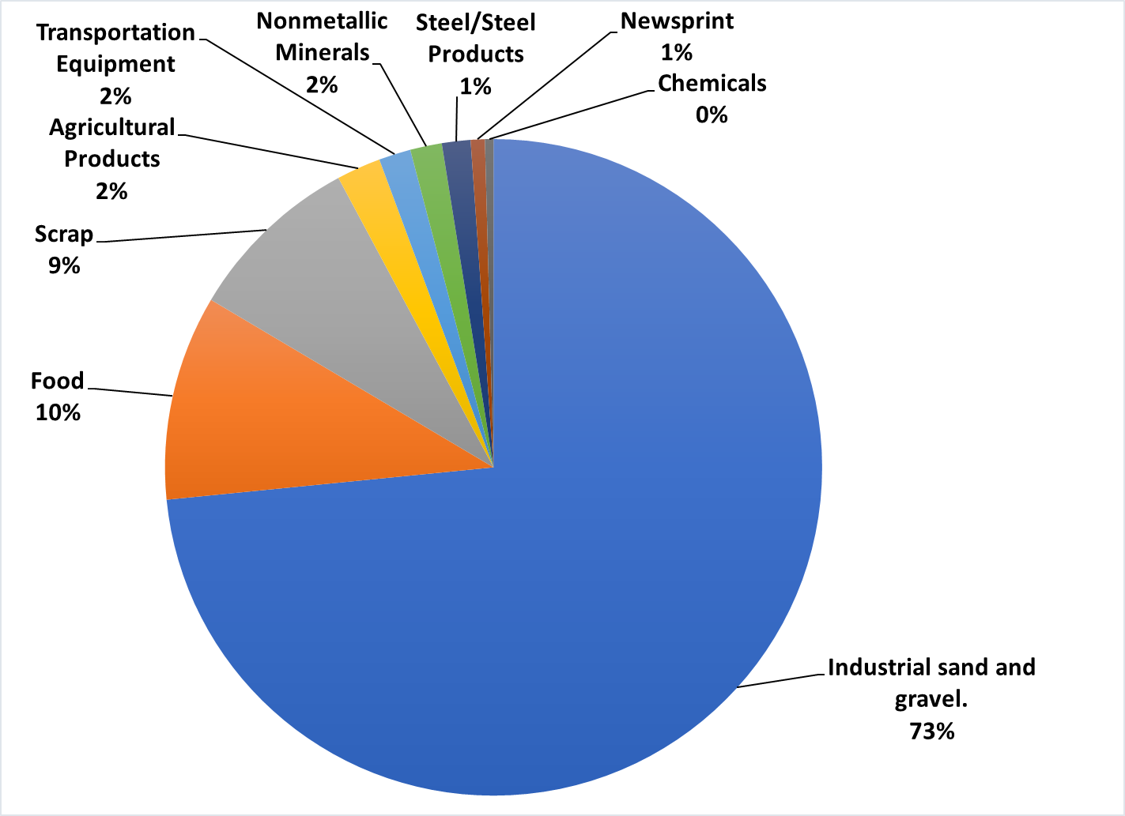
Industrial Park with Diverse Customer Base

Slide 8
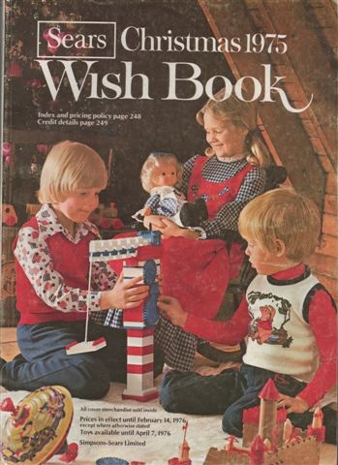
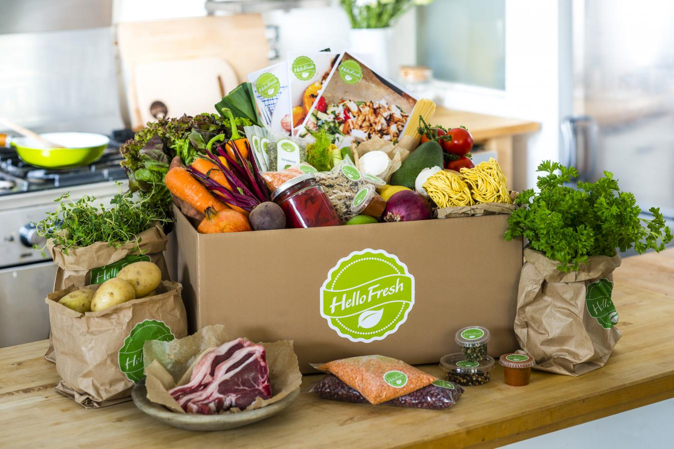
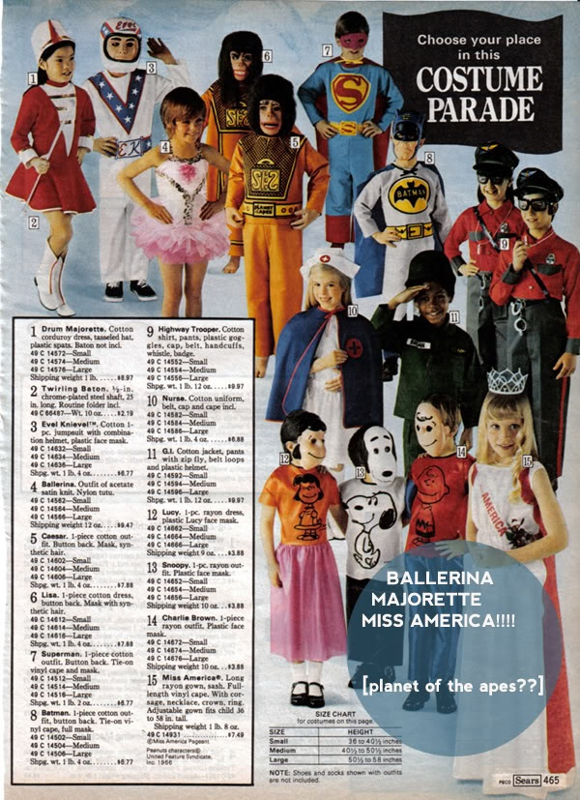
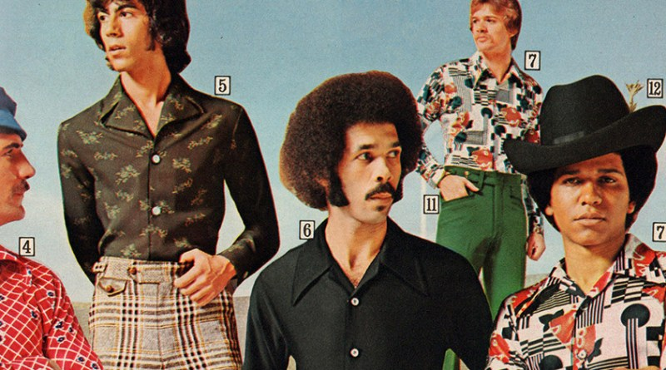

New Marketplace
Today
Shorter Timelines
Partial Information
Limited Resources
Results
Breakdown silos
Empowered employees
Quicker decisions
Demand for SOLUTIONS instead of Products
Notes:
Near-instantaneous/speed response.
future of your company is not in measured, considered responses and carefully planned initiatives.
Strip away silos
Empowered employees

Slide 9
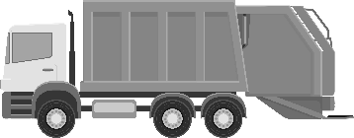

Single Solution- Leachate
Origin: Seneca Meadows, NY
Destination: Newark, NJ
Commodity: Leachate
Waste
Truck pick-up from Customer
Transload from Truck to Rail
Rail Transportation
Transload from Rail to Truck
Truck delivery to Customer
Single Source for Customer
Reduced Risk and no capital expended
Outsource to transportation experts
Freight Negotiations
Rail Equipment Lease
Tracing and Expediting
Truck Logistics
Complex solution, Simplified View
Notes:
Sample speed to mkt

Slide 10

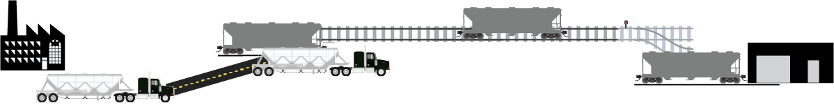
Single Solution- Fly ash
Origin: Nitro, WV
Destination: Various
Commodity: Fly ash
Beneficial Reuse Product
Truck pick-up from Customer
Transload from Truck to Rail
Rail Transportation
Rail Delivery to final customer
Customer expands Market Reach
Increases number of Cost-Competitive Suppliers
Reduced risk and no capital expended
Outsourced Supply Chain items where little or no internal expertise

Slide 11
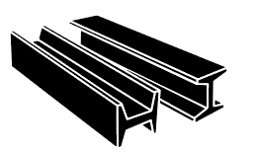

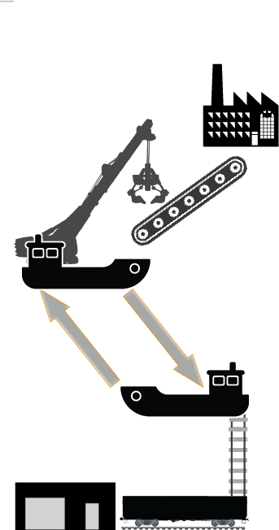

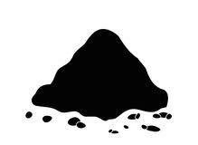
Single Solution- Scrap
Scrap
Origin: Mexico
Destination: US
Commodity: Scrap & Steel
Steel
Rail Mexico Supplier
Transload: Rail to Pad
On-demand Barge loading
Barge Transfer to Steel Mill Scrap Line
Scrap recipe delivery to Steel Mill
Reload Barges with Finished Steel Product
Barge to Storage
Transload to Rail for delivery to customers
Expanding Supply geography = Better Economics
Improves production with JIT delivery
Significant cost reduction with two-way loaded moves
Outsource operations for insured supply chain delivery
Single Invoice

Slide 12

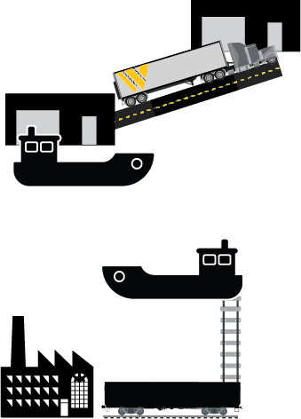
Single Solution- Paper
Origin: Paper Mill US South
Destination: Chicago, IL
Commodity: Brown Paper
Paper
Rail from Paper Mill to Port
Transload Rail to Barge
Barge to Chicago Terminal
Transload to Storage
Load and truck on-demand final customer delivery
Major reduction in cost for product delivery
Forward placement of product for JIT delivery to customer
Redesign of supply chain with single bill

