Slide 2
TTX Fleet Overview
ACACSO Annual Meeting
Jeff Haurykiewicz, Manager – Automotive
San Antonio, TX
May 10, 2018

Slide 3
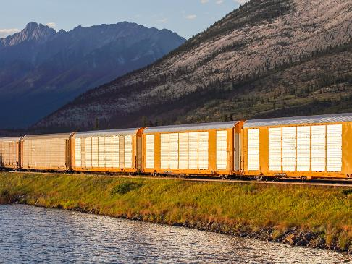
Agenda
TTX Company Overview
Industry & Economic Outlook
North American Rail Fleet
Closer Look at Select Markets
Intermodal: An Evolving Market
Customer Choices
Questions

Slide 4





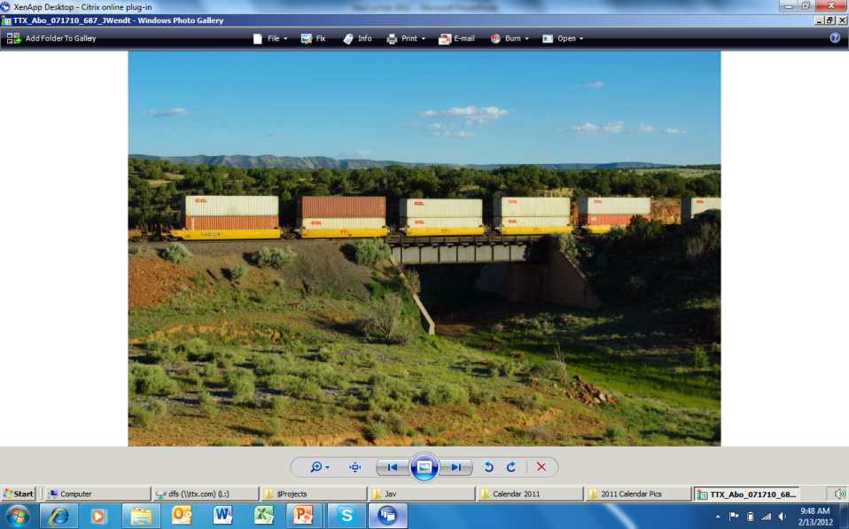
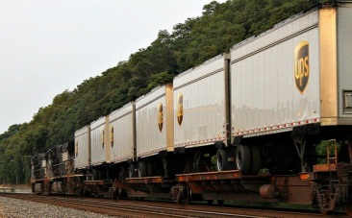
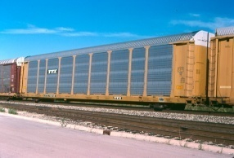
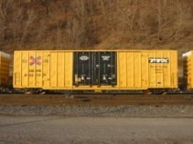
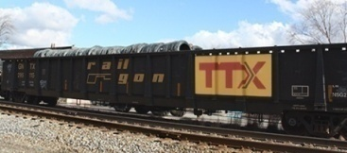

TTX Company Overview
TTX functions as the industry’s railcar cooperative, operating under pooling authority granted by the Surface Transportation Board
$1.2 billion company, serving and owned by the Class I Railroads
The Company owns and maintains a pool of over 200,000 railcars:
Owners enjoy financial and operational benefits of the pool, in line with their strategic business needs:
Rail customers benefit from a well-maintained fleet of free-running cars
http://www.ttx.com/AboutTTX/pooling-benefits.aspx
Intermodal
Automotive
General Merchandise
Empty mile minimization
Capital outlay reduction
Risk mitigation

Slide 5
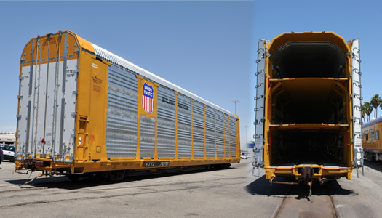
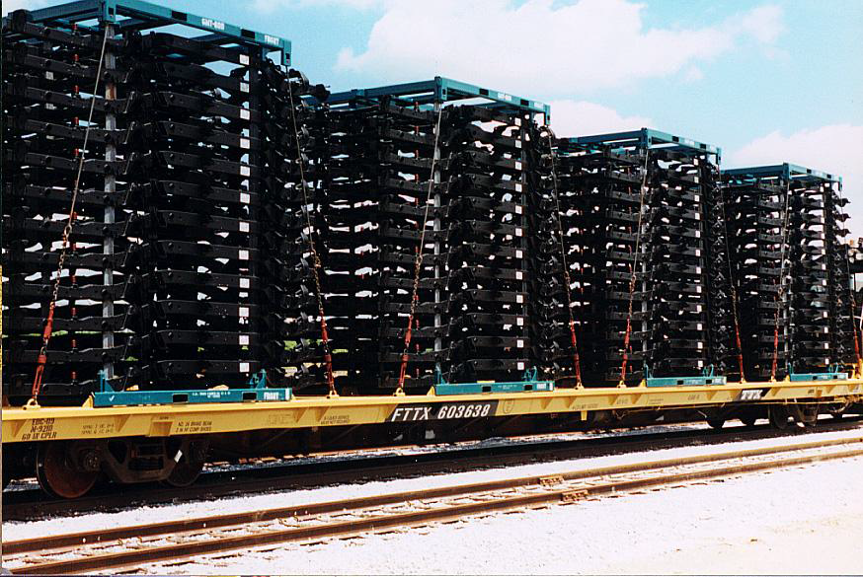
TTX Company Overview – Automotive
Automotive Flatcars
Frame Flatcars
Tri / Bi / Uni-level Commodities:
Passenger Cars, Light Trucks, and SUVs
Uni-levels: extra height vans, first responder vehicles, high profile vehicles
Marks:
BTTX, CTTX, ETTX, TOCX, TTGX, TTUX
Frame Flat Commodities:
Auto and Light Truck Frames
Marks:
FTTX

Slide 6
Industry & Economic Outlook
U.S. GDP 2018 forecasts stronger after tax reform late last year
Latest GDP forecast the first to top 3.0% since 2005
Sources: Bureau of Economic Analysis, Moody’s Analytics – Consensus Scenario
Notes:
GDP initial measurement for 2017 was 2.1%; revised up to 2.3%. GDP forecast for 2018 initially 2.4% at the beginning of 2018; revised up to 3.1%.

Slide 7
Industry & Economic Outlook
Fuel prices expected to remain flat through the forecast period
Sources: U.S. Energy Information Administration, Moody’s Analytics – Consensus Scenario

Slide 8
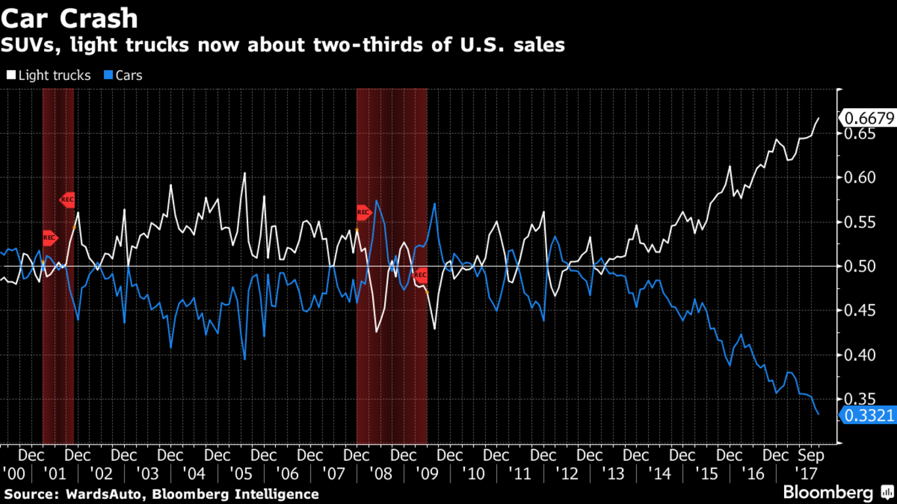
Industry & Economic Outlook
Strong consumer demand continues for SUVs, light trucks
Passenger car market in significant decline

Slide 9
Industry & Economic Outlook
N.A. vehicle sales expected to flatten
Sources: Monthly Autocast, Wards, TTX

Slide 10
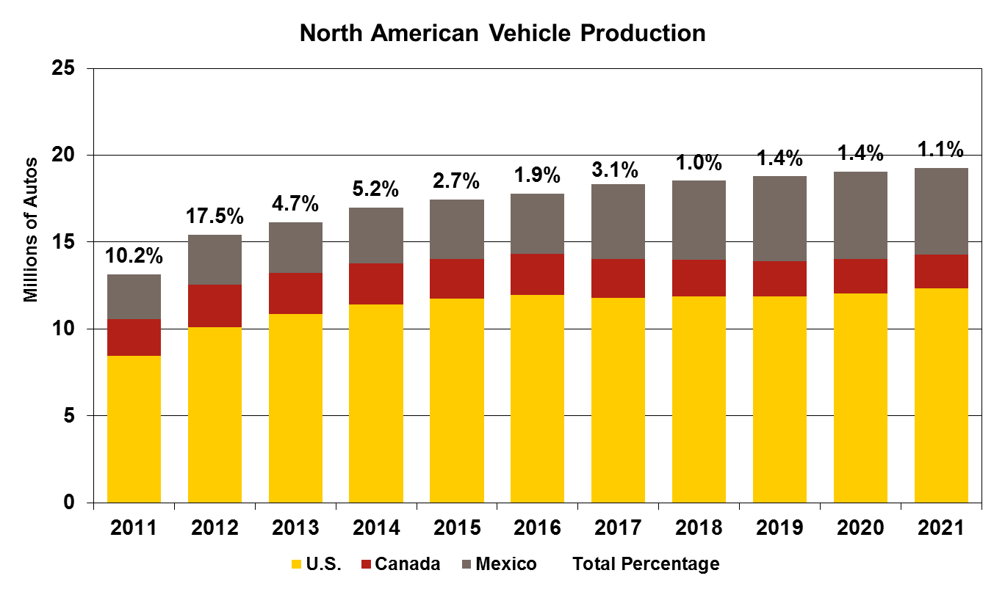
Industry & Economic Outlook
Mexico continues to take an increasing share of N.A. vehicle production
Sources: Monthly Autocast, Wards, TTX

Slide 11
Industry & Economic Outlook
Housing starts will grow slowly over the next few years
Home prices have continued to rise in recent months, but tax policy may push them lower
2018 Total Housing Start Forecasts
RISI: 1,360,000 WSJ: 1,320,000
TTX: 1,306,000 IHS: 1,346,000
Sources: Bureau of Census, Moody’s Analytics – Consensus Scenario
Notes:
Housing starts fell 7% month-over-month in February – all decline in the multi-family segment.
Single-family housing starts up moderately compared from previous month and year-over-year.
S&P CoreLogic Case-Shiller Home Price Index has been steadily rising at about 6% since September 2017, but Moody’s believes the tax reform policy may push housing prices lower in the coming months. Because the tax benefit for mortgage interest and property taxes has been reduced, home ownership will become more expensive, so prices should drop.

Slide 12
Industry & Economic Outlook
E-commerce sales growth has consistently outpaced traditional retail
Leads to higher inventory-to-sales ratios, production, and imports
Sources: U.S. Census Bureau

Slide 13
North American Rail Fleet – Macro-level View

Slide 14
U.S. Railcar Fleet Composition
By Number of Railcars in Service | 1980-2017
Source: Progressive Railroading (based on AAR data)

Slide 15
U.S. Railcar Fleet Composition
By Percentage of Total Railcars | 1980-2017
Source: Progressive Railroading (based on AAR data)

Slide 16
Railroad vs. Private Ownership
By New Railcar Installations | 2000-2016
Source: Progressive Railroading (based on AAR data)

Slide 17
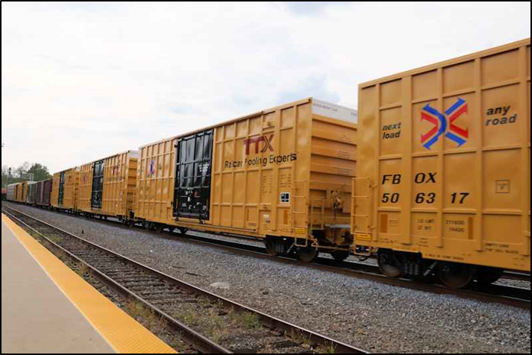
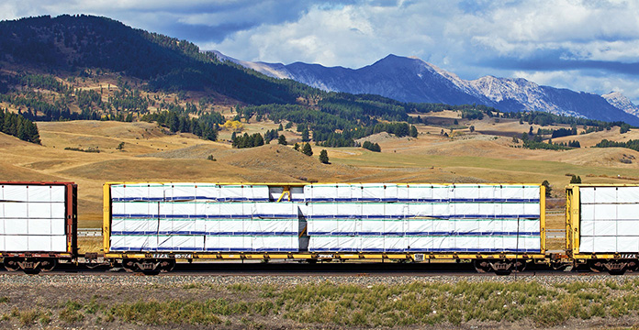
A Closer Look at Select Markets

Slide 18
Current Centerbeam Market
Usage expected to trend upwards with single-family housing starts
Source: TTX
Notes:
Updated 08/14/17 (SEPT BOARD in SAS)

Slide 19
Current Centerbeam Market
Centerbeam fleet utilization steadily rising with housing market recovery
First order for new centerbeam cars since 2006
Source: AAR

Slide 20
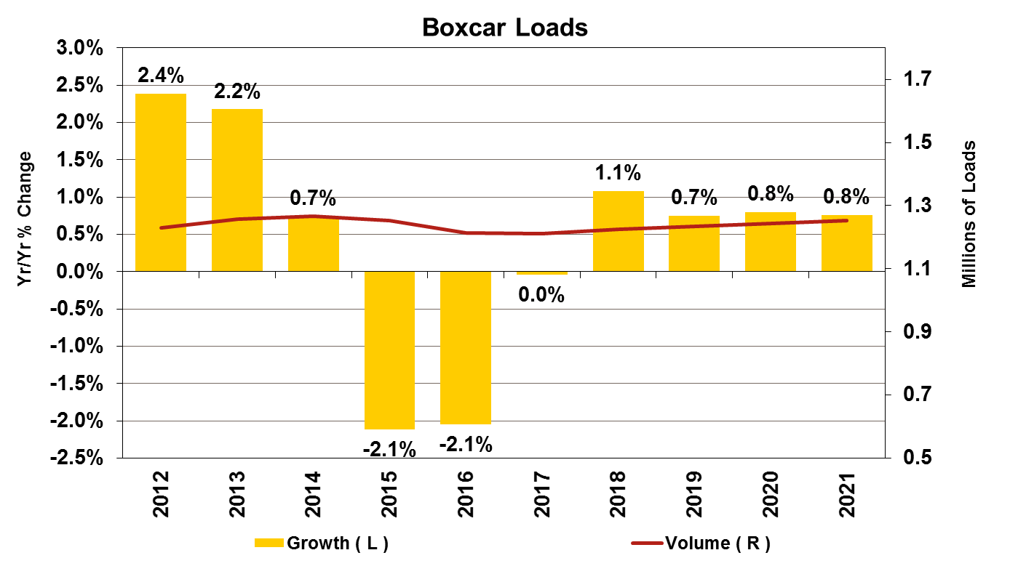
Current Boxcar Market
Primary Markets:
Pulp & Paper 51.7%
Food Products 17.7%
Lumber / Wood Products 16.2%
North American Fleet:
110,903 railcars (7% of total fleet)
A gradual single-family housing start growth rate should push boxcar loads up at an even pace
National boxcar pool has improved productivity of the car type
Car of the Future
60’ Plate F, 110-ton boxcar with 16’ door opening (double 8’ plug doors)
Source: Progressive Railroading (based on AAR data)

Slide 21
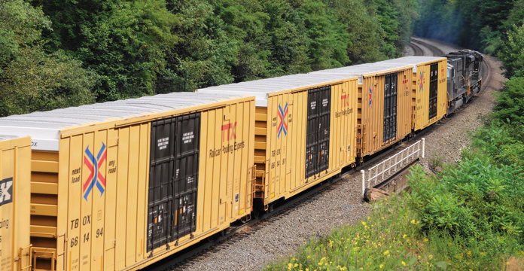
Current Boxcar Market
Source: TTX, FTR, Association of American Railroads - Licensed Material
Notes:
Commodities are paper but also food and building products
Newsprint/printing paper are down but packing paper growing with the economy
Housing is growing as are shipments of OSB and plywood
Boxcar production is occurring and will through 2018/2019 (FTR)
New cars are mostly 60-ft Plate-F 100-tons but 50-ft cars being built too
Great velocity is creating more capacity
Fallouts are 1500-2000/yr
Availability is good for this fleet too

Slide 22
Intermodal – An Evolving Market

Slide 23
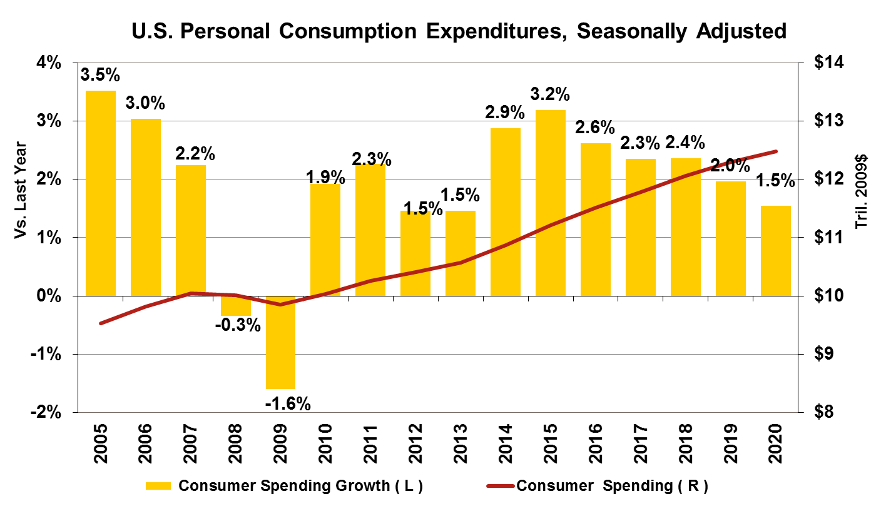
Intermodal: An Evolving Market
Overall increase in 2017 Q1-Q3, a rebound from Q3 and Q 4 2016
Consumer spending growth should continue
Domestic intermodal has transload advantage
Source: Intermodal Association of North America, Cass Information Systems

Slide 24
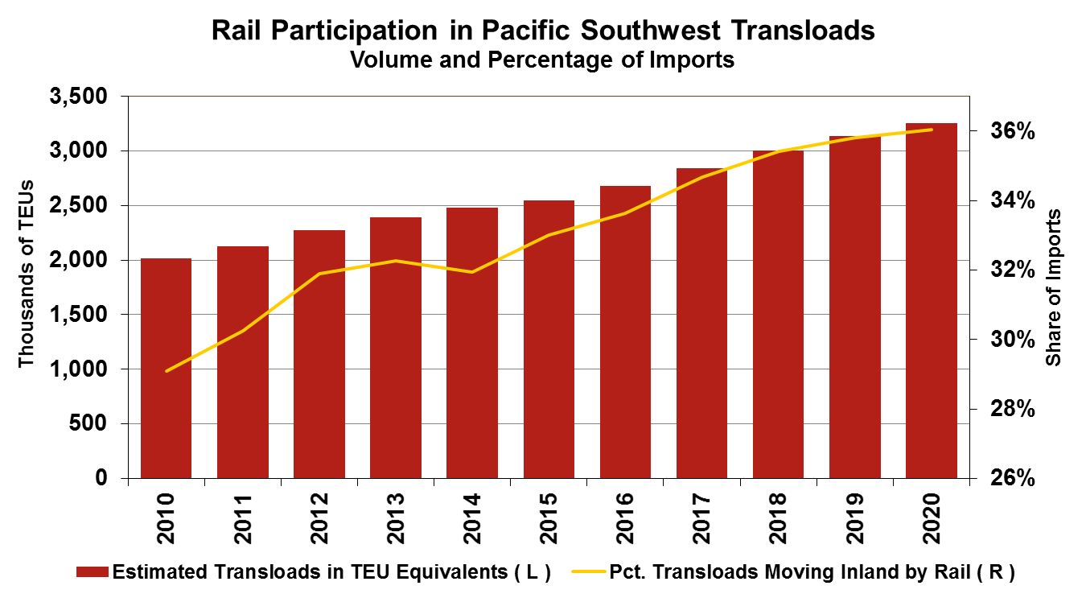
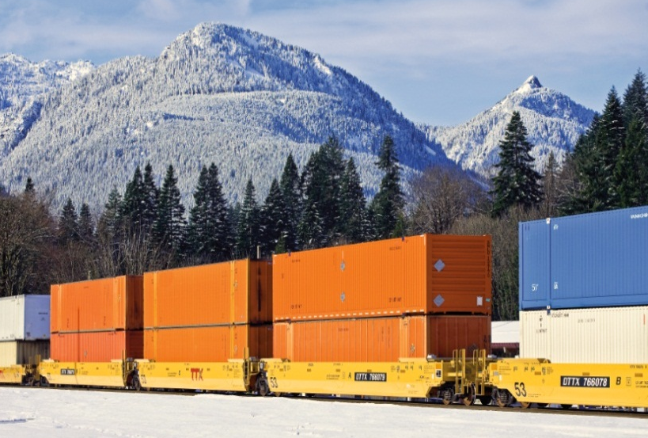
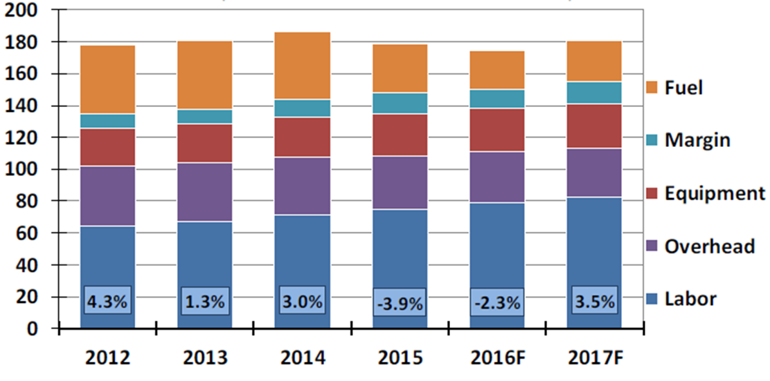
Intermodal: An Evolving Market
Truckload Costs
Source: FTR, TTX
($/Loaded Mile, OTR; Index: 2003=100)
Notes:
Traffic is domestic containers in double-stack railcars
Shippers are enjoying about a 5% trucking industry over-capacity
Created by HOS roll-back in 2014 and slow freight economy
Also pushed lower on lower FSC that makes trucking cheaper than prior-year
Putting pressure on domestic intermodal growth
Domestic intermodal is growing, but at a slower pace vs. prior 8-10% growth
Long-term, trucking costs are rising + fuel prices are stabilizing/rising
Electronic Logs in Dec. 2017 and could begin impacting by mid-year >>>5% loss min.
Driver shortages are anticipated
Also, faster cycles times are creating capacity in this segment too

Slide 25






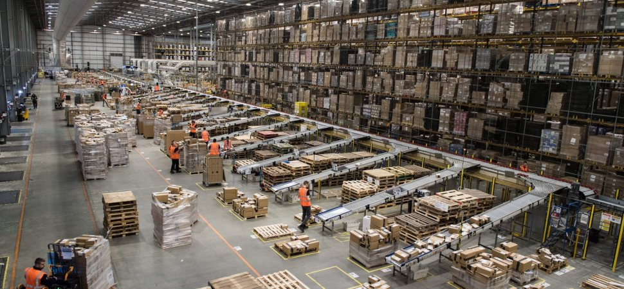

Customer Choices

Slide 26
Customer Choices
Favorable for Customers
Favorable for Car Owners
NA Fleet is still oversized for many car types
Manufacturing / Production indices remain strong
Competitive Grain Export Market
Intermodal Growth
Plastics and Sand Markets expected to maintain strength
Metals & Steel experienced growth in ’17
The “Amazon Effect”
Potential Infrastructure Bill

Slide 27

Questions ?
Thank you!

