Slide 1
ACACSO May 9, 2018
An equipment manager’s perspective
Notes:
Good morning, and thank you ______ for the introduction.
I also want to thank you for the opportunity to share my thoughts with you. I’ve wanted to attend an ACACSO meeting since I got this job in early 2010.

Slide 2
But first
a bit about NS’ organization

Slide 3
The NS Car Management Team is in Operations
Terminal Operations
  Intermodal train movement
  Automotive train and car movement
Unit Train Operations
  Agricultural, Stone, Coal and Fuel movement
Equipment Planning
  Fleet sizing – Auto, Coal, Industrial Products and Intermodal
  Intermodal car and chassis distribution
  Industrial Products – car distribution
Notes:
Our team is within the Customer Service Department of Operations along with the Mech/Transportation department and the Engineering department.
This arrangement is the result of a September 2017 re-organization in which the Intermodal Operations group moved from Norfolk to Atlanta.

Slide 4
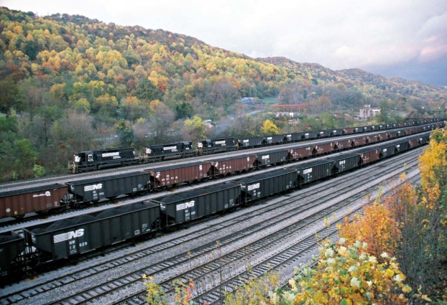
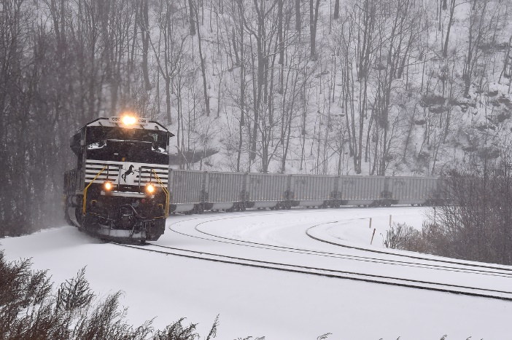

Coal keeps surprising
21,200 Coal cars

Slide 5

The Auto fleet is steady
10,000 Multilevels
1,800 Boxcars

Slide 6

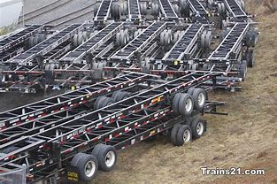
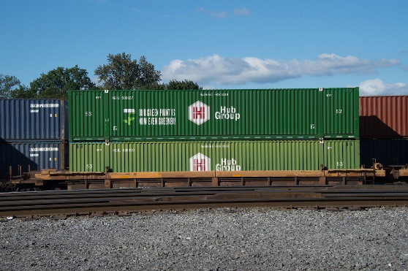
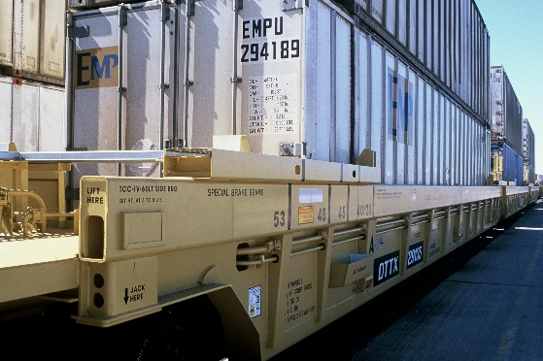
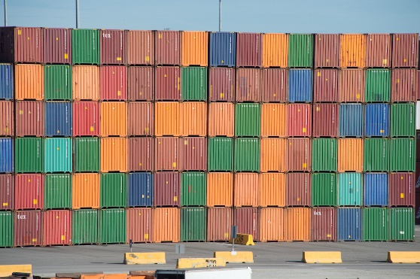
The Intermodal fleets are growing
33,000 Domestic 53’ chassis
17,000 Domestic containers
37,000 Platforms
Notes:
The steady growth of the intermodal business is supported by steady growth in our fleets.
This year we are purchasing 5,155 chassis for the NS fleet. We are also slated to receive nearly 3,000 additional 53’platforms of additional capacity through TTX.
33,000 Domestic 53’ chassis
17,000 Domestic containers
12,000 40’ Platforms (primarily international)
20,000 53’ Platforms (primarily domestic)
5,000 Conventional platforms (primarily TOFC)

Slide 7
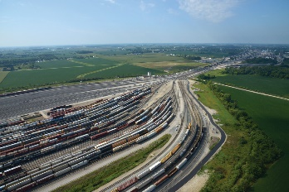
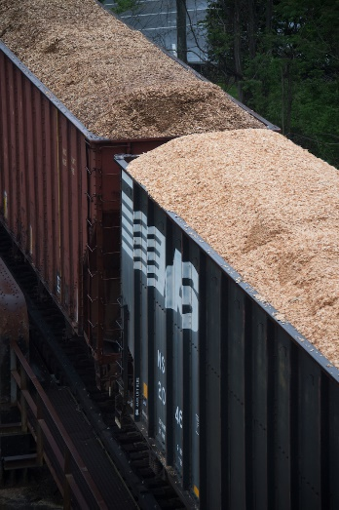
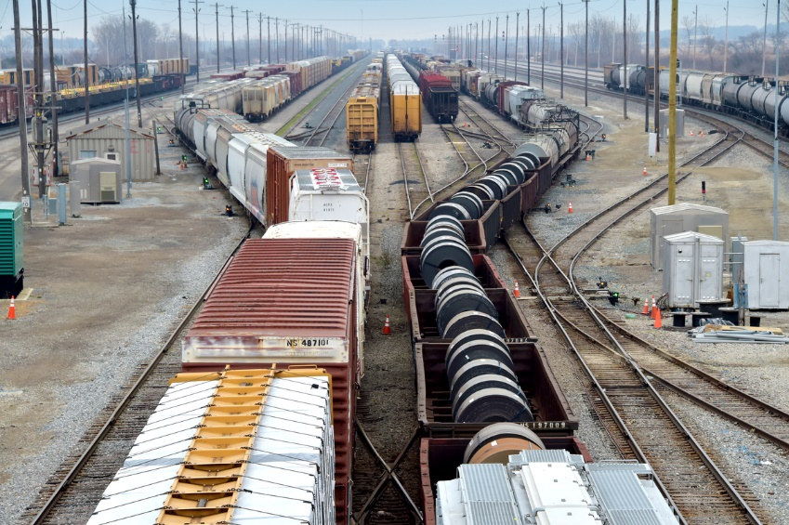
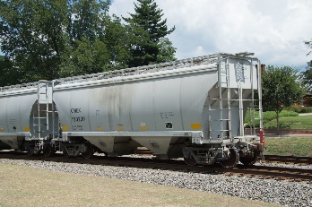
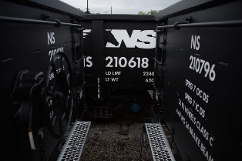
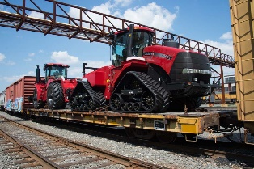
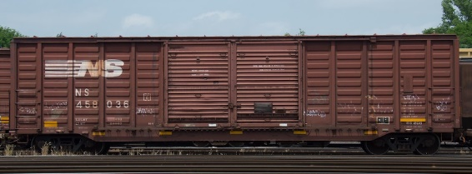
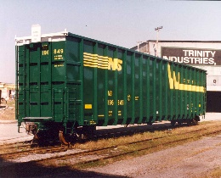
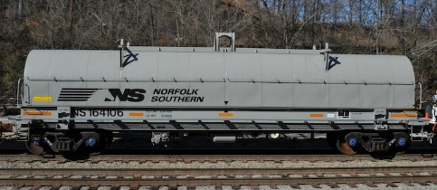
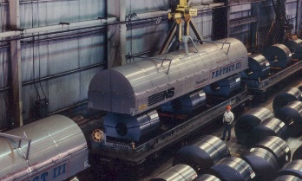
The Industrial Products fleets are evolving…
40,500 Cars
62 Different types
13 Strategic types

Slide 8
AND NOW
what we have been working on

Slide 9
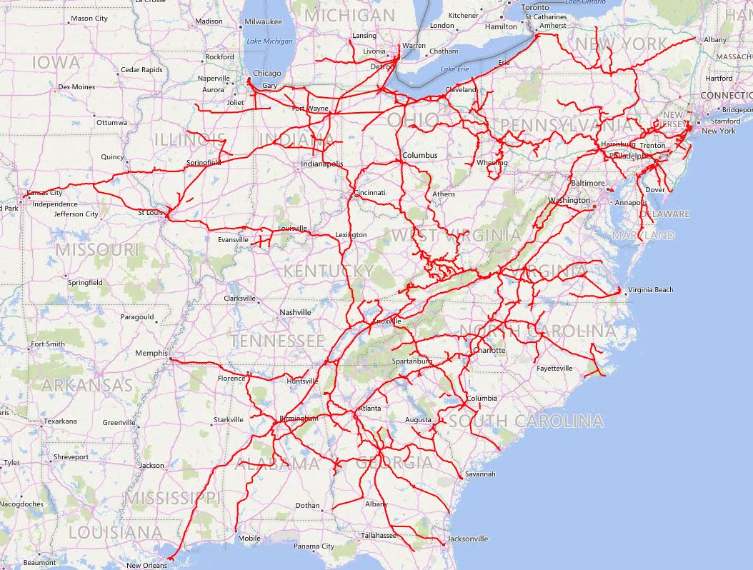

The way it used to be
Notes:
Then our Specialists adjust the flows at a yard level to meter cars from origin to destination by opening or closing valves to direct car flows. [now obviously they’re not real valves, but that’s the best analogy I can think of]. Currently we don’t so much distribute cars as manage flows of cars.

Slide 10
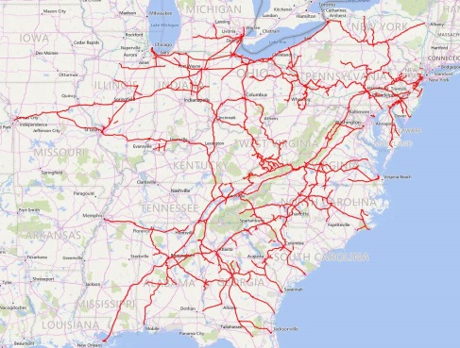
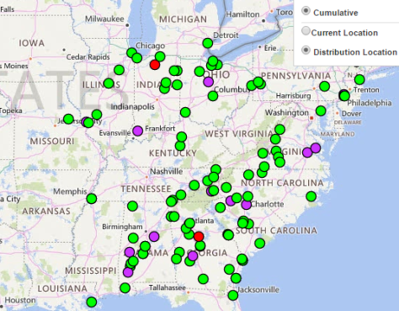


When will the car become empty?
Where will a car become empty?
How fast will the car get there?
How are customers prioritized?
Can the customer use a substitute car?
How many cars are already there?
Notes:
This is kinda what we ask our front line folks to do – take all of this in mind – and turn the valve handles to get cars to customers.

Slide 11


When will the car become empty?
Where will a car become empty?
How fast will the car get there?
How are customers prioritized?
Can the customer use a substitute car?
How many cars are already there?
Notes:
This is kinda what we ask our front line folks to do – take all of this in mind – and turn the valve handles to get cars to customers.

Slide 12

Boxcar Requests
124 Demand Points
2,421 Cars Requested
Notes:
Obviously we’ll still start with the customer demand. In this particular example there were 124 Customers who requested a total of 2,421 cars for next week.

Slide 13
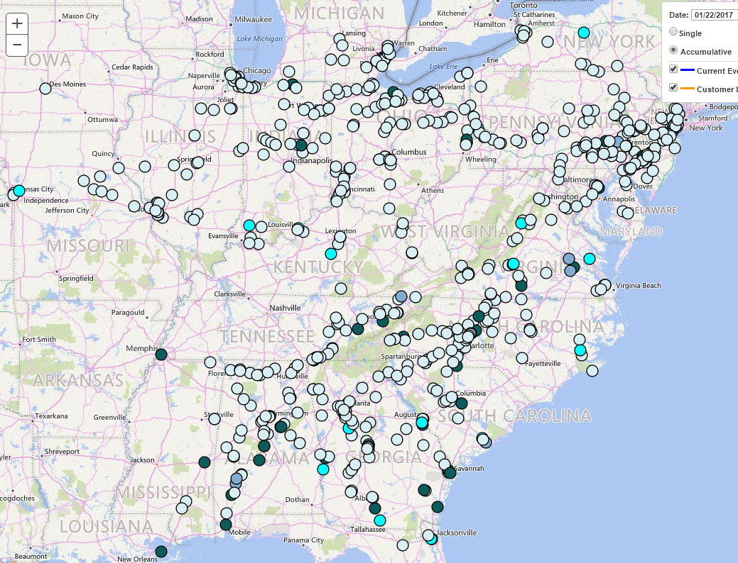
Boxcar Requests
124 Demand Points
2,421 Cars Requested
622 Possible supply points
Notes:
Obviously we’ll still start with the customer demand. In this particular example there were 124 Customers who requested a total of 2,421 cars for next week.

Slide 14
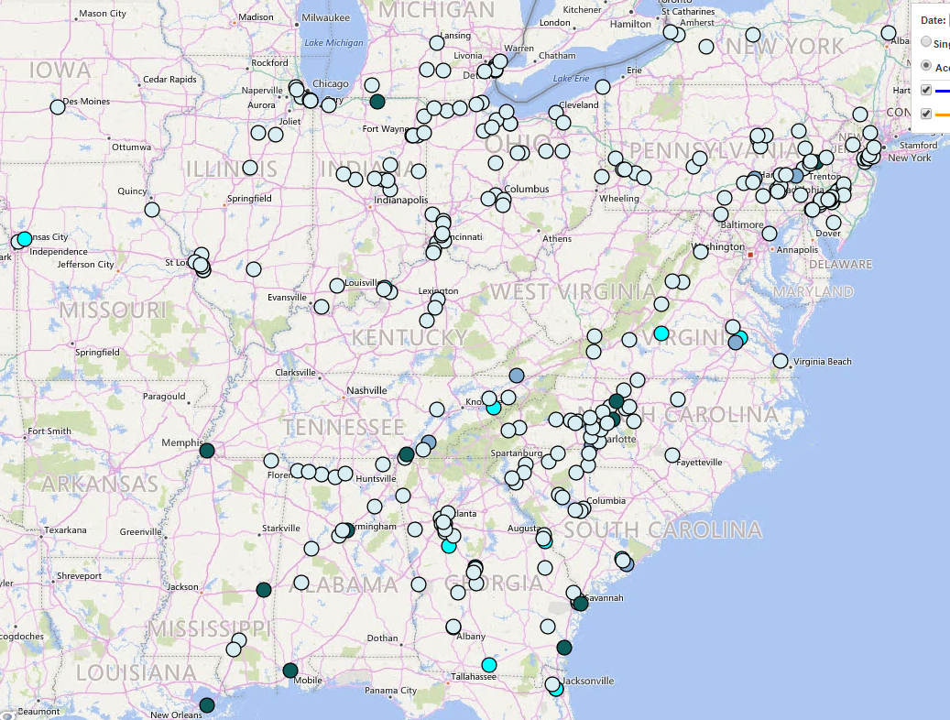
Boxcar Requests
124 Demand Points
2,421 Cars Requested
622 Possible supply points
276 Available Supply Points
1,642 Still Required
Notes:
Obviously we’ll still start with the customer demand. In this particular example there were 124 Customers who requested a total of 2,421 cars for next week.

Slide 15
Boxcar Math
124 Demand Points
276 Available Supply Points
1,642 Still Required
When will each car be available?
When could each car reach each appropriate destination?
What is the cost of getting a particular car to a specific destination?
What is the benefit?
What is the customer’s priority?
Notes:
We’re going to use some basic statistics to project when a load will become empty and available again for distribution. Not only that we’ll do so knowing what the local operating plan and service days are.
Then since this is the age of computers, we’ll be able to project how long it would take each car to reach each destination. And after considering the costs and benefits of getting each car to each destination we’ll be able to include a customer’s priority as we select which cars to send where.

Slide 16
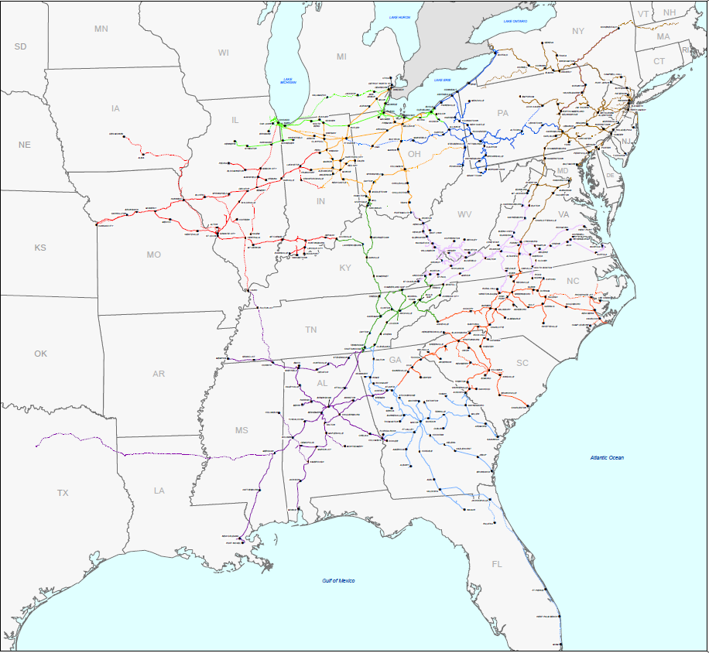
It starts with an RLOD
When Shipper releases a load to Receiver TEAMS projects when the car will be unloaded and available for distribution.
D
1
A
B
A
C
2
E
1

Slide 17
Each car to each Request
Given that projected availability date, it then considers that single car for each Request.
  Can it make it in time?
  What’s the value of filling that Request?
D
A
B
C
2
M | T | W | T | F | S | S
N | N | N | N | N | Y | Y
E
1
M | T | W | T | F | S | S
N | N | Y | Y | Y | Y | Y

Slide 18
Each car to each Request
Each car then has a whole list of possibilities and values:
D
A
B
Car | To Request | Value
NS123 | 1W | 300
NS123 | 1T | 300
NS123 | 1F | 300
NS123 | 1Sa | 300
NS123 | 1S | 800
NS123 | 2Sa | 1,400
NS123 | 2S | 1,300
C
2
M | T | W | T | F | S | S
N | N | N | N | N | Y | Y
E
1
M | T | W | T | F | S | S
N | N | Y | Y | Y | Y | Y

Slide 19
All Requests & all Feasible cars are considered in the optimization
Car | To Request | Value
NS123 | 1W | 300
NS123 | 1T | 300
NS123 | 1F | 300
NS123 | 1Sa | 300
NS123 | 1S | 800
NS123 | 2Sa | 1,400
NS123 | 2S | 1,300
Car | To Request | Value
NS234 | 1Sa | 300
NS234 | 1S | 1,000
NS234 | 2Sa | 1,100
NS234 | 2S | 500
Car | To Request | Value
NS345 | 2Sa | 1,000
NS345 | 2S | 300

Slide 20
All Requests & all Feasible cars are considered in the optimization
Car | To Request | Value
NS123 | 1W | 300
NS123 | 1T | 300
NS123 | 1F | 300
NS123 | 1Sa | 300
NS123 | 1S | 800
NS123 | 2Sa | 1,400
NS123 | 2S | 1,300
Car | To Request | Value
NS234 | 1Sa | 300
NS234 | 1S | 1,000
NS234 | 2Sa | 1,100
NS234 | 2S | 500
Car | To Request | Value
NS345 | 2Sa | 1,000
NS345 | 2S | 300
Car | To Request | Value
NS123 | 2S | 1,000
NS234 | 1S | 1,000
NS345 | 2Sa | 1,000

Slide 21

The Math of the 1,642 Remaining Boxcars
124 Demand Points
276 Available Supply Points
Notes:
In all for this week there were nearly 170,000 ways to get cars to customers. And speaking from experience there are at least twice as many ways to fail to do it well.
So what does this look like?

Slide 22
The Math of the 1,642 Remaining Boxcars
169,497
Notes:
In all for this week there were nearly 170,000 ways to get cars to customers. And speaking from experience there are at least twice as many ways to fail to do it well.
So what does this look like?

Slide 23

TEAMS launched June 2017
8 consecutive weeks of fleet introductions
Much input data cleaning performed
Currently:
  Cleaning up known problems
  Testing predictive abilities

Slide 24
TEAMS has driven significant improvement

Slide 25
TEAMS has driven significant improvement

Slide 26
TEAMS has driven significant improvement

Slide 27
What’s next?
Thank you for your Request for 50 cars for the week of May 7th, 2018.
  Accepts
  Declines
  Modifies

Slide 28
