Slide 1
RAMP-ED Basics & Benefits
Created for May 10, 2019

Slide 2
Today’s Agenda
What is RAMP-ED?
Roles/Permissions and how to get access to RAMP-ED
Training Materials available for RAMP-ED
Questions

Slide 3
What is RAMP-ED?

Slide 4
Overview
RAMP-ED stands for Rail Asset Management Process for Exception Disposition.
This allows for the efficient movement of Railroad and Private equipment to places like: Contract Shops, Storage Locations, a new Lease, new assignments or to the home Railroad.
The system enables railroads, equipment owners and leasing companies to use a uniform industry process to submit billing instructions when moving railroad and private freight cars to shop, new lease, next lease or new points of assignment.
Equipment moving under RAMP-ED instructions are exceptions.
Exception equipment must be:
Empty
and
Fall outside of AAR Car Service Rules or
Private equipment returning empty per tariff authority
Notes:
For Example, if an owner/lessee has instructions for an equipment and the instruction is broken into 3 parts, i.e. 3 different rr’s, and then, all rr's need to log in and accept the instructions. All 3 rr’s need to be participants in RAMP-ED for the full instruction to process as expected/designed.

Slide 5
Key Features of RAMP-ED
Create Disposition(PII) Instructions/Patterns
All disposition instructions are assigned a unique Pending Instruction Identifier (PII) . This PII and the details of the movement are transmitted as messages to the associated parties.
Create Sequences - Capture at Destination or Overflow
RAMP-ED provides the ability to sequence disposition instructions by allowing users to specify a group of equipment to move in a sequential manner across multiple instructions. The manner in which equipment is moved to the next instruction is determined by the type of association it has with the instruction – either “Captured at Destination (CAD)" or “Overflow (OF)”.
Manage Patterns
RAMP-ED allows you to create and save patterns to use as templates when creating new instructions. Any instruction may be saved as a pattern, new patterns can also be created from scratch by using the Patterns tab.
View Existing PII Instructions
All instruction information can be viewed by participants in that instruction – all roads in the route and the creator of the instruction.

Slide 6
Key Features of RAMP-ED
Edit Existing PII Instructions
Depending on your role in the instruction and its status, existing instructions can be edited and resubmitted.
Early Expire PII Instructions
RAMP-ED allows for the early expire of an existing PII.
Associate Equipment
Allows a RAMP-ED user to add equipment to an existing PII.
Automatic Authorization of PIIs
Allows RAMP-ED users to approve or deny PIIs.
Delete PIIs
Delete existing PIIs prior to the effective date. All equipment will be available for new PIIs.
Indicate Equipment has Reached Destination
Manually specify the date PIIs have been completed. The allows owners the ability to show equipment has arrived at final destination.
Query PIIs
Allows for the search of PIIs. Data is available for 18 months.

Slide 7
Roles/Permissions and how to get access to RAMP-ED

Slide 8
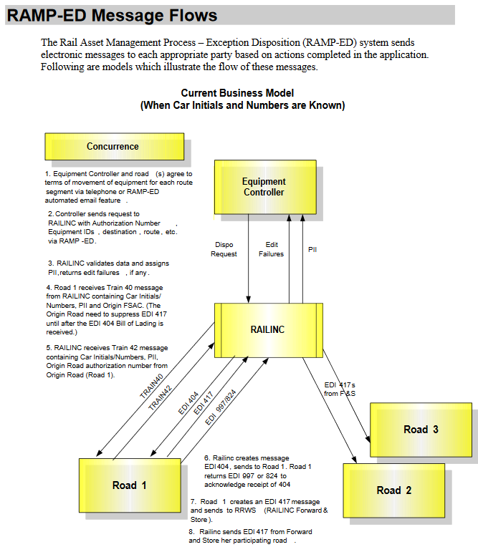
RAMP-ED Roles
There are two main roles in RAMP-ED:
Accessing the system as a Railroad
Approve or Reject PIIs
Process TRAIN40,41,42 messages
Process EDI 404 BOLs
Create EDI 417 Waybills
Accessing the system as an Equipment Owner
Create PIIs
Manage PIIs
Notes:
For Example, if an owner/lessee has instructions for an equipment and the instruction is broken into 3 parts, i.e. 3 different rr’s, and then, all rr's need to log in and accept the instructions. All 3 rr’s need to be participants in RAMP-ED for the full instruction to process as expected/designed.

Slide 9
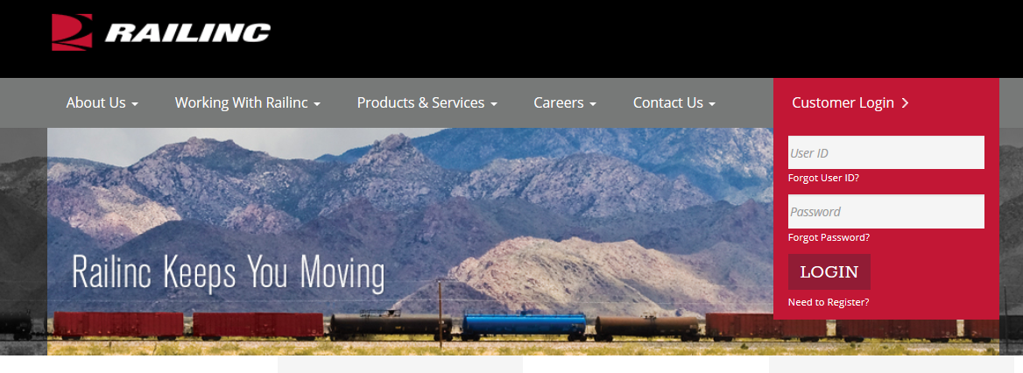
RAMP-ED Access
Each RAMP-ED user must register to use Railinc Single Sign On, which can be accessed from the Railinc homepage at http://www.railinc.com.

Slide 10
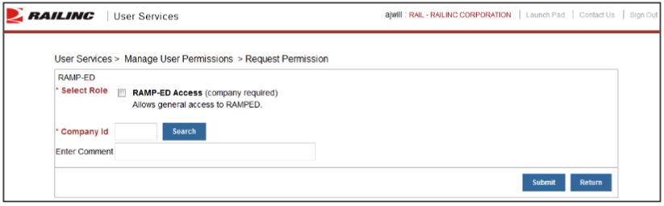
RAMP-ED Access
Once User ID registration is complete, users must request general access to RAMP-ED via the link titled View/Request Permissions in your User Services portlet.
Access to certain functions within RAMP-ED is handled by the user’s company administrator, that individual has the rights to specify user tasks.

Slide 11
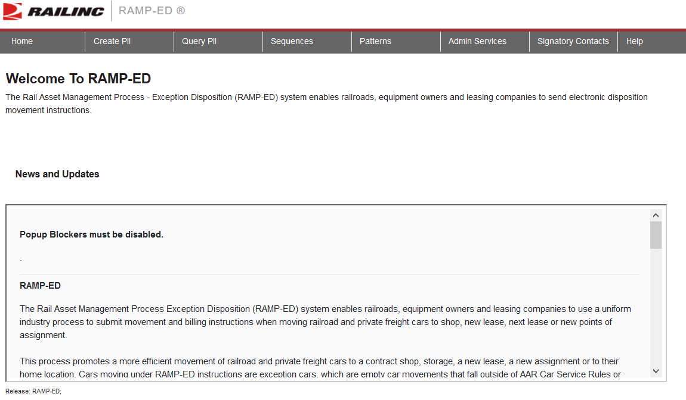
RAMP-ED Access
When e-mail notification of access to RAMP-ED is received, the user can log on and begin using the application.

Slide 12
Training Materials available for RAMP-ED

Slide 13
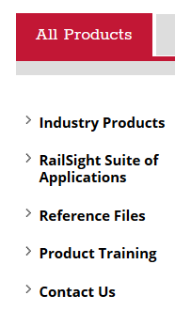
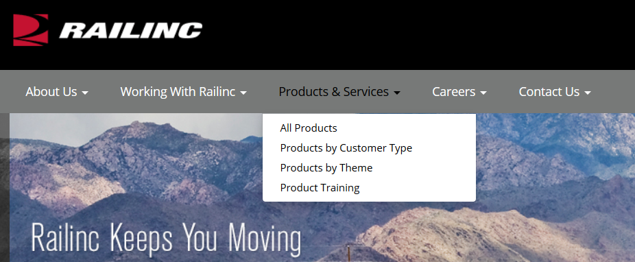
Training Materials
The application User Guide for RAMP-ED is in depth and walks user step by step through the various features within the application.
To access the User Guide: Visit www.railinc.com, select Products & Services from the toolbar and choose All Products
Next Select ‘Industry Products’ on the All Products Page

Slide 14
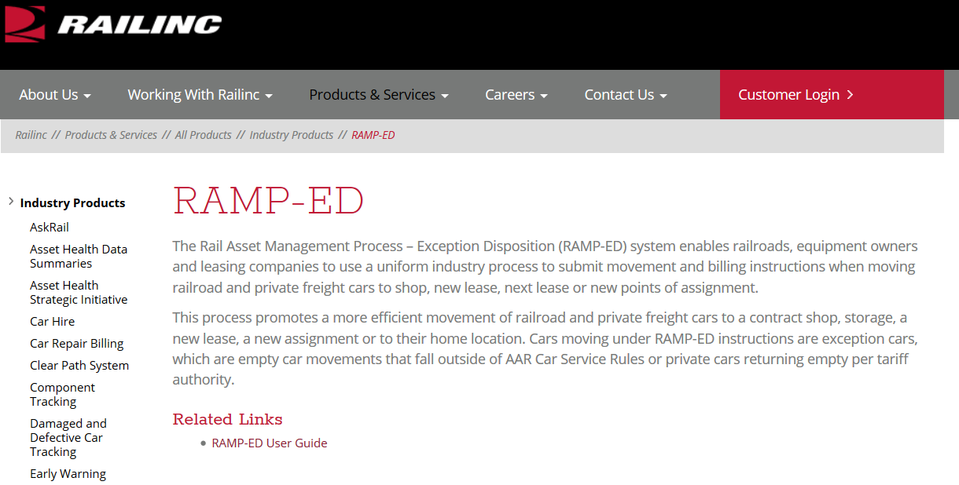
Training Materials
Industry Products are listed alphabetically, scroll down and select RAMP-ED
Product page displays the link to the User Guide

Slide 15
Questions?
Contact Railinc’s Customer Success Team:
by Phone (877) RAILINC (1-877-724-5462)
or by email csc@railinc.com

Slide 16
Railinc Keeps You Moving.
Doni Reece
Phone: 919-651-5049
Email: Doni.Reece@railinc.com

