Slide 1
Car Hire Rule 5
Antwan Dozier
ACACSO
May 9 - 11, 2018

Slide 2
Topics
Overview of Car Hire Rule 5
TOL Examples
TOL Edit Issues

Slide 3
Overview of Car Hire Rule 5
Applies to Cars in Switching Service
Line Haul Carrier Responsible for Car Hire
  Terminal Switching Up to 120 Hours
  Intermediate Switching Up to 24 Hours
  Blocking Service Up to 24 Hours
  Interterminal Not Covered

Slide 4
Overview of Car Hire Rule 5
Longer or Shorter Limits Can Be Negotiated
  Revised Limits Must be Registered with Railinc

Slide 5
Overview of Car Hire Rule 5
Requirements to Transfer Car Hire
  Car in Switching Service (Auditors Will Check)
    Switching Settlement Data Exchange (SSDX) Settlement
    Switch Settlement Statement
    Other Supporting Documentation

Slide 6
Overview of Car Hire Rule 5
Requirements to Transfer Car Hire
  Submit “Required Information” via TRAIN II
  Pass TRAIN Edits
    Car Must be on Line
    Car Hire Must be in Switch Carrier’s Account
    Must Not Exceed Established Limits

Slide 7
Overview of Car Hire Rule 5
What is Not Required
  Registration as a Switch Carrier
    Switching Settlement Proves Switch Occurred
    (Class I Carriers are Major Switch Carriers)
  Registration of Location as a Switch Location
    If a Car is Handled in Switching Service, the Location is a Switching Location

Slide 8
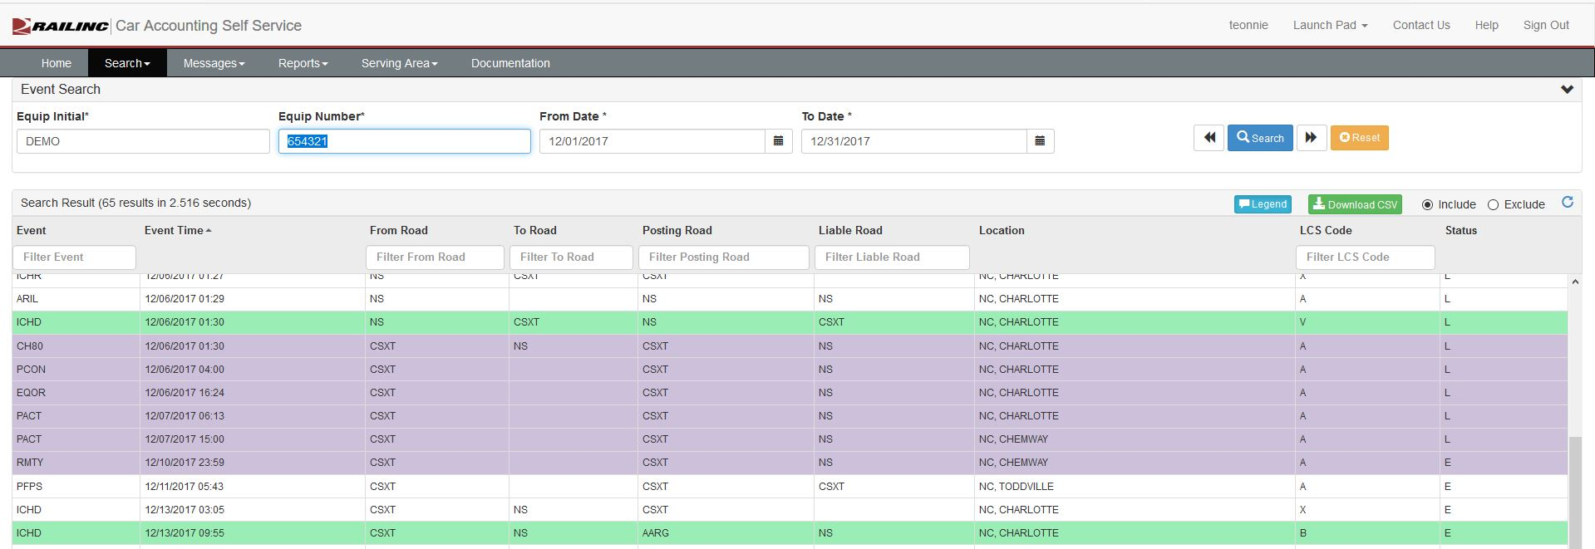
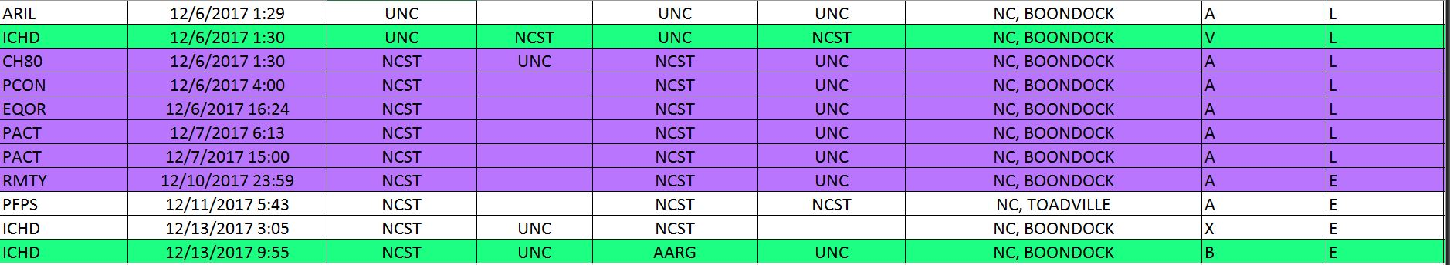
TOL Example – Terminal Switch
Notes:
Above is an example of the events typically seen in a terminal switch.
The equipment was received from carrier UNC.
The appropriate TRAIN messages were sent to Railinc.
Railinc found no error in the submission.
Railinc created a TRAIN 28 for the same date/time and the interchange.
The switch carrier transferred 92 hours of car hire to UNC.

Slide 9
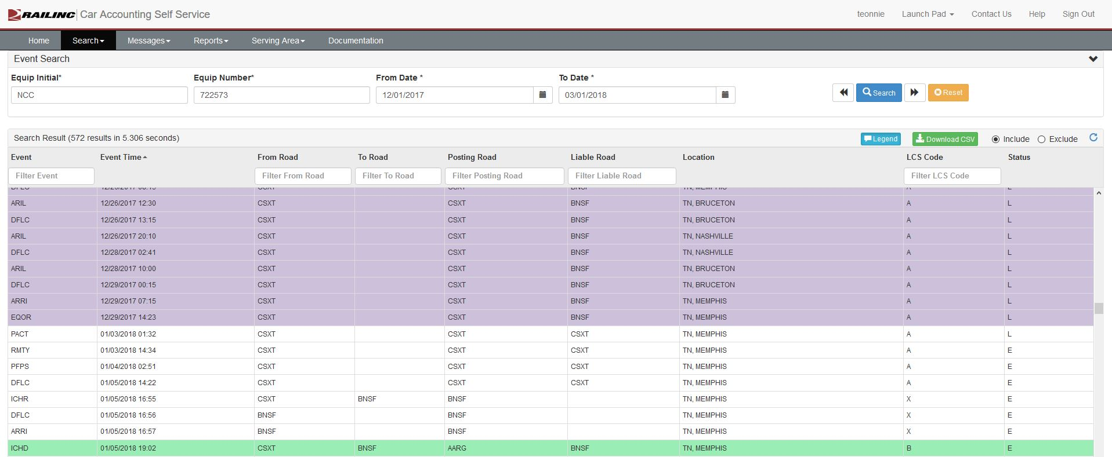
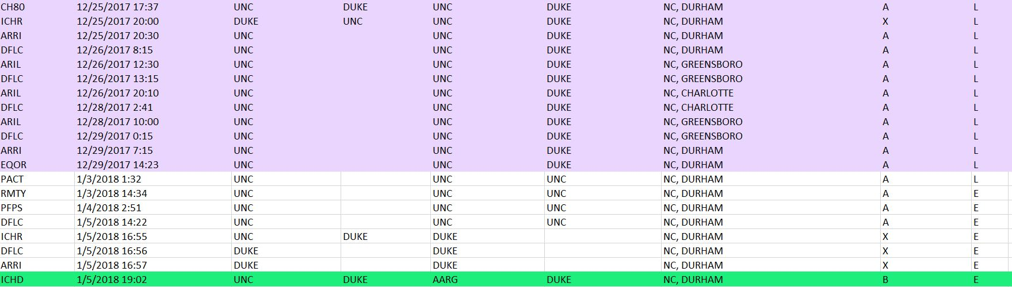
TOL Example – Terminal Switch

Slide 10
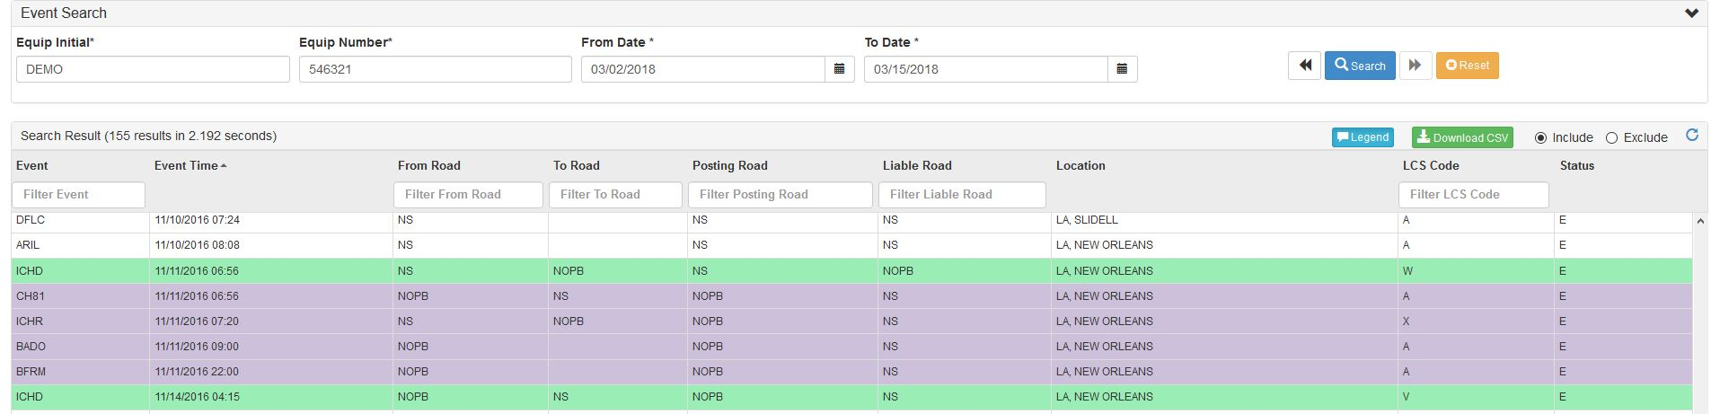
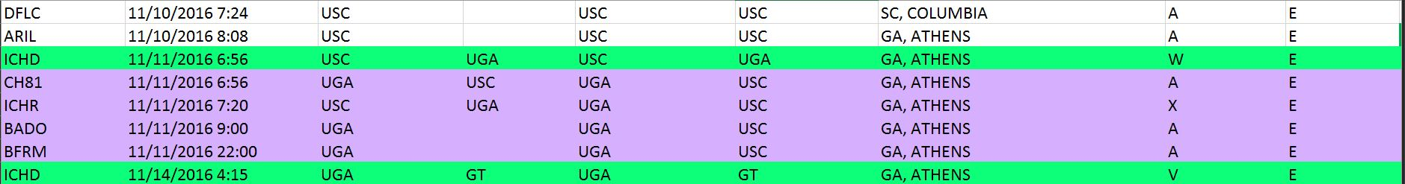
TOL Example – Intermediate Switch
Notes:
The above example illustrates the events typically seen when intermediate switching is performed.
The equipment was delivered to UGA.
The appropriate messages were sent to Railinc by UGA.
Railinc created a TRAIN 28 message to transfer 24 hours of car hire from UGA to the line haul carrier.
UGA incurred no car hire liability.

Slide 11
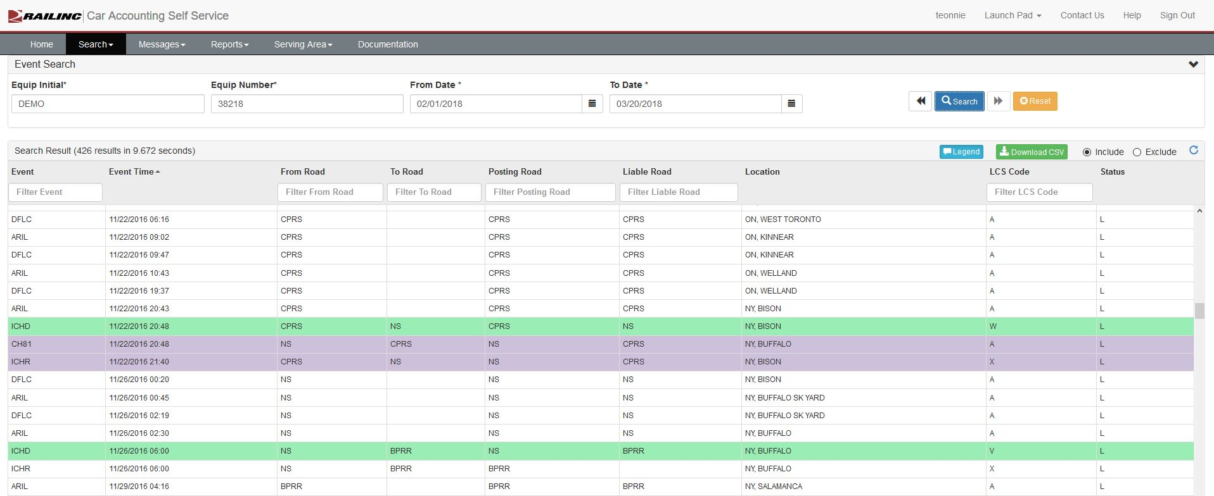
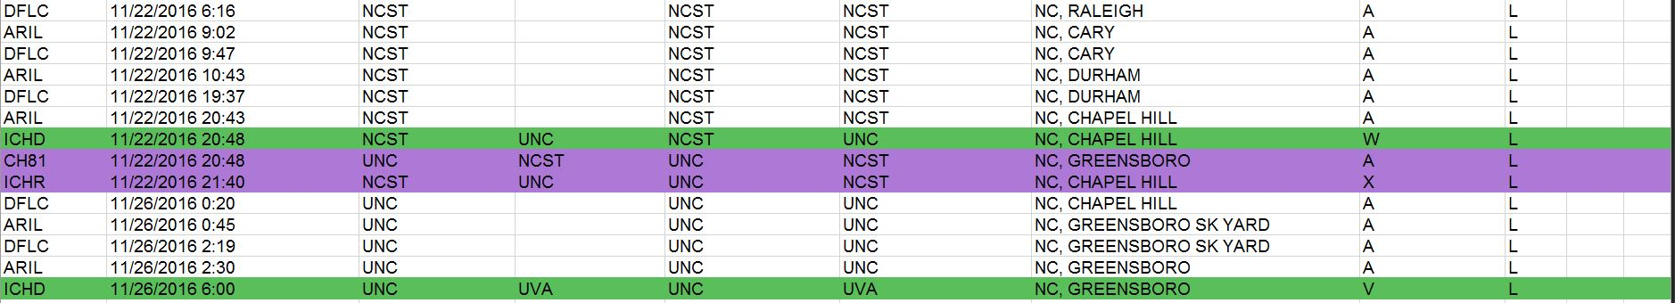
TOL Example – Intermediate Switch

Slide 12
Rejection Example
Road A Submitted:
  TOL 3/1-1500
  LCS Showed Interchange 3/6 – 1300
TOL Rejected because Road A did not have Liability
TRAIN 58 Sent to Road A to Allow Correction

Slide 13
Reasons for Rejecting Submission
Syntax Errors
  Invalid Start Character
  Missing Data Element
  Invalid Sequence
  Not Numeric
  Not Alphabetic
Notes:
Invalid Start Character—Indicates the start character required to identify the beginning of a record
level within a message is missing
Missing Data Element—Indicates a mandatory data item is missing.
Invalid Sequence—Indicates a variation exists in the expected sequence of the message number in
the Message Header or Group Level records
Not Numeric—Indicates a field whose input must be numeric was not.
Not Alphabetic—Indicates a field whose input must be alphabetic was not.

Slide 14
Reasons for Rejecting Submission
Data Errors
  Invalid Date/ Time
  Invalid Entry
  Not found
  Reporting Road Not Authorized
  Invalid Junction
  Duplicative Entry
Notes:
Invalid Date/Time—Indicates an error in the date/time field of the message. There are numerous
ways in which the date/time may be invalid: day may exceed 31 or month may exceed 12 or the event
time may be later than the time of processing. For Rule 5/15, calculated hours for TOL are zero.
Invalid Entry—Certain data, such as Standard Point Location Codes (SPLC), Standard Transportation
Commodity Codes (STCC) and railroad reporting marks are automatically checked against tables of
valid entries. The 02 code indicates that the input was not found in the appropriate table.
Not Found—Indicates a data item or message was not located anywhere in the TRAIN II database.
For example, if a corrective entry is submitted and the system cannot locate the original entry to be
deleted a 09 would be generated. For message retransmission request, a 09 indicates no match within
the message History File.
Reporting Road Not Authorized—Indicates a report was made by a railroad not authorized to report
an event. An example would be an interchange reported by railroad without responsibility for report
activity at the referenced junction, or receipts reported at an interchange location where only deliveries
are acceptable. All reports by unauthorized roads are rejected.
Invalid Junction—For Interchange reportings (TRAIN01), indicates the reported Road From, Road To,
and Standard Point Location Code (SPLC) do not form a valid Interchange point or junction. Refer to
TRAIN II SPLC Junction Table Update Request for instructions and forms to register the valid point.
For Car Hire Rule 5 Transfer of Liability (TRAIN08), Road From, Road To and SPLC combination is
invalid.
Duplicative Entry—Indicates two reports have been input with the same identification, such as a
waybill number, but are otherwise dissimilar. (Duplicate entries are often the result of unintended
retransmissions of input messages. Exact duplications are screened out of the system with no
exception sent).

Slide 15
Additional Support Contacts
Railinc Customer Success Center
Available Monday – Friday, 7am-7pm EST
1-877- RAILINC (724-5462)
csc@railinc.com

Slide 16
Reasons for Rejecting Submission
  Late Reporting of Delivery
  Transportation Codes are Invalid
  Unit not Registered
  Time Exceeded
  Late Reported TOL
  TOL Not Within Interchanges
  Conflicting Entry

Slide 17
Antwan Dozier
Antwan.Dozier@Railinc.com
919-651-5162
Questions?

