Slide 1
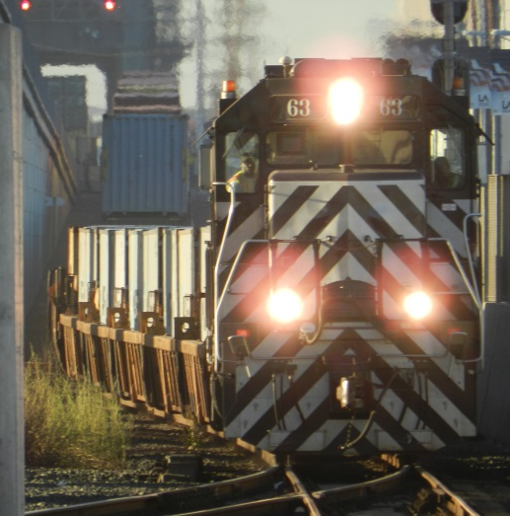
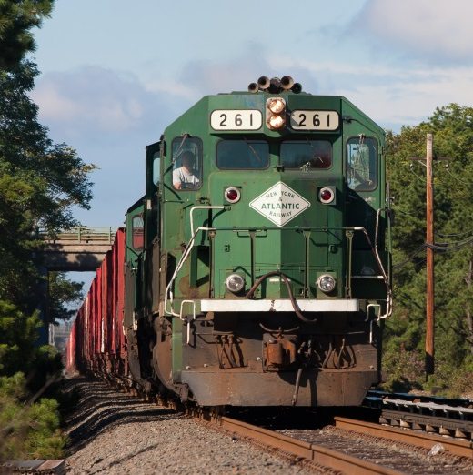
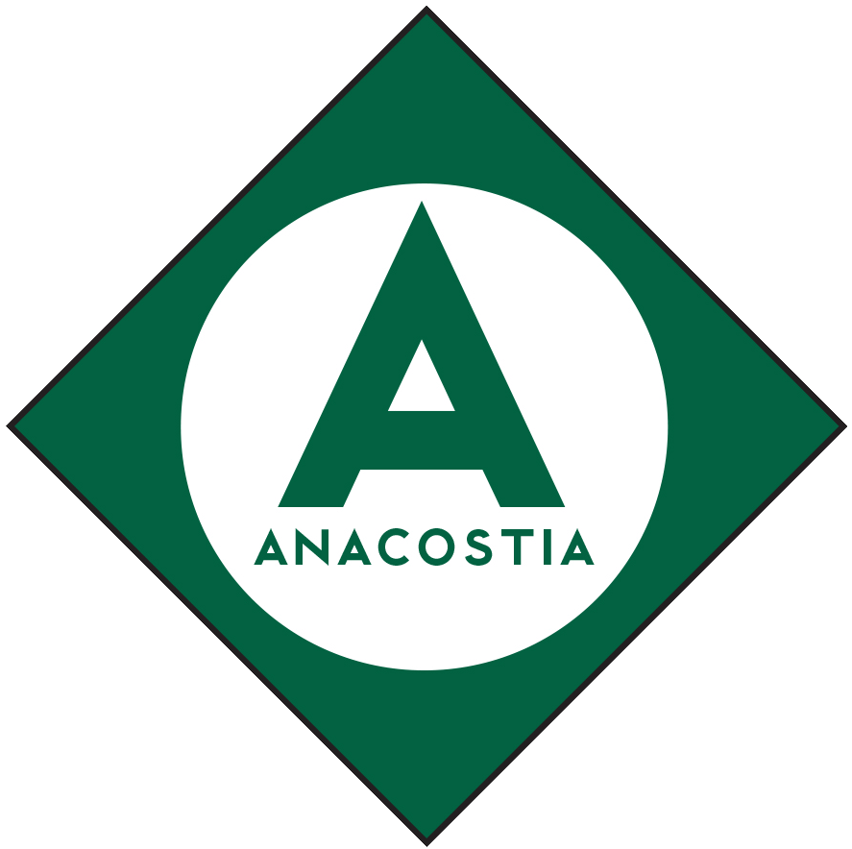
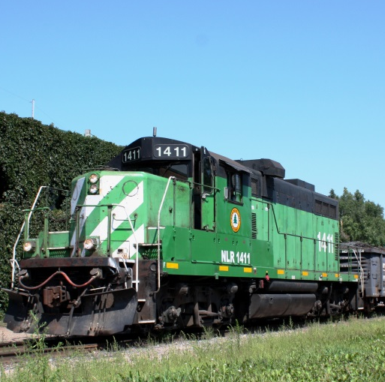
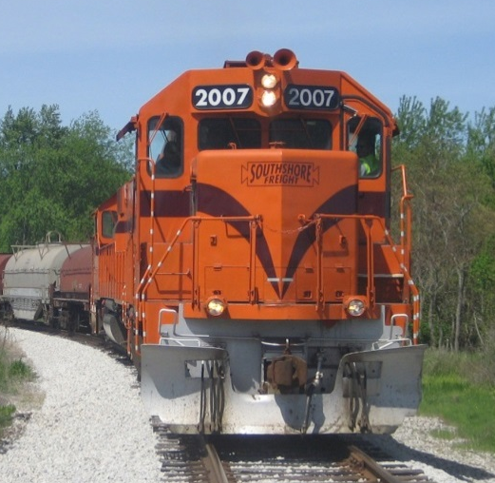
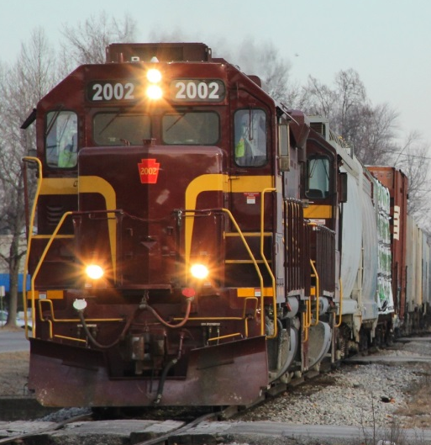
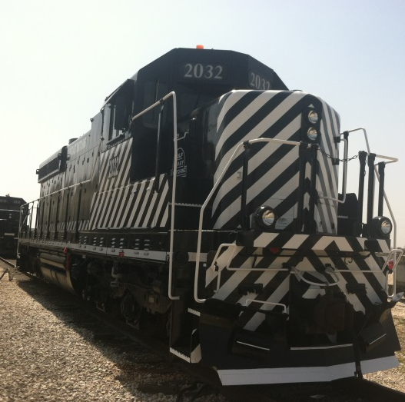
Anacostia Rail Holdings 2019

Slide 2

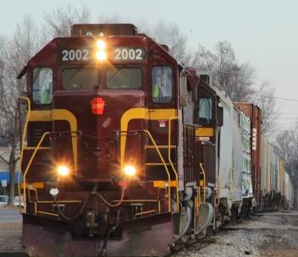




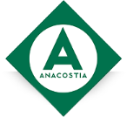
Company Information
Established in 1994
Owns and manages six U.S. railroads operating in seven states
Handles the equivalent of more than 2,000,000 carloads per year
More than 350 employees
Locomotive fleet: 67
Car fleet: 527

Slide 3
Senior Officers
Peter Gilbertson Chief Executive Officer
Bruce A. Lieberman Chief Financial Officer
Eric T. Jakubowski Chief Commercial Officer
Thomas A. Leopold Chief Safety & Compliance Officer
James R. Zubik Vice President Finance & Administration
Mark H. Sidman General Counsel

Slide 4
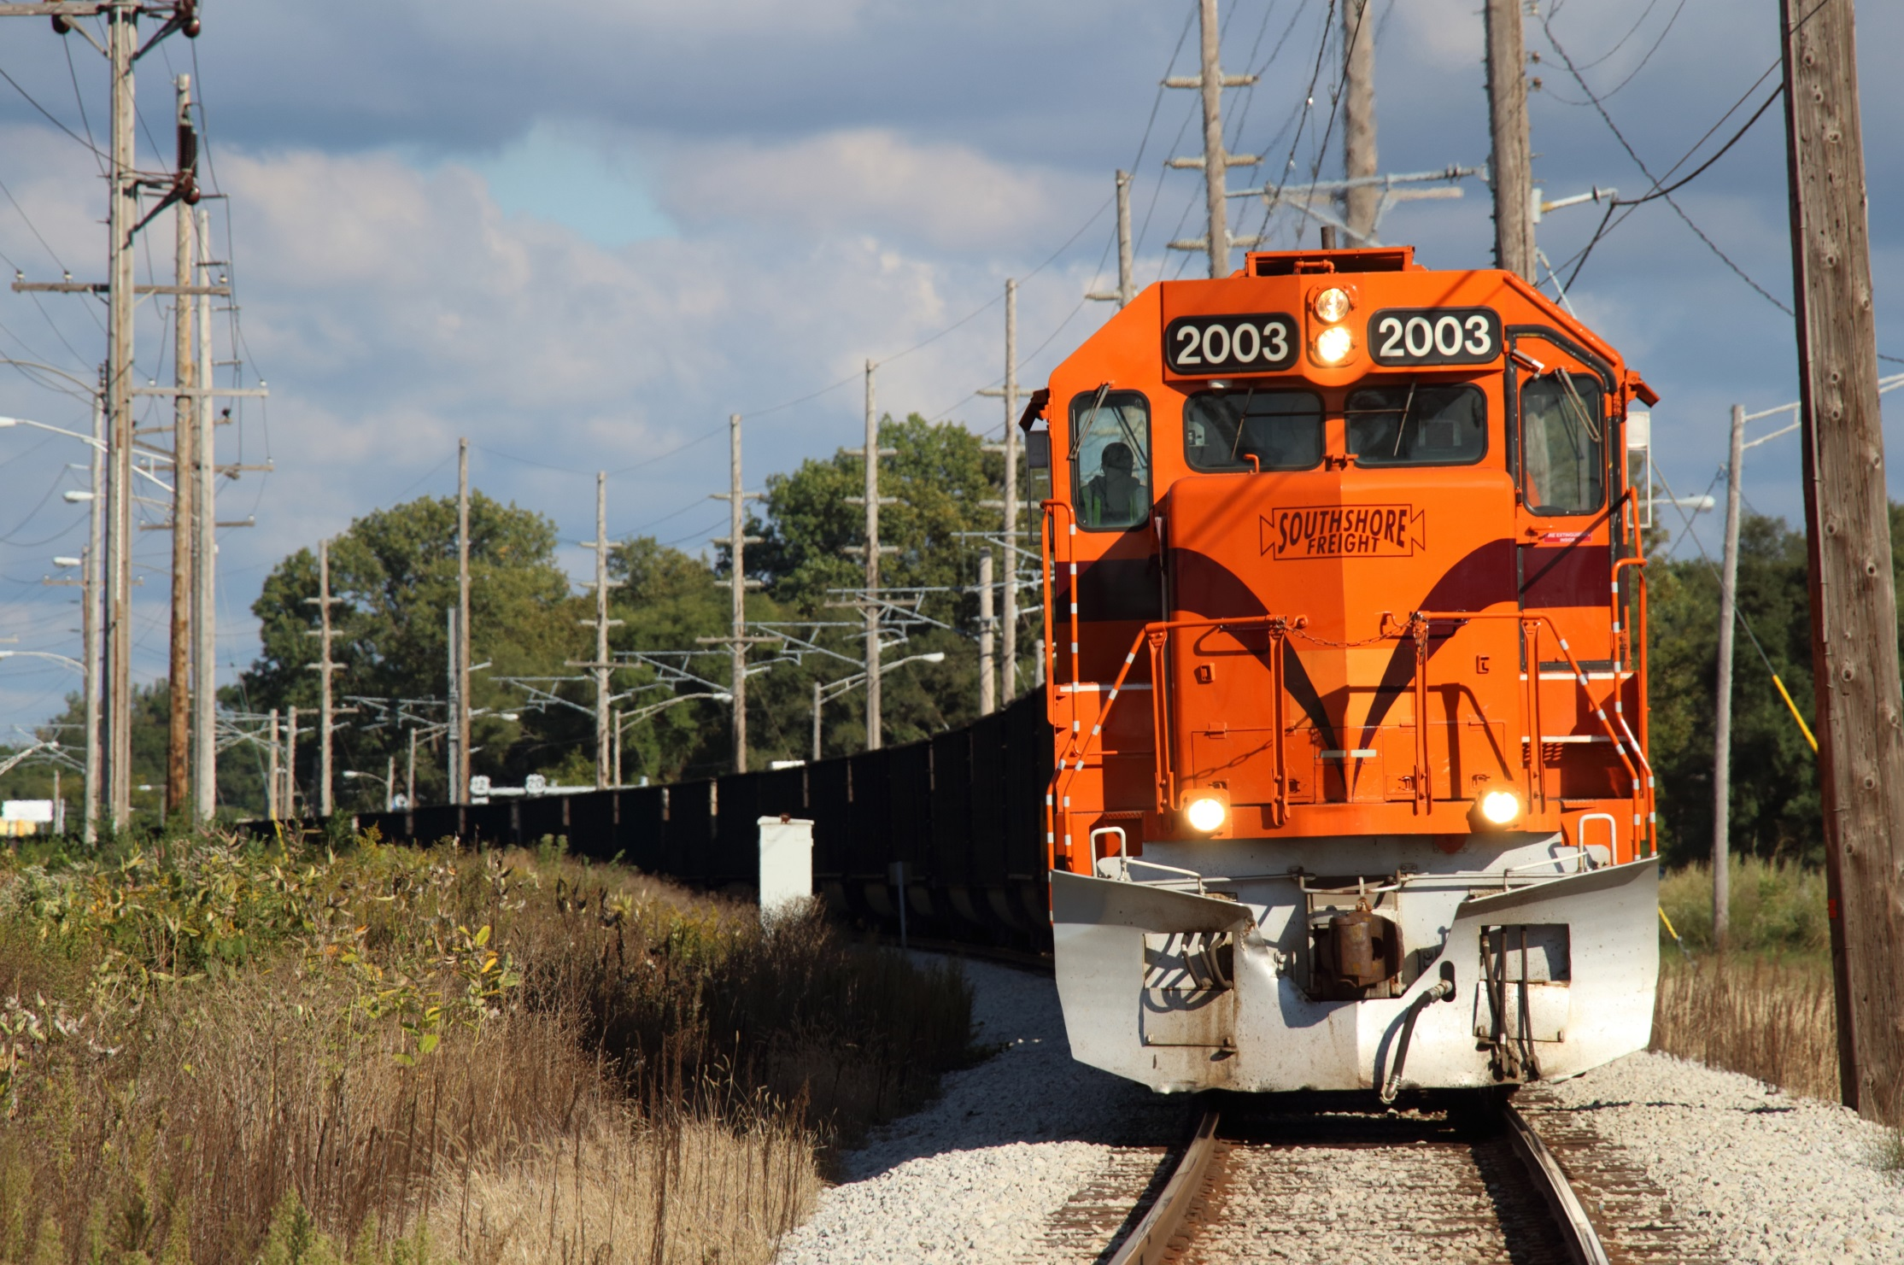

Chicago South Shore & South Bend Railroad

Slide 5
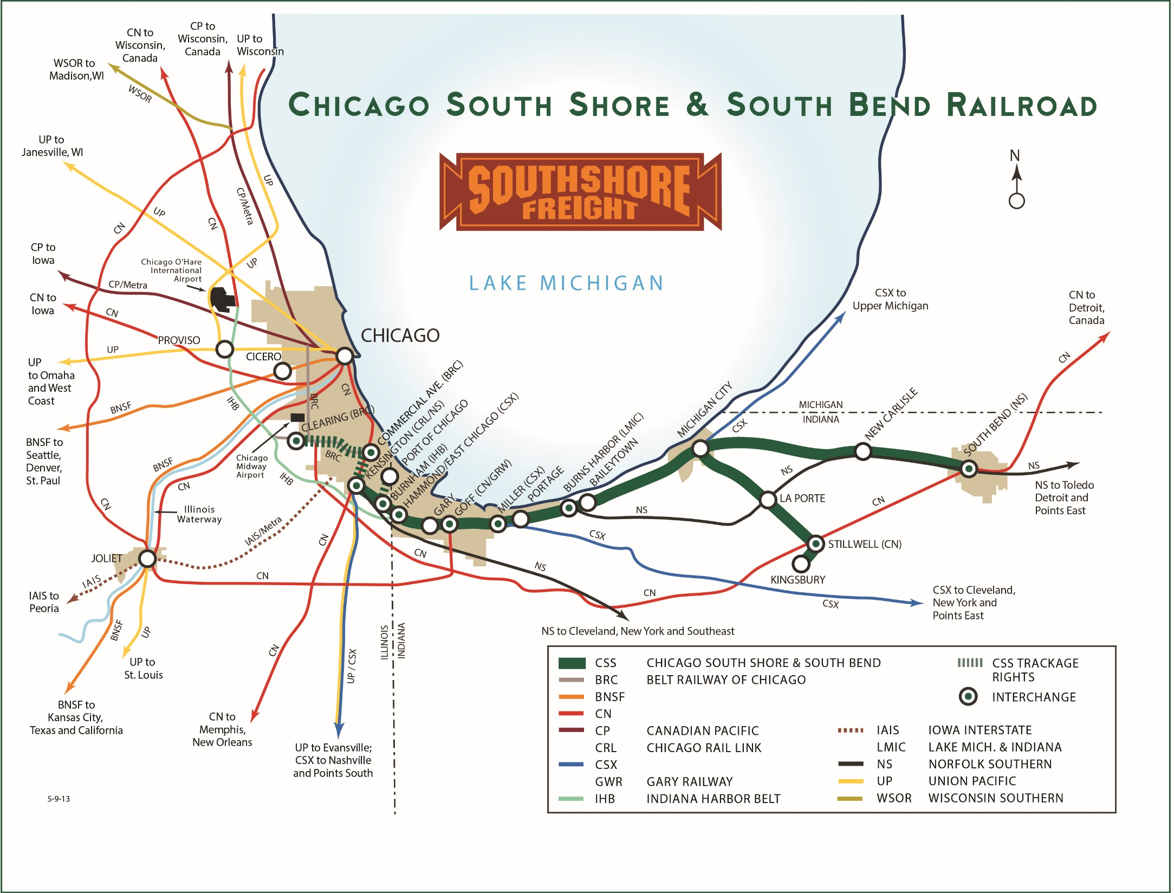

Slide 6

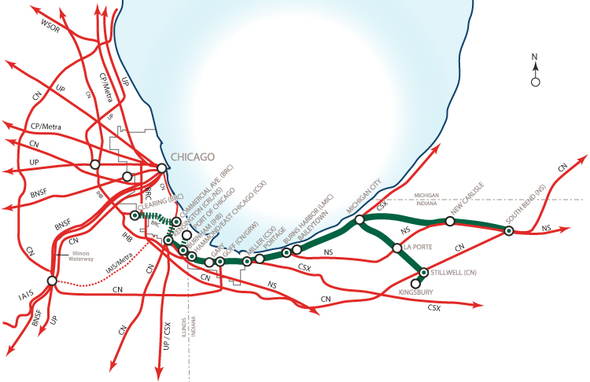
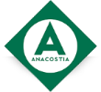
CSS&SB: Vital Information
Established
1990, purchased from bankruptcy
Serves
Chicago, IL and Northwest Indiana
Connections
All Chicago railroads
(directly or via BRC)
Commodities
Steel; coal; chemicals; building materials; grain; food products
Route Miles
182 (75 shared with transit agency)
Carloads
55,000
President
Mr. Todd Bjornstad

Slide 7





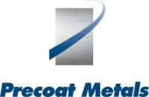


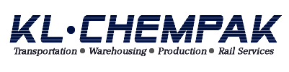







CSS&SB: Customers Served
Steel/Metals
Fuel/Energy
Chemicals
Paper
Minerals
Lumber/Building

Slide 8
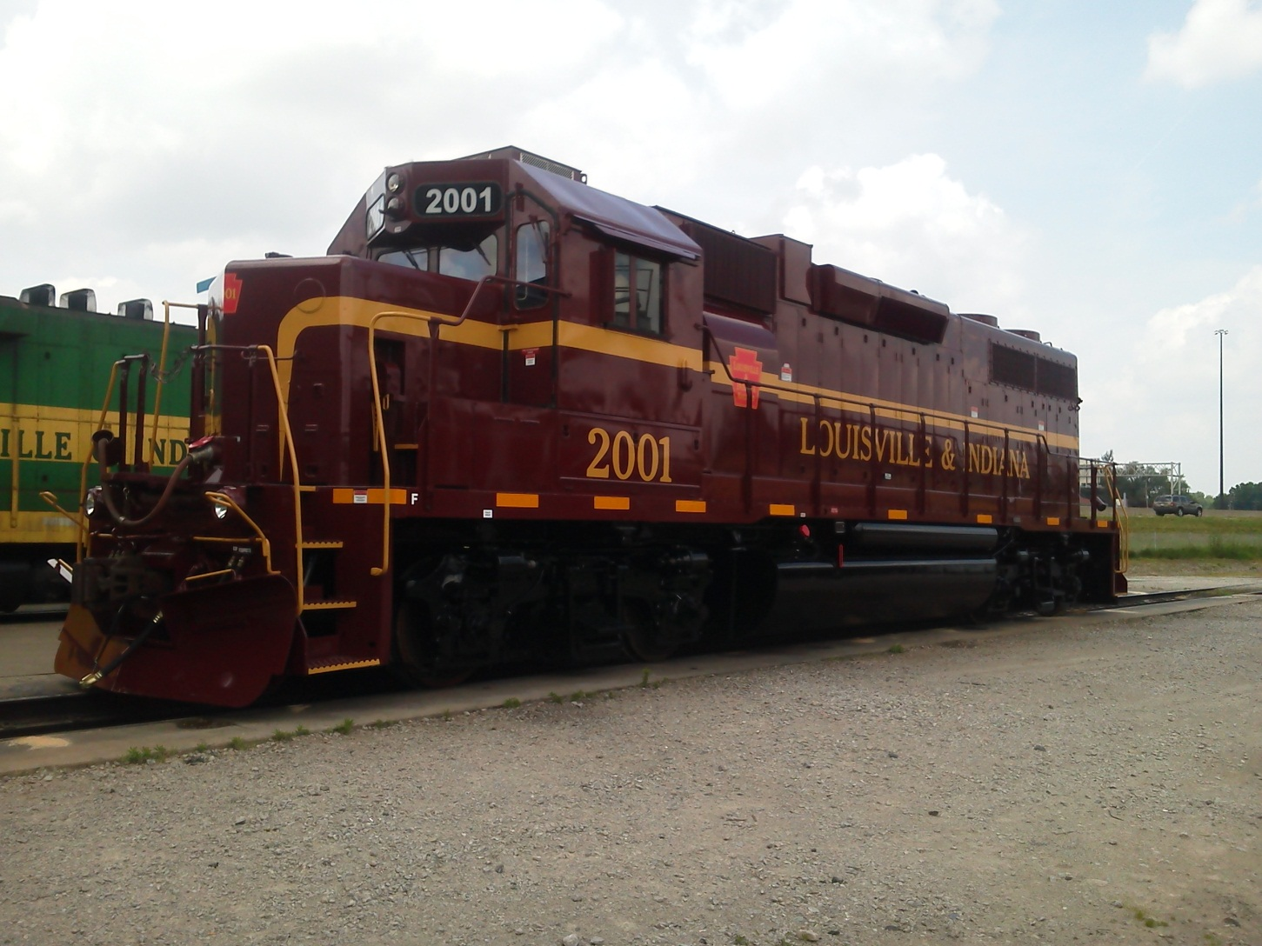
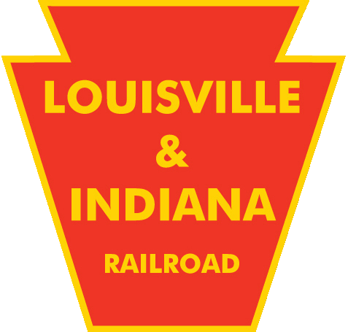
Louisville & Indiana Railroad

Slide 9
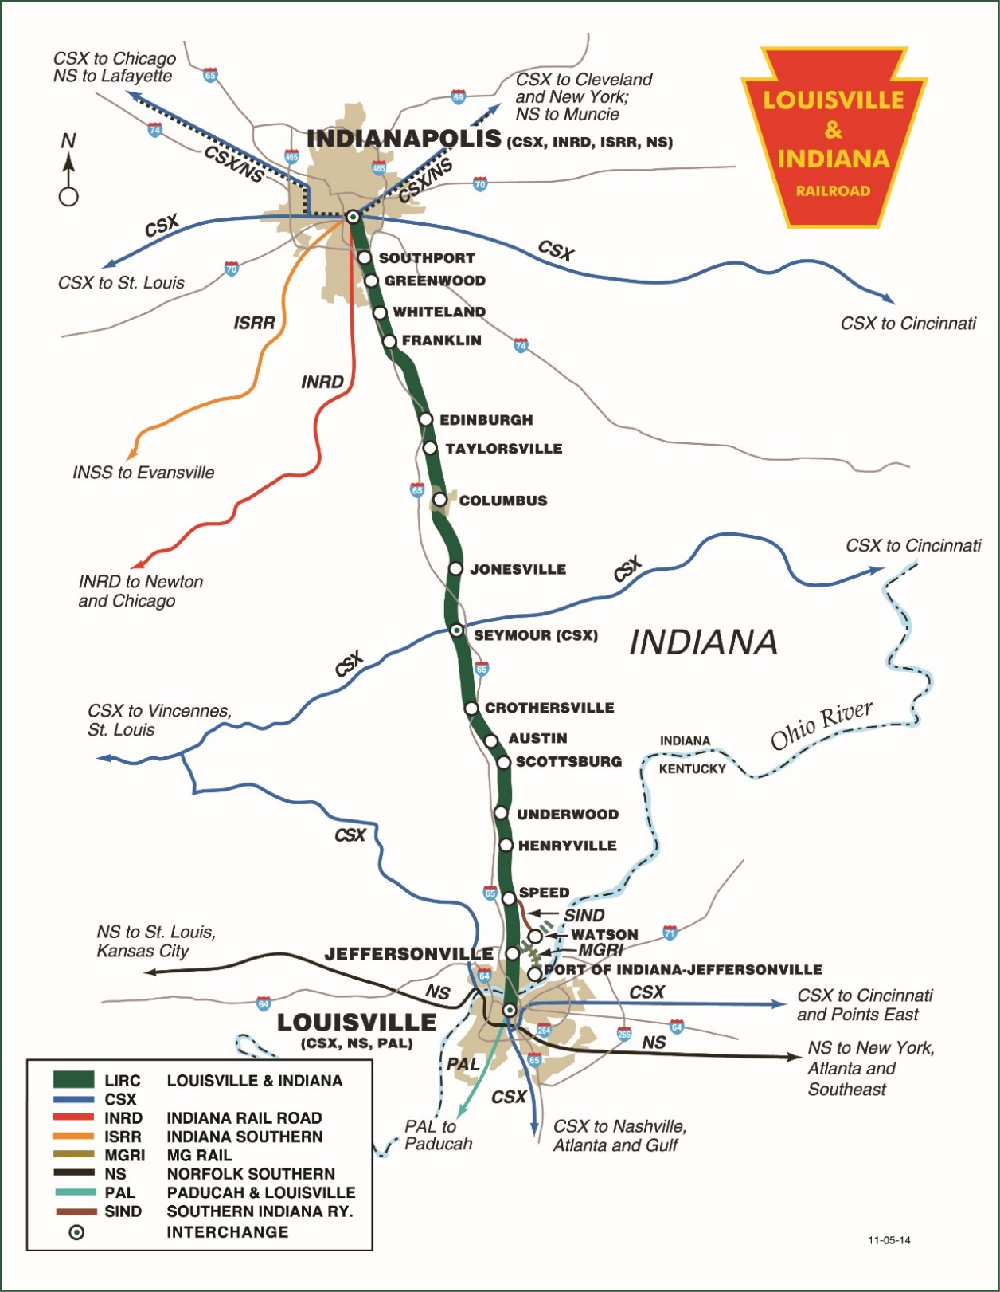

Slide 10
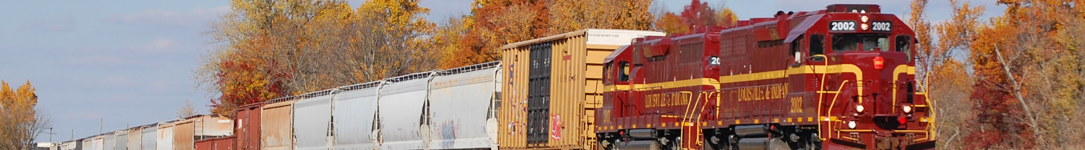
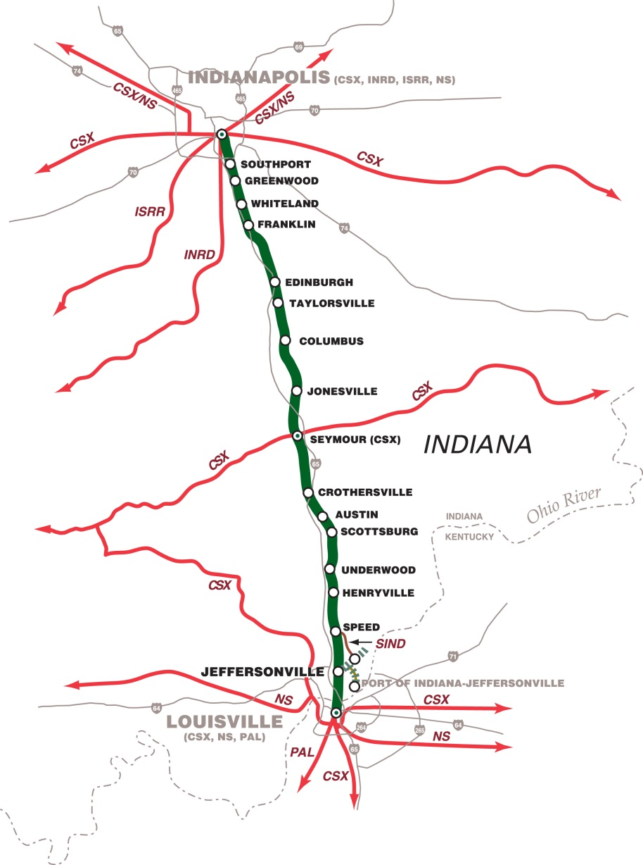
L&I: Vital Information
Established
1994
Serves
Indianapolis, Columbus, Seymour, Franklin, Jeffersonville, IN; Louisville, KY
Connections
CSX, NS, INRD, P&L
Commodities
Diversified
Route Miles
106.5
Carloads
20,000
President
Mr. John Goldman

Slide 11



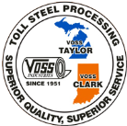
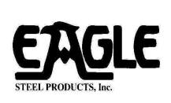


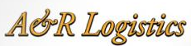

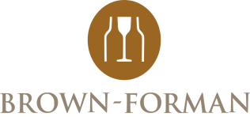












L&I: Customers Served
Plastics
Food Products
Steel/Metals
Minerals
Chemicals
Paper

Slide 12
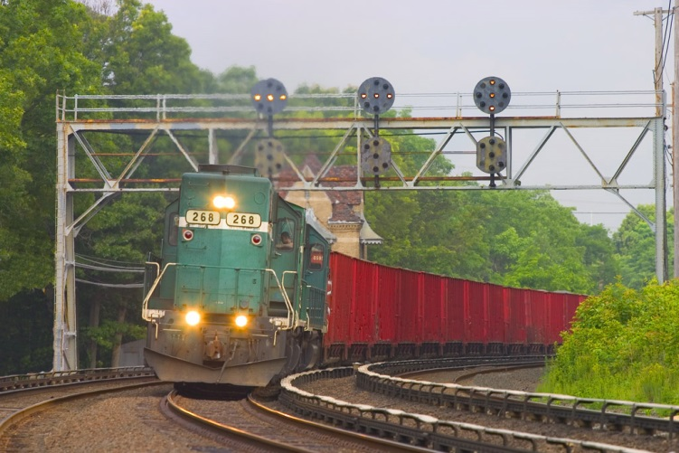
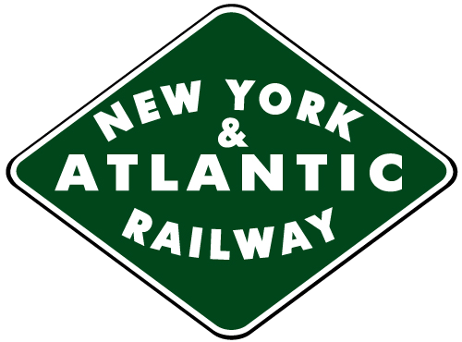
New York & Atlantic Railway

Slide 13
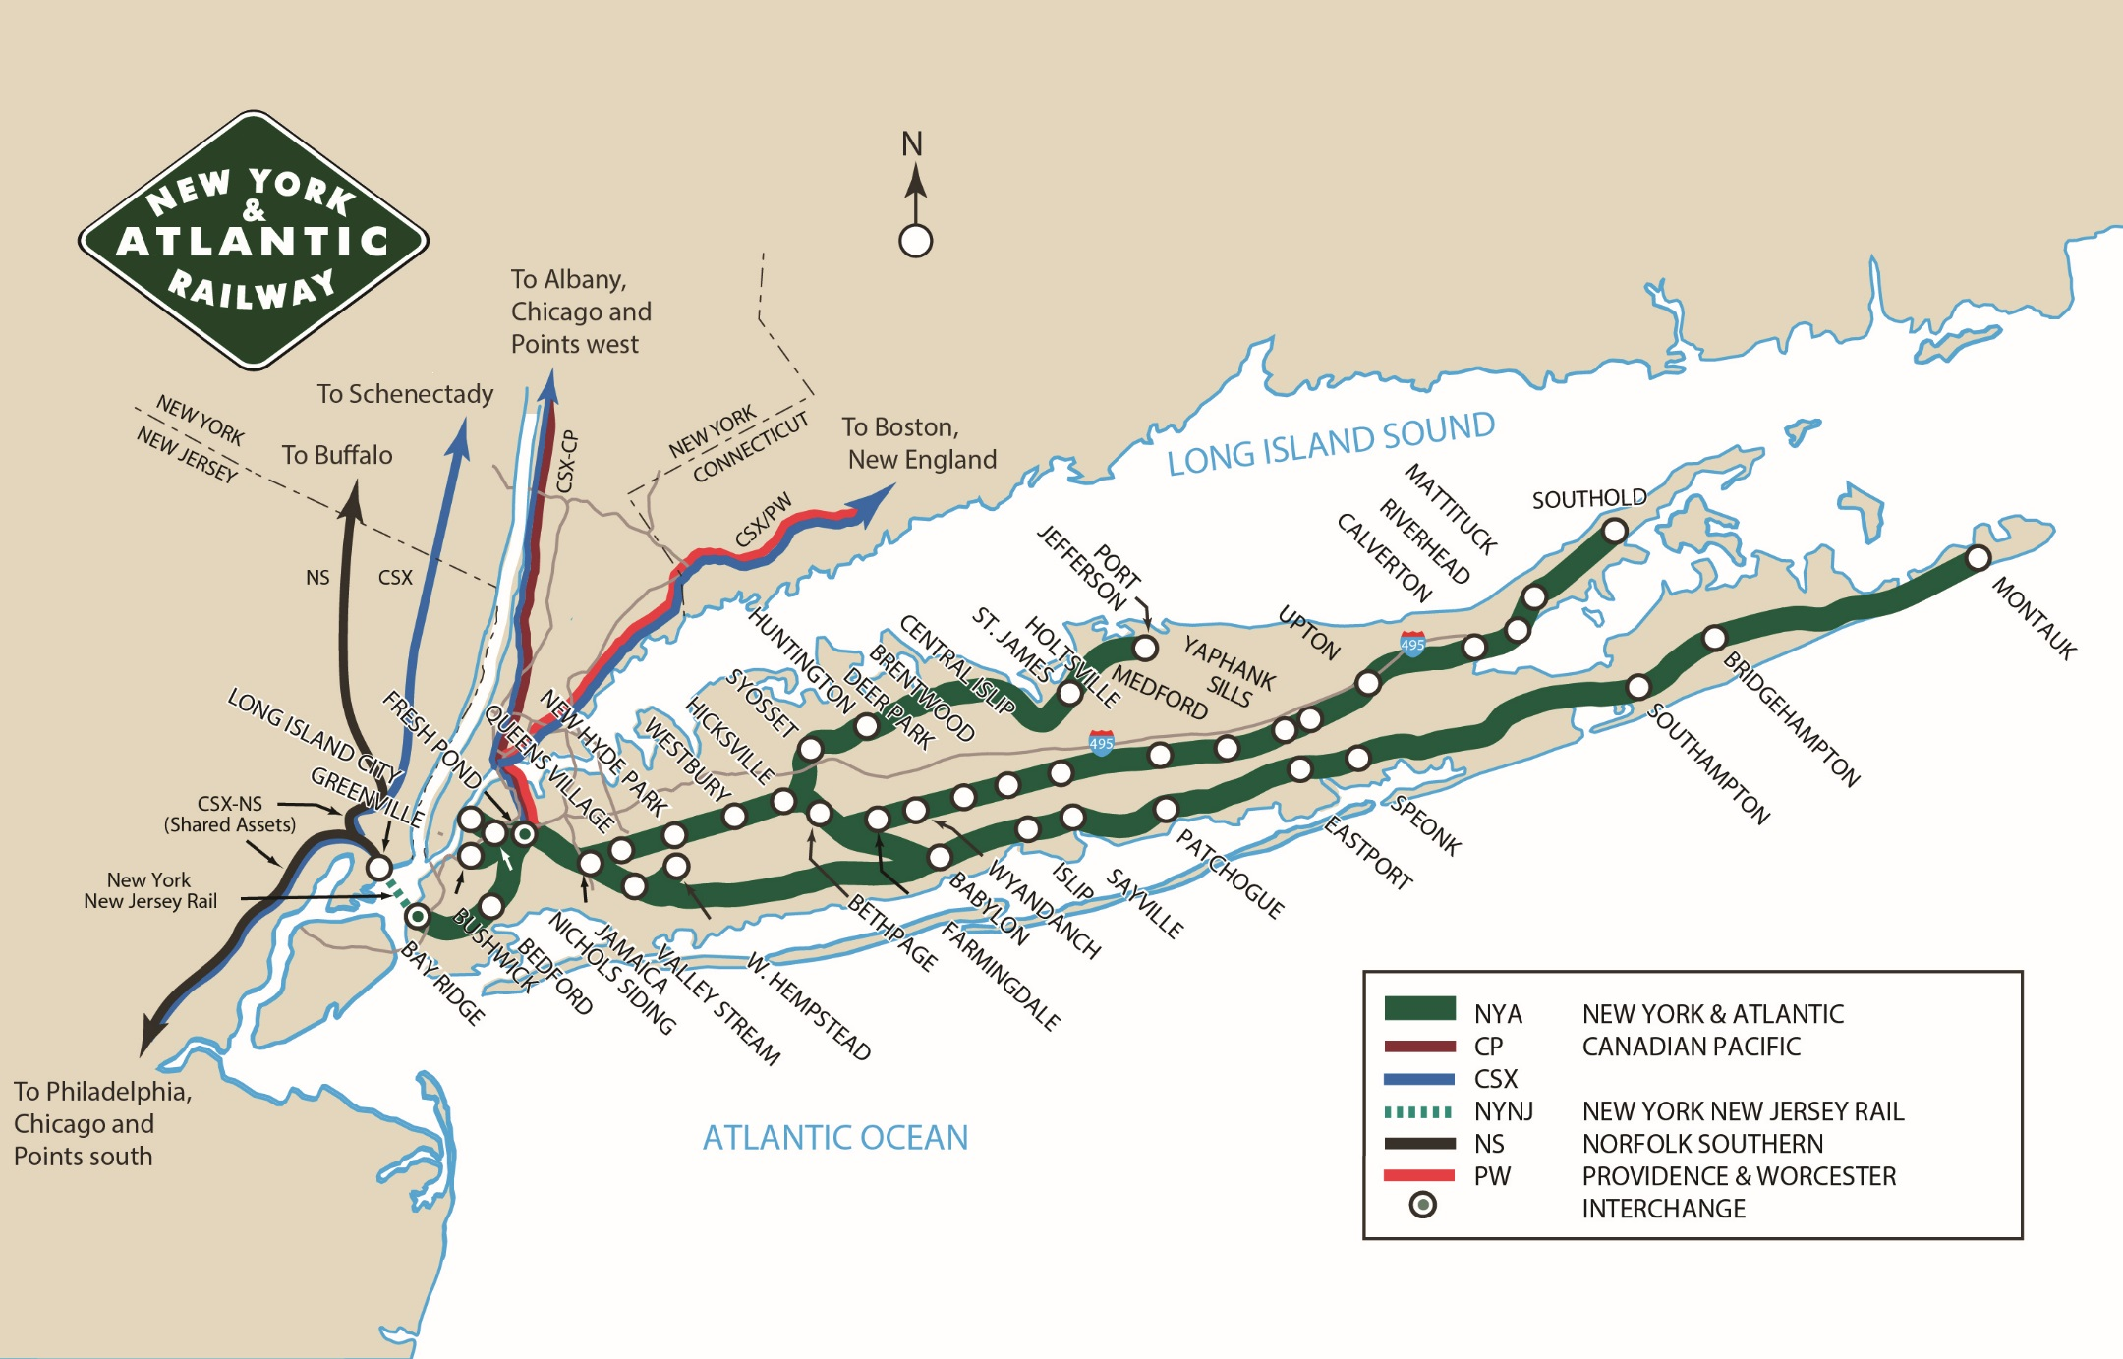

Slide 14
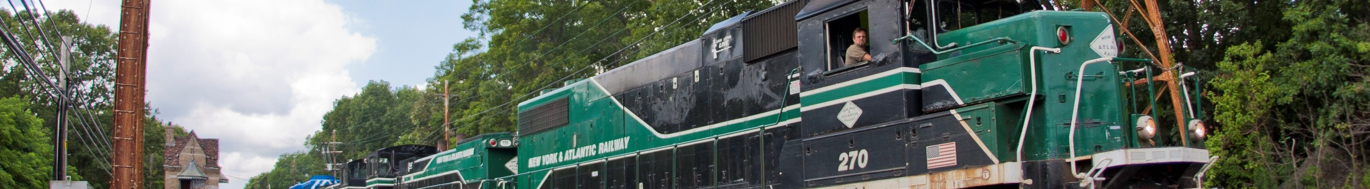
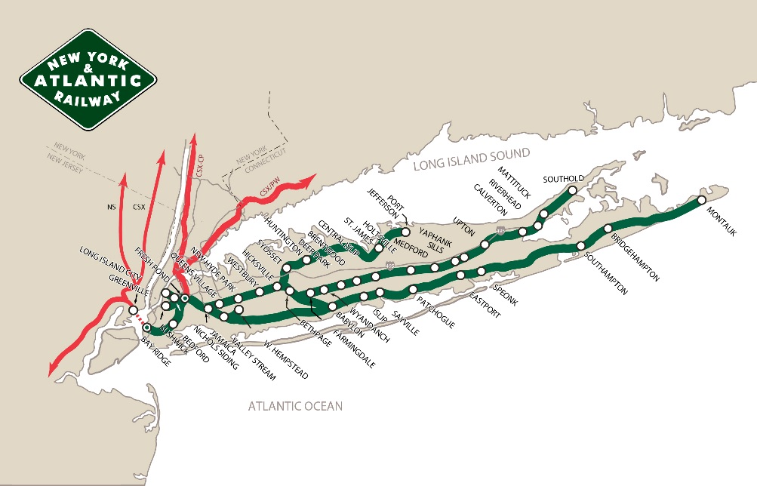
NY&A: Vital Information
Established
1998, concession from LIRR
Serves
Queens; Brooklyn; Long Island, NY
3 transload facilities
Connections
CP, CSX, NS, P&W, NYNJ
Commodities
Food products, building materials, solid waste
Route Miles
269
Carloads
30,000
President
Mr. Paul Victor

Slide 15
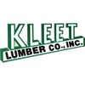







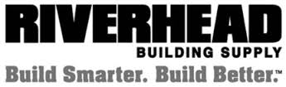









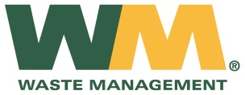
NY&A: Customers
Minerals
Lumber/Construction
Paper
C&D Materials

Slide 16













NY&A: Customers
Food Products
Fuel/Energy
Steel/Metals
Chemicals

Slide 17
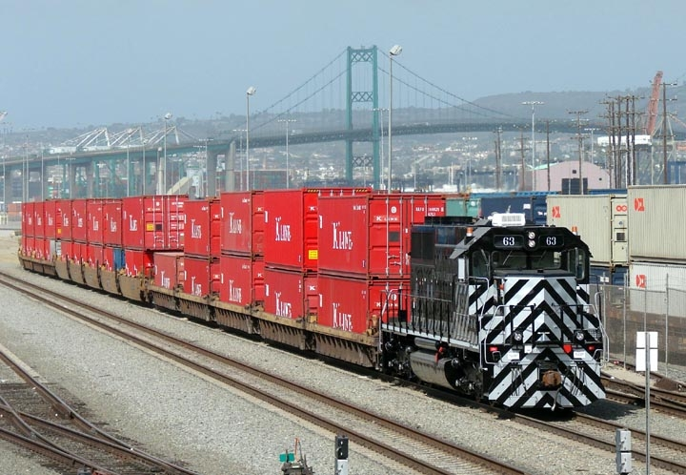
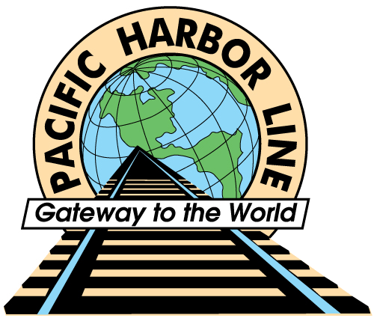
Pacific Harbor Line

Slide 18
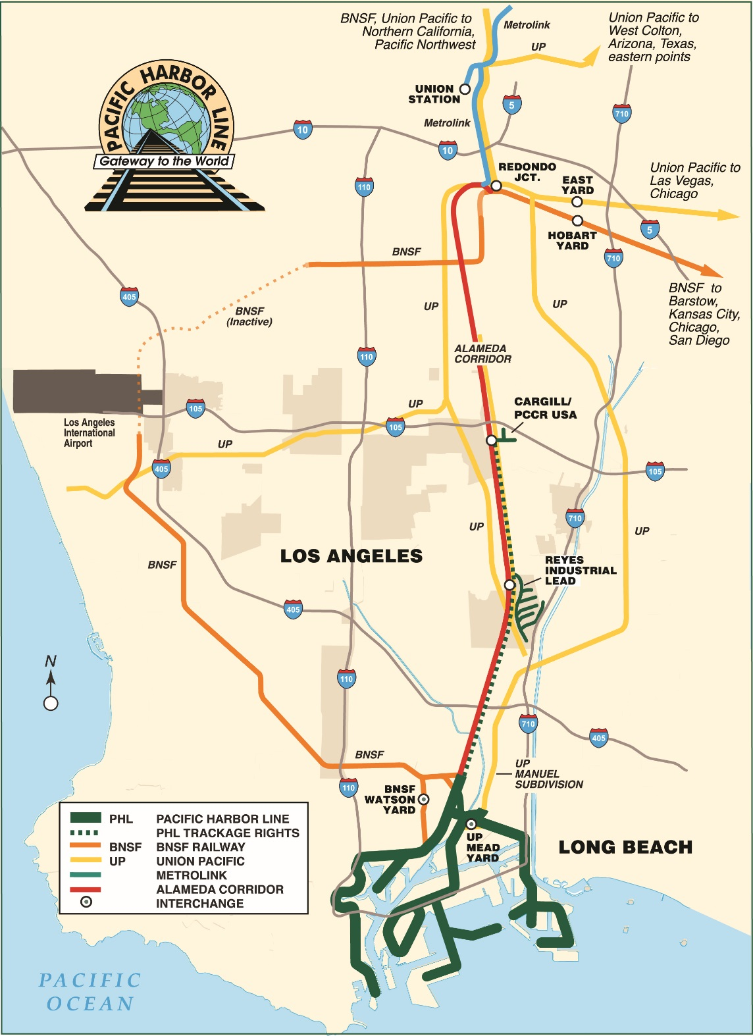

Slide 19
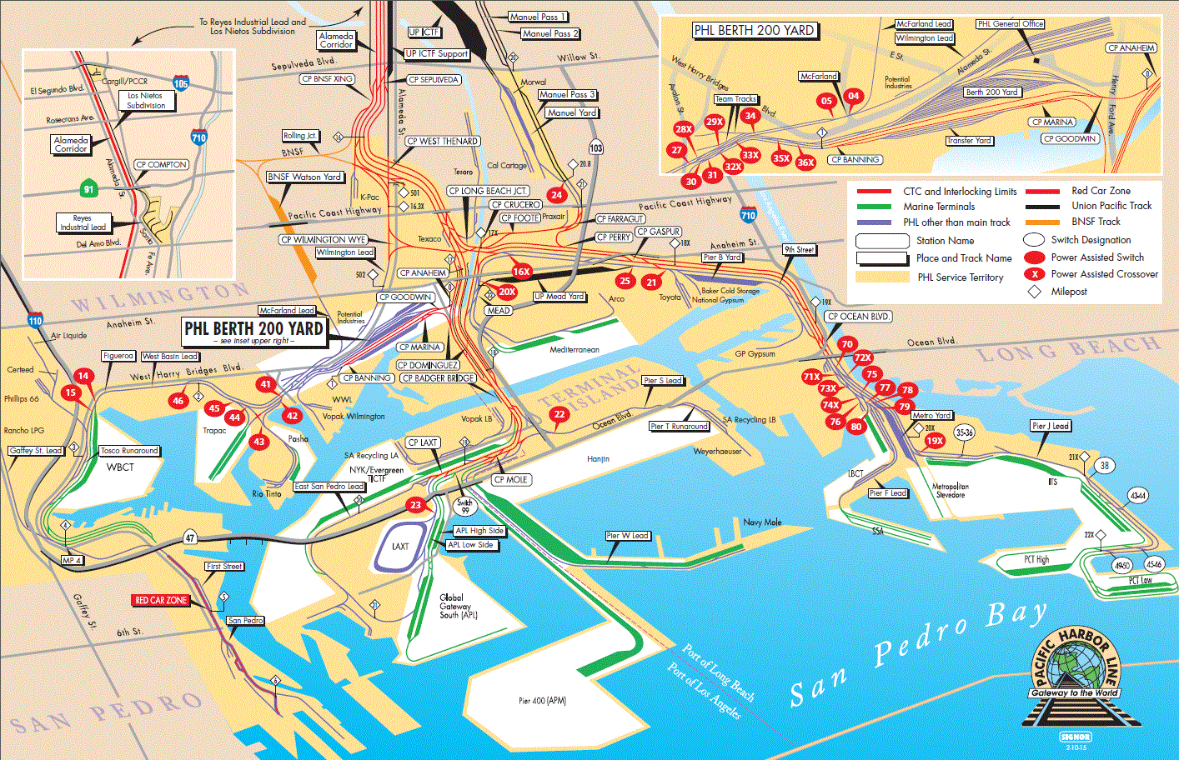

Slide 20
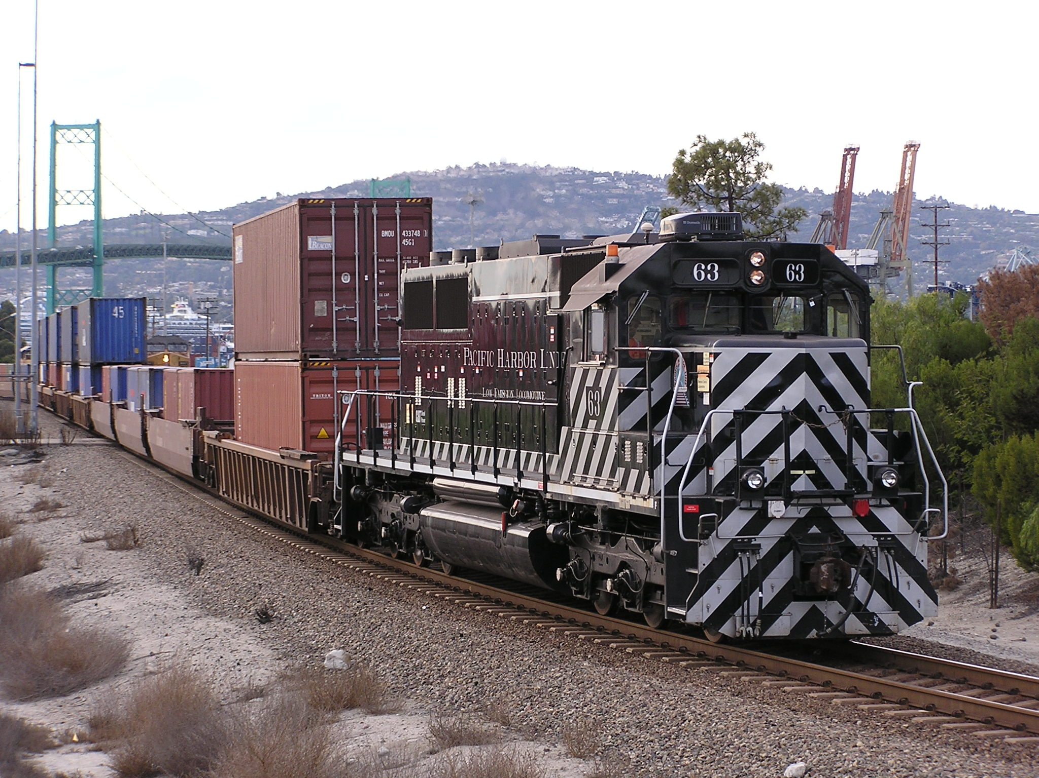
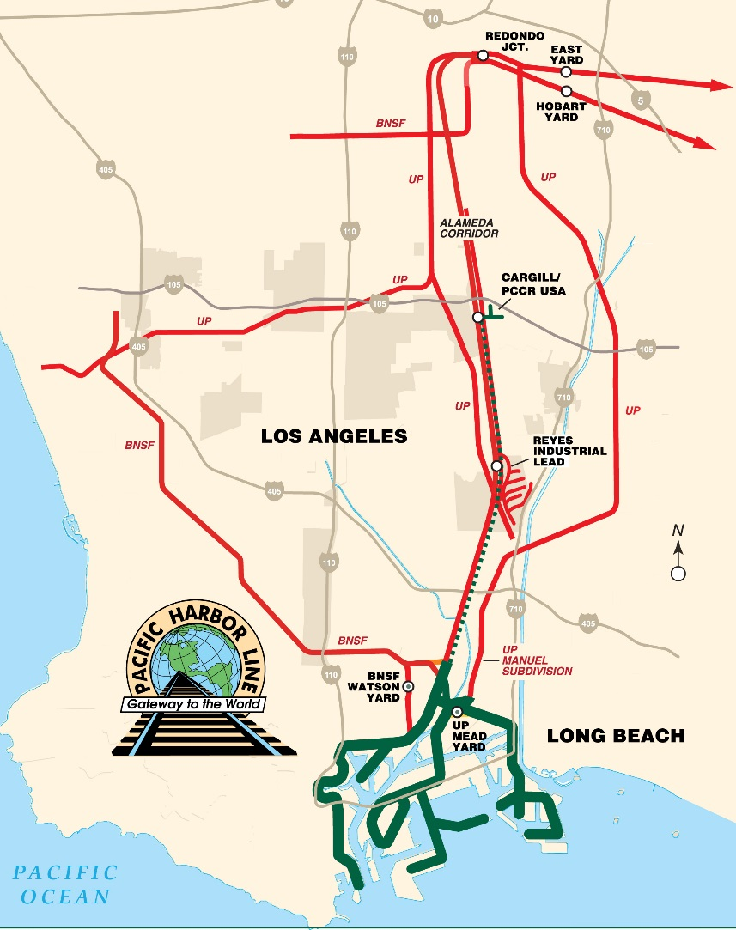
PHL: Vital Information
1998
Established
Serves
Ports of Los Angeles and Long Beach
Connections
BNSF and UP
Commodities
Intermodal, Auto, Chemical, Bulk
Additional
Responsibilities
Dispatches and maintains all Port rail operations and infrastructure
Route Miles
18
Carloads
37,000 excluding intermodal
President
Mr. Otis Cliatt

Slide 21




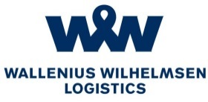

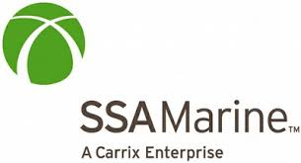


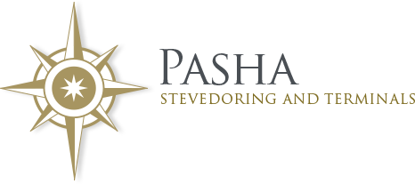



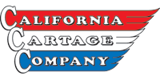
PHL: Customers
Intermodal/Container
Vehicles
Chemicals/Minerals
Breakbulk

Slide 22

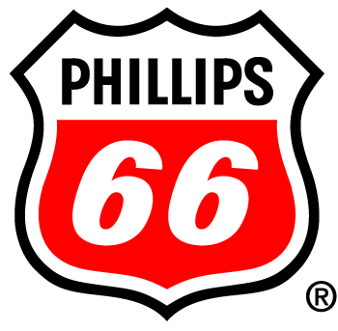
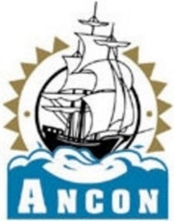

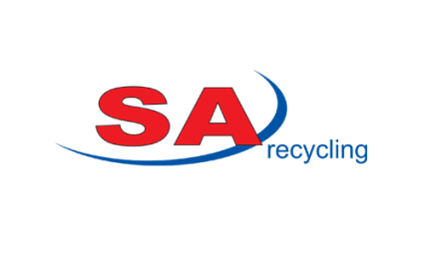











PHL: Customers
Fuel/Energy
Steel/Metals
Building Products
Food Products
Paper

Slide 23

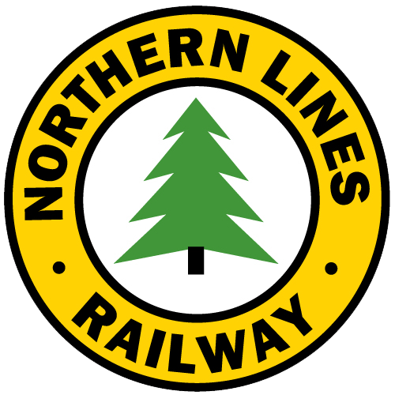
Northern Lines Railway

Slide 24
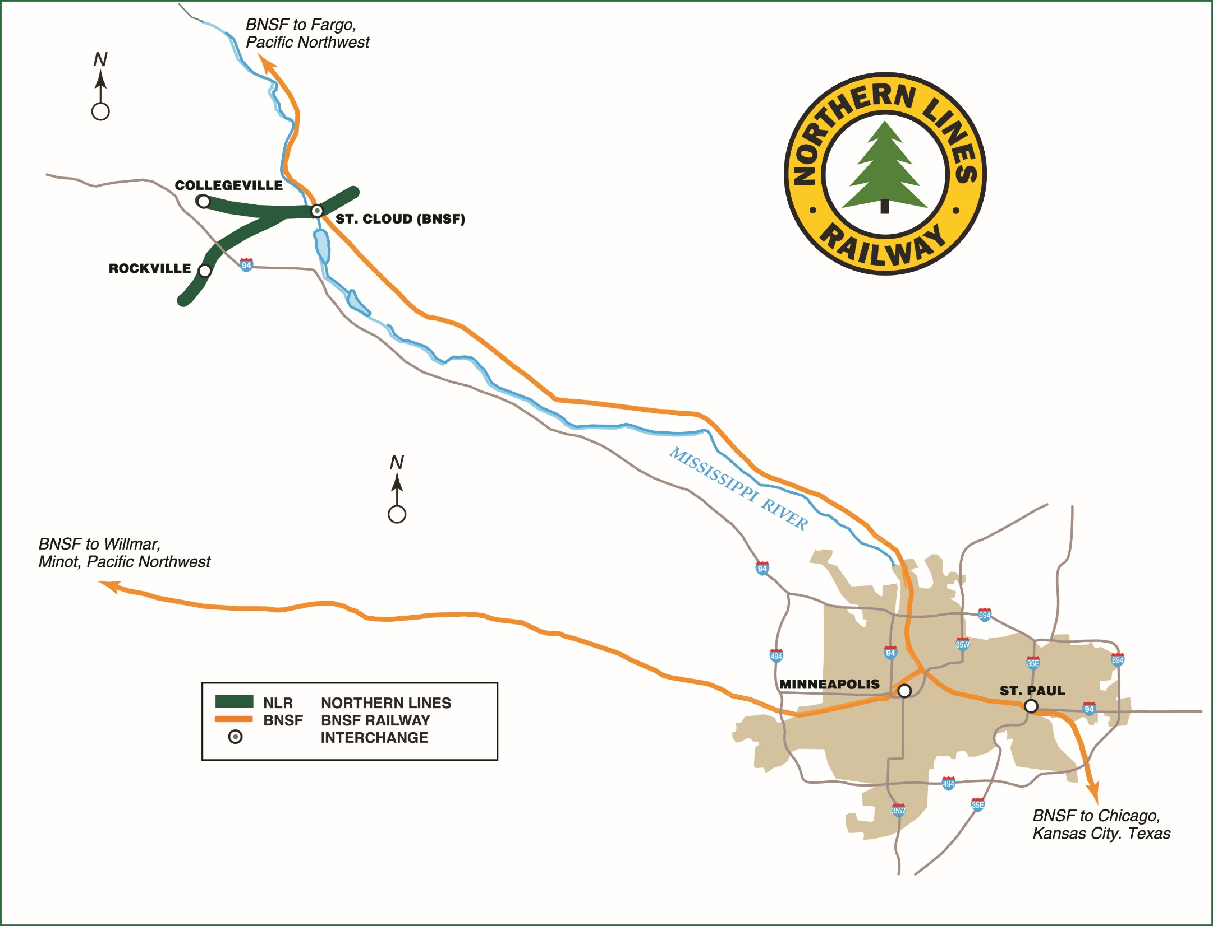

Slide 25
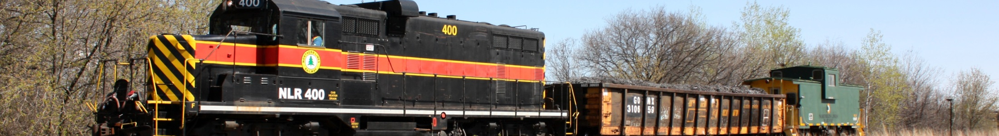
NLR: Vital Information
Established
2005 lease from BNSF
Serves
St. Cloud, MN
Connections
BNSF
Commodities
Paper, building materials, stone
Route Miles
17.1
Carloads
8,000
President
Mr. Justin Chalich

Slide 26



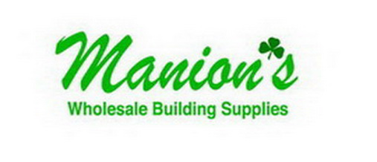









NLR Customers Served
Stone
Lumber/Building
Propane
Manufacturing
Aggregate/Farm
Paper
Central Minnesota Dust Control, LLC

Slide 27
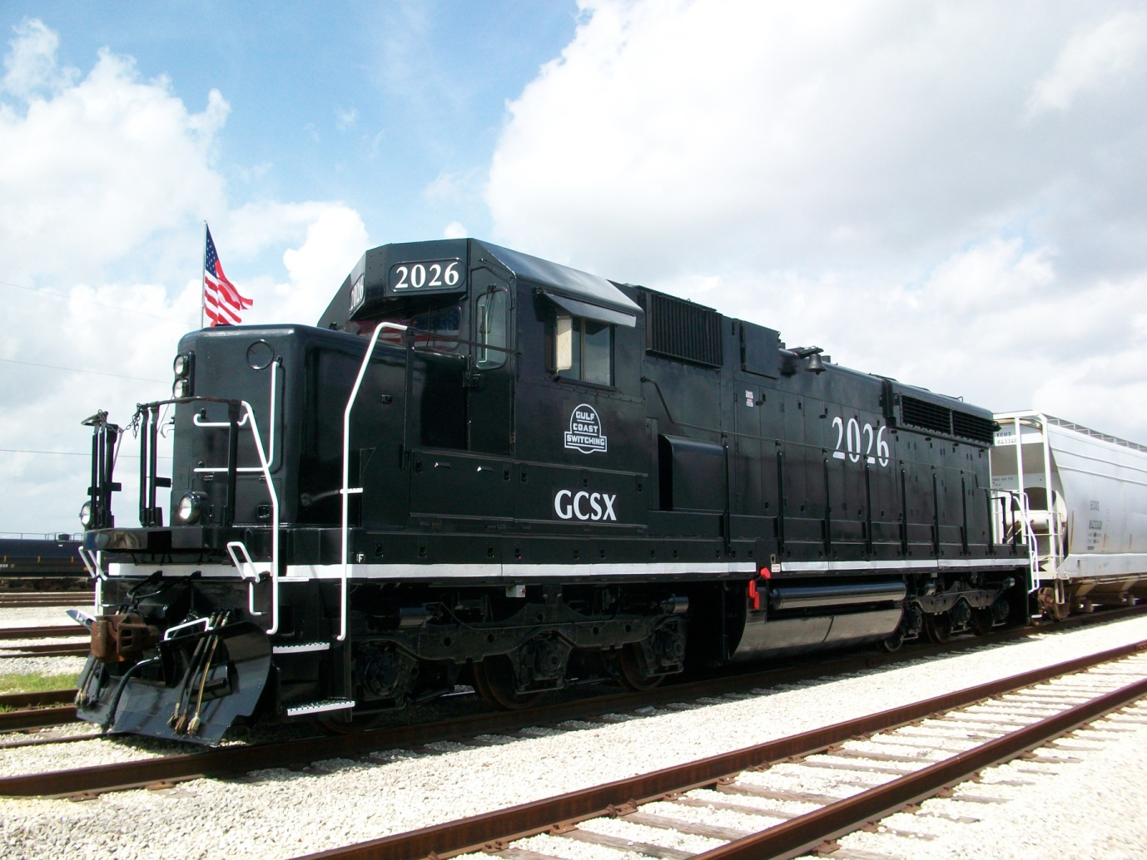

Gulf Coast Switching Company

Slide 28


Slide 29


GCSC: Vital Information
Established | 2008 contract with Union Pacific
President | Leigh Walters
Serves | Robinson Yard, Dayton, TX
Connection | Union Pacific
Commodity | Plastic – Storage in Transit
Route miles | 3
Carload equivalents President | 10,000 Mr. Leigh Walters

Slide 30

Operational Depth and Experience
Strong safety culture.
Full-time safety compliance officer.
Extensive experience in complex operating environments
Freight and passenger corridors
Terminal areas
Class I trackage rights operations
Relationships with all Class I railroads.

Slide 31
Service in Complex Operating Environments
Operations in New York, Chicago and Los Angeles.
PHL dispatches all trains in Ports of Los Angeles and Long Beach.
Operations on joint freight/passenger corridors.
Operations on UP, BNSF, CN and CSX mainlines.
Service to large, complex customer facilities.

