Slide 1
North American Railcar Review
David Humphrey, PhD
ACACSO
May 9, 2014

Slide 2
Today’s Presentation
Fleet Dynamics: EOY 2012 to EOY 2013
Analysis on Revenue-Earning Fleet
Total Fleet Size Up Approximately 1%
Increases: Tanks (24k) and Flats (3k)
Decreases: Box Cars (3%), Open Hoppers (3%) and Gondolas (2%)

Slide 3
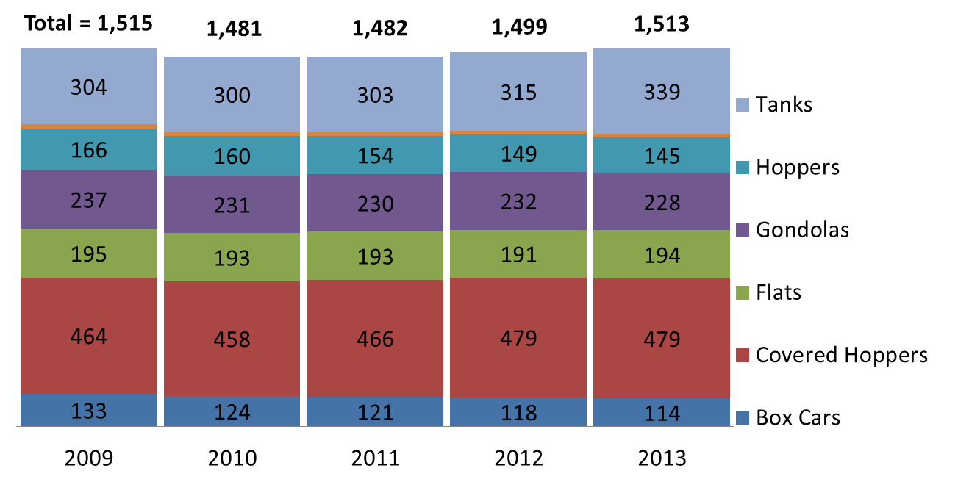
North American Freight Car Fleet, by Group
(Counts at year end, shown in thousands)

Slide 4
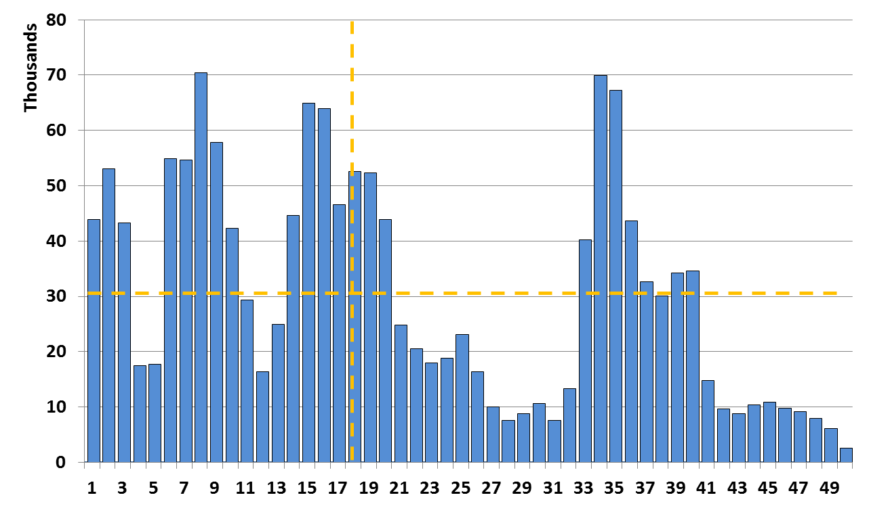
North American Freight Car Fleet Number of Cars by Age (Revenue-Earning Fleet)

Slide 5
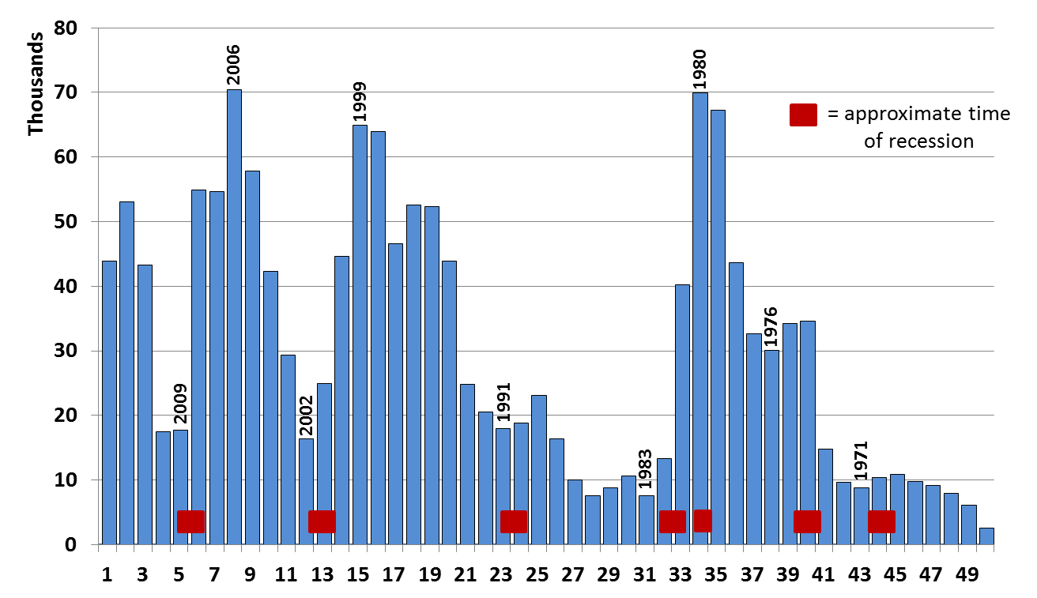
North American Freight Car Fleet Number of Cars by Age (Revenue-Earning Fleet)

Slide 6
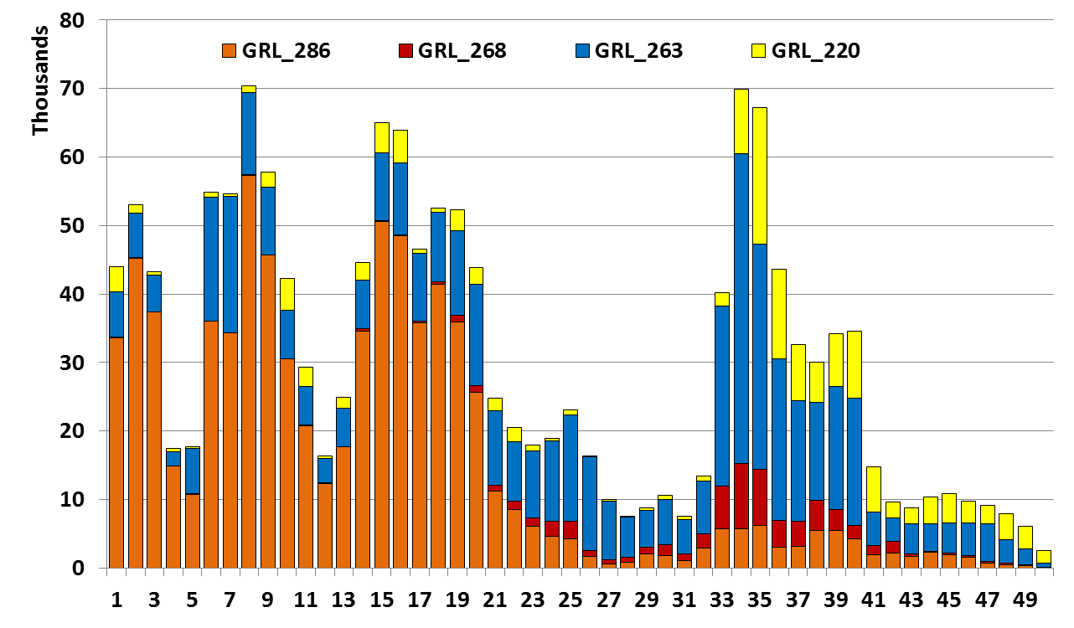
North American Freight Car Fleet Number of Cars by Age (Revenue-Earning Fleet)

Slide 7
North American Freight Car Fleet Top 10 ETCs in Revenue-Earning Fleet
Rank | Change | ETC | Count | Description
1 |  | C113 | 127K | CH – Medium
2 |  | C114 | 117K | CH – Large
3 |  | J311 | 106K | Coal Gondola
4 |  | C214 | 106K | CH – Large
5 |  | C112 | 73K | CH – Small
6 |  | T108 | 67K | Tank – Large
7 |  | T106 | 47K | Tank – Medium
8 |  | T104 | 41K | Tank – Small
9 | ↑ 1 | T107 | 41K | Tank – Medium
10 | ↓ 1 | K341 | 39K | Coal Hopper
These 10 ETCs represent just over 50% of the revenue-earning fleet.
Over 700 ETCs are present.

Slide 8
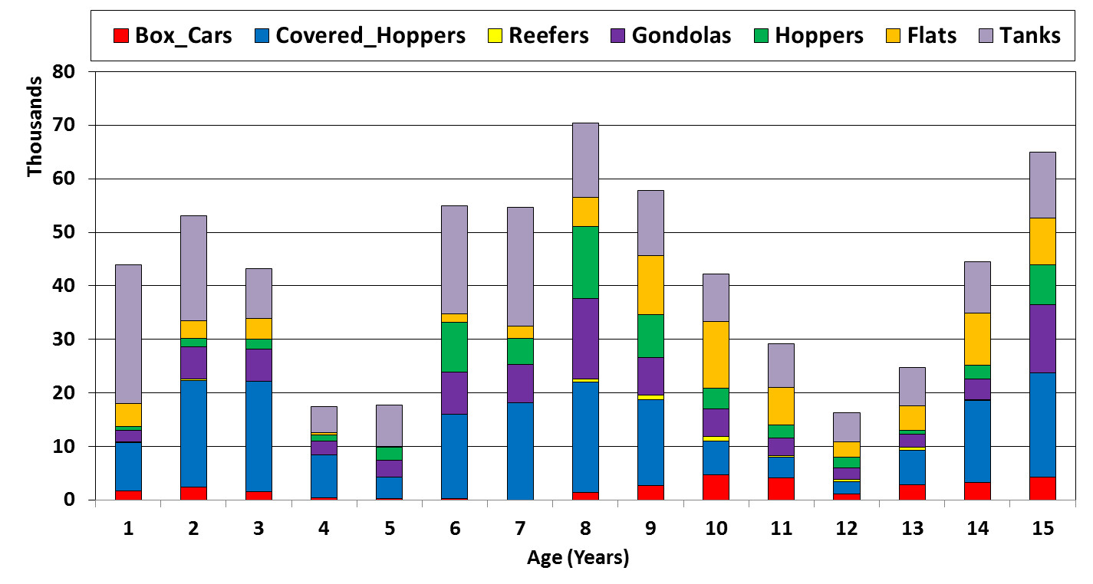
North American Freight Car Fleet Cars by Age and Type

Slide 9
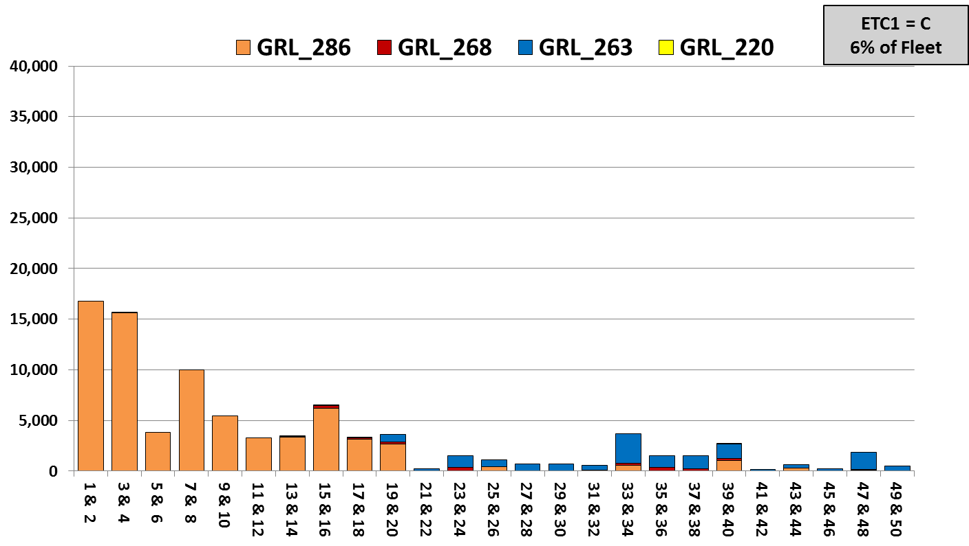
Small Covered Hoppers (Up to 4K ft³)
Age Distribution by GRL (Revenue-Earning Fleet)

Slide 10
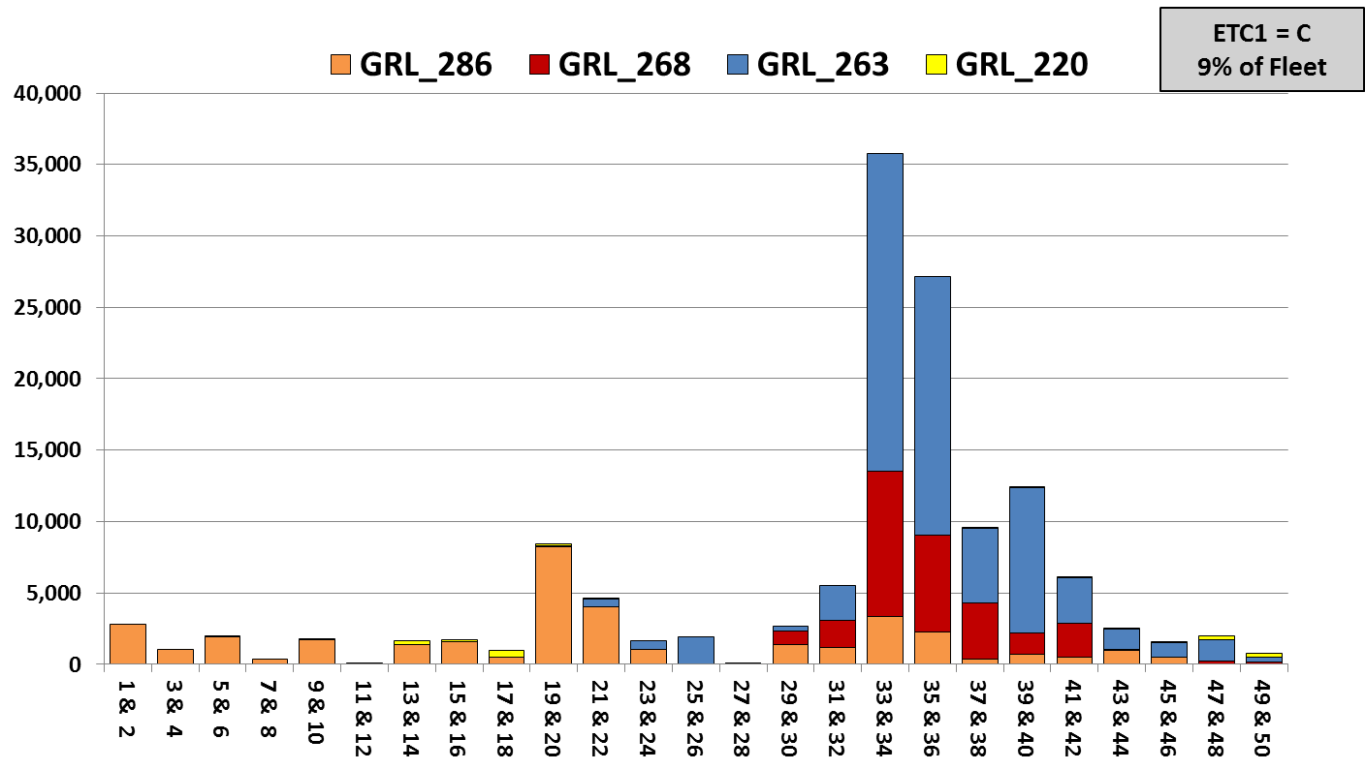
Medium Covered Hoppers (4K – 5K ft³)
Age Distribution by GRL (Revenue-Earning Fleet)

Slide 11
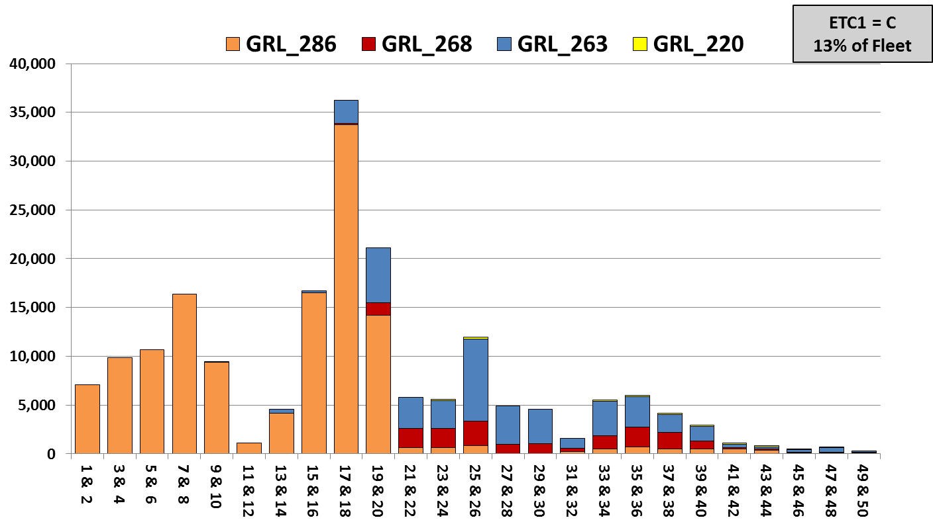
Large Covered Hoppers (5K – 6K ft³)
Age Distribution by GRL (Revenue-Earning Fleet)

Slide 12
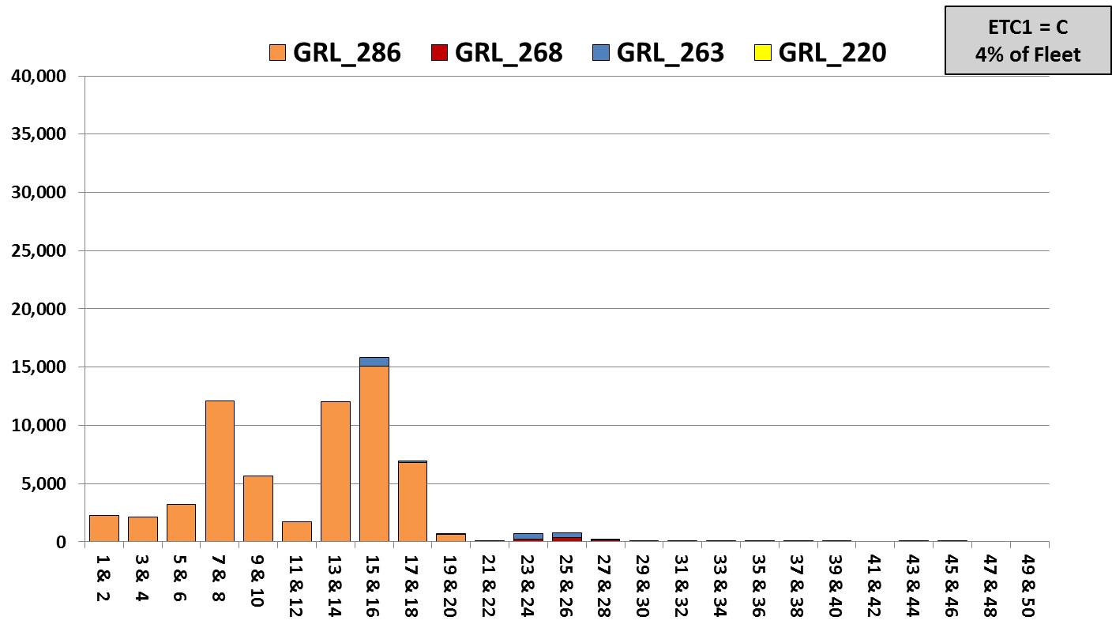
Jumbo Covered Hoppers (6K ft³ and Over)
Age Distribution by GRL (Revenue-Earning Fleet)

Slide 13
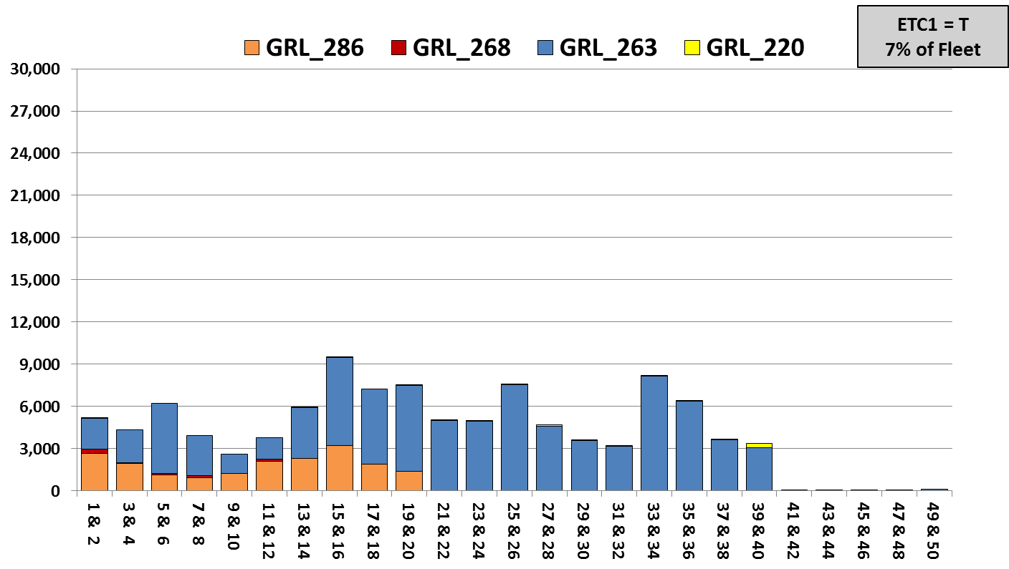
Small Tanks (under 22.5K Gallons)
Age Distribution by GRL (Revenue-Earning Fleet)

Slide 14
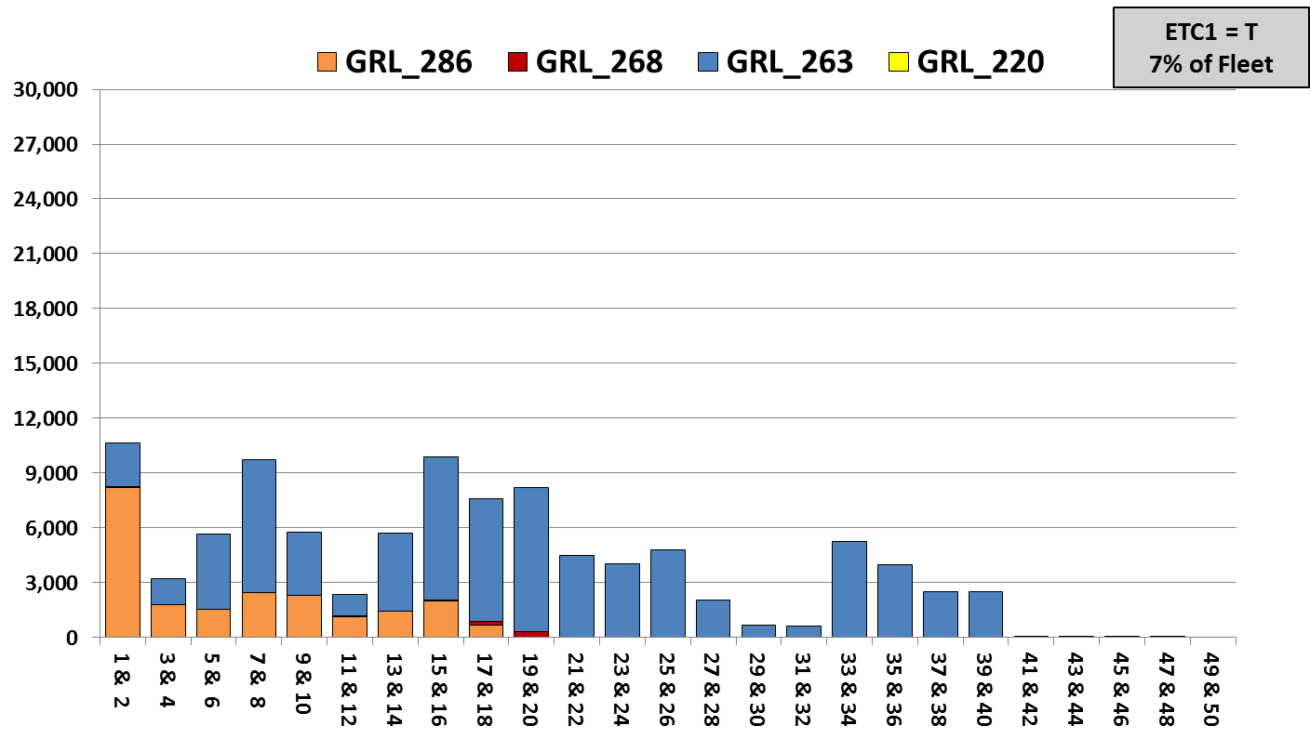
Medium Tanks (22.5K – 27.5K Gallons)
Age Distribution by GRL (Revenue-Earning Fleet)

Slide 15
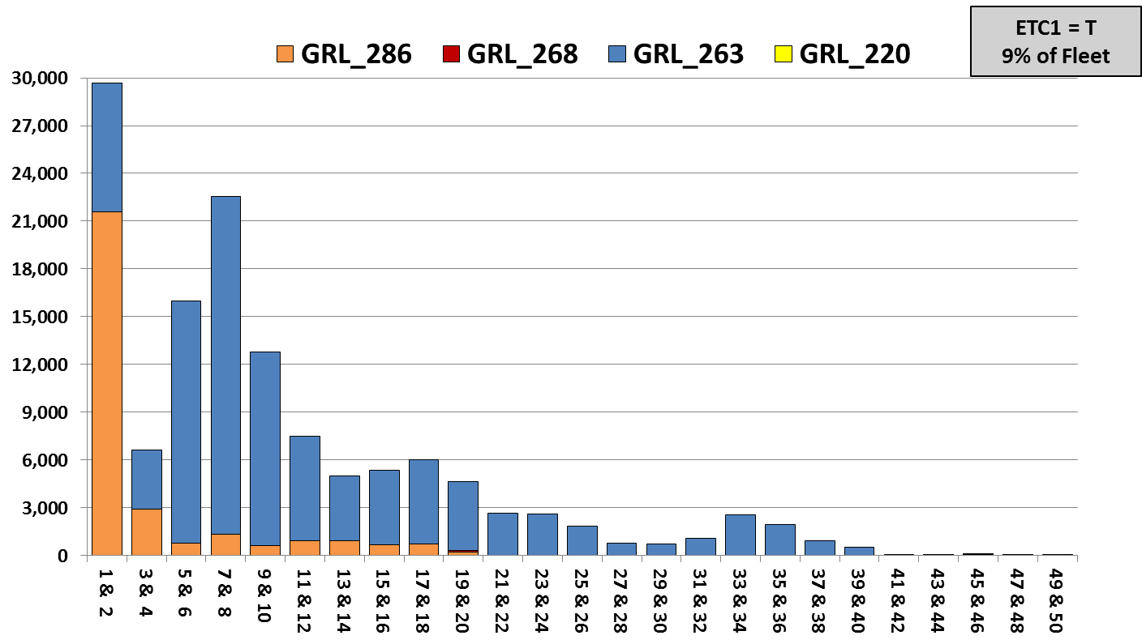
Large Tanks (27.5K Gallons and Over)
Age Distribution by GRL (Revenue-Earning Fleet)

Slide 16
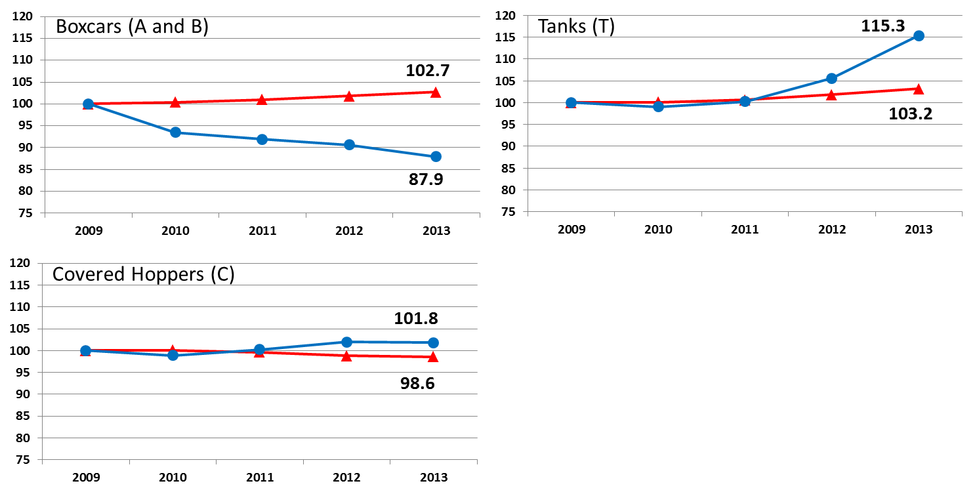
Fleet Capacity and Average Car Size
Blue: Total Fleet Capacity
Red: Average Car Size (gal or ft³)
Index: 2009 = 100

Slide 17
QUESTIONS?

Slide 18
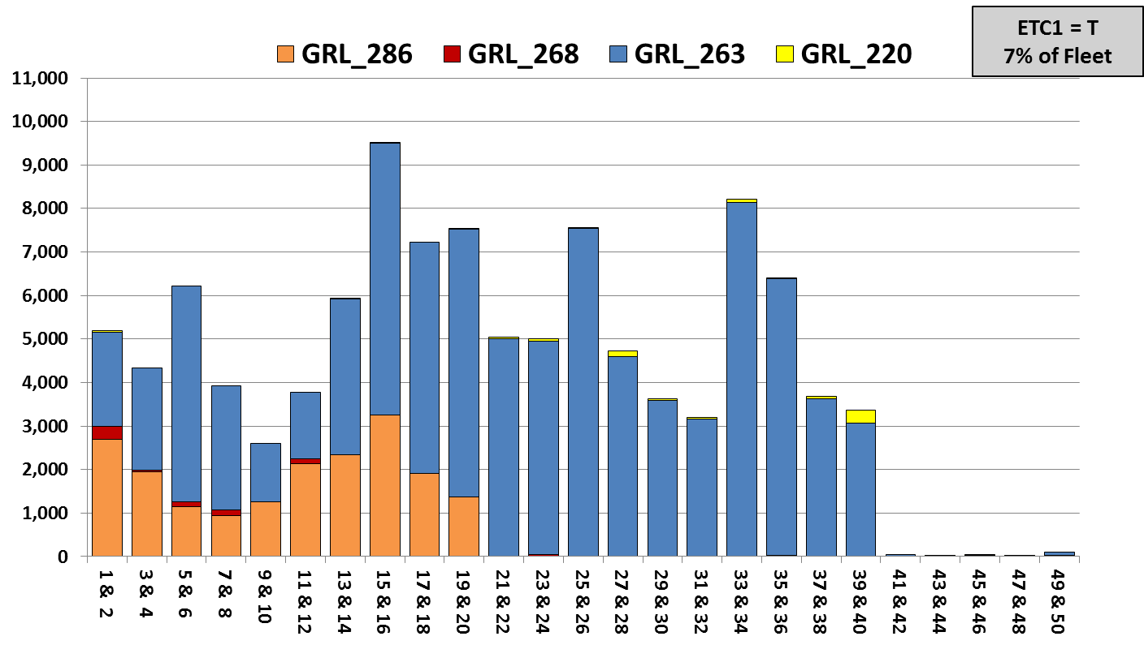
Small Tanks (under 22.5K Gallons)
Age Distribution by GRL (Revenue-Earning Fleet)

Slide 19
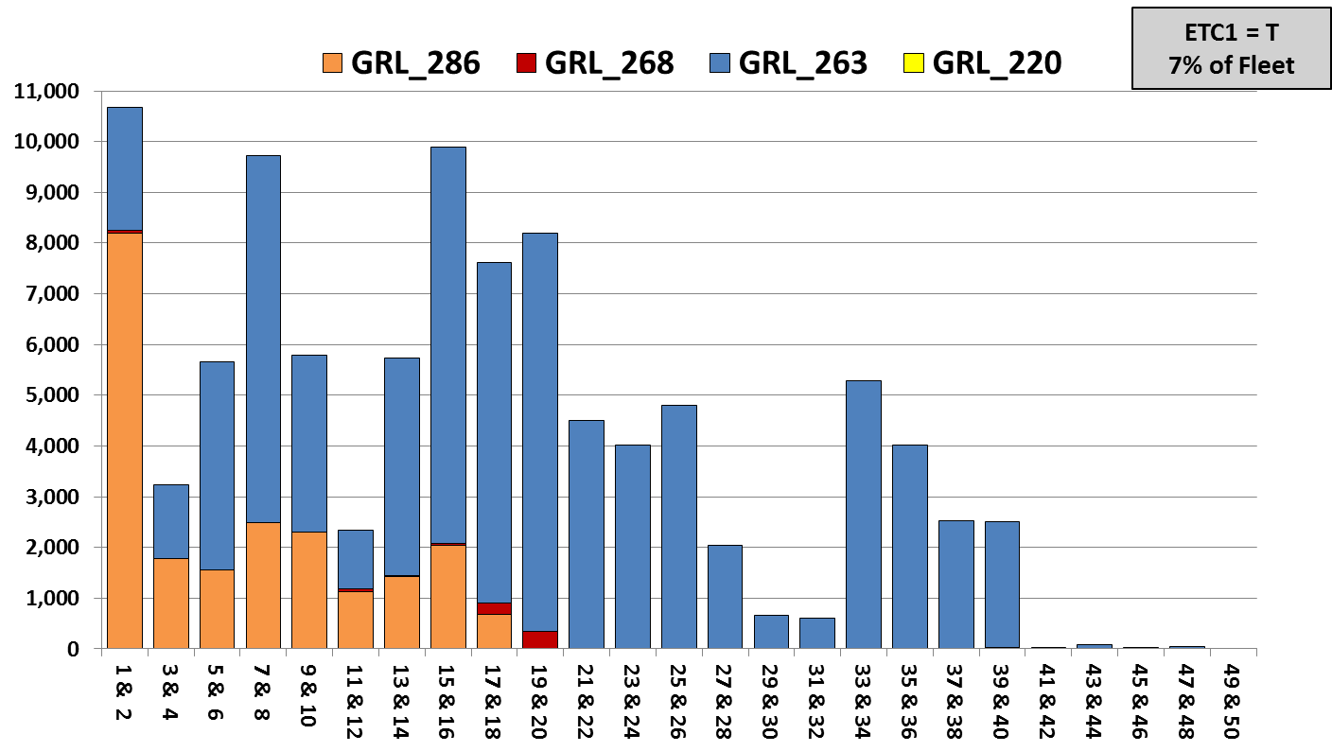
Medium Tanks (22.5K – 27.5K Gallons)
Age Distribution by GRL (Revenue-Earning Fleet)

Slide 20
Large Tanks (27.5K Gallons and Over)
Age Distribution by GRL (Revenue-Earning Fleet)

