Slide 1
Association of Car Accounting and Car Service Officers
Austin, Texas
November 12, 2014

Slide 2
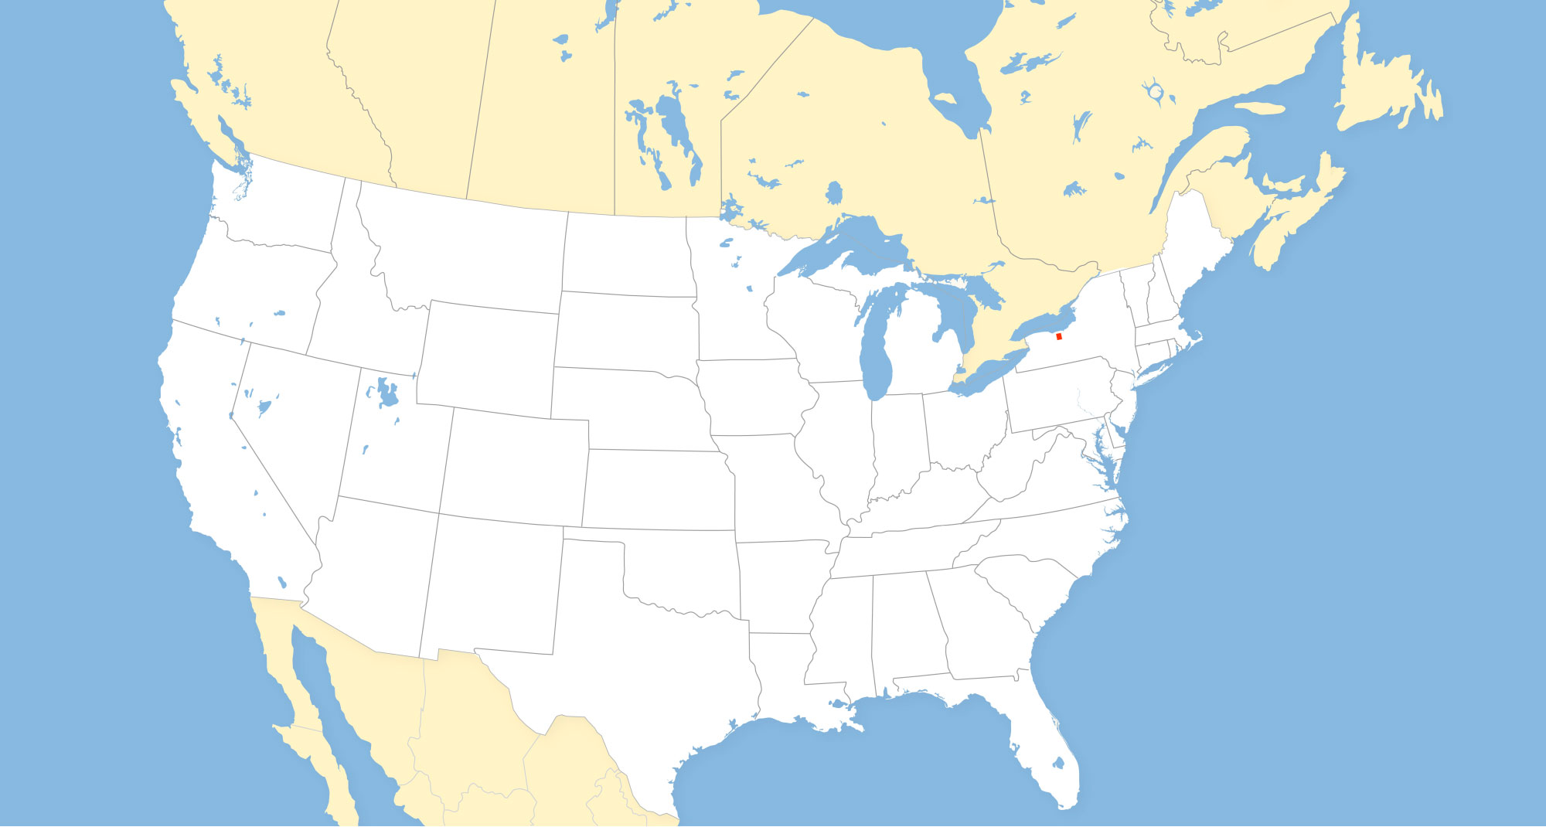
Genesee & Wyoming Inc. 1899
The original
Genesee & Wyoming Railroad;
14-miles in upstate NY
serving one customer
that we still serve today

Slide 3
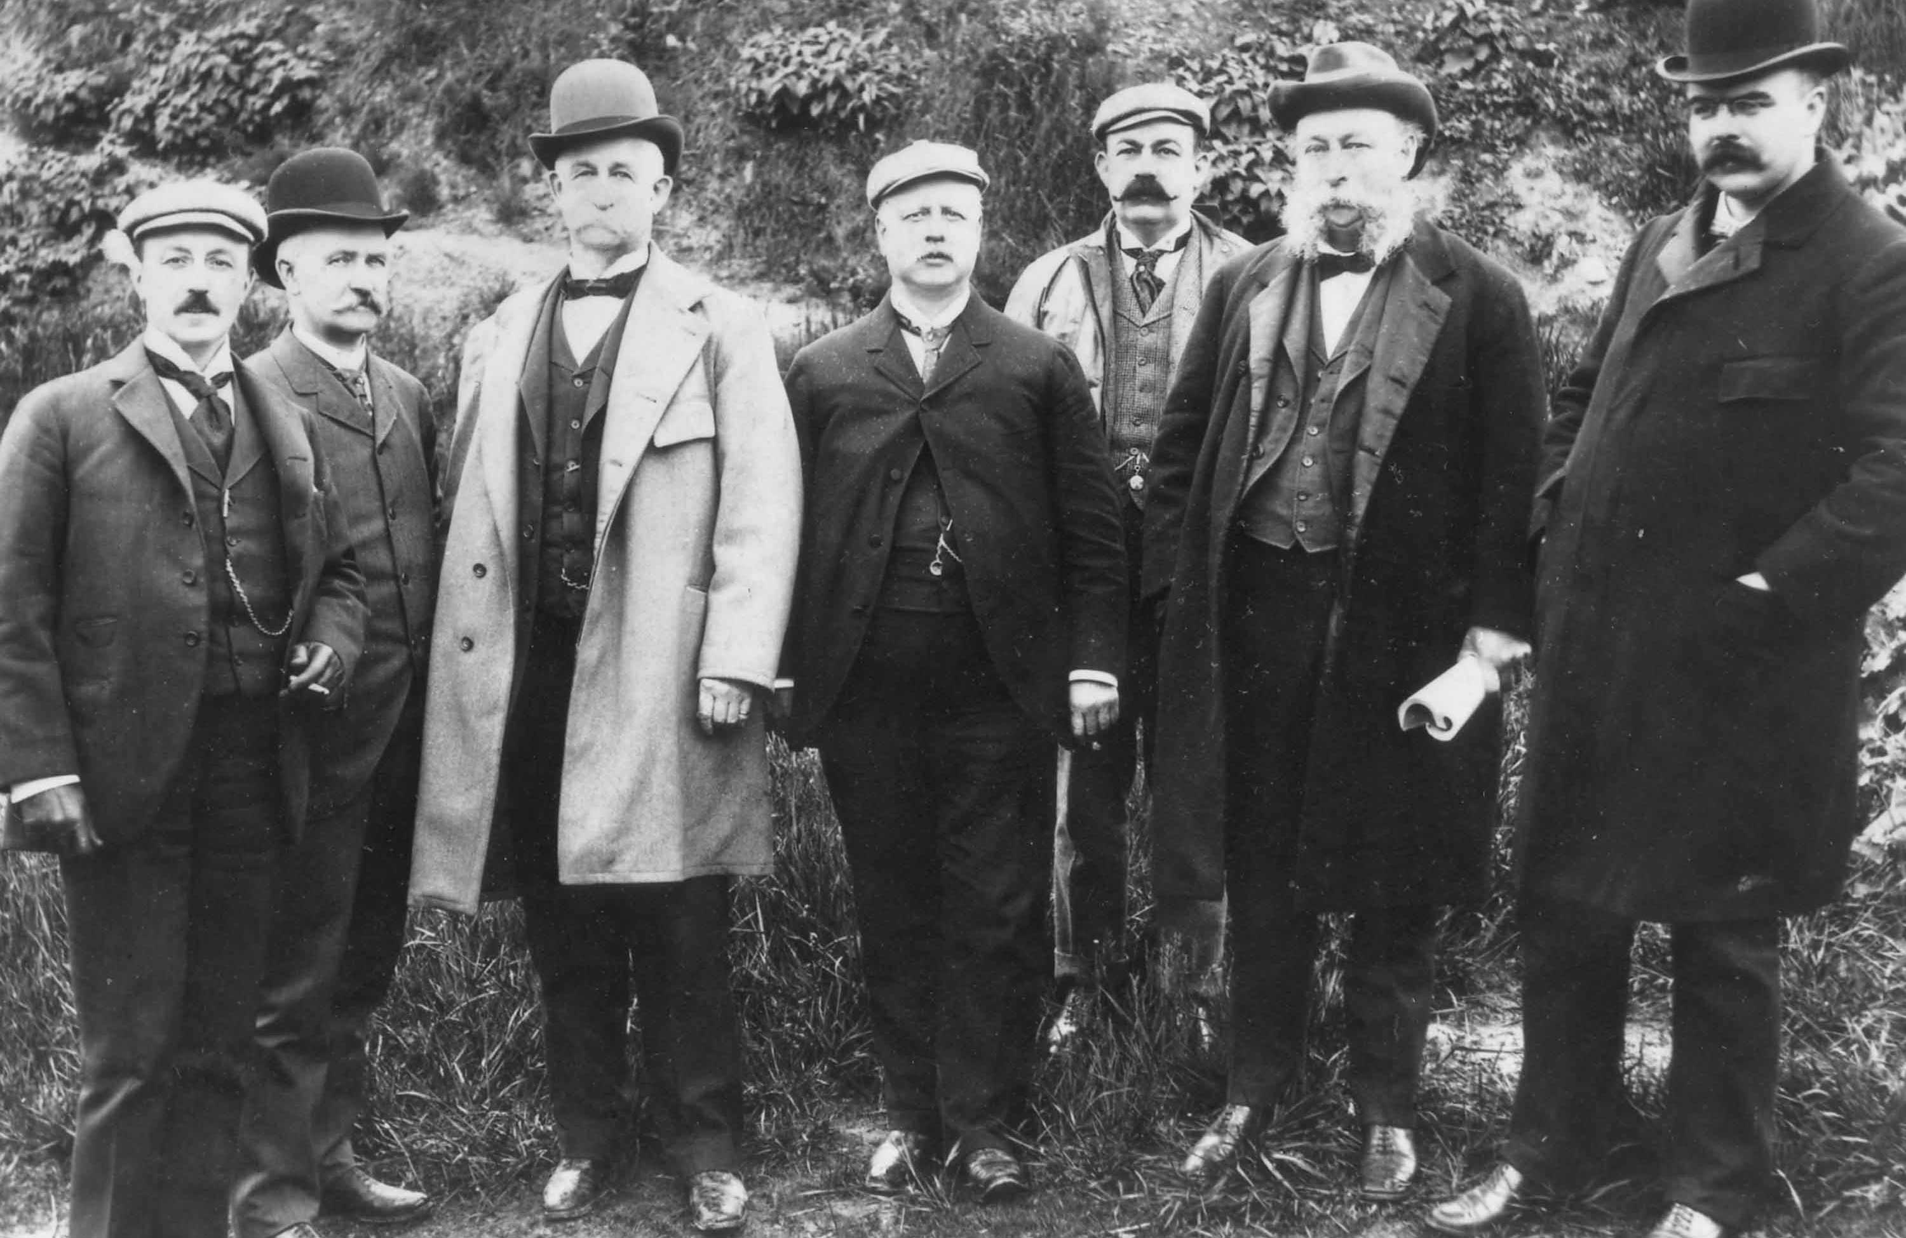
G&W Board of Directors 1899

Slide 4
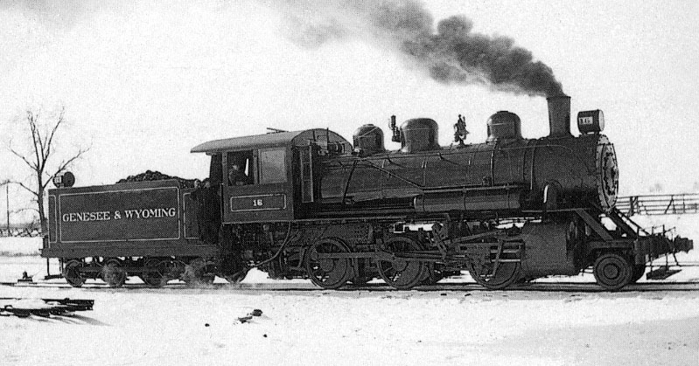
Early G&W Power

Slide 5



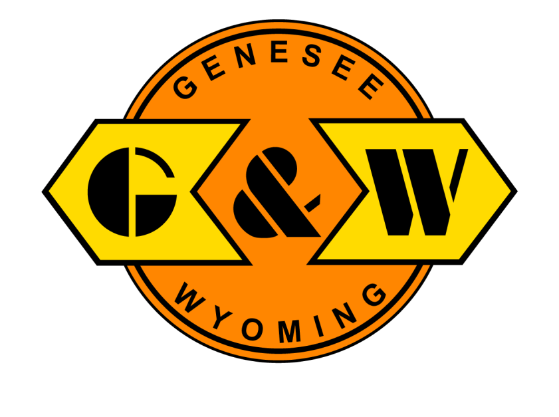
Origin of G&W Logo
Milton Glaser: “America’s most celebrated designer.”
November, 1977

Slide 6
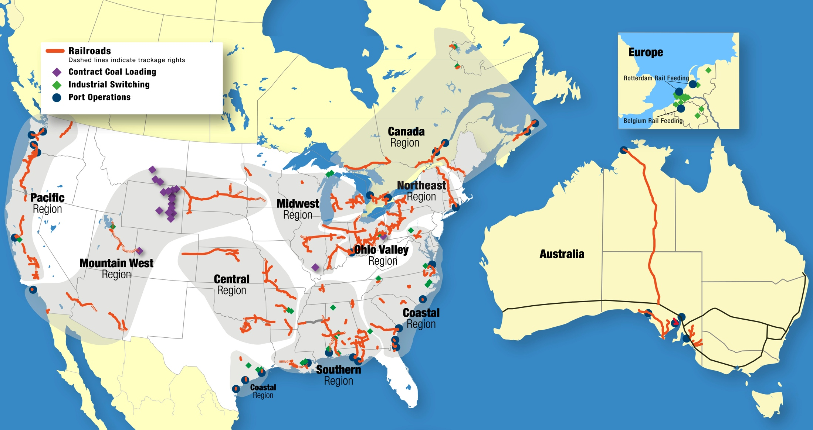
Genesee & Wyoming Inc. 2014
Genesee & Wyoming
G&W (2014) – U.S., Canada, Australia, The Netherlands and Belgium

Slide 7
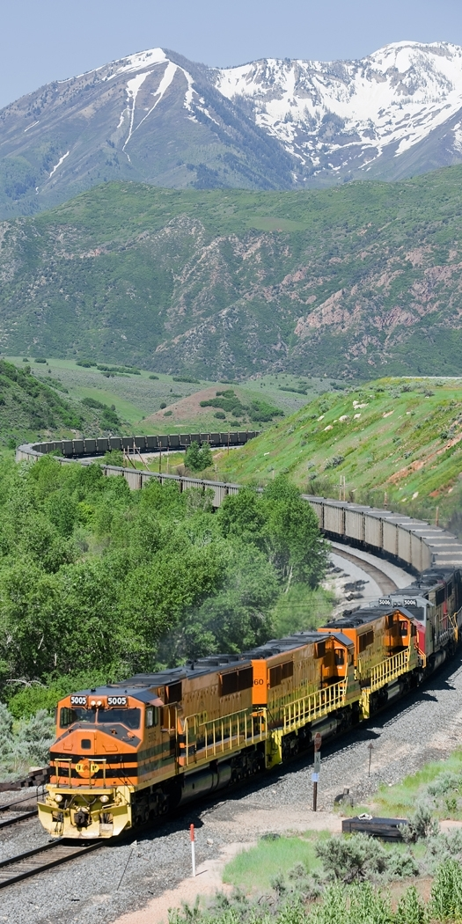
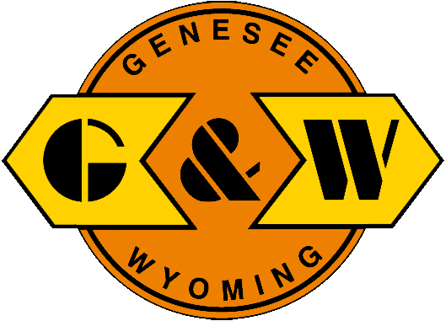
Today
Listed on NYSE (“GWR”)
with $1.6 billion of revenues
Own 112 railroads and employ
5,000 people serving 2,000 customers
Operate over 15,000 track miles
with ~1,000 locomotives
11 operating regions worldwide

Slide 8
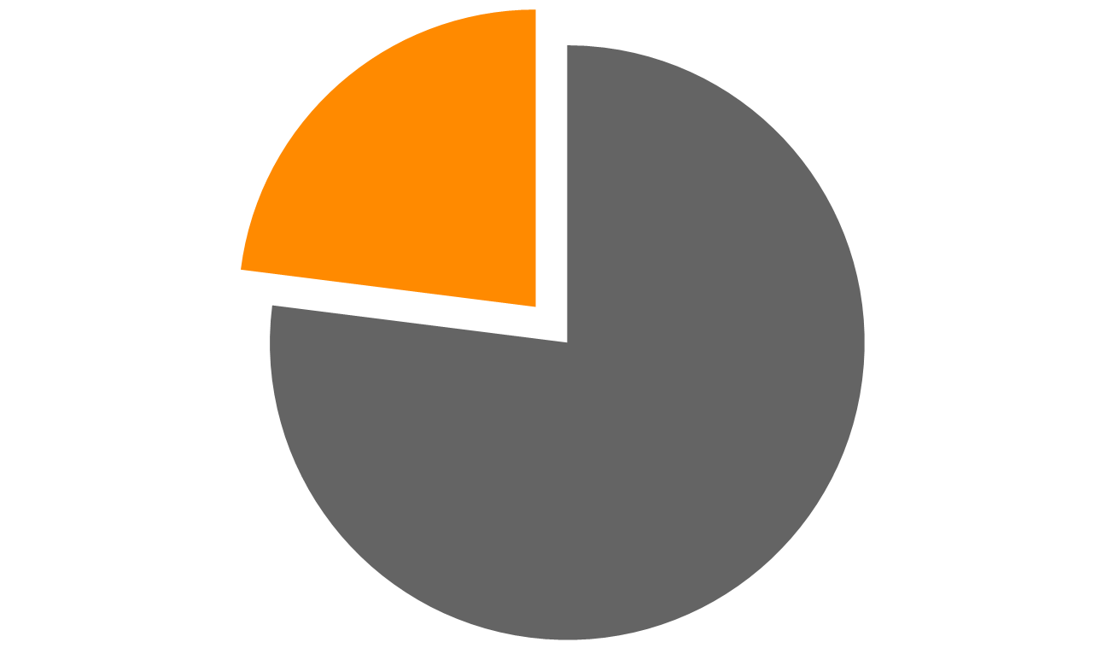
43,000 U.S. Short Line Track Miles
23%
Rest of Industry
77%
Total Class II & III miles per ASLRRA

Slide 9
Broadest Geographic Coverage in North America with Significant International Diversity
Region | G&W | UP | BNSF | CN | CP | KCS | NS | CSX
Northwest
Southwest
Midwest
Southeast
Northeast
Canada
Mexico
International

Slide 10
Consistent Long-Term Growth
($ millions)
Revenue CAGR ~19% from IPO thru 2013
≈
Notes:
10

Slide 11
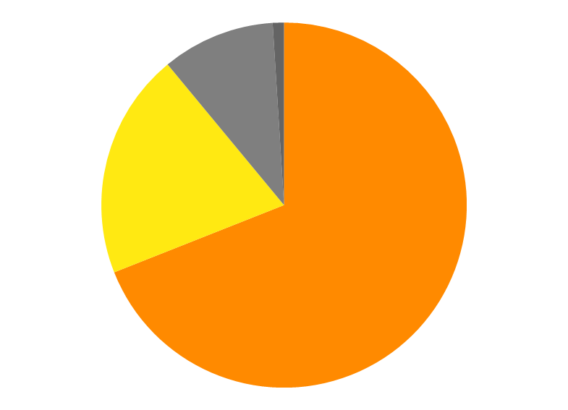
Revenue Diversity by Geography
Europe 1%
Canada
9%
Australia
20%
U.S. 70%
(8 Regions)

Slide 12
Revenue Diversity by Commodity
2014 Freight Revenue* by Commodity (Q3 Run Rate)
*Freight revenue is 75% of total revenues

Slide 13
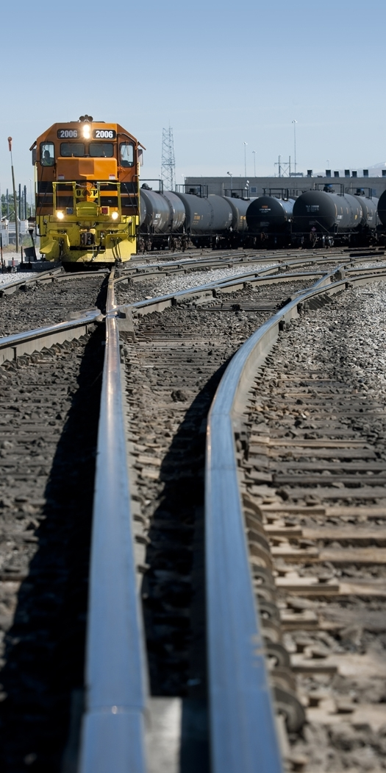
G&W’s Decentralized
Operating Philosophy
Eleven regions with strong local management backed by centralized corporate staff support
Continuous Safety Improvement
Focused Regional Marketing
Lower Operating Costs
Efficient Use of Capital
Our local focus is key to G&W’s strong safety and customer-satisfaction results

Slide 14
G&W Revenue By Region
In 1999, G&W had 21 railroads and $175 million in revenues
Today, an average G&W region has 10 railroads and $150 million
in revenues
Mtn
West
Midwest
Australia
Northeast
Central
Canada
Ohio Valley
Pacific
Southern
Coastal

Slide 15
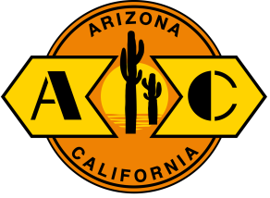
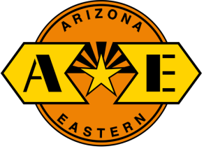
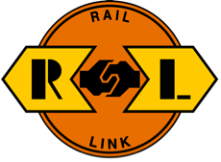
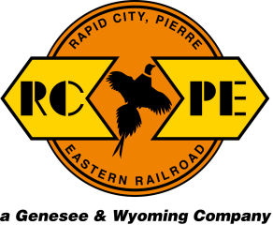
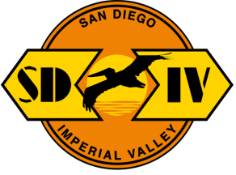
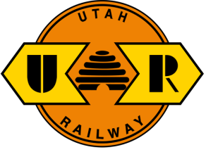
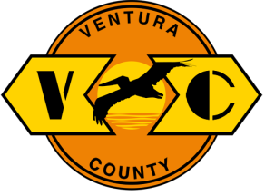
Regional Operating Structure:
Designed to be Close to Customers
Mountain West Region
Safety
Finance
Marketing
/Sales
Transportation
Mechanical
Engineering
HR
IT
Customers
15

Slide 16
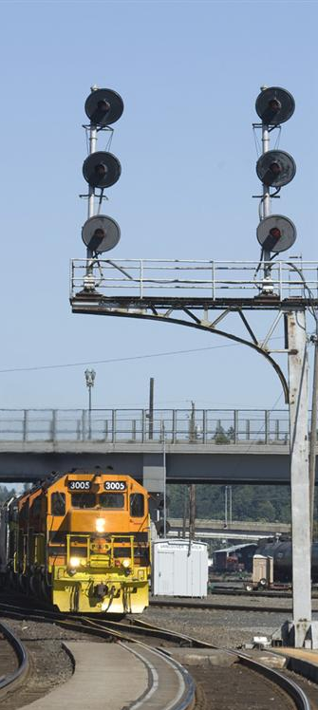
Our Core Purpose
To be the
safest and
most respected
rail service
provider
in the world.

Slide 17

Industry-Leading Safety Performance
2014 Injury-Frequency Rate per 200,000 man-hours
G&W through September; others through July

Slide 18
G&W Railroad Injury Frequency Rate and Number of Employees
Injury Frequency Rate per 200,000 Man-Hours
Employees

Slide 19
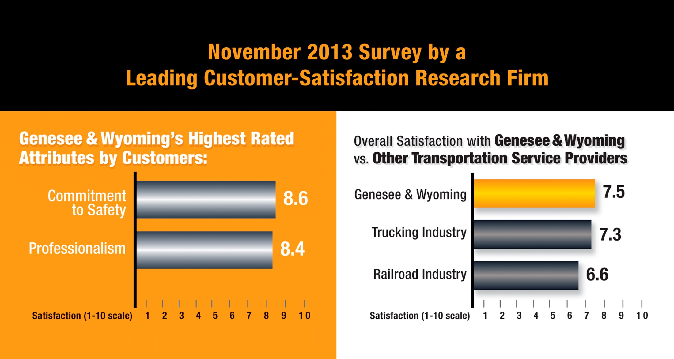
Respected by Our Customers:
Industry-Leading Customer Satisfaction

Slide 20
Respected by Our Customers:
Gross Capital Investment
($ millions)

Slide 21



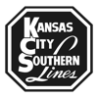



Respected by Class I Partners
2014: 1.7MM* G&W Carloads Interchanged
*Q3 Run Rate
70,000
155,000
408,000
328,000
59,000
279,000
404,000

Slide 22

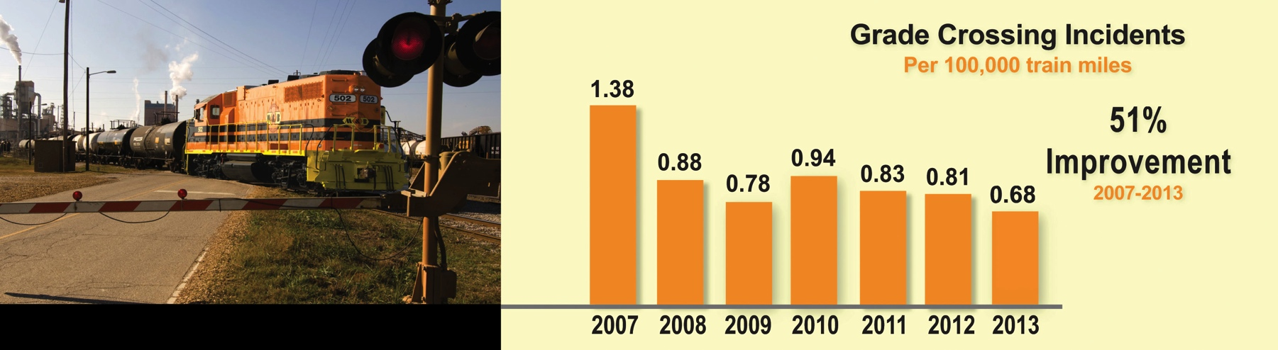
Respected by Our Communities:
G&WCommunity
In recent years, our employees made 1,000 Operation Lifesaver presentations to more than 50,000 schoolchildren, school bus drivers and others on the importance of rail-crossing safety.

Slide 23
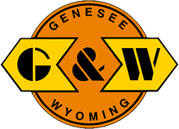
Respected by Our Shareholders:
Consistent Share Price Appreciation
$100 Invested January 2000

Slide 24
Components of Growth
Traditional
Class I spinoffs
after Staggers Act

Slide 25
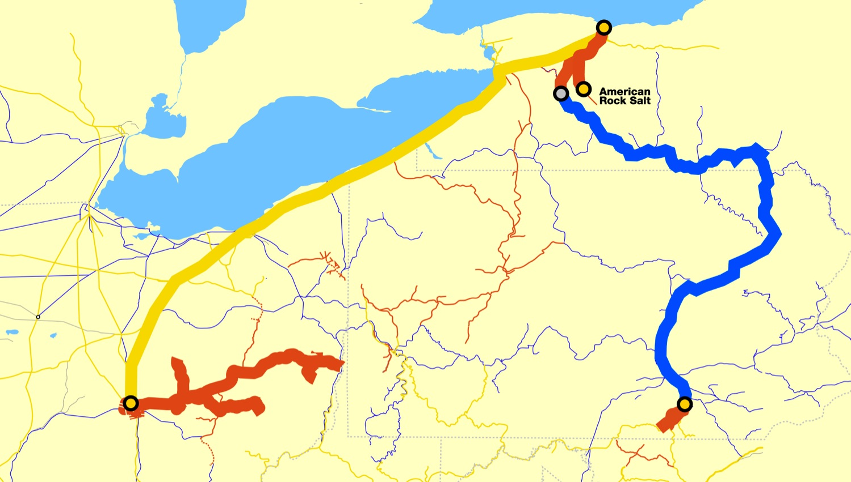
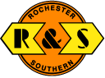

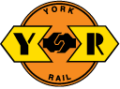
1. Traditional Class I spinoffs
“First & Last Mile” to the Customer

Slide 26
Components of Growth
Railroads embedded in industrial facilities

Slide 27
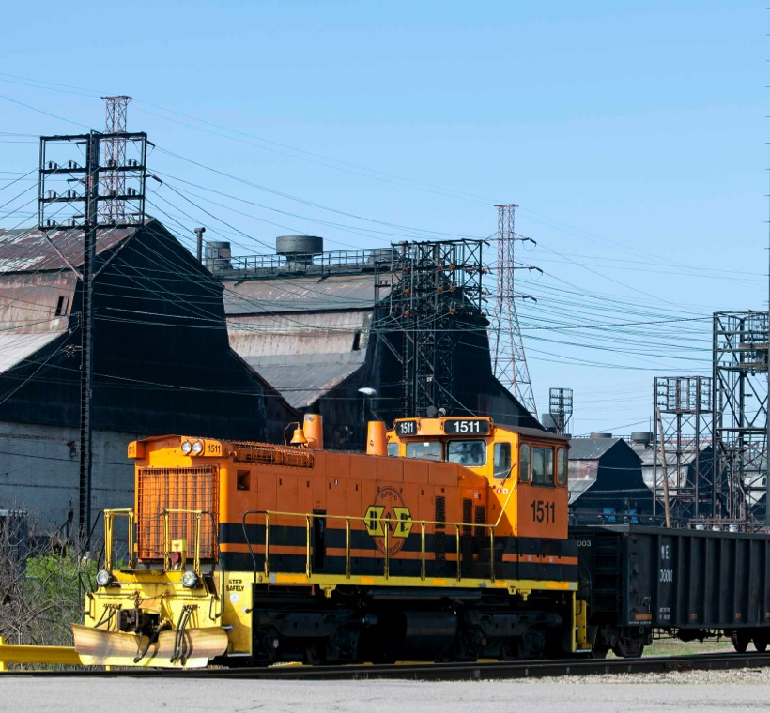
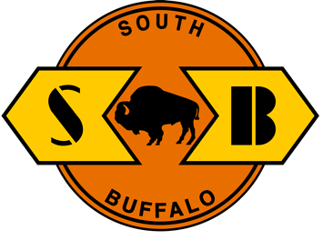
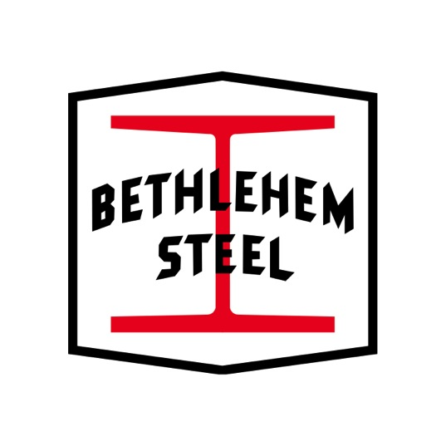
2. Embedded Industrial Railroads
Non-Core Competence for Owners

Slide 28
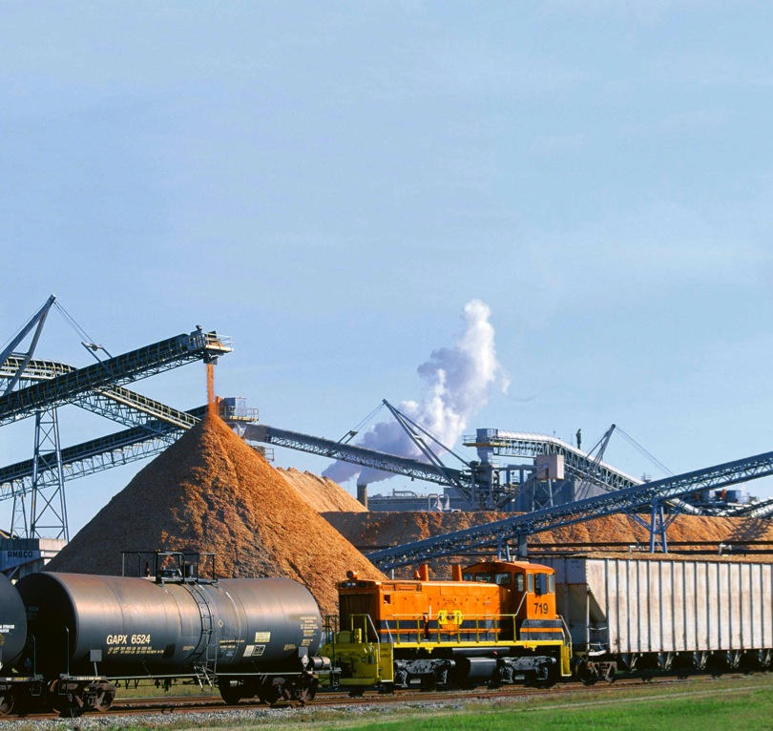

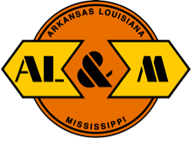

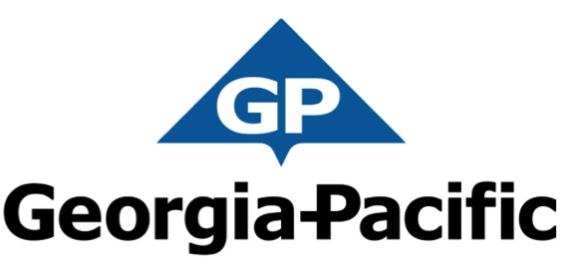
2. Embedded Industrial Railroads
Non-Core Competence for Owners
Genesee & Wyoming Companies

Slide 29
Components of Growth
Contiguous railroads as building blocks of regional rail systems

Slide 30
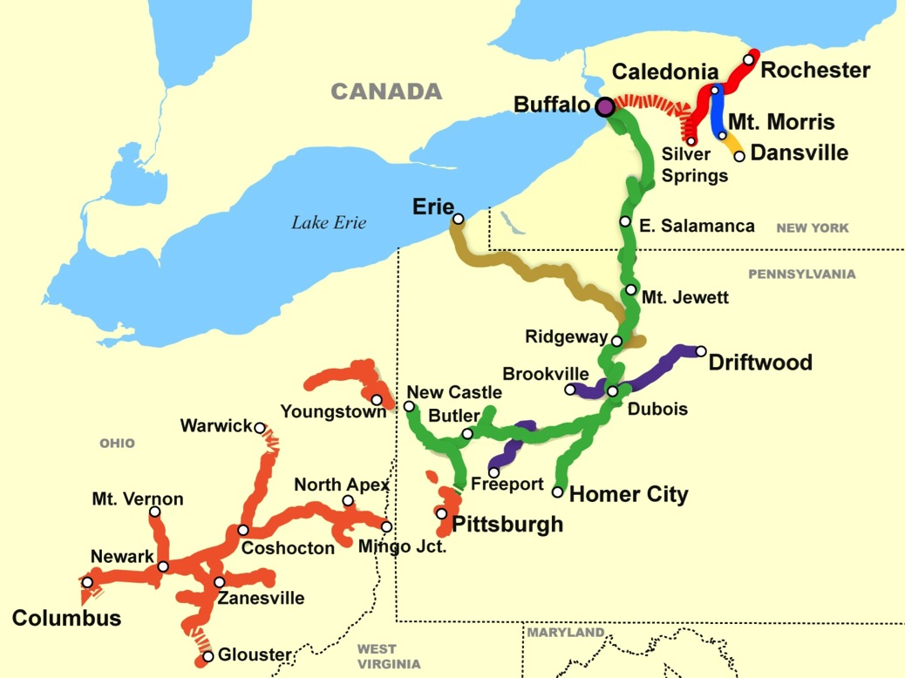
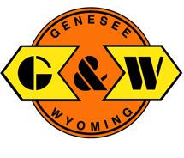
3. Contiguous Railroads
Building Regional Rail Systems
1977 Genesee & Wyoming Railroad (GNWR)
1985 Dansville & Mount
Morris Railroad (DMM)
1986 Rochester & Southern Railroad (RSR)
1988 Buffalo & Pittsburgh Railroad (BPRR)
1992 Allegheny & Eastern Railroad (ALY)
1996 Pittsburg & Shawmut Railroad (PS)
2001 South Buffalo Railway (SB)
2008 Ohio Lines

Slide 31
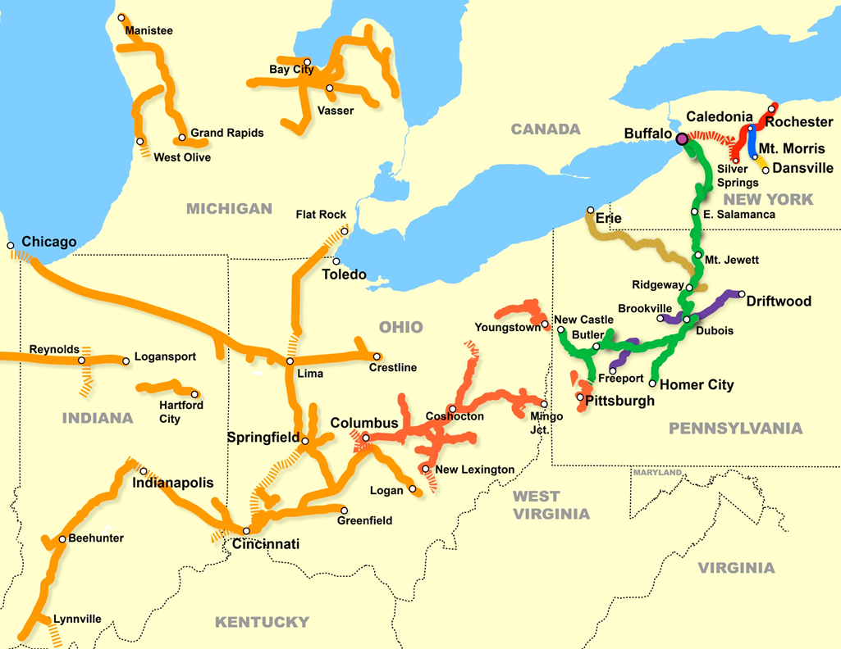
3. Contiguous Railroads
Building Regional Rail Systems
1977 Genesee & Wyoming Railroad (GNWR)
1985 Dansville & Mount
Morris Railroad (DMM)
1986 Rochester & Southern Railroad (RSR)
1988 Buffalo & Pittsburgh Railroad (BPRR)
1992 Allegheny & Eastern Railroad (ALY)
1996 Pittsburg & Shawmut Railroad (PS)
2001 South Buffalo Railway (SB)
2008 Ohio Central railroads
2012 RailAmerica railroads

Slide 32
Components of Growth
International
privatizations

Slide 33
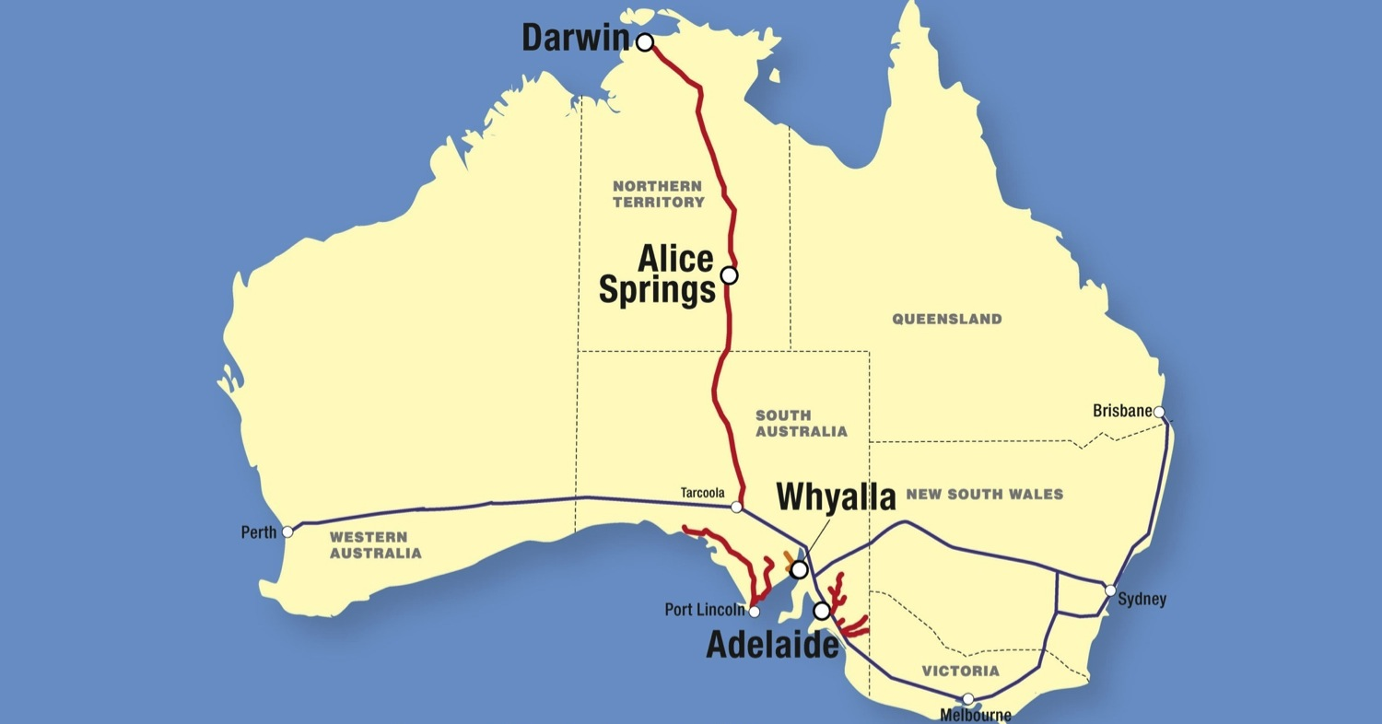

4. International Privatizations
G&W in Australia: de facto Class I Railroad

Slide 34
Components of Growth
Mining-focused railroads serving Asian industrialization

Slide 35
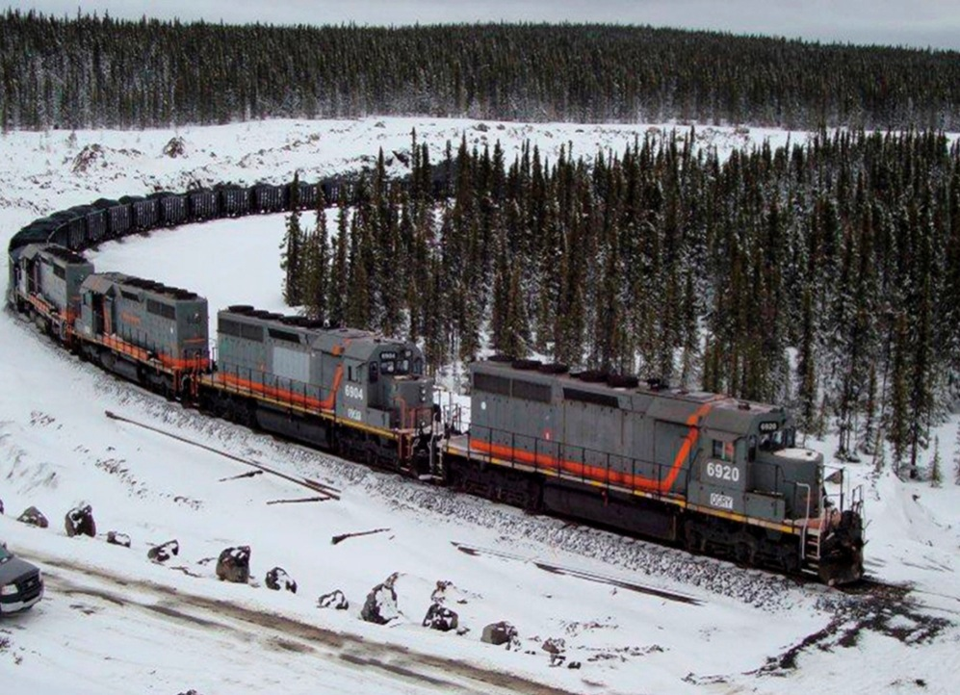



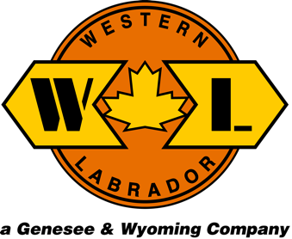
5. Mining-Focused Railroads Serving Asian Industrialization
  Iron Ore Mines in Canada

Slide 36
Components of Growth
Consolidation of
short line industry with G&W acquisition of RailAmerica

Slide 37
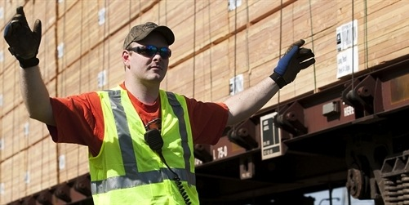
G&W acquisition of RailAmerica:
Natural progression in the evolution of the rail industry since deregulation
Step 1: rationalization and dramatic improvements by Class I railroads; industry now capable of earning its cost of capital and reinvesting in its network for decades to come

Slide 38
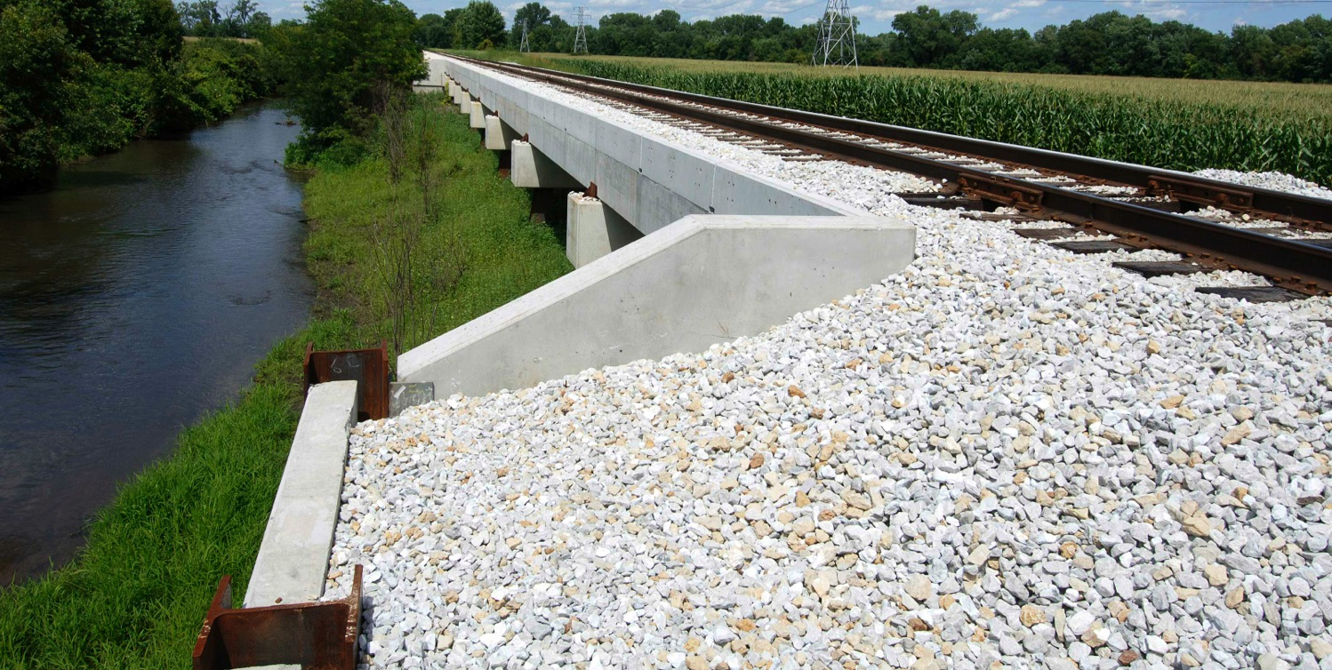
G&W acquisition of RailAmerica:
Natural progression in the evolution of the rail industry since deregulation
Step 2: consolidation of lower-density short lines, creating the ability to invest in long-term infrastructure and provide customers world-class service from door to door

Slide 39
Beyond the First and Last Mile
Short line industry has matured greatly since
its birth in 1980
Successful business model of being close to customers with entrepreneurial decision-making unchanged
Transformation from “Mom & Pop” railroads to professional, well capitalized partners to support customer growth in the U.S. and abroad

Slide 40
