Slide 1
Car Hire Liability File
Matt Cox
ACACSO
May 10, 2013

Slide 2
Car Hire Liability File: Basics
A different format of the car hire data you are already familiar with, in one place as an easy to use snapshot
All of the data you receive in Train6X LCS messages and TRAIN28 TOLs
Contains LCS evaluated interchanges, Rule 5 and Rule 15 TOLs, DDCT, haulage and more
Notes:
What is it

Slide 3
Car Hire Liability File: Basics
The file contains one record for a railcar per railroad
Shows details of the start of the move and the end of the move
Calculates time based on LCS evaluated interchanges using Car Hire Rule 2A
Notes:
What is it

Slide 4
Car Hire Liability File: Benefits
No need to compile, sequence and store data from TRAINII messages
Reduced carrier processing- Railinc calculates hours for time liability
Easier visibility into Haulage than TRAINII
Notes:
benefits

Slide 5
Car Hire Liability File
File is distributed via FTP
Recipients parse out and digest data
Cycles are applied (in current production version of CHLF)
CHDX records are created and sent back to Railinc
Notes:
How it is used

Slide 6
CHLF Sample: General Info
MSTR_REC_TYPE | EQUIP_OWNER | EQUIP_UNIT_INIT_CD | EQUIP_UNIT_NB | POSSESSION_ROAD | LIABLE_ROAD
AF | ABC | ABC | 55 | XYZ | XYZ
AF | ABC | ABC | 55 | XYZ | XYZ
AF | ABC | ABC | 55 | XYZ | XYZ
AF | ABC | ABC | 55 | XYZ | XYZ
AF | ABC | ABC | 585067 | XYZ | XYZ
AF | ABC | ABC | 585067 | XYZ | XYZ
AF | ABC | ABC | 585067 | XYZ | XYZ
AF | ABC | ABC | 585067 | XYZ | XYZ
AF | ABC | ABC | 585067 | XYZ | XYZ
AF | ABC | ABC | 585067 | XYZ | XYZ

Slide 7
CHLF Sample: Movement Start
START_LIAB_CD | START_LIAB_TYPE | START_EVENT_TS | START_MONTHHR | START_ROAD | START_LOC_SPLC_CD | START_LE_STATUS
MTH | S | 01FEB2013:00:00:00.000000 | 0 | XYZ | 411700000 | E
ECB | S | 05FEB2013:05:00:00.000000 | 125 | XYZ | 411700000 | E
LCS | B | 25FEB2013:01:20:00.000000 | 578 | XYZ | 403845000 | E
ECB | S | 26FEB2013:01:20:00.000000 | 602 | XYZ | 403845000 | E
LCS | V | 06FEB2013:10:05:00.000000 | 131 | XYZ | 403845000 | E
ECB | S | 07FEB2013:10:05:00.000000 | 155 | XYZ | 403845000 | E
LCS | B | 14FEB2013:00:17:00.000000 | 313 | XYZ | 403845000 | E
ECB | S | 15FEB2013:00:17:00.000000 | 337 | XYZ | 403845000 | E
LCS | B | 22FEB2013:00:55:00.000000 | 505 | XYZ | 403845000 | E
ECB | S | 23FEB2013:00:55:00.000000 | 529 | XYZ | 403845000 | E

Slide 8
CHLF Sample: Movement End
END_LIAB_CD | END_LIAB_TYPE | END_EVENT_TS | END_MONTHHR | END_ROAD | END_LOC_SPLC_CD | TOT_HOURS
ECB | S | 05FEB2013:05:00:00.000000 | 125 | XYZ | 411700000 | 125
LCS | W | 14FEB2013:11:45:00.000000 | 324 | XYZ | 411700000 | 199
ECB | S | 26FEB2013:23:59:59.999999 | 602 | XYZ | 403845000 | 24
MTH | E | 28FEB2013:23:59:59.999999 | 672 | XYZ | 403845000 | 70
ECB | S | 07FEB2013:08:30:00.000000 | 155 | XYZ | 403845000 | 24
LCS | V | 08FEB2013:08:30:00.000000 | 177 | XYZ | 403845000 | 22
ECB | S | 15FEB2013:08:35:00.000000 | 337 | XYZ | 403845000 | 24
LCS | W | 18FEB2013:08:35:00.000000 | 417 | XYZ | 403845000 | 80
ECB | S | 23FEB2013:07:55:00.000000 | 529 | XYZ | 403845000 | 25
LCS | W | 26FEB2013:07:55:00.000000 | 608 | XYZ | 403845000 | 79

Slide 9
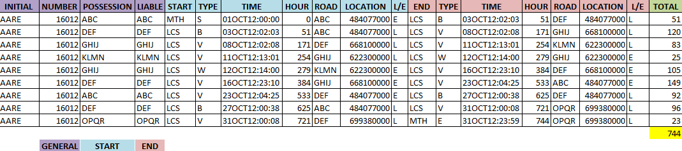
CHLF Sample: All Sections

Slide 10
Car Hire Liability File 2013 Expansion Project
Expand the file to include more data:
Rates: Default or Market from CHARM as applicable
Cycles: Break L/E cycles, US/Canada Border
Mileage: Apply mileage to cycles using Railinc’s Accumulated Mileage Process
Integration with CASS!

Slide 11
Car Hire Liability File 2013 Expansion Project
Is the foundation of the ongoing Centralized Car Hire roadmap being developed by Equipment Assets Committee
Note: Car Hire Mileage will not be immediately available outside of the Car Hire Liability File

Slide 12
Expanded Car Hire Liability File: Benefits
More data calculated by Railinc means even less computing on the part of recipients
Railinc consistently calculates and manages data for mileage liability
Applicable CHARM rate (market or default) is provided for each cycle
Did I say integration with CASS?! Access to more data for CHLF recipients
Notes:
benefits

Slide 13
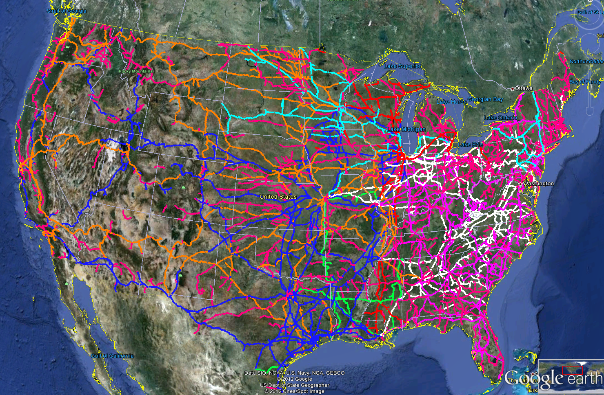
CHLF: Mileage

Slide 14
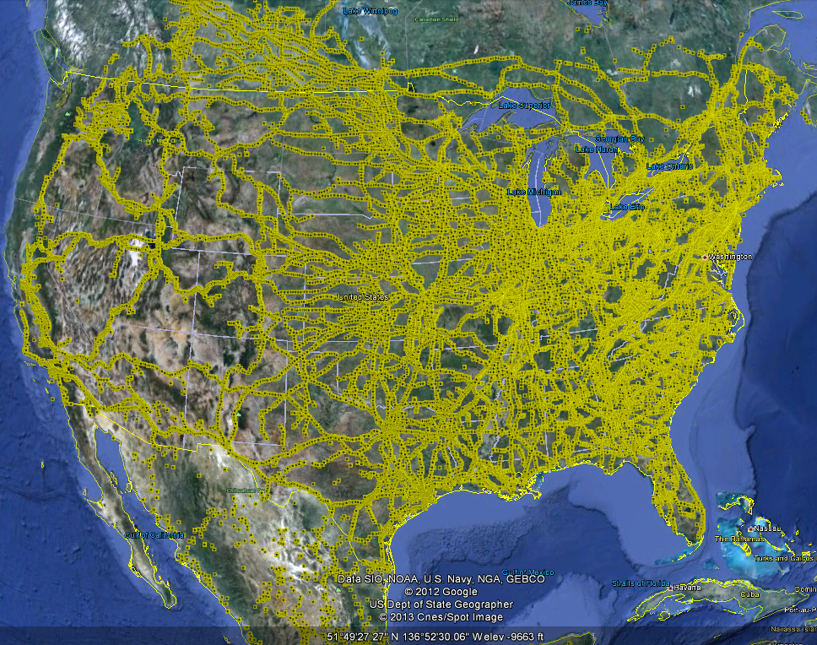
CHLF: Mileage

Slide 15
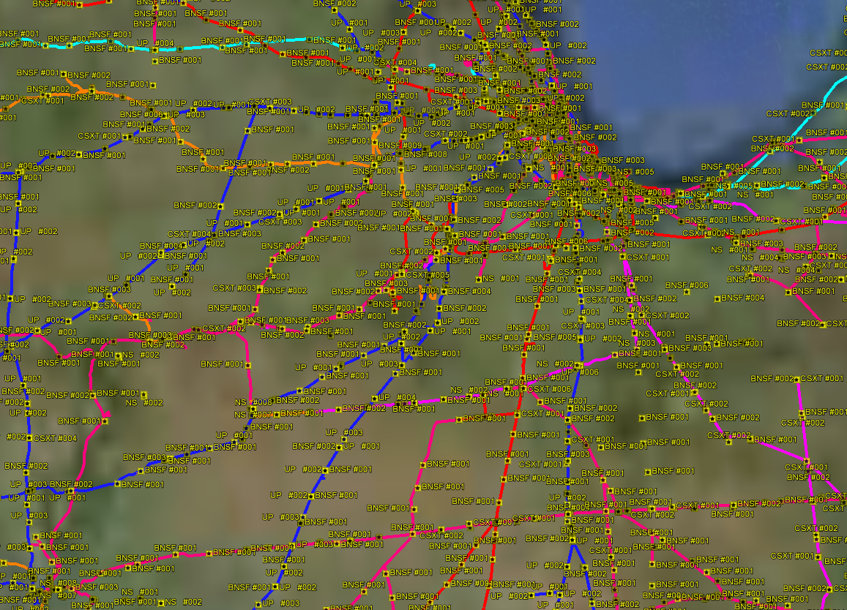
CHLF: Mileage

Slide 16
Questions?
https://www.railinc.com/rportal/alf_docs/Circulars/OT-10.pdf
Matt Cox
Business Analyst
Railinc
csc@railinc.com
1-877-RAILINC

