Slide 1
Special Car Order 90 Update and Upcoming Changes
May 15, 2015

Slide 2
Presentation Agenda :
Brief Car Service Rules History
Special Car Order 90 Defined
How SCO90 Interacts with Directives
Upcoming Changes

Slide 3
Brief Car Service Rules History

Slide 4
Car Service Rule History The Early Years - Interchanges
In early years, railroads did not permit their cars to leave their own tracks. The lading was trans-loaded at interchange.
This practice was gradually abandoned in the interest of improving service and efficiencies.
In 1893, the ARA published the first car service rules known as the Rules to Prevent Misuse and Diversion of Freight Cars
In 1900 the rules were modified and called the Code of Car Service rules. By 1910, there were four rules in effect.
In 1911, the Interstate Commerce Commission mandated the interchange of equipment.

Slide 5
Car Service Rule History First Four Rules
Rule 1 – Prompt return of cars not needed for loading
From 1920 to 1967, system cars prohibited in off-line loading if foreign cars were available.
Rule 2 – Returning of loaded cars
Rule 3 – Returning of Empty Cars
When necessary to short route a car home, both owner and bridge road must consent and the move was chargeable at $.025 per mile
Rule 4 – Cars handled in switching service

Slide 6
Car Service Rule History The First World War Years
1916 issues with car supply intensified
1917 a group of representatives where organized to work with the ICC to address car supply and service complaints
The group became known as the Commission on Car Service and actually served from January 1919 to March 1920 when the government operated railroads
This group became the Customer Service Division (CSD) of the ARA following the war with authority to issue directions in matters of car service and distribution

Slide 7
Car Service Rule History SCO90 and Transportation Codes
July 1953, the CSD issued Special Car Order 90 for handling empty, plain boxcars.
Established a set of interchange outlets for indirect connecting roads to get surplus foreign boxcars home.
In 1986, railroads agreed to utilize transportation codes to guide empty movement for all general service and unassigned, special equipped cars between indirect connecting carriers
T transportation code for unassigned cars
E transportation code for assigned cars

Slide 8
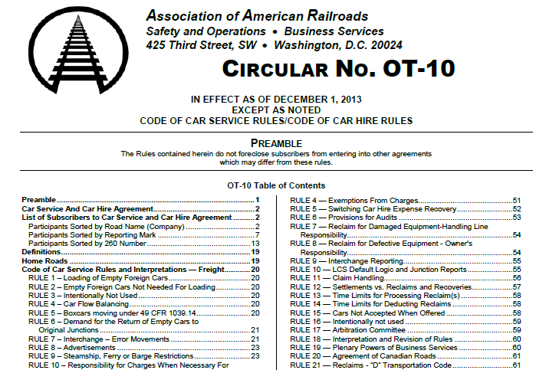
Car Service Rules Reference Information
Circular OT-10
Contains all of the Car Service Rules, Special Directives, and other important information regarding the movement of empty cars
Copy can be found at
https://www.railinc.com/rportal/alf_docs/Circulars/OT-10.pdf

Slide 9
CSR 1 Loading of Empty Foreign Cars
Scope:
To maximize utilization
Purpose:
Unless Covered by a Car Service order or directive, (or special provisions) this rule allows for loading or reloading foreign cars without the need to contact the car owner

Slide 10
CSR 2 Empty Foreign Cars Not Needed For Loading
Scope:
Fall back rule when freight cars are not covered under a Car Service Directive or Special Car Order
Purpose:
Promotes return of empty freight cars to car owners without the need to gain permission from other railroads to accept empty cars moving to the owning road

Slide 11
Special Car Order 90 Defined

Slide 12
Special Car Order 90 General Information
Addresses the need to move surplus, indirect connection railroad cars to the home railroad without incurring the time or costs involved with moving them empty in reverse of prior loaded shipments.
Interchange Outlets are maintained in a table by Railinc and are intended to evenly distribute obligations among carriers.
Transportation Codes and Transportation Condition Codes that are generated by certain movement events are passed to railroads through Umler and used for distribution decisions.
(EC, EP, EJ, ER, T, TU, TO)

Slide 13
Special Car Order 90 the Equipment Covered
SCO90 has been expanded since 1953 to cover additional equipment types
Boxcars (RB, RBL, RP, RPL, LC, LU, XL, XLI, XM, XP, XPI)
Flats (FB, FBC, FBS, FC, FCA, FDC, FL, FM 4 axle, FMS)
Gondolas (GB, GBR, GBS, GBSR, GS, GSS, GWS, LG)
Some notable exclusions include
Hoppers
Multilevels
Tanks
Certain Heavy Duty Flats and Gondolas

Slide 14
Special Car Order 90 the Distribution Decision
When the owning or leasing railroad participated in the prior loaded shipment
Direct Connects can forward empty to the leasing or owning road at any junction. (exceptions for a switching road).
Indirect Connects can return the car reverse of prior loaded shipment.
When the owning or leasing railroad did NOT participate in the prior loaded shipment
Direct Connects can forward empty to the leasing or owning road at any junction or to the road where originally received under load if that road is also a Direct Connect with the owning or leasing road.
Indirect Connects shall use their designated SCO90 outlet to forward the car empty towards the leasing or owning road or return the car reverse of prior loaded shipment if no SCO90 outlets are provided.

Slide 15
How Special Car Order 90 Interacts with Car Service Directives

Slide 16
Special Car Order 90 Directives That Utilize SCO90
Car Service Directive 145
Applies to railroad controlled cars assigned to shippers, agent, commodity, or national boxcar pools
Covers most Boxcars, Flats, Gondolas, Open Hoppers, Multilevels, and Tanks
Car Service Directive 150
Applies to railroad marked cars that are NOT assigned in pools
Covers most Boxcars, Flats, Gondolas, Open Hoppers, Multilevels, and Tanks
Car Service Directive 175
Applies to all railroad cars assigned into O type pools (for lease termination, program, or reassignment)

Slide 17
Special Car Order 90 Transportation Codes and Directives
Car Service Directive 145
Assigned cars with C, P, J, or R transportation codes are handled empty under provisions in CSD145
Assigned cars covered by SCO90 with transportation condition codes of EC, EP, EJ, or ER can be handled under provisions in SCO90
Car Service Directive 150
Unassigned cars NOT covered by SCO90 with transportation codes of U or ‘blank’ are handled empty under provisions in CSD150 or Rule 2
Unassigned cars covered by SCO90 with transportation codes of Blank, T, U, or TU can be handled under provisions in SCO90
Car Service Directive 175
Assigned cars with a transportation code of O are handled empty under provisions in CSD175.
Assigned cars with a transportation code of TO can be handled under provisions in SCO90

Slide 18
Special Car Order 90 Example Use of Transportation Codes
Assigned or Unassigned | Applicable Car Service Directive | Loading Scenario For A Car That Qualifies for SCO90 | Transportation Code / Condition Code | Typical Empty Handling Option for Road B
Assigned | CSD145 | Road A is the pool operator for a car that is loaded by Road A to Road B | C, P, R | Empty reverse of prior loaded shipment
Assigned | CSD145 | Road A is the pool operator for a car that is loaded by Road C to Road B | EC, EP, ER | Forward to Road A via SCO90 else reverse route
Unassigned | CSD150 | Road A is the home road for a car that is loaded by Road A to Road B | U | Load to home road or return empty to home road
Unassigned | CSD150 | Road A is the home road for a car that is loaded by Road C to Road B | TU | Load to home road or forward to road A via SCO90 else reverse route

Slide 19
Special Car Order 90 A Drive Wheel to Reduce Costs
CSD145
Cars of indirect connect
that are loaded by other
than the Controlling Road
are ensured to have a
path home.
SCO90
CSD150
CSD175

Slide 20
Some Upcoming Changes

Slide 21
Special Car Order 90 Changes Effective June 1
CSD145
Add paragraph that states cars carrying an E transportation code will be covered under SCO90
SCO90
References to Home Road or Leasing Road are being replaced with the term “Controlling Railroad”
Controlling Railroad for cars carrying a T or E transportation code are defined as:
For assigned cars, the Pool Operating Road as defined by the first three digits of the pool number
For unassigned railroad cars, the Leasing Road as shown in Umler
For unassigned and non-leased railroad cars, the Road that owns the stenciled mark on the car

Slide 22
Questions ?

