Slide 1
2014 Industry Initiatives
Kristi Talley
ACACSO
November 14, 2013

Slide 2
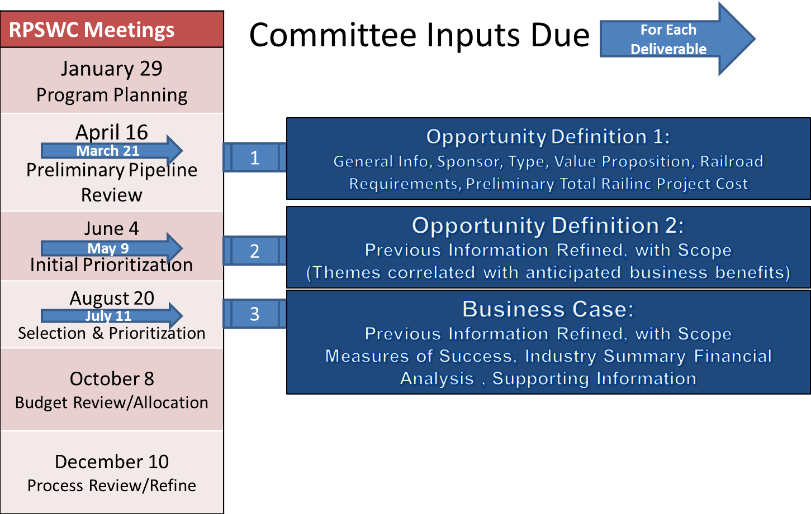
Railinc has works with the RPSWC to prioritize industry projects

Slide 3
In 2014, 11 of the 14 projects are related to one of these current programs
Asset Health Strategic Initiative
Address the rail network challenges related to asset health to help maximize the returns on local investments through pursuit of the following specific targets: Reduce Mechanical Service Interruptions, Improve Inspection Quality, and Increase Yard and Shop Efficiency.
Centralized Car Hire
Reduce and avoid costs incurred and to be incurred by railroads and other industry stakeholders to process car hire payables and receivables. Employ process simplification, automation, and centralization of functions and avoidance of the cost of mainframe system replacement.
Gateway Services
Rail operations personnel overseeing gateways need improved tools to increase velocity. Provide gateway personnel actionable information within appropriate planning horizons to anticipate upcoming conditions and enable mitigation of disruptions.
Notes:
Sharing information, improve communication, gateway view instead of individual RR view

Slide 4
Fourteen industry projects were approved by the RPSWC for 2014
EDI 432 7010 Upgrade
Forward and Store 7010 EDI Upgrade
IRF 7010 EDI Upgrade
Centralized Car Hire Foundation (User Support)
Asset Information Repository - Phase 2
E-Train - Phase 2
Inspection Quality - Phase 2
Asset Health and Mechanical Referential Data - (Mech. Ref. Repository Phase 2)
Expand DDCT Rule Compliance
AEI Data Quality
Location Master
Major Gateway Bulletin Exchange Automation - Phase 2 (Capturing Bulletins)
Major Gateway Decision Support
Component Tracking - Brake Valves

Slide 5
Approved 2014 industry projects in asset utilization and compensation
EDI 432 7010 Upgrade
Upgrade the Car Hire Rate Negotiation EDI message from version 3030 to 7010
Includes the capability to send more cars on each EDI message
The new EDI guidelines will be published by the X12 committee in early 2014

Slide 6
Approved 2014 industry projects in asset utilization and compensation
Centralized Car Hire Foundation - User Support
Create tax reports for individual state tax, Canadian and Mexican taxes
User interface to view and manage car hire payments and submit payable records directly to CHDX
Rule 5 Transfer Of Liability (TOL) error-handling process

Slide 7
Planned 2014 maintenance activities for asset utilization and compensation
Loading Authority (OT 5) - TAG formed with EAC
  Ideas considered:
    Remove single car from authority
    Improve version process
    Improve UI - search options, flag for cars moving on line
    Include EW and EHMS alerts
Car Hire Rate Negotiation Self-Service
  Quarterly maintenance releases

Slide 8
Mainframe migration complete in 2014
2011
2012
2013
2014
Building Blocks
MARK, Railroad Register, SPLC, CSM, Hazmat, Route, STCC, JUNC
CIF
Revenue
REN, STB Waybill, Deprescription\CHARM
ISS, FLDX
Movement Initial
ISM-Edit
F&S, Car Hire, SCO90, EOT
Movement Core
ER, Waybill, Trip Plan, EQC, LCS, CSDB, ER History, PETA, DQ
Commercial
Demand Trace & Q87
RailSight
RailSight Push
Train Trace
Steelroads,
Refactor to Oracle
Notes:
We have built the Building Blocks – mostly done, except for D&B sync of CIF – So here, midrange applications have started to change and connect to the new database
Revenue – REN, STB Waybill, Depre and CHARM are done or almost done.
ISM Peripherals – ISM-Edit/EPP with really nice thru-put
You may notice that we removed Customs Billing from the list as we are going to sunset it as a automated process and go back to manual process.
You will also notice that the plan for Commercial applications have also changed over the time since we started.

Slide 9
Your involvement is critical for success
2013
2014
Q1
Q2
Q3
Q4
Q1
Q2
Q3
Q4
CHLF
CIF
F&S
Haulage/TOL
FLDX
ISS
EOT
SCO90
LCS
CSDB
PETA
Ramp-ED
EAC
CLTF
EDI
EAC
CLTF
IRC
EAC
EAC
EAC
EAC
EAC
Customer involvement or communication
Development Effort

Slide 10
Questions?

