Slide 1
Findus.Rail Application
Sara Maples
ACACSO
May 13, 2015

Slide 2
Agenda
Application Overview
Findus.Rail Roles and First-Time Access
Creating a Contact
Searching, Viewing and Managing Contacts
Mandatory Contact Information (Rule 114)
How Other Railinc Applications Use Findus.Rail
Agencies in FindUs.Rail

Slide 3
The FindUs.Rail Application
A web-based application, FindUs.Rail is a source of comprehensive industry contact data that enables users to:
Search contacts by company and category
Manage their own contacts
Download contacts
Assign a third party to manage contact data

Slide 4
Gaining First-Time Access
Users need a Railinc Single Sign-on (SSO) account.
Register at: www.railinc.com.
Users need FindUs.Rail permissions assigned to access the application.
Notes:
Tracing Products Grantee, Other products Grantee

Slide 5
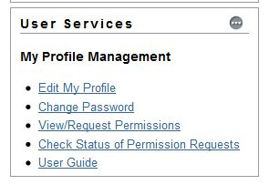
Request Access
After logging in, locate “User Services” and select View/Request Permissions.

Slide 6
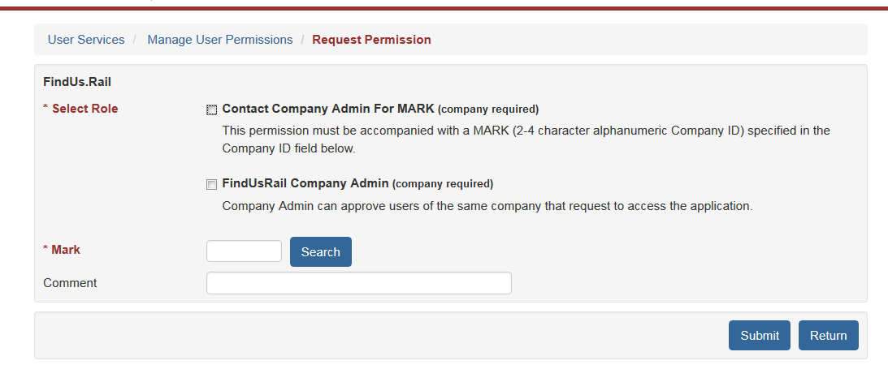
Request Access (cont’d)
Click the “Request” button to the right of FindUs.Rail and select the applicable role.

Slide 7
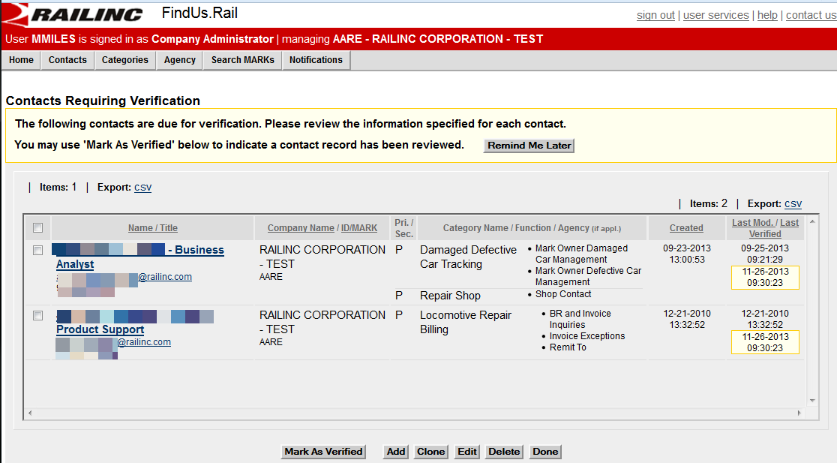
Contact Verification Page
Notes:
When you log in for the first time, you may see this page. FindUs.Rail periodically requires that contact information be verified and updated as needed.

Slide 8
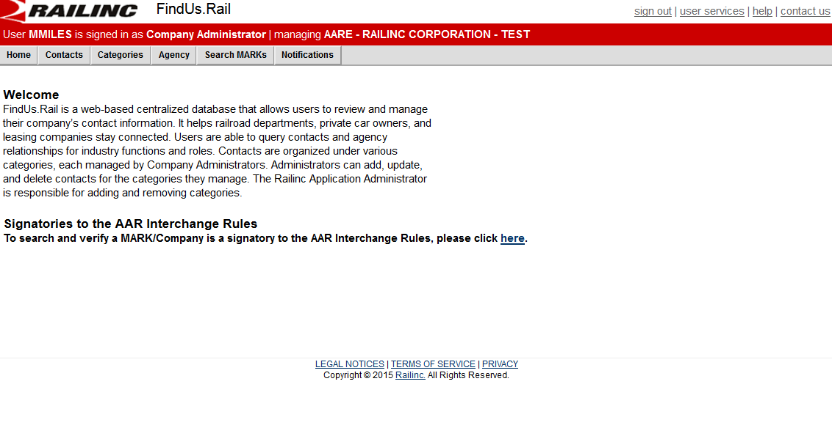
Home Page
Notes:
If you manage a single company, then following a successful login the FindUs.Rail Welcome page is displayed with the company identified in the page header

Slide 9
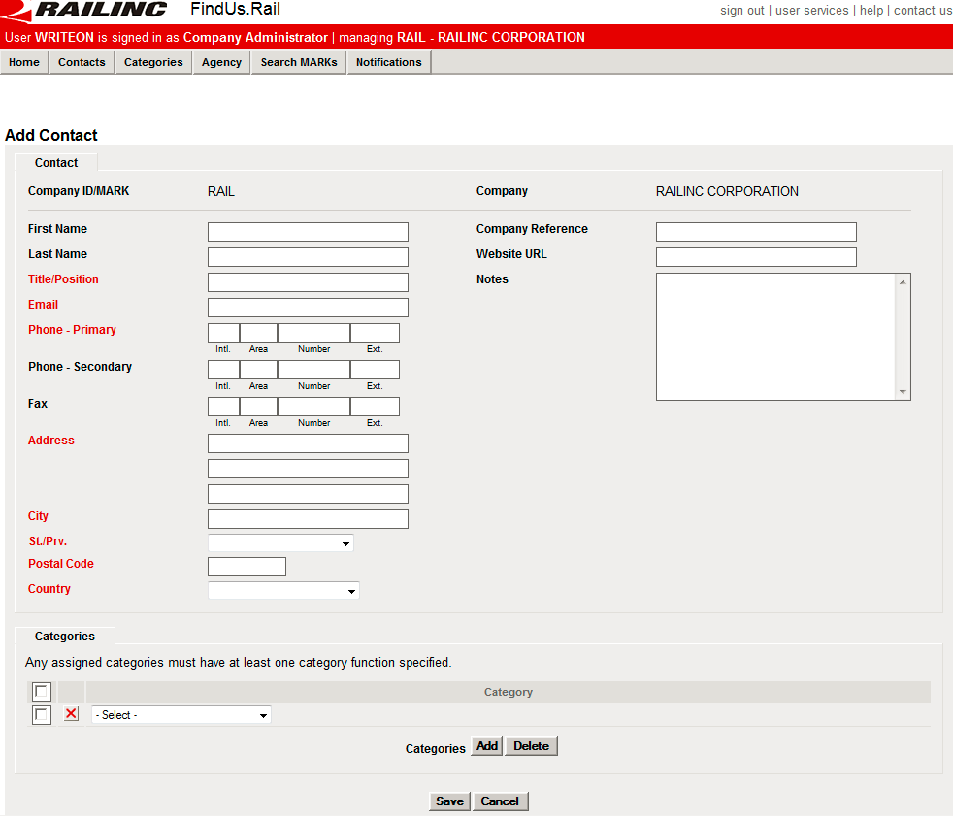
Creating a Contact
Select Contacts > Add Contacts. Complete the available input fields. Red fields are required fields.

Slide 10
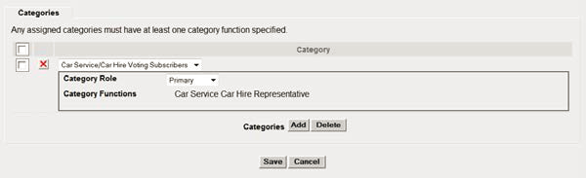
Creating a Contact
Under the category listing, select the appropriate category for the contact (for example, Car Service/Car Hire Voting Subscribers). Depending on the selection, additional details appear regarding the category role.
Select Save to save the new contact record.

Slide 11
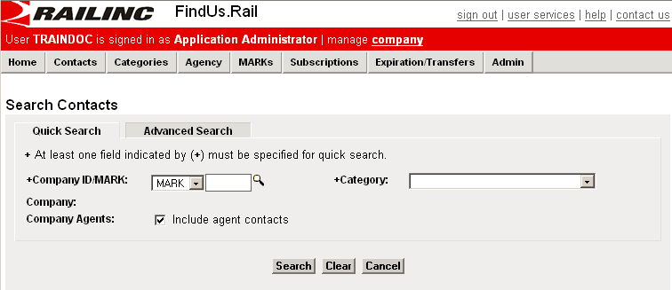
Searching Contacts
Select Contacts > Search Contacts to display Search Contacts page. You can search by mark and/or category.

Slide 12
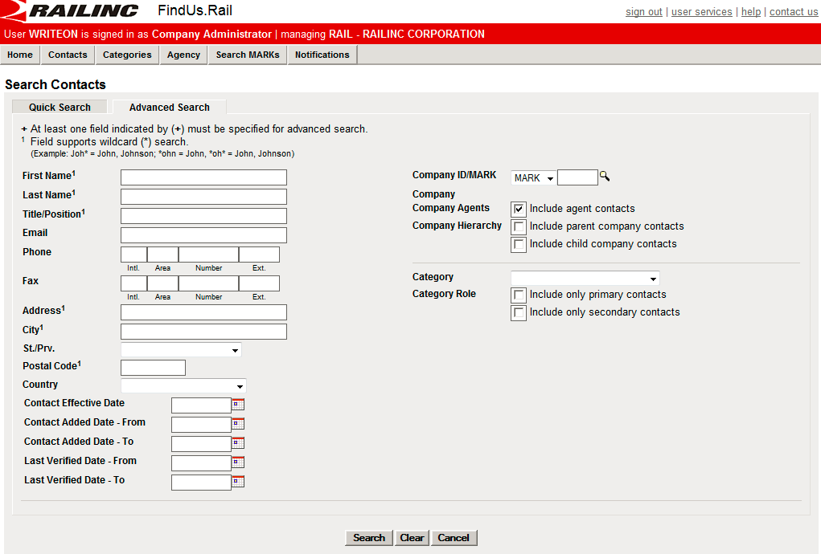
Advanced Contact Search
Click on the Advanced Search tab to perform an advanced search.
Notes:
At least one field must be input. Wildcard search is supported by ‘*’.

Slide 13
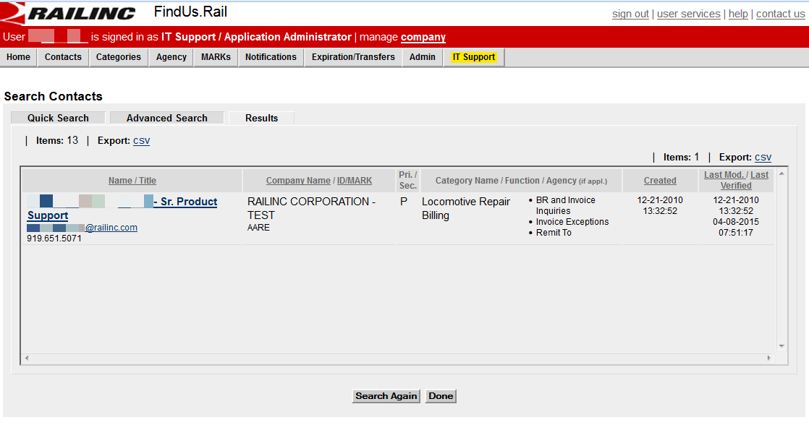
Contact Search Results
Your search will produce a screen like the one to the right that will show your results.
Select the hyperlinked name of a found contact to view details for that contact.

Slide 14
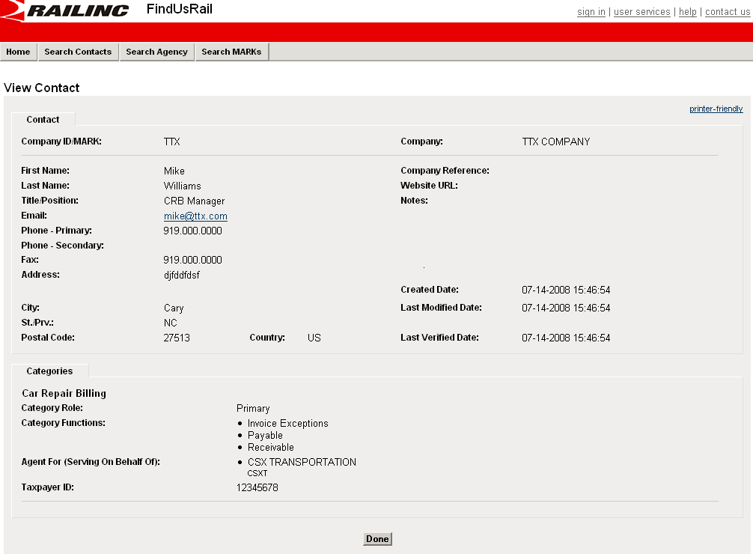
View Contact
After you click the contact name, you will see a screen like the one to the right.

Slide 15
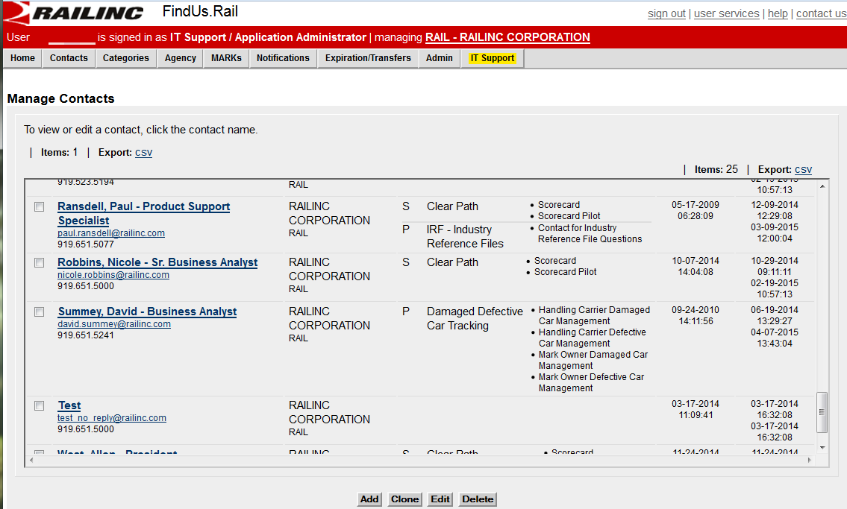
Managing Contacts
Select Contacts > Manage Contacts. The Manage Contacts page is displayed.
Notes:
Perform one of the following described actions: a. Select Add to add a new contact
b. Select an existing contact and select Clone to create a new contact based on the selection.
c. Select an existing contact and select Delete to delete that contact. A message appears asking you to confirm this decision.
d. Select an existing contact and select Edit to edit that contact
e. Select a hyperlinked name of a listed contact to view/manage that contact. The View Contact screen is displayed.

Slide 16
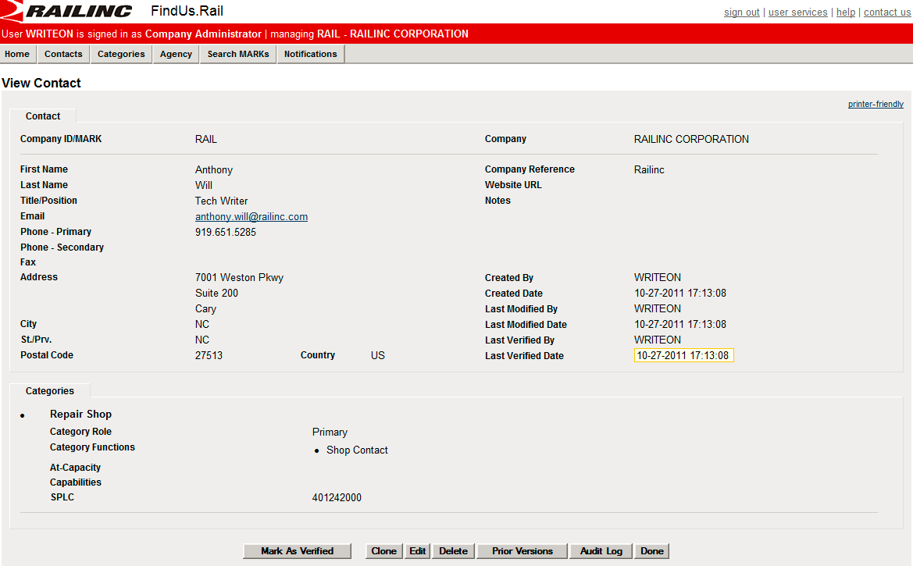
Managing Contacts View
Notes:
From the view contact page you may perform one of the following actions:
a. Select Mark as Verified to verify a contact. A message appears at the top of the View Contact page, “Contact was marked as verified”.
b. Select Clone to create a new contact based on the displayed record
c. Select Edit to edit the displayed record
d. Select Delete to delete that contact. A message appears asking you to confirm this decision.
g. Select Done to exit the View Contact screen. The Manage Contacts screen is redisplayed

Slide 17
Mandatory Contact Information
AAR Interchange Rule 114 indicates which contact categories are mandatory in FindUs.Rail.
Umler
DDCT
Early Warning
EHMS
Car Repair Billing (required functions include Billed Party (BP), Invoicing Party (IP), Inquiries (IQ), Exceptions (EX) and Remit To (RT))
The Office Manual of AAR Interchange rules has a complete listing.

Slide 18
How Railinc Apps Use FindUs.Rail
DDCT — To identify and maintain repair shops, scrap and storage facilities for disposition within DDCT. These facilities must be registered in FindUs.Rail to report the completion of repairs.
Tank Car Mileage Equalization — To identify and maintain a user list for reports.
Mechanical Reference Repository — To identify and maintain AAR-approved Running Repair Agents.
AskRail – To identify and maintain an emergency contacts list to report emergencies or inquire about hazardous materials being transported.

Slide 19
Agencies
An agency is a business or an administrative division that provides a particular service. An agency relationship is set up between a company and the agent(s) for that company. For example, agents typically manage functions such as Car Repair Billing.
Functionality includes the ability to Search, Manage and Add Agencies.

Slide 20
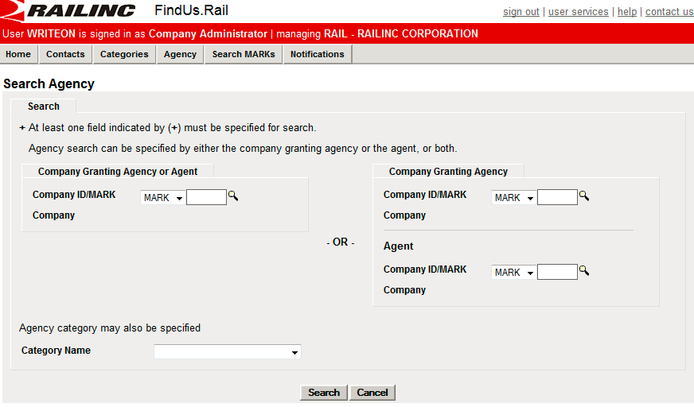
Agency Search
You can specify and Agency Search by the company granting agency, the agent, or both. Select Agency > Search Agency to search an agency.
Notes:
Ability to search by mark and category

Slide 21
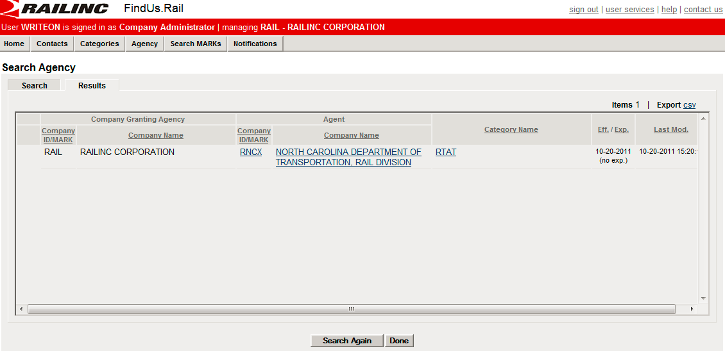
Agency Search Results
Notes:
You may perform one of the following actions: a. Select Search Again to initiate a new agency search.
b. Select Done to exit the Search Results page.
c. Select Export CSV to save the results as a CSV file (see Exporting CSV Files).
d. Select one of the hyperlinked fields of a found agency record to view details of that record.

Slide 22
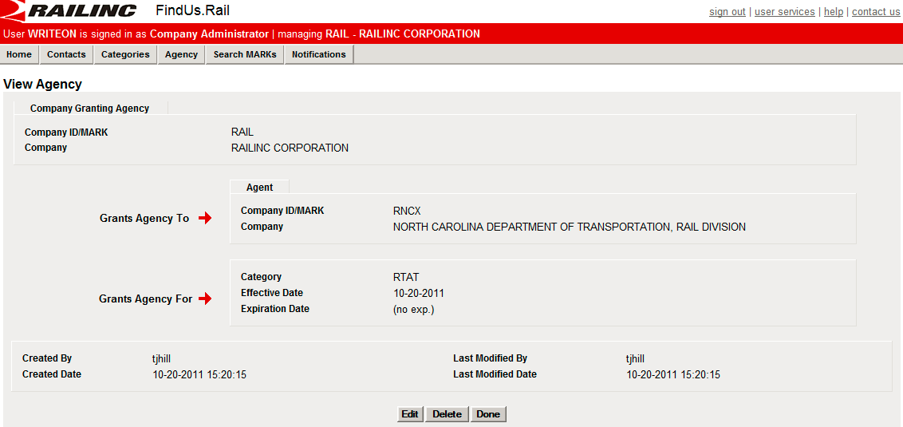
Agency View
From the view agency page you can:
Select Edit to make edits to the displayed agency
Select Delete to remove the displayed agency
Select Done to exit the View Agency page.
Notes:
This is the view you will see after clicking on one of the hyperlinked fields from your search.

Slide 23
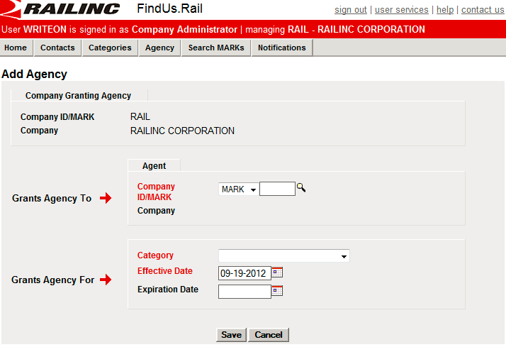
Agency Add
Select Agency > Add Agency to add an agency.
Notes:
Granting agency is prefilled with the mark you are managing. Complete the available fields and save or cancel.
Note: You can only edit the expiration dates of an agency. If you desire to change the agent company or the effective date, add a new agency relationship and delete the one you want to edit (or set it to expire) as appropriate.

Slide 24
For Additional Support
Customer Support
csc@railinc.com
1-877-724-5462
FindUs.Rail Users Guide (under the help tab)
FindUs.Rail product page at https://www.railinc.com/rportal/findusrail

Slide 25
Questions?

