Slide 1
Asset Utilization and Compensation Overview
Kristi Talley
ACACSO
May 8, 2014

Slide 2
Railinc’s Current Asset Utilization and Compensation Initiatives
Mainframe Migration
2014 Industry Projects
Maintenance Work
Potential Industry Projects for 2015

Slide 3
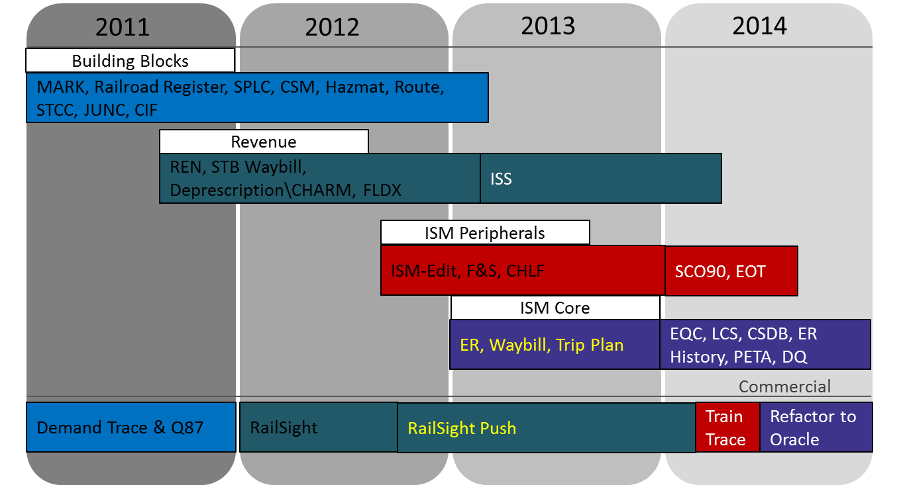
Mainframe Migration Overview

Slide 4
Your Involvement Critical for Success

Slide 5
2014 Industry Projects
EDI 432 7010 Upgrade
Upgrade the Car Hire Rate Negotiation EDI message from version 3030 to 7010
Includes the capability to send more cars on each individual EDI message
Project is scheduled for completion in October

Slide 6
2014 Industry Projects
Centralized Car Hire Foundation – User Support
Create tax reports for individual state tax, Canadian and Mexican taxes
User interface to view and manage car hire payable records
Rule 5 Transfer of Liability (TOL) error-handling process
Project is scheduled for completion in November

Slide 7
2014 Maintenance Activities
Car Hire Rate Negotiation Self-Service
Quarterly maintenance releases
April release focused on the bid/offer query
Loading Authority (OT-5)
EAC TAG prioritized maintenance ideas
DDCT integration is the top priority

Slide 8
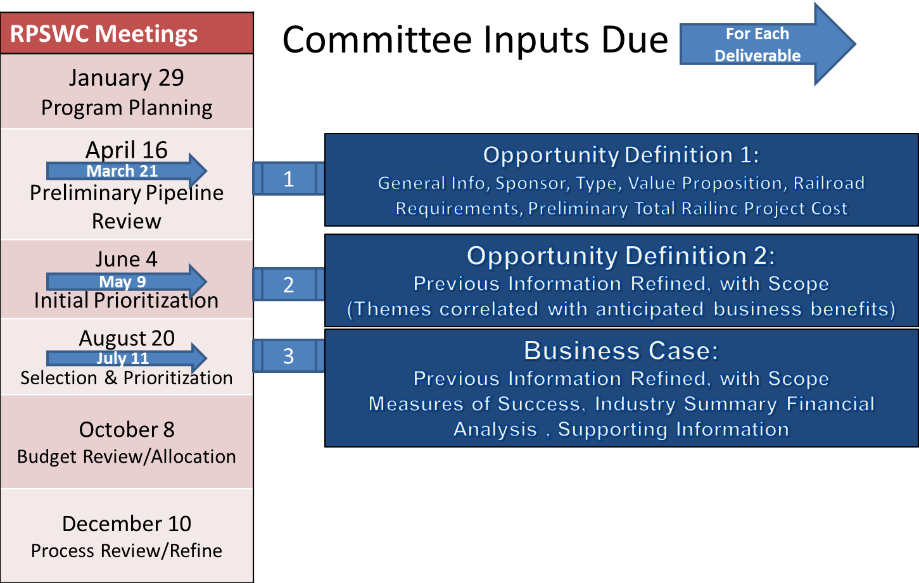
Railinc Works with the RPSWC to Prioritize Industry Projects

Slide 9
Potential Industry Projects for 2015
Appendix S
Implement mandatory change to Appendix S. The table is used to calculate appurtenance rates. The change expands the age band for appurtenances from 12 to 18 years.
Special Rate Master
This project supports the Centralized Car Hire Roadmap by providing a platform for carriers to manage their special rates existing outside CHARM. A rating hierarchy will select the appropriate rate for the cycle and append it to the CHLF, which will reduce the work for the carrier using CHLF. The result will be a file that will represent a car mark owner’s payable and receivable car hire liability.

Slide 10
Potential Industry Projects for 2015
Car Hire Market Data Application Enhancements
Car hire market data reports are critical for the industry to gather market intelligence on car hire rates to assist in the bid and offer process. These enhancements will streamline the process, allowing for more data to be utilized and improving the end-user experience.
Centralization of Car Hire Rule 22
This project supports the Centralized Car Hire Roadmap by replacing the existing Car Hire Rule 22 reclaim process with centralized processing using car movement records, LCS interchanges and waybill data.

Slide 11
QUESTIONS?

