Slide 1
Centralized Car Hire Foundation User Support Project
Sara Maples
ACACSO
November 11, 2014

Slide 2
Centralized Car Hire Foundation User Support Project
RPSWC-Approved Project
Sponsored by EAC
Supports Centralized Car Hire Roadmap
Notes:
The 2014 Centralized Car Hire Foundation User Support project was requested by the Equipment Asset Committee (EAC). The Centralized Car Hire Foundation User Support project will provide a user interface to view car hire payments via Railinc hosted user interface, monthly mileage reporting, and a transfer of liability (TOL) Rule 5 error handling process. This project is in support of the Centralized Car Hire Roadmap.
Carriers will be able to view car hire payments formatted from CHLF at a centralized Railinc-supported solution, thereby avoiding replacement or upgrade development costs. Mileage reporting and the transfer of liability (TOL) Rule 5 error handling process will provide a centralized, streamlined way to manage these processes saving the carriers time and money. This project is a continuation of the overarching EAC vision of processing car hire centrally at Railinc.

Slide 3
Benefits
Increased visibility of the TOL Rule 5 corrections
Ability to correct TOL Rule 5 errors
Reduce costs related to time and effort spent on processing, analyzing and responding to TOL Rule 5 errors
Increased TOL Rule 5 accuracy
Standard mileage reporting for US, Canada, Mexico
Elimination of carriers’ internal process to create the individual mileage reports
Notes:
The Car Accounting User Support system is a foundational project in support of the EAC vision of automating car hire and supports the Centralized Car Hire roadmap. Carriers have processes in place to support TOL Rule 5 error processing. This project will replace those processes by centralizing it at Railinc. The user interface will provide a way to view car hire payment records for railroad marked cars and TTX non-members. Also, the ability to create standard mileage reports will provide immediate benefit to the industry. This project will allow carriers to turn off parts of their current car accounting systems, reducing costs and overhead to maintain and update these systems.

Slide 4
Benefits – cont’d
Reduce industry-wide duplicate processing costs for future changes
Features in CASS used as foundation for CCH
Event Search, LAM Messages, CHLF Expanded File
Step towards the centralization of car hire
Notes:
The Car Accounting User Support system is a foundational project in support of the EAC vision of automating car hire and supports the Centralized Car Hire roadmap. Carriers have processes in place to support TOL Rule 5 error processing. This project will replace those processes by centralizing it at Railinc. The user interface will provide a way to view car hire payment records for railroad marked cars and TTX non-members. Also, the ability to create standard mileage reports will provide immediate benefit to the industry. This project will allow carriers to turn off parts of their current car accounting systems, reducing costs and overhead to maintain and update these systems.

Slide 5
Project Themes
TOL Rule 5 Corrections: Rule 5 Transfer of Liability (TOL) Error handling process
Mileage Information: Supply mileage information for individual US states, Canada, Mexico
CHLF to CHDX Payments: Convert CHLF V2 to CHDX format and have the ability to view car hire payments via Railinc hosted user interface.
Notes:
TOL Rule 5 Corrections - Rule 5 Transfer Of Liability (TOL) Error handling process.
Ability to view all TOL Rule 5 Errors
Ability to correct individual or groupings of TOL Rule 5 Errors
Ability to submit corrected TOL Rule 5 Errors
System auto-correction of Invalid Date/Time TOL Rule 5 Errors
Ability to view events related to TOL Rule 5 Errors
Validation of corrected TOL Rule 5 Errors prior to submission
Ability to view TOL Rule 5 Error history
Mileage Information – Supply mileage information for the individual US states, Canada and Mexico.
Standard Summary and Detail report capabilities.
CHLF to CHDX Payments – Convert CHLF V2 to CHDX format and have the ability to view car hire payments via Railinc hosted user interface.
Format CHDX file from the CHLF V2 and needed data sources.
Ability to select and view CHDX Account Type 10 payment records formatted from CHLF V2.0.
Ability to download selected CHDX Account Type 10 payment records formatted from CHLF V2.0.

Slide 6
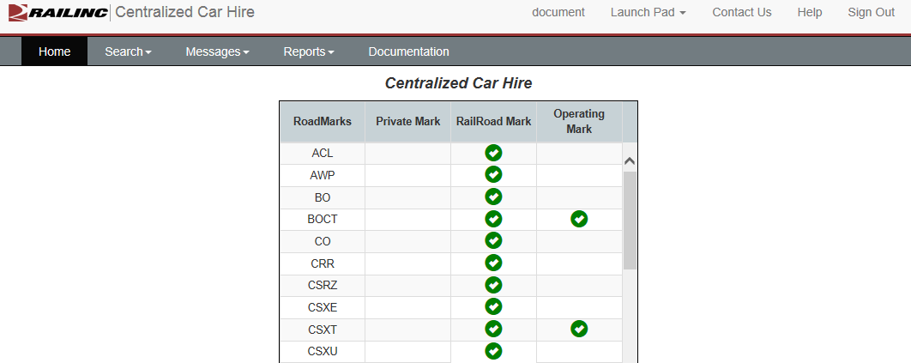
Centralized Car Hire
Notes:
Landing page – just like CASS
Continue by selecting one of the following CCH menu options:
Search Search for events or Car Hire Liability Files (CHLFs) for records for a single car.
Messages Work with TOL Rule 5 messages, create new Liability Acceptance Messages, and search the Liability Acceptance Message history.
Reports Access reports for Haulage Agreements, TOL Rule 5 Liability Limits, and DDCT Dismantled Equipment.
Documentation Retrieve support documentation

Slide 7
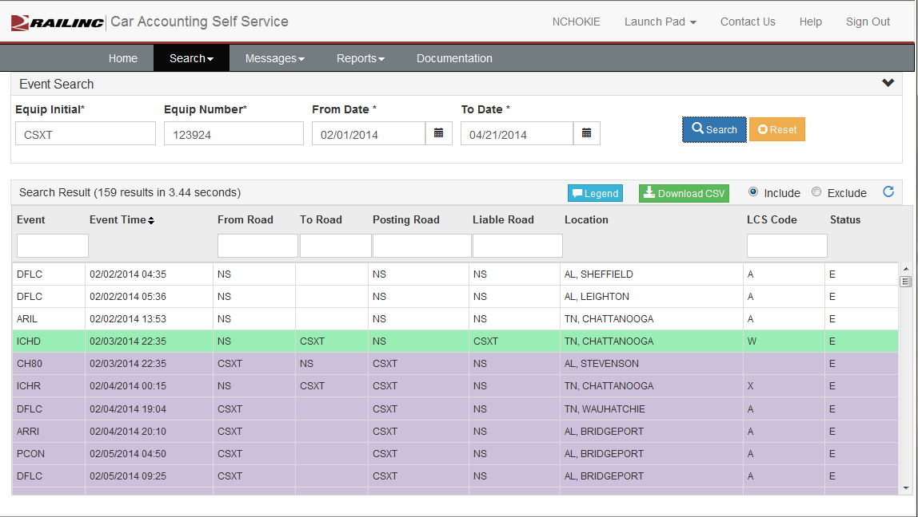
Search
Events
Notes:
Search ~ Events

Slide 8
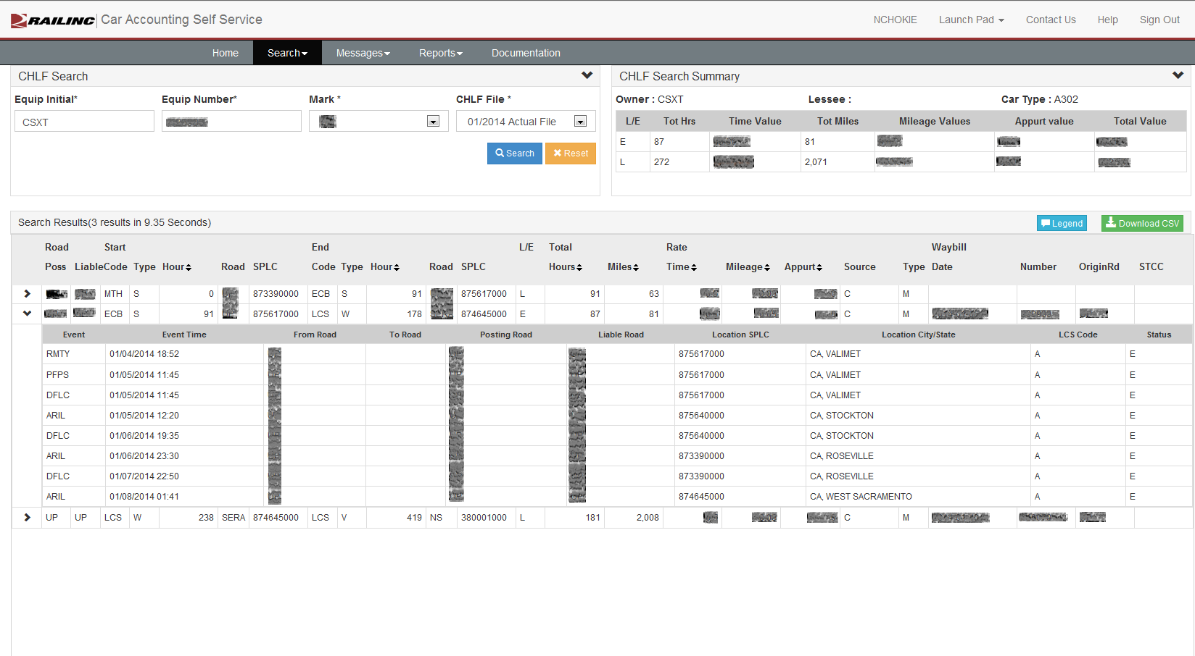
Search
CHLF File - Expanded
Notes:
Search ~ CHLF
Mark - Choose the mark. Marks listed in the drop-down match your SSO permissions and should correspond with your main mark as a CHLF participant. You can see all your system equipment and foreign equipment on your line. If you are an agent, you can see equipment for any mark for which you are the agent.
CHLF File - Select a CHLF file. You can choose from the most recent Periodic Estimate, the last Monthly Estimate, or any Actual File within the past two years.

Slide 9
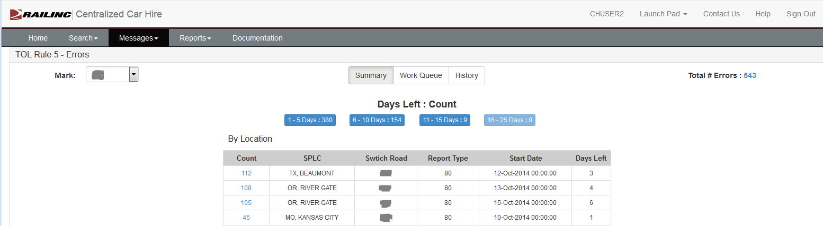
TOL Rule 5 Errors
Summary View
Notes:
THIS SLIDE MAY CHANGE
Summary view will tell a user how many TOL Rule 5 Errors they have
Workflow management tool
How many days left until they are expired
Grouped by Location – helps user work group errors

Slide 10
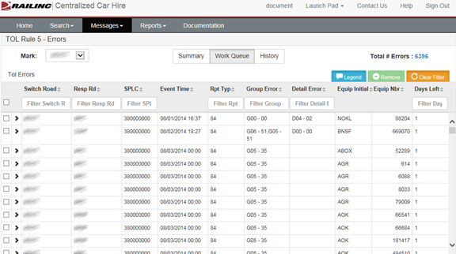
TOL Rule 5 Errors
Work Queue
Notes:
Work Queue – manages your work
Tells user how many errors (top left)
Detail on errors
Simple sorting and filters
Hover over Report Type
Hover over Errors

Slide 11
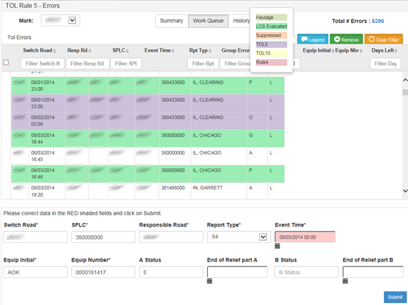
TOL Rule 5 Errors
View Events
Notes:
View events related to error (Event Time)
30 days worth (10 days prior/20 days after)
Legend view stays open

Slide 12
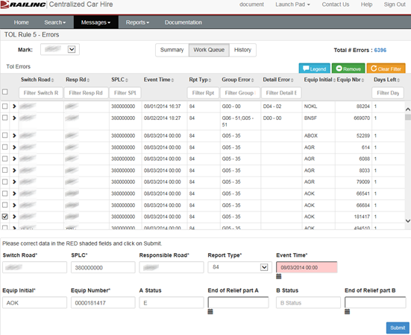
TOL Rule 5 Errors
Correcting Errors
Notes:
Checkboxes
User can choose individual or group of errors to correct
Field that generated the error highlighted
Clicking Submit will use validations for Rule 5
Remove errors to history

Slide 13
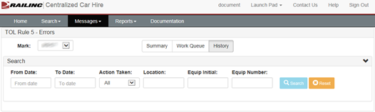
TOL Rule 5 Errors
Search Error History
Notes:
History search
Search 31 days (month)
From & To dates – date added to error queue
Action Taken – corrected, auto-corrected, expired, removed
Location – SPLC
Equip Initi & Number

Slide 14
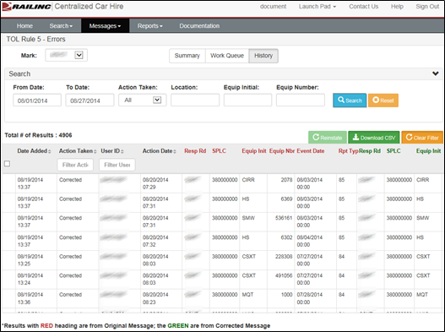
TOL Rule 5 Errors
History Results
Notes:
History results
Total #
Can reinstate removed errors that have not gone past 25 days
Red – Original Message
Green – Corrected Message
CSV Download

Slide 15
Existing Reports
Haulage Agreements Report: This report shows your current haulage agreements so you can verify your haulage setups with other carriers. Haulage agreements are displayed when the Selected Railroad Mark is listed as Carrier 1, Carrier 2 or Car Hire Liable.
TOL Rule 5 Liability Limits: This report shows the agreed limit between the Switch Carrier and the Line–Haul Carrier.
DDCT Dismantled Equipment Report: This report shows all of your cars that have moved to DEAD status. DEAD denotes that a car has been designated for dismantling.
Notes:
Search ~ Events

Slide 16
New Reports
Mileage Information: These reports show monthly and annual mileage information at the state and owner level.
CHDX Information: Converted CHLF data into CHDX format.

Slide 17
Mileage Information
Summary and Detail reports
Railroad and Private
Monthly and Yearly
Notes:
Railroads can download summary and detail reports by Month/Year
Where liable road = mark
Results contain all private and TTX equipment
Private Owner can download summary and detail reports by Month/Year
Where Equip Owner = mark
Results on all liable roads

Slide 18
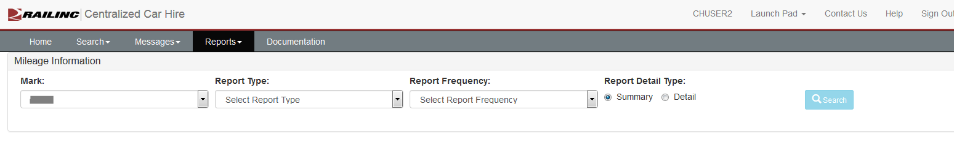
Mileage Information
Notes:
Railroads can download summary and detail reports by Month/Year
Where liable road = mark
Results contain all private and TTX equipment
Private Owner can download summary and detail reports by Month/Year
Where Equip Owner = mark
Results on all liable roads

Slide 19
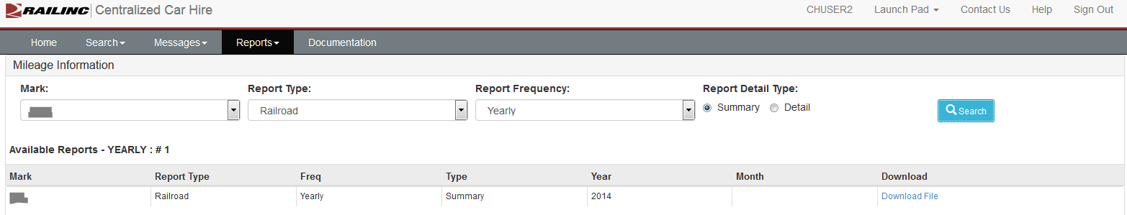
Mileage Information
Notes:
Railroads can download summary and detail reports by Month/Year
Where liable road = mark
Results contain all private and TTX equipment
Private Owner can download summary and detail reports by Month/Year
Where Equip Owner = mark
Results on all liable roads

Slide 20
CHDX Information
CHDX file from the CHLF V2 and needed data sources
Ability to select and view CHDX Account Type 10 payment records formatted from CHLF V2
Ability to download selected CHDX Account Type 10 payment records formatted from CHLF V2

Slide 21
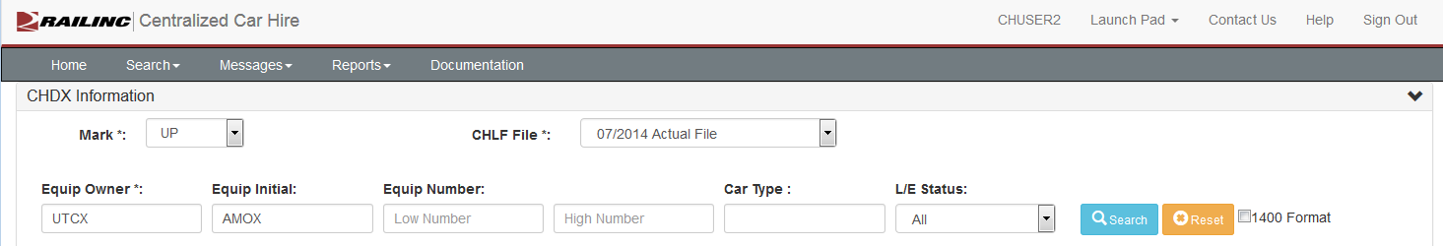
CHDX Information
Search by CHLF File

Slide 22
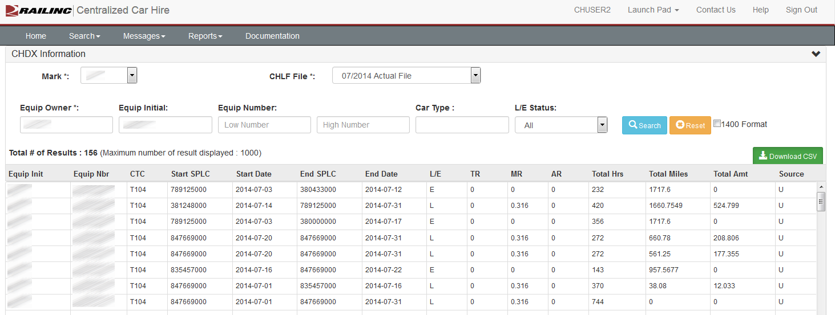
CHDX Information
Notes:
Ability to view summary info
Download CHDX format
* CSV or fixed 1400 byte

Slide 23
Timeline
Project Release - November 18, 2014

Slide 24
Questions?

