Slide 1
Equipment Quality Reporting
Jim Pinson
ACACSO
May 15, 2015

Slide 2
Agenda
Origin of EQR
EQR TAG Members
Goals
Project Overview
EQR Benefits
Schedule
Functionality

Slide 3
Origin of EQR
Originally developed under the Damaged and Defective Car Tracking System Technical Advisory Group (TAG)
Consisted primarily of mechanical experts
Identified a need for wider variety of expertise

Slide 4
Origin of EQR
Equipment Quality Reporting TAG formed and includes:
Mechanical
Customer Service
Car Management

Slide 5
EQR TAG Members
TAG members include
Class I railroads
Car owners
Short line representatives

Slide 6
EQR TAG Members
AAR | Nichole Fimple
BNSF | Joe Kerber
CN | Billy Baisden
CP | (vacant)
CSXT | Kyle Campbell
GATX | Ray Burke
GBRX | JD Pavek
GE (RMI) | Andrew Parker
GWI | Joey Evans
KCS | John Thompson
NS | Jeff Roton
TTX | Sylvana Meza
UP | Gary Gaule (Chair)
WTCO | Todd Poland
Notes:
CN & CP did not participate in project, but original contacts were the following:
CN – Nick Hoffman
CP – Ken Gorra
KCS participated in the beginning of the project and approved the charter, but did not participate the second half of the year. Contact is Ben Mitchell.
Bridgid Rich of North Shore Railroad was our shortline representative who participated throughout the project. She has since moved on to a new position at her company.

Slide 7
EQR Goals
Track equipment rejected by shippers
Use the information to help identify the root cause for rejected cars

Slide 8
EQR Goals
Provide a tool that transmits information about rejections to:
Class I railroads
Car mark owners

Slide 9
EQR Goals
Provide a process to allow
Timely reporting
Accurate reporting
Identify rejected equipment
Minimize handling of bad ordered equipment

Slide 10
EQR Project Overview
Develop a repository that captures reject data supplied electronically by railroads

Slide 11
EQR Project Overview
Carriers and car mark owners receive notifications when their cars/cars on their line are rejected by shippers
MQ/email notification options

Slide 12
EQR Project Overview
User Interface created that allows handling carriers and car mark owners to query rejections

Slide 13
EQR Process Flow
Shippers
Class I/Short line Customer Reject Systems
Railinc EQR Application

Slide 14
EQR Benefits
Ability to identify and minimize the handling of bad ordered equipment

Slide 15
EQR Benefits
Provide visibility into:
Rejection of cars on foreign roads
Identify issues/defects discovered during unloading

Slide 16
EQR Benefits
Provide the ability to analyze loss of utilization

Slide 17
EQR Benefits
Improve and standardize existing rejection codes to an industry standard

Slide 18
Current Industry Shipper Reject Codes
A | Dirty
B | Dirty – Infestation
C | Dirty – Contamination
D | Grade Not Satisfactory For Customer’s Requirement
E | Grade Does Not Match TRAIN II/Umler
F | Unit Does Not Match Umler Specifications
G | Railroad Error – Car Not Ordered
H | Ordered Not Used
I | Bad Doors
J | Bad Floor
K | Bad Roof
L | Bad Lining
M | Bad Hatch Covers
N | Bad Outlet Gates
O | Bad Interior Bulkheads
P | Bad Order Refrigerator System
Q | Other Mechanical Defects
R | Rust Contamination
U | Unknown or Other than Specific Code Description

Slide 19
Carrier Codes/Industry Standard Codes
Shipper Enters Detailed Reject Reason into Carrier’s System
Carrier Maps Detailed Reject Reason to Industry Standard Code
Railinc Receives Customer Reject Information with Standard Industry Shipper Reject Reason

Slide 20
EQR Schedule
System was implemented in 2013
Railroads can send in EQR Incidents via MQ platform or through CSV Upload functionality
A user interface input screen will be built in 2015

Slide 21
EQR Schedule
2014 and 2015 are being used for collecting the data and data analysis
Future work will be decided after analysis

Slide 22
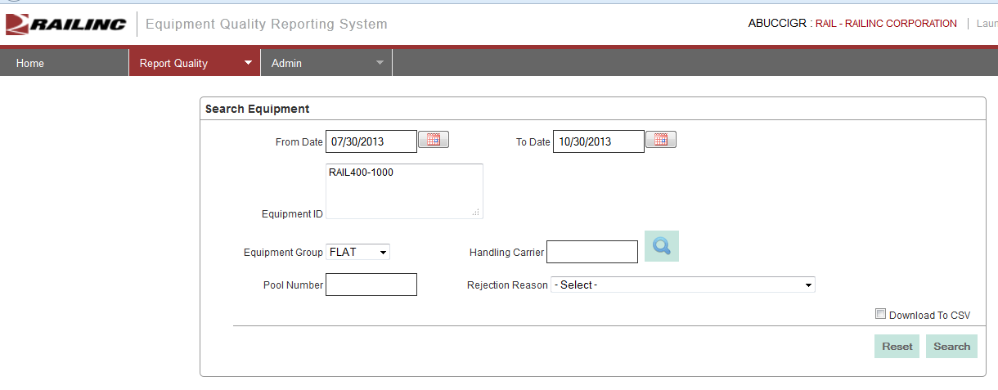
Query Functionality

Slide 23
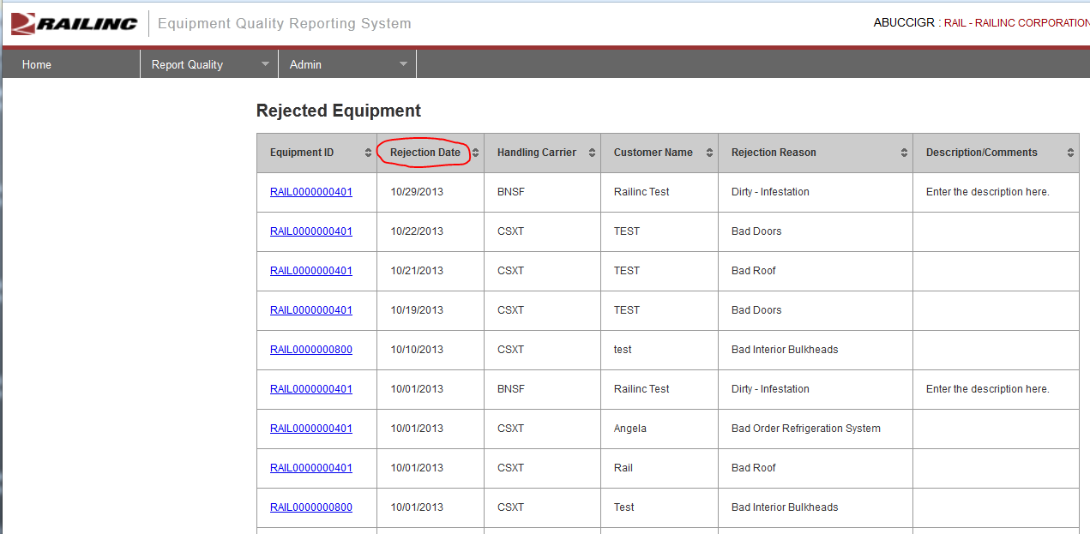
Query Results UI

Slide 24
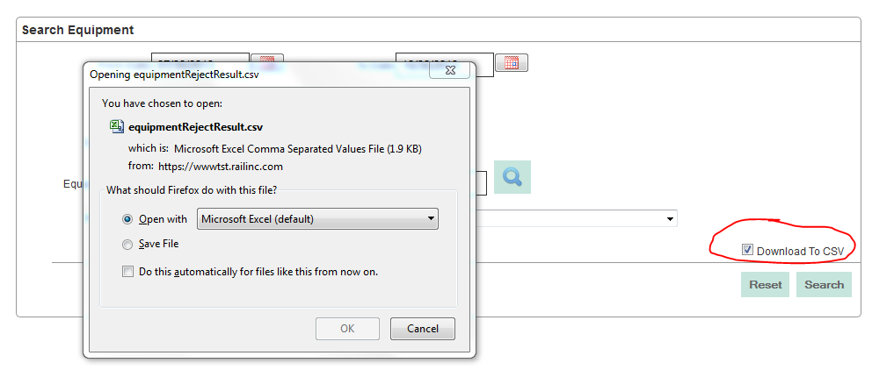
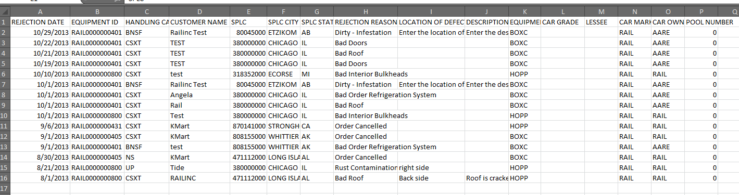
Query Results CSV Download

Slide 25
Questions?

