Slide 1
Railinc Project Support Working Committee
RPSWC Overview
Jerry Vaughn
5/12/16

Slide 2
Agenda
  RPSWC Purpose and Objectives
  2017 Portfolio Selection Process

Slide 3
Railinc Project Support Working Committee (RPSWC)
Established in 2010 with the mission to:
Maximize Business Process Understanding and the Communication Link between the Industry Business Stakeholders and Railinc
Three primary roles:
  Act as Ultimate Sponsors for Industry Initiatives, Interfacing with SOMC and Home Road Decision Makers
  Prioritize Railinc’s Industry (AAR) Product Investment and Ensure that Industry Needs are Supported
  Commit to Home Road Finance and Resource Support for Approved Projects

Slide 4
Railinc Project Support Working Committee:
Led by Railroad Executives
Name | RR | Title
Tim Ziethen | Amtrak | Group Information Officer - Operations
Jo-ann Olsovsky | BNSF | VP Technology Services & CIO
Gerry Weber | CN | VP Supply, Fleet and Fuel Management
Ray Elphick | CPR | General Manager Service Design
David Olson | CSX | AVP Process Excellence
Jeff Songer (Chairman) | KCS | Executive Vice President and Chief Operating Officer
Fred Ehlers | NS | VP Information Technology
Kate Betsworth | UP | VP National Customer Service Center
Railinc PMO provides foundational committee support in the role of Secretary
Barbara Bostian | Railinc | Director Project Management Office

Slide 5
2016 RPSWC Objectives
  Champion great industry product work.
  Select and prioritize the industry product portfolio to ensure that industry product work has business case benefits and the appropriate level of commitment.
  Align Railinc work with customer/carrier needs.

Slide 6
Measures of Success for 2016
  Great industry work is identified and supported, as measured by a positive ROI and qualitative benefits:
    - safety and environmental - cost reductions
    - operational efficiencies - customer service criteria
  The process for submitting and vetting potential work is clearly communicated to constituents, leverages railroad and industry investments, and supports budgeting cycles.
  Sign-off and resource approvals at home roads are monitored and documented for business case implications.
  Approved 2016 Industry Projects are completed on schedule and in accordance with achieving stated ROI’s.

Slide 7
Agenda
  RPSWC Purpose and Objectives
  2017 Portfolio Selection Process

Slide 8
Industry Project Definition-Decision Criteria
Industry Project Definition
Over $100,000 of spend (Railinc project investment)
Significant railroad involvement (guide/test) or
Requires railroad resources (I.T. work)
Decision Criteria (for August selection meeting)
Support from users/functional decision-makers
A positive Return on Investment (ROI)
Railroad executive commitment

Slide 9
Committee Inputs Due
2016 Calendar
January 27 2015 Closure/2016 Plan
April 27 Preliminary Pipeline Review
June 14 Initial Prioritization
August 18 Selection & Prioritization
November 8 Budget Review/Allocation
December 14 Process Review/Refine
For Each Deliverable
Opportunity Definition 1:
General Info, Sponsor, Type, Value Proposition, Railroad Requirements, Preliminary Total Railinc Project Cost
March 16
1
Opportunity Definition 2:
Previous Information Refined, with Scope
(Themes correlated with anticipated business benefits)
May 4
2
3
Business Case:
Previous Information Refined, with Scope
Measures of Success, Industry Summary Financial Analysis , Supporting Information
June 29

Slide 10
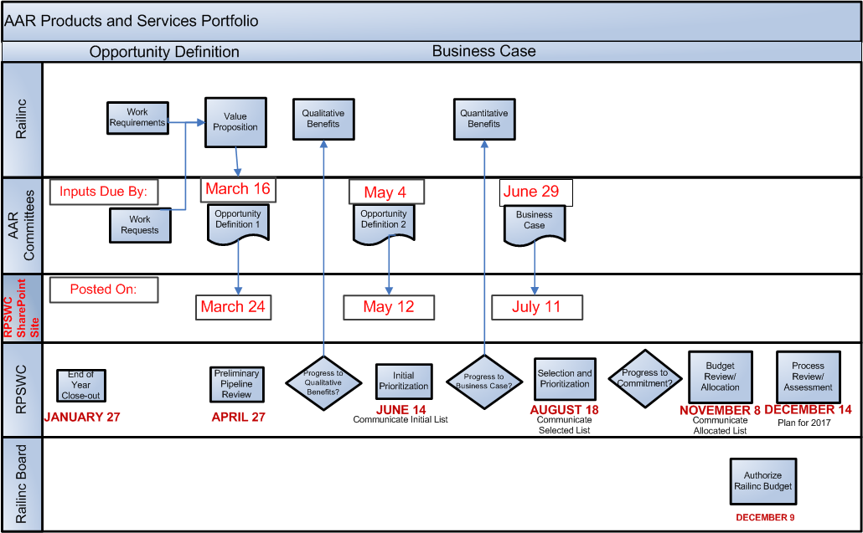
RPSWC will make preliminary and final decisions on the 2017 projects in June and August, respectively.

Slide 11
60 Day Calendar: Key Dates/Deliverables
May 4 – 2017 project submissions due (by committees)
May 13 – Ranking Tool sent (for individual RPSWC Ranking L/M/H)
May 19 – Individual Ranking Results returned to Barbara
May 27 – Meeting Materials sent to RPSWC members
June 7 – RPSWC Initial Prioritization meeting
June 29 – Business cases due (by committees) on projects progressed at June 7 meeting

Slide 12
Questions

