Slide 1
Car Hire 101 - TOL’s ACACSO, Coeur d’Alene, ID May 11 – 13, 2013

Slide 2


Transfer of Liabilities – A Car Hire 101 Perspective
Basics
Rule 4
Rule 5
Rule 15
Notes:
Brief bio for Scott?

Slide 3
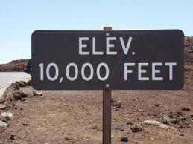
Car Hire 101 – TOL’s
50,000

Slide 4

Transfer of Liabilities - TOL
What are TOL’s?
Why do they happen?
What does it mean to me?

Slide 5

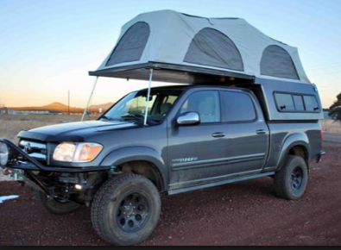
Transfer of Liabilities - TOL
Allows railroads to electronically move Car Hire to another road
Specific switching & interchange requirements
TRAIN II Manual, Section 5
Car Hire Rules – OT-10
Road with car is not paying Car Hire

Slide 6
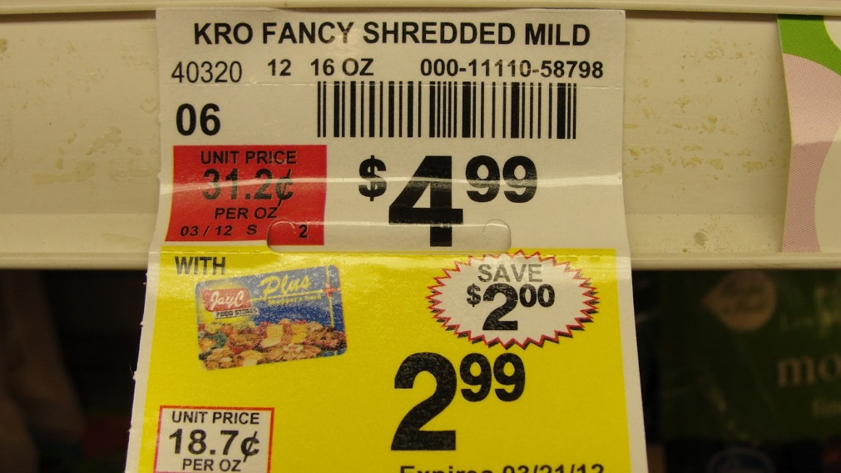
Transfer of Liabilities - TOL
One option allows you to get some $$ back
Car Hire Rules 4, 5 & 15
This is NOT a reclaim!
Not a separate transaction
Similar to when a store has a sale
You pay the sale price after the discount
Notes:
TOL
Rule 4
Must be empty, valid 417 waybill, AND specific STCC
Rule 5
– Must be switch road
Terminal Switch - 120 hours
Intermediate Switch – 24 hours
Rule 15
Cars offered, unable to deliver
Road WITH the cars transfers car hire liability to another road
Mention sessions going into detail on TOL’s.

Slide 7
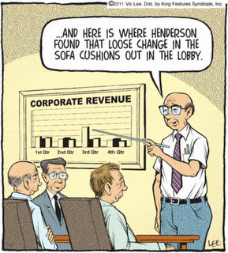
What is Car Hire Rule 4?
Provides handling carrier
Car Hire relief
for revenue empty billed shipments

Slide 8
Car Hire Rule 4 - Present
For empty cars handled under revenue billing in line haul or switching service, car hire costs for the revenue billed cycle shall be the responsibility of the car mark owner
B. Assignment of Car Hire Liability
The AAR Car Hire Rule 4 process will identify empty revenue cycles based on the Standard Transportation Commodity Code (STCC) transmitted to Railinc on the EDI 417 waybill transaction. In order to be eligible for relief, the handling carrier must submit the EDI 417 waybill transaction to Railinc
The following commodity codes will designate empty, revenue shipments. 3742205, 3742210, 3742213, 3742214, 3742215, 3742216, 3742217, 3742219, 3742233, 3742239, 3742263, 3742264, 3742293, 3742295, 3742298, 3742299
A TRAIN 28 message will be created to assign car hire liability for the revenue empty cycle to the car mark owner
Notes:
• Transportation Code XB - 20,360 cars reported
• Transportation Code XC – XY – 2,330 cars reported
• Transportation Code XA (overage) – 22,283 cars reported
• Transportation Code YA (over 50 years) – 4,249
• Transportation Codes S_/SX (scrap) – 3,059/1,108 (4,167) cars reported

Slide 9

Rule 4 – Layman’s Terms
If cars qualify…
Car hire responsibility is with Car Owner
LCS sends ‘interchange’ records moving Car Hire
How to Qualify:
You need an Electronic Waybill (417)
Need the right STCC
Must be Empty

Slide 10
Car Hire Rule 4 - Automation
Automated process
Car movement records, LCS interchanges, Waybill data
Reduced reclaims, associated efforts & costs for car owners and railroads
Resources previously utilized were redirected
Information (TRAIN28) sent to car owner and handling carrier
Important Dates
20th day of month – waybills from previous month must be submitted
21st day of month – TRAIN28 messages created
Notes:
• Transportation Code XB - 20,360 cars reported
• Transportation Code XC – XY – 2,330 cars reported
• Transportation Code XA (overage) – 22,283 cars reported
• Transportation Code YA (over 50 years) – 4,249
• Transportation Codes S_/SX (scrap) – 3,059/1,108 (4,167) cars reported

Slide 11
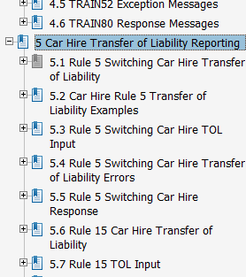
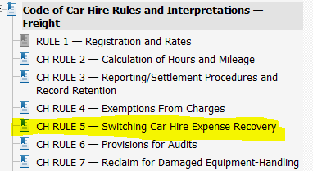
Car Hire Rule 5 – What Is It?
Allows railroads to electronically move Car Hire to another road
Specific switching & interchange requirements
TRAIN II Manual, Section 5
Road with car is not paying Car Hire
OT-10: Car Hire Rules
TRAIN II Manual
Notes:
Basically the Car Hire Rules allow for the transfer of the Car Hire Liability to someone else.
Separates the Car Hire from the physical car
Specific situations
Specific Requirements.

Slide 12
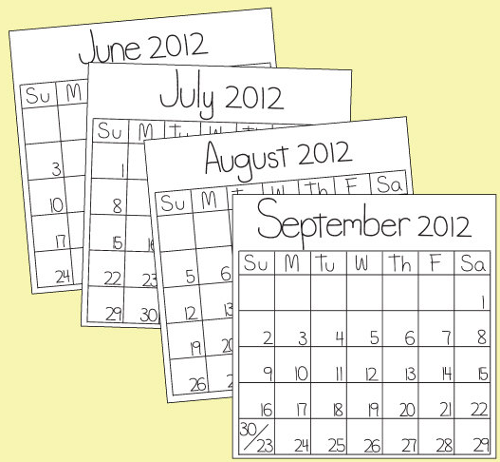

Rule 5 & Rule 4 – Differences
Rule 5
Only for switch moves
Against prior line haul road
LCS entries come through all month
Loaded receipt or delivery only
Time limit
Intermediate Switch 24 hours
Terminal Switch 120 hours
Start & stop time can span across months
Notes:
A railroad can be a line haul road but do switch moves in specific locations or for specific customers.
Rule 5 = 24 hr for intermediate switch
120 hour for terminal switch
Delivery prior to max time stops
Source = TOL R5 Receivable
Pay Code = Y

Slide 13


Rule 5 & Rule 4 – Differences
Rule 4
Can be on any railroad, not just switch roads
Against car owner
LCS entries arrive at one time for the month
Specific requirements
Empty time AND
Specific STCC AND
Electronic 417 Waybill
Unlimited time
Moves spanning months, separate entry each month
Notes:
Any road can receive the rule 4
Add in notes the STCC codes from the rule
Date of following month when entries arrive.
Delivery, Loaded release or loaded PFPS stop Rule 4
Rule 4 takes precedence over empty time. Rule 5 takes remainder of loaded time up to maximum
If move spans more than 1 month, there is a new rule 4 receipt/delivery each month
Source = CHP23-Data-Source
Pay Code = 4

Slide 14

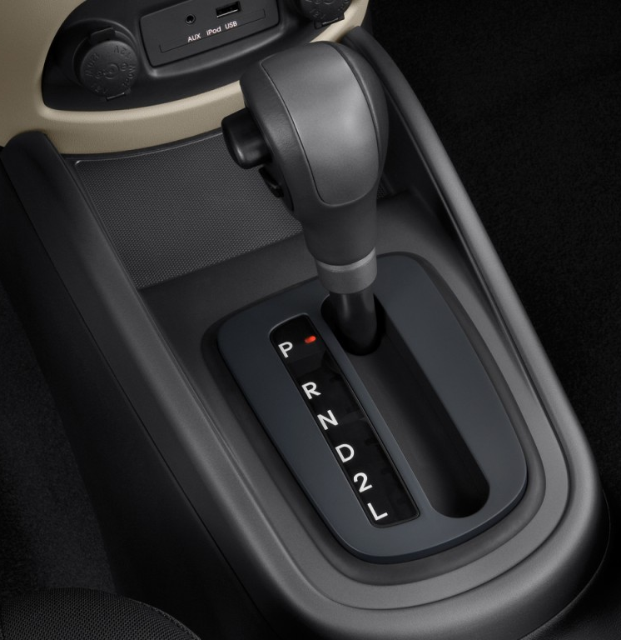
Car Hire Rule’s 5 & 4 – Similarities
Reclaim
They are Not reclaims!
Automated interchanges from LCS
Road with the car is not paying Car Hire
Car Hire starts after the Rule 4 or 5 TOL is done
Not a separate entry on the CHDX
Notes:
Heard from Scott about Rule 4
How is that different from a Rule 5
How are they the same

Slide 15
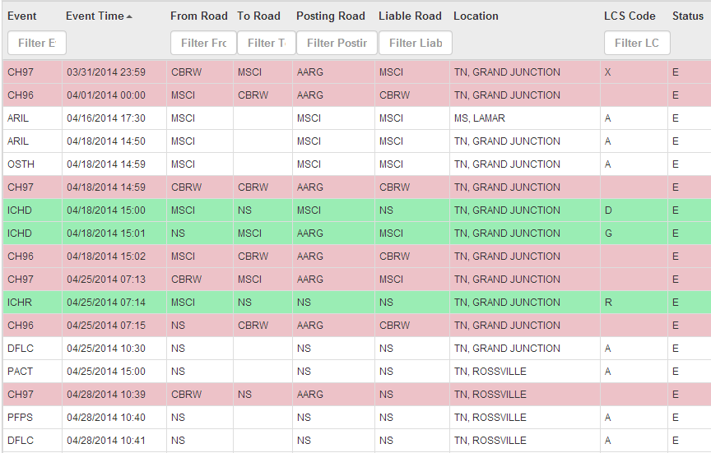
Rule 4 - Example

Slide 16
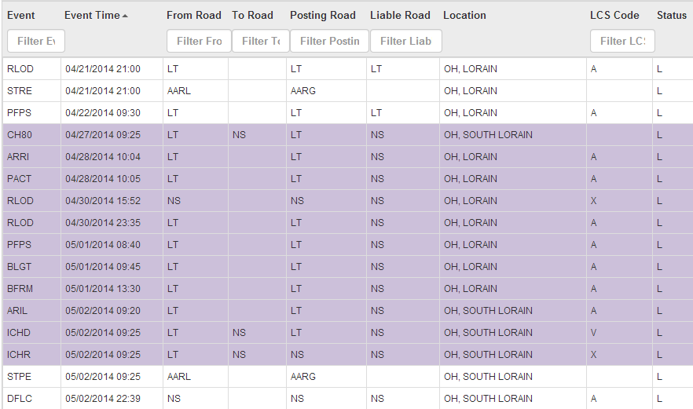
TOL Rule 5 Example

Slide 17

Car Hire Rule 15
Allows for Car Hire relief when a road is not able to accept the cars in interchange!
Road with the car is not the road Paying for the car!
Railroads must be in communication
Notes:
Communication is key
Again, this is not a reclaim

Slide 18



Car Hire Rule 15
Holding Carrier sends TRAIN message to Railinc
Railinc forwards to Receiving carrier
Agree to accept car hire liability
Deny the TOL
NOTE: Denying the Rule 15 TOL indicates that the receiving carrier is able to accept the cars offered
Notes:
Paper Rule 15 form
Filled out by Holding Agent
Signed by Receiving Agent
Sent to Car Accounting → Reclaim
Completely Manual!
Advantage of Paper Reclaims
Paper Trail
Both agents had agreed that reclaim was proper
disputes settled between agents
Problems:
Rule 15 Reclaims were 100% manual
Illegible, late data or incomplete data
Data keyed incorrectly
Extensions incorrect
Any error could cause the reclaim to be declined
Payment was delayed for months
System was automated in 2002!
Car Service Rule 7 – Conditions that must be complied with for the interchange of cars
Car Service – RULE 7 – Interchange – Error Movements
C. Delayed Interchange:
When interchange required by Section (B.2., .3), of the rule cannot be accomplished, the provisions of Car Hire Rule 15 apply.
Technical information on what information and requirements are in the TRAIN II manual available from Railinc.

Slide 19



TOL – Rule 15 Liability Accepted by Receiving Road
(1) → Train 08 /
Train 10 type 82
LCS
(3) Train 08 / 10 type 86
(4) Train 28
(2) Train 26
Car Hire Liability
Car Hire Liability Transferred with Date & Time of Original Train08
Source: Circular OT-10, CH Rule 15 C.1.a.
Notes:
The receipt time of the original Train 08/10 Type 82 message to Railinc is saved as the start time of the TOL.
CASS Event type for start of Rule 15 = CH82 (for the type 82) Will not show as an ICHR
This receipt time is recognized by LCS as a verified interchange (LCS V) of Car Hire.

Slide 20

TOL – Rule 15 Liability Rejected by Receiving Road
(1) → Train 08 /
Train 10 type 82
LCS
(3) Train 08 / 10 type 89
(4) Train 29
(2) Train 26
Car Hire Liability
No Car Hire Liability Transferred ➔
They can take the cars in interchange
Source: Circular OT-10, CH Rule 15 C.1.a.
Notes:
If the receiving road declines the TOL Rule 15, a Train 10/08 report type 89 is sent back to the holding road indicating the denial of the TOL. The Car Hire responsibility remains with the Holding Carrier until actual interchange.
Will NOT show up in CASS

Slide 21
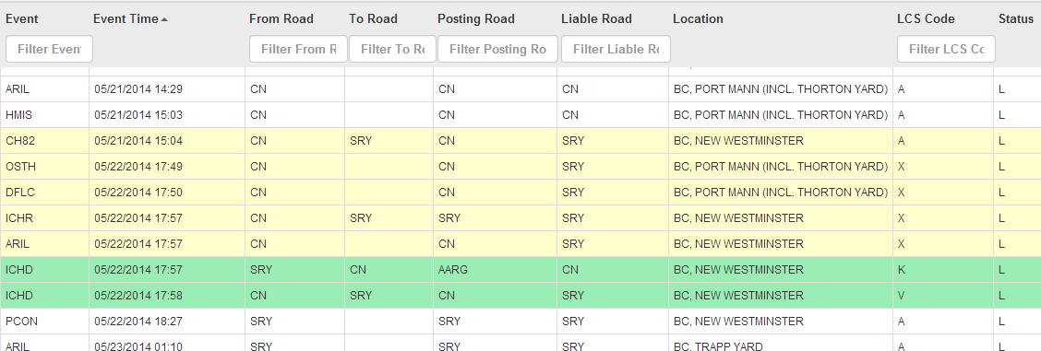
TOL Rule 15 Example
LCS K = End of Rule 15
1 minute prior to physical delivery
Notes:
CN sending the Rule 15 to this road. It has been accepted.
Start shows TOL R15
End 1 minute prior to physical ICHR of car
“Moves” back to car which is then physically interchanged.

Slide 22

TOL Car Hire Rule 4, 5, & 15
Questions?
Notes:
Any road can receive the rule 4
Add in notes the STCC codes from the rule
Date of following month when entries arrive.
Delivery, Loaded release or loaded PFPS stop Rule 4
Rule 4 takes precedence over empty time. Rule 5 takes remainder of loaded time up to maximum
If move spans more than 1 month, there is a new rule 4 receipt/delivery each month
Source = CHP23-Data-Source
Pay Code = 4

