Slide 1
Rail Vehicle Defect, Condition and Performance Monitoring: 2015 Update
RB Wiley
Sr. Principal Investigator
May 14, 2015

Slide 2
Automated Vehicle Health Monitoring
Data flow overview
Central Detector Data Warehouse Integrated Railway Remote Information Service (InteRRIS® )
Equipment Health Management System (EHMS)
Alerts (rule supported response required)
Data summaries (informational alerts)
Basic wayside system distinctions
Data Integrity

Slide 3
Implementation of Automated Equipment Health Monitoring & Management
Data Integrity
Carrier
Wayside
System
Carriers
Car Owners
Via Industry
Systems
Outside of Stress-
State Condition
Raw Data
®
Equipment
Identification
InteRRIS®
Stress-
State
Condition
Industry Systems
AEI
Wayside systems feed InteRRIS^{Ò} after identifying the car with automatic equipment identification (AEI)
InteRRIS^{Ò} identifies a “stress-state” condition
InteRRIS^{Ò} communicates with Railinc systems for processing

Slide 4
EHMS Vehicle Health Detectors on North American Freight Railroads
2009: 128
Current
Wheel Impact Load Detector System (167 reporting/181 in database)
Truck Steering Performance (14/22)
Acoustic Bearing (33/39)
High Speed Stability* (Truck Hunting: 89/95)
Optical Geometry Detectors (28/30)
Wheel Profile (11/28)
Pending
Brake Performance
Data Integrity
Detectors installed and maintained by railroads
Must be coupled with AEI — direct or virtual
*Added feature to some wheel impact load detectors

Slide 5
Industry Alerts
Wheel Impact Load Detector (WILD)
Window Open: ≥ 65 kips
Opportunistic Repair: ≥ 80 kips
Condemnable: ≥ 90 kips
Final Alert: ≥ 140 kips
Truck Hunting Detector (THD)
Window Open: ≥ 0.2 once
Condemnable: ≥ 0.5 once or ≥ 0.35 twice in 12 months
Acoustic Bearing Detector (ABD), Condemnable only
TADS®: Growler 5
Truck Performance Detector (TPD), Condemnable only
TPDL: LAHRLV ⃰ ≥ 1.05 twice in 12 months
TPDG: Gage Spread ≥ 28+ kips (by degree curve) twice in 12 months
Data Integrity
⃰ Lead Axle High Rail Lateral/Vertical

Slide 6
Automated Equipment Health Management
Data Integrity
Does it work?

Slide 7
Equipment Health Monitoring Systems for AAR Interchange Fleet (> 1.4-million rail vehicles)
InteRRIS®: Central Detector Data Warehouse History
Receive, analyze, and transmit rail vehicle performance data
Total fleet size of intensively managed: approaching 1,250,000 rail vehicles (85% of NA fleet)
300+ detectors worldwide \ 500-million records per month
Detailed performance data tracking
Alert determination for Advanced Technology Safety Initiative — now Equipment Health Monitoring Committee
EHMS: Central Vehicle Health Alerts Status
Rule-based alerts
Informational (Data Summary) alerts
Operational October 1, 2004
Alerts closed by repair or auto-closed
Data Integrity

Slide 8
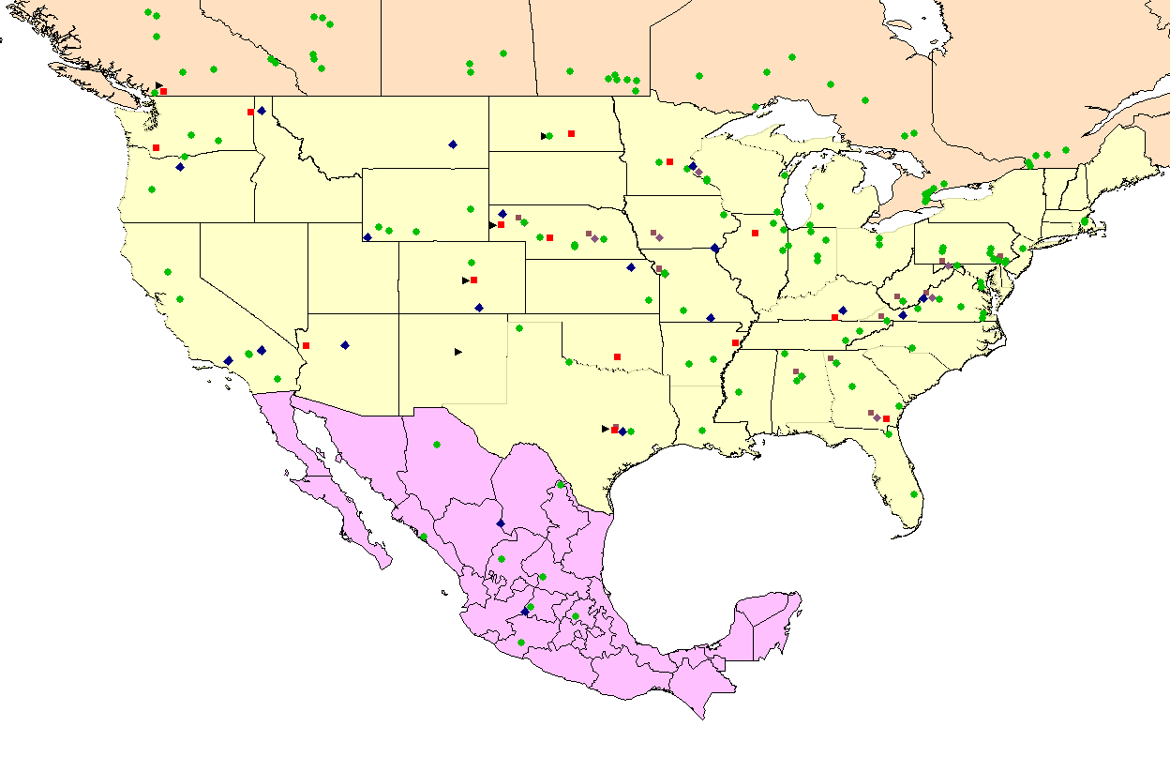
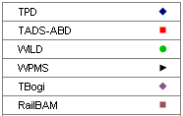
Data Integrity
N
14
25
180
20
28
14
1
0
0
0
0
1
0
0
0
2
0
0
0
M
i
l
e
s
W
a
y
s
i
d
e
D
e
t
e
c
t
o
r
D
i
s
t
r
i
b
u
t
i
o
n
03/14/2015
.
B
a
s
e
d
o
n
U
S
G
S
D
L
G
.
1
:
2
5
,
5
0
0
,
0
0
0
,
G
e
o
g
r
a
p
h
i
c
P
r
o
j
e
c
t
i
o
n
,
D
D
.
2015
(
c
)
,
T
r
a
n
s
p
o
r
t
a
t
i
o
n
T
e
c
h
n
o
l
o
g
y
C
e
n
t
e
r
,
I
n
c
.
8

Slide 9
Newly Available (at the industry level) Condition and Performance Monitors
Optical Geometry Detector (OGD)
In production InteRRIS® (since Monday, March 16)
Wheel Profile Detector (WPD) and Wheel Profile Measurement System (WPMS)
InteRRIS® release: ~ end of May
Data Integrity

Slide 10
TPD: force-based truck curving performance monitor located in a reverse curve.
WILD: force-based out-of-round wheel detector; located on tangent track. Some (89) WILDs include THD or lateral instability monitoring capability.
TADS®-ABD (Trackside Acoustic Detector System – Acoustic Bearing Detector): Identifies defective bearings by sound signature; located on tangent track.
RailBAM®-ABD: Identifies defective bearings by sound signature; located on tangent track.
TBOGI-OGD (Optical Geometry Detector): Laser-based truck geometry and performance detector located on tangent track. Seven of the OGD sites have THD capability (TBOGI-HD).
WPMS: Laser- or vision-based wheel profile measuring system; located on tangent track.
Data Integrity

Slide 11
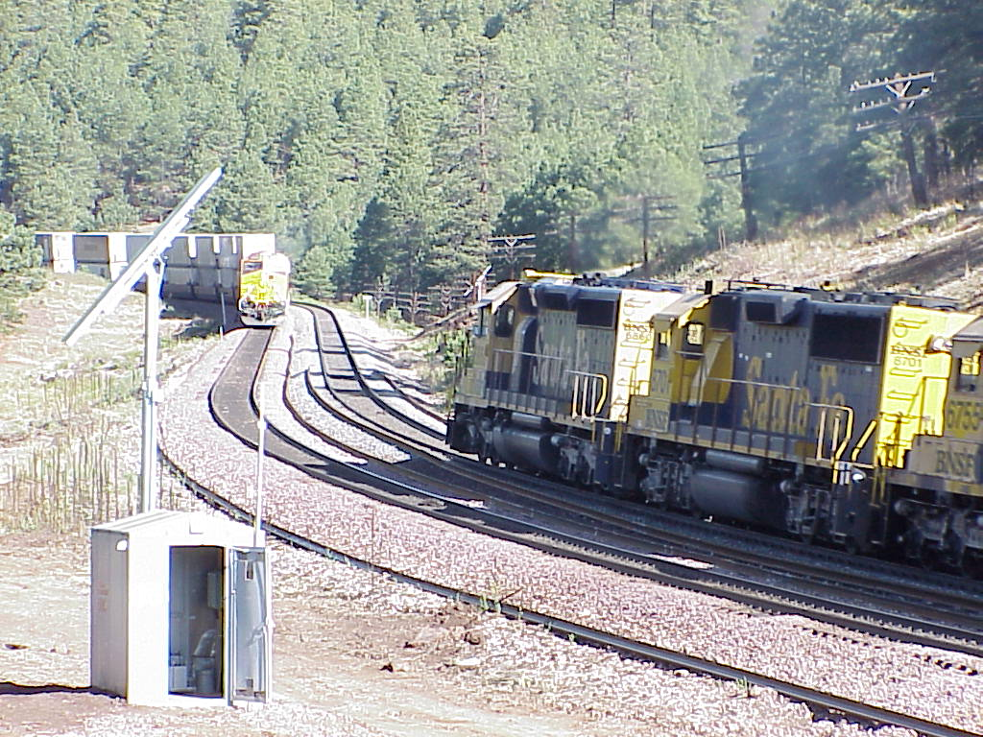
Truck Performance (Curving) Detector
Measurements:
Vertical Load
Lateral Load
AOA
Ideal Site for
Bi-directional
Traffic
Curvatures
4° – 6°
Curvatures
4° – 6°
00860cun -
1

Slide 12
TPD: force-based truck curving performance monitor located in a reverse curve.
WILD: force-based out-of-round wheel detector; located on tangent track. Some (89) WILDs include THD or lateral instability monitoring capability.
TADS®-ABD (Trackside Acoustic Detector System – Acoustic Bearing Detector): Identifies defective bearings by sound signature; located on tangent track.
RailBAM-ABD: Identifies defective bearings by sound signature; located on tangent track.
TBOGI-OGD (Optical Geometry Detector): Laser-based truck geometry and performance detector located on tangent track. Seven of the OGD sites have THD capability (TBOGI-HD).
WPMS: Laser- or vision-based wheel profile measuring system; located on tangent track.
Data Integrity

Slide 13
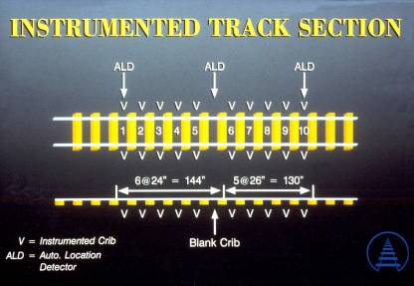
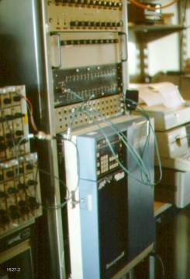
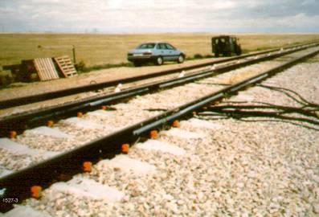
Wheel Impact Load Detectors
Electronic Equipment
TTCI Testing of Impact Load Detectors
Notes:
Basic overview of WILD
Note older, massive size vs current small footprint
Tangent (illustration is older 10 crib layout)
16+ cribs (sensor pairs) - sometimes includes lateral force sensors

Slide 14
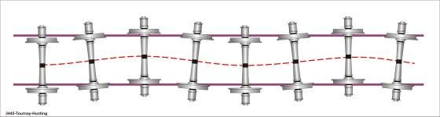
Truck Hunting Detector
Instrumented cribs measure vertical & lateral wheel loads
To establish a hunting index (HI) over a length of track
HI values typically:
HI > 0.5: Severe Hunting
0.20 < HI > 0.5: Moderate Hunting
HI < 0.20: Limited or no Hunting

Slide 15
TPD: force-based truck curving performance monitor located in a reverse curve.
WILD: force-based out-of-round wheel detector; located on tangent track. Some (89) WILDs include THD or lateral instability monitoring capability.
TADS®-ABD (Trackside Acoustic Detector System – Acoustic Bearing Detector): Identifies defective bearings by sound signature; located on tangent track.
RailBAM-ABD: Identifies defective bearings by sound signature; located on tangent track.
TBOGI-OGD (Optical Geometry Detector): Laser-based truck geometry and performance detector located on tangent track. Seven of the OGD sites have THD capability (TBOGI-HD).
WPMS: Laser- or vision-based wheel profile measuring system; located on tangent track.
Data Integrity

Slide 16
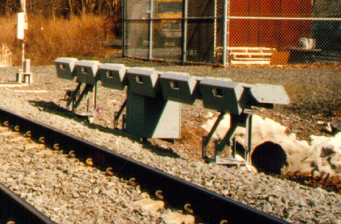
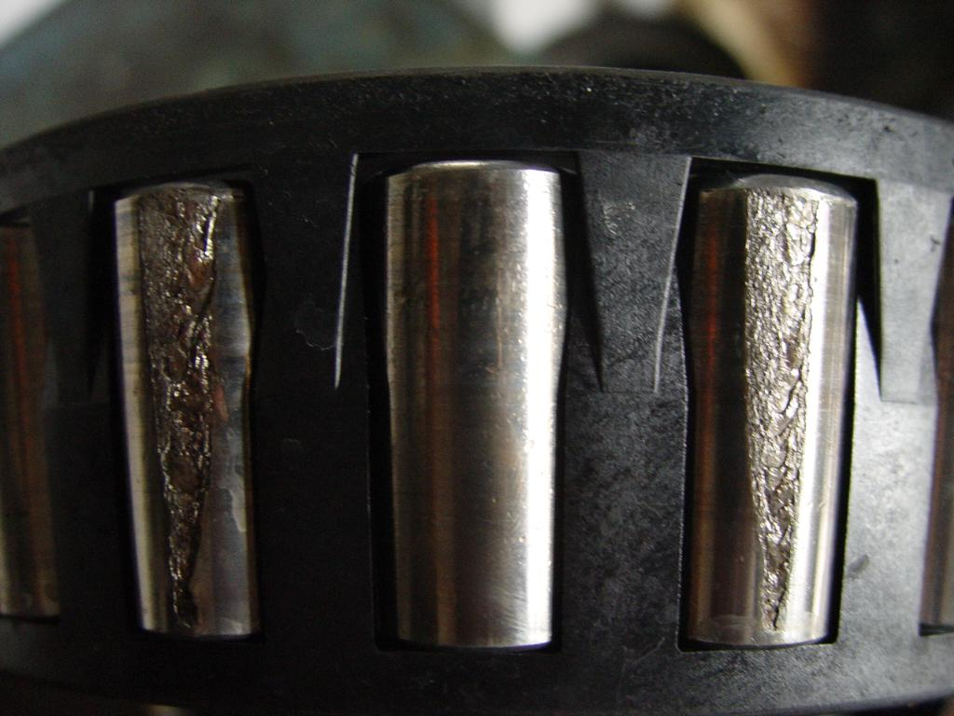
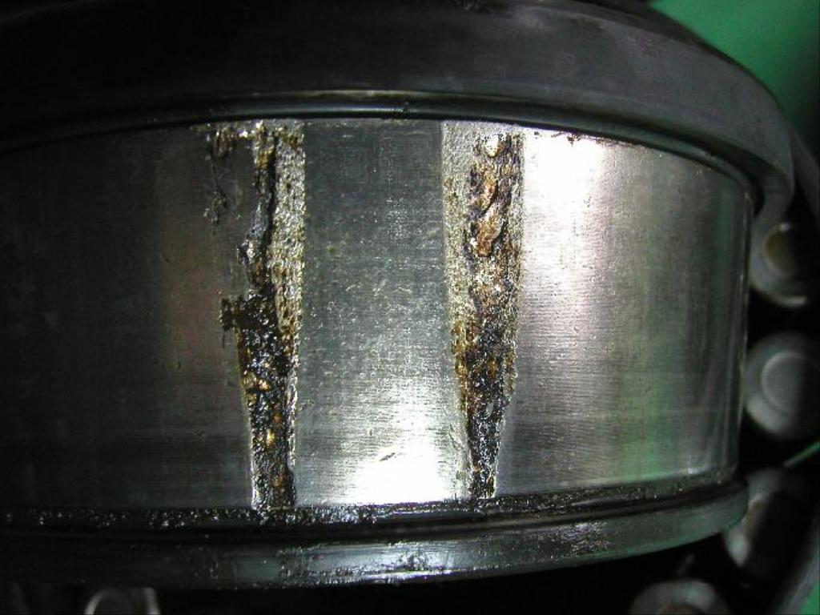
Trackside Acoustic Detection System

Slide 17
TPD: force-based truck curving performance monitor located in a reverse curve.
WILD: force-based out-of-round wheel detector; located on tangent track. Some (89) WILDs include THD or lateral instability monitoring capability.
TADS®-ABD (Trackside Acoustic Detector System – Acoustic Bearing Detector): Identifies defective bearings by sound signature; located on tangent track.
RailBAM-ABD: Identifies defective bearings by sound signature; located on tangent track.
TBOGI-OGD (Optical Geometry Detector): Laser-based truck geometry and performance detector located on tangent track. Seven of the OGD sites have THD capability (TBOGI-HD).
WPMS: Laser- or vision-based wheel profile measuring system; located on tangent track.
Data Integrity

Slide 18
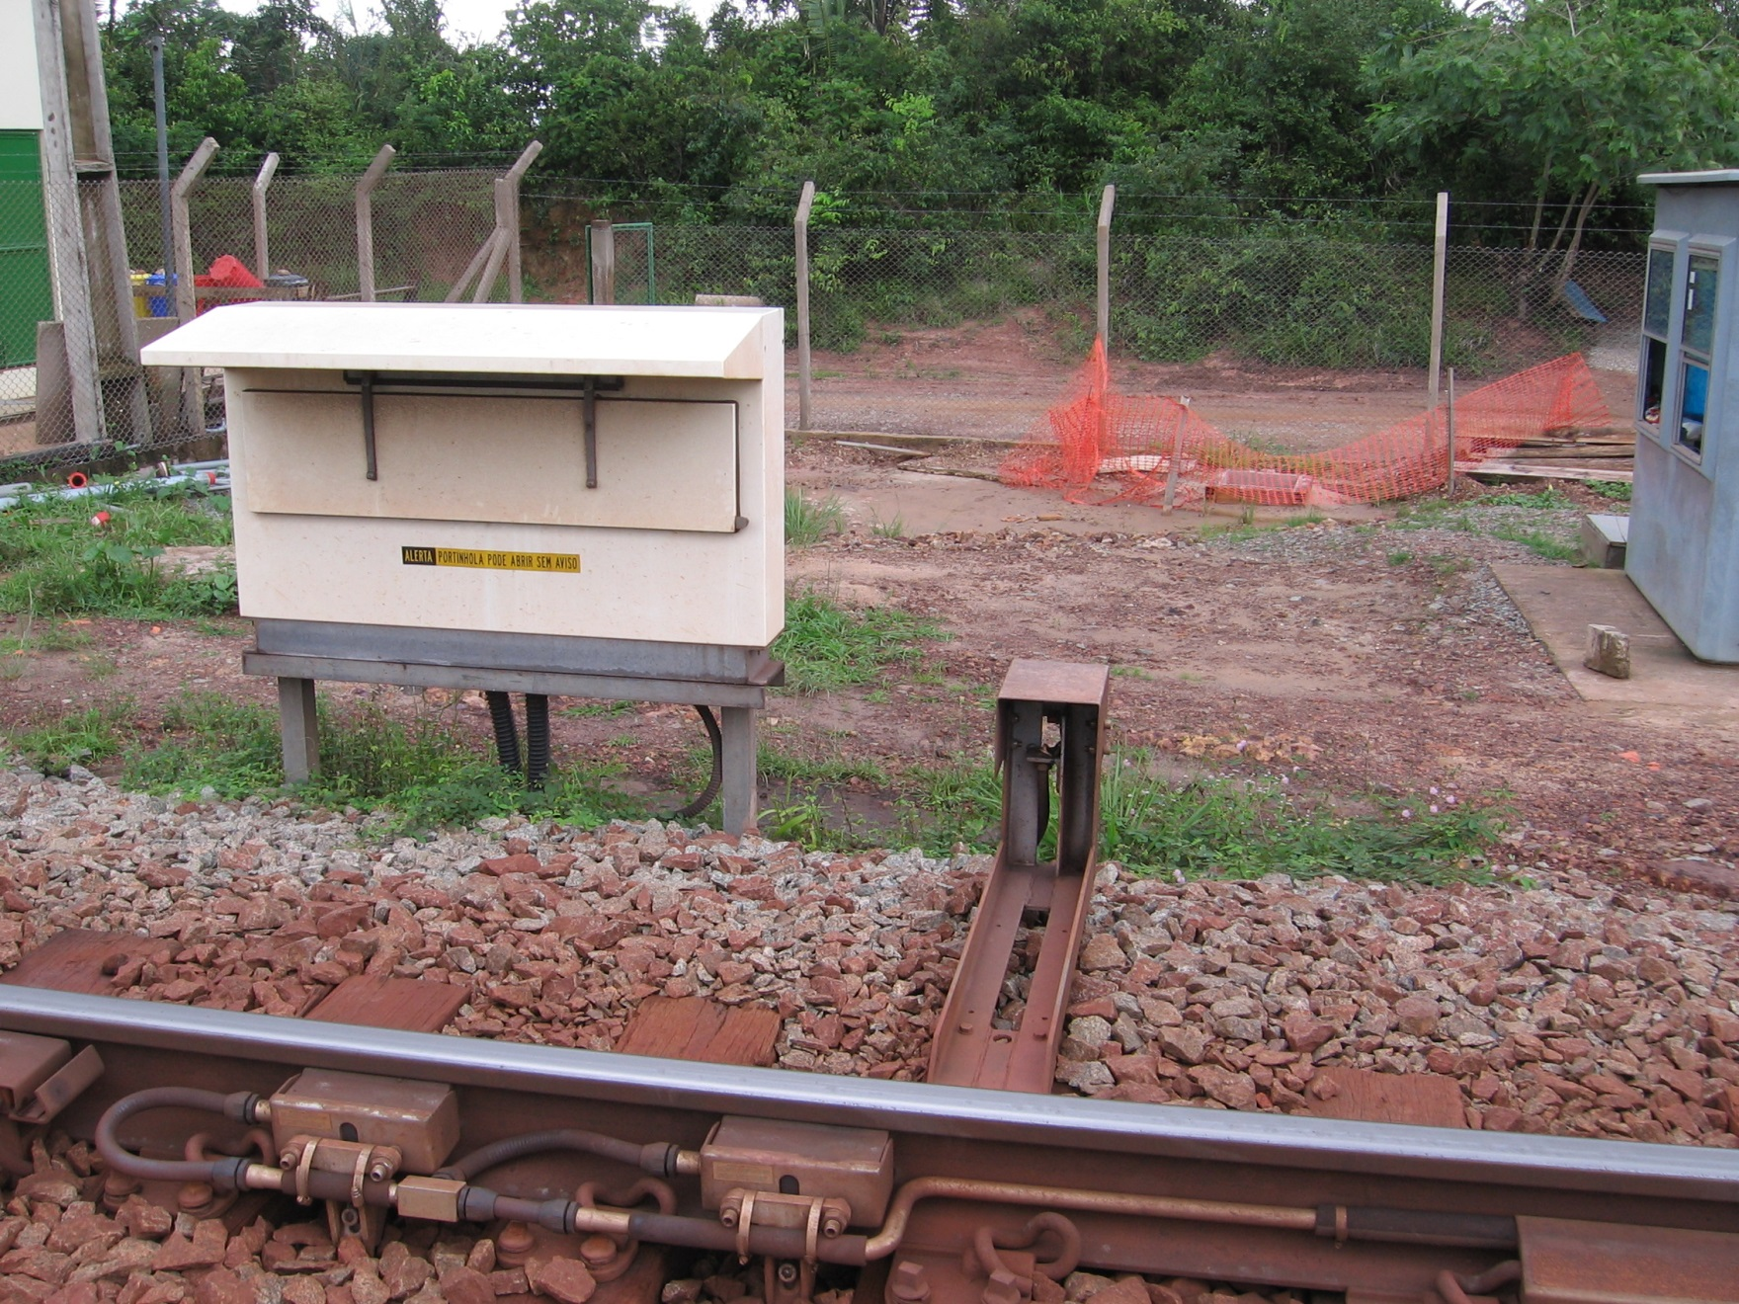
Rail Bearing Acoustic Monitor

Slide 19
TPD: force-based truck curving performance monitor located in a reverse curve.
WILD: force-based out-of-round wheel detector; located on tangent track. Some (89) WILDs include THD or lateral instability monitoring capability.
TADS®-ABD (Trackside Acoustic Detector System – Acoustic Bearing Detector): Identifies defective bearings by sound signature; located on tangent track.
RailBAM-ABD: Identifies defective bearings by sound signature; located on tangent track.
TBOGI-OGD (Optical Geometry Detector): Laser-based truck geometry and performance detector located on tangent track. Seven of the OGD sites have THD capability (TBOGI-HD).
WPMS: Laser- or vision-based wheel profile measuring system; located on tangent track.
Data Integrity

Slide 20
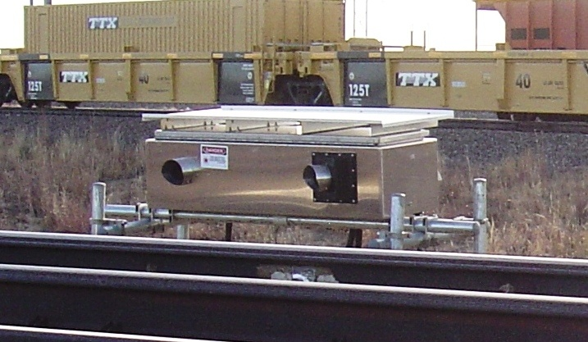
TBOGI-OGD (Optical Geometry Detector)
Optical Geometry Detector
Single-Unit
3-Units are THD capable

Slide 21
TPD (Truck Performance Detector): force-based truck curving performance monitor located in a reverse curve.
WILD: force-based out-of-round wheel detector; located on tangent track. Some (89) WILDs include THD or lateral instability monitoring capability.
TADS-ABD (Trackside Acoustic Detector System – Acoustic Bearing Detector): Identifies defective bearings by sound signature; located on tangent track.
RailBAM-ABD: Identifies defective bearings by sound signature; located on tangent track.
TBOGI-OGD (Optical Geometry Detector): Laser-based truck geometry and performance detector located on tangent track. Seven of the OGD sites have THD capability (TBOGI-HD).
WPMS: Laser- or vision-based wheel profile measuring system; located on tangent track.
Data Integrity

Slide 22
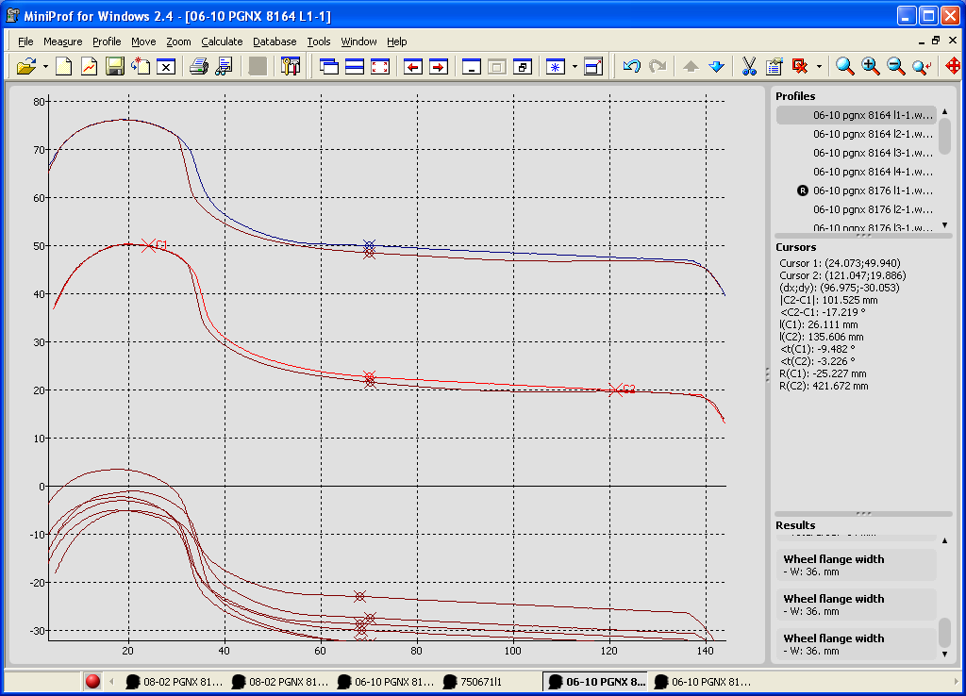
Wheel Profile Measurement System or Wheel Profile Detector
Wheel Profiles: Laser-based
Notes:
Images or profile plots supplement the measurement data

Slide 23
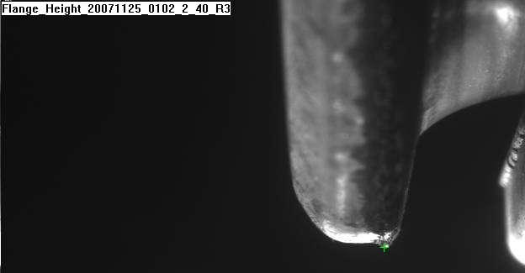
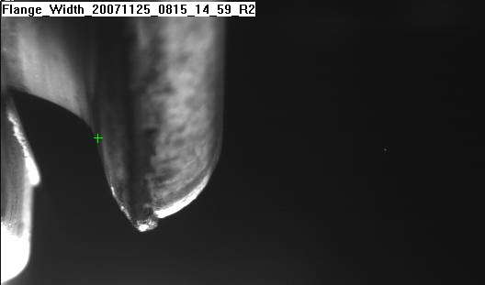
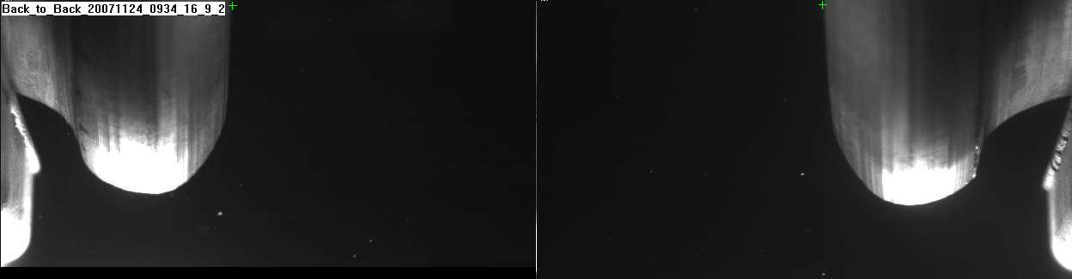
Wheel Profile Measurement System or Wheel Profile Detector
Wheel Profiles: Vision-based
Notes:
Images or profile plots supplement the measurement data

Slide 24
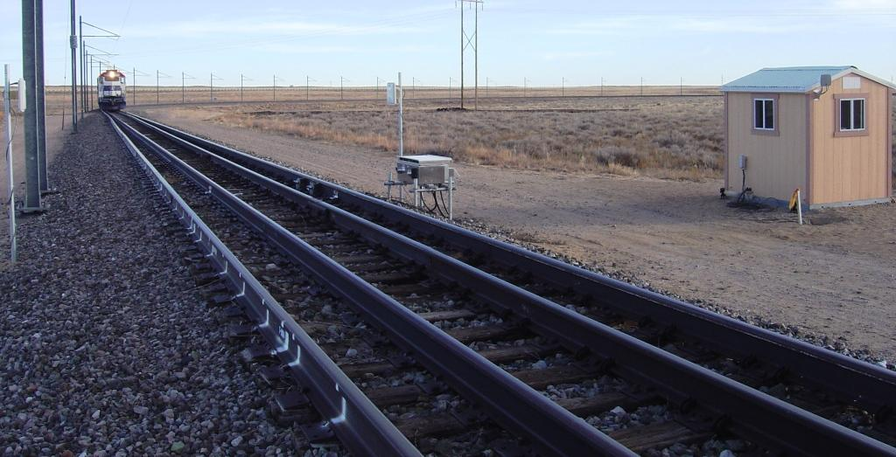
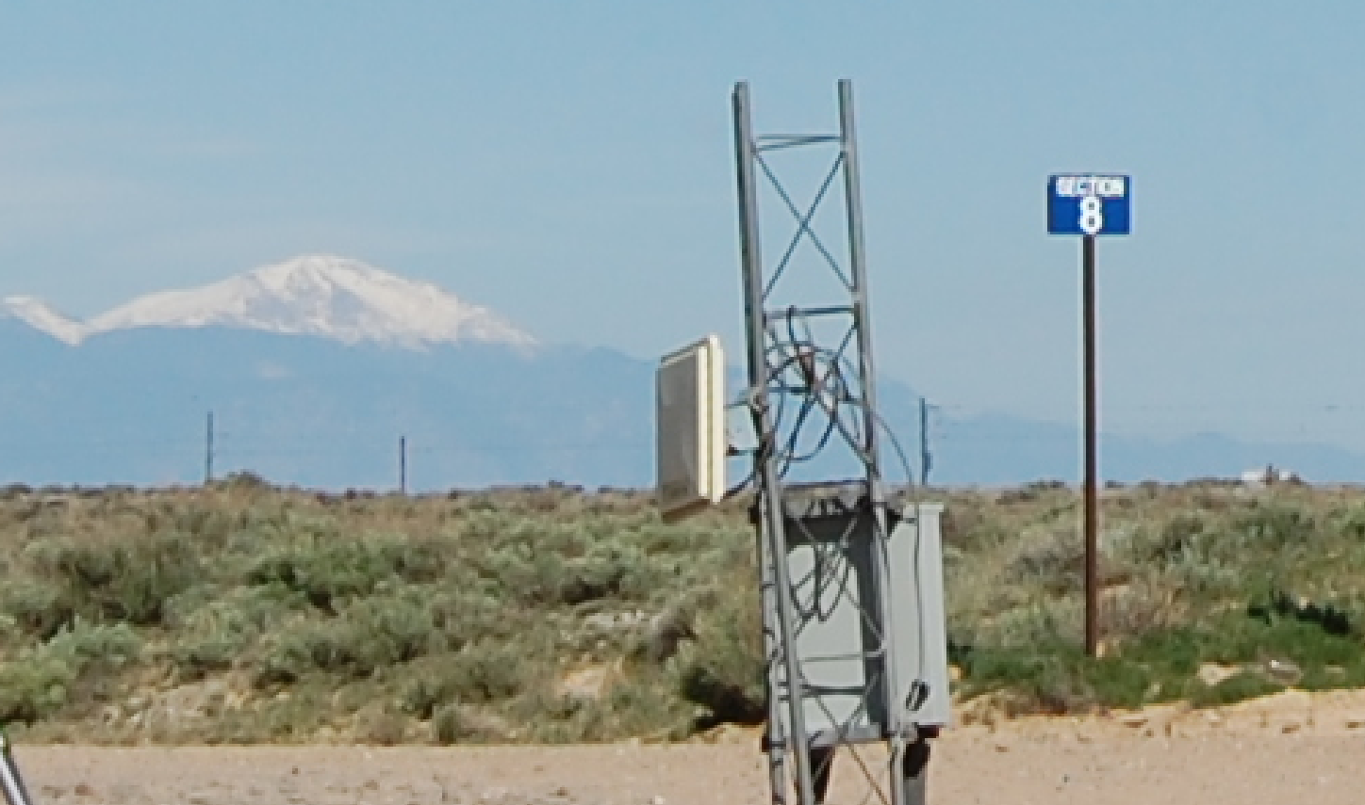
Detector and Monitor Overview: AEI
AEI
OGD

Slide 25
Vehicle Health Monitoring Systems
Truck Hunting Detector
Truck Performance Detector
Wheel Impact Load Detector
Warm Bearing Trending
Wheel Temperature Trending
Wayside Performance Monitoring
Data Integrity
Wayside Condition Detection
Wayside Machine Vision Technology
Cracked Axle Detector Cracked Wheel Detector
Thermal Scan
Acoustic Bearing Detector
Low Air Hose Detector
Dragging Equipment Detector
Databases (InteRRIS® & EHMS)
Wheel Profile Module
Brake Shoe Module
Optical Geometry
Automated Safety Appliance Inspection System
Automated Structural Inspection System
Fully Automated Train Scan
Data Summary

Slide 26
Questions?
Data Integrity

