Slide 1
Umler® & CHARM Industry critical applications working together
Mark Hawkins
ACACSO
November 11 – 13, 2015

Slide 2
Umler®
The Umler® system is an electronic resource that contains critical data for North American transportation equipment. Originally created in 1968, Umler maintains data for more than two million pieces of equipment used in rail, steamship and highway service.

Slide 3
Functions of Umler®
Equipment Cloning
Restencil Support
Equipment Lineage
Equipment Status
Conflict Management

Slide 4
Functions of Umler®
Notice Management & Ticklers
System Generated Elements
Query Data
Statistics & Analysis Services
Component Registry

Slide 5
Umler® System Benefits
Access | Updating via web, XML messaging and Web Services
Security | Control over access to confidential information
Data Quality | High data standards built into system through extensive validation and proactive conflict resolution
Real Time Updating | Transactions processed and communicated immediately

Slide 6
CHARM
CHARM = Car Hire Accounting Rate Master
CHARM helps users manage and understand the costs of rail car use and repair. CHARM is the official source of time and mileage rates on freight cars.

Slide 7
CHARM File Benefits
CHARM = Car Hire Accounting Rate Master
Confidentiality | Files are customized for each subscriber
Security | Secure delivery of confidential information
Data Quality | Default and negotiated rates stored in a secure system
Control | CHARM helps users manage and understand the costs of rail car use and repair.

Slide 8
In the beginning ------
When a car is added to Umler® the default rate is calculated and the car is available for negotiations.
The default rate holds steady during the life of the car.
Every month customized CHARM files are generated and include all default rates and negotiated rates based on the owner/user combination.

Slide 9
When things change in Umler® ----
the updates cascade to CHARM, such as ownership changes and restenciling.
When cars are rebuilt they receive a new default rate based on the current market.
If there are interchange restrictions cars are no longer eligible for negotiations.

Slide 10
Unique Identifier
Every piece of equipment registered in Umler® is assigned an EIN.
EIN = Equipment Identification Number
This unique identifier allows Railinc to maintain the lineage of the equipment.

Slide 11
The EIN is Important
When cars are deleted from Umler® and subsequently added back, the original EIN cannot be assigned to the car. The cars lose their lineage which causes the rate history to be lost.
CHARM works best when the original record for the car is updated.

Slide 12
When in doubt ----
Contact Railinc! We can help make sure that you understand any impacts to car hire rates when a change is made in Umler®.

Slide 13
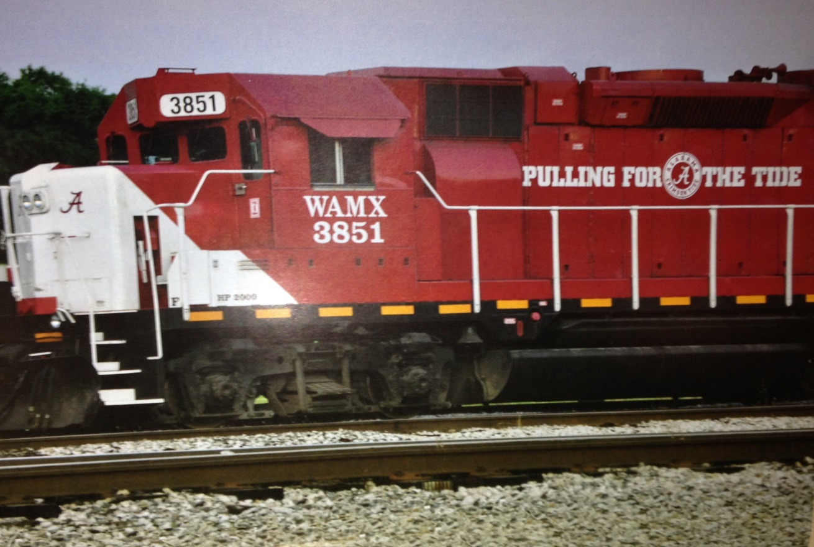
Thank You!

