Slide 1
Event Repository Reporting
Mark Hawkins
ACACSO
May 11 – 13, 2016

Slide 2
Idaho
History
Event Lifecycle
Dependencies

Slide 3
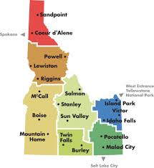
Idaho?
Originally included in the Washington territory and included Montana & Wyoming
George M Willing – Shoshone “the sun comes from the mountains”
1863 Washington state legislators petitioned to decrease the size of the territory
  The Wyoming disaster!
  You can’t put Montana in a box (sort of)

Slide 4
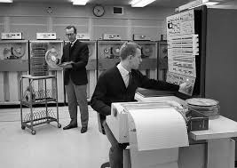
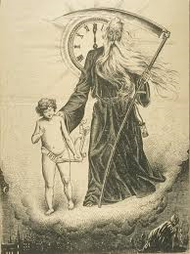
Event Reporting History
Interchange events were reported to the AAR via TRAIN I System as far back as the 60’s
ICS LCS

Slide 5
Lifecycle
Events Received (TRAIN II)
Event Preprocessors (EPP)
Event Posters
Event Repository DW

Slide 6
Why is Event reporting important?
Official record
Protects interests
Utilization
Dependencies

Slide 7
Liability Continuity System (LCS)
Analyzes events > 120 hours old
LCS makes better (more accurate) decisions with more information
Currently analyzing 10,000,000+ events per day

Slide 8
Special Car Order 90 (SCO90)
Analyzes events every 4 hours
For eligible cars, updates Umler transportation codes based on car location
Cars are routed more appropriately when more events are present

Slide 9
Damaged & Defective Car Tracking (DDCT)
Sends events to the Event Repository in support of Car Hire Rules 7 & 8
LCS reacts to these events
Recent enhancement to include and consider incident numbers (improves TRUK Hunting and multiple incident situations)

Slide 10
Car Service Database (CSDB)
Reviews events to determine car location at midnight - “Cars on Line”
Provides reporting to Class 1’s and the AAR
Line Code 30
Railroad Performance Measures

Slide 11
Clear Path™ System
Application that helps railroads plan the movement of trains through the Chicago Terminal, the busiest rail gateway in North America.
Clear Path is part of the ongoing Gateway Operations Services program
  focuses on enabling the exchange of timely, accurate and actionable information to support the Chicago Integrated Rail Operations Center
  facilitate proactive inter-carrier operations in the Chicago Terminal

Slide 12
Call Jim Pinson!
Jim.Pinson@Railinc.com
SSN 456-98-12XX
Twitter @BigBadJim80
(919) 651 - 5047
Questions?

Slide 13
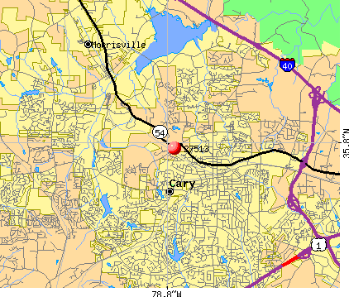

Slide 14
Call Mark Hawkins
Mark.Hawkins@Railinc.com
(919) 651 - 5076
Just Kidding

