Slide 1
End of Train (EOT)
Created for May 9, 2019

Slide 2
Today’s Agenda
What is Circular OT-18?
EOT Project Phase 1 (2017-2018)
EOT Project Phase 2 (2019)
What’s on the horizon?
Questions

Slide 3
What is Circular OT-18?

Slide 4
AAR Circular OT-18: Operating Practices For Control of End of Train (E-O-T) Devices
Contains the Code of accounting rules for End-Of-Train (EOT) Telemetry Devices.
EOT’s must be registered in Umler
Rates are a daily rate
First 1-15 days of possession are applied a rate of $15 per day
Each day after 15 days is applied a rate of $50 a day
Subscribers applicable to OT-18
BNSF Railway Company | Kansas City Southern de Mexico, S. de R.L. de C.V.
Canadian National Railway | Kansas City Southern Railway
Canadian Pacific Railway | Norfolk Southern Railroad
CSX Transportation | Union Pacific Railroad
Ferrocarril Mexicano S. A. de C. V.

Slide 5
EOT Project Phase 1 (2017-2018)

Slide 6
EOT Phase 1: 2017-2018
Updates to Circular OT-18:
Introduction of LCS decisions on movements to determine liability
New Event Types, Hand and Package delivery and receipts
Enhanced rules customized for EOT movements and determining liability
New Subscriber – KCS & KCSM
Enhanced file format including rate and max out calculations
Introduction of two new files;
Daily Estimation File
Daily In-Transit File
Introduction of the new Hand Delivery and Receipt Interchanges and Package Delivery and Receipt Interchanges.

Slide 7
EOT Project Phase 2 (2019)

Slide 8
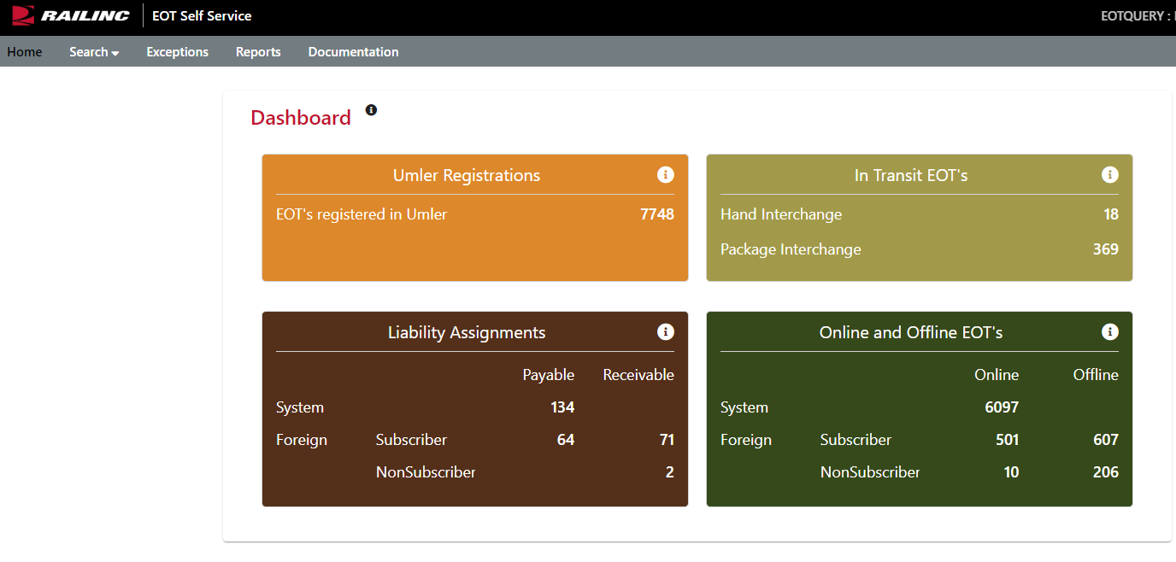
EOT Phase 2: 2019
4 Project Themes
Create a new user interface for EOT research & analysis
Home page dashboard for users to view high level details on their fleet.
Event search capability with tools to assist users research location and liability behaviors
Access to the EOT Liability File via the user interface with features that include filtering and sorting

Slide 9
EOT Phase 2: 2019
Project Themes Continued
Create EOT Exception UI capability
Create exceptions for EOT via the new online user interface where users can accept and reject exception requests.
Create adjustment records for accepted exceptions for view via the user interface.
Create ability for input of tracking information of EOT devices
Allow for input of tracking information that are shipped back to EOT owners using a courier service via the user interface and/or messaging.
Create an interface for users to view the tracking status of their EOT
Create ability to manage railroad relationships so EOT liability can be applied correctly
Introduce a relationship between subscribers and non-subscribers when an EOT is moving on an already identified non-subscriber

Slide 10
AHSC EOT Utilization & Management Project
Increase Foreign Asset Visibility:
Standardize foreign EOT device location and status messaging.
Ingest, persist, and share foreign EOT device location (AEI, Event, and GPS) and status data with interested and authorized parties via the new user interface.
Present the last location of all authorized EOT devices on a Railroad GIS map (AEI, Event, and GPS) with cartography (status, voltage, battery percent, brake pipe pressure, and high visibility marker).

Slide 11
What’s on the horizon?

Slide 12
EOT Phase 2 Part 2: 2020
Project Themes Approved for 2020
Create EOT specific reports, files or user interfaces to help with the management of EOTs throughout the network
Create EOT settlement reports, for example
EOT Payable Reports, Participant and Non-Participant
EOT Receivable Reports, Participant and Non-Participant
EOT Net Reports, Participant
Proposed for 2020 Project Consideration
Send EOT settlement records to RCH for distribution

Slide 13
AHSC EOT Utilization & Management Phase 2: 2020
Proposed for 2020 Project Considerations
A single EOT device breadcrumb trail (AEI, Event, and GPS) on a Railroad GIS map in 90 day increments with cartography (status, voltage, battery percent, brake pipe pressure, and high visibility marker) for location.
Launch breadcrumb trail from EOT Self Service app
Asset Management metrics
NextGen wireless and hardware specifications

Slide 14
Questions?
Contact Railinc’s Customer Success Team:
by Phone (877) RAILINC (1-877-724-5462)
or by email csc@railinc.com

Slide 15
Railinc Keeps You Moving.
Doni Reece
Phone: 919-651-5049
Email: Doni.Reece@railinc.com

