Slide 1
Railinc Tracing Solutions
Kristi Talley
ACACSO
May 9, 2013

Slide 2
Tracing Overview
RailSight™
Track and Trace – B2B integration using industry standard messages
Monitor – Exception management dashboard
Steelroads®
Ad-hoc & scheduled queries
Shipping instructions
Train Trace
Trace offline equipment
Fleet trace
Demand Trace – Ad-hoc & scheduled queries
Train Query
Ad-hoc query

Slide 3
RailSight™ Suite of Applications
RailSight Track and Trace | RailSight Monitor | RailSight Demand Trace
Real-time visibility System-to-system Fleet or waybill populated Flexible delivery Easy integration | Real-time updates Web based Exception management Downloadable reports Flexible | Real-time shipment updates Automated reports Quick lookup Web-based
Used by Shippers, Car Owners, Logistics Providers, Intermodal Service Providers, TMS Providers and ERP Providers

Slide 4
RailSight Track and Trace
Automatic system-to-system CLM feed
Equipment sightings, waybill data, ETAs
Complete end-to-end visibility
Customizable equipment groups (Fleets)
530+ reporting carriers and shops
Data can be customized to your needs

Slide 5
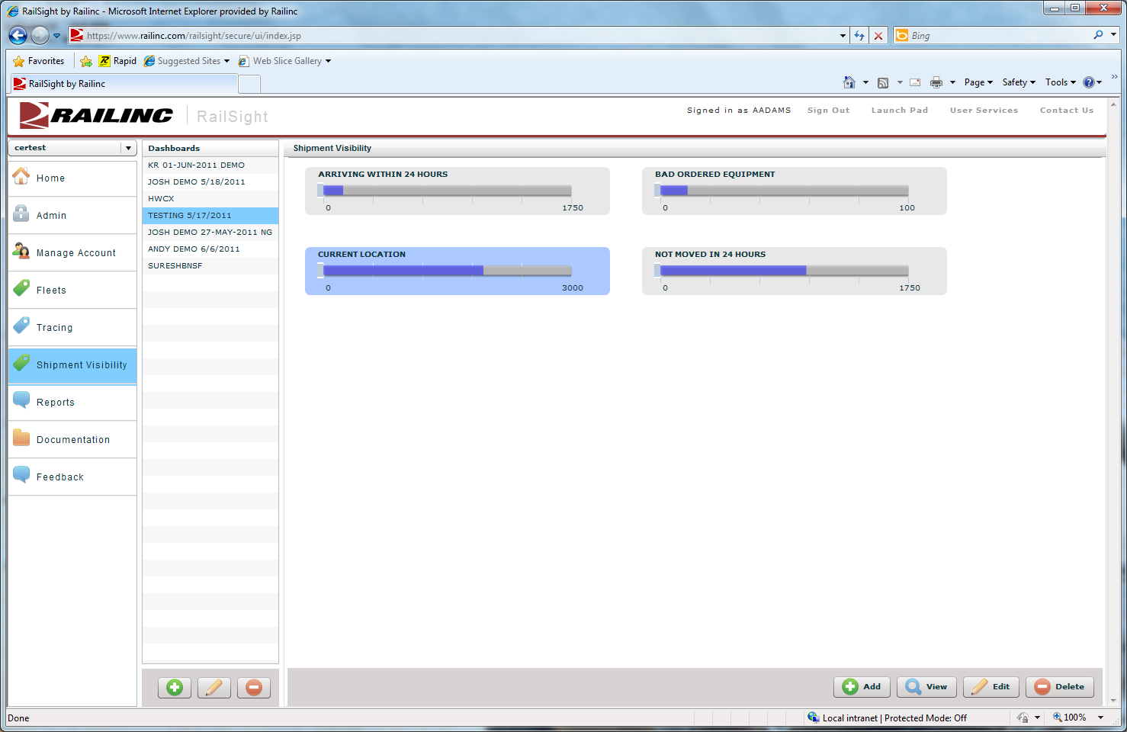
RailSight Monitor
Web-based dashboard
Customizable views based on your business metrics
ETAs, No Movement, Bad Orders, Placed Equipment, L/E Status, and Released from Customer
Exception management
Automated reports

Slide 6
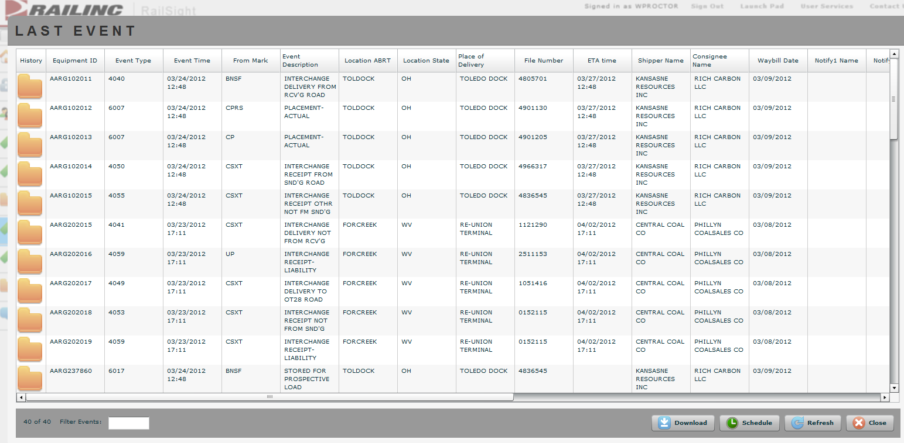
RailSight Monitor Expanded View
Expand View for shipment-level detail
Up to 90 days of equipment sighting history

Slide 7
RailSight Demand Trace
On-demand equipment traces
Multiple CLM output formats
Web-based interface
Automated reports
Historical reporting (up to 90 days)

Slide 8
Steelroads®
Industry portal for tracking and tracing your shipments
Create a bill of lading
Access Industry Reference Databases
Report shortline events
Used by Shippers, Shortlines, and Car Owners

Slide 9
TRAIN Trace/Query
TRAIN Trace
Trace offline equipment
Parameter-driven tracing
TRAIN Query
Ad-hoc tracing request
Commodity information
Used by Class I Railroads, Shortline and Car Owners

Slide 10
Questions
Railinc Customer Support Center
Email: csc@railinc.com
Phone: 1-877-RAILINC

