Slide 1
ACACSO Understanding and Establishing Pool Codes
Jeffery D. Roton
November 14, 2013

Slide 2
Definition and Purpose
What is a pool ?
A collection of equipment assigned for a specific purpose and identified by a unique 7 digit number
Why are pools created ?
To serve railroad customers and the needs of a specific railroad (RR 260 Code)
To facilitate multiple railroads operating jointly to service one customer or service type (998)
To handle customer and rail industry needs through National Pools established by AAR (999)

Slide 3
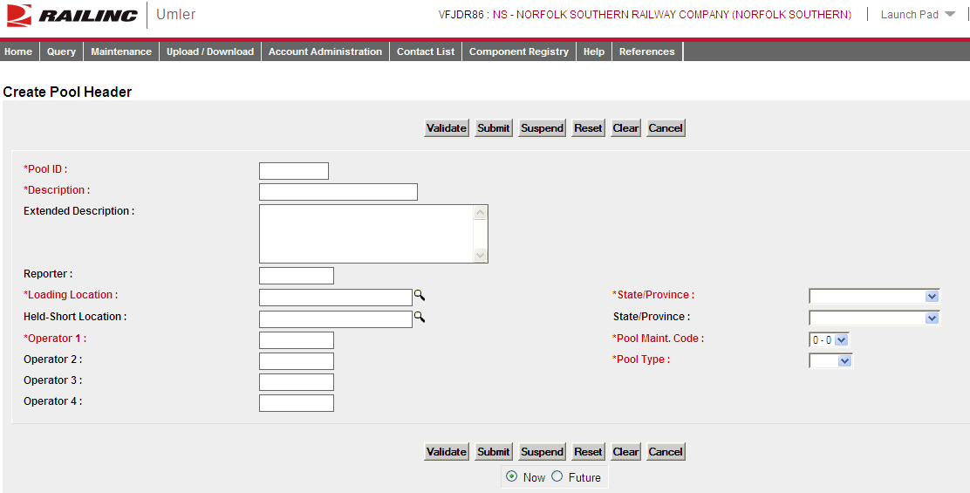
Create Pool Header Screen

Slide 4
Required in the Pool Header
Pool ID
Railroad - RR 260 code and four digits assigned by the railroad
Jointly Operated – 998 and four digits assigned by the pool operator
National – 999 and four digits assigned by the pool operator
Descriptive Name (company, commodity, agent)
Loading Location, State
Operator(s)
Operator 1 is typically the Pool Operator/Reporter
Maintenance Code (Multi-level Pools only)
Pool Type (used to generate Transportation Codes)

Slide 5
Pool Type Codes
C – Specific Shipper at a Specific Location
G – Contaminated
J – Equipment Assigned to an Agent
N – Equipment Assigned in a National Pool
O – Recall Pools (i.e. lease turn-backs)
P – Specific Commodity Loading
T – Equipment Assigned to an Agent
Commodity Challenged
Notes:
Car Service Rule 14 and OT34 are being reviewed by Car Service Rules Committee to eliminate the verbiage “contaminated” We may look at changing the name of a G type pool later to something like…

Slide 6
C Type - Shipper Assigned Umler Transportation Code = C
Circular TD-5
Car Service Rule 16 – Procedures of Assignment
Shipper should request in writing 10 days before intended use of a specific number of cars
Originating road haul carrier(s) must agree to the size of the pool
Cars should not be unassigned from the pool without a minimum one day notice
Pool operator is eligible for Car Hire Rule 22 loading point and held short reclaim
Reload Without Owner Permission ? | Empty Car On Indirect Connection | Empty Car on Direct Connection | Order
No | Reverse Route | Reverse Route | CSD 145, 435

Slide 7
G Type – Contaminated Service UMLER Transportation Code = G
Circular TD-5
Car Service Rule 14 – Appendix A
K, N, and W grade commodities
UMLER Data Specification Manual
Covered Hoppers with N grades (ruminant protein) and Boxcars with W grades (municipal waste) are automatically assigned the Transportation code G
Cars unassigned from G type pools will retain a G transportation code until a second transaction removing the G is reported by the stenciled mark owner
Reload Without Owner Permission ? | Empty Car On Indirect Connection | Empty Car on Direct Connection | Order
No | Reverse Route | Reverse Route | CSD 145, 435

Slide 8
J Type – Agents Pool Umler Transportation Code = J
Circular TD-5
Car Service Directive 145 – Exception 1
Owners may allow their equipment to be loaded without regard to route or destination by assigning their cars to a Pool Type J to generate the J Transportation Code
UMLER Data Specification Mnual
Covered hoppers with mechanical designation of LO and Intermodal flats with mechanical designation of FC are not assignable in J type pools
Reload Without Owner Permission ? | Empty Car On Indirect Connection | Empty Car on Direct Connection | Order
Yes | Reverse Route | Reverse Route | CSD 145

Slide 9
N Type – National Pool Umler Transportation Code = N
Circular TD-5
UMLER Data Specification Manual
9990001 to 9990011 – Railinc
Submitter of activity must be mark owner
9990012 to 9990699 – TTX
If Operator is TTX, submitter of activity must be TTX
If Operator is RLOD, submitter must be TTX or mark owner
If Operator is RBXC, submitter must be TTX or mark owner
Reload Without Owner Permission ? | Empty Car On Indirect Connection | Empty Car on Direct Connection | Order
No | Pool Operator Instructions | Pool Operator Instructions | CSD 145

Slide 10
O Type – Recall Pool Umler Transportation Code = O
Circular TD-5
Car Service Directive 175
All Railcars with O or TO transportation codes indicate owner has reported cars in Umler to expedite movement home for lease termination, repair programs or assignment.
Transportation Condition/Code | Reload Without Owner Permission ? | Empty Car On Indirect Connection | Empty Car on Direct Connection | Order
O | No | Reverse Route | To Owner or Reverse Route | CSD 175
TO | No | SCO90 Outlet or Reverse Route | To Owner, Lessee or Reverse Route | CSD 175/SCO90

Slide 11
P Type – Commodity Pool Umler Transportation Code = P
Circular TD-5
UMLER Data Specification Manual
Railroad and Privately-marked Covered Hopper cars leased to a railroad (Umler Lessee) are automatically assigned Transportation code ‘W’ until car is assigned to a pool. CSD 435 governs assigned and unassigned Covered Hopper cars.
Reload Without Owner Permission ? | Empty Car On Indirect Connection | Empty Car on Direct Connection | Order
No | Reverse Route | Reverse Route | CSD 145, 435

Slide 12
T Type – Agents Pool Umler Transportation Code = R
Circular TD-5
UMLER Data Specification Manual
Cars can not be reloaded without owner’s permission
Covered hoppers with mechanical designation of LO and Intermodal flats with mechanical designation of FC are assignable in T type pools (Not J type pools)
Reload Without Owner Permission ? | Empty Car On Indirect Connection | Empty Car on Direct Connection | Order
No | Reverse Route | Reverse Route | CSD 145, 435

Slide 13
Relationship to EMC’s
For cars to be assignable into industry pools, the existing Equipment Management Codes (Transportation codes) must not indicate that the equipment is restricted in interchange (X, Y) or scrap (S) or a cancelled mark (M).
Exceptions:
XA and XB can be assigned in C, J, P, T, G type pools
XA can not be assigned in N pools
Notes:
Car Service Rule 14 and OT34 are being reviewed by Car Service Rules Committee to eliminate the verbiage “contaminated” We may look at changing the name of a G type pool later to something like…

Slide 14
E Transportation Codes
Circular TD-5
Special Car Order 90 – Paragraph 2, Note 2
The Umler Pool Number will govern the empty return of freight cars subject to SCO-90 for cars carrying Transportation Code E.
Transportation Condition/Code | Reload Without Owner Permission ? | Empty Car On Indirect Connection | Empty Car on Direct Connection | Order
E – C, G, P, R | No | SCO90 Outlet or Reverse Route | To Owner, Lessee or Reverse Route | SCO90 /CSD 145, 435
E - J | Yes | SCO90 Outlet or Reverse Route | To Owner, Lessee or Reverse Route | SCO90 / CSD 145

Slide 15
D Transportation Codes
Circular TD-5
Special Car Order 200
Railroad marked equipment that has never located on the car owner’s property, has not loaded on the railroad to which it is assigned, has not been loaded on its leasing railroad
Private marked equipment prior to first load
Transportation Condition/Code | Reload Without Owner Permission ? | Empty Car On Indirect Connection | Empty Car on Direct Connection | Order
D | Yes | Reverse Route | To Owner or Reverse Route | SCO 200
D – C, G, P, R, W | No | Reverse Route | Reverse Route | CSD 145, 435
D – J | Yes | Reverse Route | Reverse Route | CSD 145
D – N | No | Pool Operator Instructions | Pool Operator Instructions | CSD 145

Slide 16
Unassigned Cars
T Transportation Code
System generated code when the owner or lessee did not participate in the last load
Handled empty under SCO-90
U Transportation Code
User Reported Code
Load to or via the home road (CSD150)

Slide 17
Questions ?

