Slide 1

History of Car Hire/De-prescription
Lisa Butts
ACACSO
May 2016

Slide 2

Definition & Purpose of Car Hire
Car Accounting
De-prescription
Car Hire Today

Slide 3
Definition and Purposes of Car Hire
Definition: Rental paid by the user of rail equipment to the owner of the equipment
Purpose: Provide income to equipment owners.
Purpose: Encourage good equipment utilization.

Slide 4

“ Back to the Past”

Slide 5
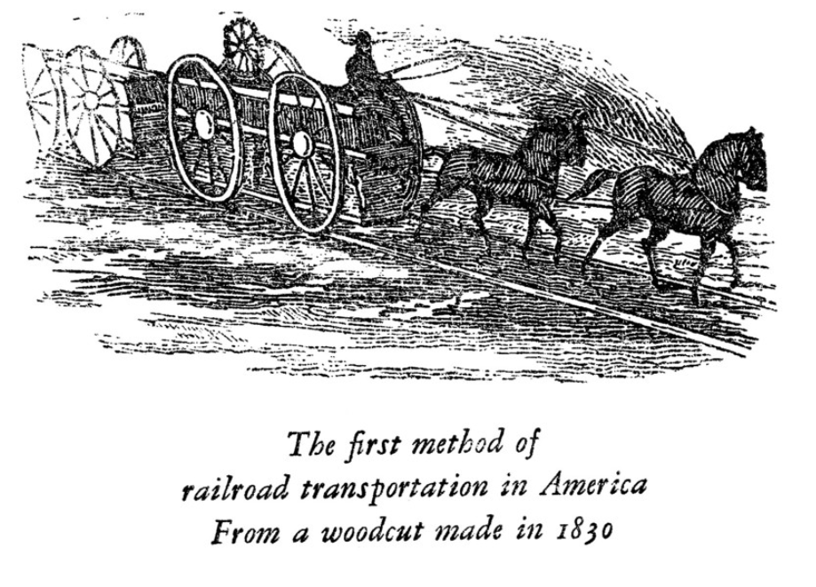
Car Hire – Prequel
Early railroads
Granite Railway
Baltimore & Ohio
South Carolina Canal and Railroad
Mohawk and Hudson
Notes:
In 1830, the South Carolina Canal and Rail-Road Company was formed to draw trade from the interior of the state. It had a steam locomotive built at the West Point Foundry in New York City, called The Best Friend of Charleston, the first steam locomotive to be built for sale in the United States. A year later, the Mohawk & Hudson railroad reduced a 40-mile wandering canal trip that took all day to accomplish to a 17-mile trip that took less than an hour. Its first steam engine was named the DeWitt Clinton after the builder of the Erie Canal.

Slide 6
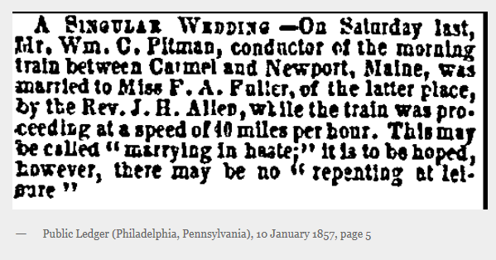

Slide 7
Car Accounting – The Beginning
1877
The Association of Car Accountants was formed
Car rates were agreed to - 15 cents a day, ½ cent per mile
The system was abandoned after 6 months – Too much work !

Slide 8
Car Accounting– The Beginning
1878
First per diem rules were drafted
Every loaded car delivered required an empty car
The idea delayed loaded cars
These rules were also canceled
1880’s
After the gauge change of 1886
Cars began to interchange freely between roads
Bilateral Agreement charged for “loaded miles” only
Railroads started using foreign cars for storage

Slide 9
Car Accounting– The Beginning
1890’s
More and more cars began to interchange
ICC introduced a “Rental System” for cars
Loaded miles @ .75 cents per mile
System still didn’t resolve the storage issue
ICC developed a “Per Diem” system
Car rates are 20 cents per day
Replacing the mileage system

Slide 10
Car Accounting– The Process
1902: The Committee on Car Hire created
Car Accounting Rule 5 – Switching Relief – was adopted
Car Accounting Rule 7 – Damaged Car Relief – was adopted
Car Accounting Rule 8 – Defective Car Relief - was adopted
Cars were 20 cents a day and ½ to ¾ cent per mile
Railroads created the Car Accounting Functions
Record interchanges
Record wheel movements
Calculate days and miles traveled on-line
Audit Car Accounting

Slide 11
Car Accounting – The Process
Operationally
The delivering road listed all delivered cars and signed it
The receiving road verified cars received and signed it
Documents were SEVEN PART CARBONS
Two copies of the documents were mailed to Car Accounting
When Car Accounting received the reports
Kept one copy for their records
Cut one copy into strips
A strip for each car was pasted into record books
Other copy was used to manually calculate the car hire owed

Slide 12
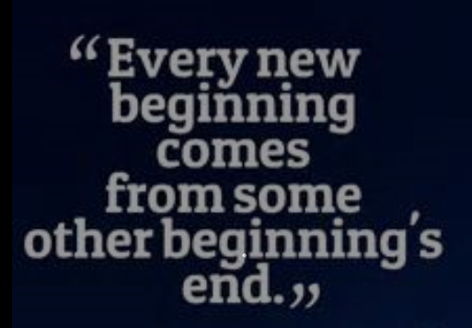
Car Accounting – The End & Beginning
1920: The Daily rate went to $1.00 per day
1951: The Daily rate went to $2.00 per day
1970: ICC imposed an “Incentive” rate for cars in short supply
1977: ICC prescribed formula to determine car hire rates
“CAR HIRE IS BORN”
1979: Car hire based on hours instead of days
1982: Regulation occurred
Railroads could enter into freight contracts

Slide 13
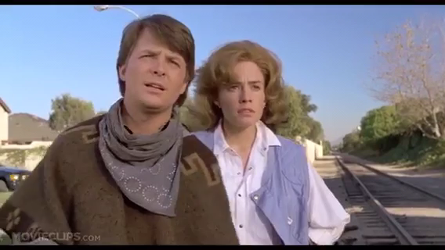
“Back to the Future”

Slide 14
De-prescription
1993: De-prescription was approved. Carriers and car owners were allowed to negotiate car hire rates
De-prescription refers to the conversion of car-hire rates earned by railroad-marked cars from “prescribed” rates set by the ICC formula to negotiated rates

Slide 15
De-prescription – Why??
Tax code reform encouraged new investors
Imbalance of railcars
High car hire rates based on ICC formula
Low revenue due to de-regulation

Slide 16
De-prescription – How???
Phased in over 10 years
All railcars were de-prescribed except for “grand-fathered” box cars
Car hire rates are established by negotiations between owners and users
1992-1994: no new rates except for new cars
Lowest negotiated rate, or prescribed rate in place in prior quarter
New negotiated rate table each quarter
Looks back at prior quarter
Sorts by car type and selects lowest hourly rate
This can then be negotiated for market rate
Negotiated rates are confidential and recorded on the Car Hire Account Rate Master (CHARM) file.

Slide 17

De-prescription - Finished
2003: De-prescription fully implemented

Slide 18
Car hire – Highlights
1994: Rule 5 and Rule 15 Reclaims were replaced with Transfers of Liability
1996: ICC abolished and railroad review given to Surface Transportation Board
1999: Liability Continuity System implemented
2008: Settlement through the Railroad Clearinghouse implemented
2011: Rule 7 and Rule 8 Reclaims replaced with Damaged & Defective Car Tracking records
2013: Car Accounting Self Service
2014: Automated Rule 4
2014: Automated Rule 5
2014 : Car Hire Liability File

Slide 19
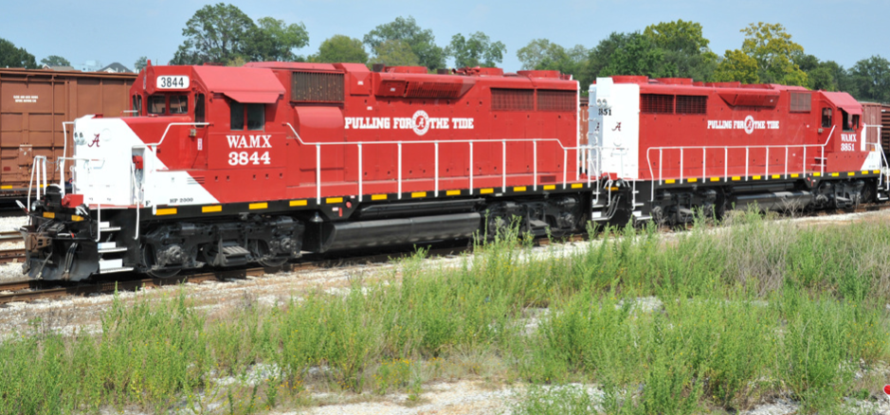
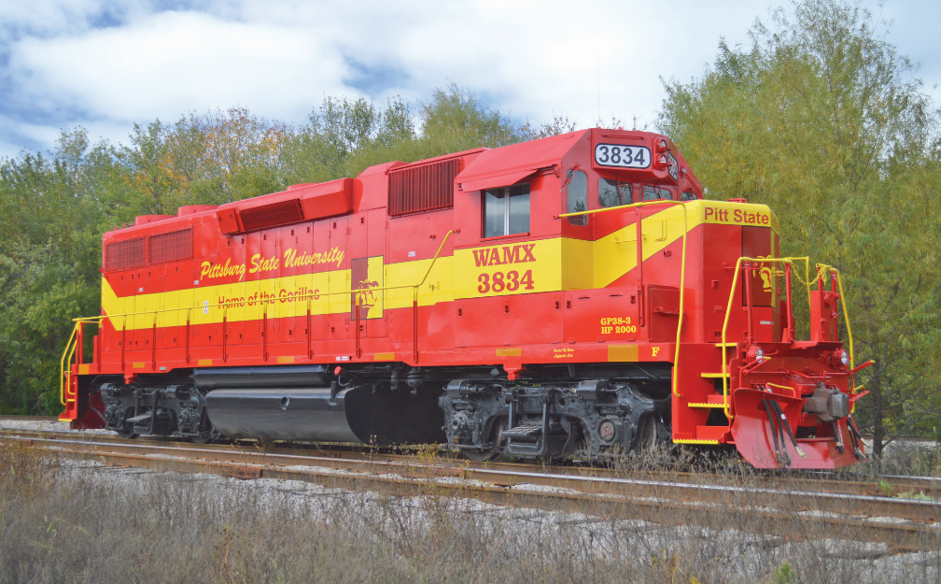
THANK YOU
THANK YOU

Slide 20


