Slide 1
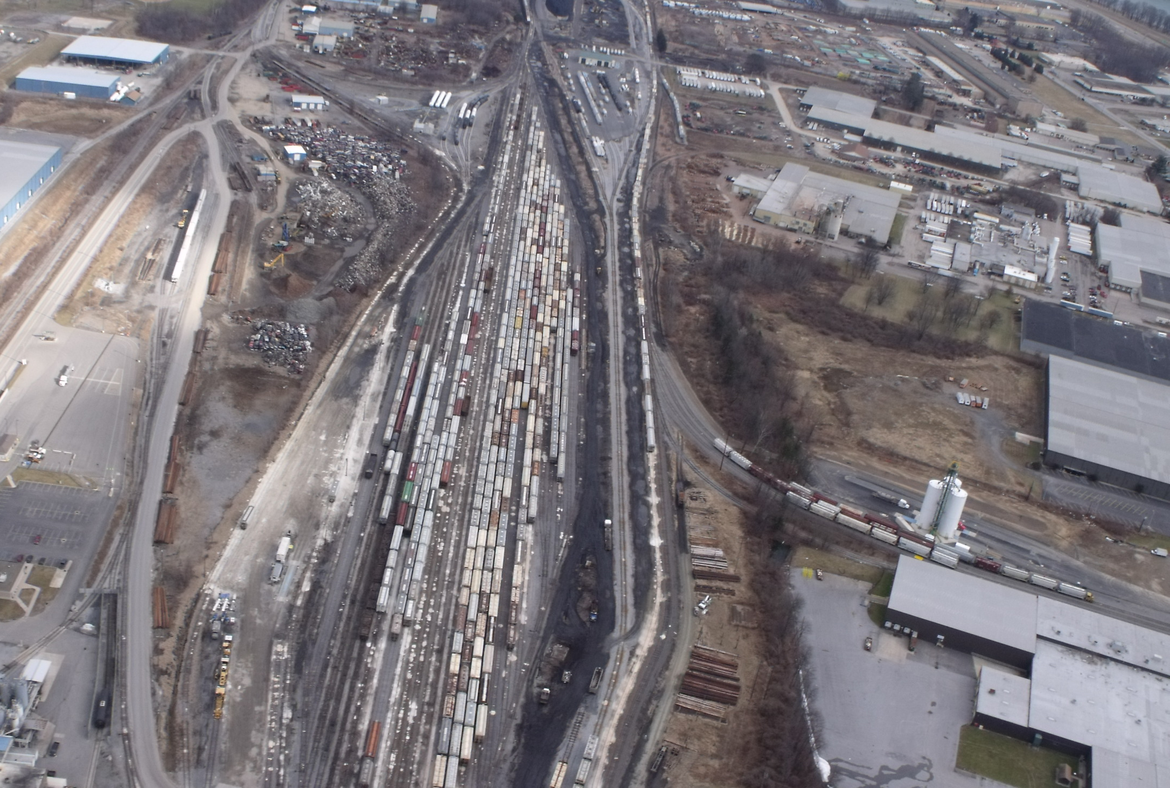
Interchange
Presenter: Lisa Butts
Watco Companies

Slide 2
Movement Events
Car Hire Rate
Negotiations
CHARM
DDCT
Liability Continuity System - LCS
Carriers Report Car
Hire Payables
Haulage
Flags
TOL
Reclaims
TOL
Event Repository - ER
Car Hire Data Exchange - CHDX
Car Hire Receivables
CASS
CHLF
Claims
Railroad Clearinghouse

Slide 3
Interchange
Definition – Exchange of railcars between carriers
Interchange has been accomplished when:
  They are placed upon the track agreed upon as the interchange track
  They are preceded by or accompanied the necessary data for forwarding
  They are accepted by the receiving road

Slide 4
General Types of Interchange
Main Types of Interchanges
  Normal – Physical exchange and divide revenue
  Revenue – No physical exchange – revenue division only
  Operating – Physical exchange only – no division of revenue

Slide 5
Reporting Interchange
Interchanges should be reported through TRAIN II
TRAIN 01 and TRAIN 10 messages are used to report
Special interchange messages
  TRAIN 31, Type A – Haulage interchange
  TRAIN 31, Type 5 – Liability Acceptance Message

Slide 6
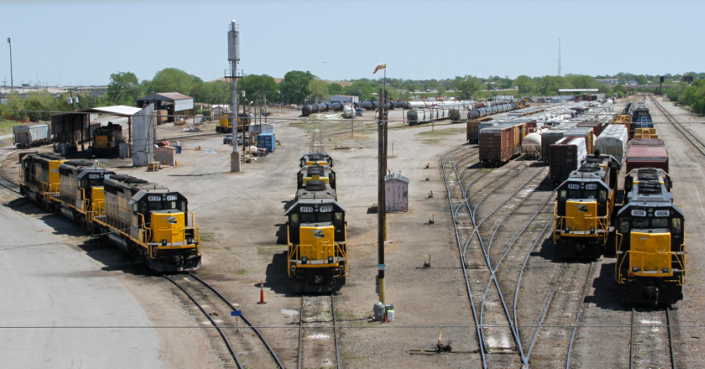
Special Types of Interchanges
One Road Reporting
  Bilateral agreement
  One carrier is responsible for all reporting at a location
  Reports made by the non-reporting carrier will be ignored by LCS

Slide 7
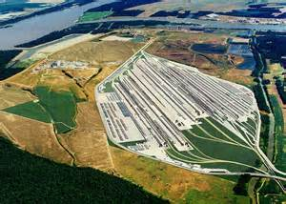
Special Types of Interchanges
Delivery Only
  Bilateral agreement
  Interchange date/time reported by delivering carrier will govern
  Reports by the receiving carrier will be ignored in LCS

Slide 8
Special Types of Interchanges
Suppressed Interchange
  Bilateral agreement
  LCS will ignore the interchange
  Car hire will remain with the delivering carrier
  Events are not masked
  Next interchange will end suppression

Slide 9
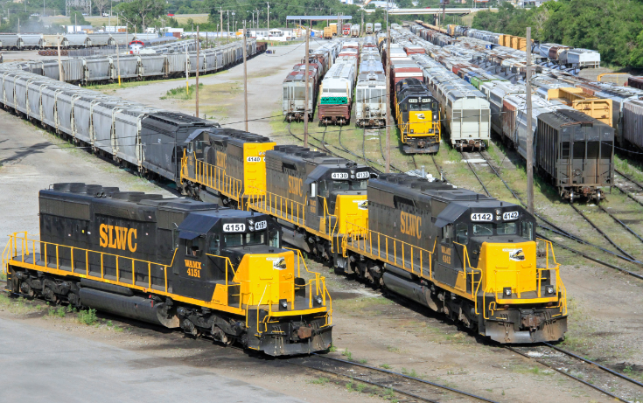
Special Types of Interchanges
Haulage
  Bilateral agreement
  One carrier agrees to act as agent for another
  Events after the interchange are masked – Traces will show the car(s) on the line of the delivering carrier
  Three ways to end haulage
    Next Interchange
    Two changes in L/E status
    After 60 days

Slide 10

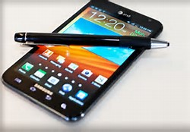





Communicate !!!

Slide 11


