Slide 1
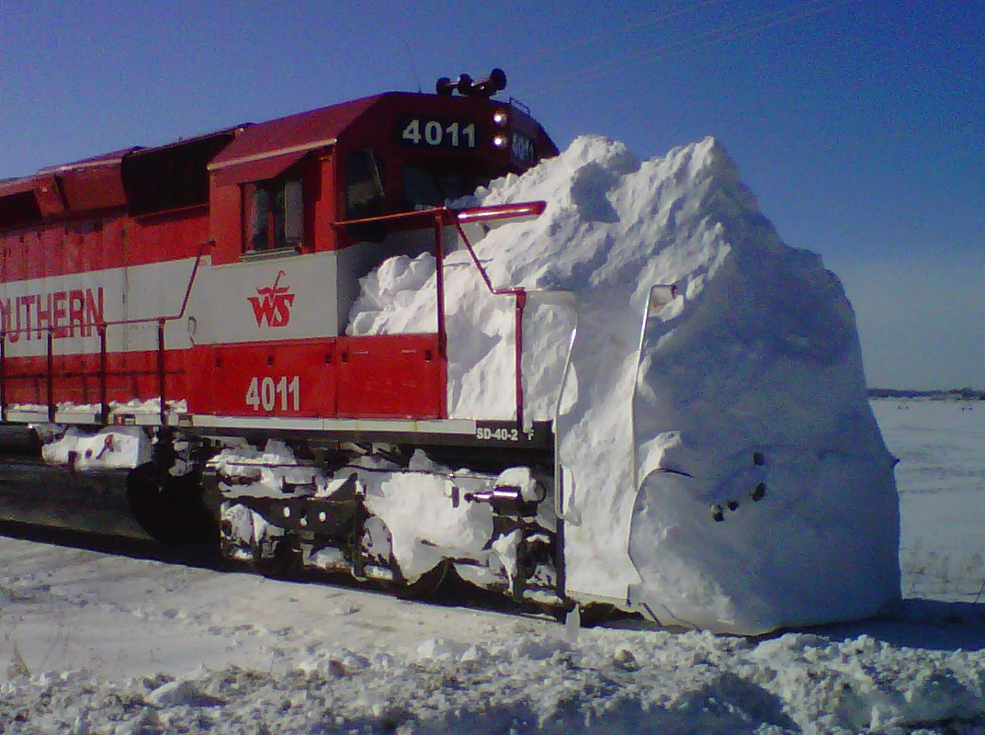
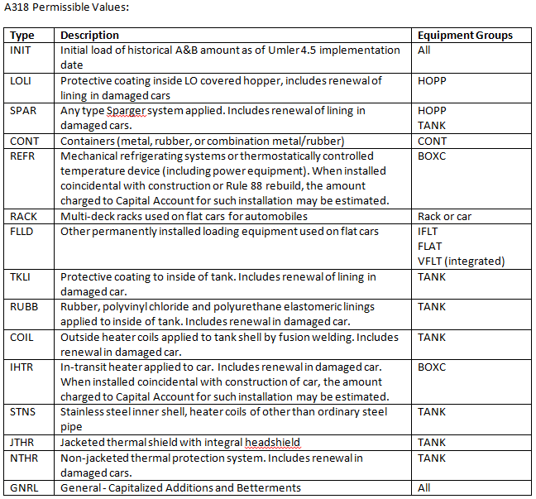
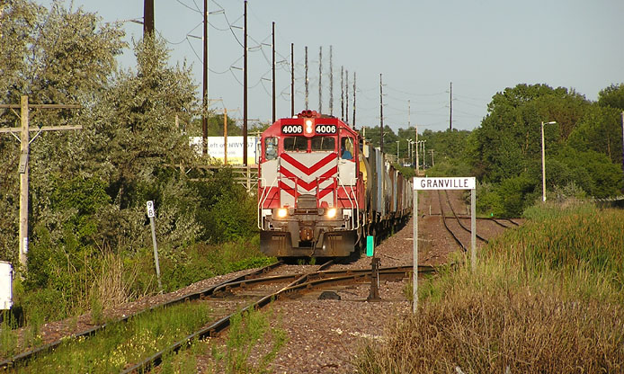
UMLER COMMITTEE 2013

Slide 2
CORRECTION OF WEIGHT RELATED ELEMENTS
Gross Rail Load does not equal Tare Weight plus Load Limit.
August 2011, 99,770 cars had values to correct.
March 2013 number was 1,296.

Slide 3
IDENTICAL TARE WEIGHT
At least 10 cars in sequence with the same Tare Weight, the current numbers of cars are as follows:
Month BOXC FLAT GOND HOPP MISC TANK Total
July 2012 4,279 7,704 42,695 62,599 3,367 8,589 129,233
August 0 7,647 42,023 62,449 0 6,064 118,183
September 0 7,469 41,643 60,966 0 6,391 116,469
October 4,067 6,121 40,437 59,165 3,352 6,400 119,542
November 4,146 5,653 40,476 59,191 3,352 6,420 119,238
December 4,136 5,706 40,373 59,253 3,372 6,471 119,311
January 2013 4,073 5,642 40,368 58,269 3,416 6,394 118,162
February 3,923 4,951 39,447 58,041 3,444 6,202 116,008
March 3,975 5,036 39,380 56,656 3,458 6,259 114,764

Slide 4
Continue audit of weight-related data elements.
Provide information to car owner.
Work with car owners to create exception file.
EIN required.
Scorecard development to track progress.
Need to automate.

Slide 5
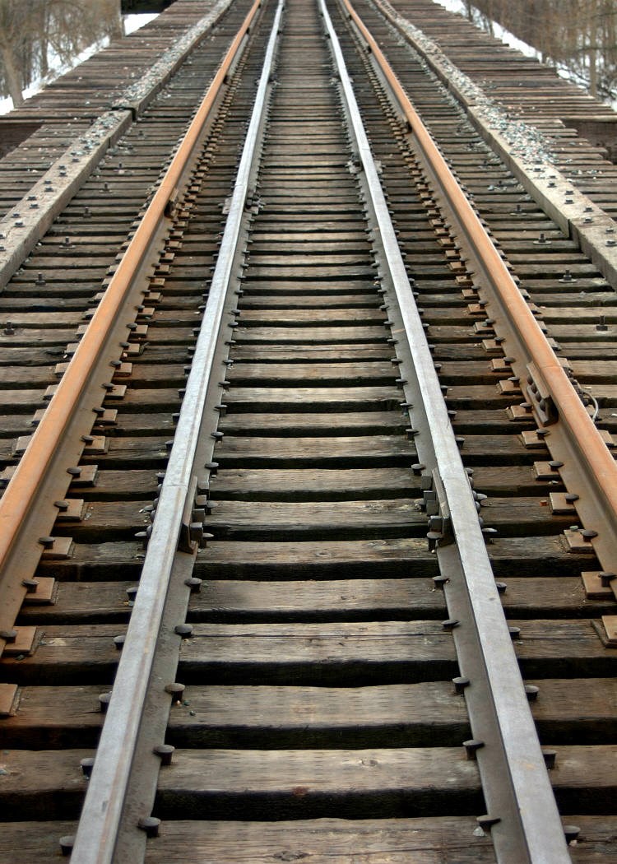
Cost savings to railroads.
Reduce overload incidents.
Transportation savings
Customer savings
Reduce wear on track/bridges.

Slide 6
Support industry initiatives and technological advancements.
Advance notice on end of service dates prior to codes XA (AAR Overage) or YA (FRA Overage).
Working with the Equipment Engineering Committee (EEC) on feasibility of reducing stencils and adding data elements in Umler.

Slide 7
Expansion of Additions and Betterments
This will provide better estimate DV values for DDTCS.
A&B will be reported by type and depreciated at the Rule 107 rate.
All A&B values currently in UMLER will be assigned type INIT.

Slide 8
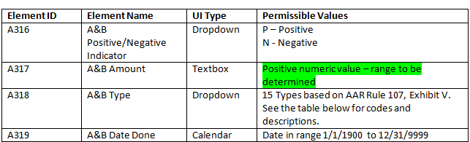
15 individual A&B will be allowed per car. Permissible values range for A317 will be set based on car type and A&B type.

Slide 10
Locomotive Blue Card project for 2013.
Kickoff occurred on March 15.
Implementation target date in October, depending on the scope of the changes.

Slide 11
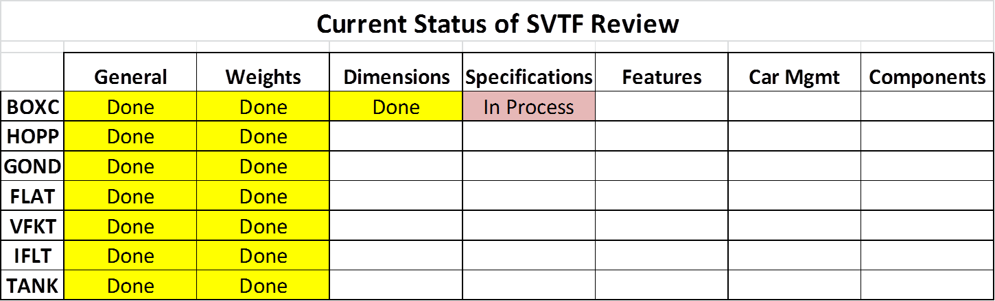
System Validation Task Force is reviewing Umler data elements.
Permissible values and ranges
Business rules
Data Specification Manual

Slide 12



