Slide 1
Car Hire Rate Negotiation Self-Service (CHRNSS)
Craig Bicknell
Mgr. Equip Plng & Car Compensation
Norfolk Southern

Slide 2
Car Hire Rate Negotiation Self-Service
Railinc’s Car Hire Rate Negotiation Self-Service (CHRNSS) application provides users with a convenient, single access point where they can participate in negotiations related to car hire, the amount of money paid for the use of a railcar.
Notes:
CHRNSS provides users with a single access point where they can participate in negotiations related to car hire, or the compensation paid by a user to an owner for the use of a railcar. CHRNSS enables users to transition from legacy in-house deprescription bid-and-offer systems to a centralized, Railinc-supported solution.
Through features like a detailed bid-and-offer dashboard, CHRNSS lessens the administrative effort required to participate in bid-and-offer negotiations, streamlining operations and leading to cost reductions. Because Railinc supports this solution, users also can avoid replacement and/or upgrade development costs associated with their in-house systems. Users can receive immediate feedback during the bid-creation process, and upload or download a list of equipment into the bid-and-offer system. Railinc decommission the deprescription application in March 2013.

Slide 3
Benefits and Capabilities
Productivity
Cost Savings
Improved Decisions
Convenience
Notes:
CHRNSS provides users with a single access point where they can participate in negotiations related to car hire, or the compensation paid by a user to an owner for the use of a railcar, and ensure that the needs of lessees match with the characteristics of available railcars. The primary benefits of CHRNSS are:
Productivity: Through features like a detailed bid-and-offer dashboard, CHRNSS lessens the administrative effort required to participate in bid-and-offer negotiations, streamlining operations and improving productivity.
Cost Savings: CHRNSS enables users to transition from legacy in-house deprescription bid-and-offer systems to a centralized, Railinc-supported solution. Because Railinc supports this solution, users can avoid replacement and/or upgrade development costs associated with their in-house systems.
Improved Decisions: CHRNSS provides specific information about car type and characteristics. This helps users better define the types of cars they need, car owners better segment their cars during the rate negotiation process and bid recipients quickly validate that the offered
Convenience: With CHRNSS, users have a single point of access where they can manage and participate in the bid-and-offer negotiation process.
cars meet their expectations.

Slide 4
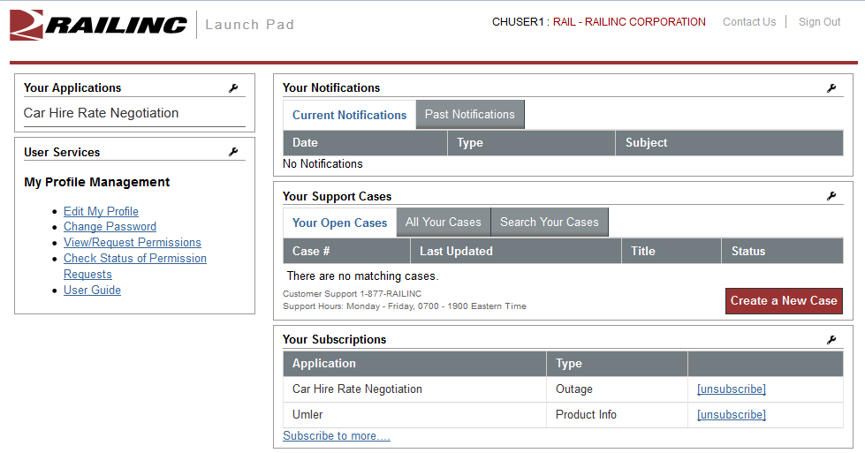
Car Hire Rate Negotiation
Notes:
Can I see a show of hands – How many of you have rate negotiation responsibilities, but have not used this system?
Car Hire Rate Negotiation is accessed via a
Centralized point of access under within your Launch Pad

Slide 5
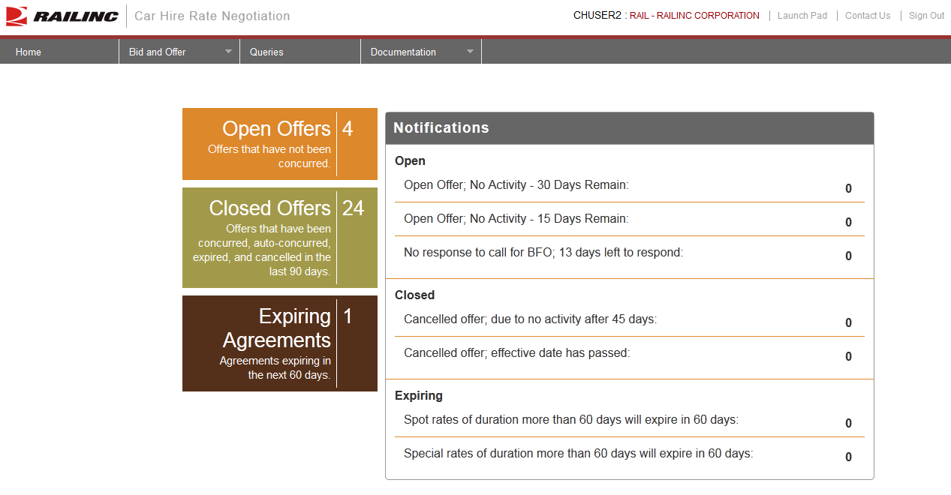
Bid and Offer Dashboard
Notes:
Ability to keep track of all bids and offers in a single dashboard is desired by all of the carriers with whom we had discussions.
A single access point for all open offers would allow the user to see which offers are pending their action as well as visibility into offers that they have sent to other users.
A bid and offer dashboard would also allow users a way to easily manage ticklers for open offers and search their offers by expiration date.
Users will be provided with a history of each negotiated rate, so that they can better keep track of the back and forth negotiations on a specific open offer

Slide 6
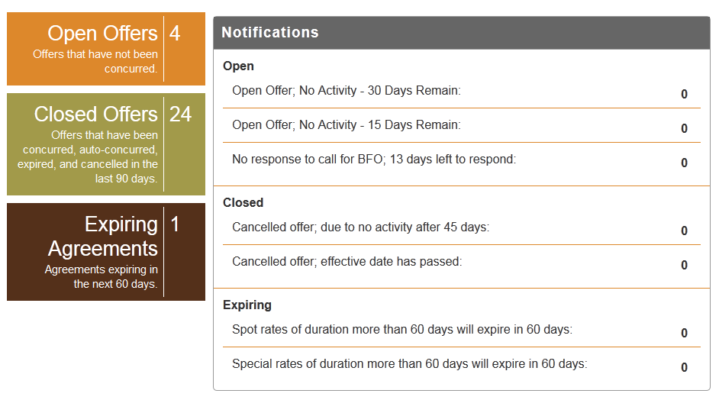
Open Offers
Notes:
Count of Open offers – not concurred

Slide 7
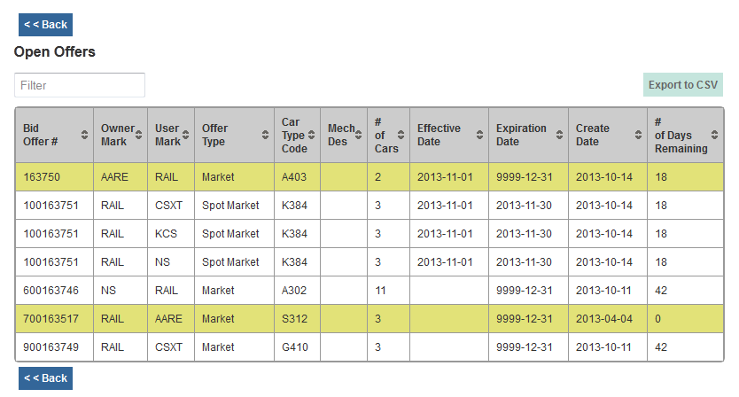
Open Offer Summary
Notes:
Open offer summary:
Filter – type in any test, i.e., car type code
Highlights offers that have a Call for BFO
No. of days remaining
No. of cars on offer
Click on columns to sort
Export list to CSV

Slide 8
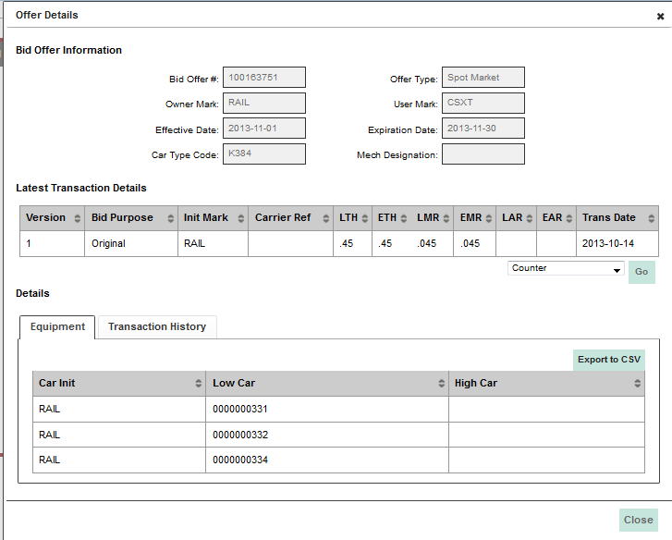
Open Offer Detail
Notes:
Open offer detail:
View offer details
Latest transaction details
Equipment list
Respond directly from offer detail
Export to CSV – equipment and transaction

Slide 9
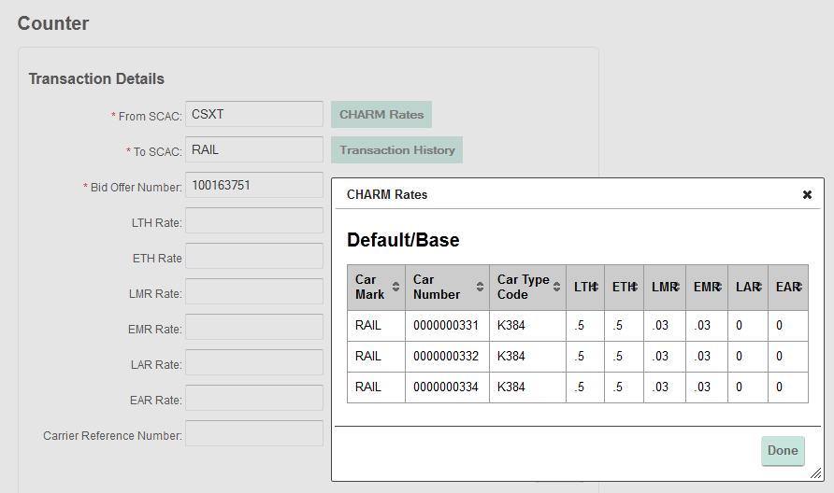
Respond to Open Offer
Notes:
When responding to an offer, user can view default rates

Slide 10
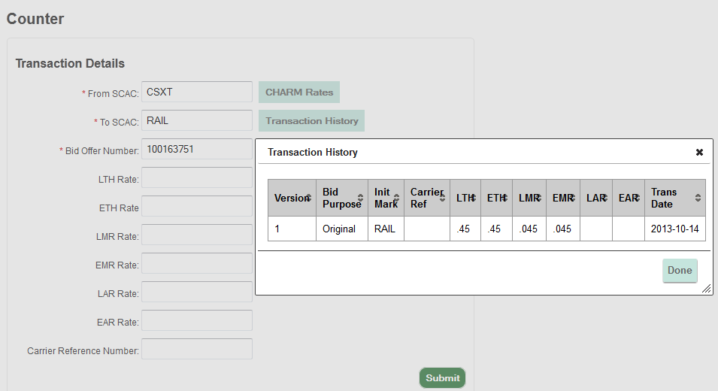
Respond to Open Offer
Notes:
When responding to an offer, user can view transaction history

Slide 11
Closed Offers
Notes:
Closed offers – last 90 days
Contains all offers activity whether concurred or not

Slide 12
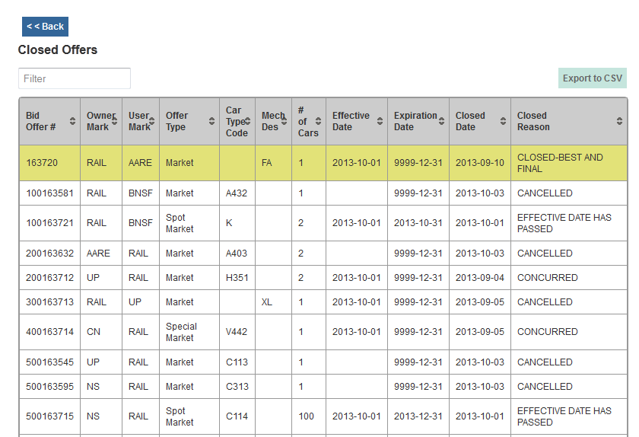
Closed Offers Summary
Notes:
Closed offer summary:
Filter – type in any test, i.e., car type code
Closed reason, i.e., concurred, cancelled, effective date passed
Highlights offers that have a Gone to BFO
No. of cars on offer
Click on columns to sort
Export list to CSV

Slide 13
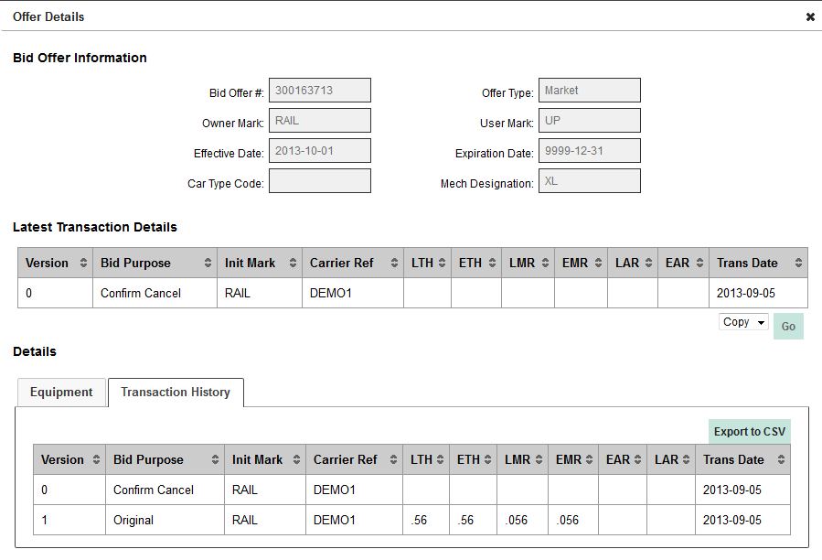
Copying a Closed Offer
Notes:
Can copy closed offer into new offer
Will copy offer type, details/rates, and equipment into new offer

Slide 14
Expiring Agreements

Slide 15
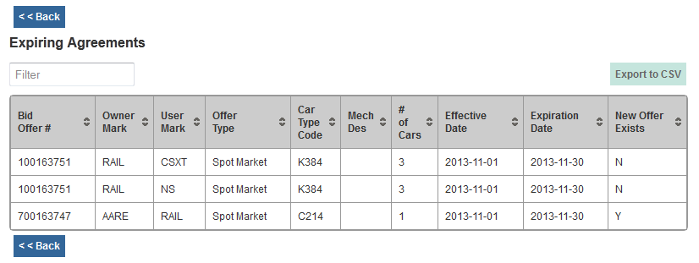
Expiring Agreements Summary
Notes:
Expiring agreements summary:
Effective and expiration dates
New offer exists – not in production until November release
Flag if new offer has been concurred – same bid type, owner/user, equipment
Filter – type in any test, i.e., car type code
Click on columns to sort
Export list to CSV

Slide 16
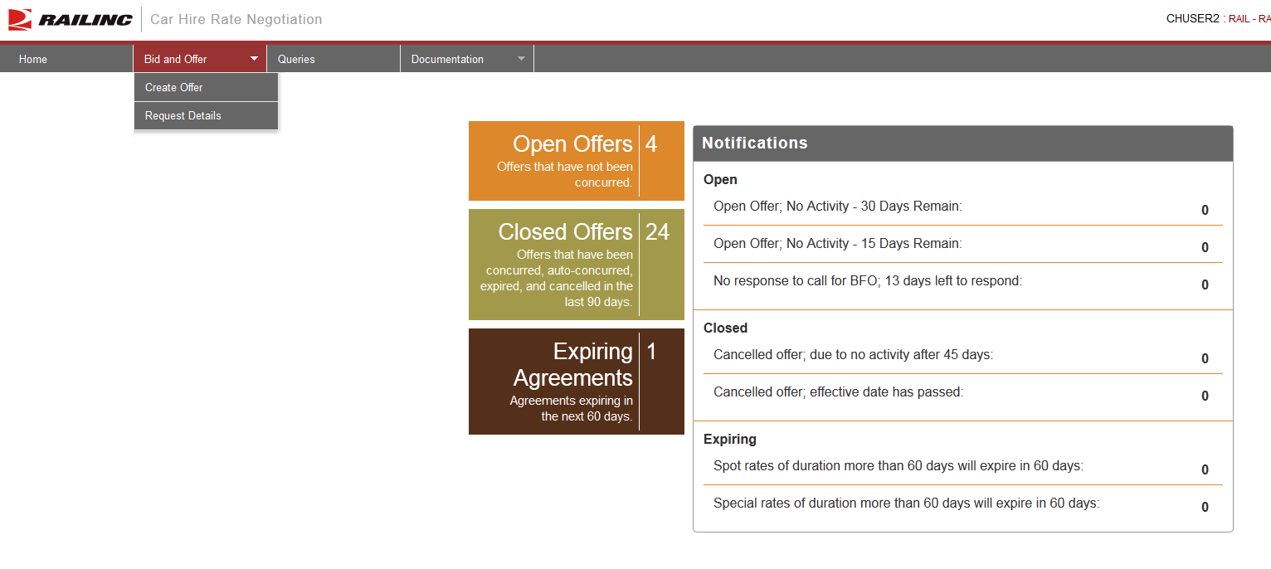
Creating a Bid/Offer
Notes:
Menu from home page
Create Offer
Request Detail – part of legacy system
Can receive email with detail of offer (not really used much anymore due to dashboard)

Slide 17
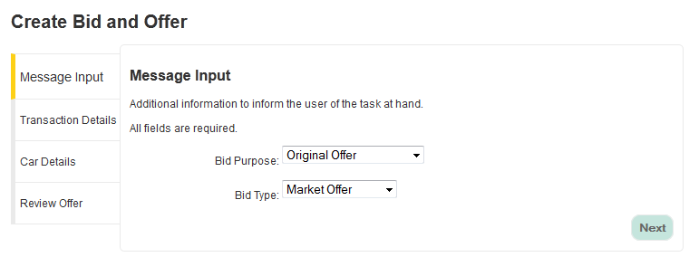
Select Bid Purpose and Bid Type
Notes:
Menu-driven
Cannot select invalid purpose and type combination

Slide 18
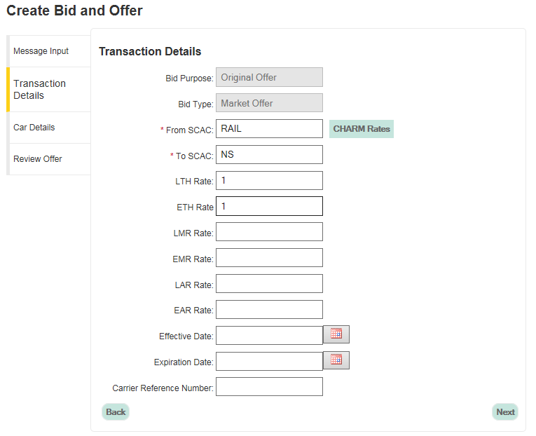
Transaction Details
Notes:
Input TO roads (single and multi)
Input rates (hourly, mileage, appurtenance)
* You are able to view CHARM rates once equipment has been added
Effective and Expirations dates
Calendar picker or enter in proper format
Carrier Ref Number (optional)

Slide 19
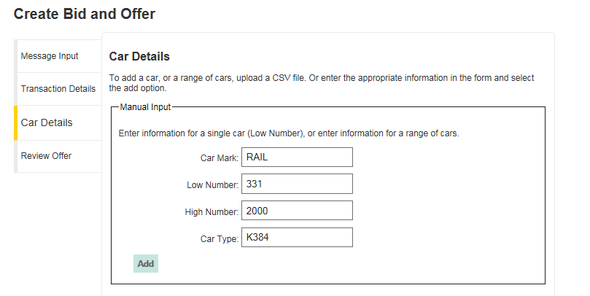
Car Details – Adding Equipment
Notes:
Upload a CSV or Manual Input
* Input single car or range
Equipment is validated for Umler registration and car type/mechanical designation

Slide 20
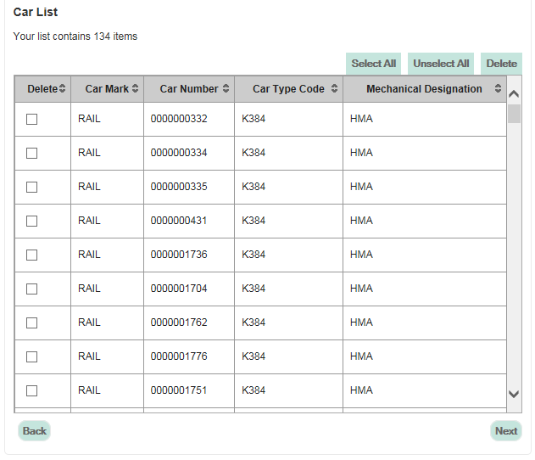
Car Details – Adding Equipment
Notes:
Car count
Can manually remove delete equipment from offer
This window is now scrollable – functionality was released on October 13, 2014

Slide 21
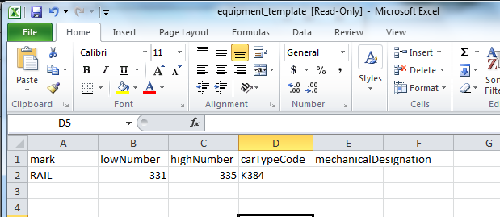
Car Details – CSV Upload
Notes:
Upload a CSV or Manual Input Template
Use CTC or Mech Desg
Equipment is validated for Umler registration and car type/mechanical designation

Slide 22
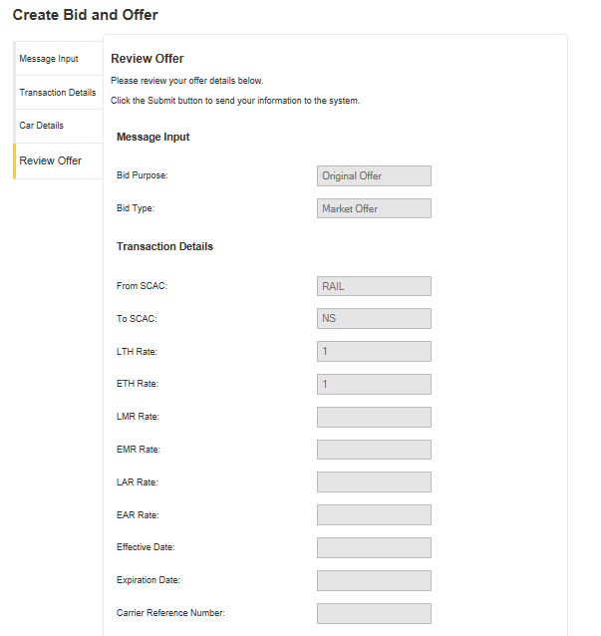
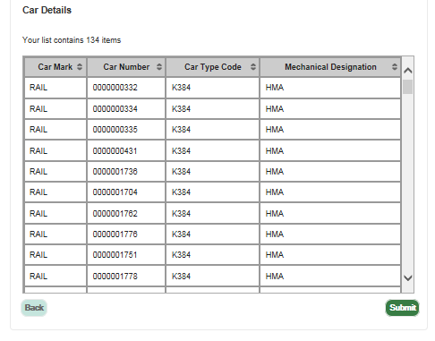
Review Offer
Continued…
Notes:
Review offer detail prior to submitting
Equipment is validated for Umler registration and car type/mechanical designation
Car detail window in review offer is also scrollable now

Slide 23
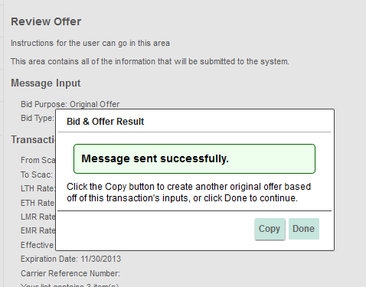
Submit Offer
Notes:
Copy offer to send to multiple roads
Proactive validations
Equipment on another offer
Non-market equipment on a market offer
Etc…
Ability to remove invalid equipment prior to submitting offer when creating a new offer
November release – equipment automatically removed; user can resubmit

Slide 24
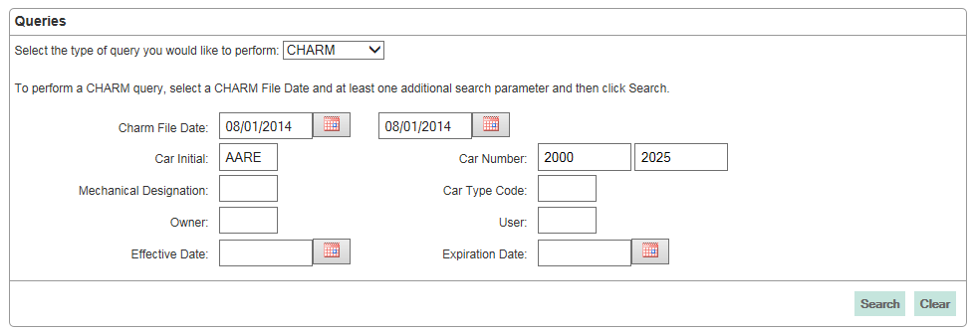
CHARM Query
Notes:
Query by CHARM file date and one other search parameter
CHARM can query 3 months at a time
Has at least 3 years of history

Slide 25
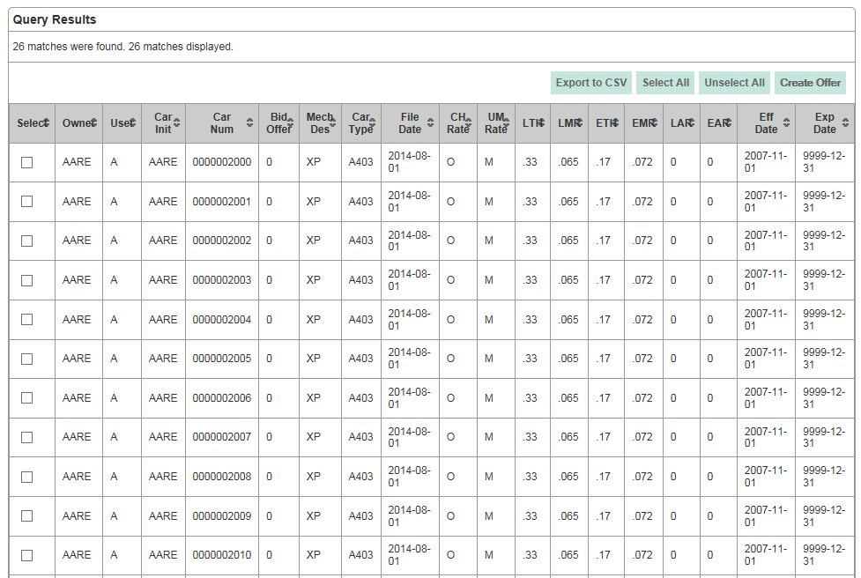
CHARM Results
Notes:
Can view 1500 on screen; export 5000

Slide 26
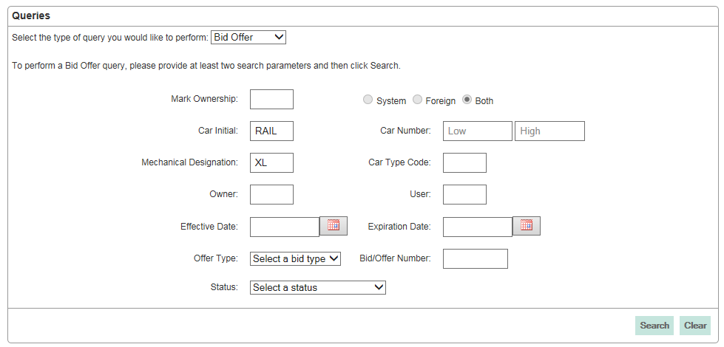
Bid/Offer Query
Notes:
Query by Bid offer history by at least two search parameters
Contains offers that have been concurred, cancelled, expired
Can view/export transaction detail for post-mainframe migration offers
View results at bid/offer summary vs. car detail

Slide 27
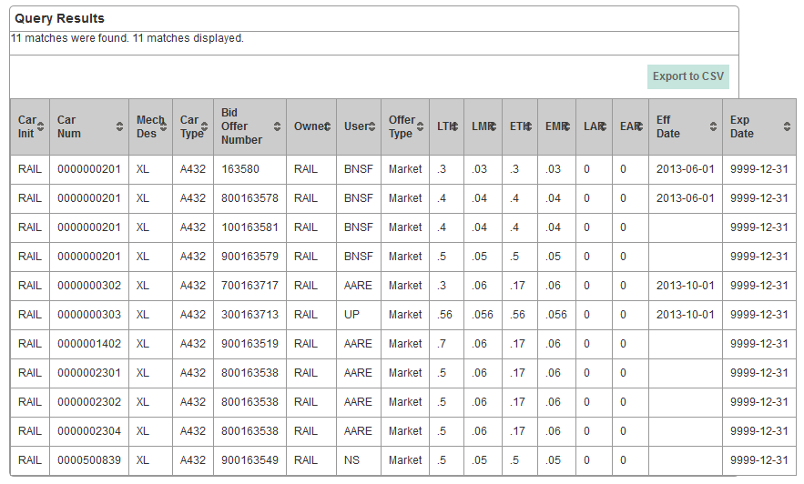
Bid/Offer Results
Notes:
Results View at equipment level
Can view 1500 and download up to 5000
Clicking on a row will pull of transaction detail of offer
Columns can be sorted

Slide 28
Car Hire Rate Negotiation Self-Service Upgrade Project Release – April 17, 2014
Highlights:
Bid Offer Query Enhancements
  Ability to query by Bid Offer Number without entering additional search criteria
  Ability to query by Status
  Ability to view Bid Offer query results at the summary level
  Ability to view Car Type Codes within the detail screen
  Ability to view Rate Type Codes within the detail screen
  Ability to view Mechanical Designations within the detail screen
Download “Error” cars when uploading car list
Manually add new cars to a copied offer
Notes:
Highlights of project release 1

Slide 29
Car Hire Rate Negotiation Self-Service Upgrade Project Release – May 19, 2014
Highlight:
Ability to upload a CSV of new cars when copying a closed or expiring offer
Notes:
Highlights of project release 1

Slide 30
Car Hire Rate Negotiation Self-Service Upgrade Project Release – August 18, 2014
Highlights:
Ability to download a CSV of equipment in error when submitting an original offer
Ability to download CHARM rates to a CSV from the CHARM rates screen in the bid offer wizard when responding to open offers
Ability to query offers by system, foreign, or both within the bid offer query
Notes:
Highlights of project release 1

Slide 31
Car Hire Rate Negotiation Self-Service Upgrade Project Release – October 14, 2014
Highlights:
Optimization of the creating and responding to bid offers
Scrollable car detail window in the bid offer detail pop-up screen
Notes:
Highlights of project release 1

Slide 32
Car Hire Rate Negotiation Self-Service Upgrade Project Release – November 2014
Highlights:
    Increase car limit from 1,500 to 10,000 when submitting offers
    Allow users to download and view up to 10,000 cars on an offer
    Streamline notification of offers to customer for content and delivery approach
Notes:
Highlights of project release 2

Slide 33
What’s Next ?
2015
Continue with prioritized maintenance user stories/enhancements
As of 10/31/2014:
  3 Ranked High
  23 Ranked Medium

Slide 34
Management History of CHRNSS
Product Manager
Lee Ann Dietz ==> Kristy Talley
Project Leaders
Sara Maples
Danielle Crowley
Meghan Finnie

Slide 35
Questions?

