Slide 1
Car Hire Rate Negotiation Self Service
Craig Bicknell
Mgr. Equip Planning & Car Compensation
Norfolk Southern
May 8, 2014

Slide 2
CHRNSS – Query Capabilities
A Bid and Offer System – and so much more.
Query current and older Bids and Offers
  Concurred and Expired
Query CHARM file
  Negotiated Rates by Owner or User
  Default Rates
Download and Upload Capabilities

Slide 3
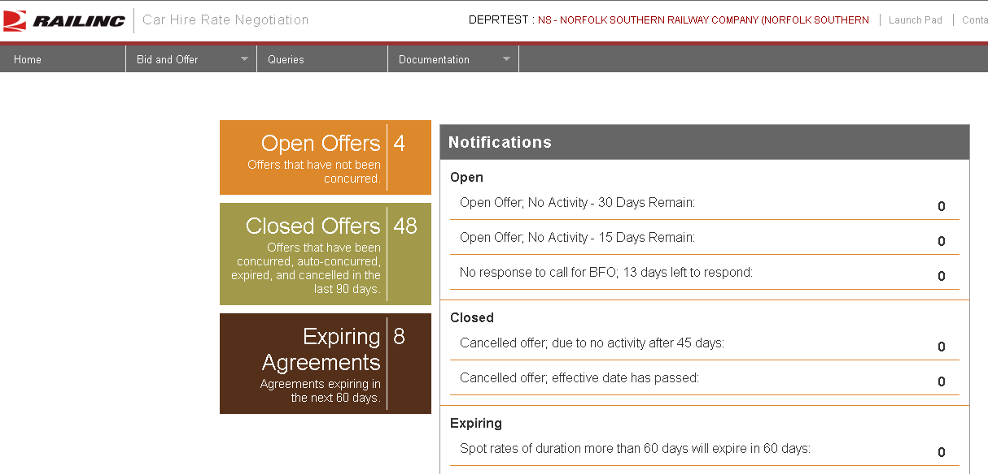
CHRNSS Home Screen

Slide 4
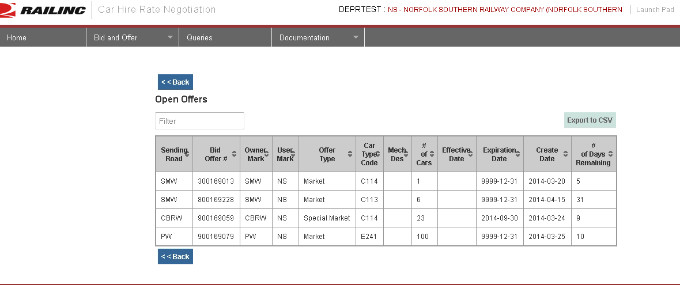
Open Offers

Slide 5
Open Offers

Slide 6
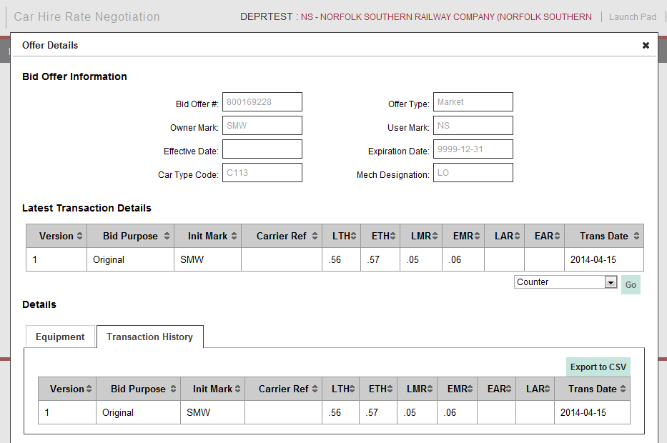
Open Offers

Slide 7
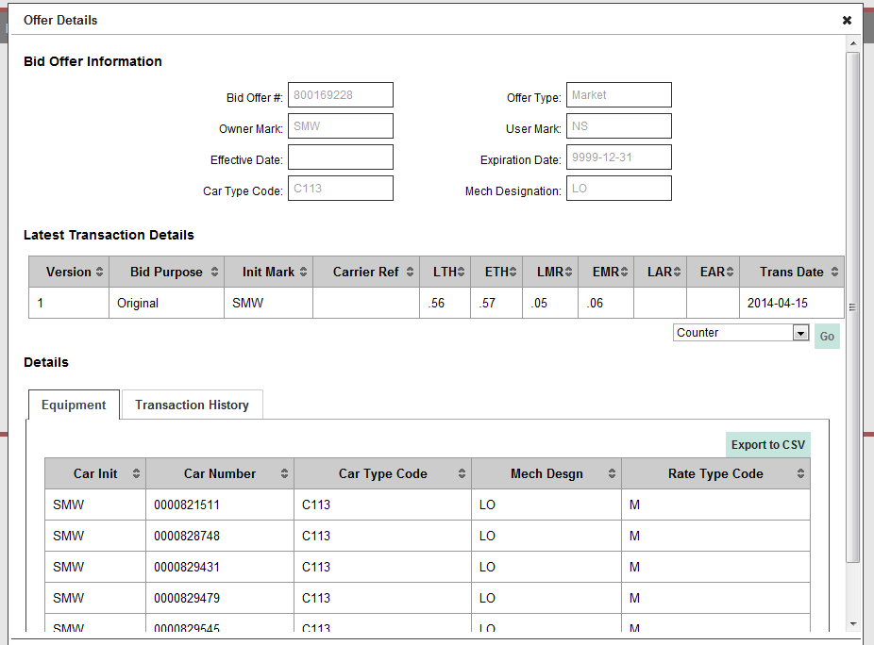
Open Offers

Slide 8
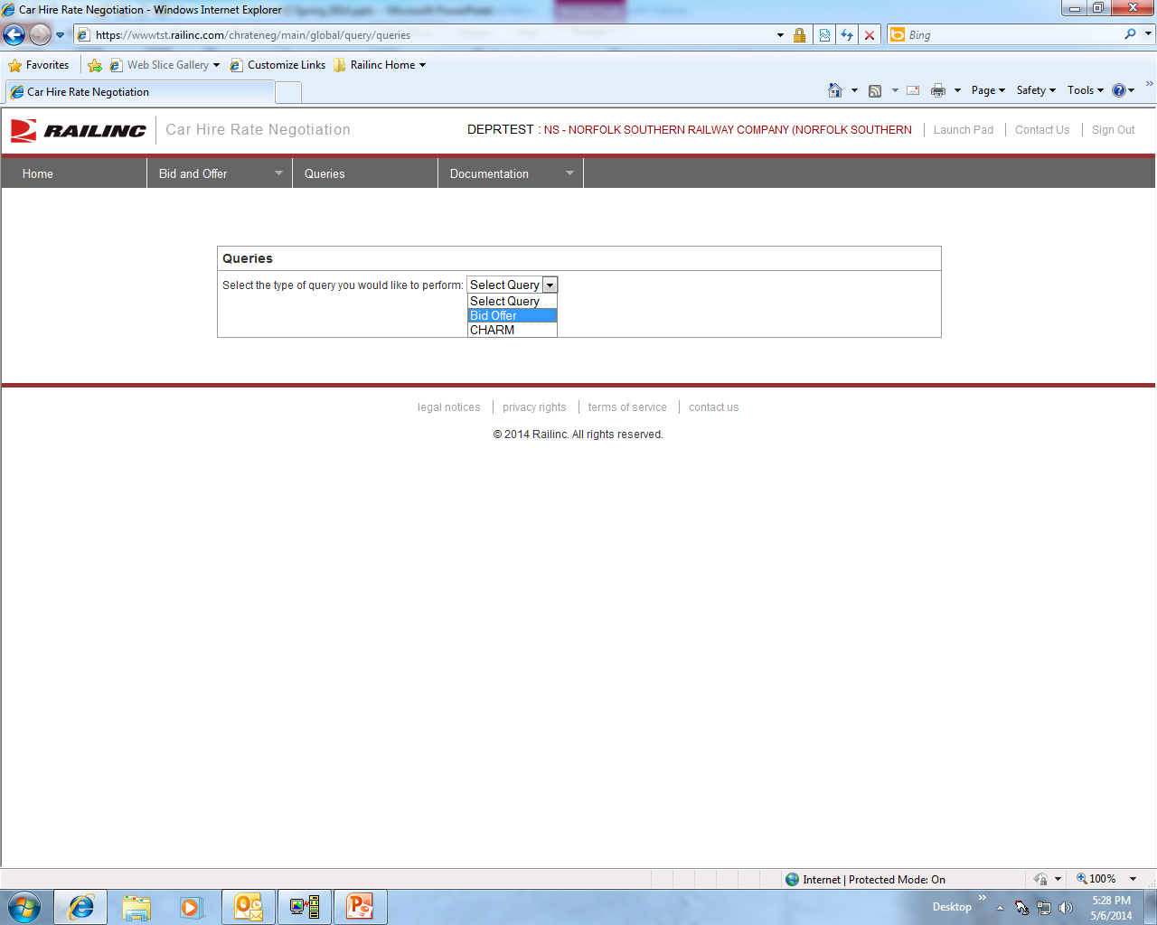
CHRNSS Home Screen

Slide 9
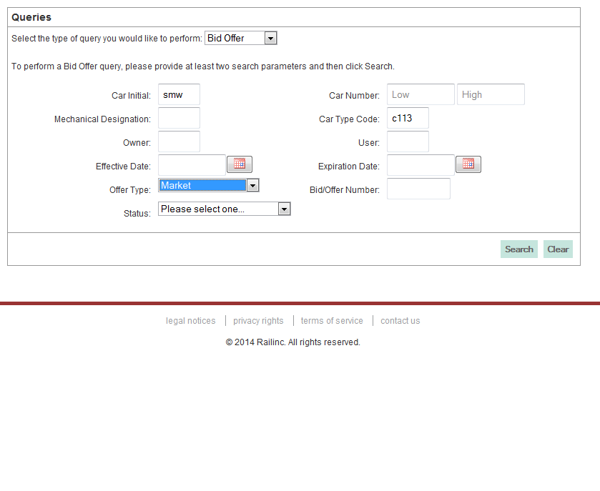
CHRNSS Queries Screen
Notes:
Select Bid Offer for SWM cars with a Car Type Code of C113
We want to look at Market Offers
Click on the Search button

Slide 10
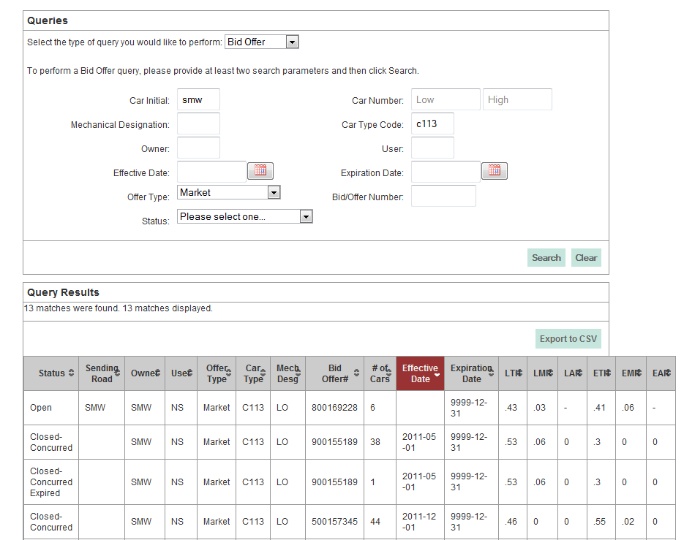
CHRNSS Queries Screen
Notes:
Our

Slide 11
CHRNSS Queries Screen

Slide 12
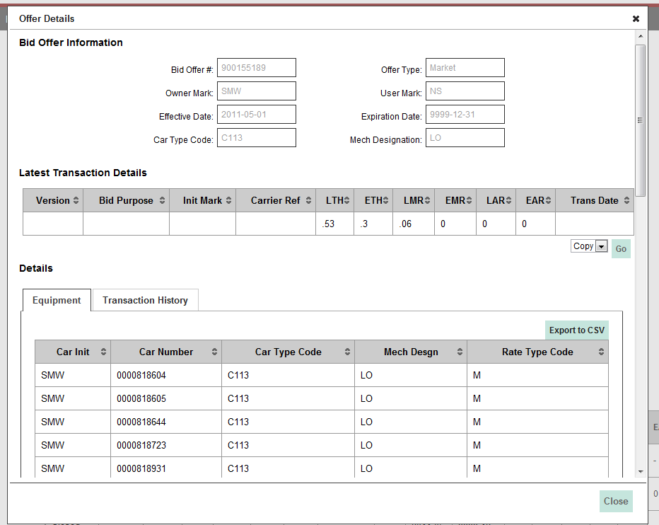
CHRNSS Queries Screen

Slide 13
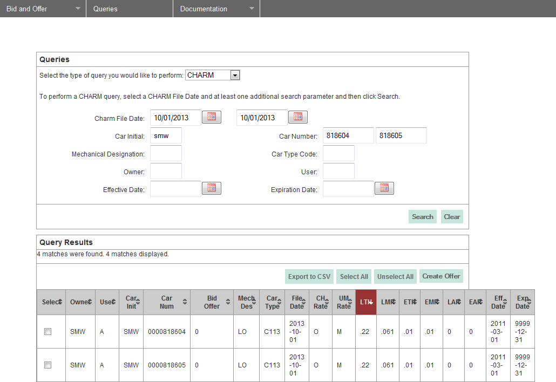
CHRNSS Queries Screen

Slide 14
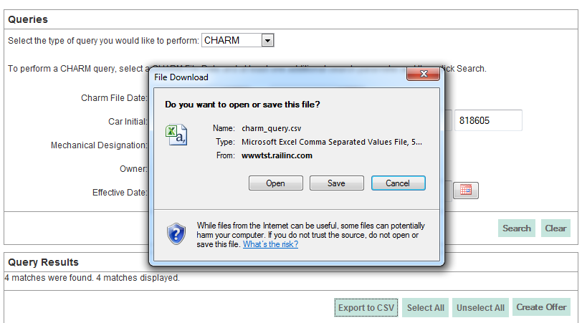
CHRNSS Queries Screen

Slide 15
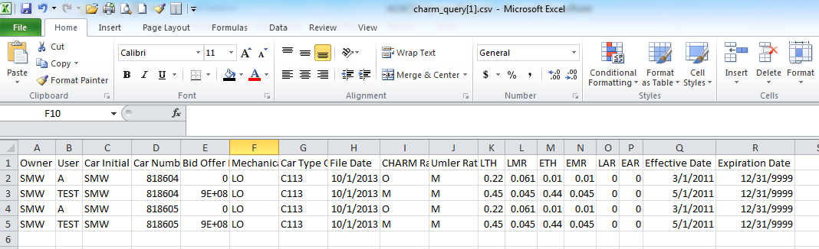
Downloaded CSV File (Excel View)

Slide 16

Questions?

