Slide 1
Car Hire Rate Negotiation Self-Service 2016 Release Highlights
Nicole Jesserer
ACACSO
May 11 – 13, 2016

Slide 2
Car Hire Rate Negotiation Self-Service Overview
Railinc’s Car Hire Rate Negotiation Self-Service (CHRNSS) application provides users with a convenient, single access point where they can participate in negotiations related to car hire, the amount of money paid for the use of a railcar.
Notes:
CHRNSS provides users with a single access point where they can participate in negotiations related to car hire, or the compensation paid by a user to an owner for the use of a railcar. CHRNSS enables users to transition from legacy in-house deprescription bid-and-offer systems to a centralized, Railinc-supported solution.
Through features like a detailed bid-and-offer dashboard, CHRNSS lessens the administrative effort required to participate in bid-and-offer negotiations, streamlining operations and leading to cost reductions. Because Railinc supports this solution, users also can avoid replacement and/or upgrade development costs associated with their in-house systems. Users can receive immediate feedback during the bid-creation process, and upload or download a list of equipment into the bid-and-offer system. Railinc decommission the deprescription application in March 2013.

Slide 3
CHRNSS 2015 Release Highlights
CHRNSS Dashboard Optimization
Car Hire Rule 1 update – zero rating changes
Car Hire Rule 1.H 3 – 18-month rule
Appendix T implementation
CHARM Query with Umler Characteristics
Notes:
The CHRNSS application allows a car owner to initiate a Bid & Offer. Once the Bid & Offer is created the receiving party will be sent an email notification. In CHRNSS the Open Offers, Closed Offers, and Expiring Agreements are accessible via the dashboard. The CHRNSS CHARM Query contains 3 years of history and the Bid & Offer Query contains all history from the previous mainframe system. These queries are used by railroads and car owners to view current and historical default and negotiated rates. This option supports querying by single equipment ID, range of equipment IDs, or a list with multiple equipment IDs. Search results will display in CHRNSS based upon the criteria entered. Refer to the CHRNSS User Guide section on ‘CHARM Query’ and ‘Bid & Offer Query’.
CHRNSS users now have the ability to perform a Car Hire Accounting Rate Master (CHARM) query with the newly added Umler Characteristics. This option allows users to utilize filter capability for specific Umler Characteristics and format results using the Column Selection Options.
EAC Extended the Earning Life of Appurtenances to 18 Years
Updates were Implemented
Appendix T Rates Applied to Some Cars Built in November and December 2015
Correction Implemented
Committee Will Confirm Correction Effective

Slide 4
CHRNSS 2016 Completed Work
Ability to use wildcards in the CHARM query
View offers by Sending Road status on the Closed and Expiring Offer dashboards
Full timestamp on transaction history screens
Standardized Bid Type in the CHRNSS application to match tickler notifications
Rates added to email notifications for Concurred Offers
Offer Type added to all email notifications

Slide 5
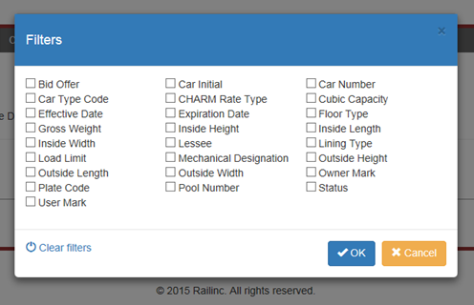
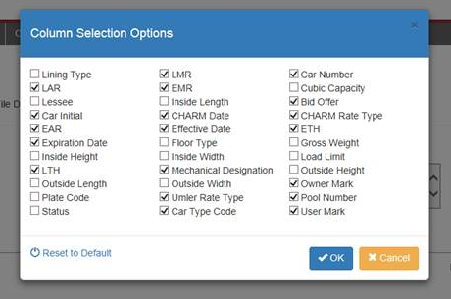
CHARM Umler Query Features
Ability to query based on 26 unique characteristics
Ability to select which data is displayed through the Column Selection Options
Notes:
The CHRNSS CHARM Query contains 3 years of history and the Bid & Offer Query contains all history from the previous mainframe system. These queries are used by railroads and car owners to view current and historical default and negotiated rates. This option supports querying by single equipment ID, range of equipment IDs, or a list with multiple equipment IDs. Search results will display in CHRNSS based upon the criteria entered. Refer to the CHRNSS User Guide section on ‘CHARM Query’ and ‘Bid & Offer Query’.
CHRNSS users now have the ability to perform a Car Hire Accounting Rate Master (CHARM) query with the newly added Umler Characteristics. This option allows users to utilize filter capability for specific Umler Characteristics and format results using the Column Selection Options.

Slide 6
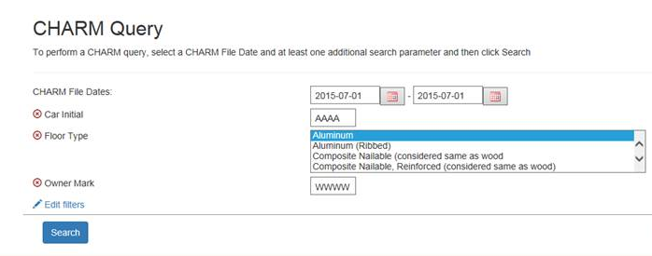
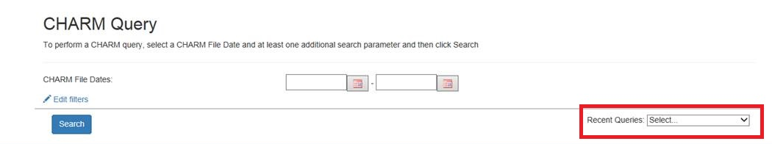
CHARM Query Features
User-friendly search
Most recent queries saved for your convenience

Slide 7
CHRNSS 2016 Release Plan Highlights
Rules Process Management for Umler-Depre Bridge
Display SSO user ID’s for Bid Offer transactions
Best and Final & Zero-Rating Behavior
Planning Groups
Technical debt focus for further enhancement & optimization

Slide 8
Rules Process Management (RPM) Umler-Depre Bridge
The ‘Connector’ between Umler and the Car Hire Rate Negotiation Self Service application
Sends important Umler characteristics
Holds essential rate calculation information for specific types of equipment
Notes:
Attend Concept Model and RulesXpress training
Kick-Off to clarify objectives and timelines
RPM Business application assessment
Vizuri Technical assessments & demos
Weekly Learn By Doings with Cindy Scullion, BRS

Slide 9
How will RPM affect You?
Increased visibility into Rate calculation
Faster resolution time for CHRNSS rate inquires
Additional business rules documentation
Increased business knowledge
Assessment of current functionality allowing for potential changes to CHRNSS in 2017

Slide 10
Nicole Jesserer nicole.jesserer@Railinc.com 919-651-5178: Office
Questions?

