Slide 1
Car Accounting Self-Service (CASS)
Mark Aldenderfer
ACACSO
May 8, 2014

Slide 2
Today’s Agenda
Background of CASS
Review of Features
New Look for CASS – Flex Migration
Walkthrough
Event Search
CHLF Version Two Search
LAM Creation
Reports

Slide 3
Background of CASS
Railinc developed CASS in 2012 to provide a one-stop shop for visibility into car hire decisions.
LCS-related questions required significant research and analysis.
The CASS system provides visibility in displaying events associated with LCS decisions.
Railroads wanted an easy way to submit Liability Accepted Messages (LAM).
The CASS system enables a railroad to easily submit a LAM through a web-based system.

Slide 4
Background of CASS
Provide visibility into complex car hire decisions created by LCS
Reduce expenses by simplifying time and effort researching car hire decisions
Reduce expense required to create and send Liability Acceptance Messages (LAM)

Slide 5
Review of CASS Features – Event Search
Event Search
CASS allows for a 90-day date range.
CASS has access to two years of events from the current day.
CASS highlights certain scenarios.
Haulage, Suppression, TOLs
LCS Interchanges

Slide 6
Review of CASS Features – LAM Creation
TRAINII explanation for LAM
If event reporting has caused car hire responsibility to be assigned to a carrier other than the carrier to whom it belongs, a TRAIN10 or TRAIN31 message with an Action Code of 5 can be used to correct the assignment of car hire responsibility. This Car Hire Liability Acceptance report will result in an LCS gap record from the current responsible road to the road submitting the acceptance interchange event.

Slide 7
Review of CASS Features – LAM Creation
LAMs can be created from the Event Details screen.
LAMs can be created from the Create Message tab .
CASS also shows a history of LAMs created.

Slide 8
Review of CASS Features – LAM Creation
CASS validates LAMs based on the following logic
Event time must be within 120 hours of Current date and time. This is based on Eastern Time Zone.
Messages could be rejected based on early reporting if event time is not entered as Eastern Time.
Must be a valid interchange point between the “From Road and To Road”
Cannot be a duplicate message

Slide 9
Review of CASS Features – CHLF Search
Search CHLF records by Equipment Initial and Number
For each CHLF cycle the search returns
Movement events
Waybill information (Rule 4)
Railinc-generated miles
User must be a CHLF Version Two receiver to have access

Slide 10
Review of CASS Features – Reports
Currently three reports are available in CASS
Haulage Agreements
TOL Rule 5 Liability Limits
DDCT Dismantled Equipment

Slide 11
New Look for CASS – Flex Migration
Flex is no longer supported and CASS was migrated to a new technology.
CASS has a new look and feel while providing the same functionality.
CASS is best viewed with the latest web browsers, Internet Explorer 9 or newer.

Slide 12
Walkthrough
Event Search
CHLF Version Two Search
LAM Creation
Reports

Slide 13
Walkthrough – Login
Access to CASS is controlled by Railinc’s Single-Sign-On System (SSO).
Access should be requested for “Car Account Self-Service.”
CASS permissions available:
CASS Company Administration
CASS LAM Creation
CASS Event Query
CHLF V2.0 Search

Slide 14
Walkthrough – Home Page
The home page displays a Mark list created at login that CASS uses for permissions
The CASS home page displays five links:
Home
Search (events and CHLF)
Messages (only available with LAM permissions)
Reports
Documentation

Slide 15
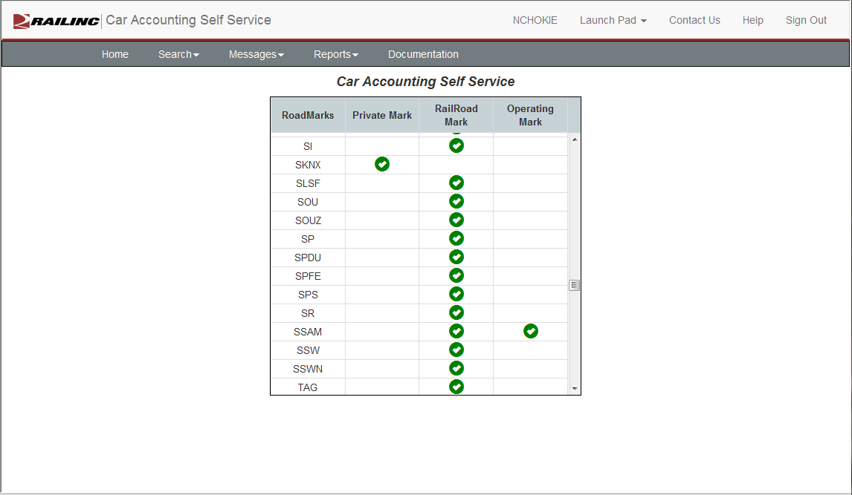
Walkthrough – Home Page

Slide 16
Walkthrough – Event Search
The system allows for the search of movement events by:
A single rail car
Date range – up to 90 days
Events are available for two years from current date

Slide 17
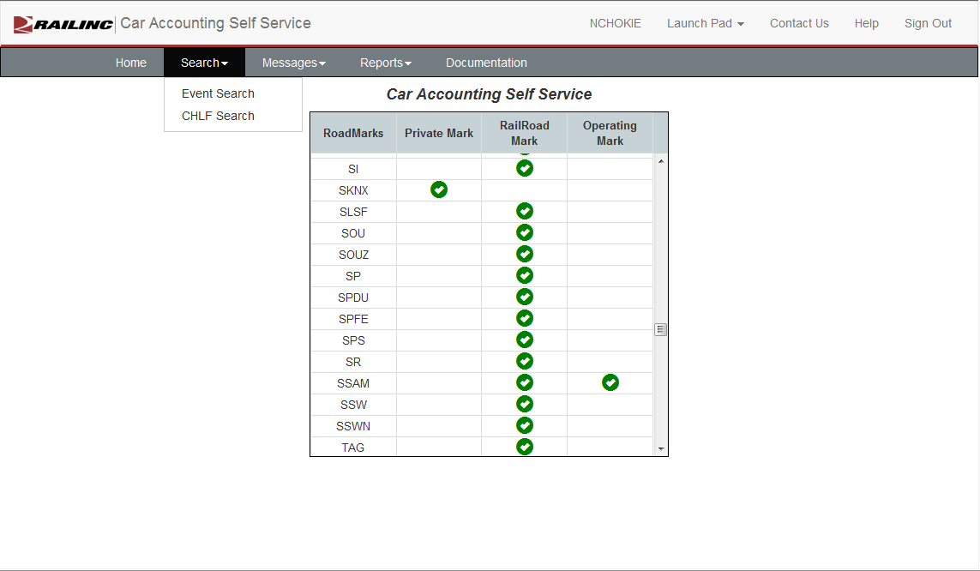
Walkthrough – Event Search

Slide 18
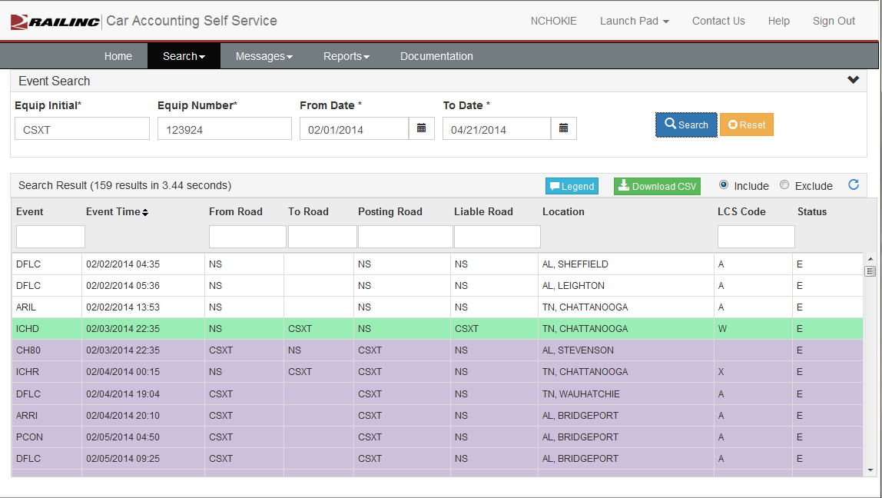
Walkthrough – Event Search

Slide 19
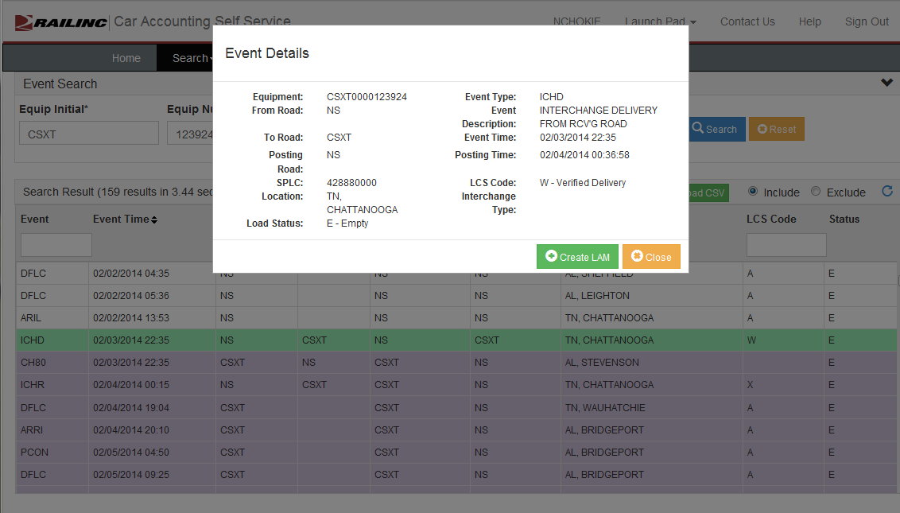
Walkthrough – Event Search Detail

Slide 20
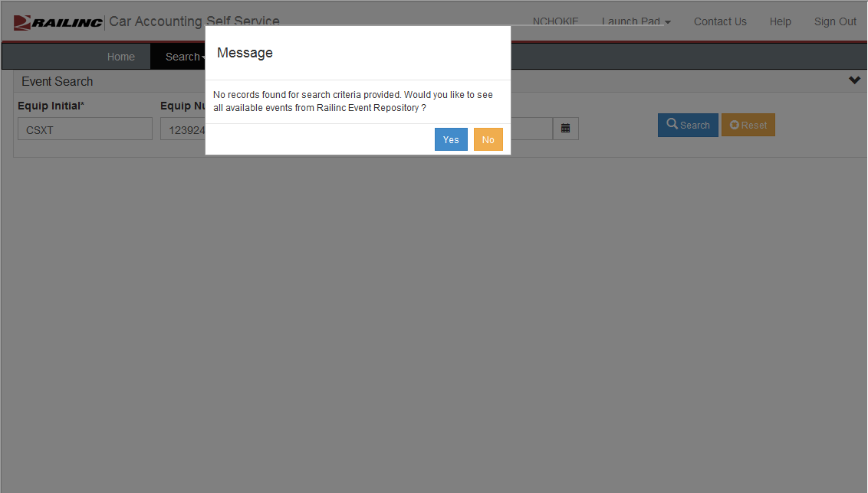
Walkthrough – Secondary Search

Slide 21
Walkthrough – Event Search
CASS highlights complex scenarios.
Haulage movements events
Suppressed movement events
Rule 15s
Rule 5s
Rule 4s
CASS highlights all LCS evaluated events.
Each scenario highlighted using a unique color.

Slide 22
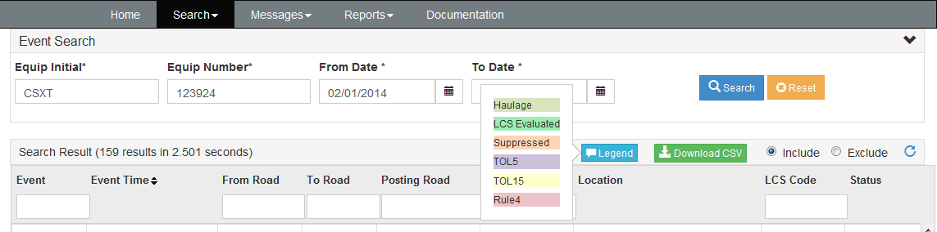
Walkthrough – Event Search Legend

Slide 23
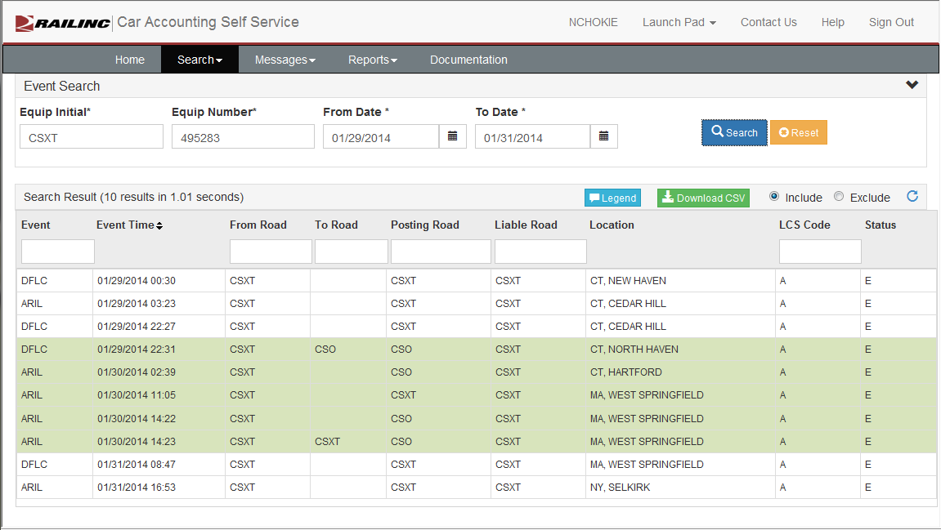
Walkthrough – Event Search, Haulage

Slide 24
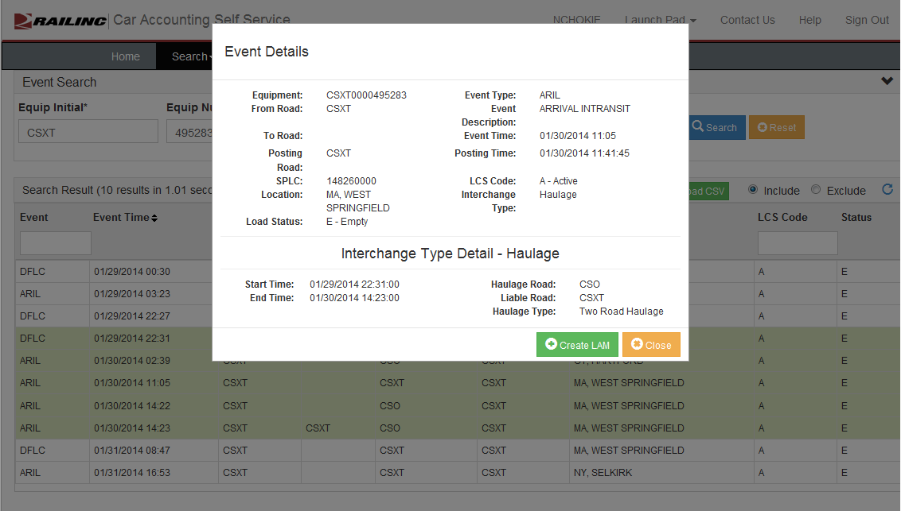
Walkthrough – Event Detail, Haulage

Slide 25
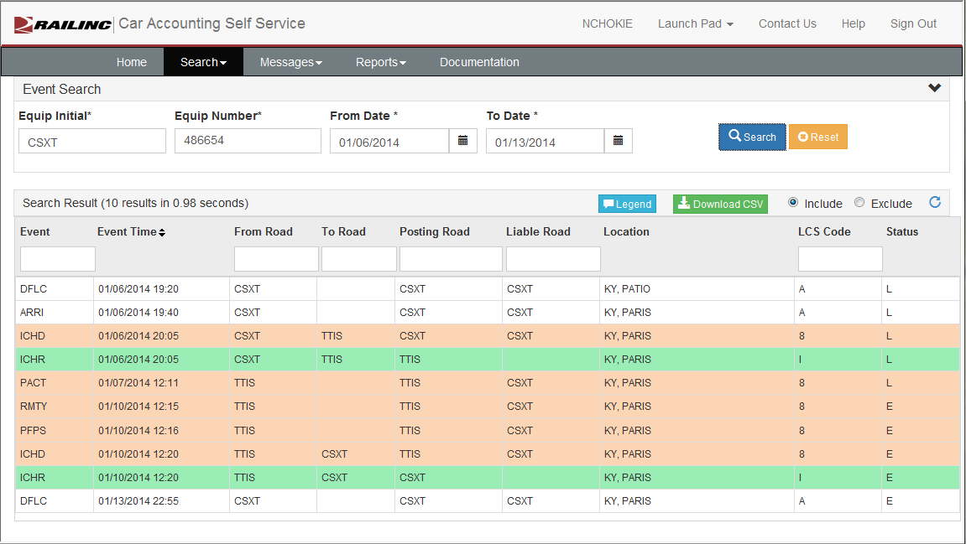
Walkthrough – Event Search, Suppression

Slide 26
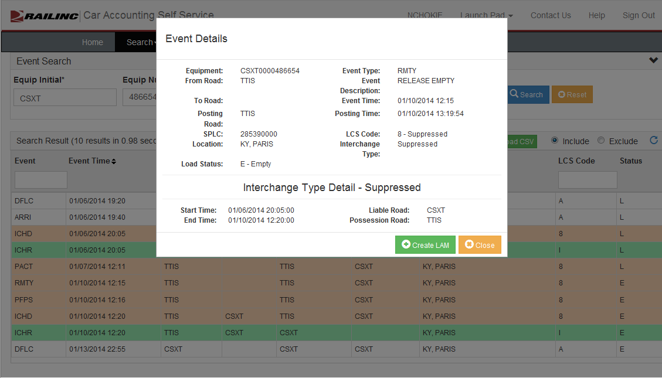
Walkthrough – Event Detail, Suppression

Slide 27
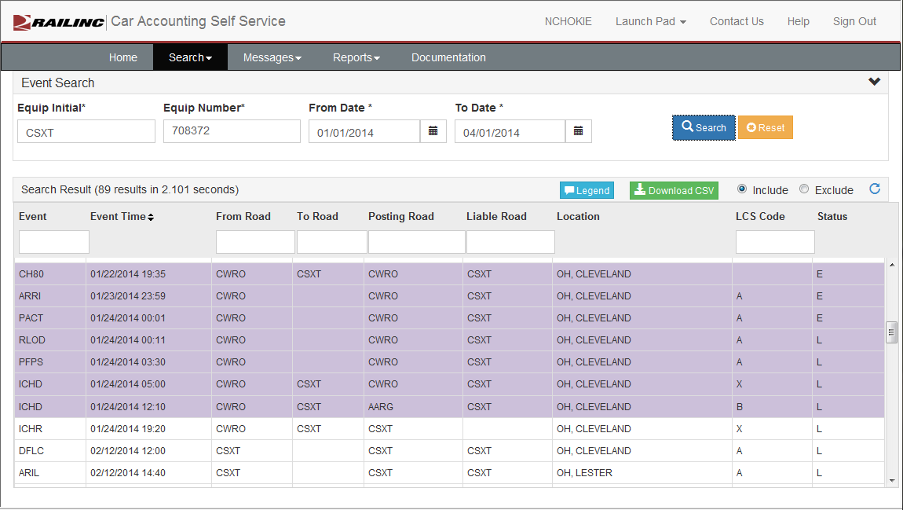
Walkthrough – Event Search, Rule 5

Slide 28
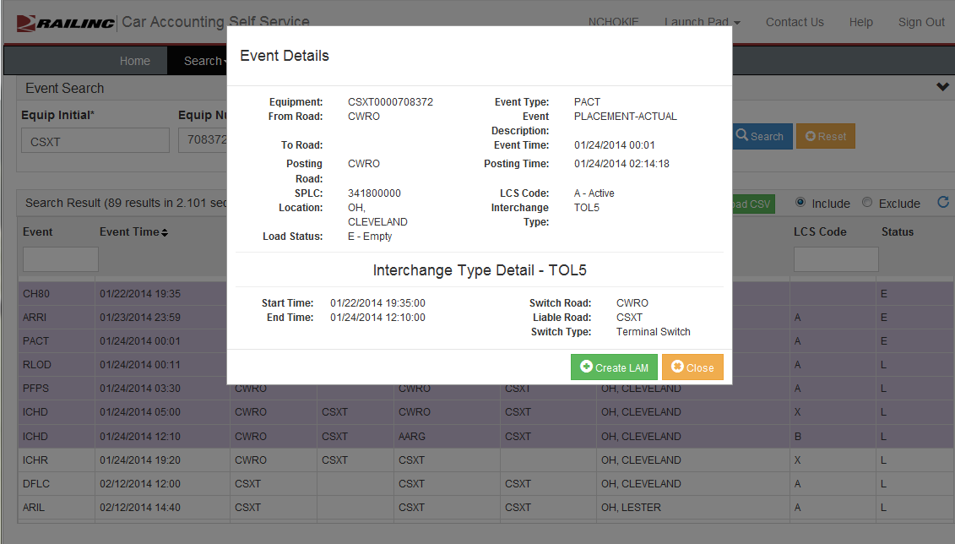
Walkthrough – Event Detail, Rule 5

Slide 29
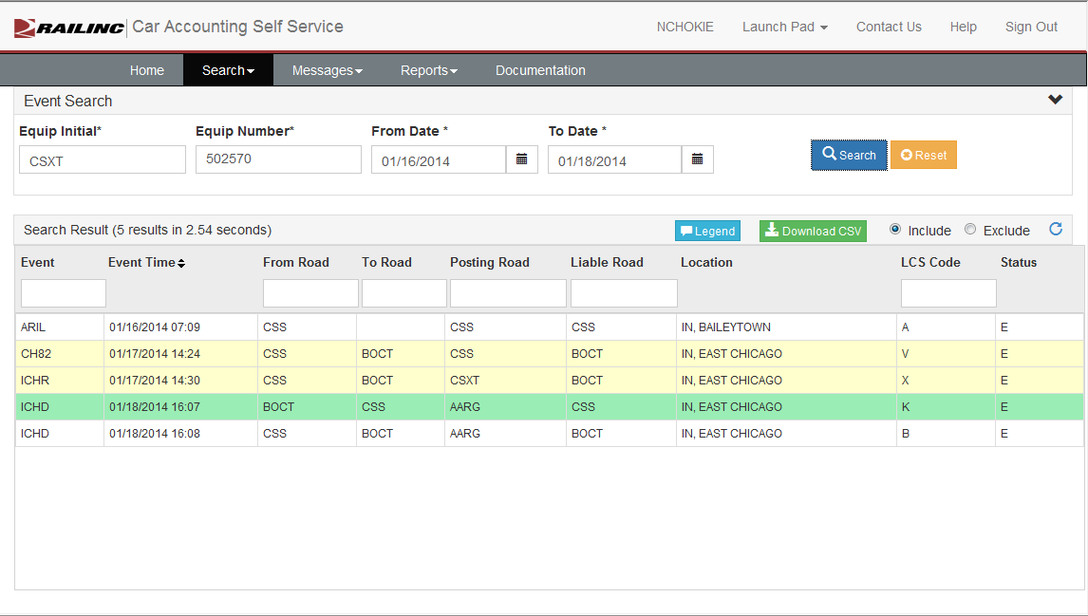
Walkthrough – Event Search, Rule 15

Slide 30
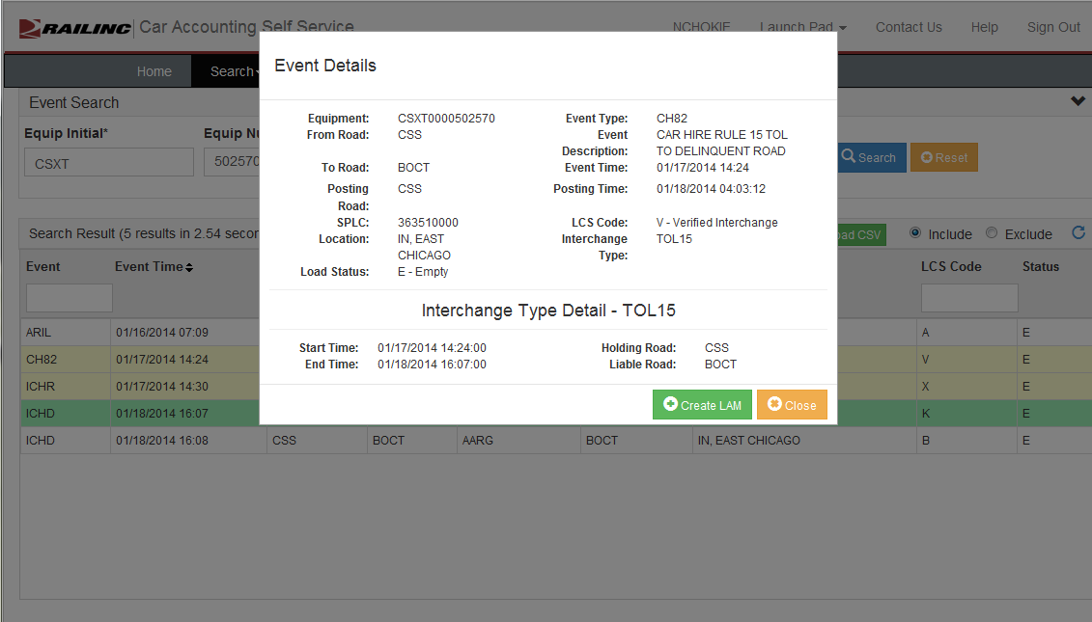
Walkthrough – Event Detail, Rule 15

Slide 31
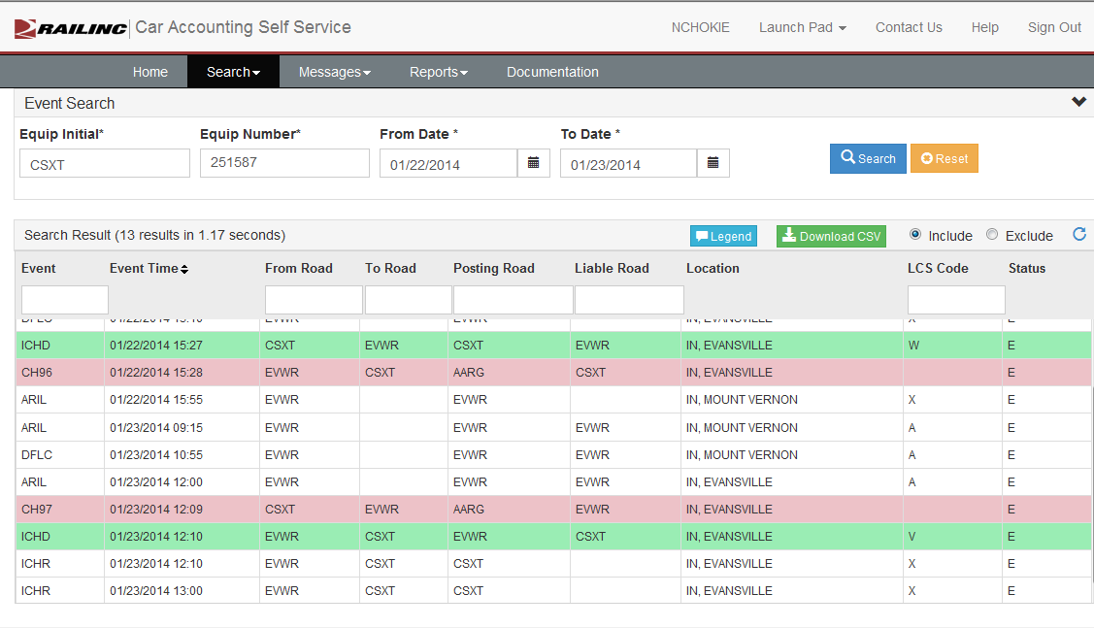
Walkthrough – Event Search, Rule 4

Slide 32
Walkthrough – CHLF Version Two Search
Allows for single equipment searches
CHLF Search Returns
CHLF records
Event data
Railinc-generated miles
CHARM rates
Waybill data (for Rule 4)
Must be an active CHLF recipient

Slide 33
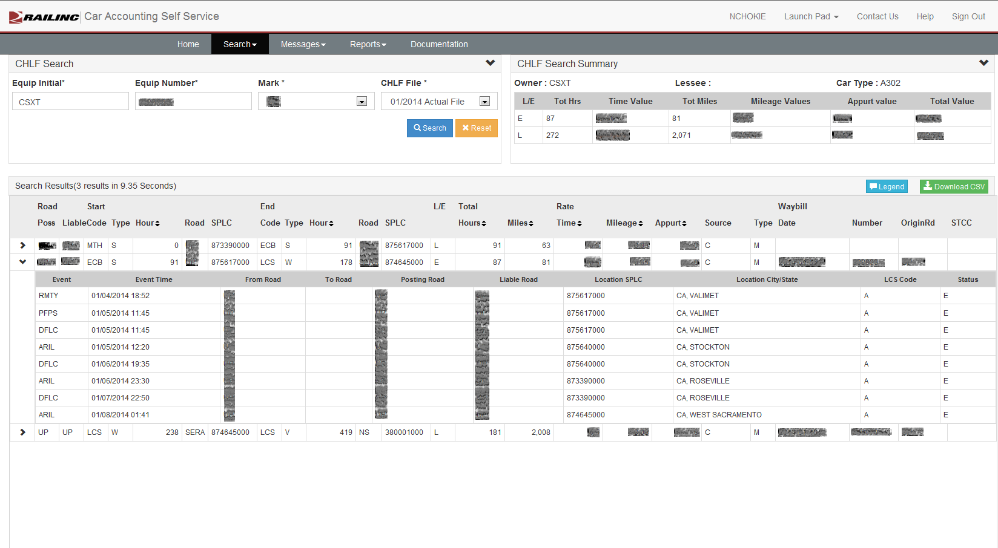
Walkthrough – CHLF Version Two Search

Slide 34
Walkthrough – LAM Creation
This special message type is used only to accept car hire liability. It cannot be used to assign car hire liability to another party.
It can be time consuming to create and send.
Not every railroad has the ability to send.

Slide 35
Walkthrough – LAM Creation
CASS validates LAMs based on the following logic:
Event time must be within 120 hours of current date and time. This is based on Eastern Time Zone.
Messages could be rejected based on early reporting if event time is not entered as Eastern Time.
Must be a valid interchange point between the “From Road and To Road”
Cannot be a duplicate message

Slide 36
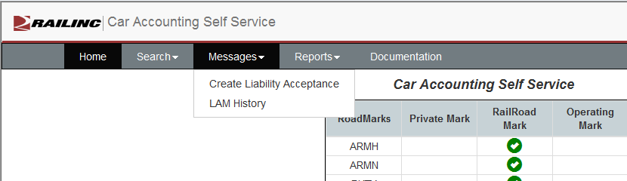
Walkthrough – LAM Creation Home Page

Slide 37
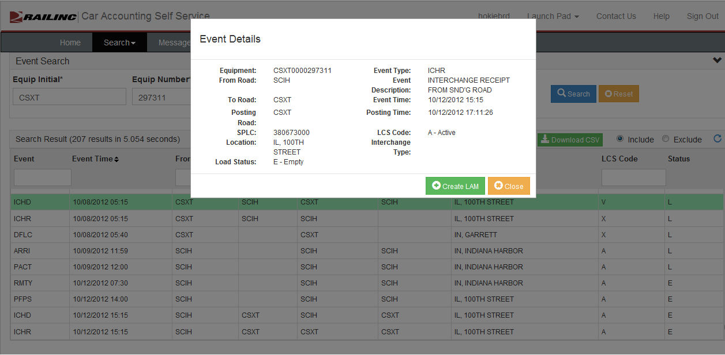
Walkthrough – LAM Creation from Event Detail Screen

Slide 38
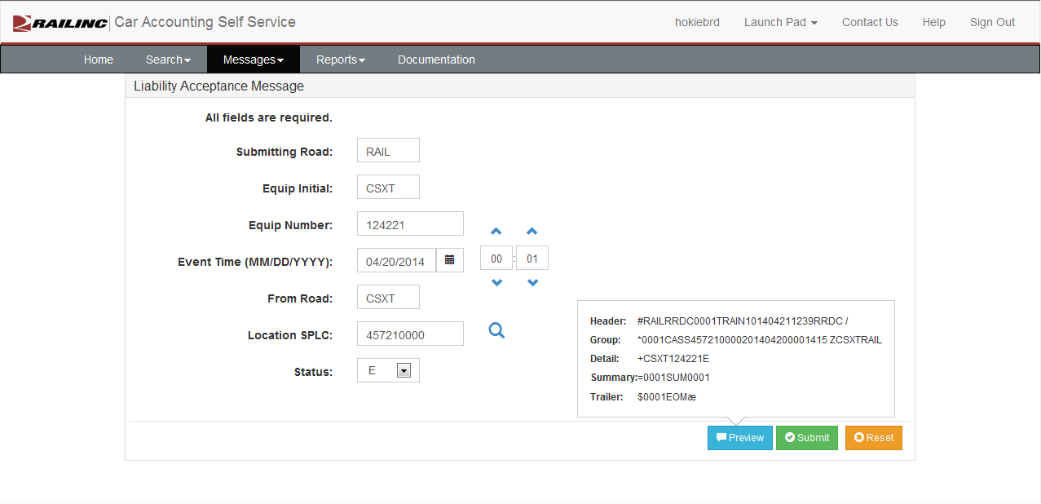
Walkthrough – LAM Creation

Slide 39
Walkthrough – LAM History
Three views are available
7, 30, and 60 Days
LAMs will have one of three statuses
Submitted – LAM has been submitted but has not reached the Event Repository.
Posted – LAM has been submitted and has reached the Event Repository. LAM will show in Event Search.
LCS Evaluated – LAM has been posted to the Event Repository and has been evaluated by LCS. LAM will show in Event Search with LCS Code “C.”

Slide 40
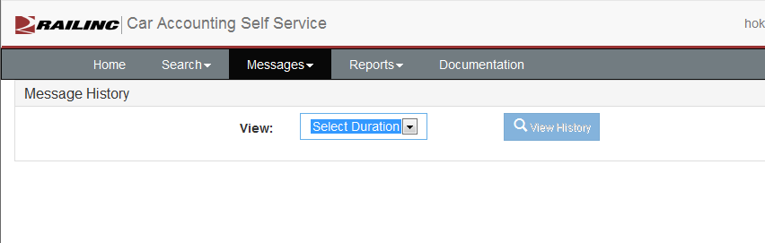
Walkthrough – LAM History

Slide 41
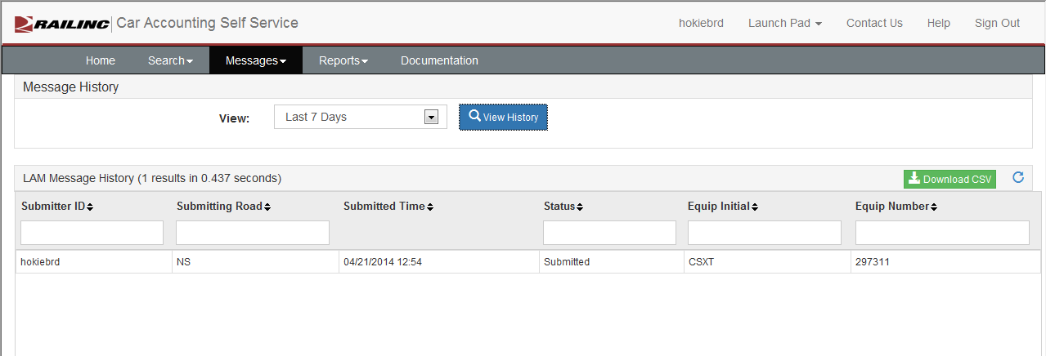
Walkthrough – LAM History

Slide 42
Walkthrough – Reports
Currently three reports are available in CASS
Haulage Agreements
TOL Rule 5 Liability Limits
DDCT Dismantled Equipment

Slide 43
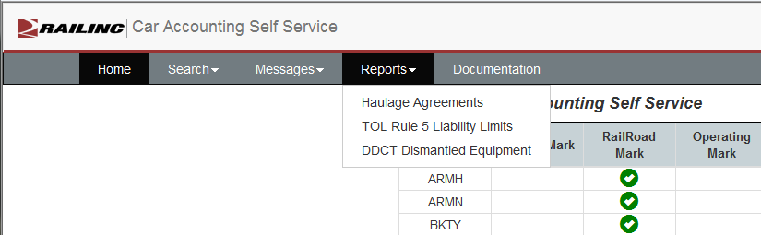
Walkthrough – Reports

Slide 44
Walkthrough – Reports, Haulage
Haulage agreements registered at Railinc
Haulage agreements are not directional and can be reported by either carrier
Haulage agreements are displayed when the Selected Railroad Mark is listed as
Carrier 1
Carrier 2
Car Hire Liable

Slide 45
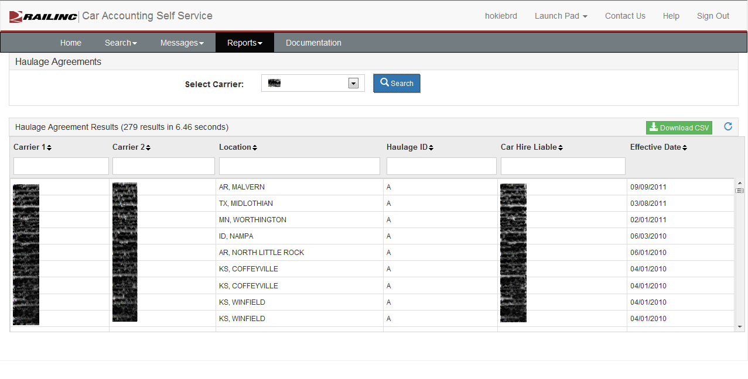
Walkthrough – Reports, Haulage

Slide 46
Walkthrough – Reports, TOL
Gives a view into the Rule 5 TOL time limits registered at Railinc
Must be either listed as Carrier 1 or Carrier 2
If Carrier 1 is the switch road then the To limit is used
If Carrier 2 is the switch road then the From limit is used

Slide 47
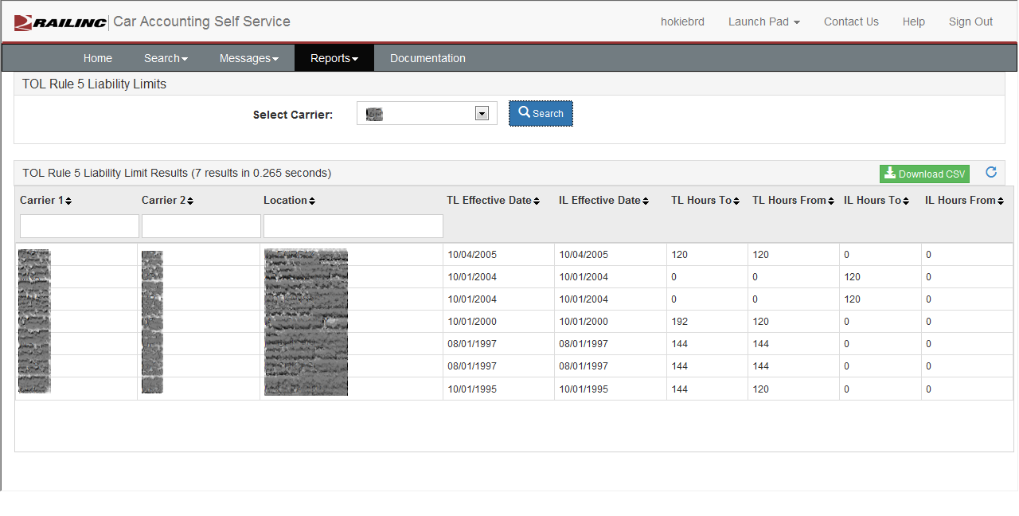
Walkthrough – Reports, TOL

Slide 48
Walkthrough – Reports, DDCT
Displays all cars that are in DDCT Dismantled status and are still registered in Umler
Report shows only cars that the selected Mark owns
Report may take some time to perform

Slide 49
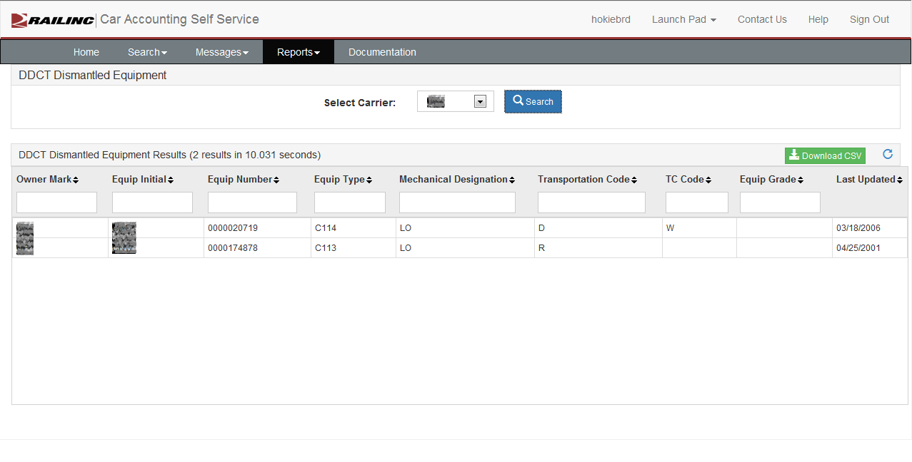
Walkthrough – Reports, DDCT

Slide 50
Learn More About CASS
Contact the Railinc Customer Support Center at 877-724-5462 (877-RAILINC) or csc@railinc.com.

Slide 51
Questions?

