Slide 1
Association of Car Accounting & Car Service Officers
May 12, 2016
Coeur d’Alene, ID

Slide 2
Watco Companies
Watco Companies was started in 1983 by Charles R. “Dick” Webb with a switching operation in DeRidder, LA that is still in existence today
Coffeyville, KS was our next expansion in 1985 with a car repair facility. This expanded into what is now the SKOL railroad which was the first short line purchase completed with the Union Pacific
Watco’s focus on Customer satisfaction has grown the company into an all encompassing industry serving rail, mechanical, switching, storage, trucking, warehousing and terminal/transloading needs of Customers throughout thirty-six states.

Slide 3

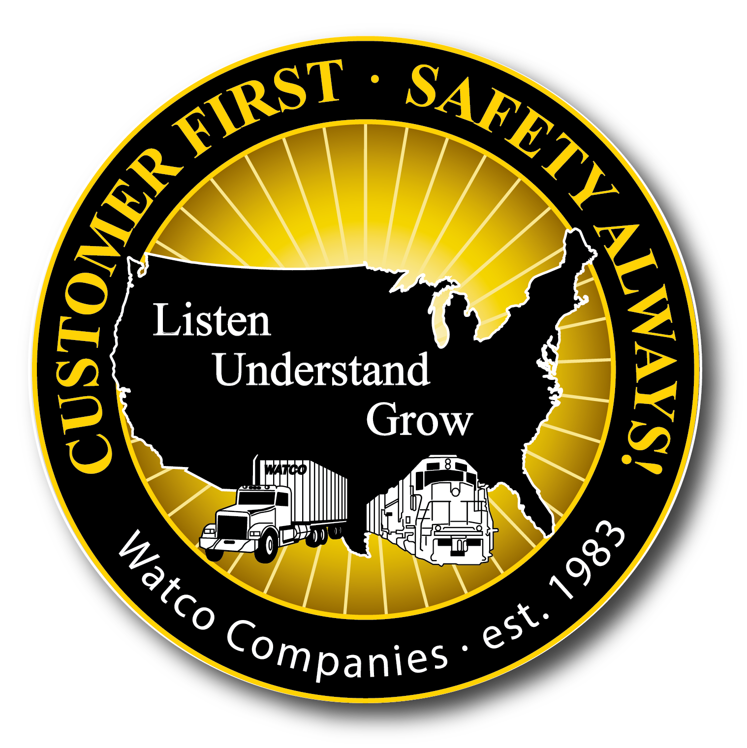
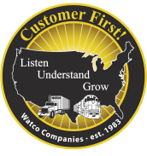
Customer First Foundation Principles
Customer First - Safety Always!
Value our Customers
Earn their business every day by providing Safe, Accurate,
and Timely Service
Create solutions that deliver value for our Customers and
Watco over the long-term
Value our People
SAFE Service, ALWAYS
Be Honest and Fair
Safely Improve Everyday
Always do the right thing and always try to find a better way
Build a tremendous future by making decisions that
protect our Customer, Team, Community, and Environment
Notes:
Value our Customers- our Customers are what we’re here for, they are purchasing a service from us not a product. We need to provide that service in a safe, accurate and timely manner and THEY are the ones who determine the measurements for meeting those needs. We also need to help them find solutions to their transportation needs that will help build our relationship for the long term.
Value our People – our people are our most important asset. We need to be sure they have the tools and training to perform their daily tasks safety. Be honest and fair –let them know what expectations are and let them know if they are meeting those expectations. Communication is the key and although the news that’s being communicated isn’t always good team members always need to about things in the business that can affect their future.
Safely Improve Everyday – each and everyday go out and do your job safely. Each and everyday find a way to perform your job in a better manner then you did the day before. Make decisions everyday that protects everyone in the supply chain. Each day the individual improves is a day the company improves.

Slide 4
Strategic Business Model
Watco Services
Class I’s
Transportation
Short Lines
Terminals
Customer
Other Customers
Supply Chain Services
Mechanical
Gov.- Eco. Development
Watco’s goal is to improve profitability and Customer satisfaction over the long-term by providing services to fill all Customer needs

Slide 5
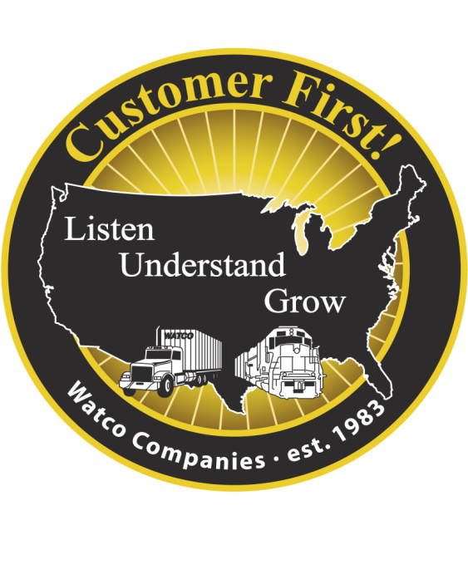

Statistics
One of the largest short line railroad operators in the U.S.
3rd largest industrial contract switching provider
Watco Supply Chain Services added in 2014
1,000,000+ annual carloads
4,750 track miles
3,000 Watco team members
450+ locomotives
3,900 railcars
36 states served
30 switching operations
35 short line railroads
33 GBW (joint venture) mechanical shops
23 railroad repair shops, 8 locomotive shops and 2 private railcar shops
54 terminal locations
International rail service in Western Australia

Slide 6
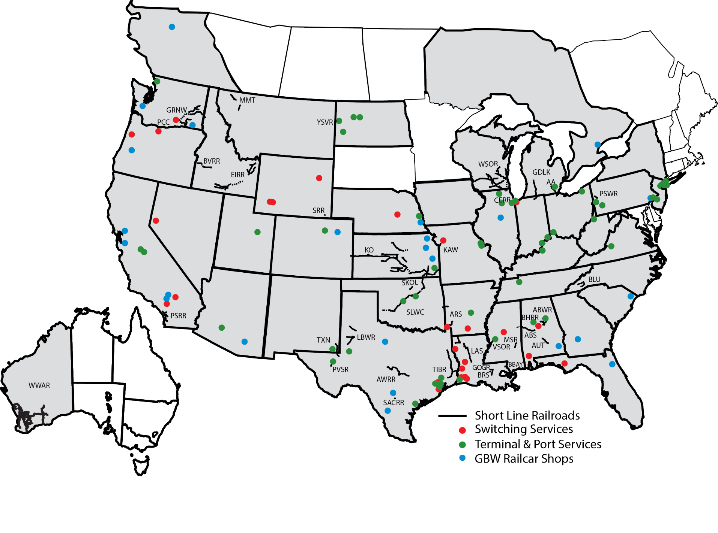
Watco System Map

Slide 7
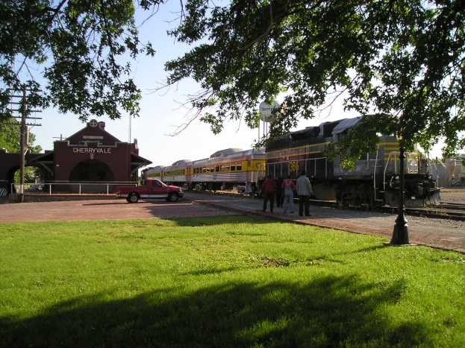
Watco Transportation Services
Railroad Locations
Alabama Southern Railroad
ABS-Tuscaloosa, AL
Alabama Warrior Railway
ABWR – Birmingham, AL
Ann Arbor Railroad
AA-Howell, MI
Arkansas Southern Railroad
ARS-Nashville, AR
Austin Western Railroad
AWRR-Austin, TX
Autauga Northern Railroad
AUT – Prattville, AL
Baton Rouge Southern Railroad
BRS – Baton Rouge, LA
Birmingham Terminal Railway
BHRR – Birmingham, AL
Blue Ridge Southern Railroad
BLU– Asheville, NC
Bogalusa Bayou Railroad
BBAY - Bogalusa, LA
Boise Valley Railroad
BVRR – Boise, ID
Cicero Central Railroad
CERR - Stickney, IL
Eastern Idaho Railroad
EIRR-Twin Falls, ID
Grand Elk Railroad
GDLK – Grand Rapids, MI
Pacific Sun Railroad
PSRR – San Diego, CA
Palouse River & Coulee City Railroad
PCC-Lewiston, ID
Pecos Valley Southern Railway
PVSR - Pecos, TX
Pennsylvania Southwestern Railroad
PSWR-Midland, PA
San Antonio Central Railroad
SACRR – San Antonio, TX
South Kansas and Oklahoma Railroad
SKOL-Cherryvale, KS
Stillwater Central Railroad
SLWC-Oklahoma City, OK
Swan Ranch Railroad
SRRR – Cheyenne, WY
Texas & New Mexico Railway
TXN-Eunice, NM
Timber Rock Railroad
TIBR-Silsbee, TX
Vicksburg Southern Railroad
VSOR-Vicksburg, MS
Yellowstone Valley Railroad
YSVR- Dore, ND
Watco Western Australia Rail
WWAR – Perth, Australia
Wisconsin & Southern Railroad
WSOR – Milwaukee, WI
Great Northwest Railroad
GRNW-Lewiston, ID
Kaw River Railroad
KAW-Kansas City, KS
Kansas & Oklahoma Railroad
KO-Wichita, KS
Louisiana Southern Railroad
LAS-Hodge, LA
Lubbock & Western Railway
LBWR-Wolfforth, TX
Mission Mountain Railroad
MMT-Columbia Falls, MT
Mississippi Southern Railroad
MSR-Bay Springs, MS

Slide 8
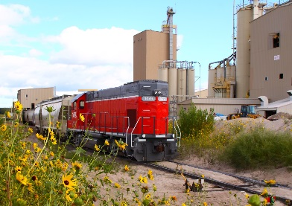
Watco Transportation Services
Switching & Railroad Repair Locations
SWITCHING SERVICES
Boise DeRidder, LA
Boise Wallula, WA
Cleco Lena, La
Condon Arlington, OR
Domtar Ashdown, AR
EDC El Dorado, AR
Entergy Westlake, LA
Gateway Reno, NV
Georgia Pacific Toledo, OR
Ingenia Houston, TX
Ingredion Kansas City, MO
International Paper Mansfield, LA
International Paper Prattville, AL
Kinder Morgan Galena Park, TX
Lyondell Lake Charles, LA
MeadWestvaco DeRidder, LA
OCI Green River, WY
Olin McIntosh, AL
PCS Hammond, IN
PPG Lake Charles, LA
Preferred Sand Genoa, NE
R&H Deer Park, TX
Solutia Alvin, TX
Solutia Pensacola, FL
Solvay Green River, WY Thunder Basin Coal Wright, WY
SWITCHING SERVICES
TPC-Petrochem Houston, TX
TPC-Petrochem Port Neches, TX
UP Brimstone, LA
Ventura Ontario, CA
RAILROAD REPAIR SHOPS
ABS Tuscaloosa, AL
ABWR Birmingham, AL
AWRR McNeil, TX
BHRR Birmingham, AL
Ensley, AL
Fairfield, AL
EIRR Minidoka, ID
GDLK Grand Rapids, MI
GRNW Lewiston, ID
KAW Kansas City, KS
KO Wichita, KS
LAS Hodge, LA
Minden, LA
SKOL Chanute, KS
Cherryvale, KS
Coffeyville, KS
Winfield, KS
SLWC Oklahoma City, OK
TIBR Silsbee, TX
VSOR/MSR Vicksburg, MS
WSOR Horicon, WI
Janesville, WI
Madison, WI
LOCOMOTIVE REPAIR SHOPS
Birmingham, AL
Grand Rapids, MI
Horicon, WI
Janesville, WI
Lewiston, ID
Silsbee, TX
Vicksburg, MS
Wichita, KS
PRIVATE REPAIR SHOPS
Gainesville, FL
Hermiston, OR

Slide 9
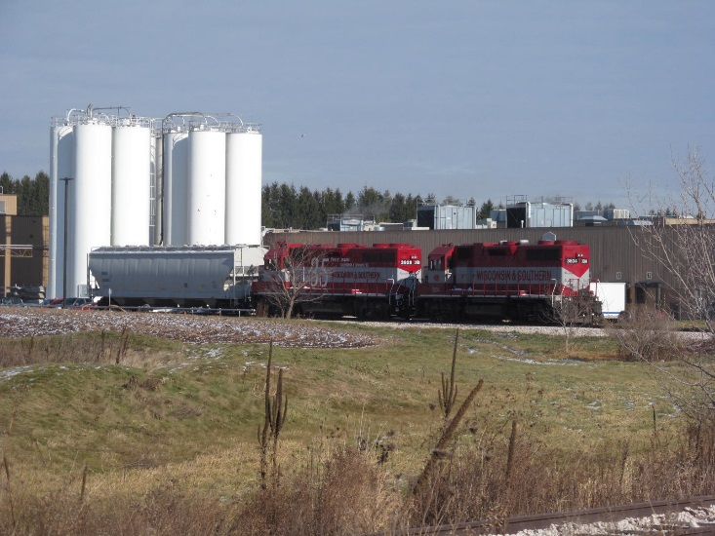
Watco Switching Services
Watco Switching Services began providing specialized industrial contract switching services in 1983. We offer a wide variety of contractual switching services to our existing Customer base throughout the US. We continue to provide switching services to our original Customer we began with in 1983. Our customer retention is built with long-term partnerships thus providing Customers with safe, efficient rail switching services. Our safety record is among the top in this industry.
Industries served:
  Energy
  Chemical
  Petroleum
  Aggregate
  Forest products
  Metals and ores
  Paper industry
  Food products
  Waste
  Storage in transit
  Ports
Services available:
  Hours & staff levels determined by Customer
  On-site managers
  Car inspections, cleaning & repair
  Track inspection and maintenance
  Computerized yard management reports
  AEI tag readers for inventory control
  Locomotive power – necessary power provided to meet Customer needs
  Access to Watco’s Project Management Team

Slide 10
Mechanical Services
Railcar Repair
  Fifteen locations throughout the United States
  May 2007 - Acquired Millennium Rail, a fully-integrated provider of repair and maintenance services such as fleet management, general repair and maintenance, specialty freight car manufacturing and program work
  June 2008 – Acquired Fitzgerald Railcar Services, Inc., a comprehensive railcar repair and maintenance company, expanding services to Georgia and Nebraska
Railroad Repair Services
  Twenty-three railroad located repair locations
  Contract and emergency repairs including, coal fleets, preparation and cleaning of boxcars and refrigerated cars
Locomotive Repair
  Eight locations available to meet Watco and Customer needs

Slide 11
Watco Mechanical Services
On June 4, 2014, Watco Companies and The Greenbrier Companies announced a 50/50 joint venture forming new company creating world-class network of railcar repair shops. GBW Railcar Services, LLC (GBW) created a diverse network of 33 facilities located across North America

Slide 12
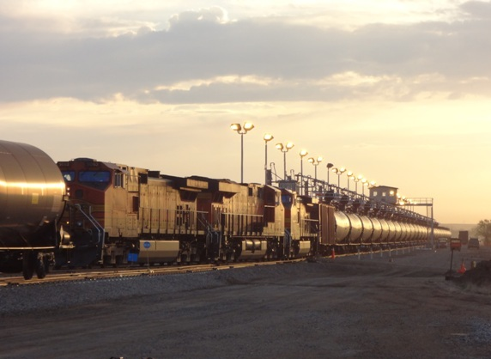
Watco Terminal & Port Services
Merchant Terminals
Contract Terminals
Alabama - Port Birmingham
Arkansas - Pine Bluff
Arizona - Phoenix
California
  Stockton – Fertilizer
  Stockton – Food Grade
Illinois
  Chicago Heights
  Rockford
  Triumph
Indiana
  Hammond
  Jeffersonville
Louisiana – Baton Rouge
Kansas – Pittsburg
Michigan - Willis
Mississippi – Vicksburg
Missouri – St. Louis
Nebraska – Omaha
North Dakota – Dore
Ohio –
  Cincinnati
  Columbus
  Euclid
Oklahoma
  Oklahoma City
  Stroud
Pennsylvania
  Avondale
  Dravosburg
  Industry
Texas
  Houston
  Pecos
Virginia – Roanoke
Wisconsin - Oshkosh
Colorado – Tampa
Illinois – Triumph
Kentucky
  Ghent
  Louisville
New Mexico - Loving
New Jersey
  Bayway
  Linden
New York
  Bronx
  Brooklyn
  Queens
North Dakota
  Fryburg
  Stanley
  Tioga
Pennsylvania - Philadelphia
Tennessee – New Johnsonville
Texas
  Houston
  Port Arthur
  Refugio
Utah - Wellington
Virginia – Waverly
Washington - Ferndale
West Virginia - Brooklyn Junction

Slide 13
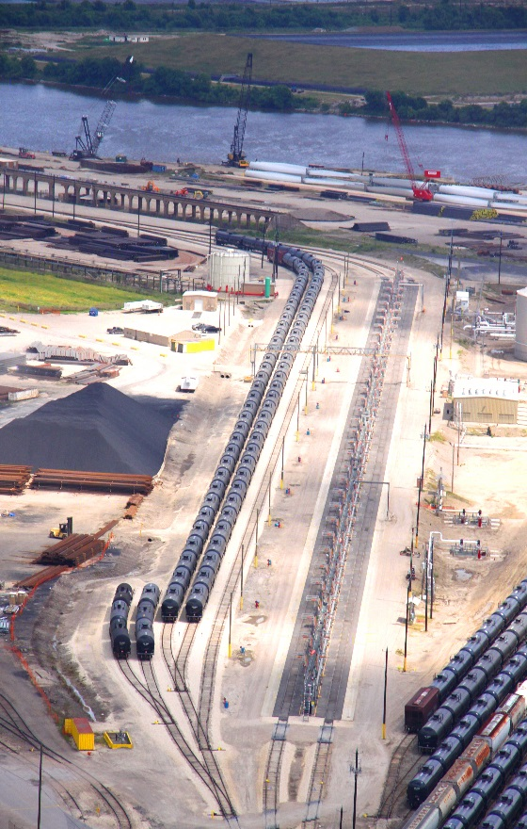
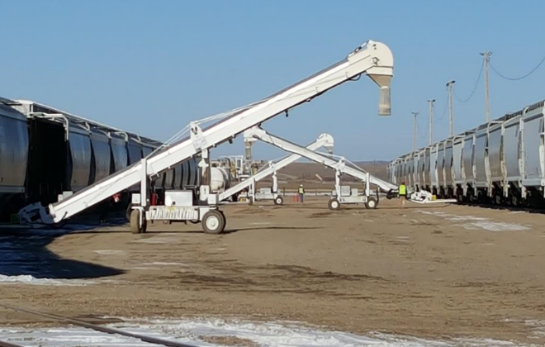
Terminal & Port Services
Multi-modal Transload Service Provider of Rail, Barge, & Truck
  Customized service offerings to meet your needs:
  Speed to market
  Railcar, barge, and truck material handling
    Liquids, bulk, or dimensional shipments
  Contract Terminal operations management
  Terminal Storage Solutions
    Warehouse
    Silo Storage
    Tank Storage
    Flat Storage
  Inventory Management
  Shifting & Fleeting

Slide 14
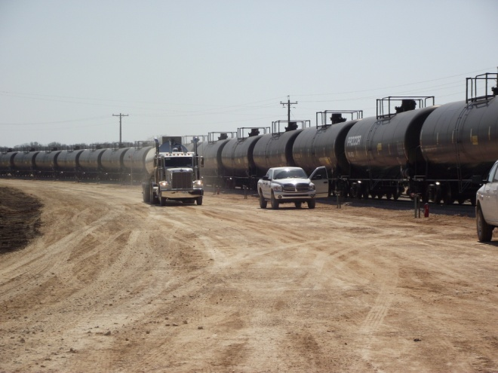
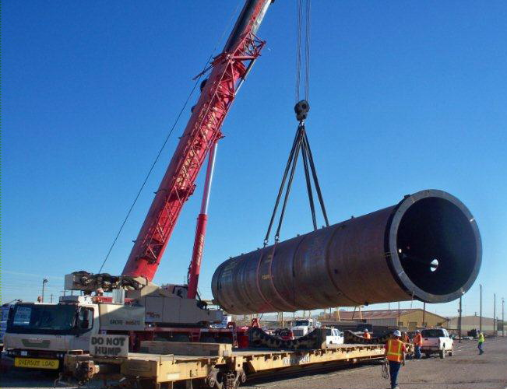
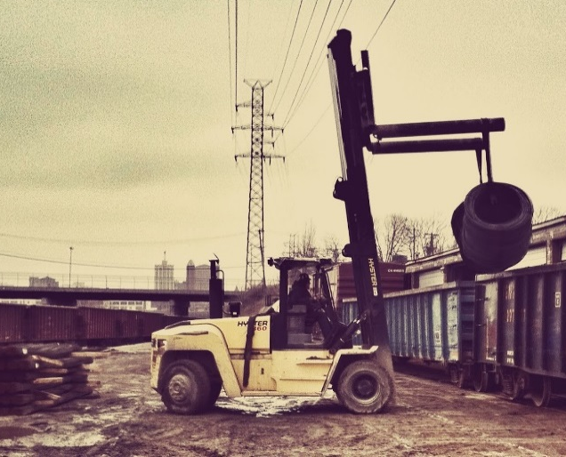
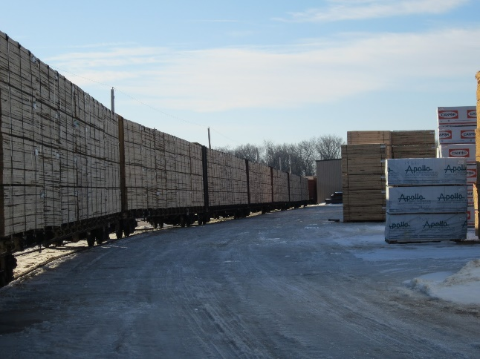
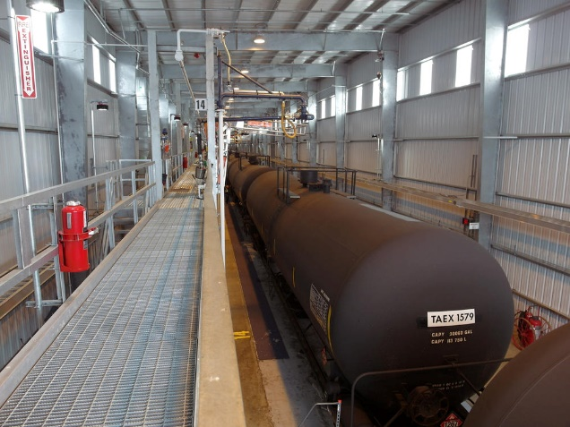
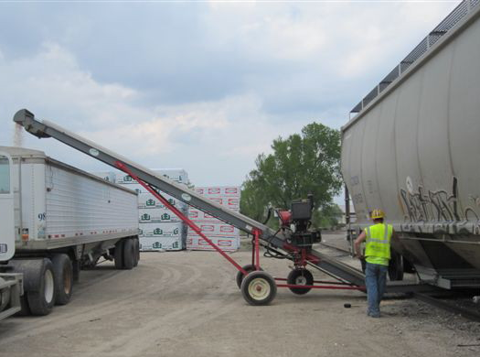
Commodities Transloaded
Liquids Transloading
Oversize Transloading
Steel Transloading
Lumber Transloading
Hazardous Transloading
Bulk Transloading

Slide 15
Project Management Team
The Project Management Team assists will all new business constructions and complete builds from designing to the completion of projects. This service is proved for all Watco entities.
Estimating
  Assist Marketing/Business Development in establishing client expectations
  Evaluate opportunities accurately
Design
  Establish consistent project delivery
  Evaluate market trends rapidly
  Open more fluid communication with Customer
  Deliver the highest possible product quality with a good design
Construction
  Maintain tight schedules
  Save money and increase quality
  First to market opportunity (transload)
  Identify Issues Rapidly

Slide 16
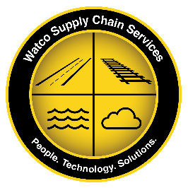
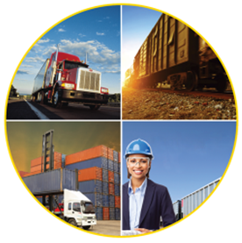
Watco Supply Chain Services
Highway
Logistics
Rail
Logistics
Intermodal
Logistics
Engineering &
Regulatory
Consulting

Slide 17
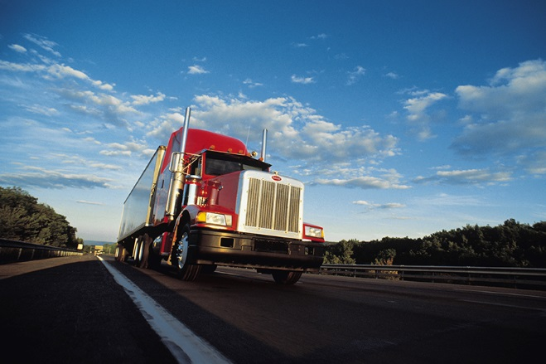

Watco Supply Chain Services
Highway Logistics
Rail Logistics
Brokerage: Truckload, LTL
Dedicated Capacity
3PL Outsource Services
Network Optimization
Mode Optimization
Freight Audit and Payment
Car Ordering/Waybilling
Diversion Management
In-transit Visibility and Monitoring
Fleet Management
Door to Door Rail Options
Dimensional/Project Coordination
Securement Design
Car Retrofitting/Design
Railcar Maintenance
Demurrage/Claims
Freight Audit and Payment

Slide 18
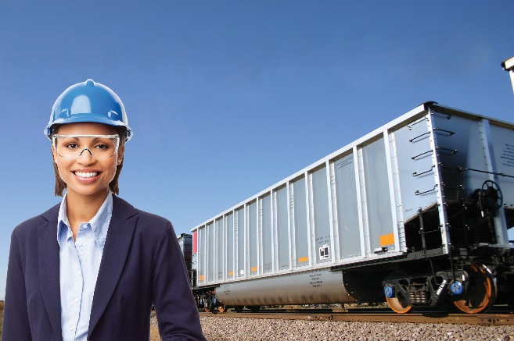
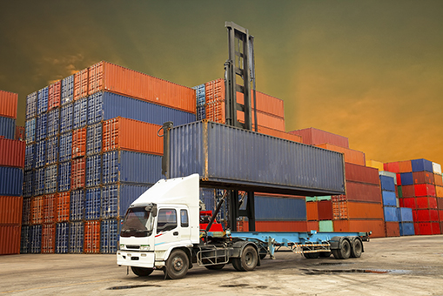
Watco Supply Chain Services
Engineering & Regulatory Consulting
Intermodal Logistics
• Certified engineers and regulatory experts, delivering:
• Ceramic engineering
• Manufacturing engineering
• Mechanical engineering
• Metallurgical engineering
• Reliability engineering
• Tank car qualification and maintenance programs
• HazMat training for railroads, shippers, and
manufacturing and maintenance facilities
• ASNT Level III support
• Welding support (AWS D15.1 and AAR Appendix W)
• AAR-based compliance audits and program development
• Expert Witness Litigation Support
Full Service Provider
• Door-to-Door Variations
• Ramp-to-Ramp Variations
Shipper Load/Consignee Unload
Transload Scenarios
Container & Chassis Management
Port Drayage
Pool Management

Slide 19
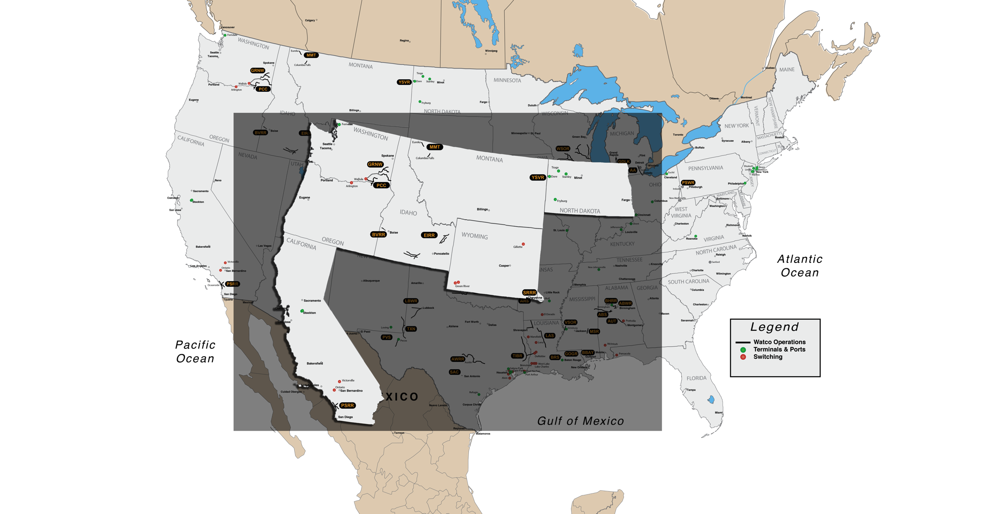
Watco in the West

Slide 20
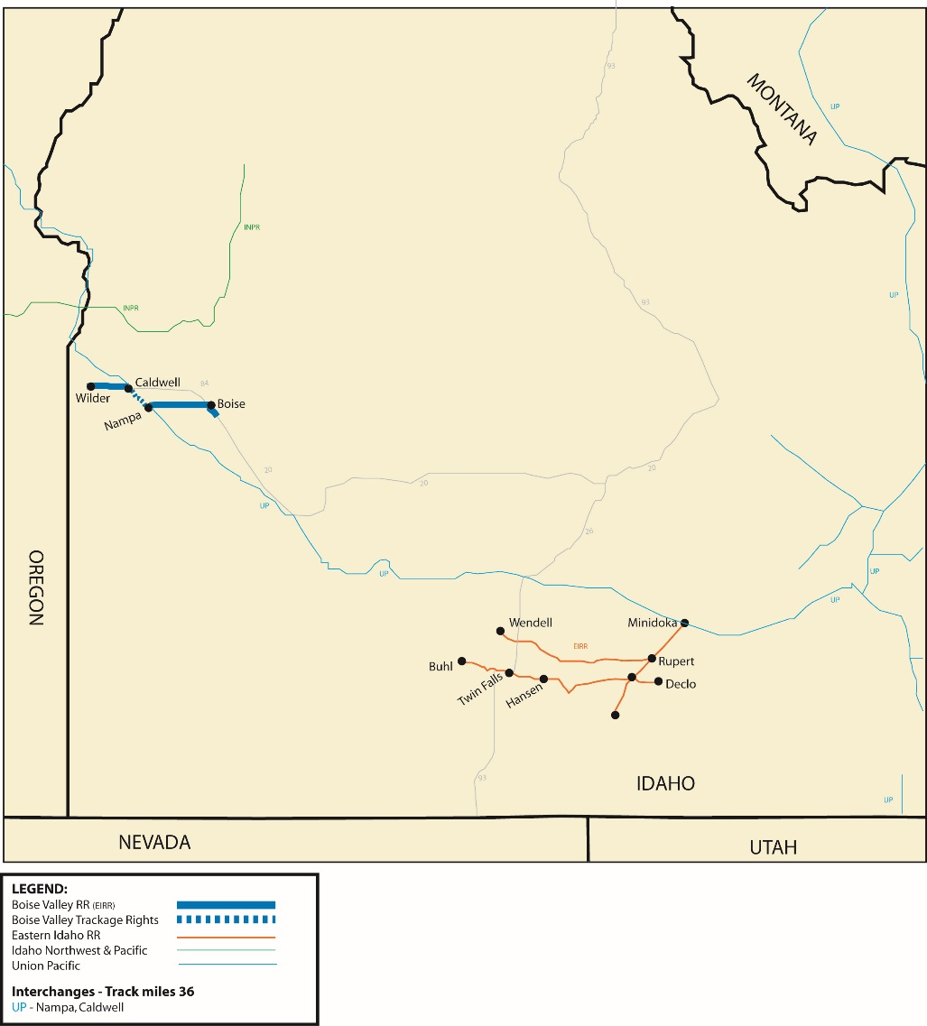
Boise Valley Railroad
QUICK FACTS:
Start Date: November, 2009
Track miles: 36
Carloads: 10,904
Team Members: 13
Top Commodities: Frozen vegetables, fertilizers and lumber products

Slide 21
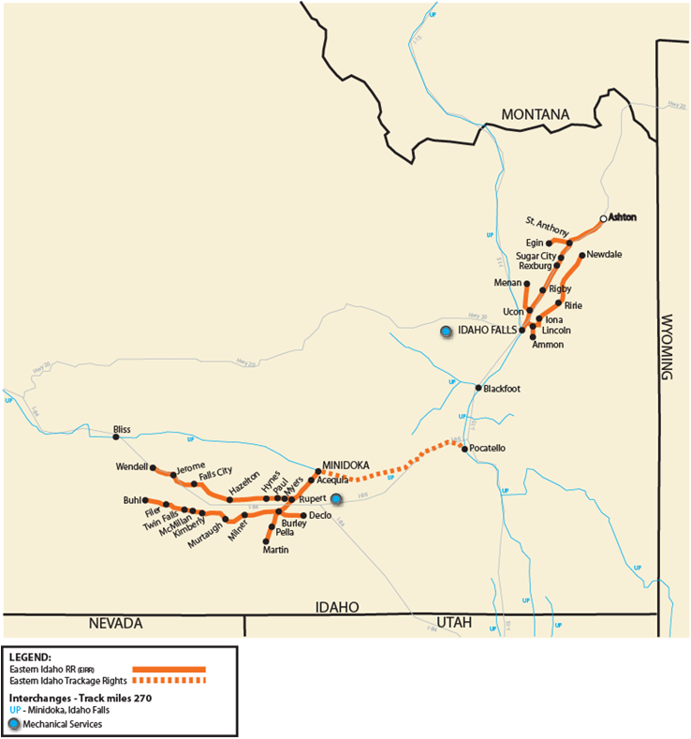
Eastern Idaho Railroad
QUICK FACTS:
Start Date: 1993
Track miles: 270
Carloads: 49,434
Team Members: 60
Top Commodities: Corn, sugar, wheat, frozen vegetables and coal

Slide 22
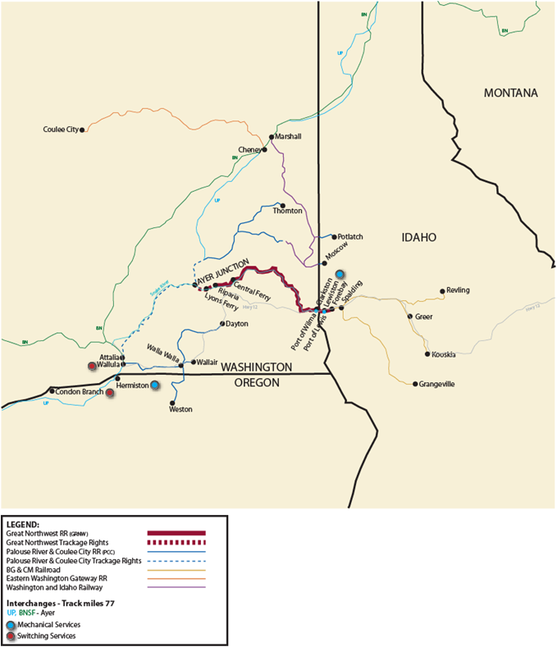
Great Northwest Railroad
QUICK FACTS:
Start Date: March, 2004
Track miles: 77
Carloads: 14,500
Team Members: 25
Top Commodities: Lumber products, fertilizers, aggregates

Slide 23
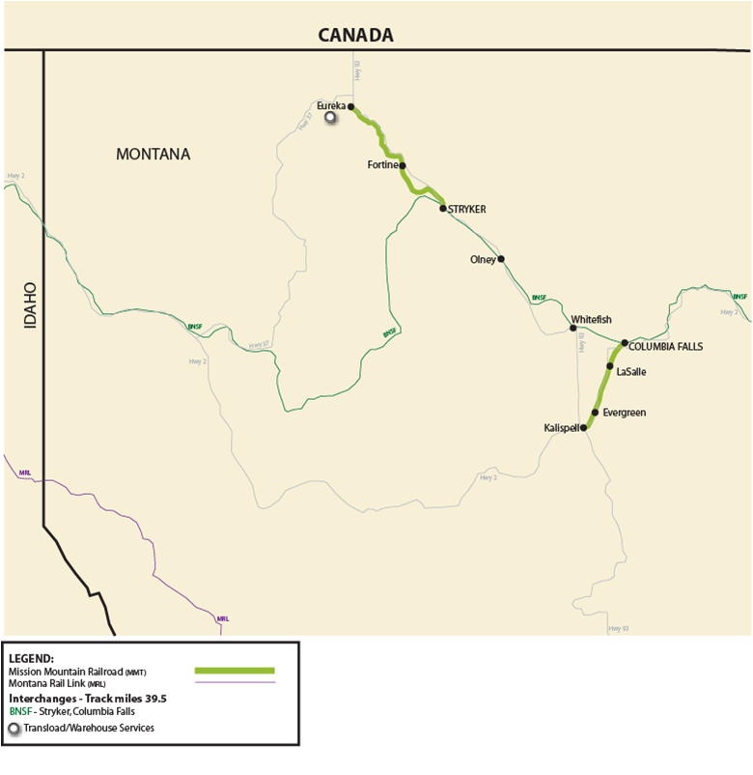
Mission Mountain Railroad
QUICK FACTS:
Start Date: December, 2004
Track miles: 39.5
Carloads: 6,440
Team Members: 8
Top Commodities: Lumber and wheat

Slide 24
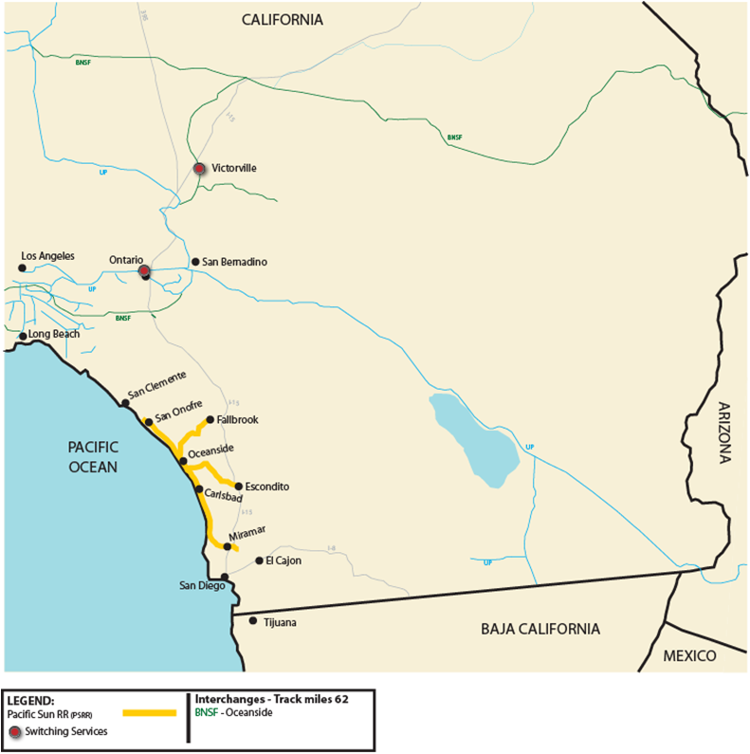
Pacific Sun Railroad
QUICK FACTS:
Start Date: October, 2008
Track miles: 62
Carloads: 2,052
Team Members: 6
Top Commodities: Corn, soy, lumber, plastic pellets, beer, paints and items for recycling

Slide 25
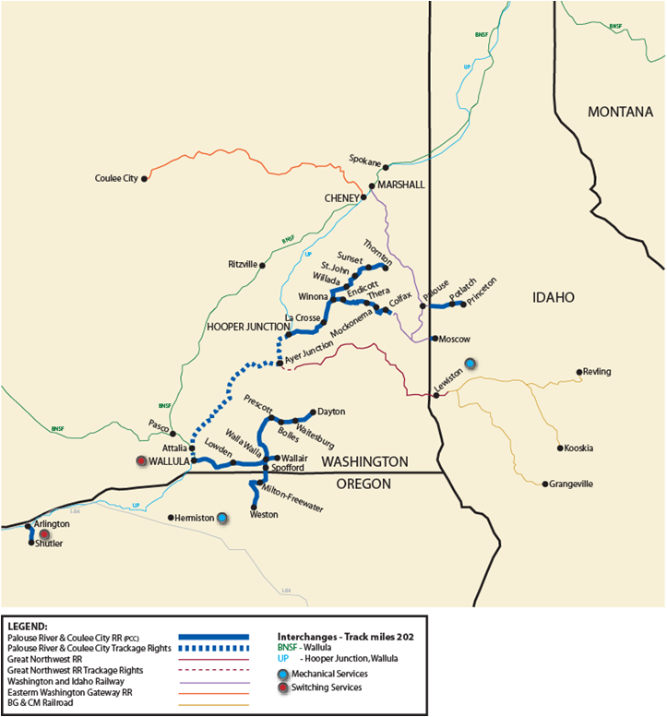
Palouse River & Coulee City Railroad
QUICK FACTS:
Start Date: 1992
Track miles: 202
Carloads: 4,100
Team Members: 14
Top Commodities: Wheat and frozen vegetables

Slide 26
Swan Ranch Railroad
QUICK FACTS:
Start Date: 2011
Facts: Serves the Swan Ranch Industrial Park
Team Members: 9
Carloads: 6,000
Top Commodities: Asphalt, Frac Sand, Crude, Wind Components, Steel

Slide 27
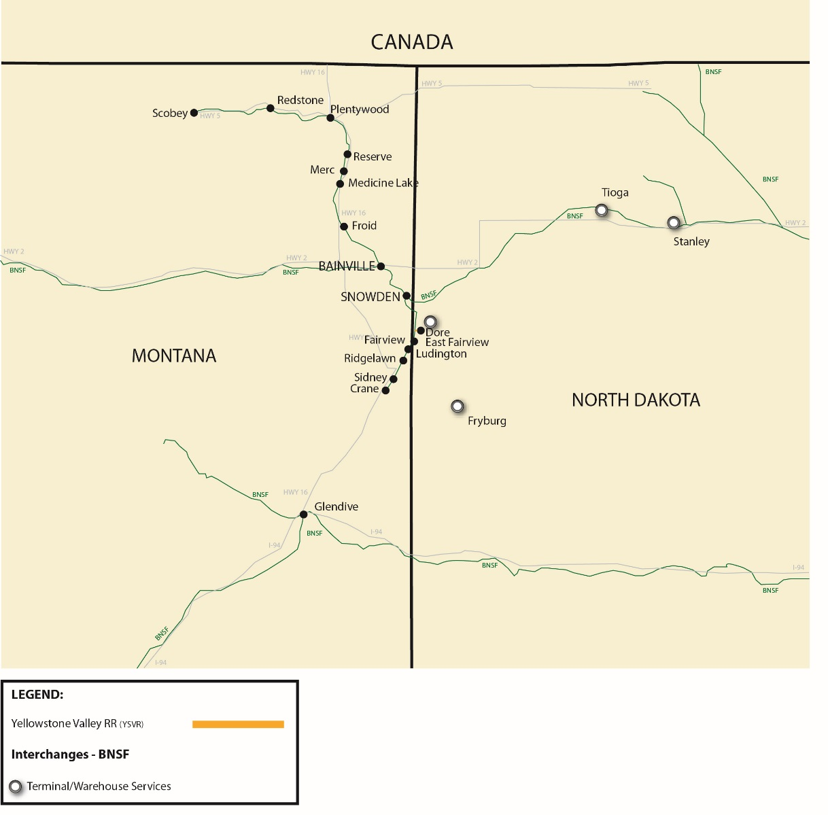
Yellowstone Valley Railroad
QUICK FACTS:
Start Date: August 2005
Carloads: 18,800
Team Members: 7
Commodities: Crude oil, sand

Slide 28
Effective Safety Program
Initiated a commitment to safety improvement in 2003 and has consistently
performed better than the industry over that period

Slide 29
Watco Safety Commitment
Watco is committed to safety for our Team Members
Compliance with our new policies and regulations is essential and required to ensure the safety of our Team Members and our company
Compliance with our rules/policies and with regulations is not an option but a condition of employment with Watco Services
Strong, effective relationships with our customers are highly encouraged and are essential to the continued improvement of our company

Slide 30
Summary of Our Strengths
Long-Term Vision & Commitment to Customers
  Customer Focused in Everything we do
  20 – 30 year Strategic Planning Horizons
  Foundation Principles Guide our Strategic and Operating Plans
Safety Commitment
  RPI ratio of 1.37 in 2010 better than all US RR’s and US Short Lines
  Focus on Continuous Improvement has allowed Watco to improve Safety by over 90% since 2003
Diversified Offering of Services
  Customer / Commodity / Geographic / Service
  Reduce volatility of cash flows / Create Growth Opportunities
  Build Deeper, Broader, and Stronger Customer Relationships by Understanding and Meeting Customer Needs

Slide 31
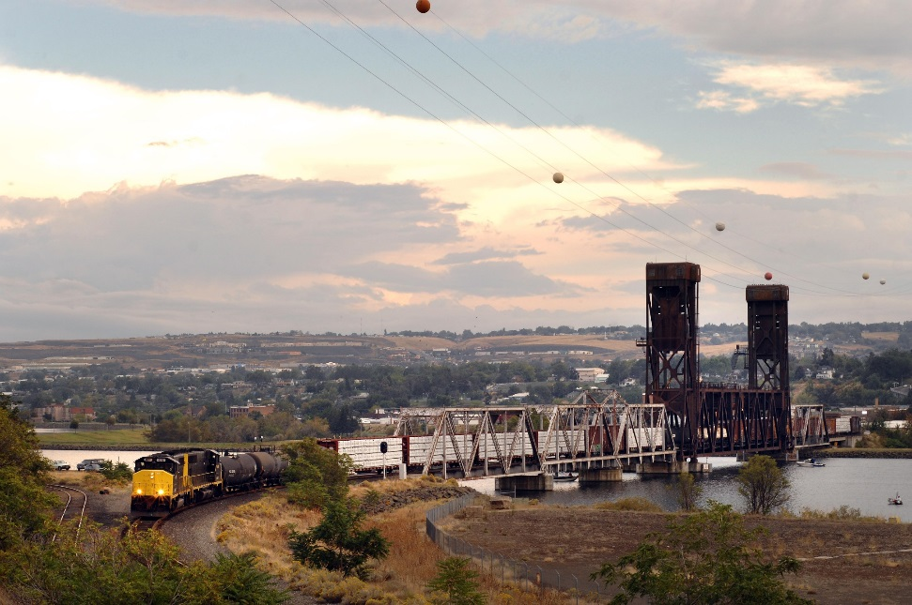
Questions?
Ted Kadau
tkadau@watcocompanies.com
208-791-8889

