Slide 1
LCS Mainframe Migration
Mark Hawkins
ACACSO
May 14, 2015

Slide 2
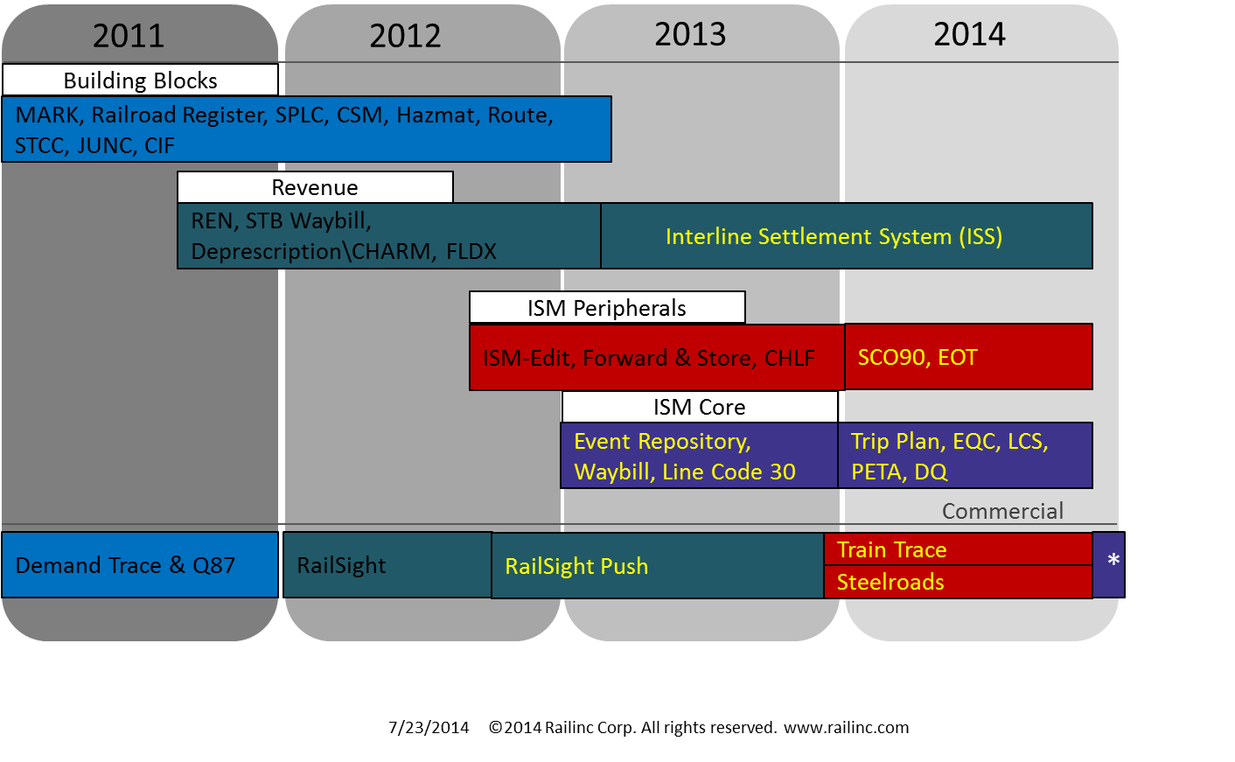
Mainframe Migration Began in 2011

Slide 3
LCS Enhancements During Migration
  Enhanced the architecture of the LCS process to allow for greater visibility and research.
  Enhanced DDCT to include incident number
  Streamlined the suppression and haulage process

Slide 4
Example of improvement made on midrange LCS

Slide 5
Example of improvement made on midrange LCS

Slide 6
Example of improvement made on midrange LCS

Slide 7
Example of improvement made on midrange LCS

Slide 8
Example of improvement made on midrange LCS

Slide 9
Example of improvement made on midrange LCS

Slide 10
Railinc would like to thank the industry for its help in testing the Mainframe Migration!

Slide 11
Questions?

