Slide 1
Car Hire Rate Negotiation Self-Service (CHRNSS)
Sara Maples
ACACSO
November 14, 2013

Slide 2
CHRNSS project
RPSWC project approval
June 13, 2012
Benefits of project start – July 1, 2012
Depre mainframe migration in progress
Core Bid and Offer functionality
Self-service capabilities
Notes:
In 2011, the Equipment Assets Committee (EAC) promoted the idea of including enhancements to the Railinc Depre system as a 2012 project. Although the project proposal projected an industry ROI of 120%, the proposal lacked a holistic view of the bid and offer functionality and was not approved. Instead, Railinc was asked by the Railinc Project Support Working Committee (RPSWC) to perform a study (2011-2012 Industry Study: Deprescription Process and Opportunity Analysis ) to gain a more complete understanding of what was needed throughout the industry as well as identify new opportunities to improve the car hire business function.
The proposed Railinc Car Hire Rate Negotiation Self Service system would take advantage of the 2012 plans to migrate Railinc’s existing Depre system from the mainframe to a mid-range platform. Industry partners have identified this as an opportunistic time to consider adding capabilities to a new system whose core would consist of bid and offer functionality, while including additional self service capabilities.

Slide 3
CHRNSS project release – March 24, 2013
Highlights:
Transition legacy depre bid & offer systems to central solution
Avoid replacement and/or upgrade costs
Improved operational efficiencies for car owners and railroads
Improvements in capabilities reduces administration required to participate in bid & offer negotiations
Dashboard provides details on open, closed and expiring offers and notifies via email
Efficient and immediate turnaround of validations with proactive validation of car lists prior to submission
Notes:
Highlights of project release 1

Slide 4
CHRNSS project release – July 8, 2013
Highlights:
Query CHARM rates from April 2013 and download as CSV file
View current and historical bid and offer transaction details and create or copy bids and offers
Manage notifications/ticklers via the CHRNSS dashboard and view bid and offer details with a single click
View transaction-history information when responding to an open offer or copying a closed/expiring offer
View default rate info when creating a new offer, responding to an open offer or copying a closed or expired offer
Notes:
Highlights of project release 2

Slide 5
CHRNSS
Railinc’s CHRNSS application provides users with a convenient, single access point where they can participate in negotiations related to car hire, the amount of money paid for the use of a railcar
Notes:
CHRNSS provides users with a single access point where they can participate in negotiations related to car hire, or the compensation paid by a user to an owner for the use of a railcar. CHRNSS enables users to transition from legacy in-house deprescription bid-and-offer systems to a centralized, Railinc-supported solution.
Through features like a detailed bid-and-offer dashboard, CHRNSS lessens the administrative effort required to participate in bid-and-offer negotiations, streamlining operations and leading to cost reductions. Because Railinc supports this solution, users also can avoid replacement and/or upgrade development costs associated with their in-house systems. Users can receive immediate feedback during the bid-creation process, and upload or download a list of equipment into the bid-and-offer system. Railinc decommission the deprescription application in March 2013.

Slide 6
Benefits and capabilities
Cost Savings: CHRNSS enables users to transition from legacy in-house deprescription bid & offer systems to a centralized, Railinc-supported solution. Because Railinc supports this solution, users can avoid replacement and/or upgrade development costs associated with their in-house systems.
Productivity: Through features like bid & offer dashboard, CHRNSS lessens admin effort required to participate in negotiations, streamlining operations and improving productivity.
Notes:
CHRNSS provides users with a single access point where they can participate in negotiations related to car hire, or the compensation paid by a user to an owner for the use of a railcar, and ensure that the needs of lessees match with the characteristics of available railcars. The primary benefits of CHRNSS are:
Convenience: With CHRNSS, users have a single point of access where they can manage and participate in the bid-and-offer negotiation process.
Productivity: Through features like a detailed bid-and-offer dashboard, CHRNSS lessens the administrative effort required to participate in bid-and-offer negotiations, streamlining operations and improving productivity.
Cost Savings: CHRNSS enables users to transition from legacy in-house deprescription bid-and-offer systems to a centralized, Railinc-supported solution. Because Railinc supports this solution, users can avoid replacement and/or upgrade development costs associated with their in-house systems.
Improved Decisions: CHRNSS provides specific information about car type and characteristics. This helps users better define the types of cars they need, car owners better segment their cars during the rate negotiation process and bid recipients quickly validate that the offered cars meet their expectations.

Slide 7
Benefits and capabilities
Improved Decisions: CHRNSS provides specific information about car type and characteristics. This helps users better define the types of cars they need, car owners better segment their cars during the rate negotiation process and bid recipients quickly validate that the offered cars meet their expectations.
Convenience: With CHRNSS, users have a single point of access where they can manage and participate in the bid & offer negotiation process.
Notes:
CHRNSS provides users with a single access point where they can participate in negotiations related to car hire, or the compensation paid by a user to an owner for the use of a railcar, and ensure that the needs of lessees match with the characteristics of available railcars. The primary benefits of CHRNSS are:
Convenience: With CHRNSS, users have a single point of access where they can manage and participate in the bid-and-offer negotiation process.
Productivity: Through features like a detailed bid-and-offer dashboard, CHRNSS lessens the administrative effort required to participate in bid-and-offer negotiations, streamlining operations and improving productivity.
Cost Savings: CHRNSS enables users to transition from legacy in-house deprescription bid-and-offer systems to a centralized, Railinc-supported solution. Because Railinc supports this solution, users can avoid replacement and/or upgrade development costs associated with their in-house systems.
Improved Decisions: CHRNSS provides specific information about car type and characteristics. This helps users better define the types of cars they need, car owners better segment their cars during the rate negotiation process and bid recipients quickly validate that the offered cars meet their expectations.

Slide 8
Legacy-depre web application
Pros
Users were able to submit bid/offer transactions
Notifications sent via email and EDI
Cons
Not under Single Sign-On (SSO)
Interface - input only
No proactive validations
Errors not real-time
Notes:
Old mainframe Depre Web Application – where we were

Slide 9
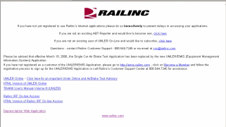
Depre web application
secureconnect.railinc.com
Notes:
Legacy application housed by Railinc @ www.secureconnect.railinc.com
Not under SSO
Getting a user ID was separate request – not self-service
Resetting a password needed Railinc Assistance

Slide 10
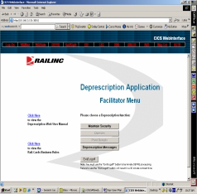
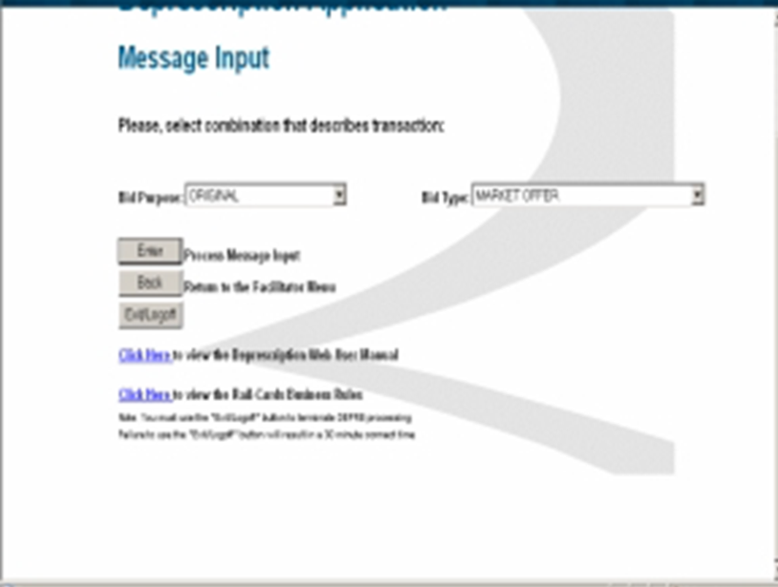
Depre web application
Notes:
Legacy Depre Web application
Shut down on March 24
Message input was manual – could make errors if counter or confirm an offer
* If bid type different from offer, transaction would fail

Slide 11
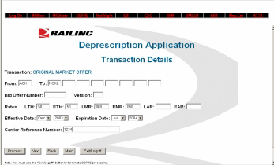
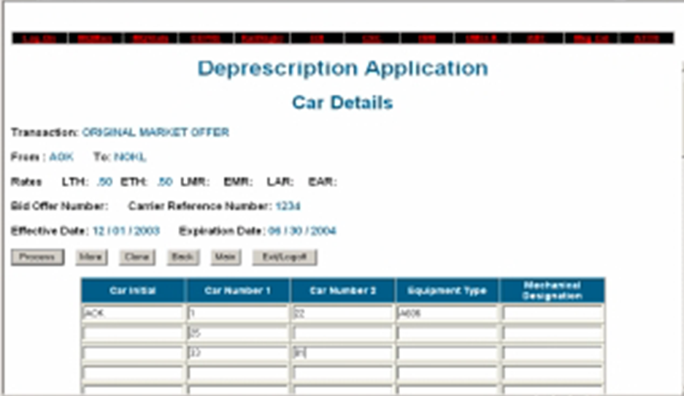
Depre web application
Decommissioned March 24, 2013
Notes:
Old input only
Same screen for all bid purposes
Car detail was manual input
App would time out if car list was long
No proactive validations – if one car was invalid, entire offer would fail

Slide 12
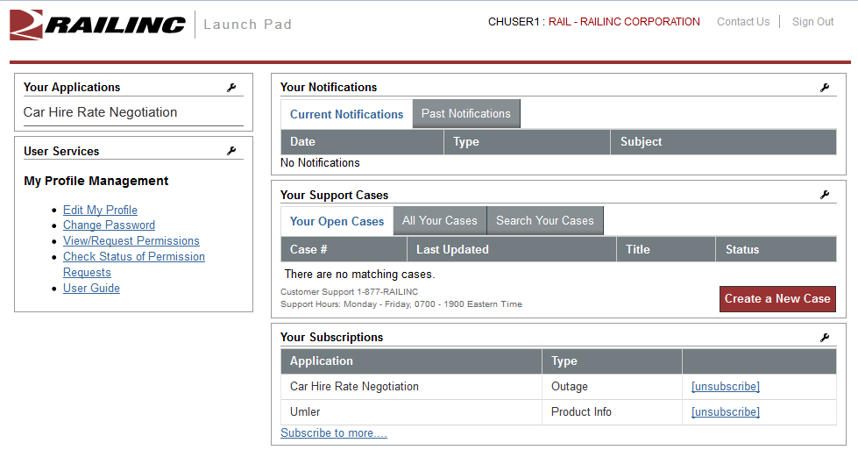
Car hire rate negotiation
Notes:
Centralized point of access under SSO

Slide 13
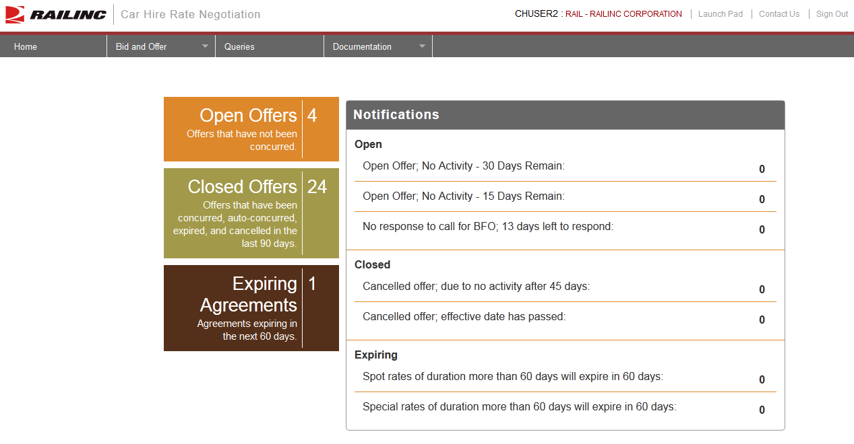
Bid and offer dashboard
Notes:
Ability to keep track of all bids and offers in a single dashboard is desired by all of the carriers with whom we had discussions.
A single access point for all open offers would allow the user to see which offers are pending their action as well as visibility into offers that they have sent to other users.
A bid and offer dashboard would also allow users a way to easily manage ticklers for open offers and search their offers by expiration date.
Users will be provided with a history of each negotiated rate, so that they can better keep track of the back and forth negotiations on a specific open offer

Slide 14
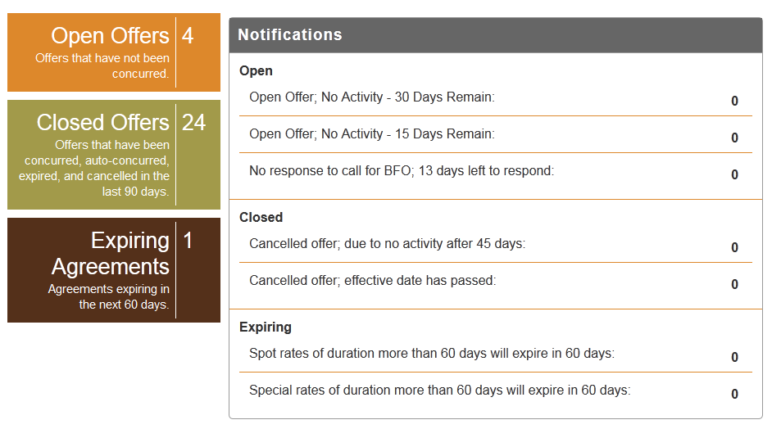
Open offers
Notes:
Count of Open offers – not concurred

Slide 15
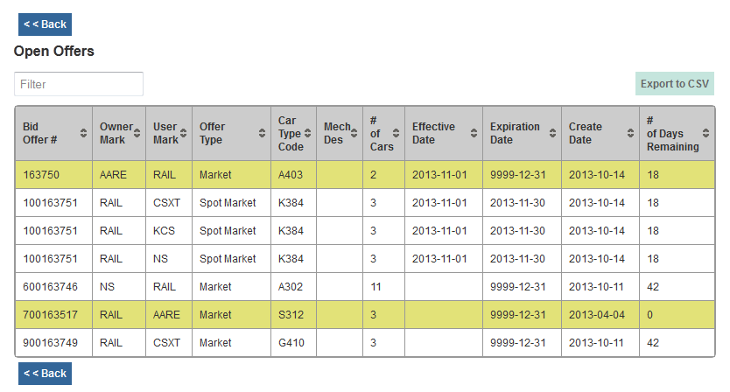
Open offer summary
Notes:
Open offer summary:
Filter – type in any test, i.e., car type code
Highlights offers that have a Call for BFO
No. of days remaining
No. of cars on offer
Click on columns to sort
Export list to CSV

Slide 16
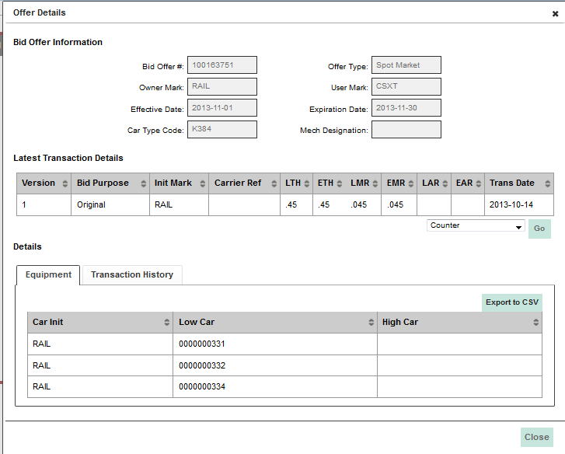
Open offer detail
Notes:
Open offer detail:
View offer details
Latest transaction details
Equipment list
Respond directly from offer detail
Export to CSV – equipment and transaction

Slide 17
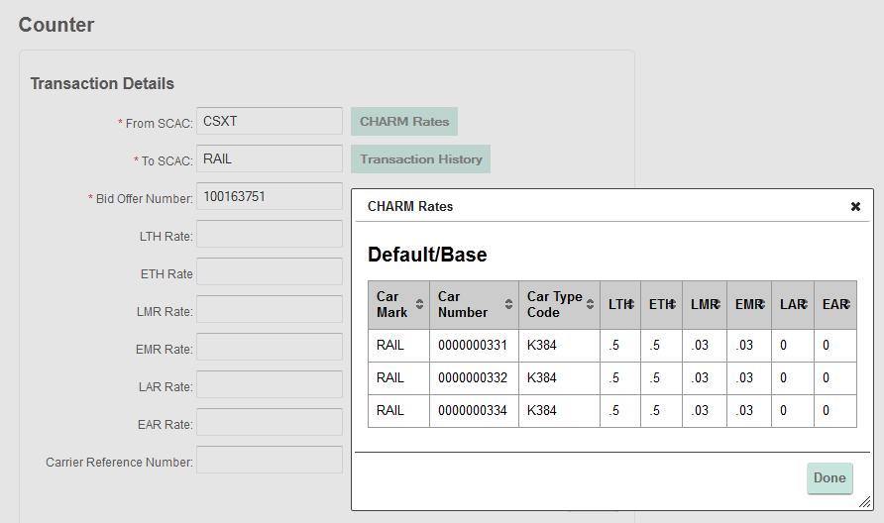
Respond to open offer
Notes:
When responding to an offer, user can view default rates

Slide 18
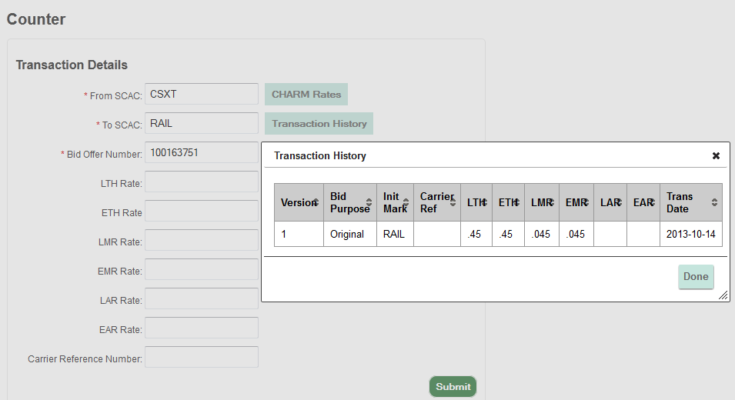
Respond to open offer
Notes:
When responding to an offer, user can view transaction history

Slide 19
Closed offers
Notes:
Closed offers – last 90 days
Contains all offers activity whether concurred or not

Slide 20
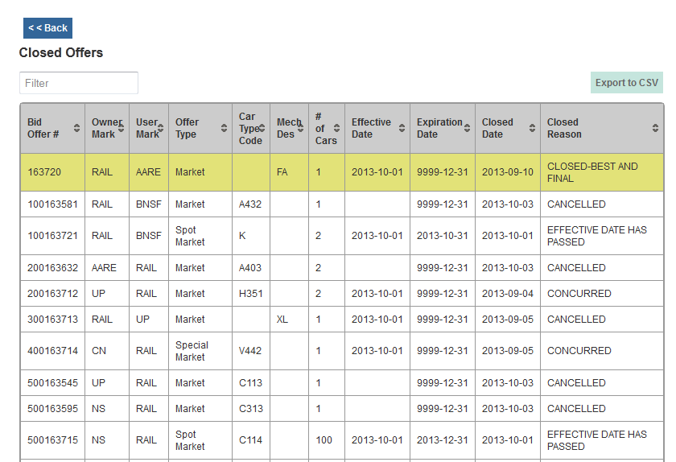
Closed offers summary
Notes:
Closed offer summary:
Filter – type in any test, i.e., car type code
Closed reason, i.e., concurred, cancelled, effective date passed
Highlights offers that have a Gone to BFO
No. of cars on offer
Click on columns to sort
Export list to CSV

Slide 21
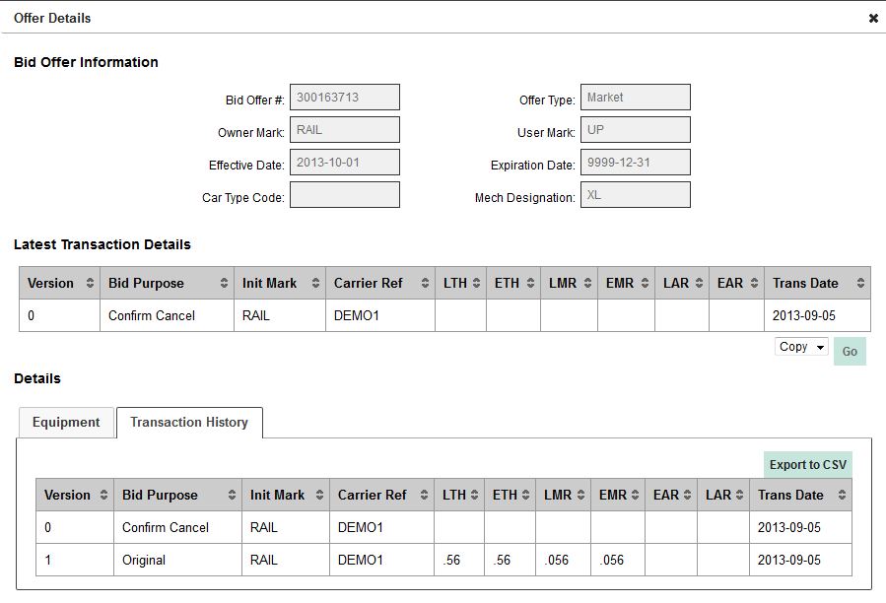
Copying a closed offer
Notes:
Can copy closed offer into new offer
Will copy offer type, details/rates, and equipment into new offer

Slide 22
Expiring agreements

Slide 23
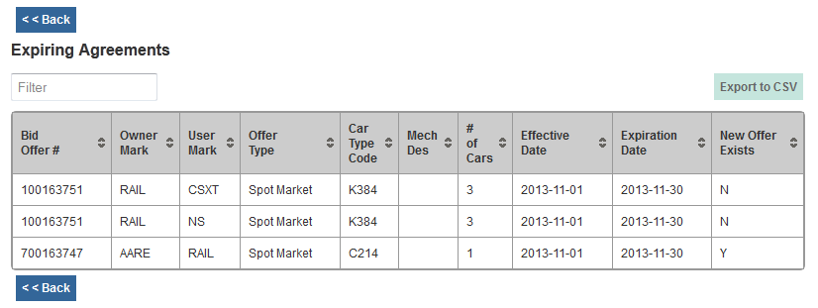
Expiring agreements summary
Notes:
Expiring agreements summary:
Effective and expiration dates
New offer exists – not in production until November release
Flag if new offer has been concurred – same bid type, owner/user, equipment
Filter – type in any test, i.e., car type code
Click on columns to sort
Export list to CSV

Slide 24
Notifications
Notes:
Notifications that have been sent out based on activity
Open
Closed
Expiring
May not be one-to-on with dashoboard
Can drill down into offer detail

Slide 25
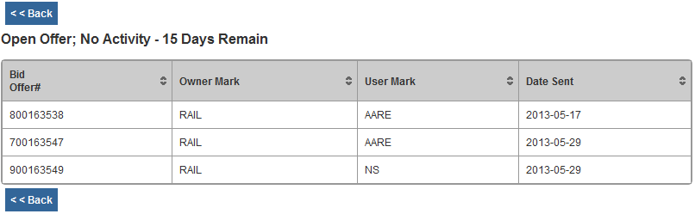
Notifications summary
Notes:
Lists notifications sent
Clicking on row will open the Transaction Details for the offer
User can respond to offer directly from that detail

Slide 26
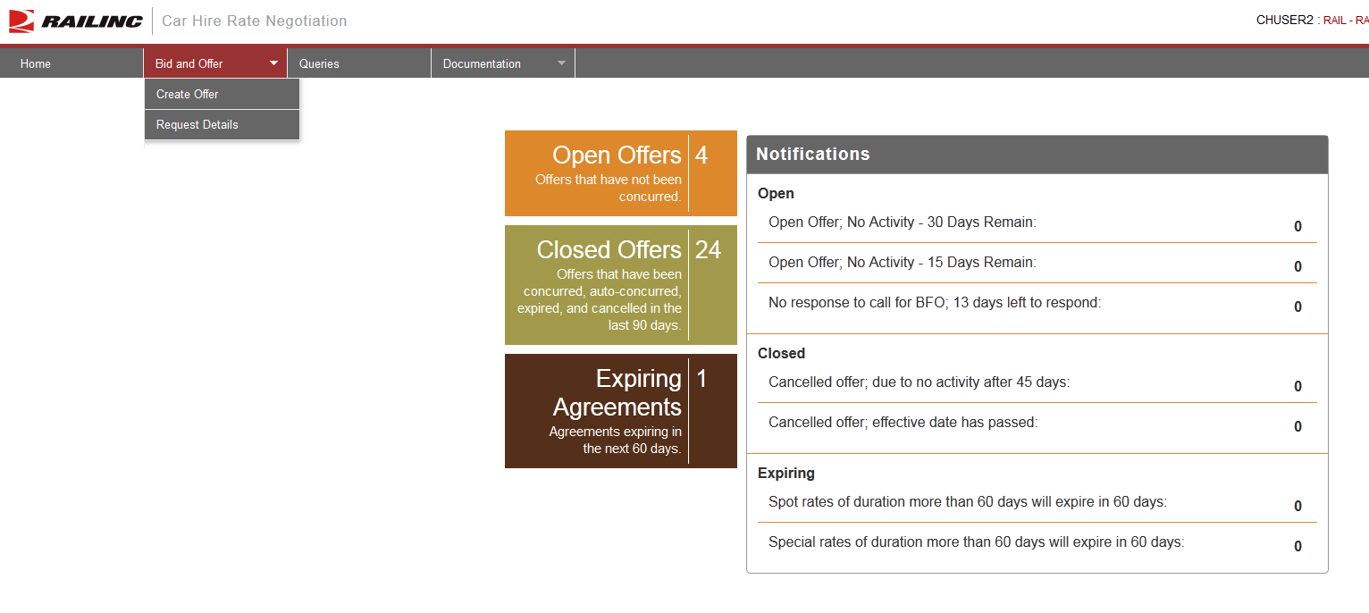
Creating a bid/offer
Notes:
Menu from home page
Create Offer
Request Detail – part of legacy system
Can receive email with detail of offer (not really used much anymore due to dashboard)

Slide 27
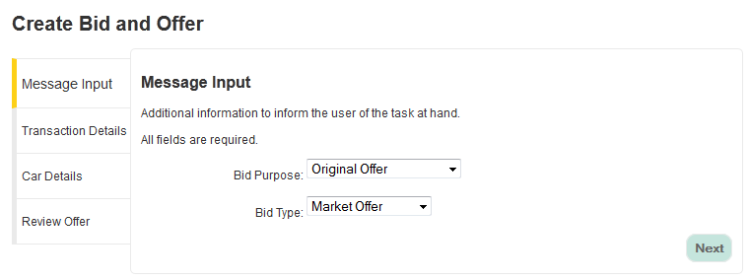
Select bid purpose and bid type
Notes:
Menu-driven
Cannot select invalid purpose and type combination

Slide 28
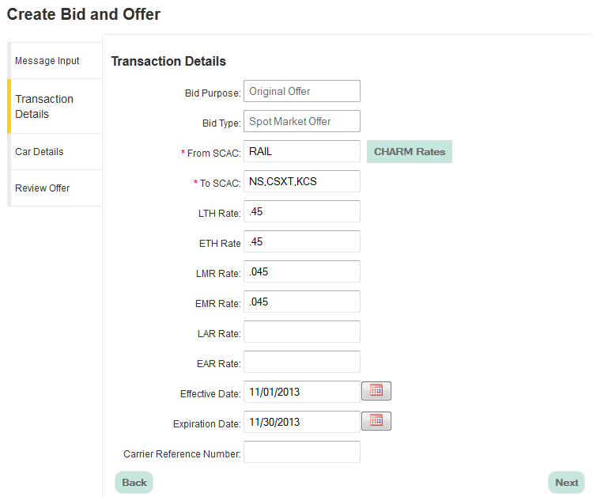
Transaction details
Notes:
Input TO roads (single and multi)
Input rates (hourly, mileage, appurtenance)
* You are able to view CHARM rates once equipment has been added
Effective and Expirations dates
Calendar picker or enter in proper format
Carrier Ref Number (optional)

Slide 29
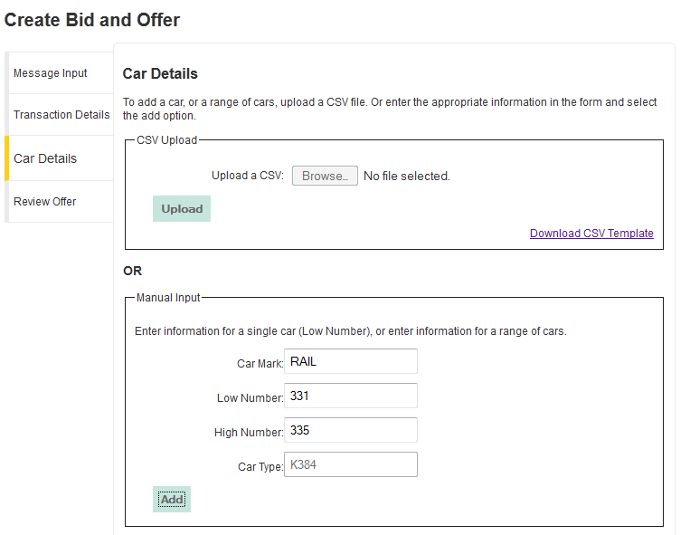
Car details – adding equipment
Notes:
Upload a CSV or Manual Input
* Input single car or range
Equipment is validated for Umler registration and car type/mechanical designation

Slide 30
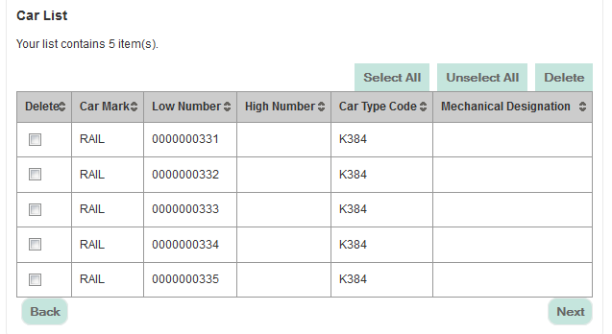
Car details – adding equipment
Notes:
Car count
Can manually remove delete equipment from offer

Slide 31
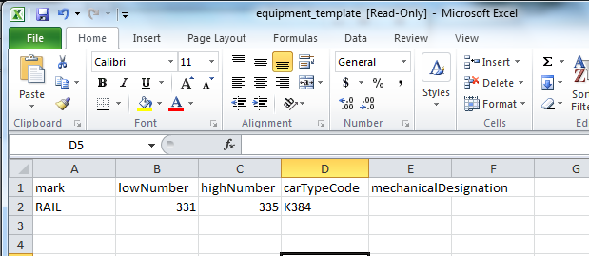
Car details – CSV upload
Notes:
Upload a CSV or Manual Input Template
Use CTC or Mech Desg
Equipment is validated for Umler registration and car type/mechanical designation

Slide 32
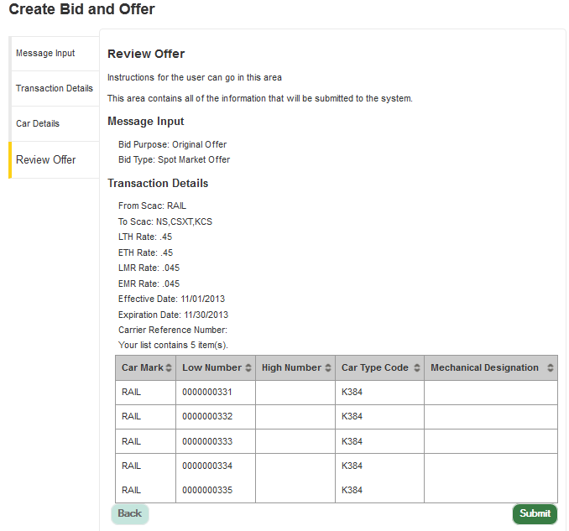
Review offer
Notes:
Review offer detail prior to submitting
Equipment is validated for Umler registration and car type/mechanical designation

Slide 33
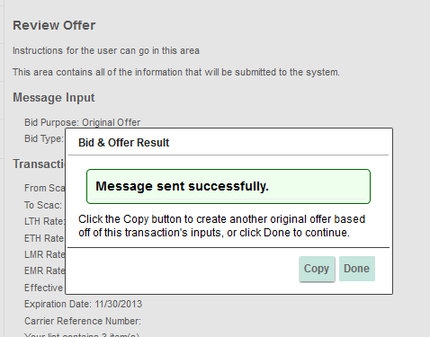
Submit offer
Notes:
Copy offer to send to multiple roads
Proactive validations
Equipment on another offer
Non-market equipment on a market offer
Etc…
Ability to remove invalid equipment prior to submitting offer when creating a new offer
November release – equipment automatically removed; user can resubmit

Slide 34
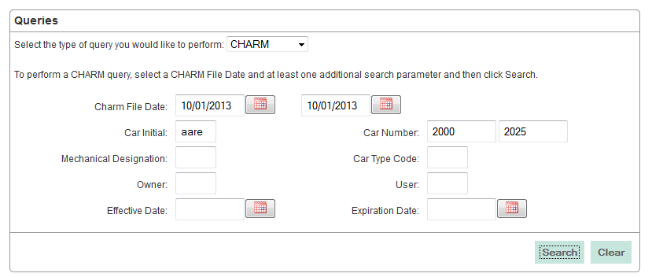
CHARM query
Notes:
Query by CHARM file date and one other search parameter
CHARM can query 3 months at a time
Will have at least 2 years of history in Nov. 2013 release

Slide 35
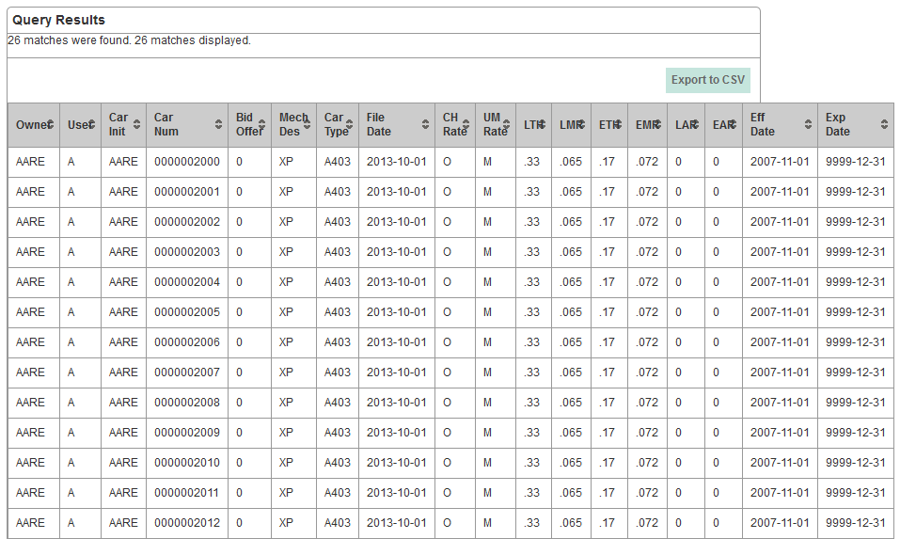
CHARM results
Notes:
Can view 1500 on screen; export 5000

Slide 36
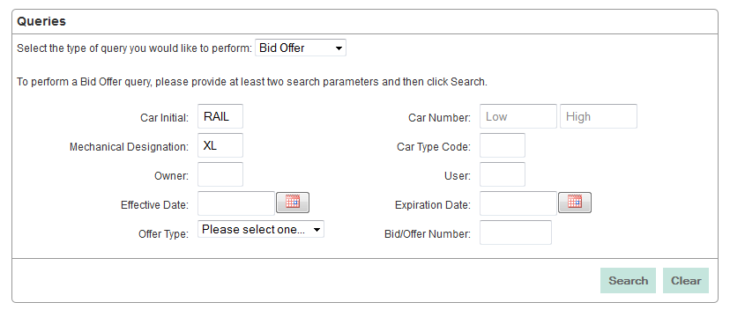
Bid/offer query
Notes:
Query by Bid offer history by at least two search parameters
Contains offers that have been concurred, cancelled, expired
Will be able to view/export transaction detail for post-mainframe migration offers
Future enhancement in 2014 – view results at bid/offer summary vs. car detail
Will give a birds eye view – much more efficient, valuable to end user

Slide 37
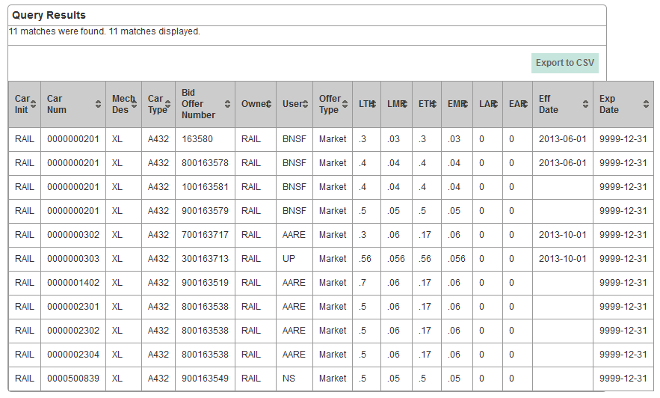
Bid/offer results
Notes:
Results View at equipment level
Can view 1500 and download up to 1500
Clicking on a row will pull of transaction detail of offer
Columns can be sorted

Slide 38
November 2013 release
New features and enhancements
Automatically remove invalid cars w/original offer
Add current agreed rates to rate information screen
Creating a new offer
Responding to an open offer
Copying a closed/expiring offer
Direct CHARM query results to create a new bid/offer
Load historical CHARM data – Jan-2011 to current month
Rolling three years in production
Expiring agreements: View list of spot/special offers that do not have a new rate negotiated
Notes:
What’s coming in November – high priority items

Slide 39
What’s next?
2014
Four quarterly releases
New features and enhancements
New query
CHARM and Umler® characteristics
RPSWC EDI432 upgrade
Update from version 3030 to 7010
Increase CIC segment from 1500 to 5000
Notes:
This may need to be modified…not set in stone regarding features/enhancements

Slide 40
Questions?

