Slide 1
Receivable and Payable
Reconciliation
ACACSO
November 2015
Tony DiMartino
Sr Manager Car Accounting

Slide 2

Agenda
Overview
Start with the Rules
The Centerpiece of the Process
Impacting Net Payments
Oops – Negative Payables
Voluntary and Other Adjustments
After the Settlement
Additional Resources

Slide 3

Overview
Car Accounting Reconciliation?
Receivable and Payable Reconciliation is Car Accounting
Accounting vs. Car Accounting
Car Accounting Terminology Throughout
249
Number of car hire participants

Slide 4
Overview
Terminology
Accounting
Haulage
Reclaims
Reclaims
Net Payer
Claims
CHDX
Railinc
Rule 15
Payables
Rule 3
Receivables
DDCT
Accruals
RCH
Voluntary
Adjustments
TOL
FindUs.Rail
Participant
Negative Threshold
Rule 5
LCS

Slide 5
Start with the Rules
Rule 3 Reporting/Settlement Procedures*
General – Applicable to All Carriers
  Car hire reported one (1) month and ten (10) days from the last day of the month earned
  Voluntary additive adjustments to car hire
    Allowed two (2) months after earned month
    Later payments incur 15% penalty
  Voluntary deductive adjustments to car hire can be made without authority from car owners
    Time - two (2) months after earned month
    Mileage - five (5) months after earned month
108k
OT-10 word count
115
OT-10 page count
*Paraphrased – some specifics excluded

Slide 6
Start with the Rules
Rule 3 Reporting/Settlement Procedures
Car Hire Data Exchange*
The means by which the industry systematically exchanges data
Participants
Railroads that submit data to the CHDX
Appendix G, H and I
Standard reports for reporting car hire and adjustments
Railroad Clearinghouse
Centralized process for transferring funds among railroads
AAR Car Hire Data Exchange Participants
  Not required to provide Appendix G, H or I
  Settle via Railroad Clearinghouse
AAR Car Hire Data Exchange Non Participants
  Subject to per cycle processing charge
  Required to provide Appendix G, H and I reports
  Must settle directly with each equipment owner
*More info available in the Car Hire Data Exchange User Guide found on Railinc’s website

Slide 7
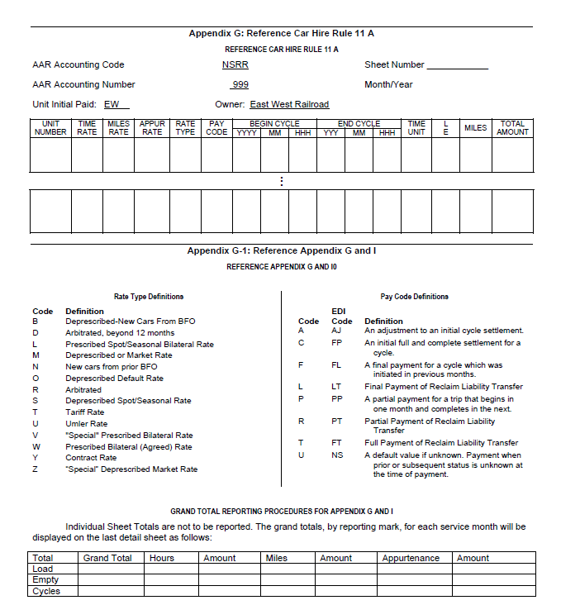
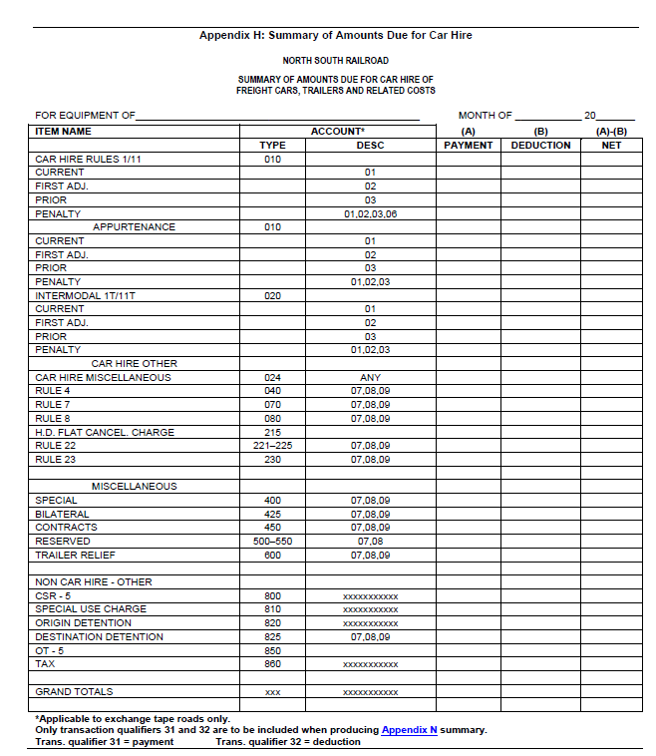
The Centerpiece of the Process
“Back in the Day”
Prior to September 2008, Car Hire Settlement was Done Directly with Each Party
Appendix H - Car Hire Summary (shown right) Used as Basis of Payment
Multiple Payments Methods and Transactions Each Month
Source: February 2015 OT-10 page 69

Slide 8
The Centerpiece of the Process
CHDX and RCH
Accounting
Haulage
Reclaims
Reclaims
Net Payer
Claims
CHDX
Railinc
Rule 15
Payables
Rule 3
Receivables
DDCT
Accruals
RCH
Voluntary
Adjustments
TOL
FindUs.Rail
Participant
Negative Threshold
Rule 5
LCS

Slide 9
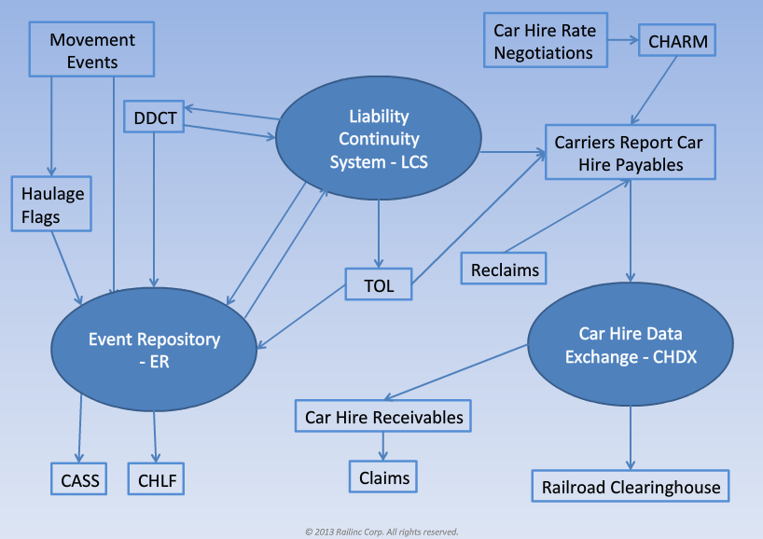
The Centerpiece of the Process
Today - Improving Processes with the RCH*
RCH Uses a Central Bank
Settlement Occurs Monthly
Funds Transfer Reports Available on the 20th of the Month
Net Payers (or is it Payors?) Make One Payment
Net Receivers Collect One Payment
RCH Used for Other Settlements
Source: “Car Hire Rules 1-4, 25” slide 2, Railinc.com/rportal/car-hire-training
*More info available in the Guide for Railroads found on Railinc.com

Slide 10
Impacting Net Payments
Upstream Data
Train II System / Event Repository
Liability Continuity System (LCS)
Transfer of Liability (TOL) – Rule 5
Transfer of Liability (TOL) – Rule 15 “the Offering”
Damaged and Defective Car Tracking (DDCT)
Haulage
$51M
Dollars settled via RCH each month
189 and 60
Number of net payers and net receivers respectively

Slide 11

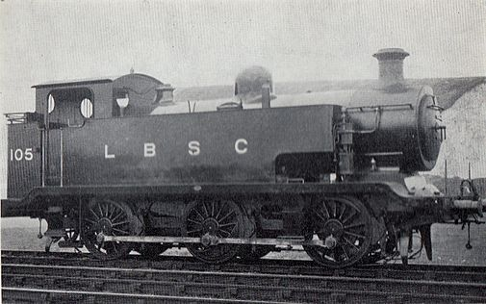
Random Fun Fact
Thomas the Tank Engine is Based on the London Brighton 0-6-0 E2*
  Primarily used for switching or “shunting”
  Only five (5) of the “E2” extended water tank versions were produced
  A brief experiment in passenger service proved the engines unreliable as they oscillated under acceleration, were unsteady at speed and would occasionally throw a piece of live coal from their chimneys.
  All units were scrapped in 1963
*Source: http://www.collectors-club-of-great-britain.co.uk/

Slide 12

Voluntary and Other Adjustments
Back to Car Accounting
Did you know?
The current train speed world record belongs to Japan’s Lo Series train reaching 373 mph.*
Voluntary Additive Adjustments Allowed One (1) Month Following Earned Month without Penalty
Voluntary Adjustments Examples:
  Mileage error queue audits
  Renumbered cars
Other Adjustment Types Include:
  400 Specials
  024 One Line Adjustments
*Source: http://www.theguardian.com/

Slide 13
Oops – Negative Payables
Did you know?
In 1883, American railroads created the four time zones still in use today?*
Deductions Exceed Payments
May or May Not Indicate an Issue with Payment
Negative Payable Tolerances Protect Participants from Unacceptable Recoupment of Funds
Amounts Exceeding the Tolerance are not Settled
Amounts not Settled must be Paid or Recouped by other Methods
*Source: www.aar.org/railroad-101

Slide 14
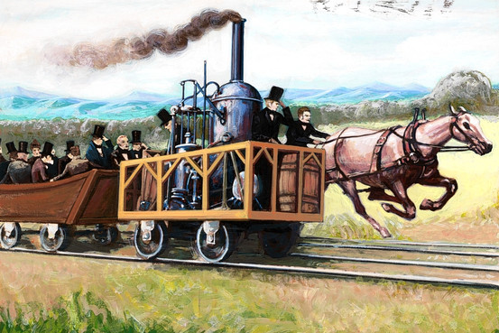
After the Settlement
Other Tasks
Did you know?
In 1830, the first steam locomotive lost a race to a horse due to mechanical issues.*
Today, wayside detectors can systematically identify many defects prior to structural failure.**
Forecasting and Accrual Adjustments
  Actuals, first and prior month activity impact accrual
 | March Forecast Accrual
Timing | March
Car Hire | $100k
March Earned Variance
May
$10k
March 1st Mo Adjust
June
$8k
Prior to March Adjust
June
$2k
Total Car Hire Expense for March | $120k
Source: *History.com **AAR.org

Slide 15
After the Settlement
Other Tasks
Did you know?
In 1830, the first steam locomotive lost a race to a horse due to mechanical issues.*
Today, wayside detectors can systematically identify many defects prior to structural failure.**
Budgeting and Accrual Adjustments
  Actuals, first and prior month activity impact accrual
Evaluation of Payables and Receivables
  Manual and systematic approach
  Comparison of CHLF and receipts → claims
Evaluation of Claims and Reclaims
Collection Efforts
Source: *History.com **AAR.org

Slide 16
Additional Resources
Railinc.com
  AAR Circulars (i.e. OT-10)
  National Tariffs
  Car Hire Training
  Several User and System Guides
ACACSO.org
  Presentations
  Guides
Other Industry Conferences, Peers and Partners
?
Questions
*Source: www.aar.org/railroad-101

