Slide 1
Equipment Quality Reporting System
Angela Buccigrosse
ACACSO
May 7, 2014

Slide 2
Today’s Agenda
Background
Goals
Project Overview
Process Flow
Benefits
User Interface

Slide 3
Equipment Quality Reporting System (EQR)
Developed under the Damaged and Defective Car Tracking System Technical Advisory Group (TAG)
  Consisted primarily of mechanical groups
  Found that wider variety of expertise was needed
Equipment Quality Reporting TAG formed
  Includes mechanical, customer service, and car-management groups

Slide 4
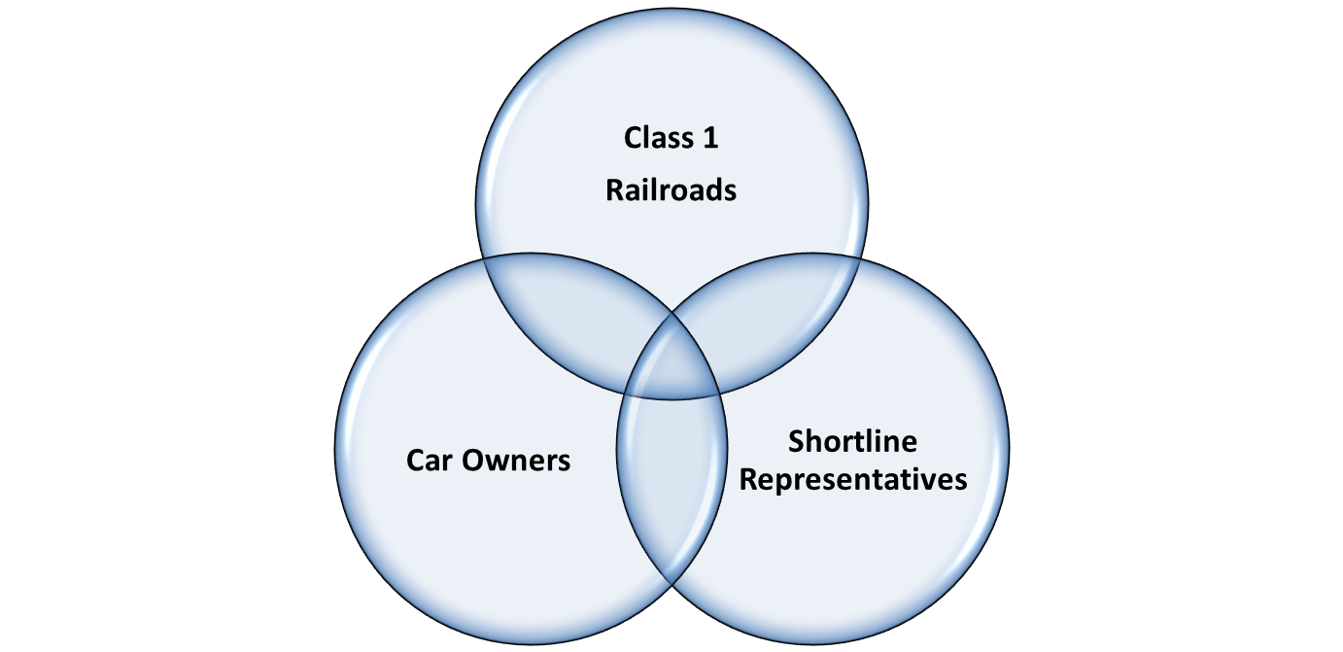
EQR TAG Members

Slide 5
EQR Goals
Track equipment rejected by shippers and use the information to help identify the root cause for rejected cars
Provide a tool that transmits the necessary information to Class I railroads and railcar owners when shippers reject cars
Provide a process to allow timely and accurate reporting to properly identify and minimize handling of bad-ordered equipment

Slide 6
EQR Project Overview
Develop repository that captures reject data sent electronically from the roads
Handling carriers and equipment owners receive notifications when shippers reject car/cars on their line
  MQ/email notification options

Slide 7
EQR Project Overview
User interface allows handling carriers and car mark owners to query rejections
Shippers will continue using carrier reject systems to enter reject information

Slide 8
EQR Process Flow
Shippers
Class I/Shortline Customer Reject Systems
Railinc EQR Application

Slide 9
EQR Benefits
Ability to identify and minimize the handling of bad-ordered equipment
Provide visibility into:
  Rejection of cars when they are rejected on foreign roads (system cars on a foreign road)
  Issues/defects discovered during unloading on a foreign road (system car received back empty)
  Loss of utilization
Improve and standardize existing rejection codes to an industry standard

Slide 10
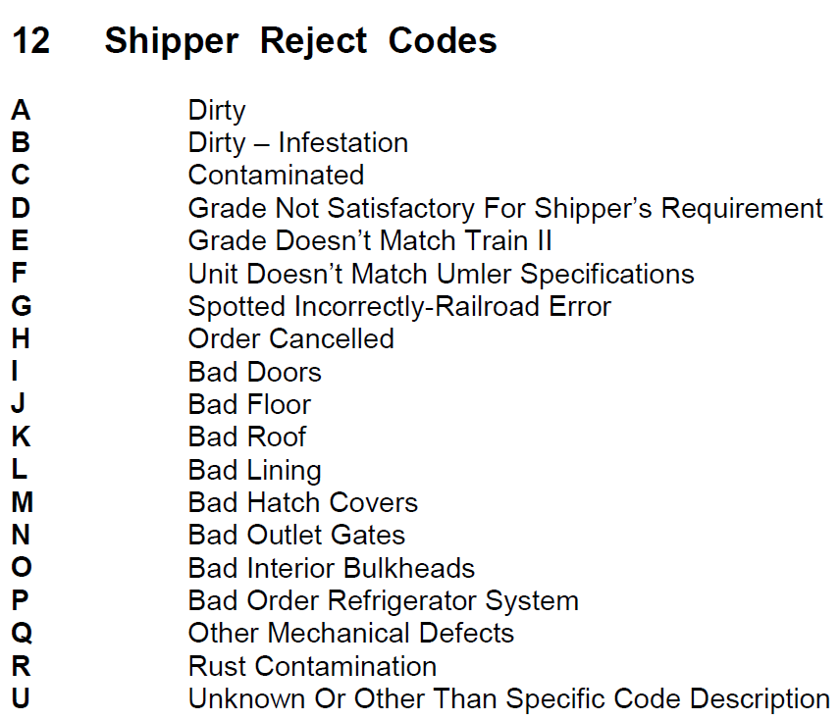
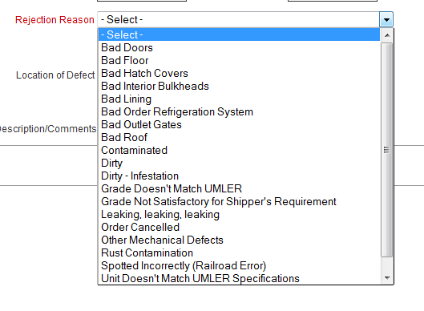
Current Industry (TRAIN II Manual) Shipper Reject Codes

Slide 11
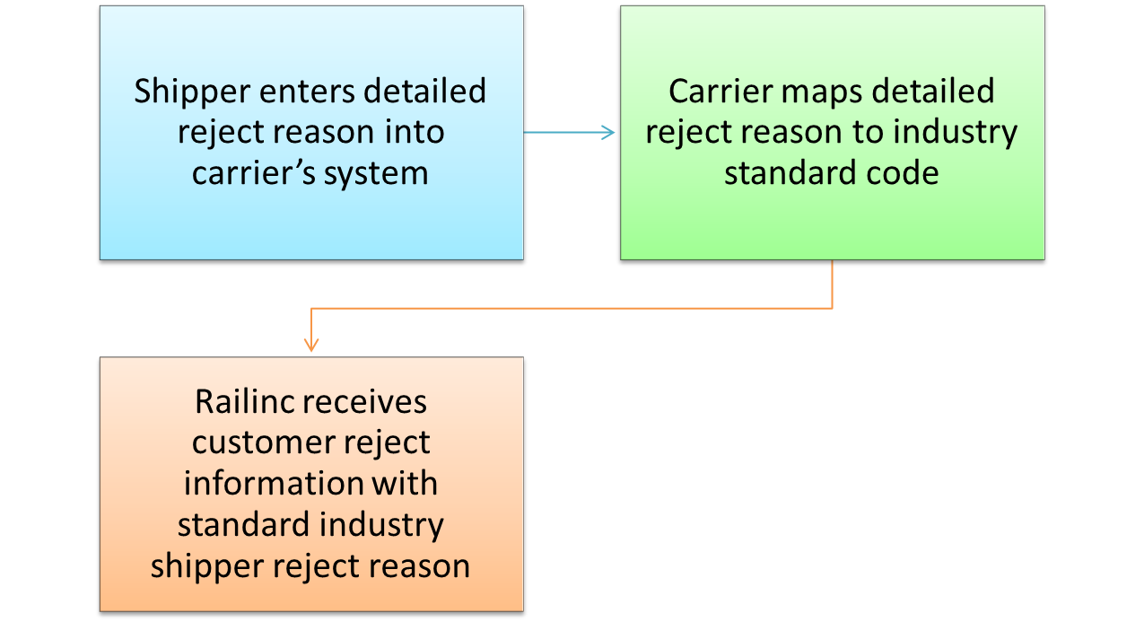
Carrier Codes/Industry Standard Codes

Slide 12
EQR Schedule
EQR integration testing began in Q4 2013 and is in progress.
CSV upload functionality is available for roads that do not plan to integrate immediately.
Railinc will collect and analyze data in 2014.
The results of this analysis will determine future EQR-related work.

Slide 13
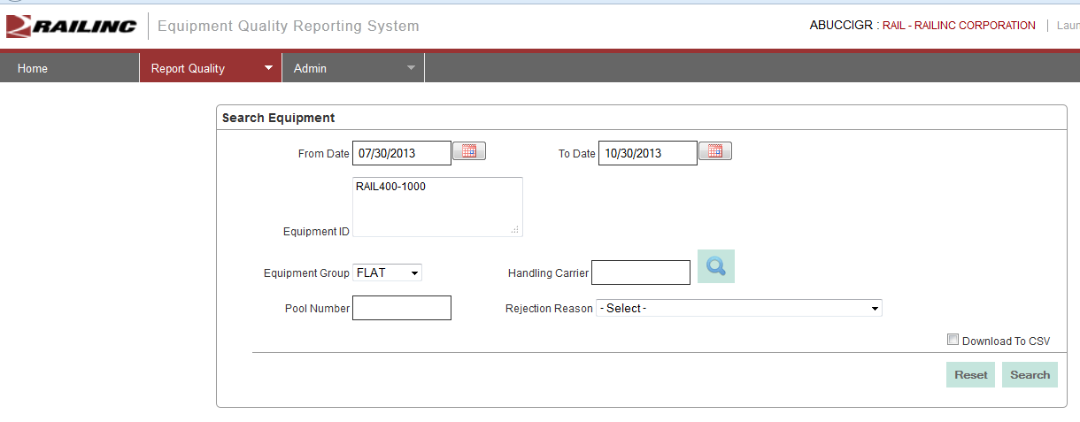
Query Functionality

Slide 14
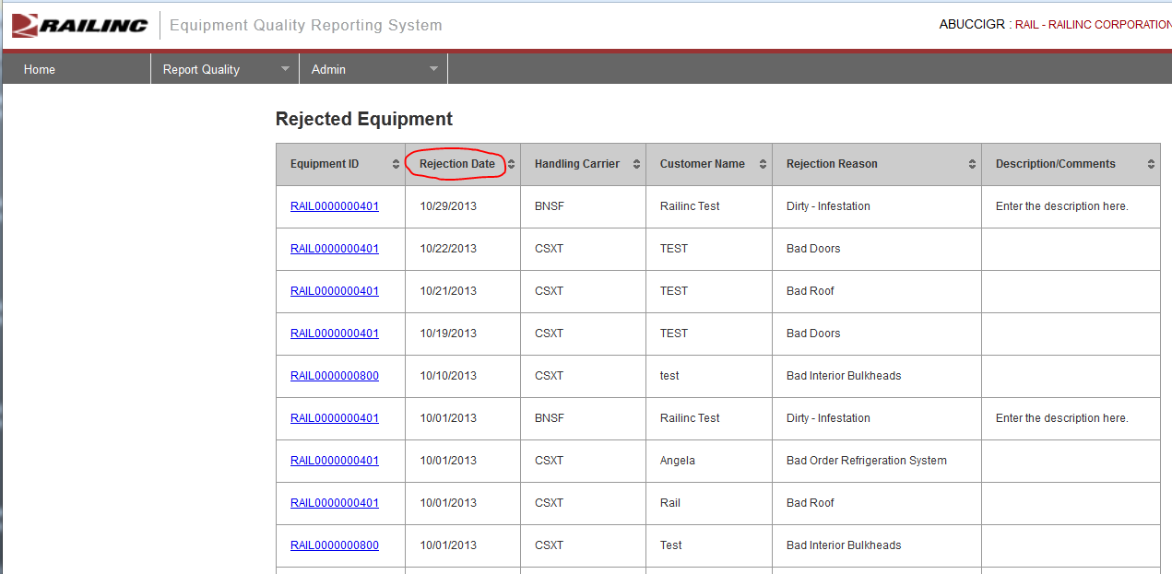
Query Results User Interface

Slide 15
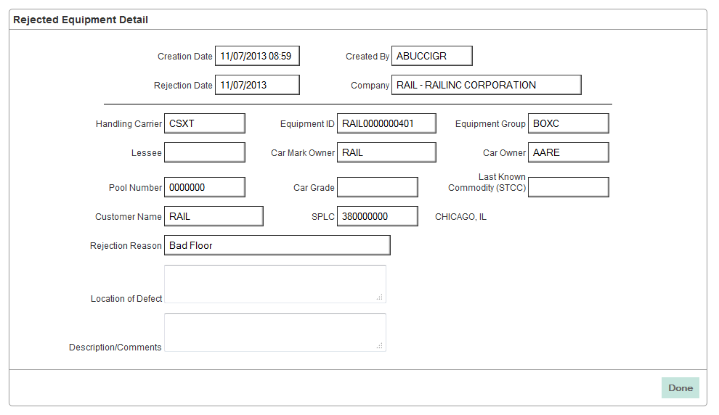
Query Results User Interface

Slide 16
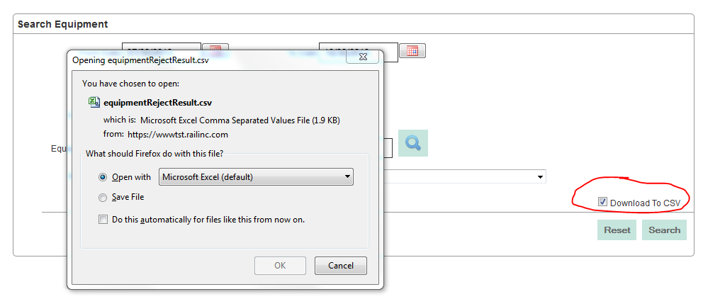
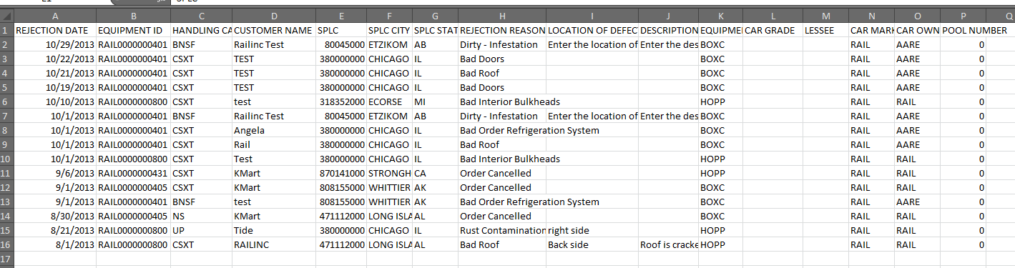
Query Results CSV Download

Slide 17
QUESTIONS?

