Slide 1

ACACSO Breakout
2015 Spring Meeting
Waybills & EDI

Slide 2
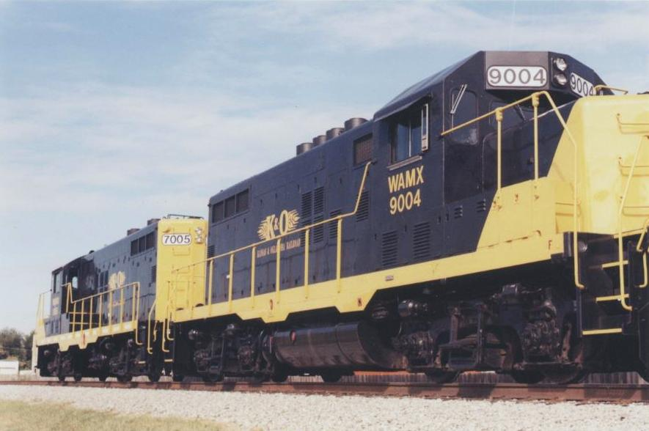
Watco Companies
Customer First Foundation Principles
Improve Customer Satisfaction
Right Service
Right Time
In the Right Condition – Delivered SAFELY
At the Right Price
Improve Profitability
Revenue Growth Rate
EBITDA Growth
Return on Assets > WACC%
Free Cash Flows
Economic Value Add (EVA)
Do Both Over the Long-Term
Building Relationships with:
Customers
Watco Team
Communities
Vendors
Investors

Slide 3
EDI Definition
EDI (Electronic Data Interchange)
EDI is the process of exchanging data electronically via a communications network in a pre-defined standardized format.
3
Notes:
Rail linc – Centralized electronic messages clearing house (Central site) Committee makes the rules that we all have to live by
Handling carrier – set rate we don’t control the rate we accept this up front, set adjustment schedule (RCAF) Interchange to customer
ISS carrier – we do have pricing authority, blended rate presented to the customer (customer does not know division)
Reciprocal switch carrier – publishes what it needs to receive at destination. Public information, tariff
On-line carrier, customer on my line to another customer on my line
Haulage, similar to handling carrier, typically the road in the middle between two other carriers

Slide 4
EDI Terms
Common EDI Terms
404 – Bill of Lading, shipping document that is both a receipt for property and a contract for hauling it.
417 – Waybill, shipping document prepared by the carrier at origin to show the point of origin, destination, route, shipper, consignee, weight, description of commodity and any other documentation to move the car between carriers.
a. This document gets forwarded through EDI to
other carriers in route on the waybill.
418 – Advance Consist, advance information of equipment to be interchanged from carrier to carrier.

Slide 5
Bill of Lading - 404
Customer uses Railroad Web Tools or 3rd Party EDI software to transmit BOL’s
First Line-haul Railroad receives BOL and converts into Waybill.
Waybill is transmitted to other carriers (line-haul or origin/delivery carriers) in the route.
5

Slide 6
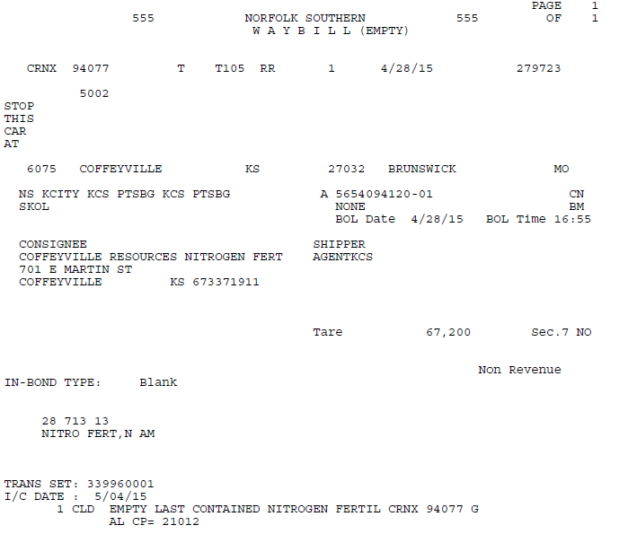
Bill of Lading - 404
6

Slide 7
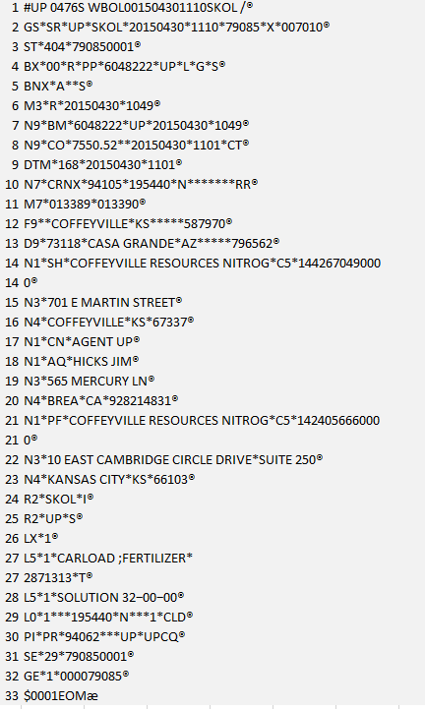
EDI - Bill of Lading - 404
7

Slide 8
Waybill - 417
Waybill are sent through hierarchy of rules to 2 separate applications – Operations & Revenue.
The operations system blocks car to customer or interchange so crews know what service to perform.
Revenue rates the car to assess charges based on service performed.
8

Slide 9
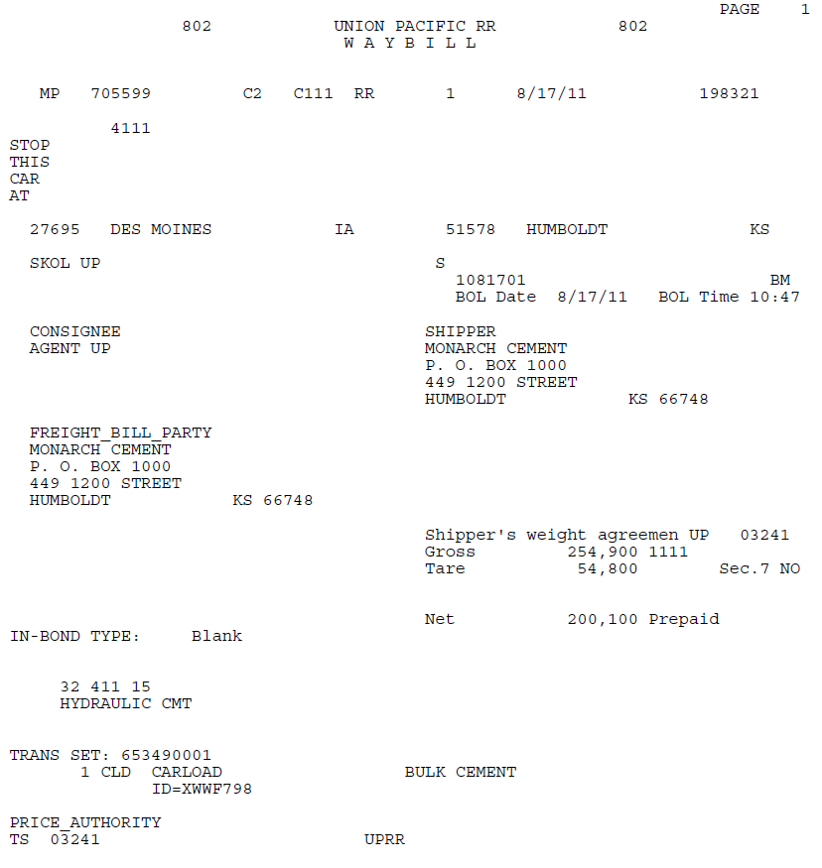
Waybill - 417

Slide 10
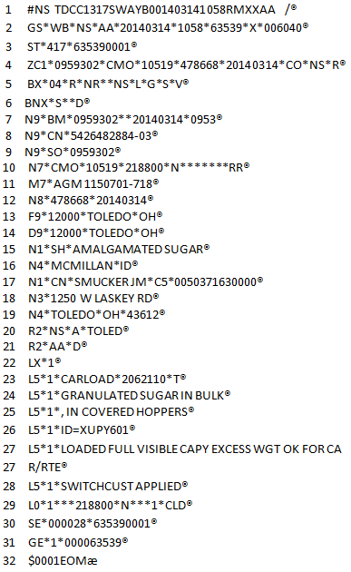
EDI Waybill - 417

Slide 11
Advance Consist - 418
Partnering RR’s send 418’s to each other so they will be able to get a preview of what is in the pipeline for interchange.
This helps both RR’s plan operations.
11

Slide 12
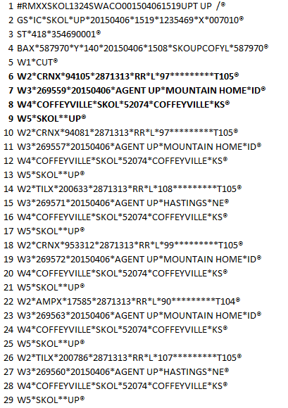
Advance Consist - 418

Slide 13
Questions?

